Slide 1

2025-2026 Consolidated Application System Training
Title I, Part A
Notes:
DeLilah

Slide 2
Agenda
Consolidated Application System Training
Changes to the Consolidated Application Title I, Part A
School Ranking Reminders
Budget Reminders
Title I, Part A GAINS Walkthrough
Notes:
DeLilah

Slide 3
Consolidated Application: Title I, Part A Changes
Notes:
DC

Slide 4
Title I, Part A Changes
Consolidated Application System Training
The LEA Title I, Part A Set-Aside has been reorganized but contains the same information.
Title I, Part A budget now has two additional tags for Specific Allowable Uses for Title I-A (Narrative Questions 3 and 4)
Practices that Reduce Student Removal (Title I Question 3)
Effective Transitions (Title I Question 4)
Start on page 20 of the Consolidated Application Planning Resource for Response Guidance and Helpful Resources on Title I, Part A

Slide 5
LEA Title I, Part A Set-Asides Changes - Overview
Consolidated Application System Training
This page must be completed prior to the School Ranking (School Profile) page and budgeting!
There is a new Title I Funds table at the top to see the Title I Allocation (including transfers), the incoming carryover, and the total amount available for Title I.
Non-Public School has its own table and pulls in from the Non-Public School page.
Parental Engagement, Homeless and Neglected Set-Aside broken out in a clearer way!
Carryover for Parental Engagement will be added to the total amount for Parental Engagement instead of subtracting it.
Administration and Indirect Costs are now in a table together to assist in calculating the 10% cap.
Additional Optional Set-Asides have been condensed.
The Summary at the bottom has been renamed to be clearer.
Notes:
DC

Slide 6
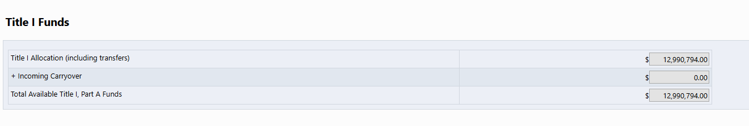
LEA Title I, Part A Set-Asides Changes – Title I Funds Table
Consolidated Application System Training
This page must be completed prior to the School Ranking (School Profile) page and budgeting!
There is a new Title I Funds Table at the top of the page. It will allow applicants an overview of the following:
Title I Allocation (including transfers),
Incoming Carryover,
Total Available Title I, Part A Funds
Notes:
DC

Slide 7
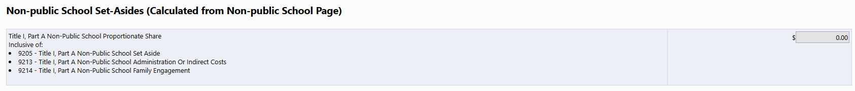
LEA Title I, Part A Set-Asides Changes – Non-Public School Table
Consolidated Application System Training
This page must be completed prior to the School Ranking (School Profile) page and budgeting!
The Non-Public School amount is now separated into its own table.
This number is pulled into the LEA Set-Asides page from the Non-Public Schools page.
Be sure to complete the Non-Public Schools page so the total amount available is correct at the bottom of the LEA Set-Asides page.
The number listed in this table should match what is budgeted for Non-Public Schools using any of the following function codes in the Title I, Part A budget:
9205 - Title I, Part A Non-Public School Set Aside
9213 - Title I, Part A Non-Public School Administration Or Indirect Costs
9214 - Title I, Part A Non-Public School Family Engagement
If the amount budgeted doesn't match the number on this page, the applicant will receive an error that will prevent submission.
Notes:
DC

Slide 8
LEA Title I, Part A Set-Asides Changes – Required LEA Set-Asides Table
Consolidated Application System Training
This page must be completed prior to the School Ranking (School Profile) page and budgeting!
Parent and Family Engagement Table
The top portion of the table will be calculated for the applicant. It will now track the 1% so applicants can see how much they plan to budget for Parent and Family Engagement Activities.
A rationale form has been created and linked in the table for LEAs to complete if they plan to budget more than 10% of the required 1% set aside for district-level parental activities.
Homeless Set-Aside and Neglected Set-Aside
These did not change.
Notes:
DC

Slide 9
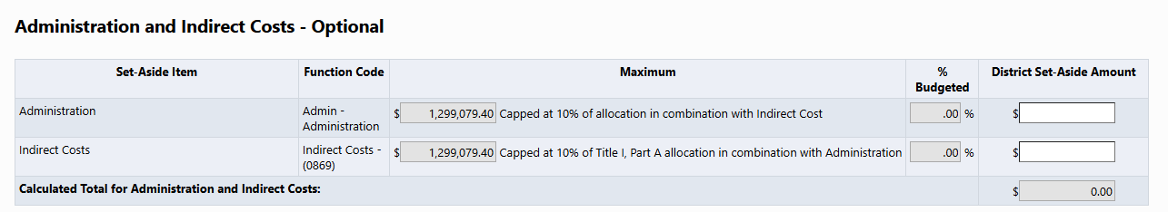
LEA Title I, Part A Set-Asides Changes – Admin and Indirect Table
Consolidated Application System Training
This page must be completed prior to the School Ranking (School Profile) page and budgeting!
Administration and Indirect Costs – Optional
Now grouped together so you can easily manage the 10% cap on Title I, Part A funds.
If you budget over 10% in the budget, the system will flag it as an error.
Please make sure the amount you enter on the LEA Set-Asides page matches what you have budgeted.
Notes:
DC

Slide 10
LEA Title I, Part A Set-Asides Changes – Additional Optional Set-Asides Table
Consolidated Application System Training
This page must be completed prior to the School Ranking (School Profile) page and budgeting!
Additional Optional Set-Asides
Structured the same as last year. However, Pay Differential and Operational Need have been condensed into one line for District Managed Activities.
A waiver is required if the District Managed Activity Set-Aside exceeds 20% of the Title I, Part A allocation. The DMA waiver has been linked in the table.
Notes:
DC

Slide 11
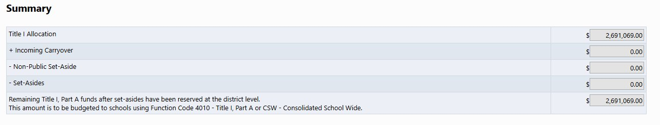
LEA Title I, Part A Set-Asides – Summary Table
Consolidated Application System Training
This page must be completed prior to the School Ranking (School Profile) page and budgeting!
The LEA-Set Asides page is going to take the Title I allocation and begin removing the Set-Asides to determine the amount available to budget to schools.
Non-Public School Set-Asides
Parent and Family Engagement Set-Asides
Homeless Set-Aside
Neglected Set-Aside (if applicable)
Administration and Indirect Costs
Additional Optional Set-Asides
Once all the Set-Asides are reserved at the district level, the "Amount Remaining for School Allocations" will be populated on the School Ranking to be distributed to schools through Rank Order.
Notes:
DC

Slide 12
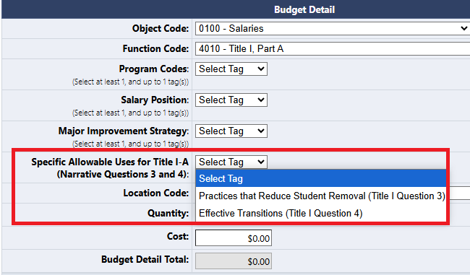
Title I, Part A Budget Change
Consolidated Application System Training
A new tag will appear in the Title I, Part A budget to identify allowable uses specific to narratives question 3 and question 4. This tag is not required but should be used if you are planning to use the funds to:
implement discipline practices that reduce student removal from the classroom
effectively transition students through school and/or prepare them for college and career readiness.

Slide 13
School Ranking Reminders

Slide 14
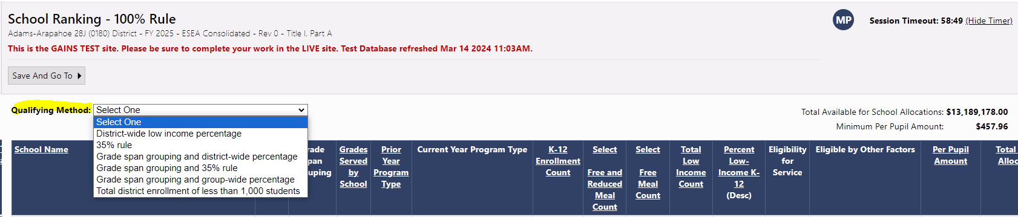
School Ranking
Consolidated Application System Training
LEAs will need to select the "Qualifying Method" before designating schools as Title I:
If you need more information on the qualifying methods and which method might be the best fit for your LEA, you can review the Title I Rank Order page or reach out to your Regional Contact.
LEAs will also see a "Minimum Per Pupil Amount" on the right-hand corner. The Minimum Per Pupil Amount is a recommended PPA to ensure schools are served with an amount that is adequate for implementing effective programming.
Notes:
DC

Slide 15
School Ranking – Total Available for School Allocation
Consolidated Application System Training
Please note in the right-hand corner, above the chart, that there is that "Total Available for School Allocation." As mentioned previously, this number is pulled from the LEA Title I, Part A Set-Asides page. This is a huge reason (and we can't emphasize it enough) why the LEA Title I, Part A Set-Asides page NEEDS to be done and set before the School Ranking page. If something changes on the Set-Asides page, this will impact PPA and rank order.
Notes:
DC

Slide 16
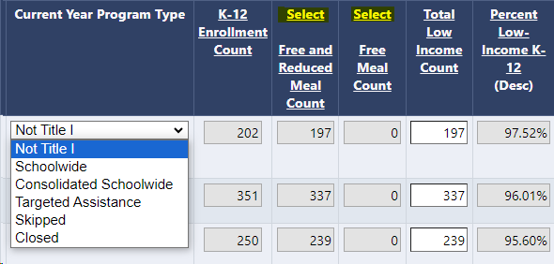
School Ranking: FRL and FL Data
Consolidated Application System Training
LEAs will click "Select" (highlighted in the screenshot below), to either use Free and Reduced Meal Count or Free Meal Count data. This will change the Percentage of Low-income K-12.
If the LEA selects something other than FRL, FL on the LEA Profile page, or would like to utilize another point in time, the LEA will be able to edit the "Total Low Income Count" column.
Notes:
DC Again, the LEA Data Profile doesn't talk to the School Ranking Page. But the LEA Data profile will be utilized if the LEA wishes to use another set of data that will need to be manually entered.

Slide 17
School Ranking – Eligible by Other Factors
The School Ranking table also has a column called, "Eligible by Other Factors." This is where a school might not be eligible for Title I, but the LEA can select one of these other factors to make it eligible.
Legacy: This option allows a school that was served the previous year, but not eligible in the current year, to be served one additional year.
Previously, schools would be served through District Managed Activities. However, with the Legacy option, the schools can be budgeted at in the budget with the 4010-function code.
Waiver: This option allows schools that are below the 40% poverty requirement to still be served schoolwide. Please keep in mind that a waiver must be submitted and approved by CDE to utilize this option.
Prioritized High School: This allows high schools with 50% poverty and above to be served as Title I schools.

Slide 18
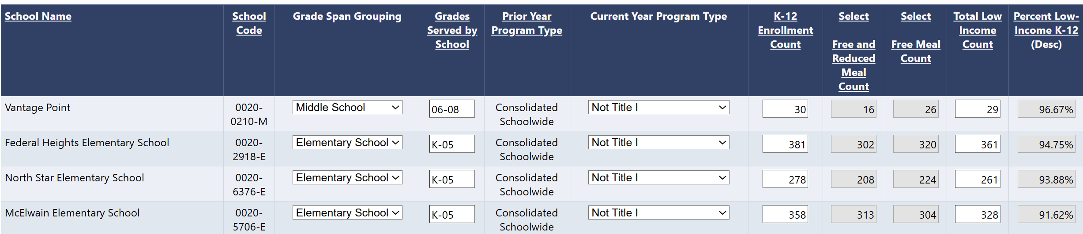
New! Editable School Ranking Page
The programmer is working on building out additional functionality where LEAs can update the school information on the School Ranking page!
LEAs will be able to change the Grade Span Grouping, Grades Served by School, and K-12 Enrollment numbers for each school.
If this feature is not available at the time of opening Title I, Part A, CDE would like LEAs to submit changes to the Schools through a Smartsheet form that will be shared. Please be aware that updates will take up to 72 hours.

Slide 19
Consolidated Application: Budget Reminders
Notes:
JH

Slide 20
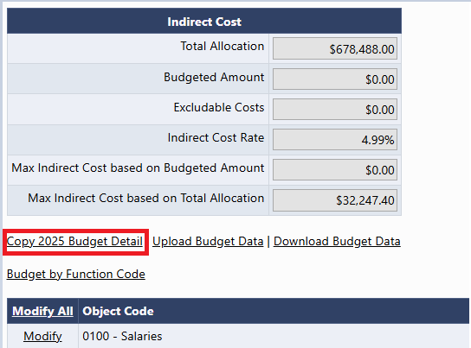
Copy 2025 Budget Detail
Consolidated Application System Training
A new link now appears in all budgets! Copy 2025 Budget Detail
This will copy last year's budget and place it in the 2026 budget.
Please be aware that you should consider using this feature before entering any line items. Once a line item is entered, this feature will disappear as an option!
Notes:
JH

Slide 21
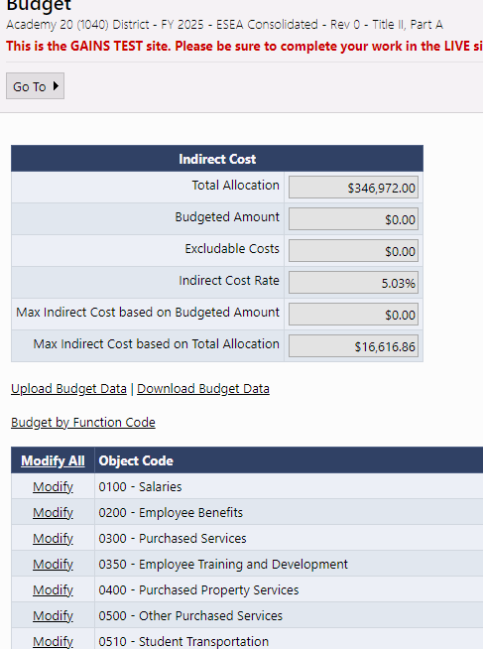
Budget Pages
Consolidated Application System Training
Budgets pages will appear in each Title program section, as applicable.
Indirect Cost table will show Total Allocation, ICR%, and Max Indirect based on Total Allocation
As budget line items are added, the table will calculate Max Indirect based on Budgeted Amount, Budgeted Amount, and any Excludable Costs.
To open any Budget to add line items, click "Modify All"
Notes:
JH

Slide 22
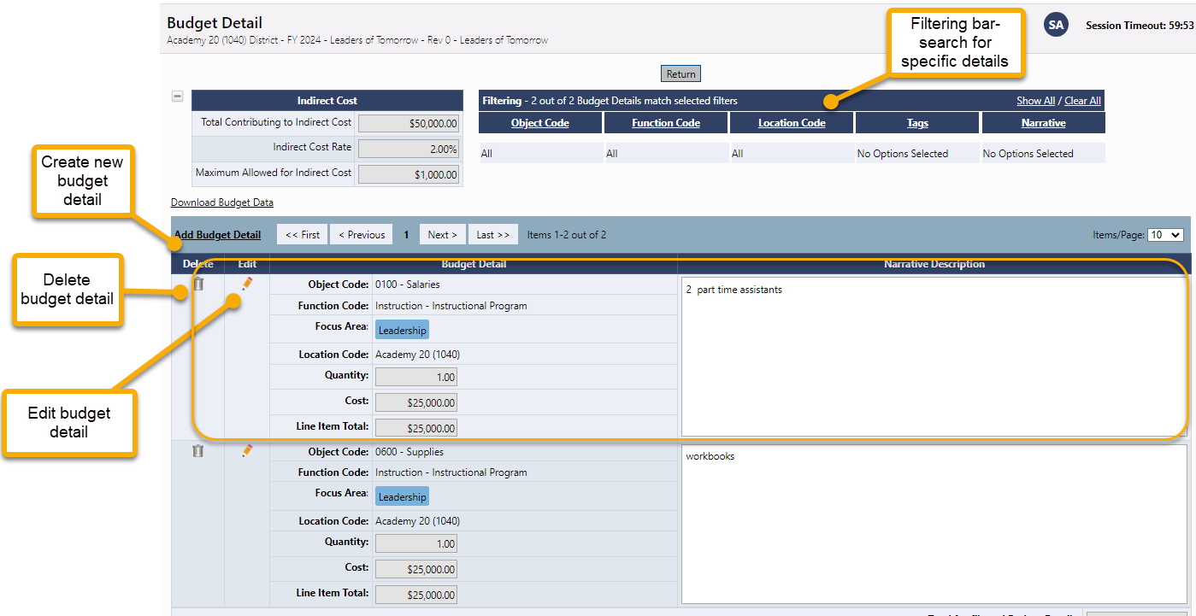
Budget Detail Page
Consolidated Application System Training
Click the Add Budget Detail link to create a new budget line entry.
On this screen, you can also edit or delete existing budget details line items.
Use the filtering bar at the top of the page to find a group of expenditures or a specific detail.
NEW! The budget will now allow users to filter by Item Key!
Notes:
JH

Slide 23
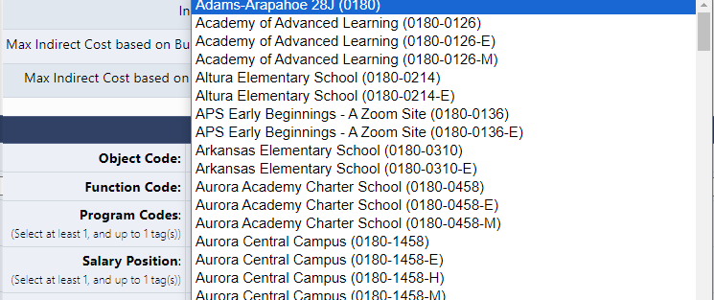
Budget Detail: Locations Dropdown
The Location Code is unique because it is going to list all schools within the LEA as E, M, H but also as a general school (not broken out by gradespan).
This is because the system is setup for grants across the department that do not breakout funding by gradespan.
It is imperative that Consolidated Application users select the gradespan for each school level activity. The School Ranking page is checking the allocation for that school based on the gradespan.
If a general school location is selected, you will get a validation error that the funds haven't been budgeted to the school correctly.
General School
Gradespan specific
Notes:
JH

Slide 24
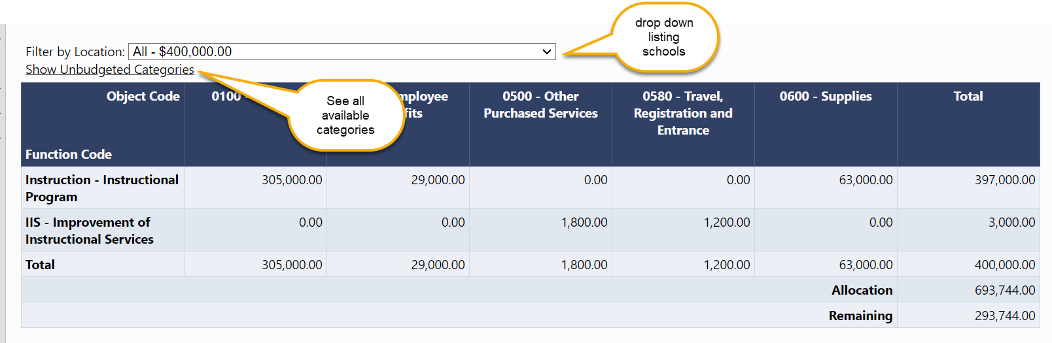
Budget Overview
Consolidated Application System Training
The Budget Overview page is a non-editable grid view of the budgeted subtotals.
The overview can be filtered by locations and can show all possible function/object code combinations by selecting Show Unbudgeted Categories.
Notes:
JH

Slide 25
Budget Upload Additional Instructions and Resources
Consolidated Application System Training
For step-by-step instructions on how to complete and upload an excel budget into GAINS and resolve commons upload errors, please see additional guidance:
Recorded Training
Text Instructions Resource
Slide Deck with Screenshots (ESEA Consolidated Application Specific)
Notes:
JH

Slide 26

2025-2026 Consolidated Application Walkthrough
Consolidated Application System Training

