Slide 1

2025-2026 Consolidated Application System Training
Title II, Part A

Slide 2
Agenda
Consolidated Application System Training
Changes to the Consolidated Application Title II, Part A Section in GAINS
Budget Reminders
Title II, Part A GAINS Walkthrough

Slide 3
Consolidated Application: Title II, Part A Changes

Slide 4
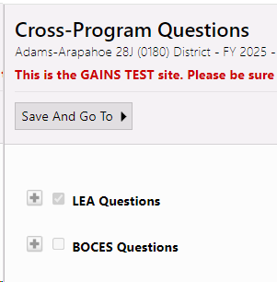
Narrative Question Layout
Consolidated Application System Training
Each narrative section has a set of questions for LEAs and a set of questions for BOCES.
These sections will be pre-selected based on your organization and expanded so questions can be seen, and responses can be entered.

Slide 5
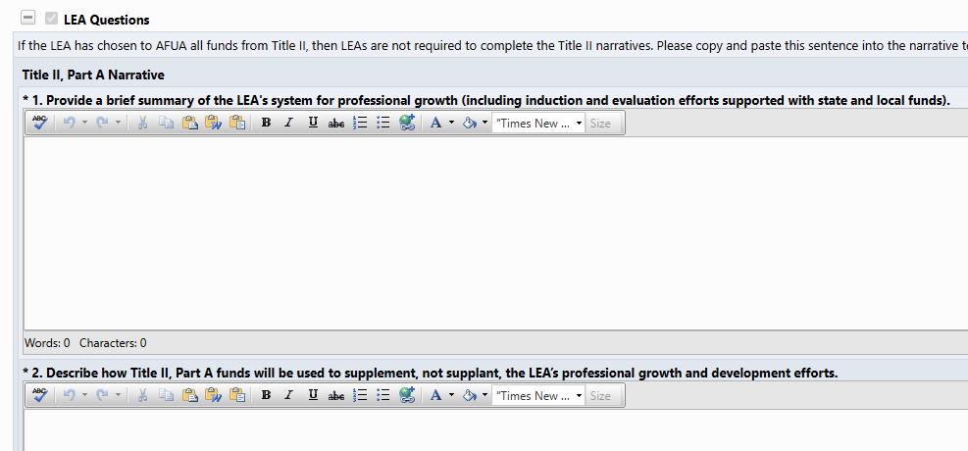
Title II, Part A, Narrative Changes: Question 1
Consolidated Application System Training
Question 1: Last year's question is now broken out into two parts:
Previous version: 1. Describe how Title II, Part A funds will be used to supplement, not supplant, the professional growth and development efforts supported with state and local funds.
See page 44 of the Consolidated Application Planning Resource for Response Guidance and Helpful Resources on Title II, A Narrative Questions.
Notes:
This year's version:
1. Provide a brief summary of the LEA's system for professional growth (including induction and evaluation efforts supported with state and local funds).
2. Describe how Title II, Part A funds will be used to supplement, not supplant, the LEA’s professional growth and development efforts.

Slide 6
Title II, Part A, Narrative Changes, Continued
Consolidated Application System Training
Question 2 in last year's application has been moved to the new ESSA Improvement Narratives page in Cross Program.
Alternative Use of Funds Authority (AFUA) Note: If the LEA has chosen to AFUA all funds from Title II, then LEAs are not required to complete the Title II narratives. Please copy and paste this sentence into the narrative text boxes "The district has chosen to AFUA all Title II funds." to avoid error messages in GAINS.
Copy Forward Prior Year Responses NOT available for the Title II, Part A narrative sections.
Copy 2025 Budget Detail IS AVAILABLE in the Budget.

Slide 7
Consolidated Application: Budget Reminders

Slide 8
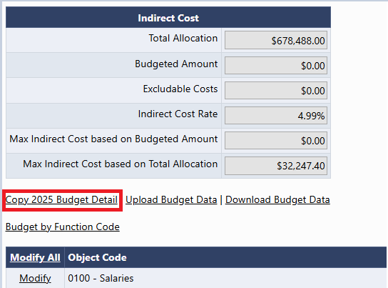
Copy 2025 Budget Detail
Consolidated Application System Training
A new link now appears in all budgets! Copy 2025 Budget Detail
  This will copy last year's budget and place it in the 2026 budget.
Please be aware that you should consider using this feature before entering any line items. Once a line item is entered, this feature will disappear as an option!

Slide 9
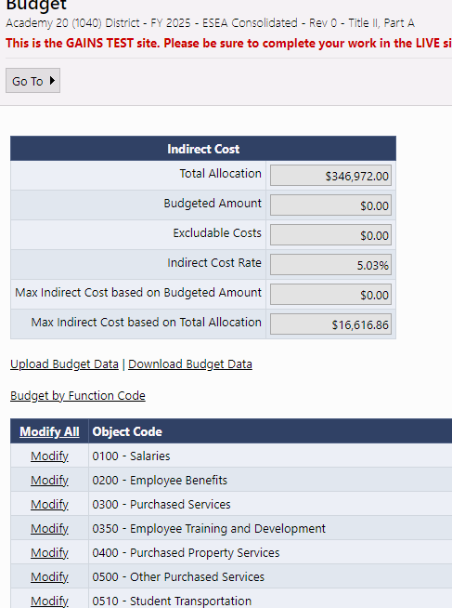
Budget Pages
Consolidated Application System Training
Budgets pages will appear in each Title program section, as applicable.
Indirect Cost table will show Total Allocation, ICR%, and Max Indirect based on Total Allocation
As budget line items are added, the table will calculate Max Indirect based on Budgeted Amount, Budgeted Amount, and any Excludable Costs.
To open any Budget to add line items, click "Modify All"

Slide 10
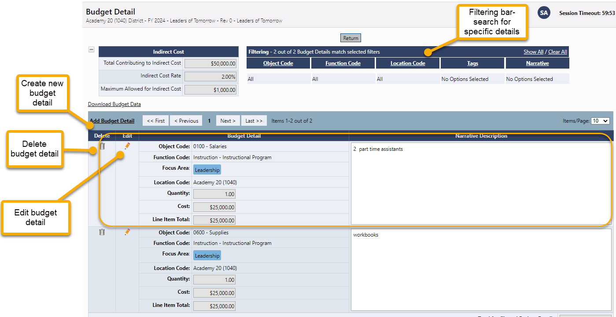
Budget Detail Page
Consolidated Application System Training
Click the Add Budget Detail link to create a new budget line entry.
On this screen, you can also edit or delete existing budget details line items.
Use the filtering bar at the top of the page to find a group of expenditures or a specific detail.
NEW! The budget will now allow users to filter by Item Key!

Slide 11
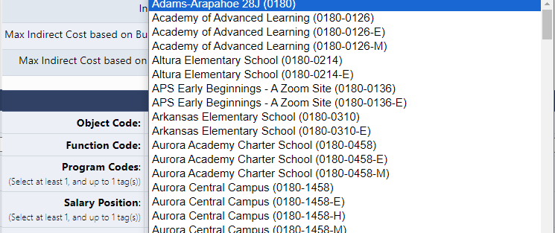
Budget Detail: Locations Dropdown
The Location Code is unique because it is going to list all schools within the LEA as E, M, H but also as a general school (not broken out by gradespan).
  This is because the system is setup for grants across the department that do not breakout funding by gradespan.
  It is imperative that Consolidated Application users select the gradespan for each school level activity. The School Ranking page and other validation checks are checking the allocation for that school based on the gradespan.
  If a general school location is selected, you will get a validation error that the funds haven't been budgeted to the school correctly.
General School
Gradespan specific

Slide 12
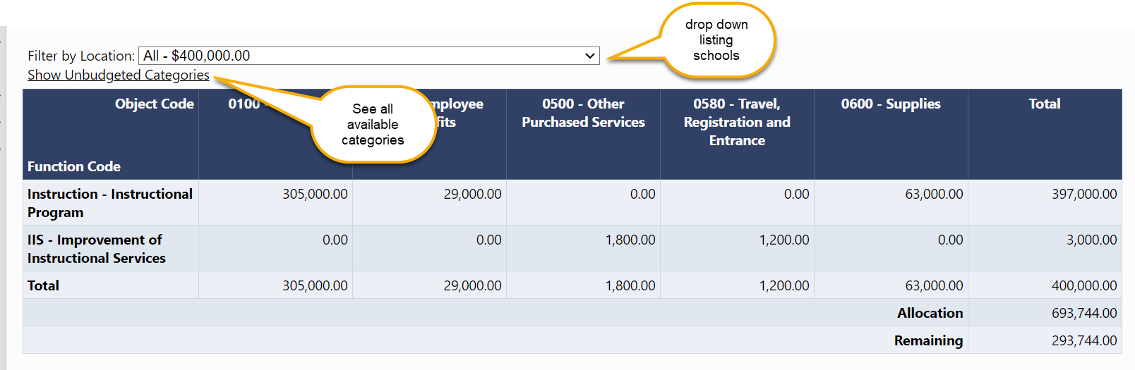
Budget Overview
Consolidated Application System Training
The Budget Overview page is a non-editable grid view of the budgeted subtotals.
The overview can be filtered by locations and can show all possible function/object code combinations by selecting Show Unbudgeted Categories.

Slide 13
Budget Upload Additional Instructions and Resources
Consolidated Application System Training
For step-by-step instructions on how to complete and upload an excel budget into GAINS and resolve commons upload errors, please see additional guidance:
Recorded Training
Text Instructions Resource
Slide Deck with Screenshots (ESEA Consolidated Application Specific)

Slide 14

2025-2026 Consolidated Application Walkthrough
Consolidated Application System Training

