Slide 1

2025-2026 Consolidated Application System Training
BOCES
Notes:
DC

Slide 2
BOCES Agenda
Consolidated Application System Training
BOCES Access to GAINS
BOCES ESEA ARAC
Requirements of BOCES Application and Member District Application
  Specific to the Cross-Program Information Section and the Title I, Part A Section.
Notes:
DC

Slide 3
BOCES Application – Access
Consolidated Application System Training
To access the BOCES application, users will need one of the following roles within the BOCES organization:
  LEA Authorized Representative
  LEA Fiscal Representative
  LEA All Funding Director
  LEA All Funding Update (unable to change the status of the application)
  LEA ESEA Consolidated Director
  LEA ESEA Consolidated Update (unable to change the status of the application)
Notes:
DC

Slide 4
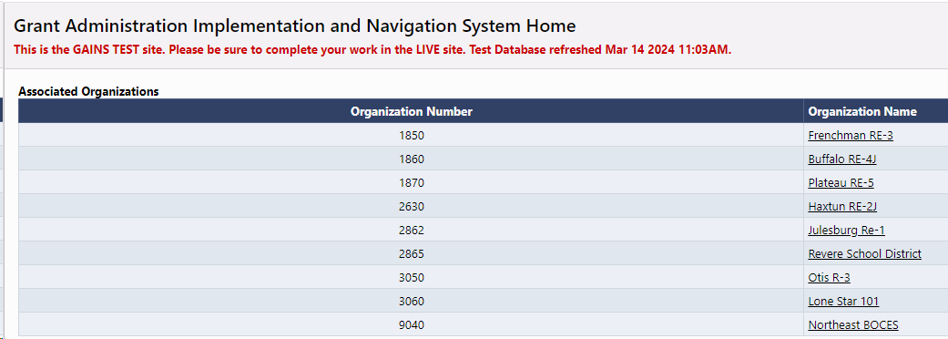
BOCES Application – Member District Access
Consolidated Application System Training
The BOCES users will need access to the Member District applications specifically for Title I, Part A.
  BOCES staff should have the role of ESEA Consolidated Director role or ESEA Consolidated Update role (which would prevent BOCES personnel from changing the status of the application).
  When the BOCES user login to the system, they will be able to see all member districts and their Consolidated Application. If you are missing a district, please let the Grants Program Administration (GPA) team know at GAINS@cde.state.co.us so we can get the district added.
Notes:
DC

Slide 5
BOCES Application – Title III Access
Consolidated Application System Training
If you are a BOCES that only manages Title III and would like your member districts to have access to the BOCES application, please notify the GPA team at GAINS@cde.state.co.us.
  GPA will ensure these member districts only have "update" access and won't be able to submit the application. They will only be able to make edits.
Notes:
DC

Slide 6
BOCES ESEA ARAC
Consolidated Application System Training
Once CDE receives the allocations, CDE will upload the allocation amounts to the ESEA ARAC. Once available, the Member Districts MUST complete the ESEA ARAC that indicate whether the funds will be Accepted, Declined, or Assigned (in this case, to the BOCES).
  If the BOCES policy allows, CDE recommends gaining the appropriate roles for the LEA ESEA ARAC. This could allow the BOCES users to assist the Member Districts in completing the ARAC and getting the BOCES application opened sooner for the specific Title Programs!
When CDE receives the ESEA ARAC from the Member Districts, CDE will be able to populate the BOCES ESEA ARAC with the Member Districts and the allocation amounts.
The BOCES will then need to complete and submit the BOCES ESEA ARAC to CDE.
Finally, CDE will populate the BOCES Application with the signed over funds so the BOCES can begin to access the Title related sections of the Consolidated Application.
Notes:
DC

Slide 7
Cross-Program Information Section Overview
Page | Application | Why
Alternative Fund Use Authority (AFUA) | BOCES Application | This will be pulled into the BOCES application after receiving the BOCES ARAC.
Contacts | Both Applications | CDE needs a Title I, Part A contact from every LEA and BOCES. CDE recommends identifying a Monitoring Contact for each LEA and BOCES.
Cross-Program Questions | BOCES Application
Non-Public Schools | Member District Application | The data needs to go into the Member District application, including the NPS Consultation forms. But the BOCES still complete the page in order to clear the errors.
2023-2024 EDT Data | BOCES Application | This will be pulled into the BOCES application after receiving the BOCES ARAC.
ESSA School Improvement Narratives | BOCES Application | This will be pulled into the BOCES application after receiving the BOCES ARAC.
Targeted and Additional Targeted Support Schools | BOCES Application | This will be pulled into the BOCES application after receiving the BOCES ARAC.
Tribal Consultation Attestation | Not Applicable
School Improvement Retention of Funds Form | Both Applications | This needs to be completed by all applicable LEAs. Centennial BOCES will also need to complete this page.
Assurances | Both Applications | Assurances need to be completed from all LEAs and BOCES.
2025-2026 ESEA General Assurances | Both Applications | Assurances need to be uploaded by all LEAs and BOCES.
Notes:
DC

Slide 8
Contacts
CDE needs to collect from every district the Title IX contact, Title I, Part A contact and Monitoring Contact.
  Please identify the Title I, Part A and Monitoring contact in the member district application.
  The Title IX contact is still in the BOCES application.
The BOCES will still need to complete the Contacts page in the BOCES application with BOCES contacts.

Slide 9
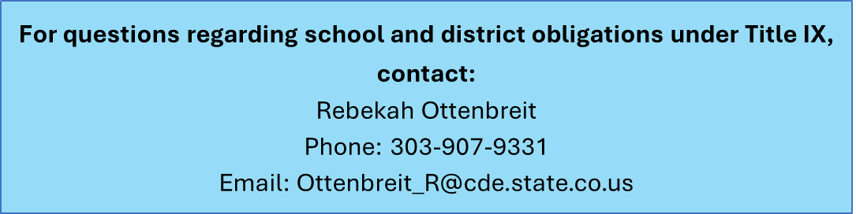
Title IX of the Education Amendments of 1972 - BOCES
Consolidated Application System Training
Requires each district to have at least one Title IX Coordinator to act as the “Lead”
This is the person that students and parents go to in order to file a Title IX (sex discrimination) complaint, such as:
  Sexual harassment (as defined under the 2020 Title IX Regulations)
  Lack of equal opportunities for girls in STEM
  Lack of equal opportunities for girls in athletics
  Discrimination on the basis of pregnancy, childbirth, false pregnancy, termination of pregnancy, or recovery therefrom
The Lead is the district level Title IX Coordinator that oversees school level Title IX Coordinators (if applicable)
Lead Title IX Coordinator's name and contact information should match the Lead Title IX Coordinator’s name and contact information that is posted on the district’s website.
Remember to include a phone number for the Title IX Coordinator!

Slide 10
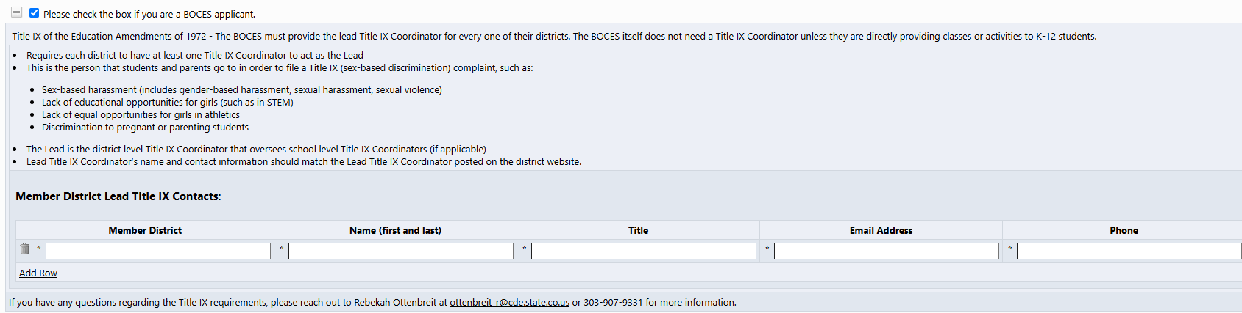
Title IX of the Education Amendments of 1972 – BOCES Section
The BOCES application will, again, have a specific Title IX section which needs to be completed on the Contacts page.
  This was pre-checked in the last application but now the BOCES needs to check the box for this section to appear.
Please be sure to enter a Title IX contact for each member district in the chart, utilizing the Add Row feature:

Slide 11
Non-Public Schools
All data for non-public schools, regardless of participation, needs to be entered in the Member District application.
The BOCES will check the box that states, “The LEA is unaware of any non-public schools within its boundaries with which to engage with in timely and meaningful consultation. Upon becoming aware of a non-public school within the LEA's boundaries, the LEA will engage in timely and meaningful consultation with non-public school officials regarding the provision of equitable services to students attending a non-public school. §§ 1112(c)(2), 1117(a)(1)(A), 1117(b); 8501(b)(1), 8501(c)(1-5).”
  By checking the box, the BOCES will clear the errors related to the Non-Public School page and be able to submit the application to CDE.

Slide 12
Title I, Part A Section Overview
Page | Application | Why
LEA Title I, Part A Set-Aside | Both Applications | This page identifies the amount that can be allocated to the schools. This number is then pulled onto the School Ranking page. The homeless set-aside must be added to the BOCES application so the BOCES can submit.
LEA Data Profile | Both Applications | The data must be selected in the member district application but the BOCES now has an option so the error can be cleared.
School Ranking | Member District Application | This page is calculating how much should be budgeted to each school.
Preschool Table | Member District Application | The member district application will contain the list of PKs and the participation selections need to be made in the Member District Application.
Title I, Part A Narratives | BOCES Application | The system has the ability to add narratives for each member district.
Title I, Part A Budget | BOCES Application | The BOCES is the fiscal agent and the fund requests are connected to the BOCES budget.
Title I, Part A Assurances | Both Applications | Assurances need to be understood and completed in both the Member District Application and the BOCES Application.
Notes:
DC

Slide 13
LEA Title I, Part A Set-Aside
Consolidated Application System Training
As mentioned, this needs to be completed in the member district application because it is calculating how much can be allocated to participating schools on the School Ranking page.
For the BOCES application, the Homeless Set-Aside still needs to be entered, and the amount needs to match what is budgeted.
  If it is not entered on this page, the BOCES will receive an error that prevents submission.
Notes:
DC

Slide 14
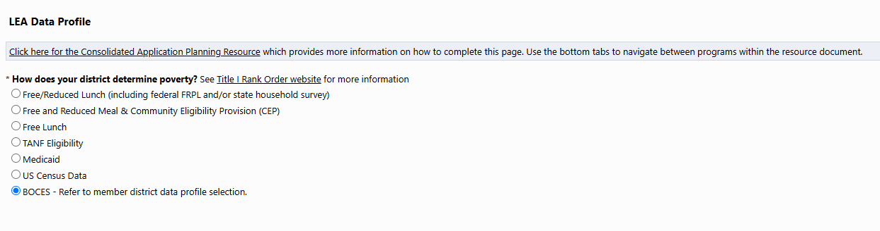
LEA Data Profile
Consolidated Application System Training
Within the member district’s application, the poverty measure needs to be selected. This can differ from district to district which is why it needs to be selected within the member district application.
The BOCES application also needs a selection in order to submit. CDE has added an option for the BOCES application. The BOCES can now select, “BOCES - Refer to member district data profile selection.”
Notes:
DC

Slide 15
School Ranking
Consolidated Application System Training
This page needs to be completed within the Member District application. The non-public school page and the LEA Title I, Part A Set-Asides page all go into the Total Amount Available for Schools which can be found in the top right hand corner of the School Ranking page.
The School Ranking page in the BOCES application will be blank. The BOCES does not need to complete anything on this page within the BOCES application.
Notes:
DC

Slide 16
Title I, Part A Narrative and Budget
Consolidated Application System Training
The narrative and budget for Title I, Part A needs to take place within the BOCES application.
The Member District application does not need to be completed on these pages.
Notes:
DC

Slide 17
Title I, Part A Assurances
Consolidated Application System Training
CDE is asking that both the Member District application and the BOCES application complete the Title I, Part A Assurances.
It is imperative that both the LEA and BOCES read and understand the assurances for all programs, even if funds are signed over to a BOCES.
Notes:
DC

Slide 18
Other Title Programs
Consolidated Application System Training
If the Member District signs over the other Title programs, they will not see those program sections within their application. These programs will all be completed within the BOCES Application:
  Title II
  Title III
  Title III-ISA
  Title IV
  Title V
Notes:
DC

Slide 19
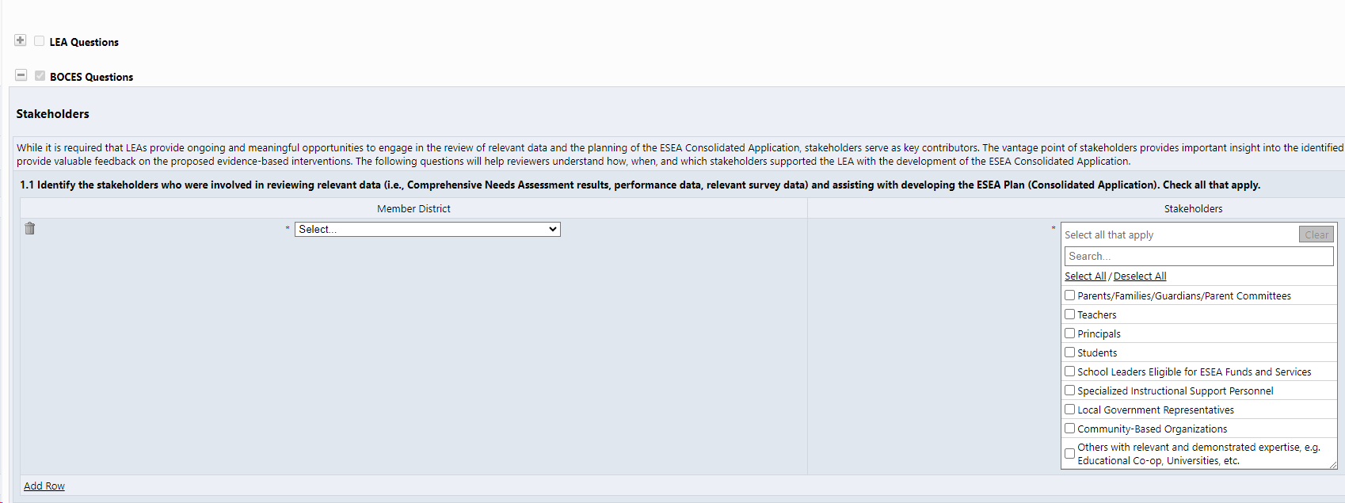
BOCES Application – Narratives
Consolidated Application System Training
The application will only show the BOCES questions.
Each question will be in a chart where the BOCES can select the member district and provide the associated response.
The BOCES will have the option to "Add Row" and enter as many responses as necessary (one for each member district).
NEW! An additional row has been added so that BOCES can add a BOCES-level response.
All narrative questions will be completed in the BOCES application.
Notes:
DC

Slide 20

2025-2026 Consolidated Application Walkthrough
Consolidated Application System Training

