Slide 1
Systems, Structures & Tips to Support a Virtual Hiring Process
Kate Bartlett & Jenny Hinkle
School & District Transformation Unit

Slide 2
COVID and Opportunity
Virtual Hiring is a New Opportunity!
Notes:
(1 minutes) We are all adjusting to a new normal because of the impact of COVID. It has caused us to look at our practices and think about how we can do business differently. It creates opportunity for us to think outside of the box on how we can be more efficient but also maintain connection with other. That is how we want to think about this learning today. We have to adjust and think differently about hiring. We can mourn our past practice or think about this as a new and exciting way to hire great teachers for the kids we serve.

Slide 3
Agenda
Session 1 - Previous Session - 12-1pm Reflect on best practices from other organizations to develop an engaging virtual hiring experience aligned with your school’s vision and mission that will allow for candidates to demonstrate desired competencies.
Session 2 - Current Session - 1:15-2:15pm Tactical tools to organize and operate a virtual hiring process. We will provide sample templates—including case studies and question banks—that your hiring team can use or adapt this spring and beyond.
Both will be recorded and posted for future viewing
Notes:
Think about introducing and reinforcing that two work best together

Slide 4
Introduction
Presenter background
Sources used to develop and inform this presentation
Previous talent professional development through the Turnaround Network
Resources and systems used in small, rural district setting, but easily adapted to a larger, urban setting
Resources provided by TNTP on hiring

Slide 5
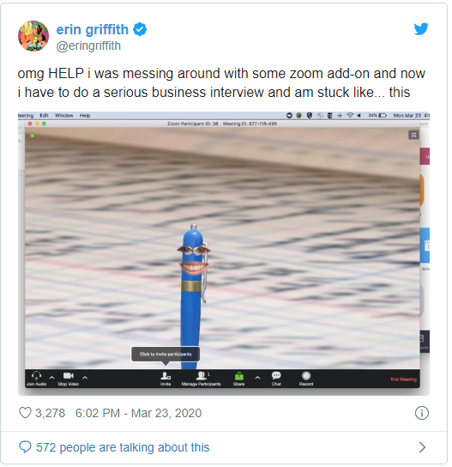
Opening
Notes:
It’s important to keep our sense of humor in our new digital world. Things could take an unpredictable turn. Have empathy for your candidate who shows up on Zoom like this…. Have empathy for each other.

Slide 6
Outcomes and 4 Domains Connection
Outcome: School leaders will develop systems and structures to support best practices in the staff recruitment and retention indicator, specifically:
Domain 2 - Talent Management
2.1 Staff recruitment and retention
Interviewing - Applicants engage in an interview process that assesses alignment to the school and skill set.
Hiring - The hiring process and timeline ensures access to highly qualified. candidates aligned to the school’s mission.

Slide 7
Reflection
What doesn’t change when hiring goes from in-person to virtual? What can we re-use or leverage, that we already know and use?
We will use the Breakout Rooms feature in Zoom to brainstorm in groups of 3 for 2 minutes. Please be prepared to report back.
Notes:
There is so much conversation about what is different right now. Let’s ground ourselves in what is the same.

Slide 8
Before you think about hiring

Slide 9
Retention
Take some time on retaining current staff, particularly your Irreplaceables
What might this look like?
Schedule a check in by phone, send an email, send a card….
Think through your timeline for commitments to return

Slide 10
Recruitment
Leverage Social Media
Online job listings - cast a wide net

Slide 11
Hiring

Slide 12
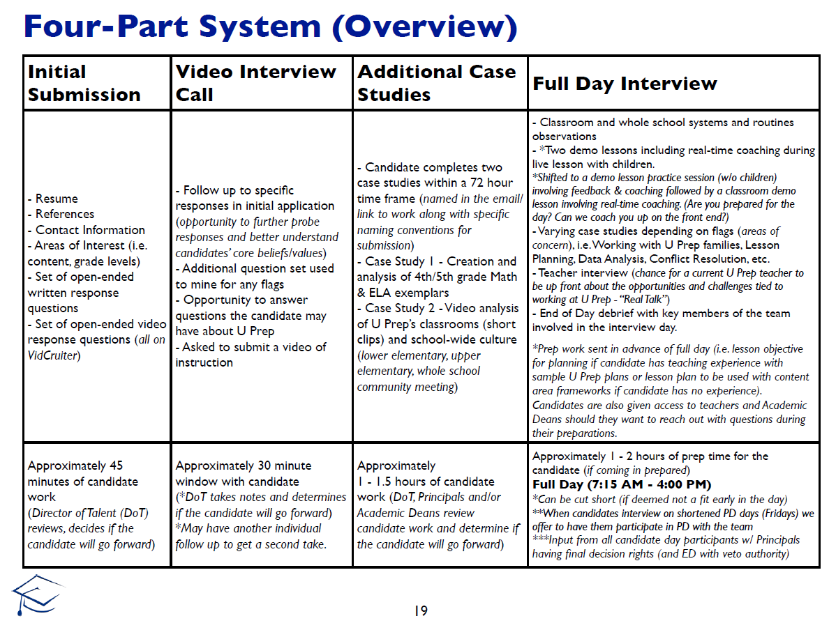
In the old days

Slide 13
In the new days
What are the big pivots?
Do not get to see the candidate interact with students
Do not get to see the candidate interact with staff
Do not get to show the candidate your school, culture in person
Do not get to interact with the candidate in person over an extended period (full day interview)

Slide 14
In the new days
What is not a pivot?

Slide 15
Sample 5-Step Virtual Hiring Process
Prior to hiring: Focus on Recruitment & Retention Form Hiring Committee
Hiring Process
1 | Phone Screening Interview
Decision Point: Proceed with candidate?
2 | Written Performance Task
3 | Video Performance Task
4 | Interview, including feedback on performance tasks
Decision Point: Proceed to reference checks?
5 | Reference Checks
Decision Point: Offer to candidate?
Post offer: Get to yes

Slide 16
Tracking
Consider a simple Google spreadsheet to keep track of candidates, tasks and next steps
Here is a sample template

Slide 17
Step 1: Phone Screening Interview
Purpose: To quickly assess whether the candidate has the competencies that align with your vision and mission
Who is involved: School leader (or HR partner)
Format: Phone or videoconference
Time: No more than 30 minutes, can do in 20, per candidate
Content:
See question bank
Do a fit check – ask questions specific to your context, such as “do you like snow?”
Do a salary check – “have you reviewed our salary and benefits information?”

Slide 18
Decision Point
You and the candidate will invest several hours from this point forward if you both decide to continue
Think through….
Were there any red flags?
Salary?
Relocation?
Experience?
Other?
Did you sense alignment with your school’s values, mission and mindset, desired competencies?
Consider moving no more than 3 candidates forward from here

Slide 19
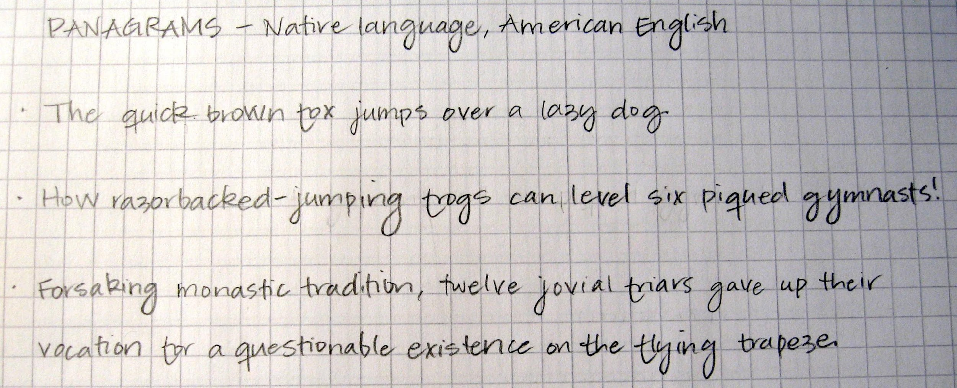
Step 2: Written Performance Task
Purpose: To assess candidate’s writing skills, mindset and alignment with your vision and mission
Who is involved: School leader (or HR partner)
Format: Email
Time: 10 minutes to request, 20 minutes to review
Content:
See sample email to candidate
See sample case studies
Consider creating your own case study or written performance task that aligns to your context or values
Set a deadline and make it short—also allows you to assess for responsiveness and commitment
Share with hiring committee and provide a place to collect feedback

Slide 20
Step 3: Video Performance Task
Purpose: To get a multi-layered sense of the candidate’s professional and interpersonal skills
Who is involved: School leader (or HR partner)
Format: Video, either live or candidate records and submits ahead of time
Time: 10 minutes to request, 20 minutes to review
Content:
See sample email to candidate
Video assignment can vary
Submit existing video of instruction (pre-COVID)
Make video of teacher-directed instruction based on a prompt you provide
Make video of another teacher-directed session, such as an opening circle, based on a prompt you provide
Set a deadline and make it short—also allows you to assess for responsiveness and commitment
Share with hiring committee and provide a place to collect feedback

Slide 21
Interview Recommendations
Provide Interview Platform Options
Set and Communicate Clear Expectations
Unintended Interruptions
Be Aware of Biases
Notes:
(2 minutes) There is a great deal of preparation that goes into virtual hiring before you even conduct the interview. Here are some recommendations that come from TNTP. First you want to determine what platform you will use for the interview and that both the team and interviewees know how to use them. Additionally, you want to create equity in your hiring so if a candidate doesn’t have access to a particular platform, you should provide an alternative. Next, you want to set and communicate clear expectation for the interview. You will want to give guidance on dress, suitable settings such as one with minimal noise and technical requirements. Because candidates are interviewing at home most likely, let them know that you understand if there are unintended interruptions like dogs barking, kids running in, etc. Lastly, you want to be sure that your team is aware of unconscious or explicit biases and that they don’t influence a decision such as a candidate’s surroundings, dress or background noise.

Slide 22
Step 4: Interview & Feedback
Purpose: To interact directly with the candidate and to give the hiring committee a chance to provide input
Who is involved: School leader, hiring committee
Format: Videoconference
Time: 45 minutes
Content:
Set norms with hiring committee—likely, they provide input, school leader decides
Think about creating a defining moment
Introductions, identify who will facilitate, review agenda
Provide feedback on the candidate’s written and video performance tasks, and ask them to respond (“what might you do differently next time, based on our feedback?”)
Ask interview questions, see question bank
Allow candidate to ask questions—you may get some you don’t know answers to yet
Clarify next steps, timeline before hanging up

Slide 23
Decision Point
Establish a feedback process with hiring committee
Match/Mismatch
Fist to five
Consider
How did the candidate respond to feedback?
Does the candidate feel like a good fit with our mission, values and culture?
Any red flags?
School leader confirms next steps before closing

Slide 24
Step 5: Reference Checks
Purpose: To get outside perspectives on the candidate
Who is involved: School leader (or HR partner)
Format: Phone or videoconference (email also possible, depending on how confident you are about the candidate)
Time: 20 minutes
Content:
District likely has a format and requirements for these
If permitted by HR, “would you re-hire this person?” is a great question
Ready to offer? Call candidate and work with HR to provide official offer via email ASAP (within 12 hours ideal)! Then focus on Getting to Yes

Slide 25
Questions or comments?

Slide 26
Resources
CDE Turnaround Network Virtual Hiring Resources & Templates - Google folder containing resources shared throughout this presentation
David Singer Talent training - Turnaround Network Convening
TNTP hiring resources
TNTP Virtual Talent Guide
Reach out any time! To your TSM, or one of us:
Kate Bartlett, bartlett_k@cde.state.co.us
Jenny Hinkle, hinkle_j@cde.state.co.us

