Slide 1
Implementing the
Specialized Service Professional
State Model Evaluation System
for
Measures of Student Outcomes

Slide 2

Agenda
Measures of Student Outcomes
Welcome and Purpose
Introductions
Measures of Student Outcomes
  Requirements
  Steps to Create Your System
  Decision Framework
Next Steps
Closing

Slide 3
Training Objectives: Desired Outcomes
What do we hope to accomplish today?
  Understand the legislative requirements for measures of student outcomes in specialized service professional evaluations
  Understand of the steps for including measures of student outcomes in your evaluation system
  Make preliminary decisions on measures of student outcomes in specialized service professional evaluations
  To determine next steps for your school, district or BOCES

Slide 4

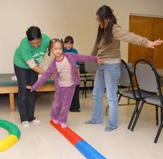

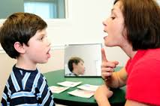
How Do You Feel About Measures of Student Outcomes?
Choose a picture from below that best reflects your feelings regarding measures of student outcomes in SSP evaluations. Why did you select the picture you did?

Slide 5
Determining
Measures of Student Outcomes for
Specialized Service Professionals

Slide 6
Colorado Department of Education
Framework for System to Evaluate
Specialized Service Professionals
Definition of Specialized Service Professional Effectiveness
Quality Standards
I. Professional Expertise
II. Learning Environment
III. High Quality Delivery
IV. Reflect on Practice
V. Leadership
VI. Student Outcomes
50% Professional Practice Standards 50% Measures of Student Outcomes
Observations of Professional Practice
Expert Input
Other Measures Aligned with CDE Guidance
Weighting: How Much Does Each Standard Count Towards Overall Performance?
Match of Measures of Student Outcomes to Assigned Duties
Weighting:
State Scoring Framework: How Do Measures of Quality Standards
Result in a Determination of Individual Performance?
Effectiveness Ratings
Ineffective Partially Effective Effective Highly Effective
Appeals Process*
Applies when professionals are not at-will employees

Slide 7
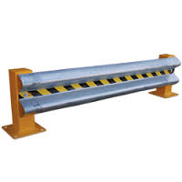
Guardrails for Evaluation System Building
Requirement language from State Board Rule:
  At least fifty percent of the evaluation shall be based on at least two measures of student outcomes, which measures shall be aligned with the role and duties and the individual SSP being evaluated

Slide 8
Guardrails for Evaluation System Building
Requirement language from State Board Rule:
  Data used in evaluating SSPs shall be collected from the sites, or a representative sample of the sites, at which the SSP provides services.

Slide 9
How Do We Make Decisions?
Individual SSP Decisions
Individual SSP and evaluator will make decisions unique to their professional responsibilities. Weights and measures will vary for every SSP in the district/BOCES.
What process will work best for your school, district or BOCES?
There is no right or wrong answer to this question! What process will work best given your context, what is feasible, meaningful and valued?
SSP Category/Group Decisions
Each SSP category will make general decisions about weights of measures, however actual outcome measures may differ. Each SSP category may have different percentages.
All SSPs Decisions
All SSPs in the district/BOCES will have the same weights or measures included in their evaluation. The weights will remain consistent, however the measures will vary based on the SSP.

Slide 10
Steps for Identifying and Determining Measures of Student Outcomes
Step 1: Determine SSP role and responsibilities to select relevant measures of student outcomes
Step 2: Select measures and assign weights aligned with the SSP role and responsibilities
Step 3: Determine success criteria for results from included measures of student outcomes
Step 4: Assign ratings based on identified success criteria
Step 5: Combine weighted ratings into an overall measures of student outcomes rating
Decision Framework

Slide 11
Measures of Student Outcomes
    Use the sample measures of student outcomes brainstormed by our SSP work groups as a starting point when thinking about the following questions:
  What does your role in supporting students look like and what are your major responsibilities?
  How do you contribute to your students’ success?
  How do you measure that success using measures of student outcomes?

Slide 12
Food for Thought
Taking into account your role and responsibilities, consider the following measures for inclusion in your evaluation system:
  Collective attribution measures
    Refers to outcomes on a measure attributed to two or more licensed personnel
  Individual attribution measures
    Refers to outcomes on a measure that are attributed to an individual licensed person,

Slide 13
Collective vs. Individual Attribution
Table Talk:
  At your table, discuss if collective and individual measures would be appropriate given the SSPs’ roles and responsibilities in your district/BOCES.
    Is there value in having collective measures?
    Is there value in having individual measures?
    Are there any shared goals in your district/BOCES that would be appropriate to include in your evaluation?
  Be prepared to share your thinking.

Slide 14
Steps for Identifying and Determining Measures of Student Outcomes
Step 1: Determine SSP role and responsibilities to select relevant measures of student outcomes
Step 2: Select measures and assign weights aligned with the SSP role and responsibilities
Step 3: Determine success criteria for results from included measures of student outcomes
Step 4: Assign ratings based on identified success criteria
Step 5: Combine weighted ratings into an overall measures of student outcomes rating
Decision Framework

Slide 15
Select and Weight Measures of Student Outcomes
Use the following information to make preliminary decisions regarding the multiple measures to be included in SSP evaluations:
  Role and major responsibilities of individual SSP, collective group of SSP or district/BOCES
  Collective versus individual attribution measures
  Values of the school, district and/or BOCES that should be captured in the evaluation system
    Example: collective reading goal for all staff

Slide 16
Creating Preliminary Pie Charts
Create a sample pie chart using poster paper.
  Your pie chart can be for an individual SSP, specific SSP group (ex. SLP, OT), or the entire district/BOCES
  Take into account the following questions:
    Role and major responsibilities of individual SSP, collective group of SSP or district/BOCES
    Collective versus individual attribution measures
    Values of the school, district and/or BOCES that should be captured in the evaluation system
  Be prepared to share your thinking!

Slide 17
Creating Preliminary Pie Charts
Collecting Feedback on Your Thinking
  Each group should select a spokesperson to share your thinking and rationale for your choices.
Audience should consider feedback on:
  Types of measures included
  The collective vs. the individual attribution
  Weights

Slide 18
Debrief/Reflection
Did the feedback help shape any of your thinking?
Any aha’s?
What might you reconsider/change if anything?

Slide 19

Select and Weight Measures of Student Outcomes
Reflection Questions
  How will your district/BOCES select meaningful measures for different SSP roles?
  How will your district/BOCES put a collaborative process in place when making decisions?
  How will you ensure the decisions you make are comparable and fair across your system?
  What resources (internal and external) do you have/need?
  How will you know if you have made meaningful decisions?

Slide 20
Steps for Identifying and Determining Measures of Student Outcomes
Step 1: Determine SSP role and responsibilities to select relevant measures of student outcomes
Step 2: Select measures and assign weights aligned with the SSP role and responsibilities
Step 3: Determine success criteria for results from included measures of student outcomes
Step 4: Assign ratings based on identified success criteria
Step 5: Combine weighted ratings into an overall measures of student outcomes rating
Decision Framework

Slide 21
Student Outcome Objectives
What are Student Outcome Objectives?
  Enables specialized service professionals to establish outcomes for individual or groups of students, monitor students’ progress toward those outcomes and evaluate the degree to which students achieve those outcomes using relevant, meaningful measures
  In evaluation systems, this process serves as a method of measuring student outcomes

Slide 22
Student Outcome Objectives
The essential steps of Student Outcome Objectives include:
  Determine professional contribution to students in order to select outcomes
  Collect baseline information to inform target and scale setting
  Assess quality, attainment level and rigor of student targets and scales
  Monitor student progress over time (formative practice)
  Determine attainment of student targets and scales
  Reflect and refine the process for Student Outcome Objectives

Slide 23
Student Outcome Objectives
Determine professional contribution to students in order to select outcomes
Turn and Talk:
Have you selected meaningful measures in Steps 1 and 2 that paint a clear picture of your performance?
How do you know?

Slide 24
Student Outcome Objectives
Determine professional contribution to students in order to select outcomes
Collect baseline information
Set Student Targets
Set Appropriate Scales for Measurement

Slide 25
Strategies for Target Setting
Possible strategies to consider when setting targets for students:
  Proficiency data Targets – students meeting grade level expectations
    Examples: a % of students will pass an exam; a % of students will achieve a specific score or better on a measure
  Growth data Targets – students growing over the course of instruction or service delivery
    Examples: a % of students will progress one level; a % of students will make projected growth or better
  Averaging data Targets – students’ average score on a measure
    Examples: Students will answer, on average, 80% of the questions correctly; students will achieve a 75% attendance rate

Slide 26
Strategies for Target Setting
Possible strategies to consider when determining how students will be captured in target setting:
  Individual – SSP sets individual goals for students and then determines how many students met their individual goals
  Whole Class –SSP sets a goal that would be applied to all students in a class
  Subgroup of Students –SSP sets a goal for a group(s) of students with similar baseline data levels
  Case Load – SSP sets a goal for the specific students he or she supports
  Some of these strategies may work better with some SSP assignments and measures. Can you think of which SSP assignments might work best with which strategy based on your local context?

Slide 27
Strategies for Scale Setting
SSPs set ranges (how many students are expected to meet the set target) across 4 rating levels: more than expected, expected, less than expected, and much less than expected
SSPs collaboratively set ranges with their evaluator
  Ranges will vary from year to year and possibly class to class or case load to case load as baseline data will vary due to student beginning points
  Collaboratively setting ranges will allow SSPs and evaluators to calibrate about expected student outcomes

Slide 28
Target Setting Practice
With a partner, use the Setting Student Targets and Scales worksheet to analyze one set of data.
  Portfolio/Performance Outcomes
  Baseline Reading Levels
  End of Course Summative Exam Results
  Rubric Outcomes
Practice setting targets and scales for expected outcomes.

Slide 29
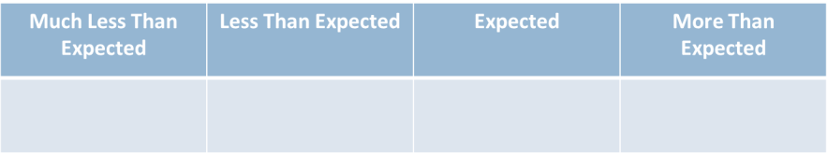
Scale Setting Practice
Think about what your expected outcomes are (targets).
Establish the ranges for each of the categories below.
How did you decide on the ranges?
Are your expectations rigorous, yet attainable?

Slide 30
Target and Scale Setting
  ALL 4 sets of data
  Performance Assessment/Portfolio Outcomes
  Reading Levels (beginning of the year)
  Cumulative exam
  Rubric Results
+ | √ | - | √ | + | √ | - | √ | + | √ | - | √ | √ | + | - | √ | - | + | + | - | √
18 | 24 | 24 | 30 | 38 | 40 | 40 | 50 | 50 | 50 | 50 | 50 | 60 | 60 | 60 | 60 | 70 | 70 | 70 | 80 | 80
66 | 89 | 68 | 75 | 74 | 80 | 94 | 99 | 60 | 55 | 71 | 73 | 95 | 96 | 84 | 82 | 79 | 81 | 98 | 74 | 86
6 | 4 | 1 | 5 | 5 | 2 | 6 | 2 | 5 | 2 | 1 | 6 | 3 | 3 | 5 | 3 | 1 | 2 | 6 | 4 | 4

Slide 31
Student Outcome Objectives
Determine professional contribution to students in order to select outcomes
Collect baseline information
Set Appropriate Scales for Measurement
Assess quality, attainment level and rigor of student targets and scales
Set Student Targets

Slide 32
Determine Target and Scale Quality
Will your district/BOCES establish quality criteria when setting targets and scales?
Criteria for establishing quality targets and scales might include:
  Approval processes
  Collaboratively established
  Balancing rigor with attainment levels
  Based on previous data and should meet or exceed past student performance

Slide 33
Student Outcome Objectives
Determine professional contribution to students in order to select outcomes
Collect baseline information
Set Appropriate Scales for Measurement
Assess quality, attainment level and rigor of student targets and scales
Set Student Targets
Monitor student progress over time (formative practice)

Slide 34
Student Outcome Objectives
Determine professional contribution to students in order to select outcomes
Collect baseline information
Set Appropriate Scales for Measurement
Assess quality, attainment level and rigor of student targets and scales
Set Student Targets
Monitor student progress over time (formative practice)
Determine attainment of student targets and scales

Slide 35
Reflection on Pre and Post Data
  Performance Assessment/Portfolio Outcomes
  Reading Levels (beginning of the year)
  End of year cumulative exam
  Rubric results
+ | √ | √ | + | - | √ | √ | + | + | √ | √ | + | + | + | ₊ | - | √ | √ | + | √ | +
30 | 40 | 38 | 38 | 50 | 50 | 50 | 60 | 50 | 60 | 70 | 70 | 60 | 70 | 70 | 80 | 80 | 70 | 80 | 80 | 80
75 | 90 | 76 | 89 | 80 | 99 | 90 | 91 | 80 | 70 | 82 | 79 | 94 | 95 | 98 | 95 | 66 | 87 | 98 | 85 | 71
5 | 5 | 3 | 6 | 6 | 4 | 3 | 5 | 6 | 6 | 4 | 5 | 4 | 4 | 6 | 5 | 3 | 6 | 5 | 6 | 5

Slide 36
Student Outcome Objectives
Determine professional contribution to students in order to select outcomes
Collect baseline information
Set Appropriate Scales for Measurement
Assess quality, attainment level and rigor of student targets and scales
Set Student Targets
Monitor student progress over time (formative practice)
Determine attainment of student targets and scales
Reflect and refine the process for Student Outcome Objectives

Slide 37
Considerations when Setting Student Outcome Objectives
Considerations when including Student Outcome Objectives in evaluation:
  Assessment literacy of SSPs when applicable
  Data literacy of SSPs
  Time and effort required of SSP and evaluator
  Focus of school, district or BOCES (all students and/or subgroups of students)
  Available information or data in school, district or BOCES
  Ease or readiness level of SSPs and evaluators
  Possible approval process
  Number of targets wanted as a school, district or BOCES

Slide 38
Student Outcome Objectives
Reflection
  What are SSPs already doing to support this process?
    Are there groups of SSPs that already do something very similar to creating student targets and scales?
  What additional ideas do you have for making Student Outcome Objectives more manageable?

Slide 39
Steps for Identifying and Determining Measures of Student Outcomes
Step 1: Determine SSP role and responsibilities to select relevant measures of student outcomes
Step 2: Select measures and assign weights aligned with the SSP role and responsibilities
Step 3: Determine success criteria for results from included measures of student outcomes
Step 4: Assign ratings based on identified success criteria
Step 5: Combine weighted ratings into an overall measures of student outcomes rating
Decision Framework

Slide 40
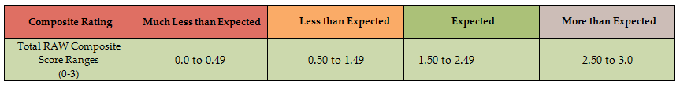
Scoring Measures of Student Outcomes Results
Score the results of criteria set during Student Outcome Objectives

Slide 41
Steps for Identifying and Determining Measures of Student Outcomes
Step 1: Determine SSP role and responsibilities to select relevant measures of student outcomes
Step 2: Select measures and assign weights aligned with the SSP role and responsibilities
Step 3: Determine success criteria for results from included measures of student outcomes
Step 4: Assign ratings based on identified success criteria
Step 5: Combine weighted ratings into an overall measures of student outcomes rating
Decision Framework

Slide 42
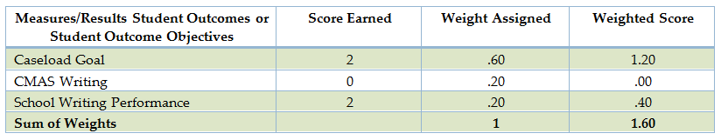
Combining Outcomes

Slide 43
Steps for Identifying and Determining Measures of Student Outcomes
Step 1: Determine SSP role and responsibilities to select relevant measures of student outcomes
Step 2: Select measures and assign weights aligned with the SSP role and responsibilities
Step 3: Determine success criteria for results from included measures of student outcomes
Step 4: Assign ratings based on identified success criteria
Step 5: Combine weighted ratings into an overall measures of student outcomes rating
Decision Framework

Slide 44

Decision Framework
Putting It All Together
  The Decision Framework helps districts and BOCES aggregate the 50% Professional Practices and the 50% Measures of Student Outcomes to reach a final rating of one of the following:
    Highly Effective
    Effective
    Partially Effective
    Ineffective

Slide 45
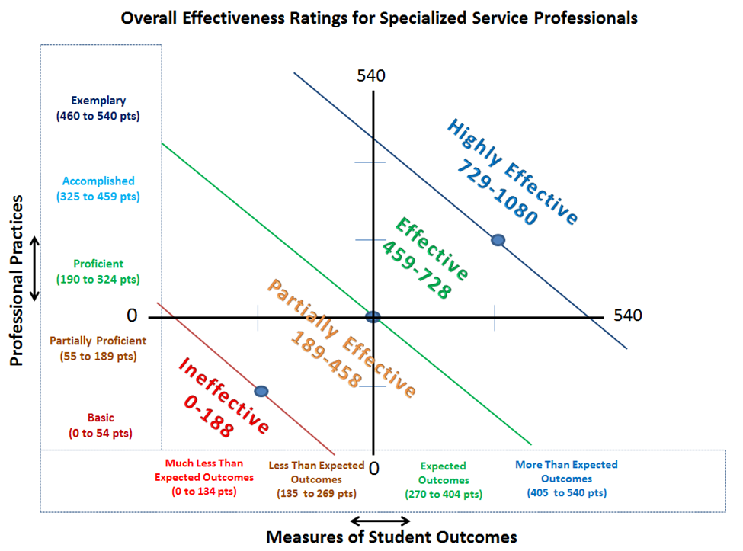

Slide 46
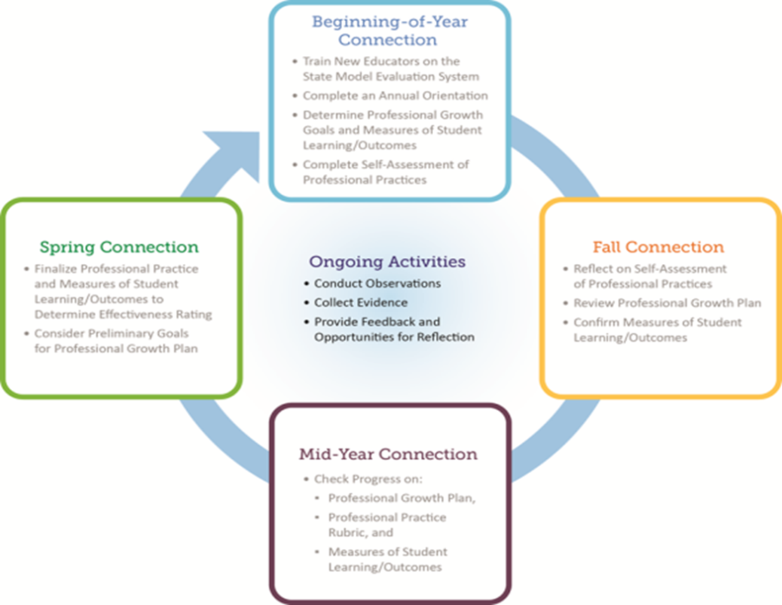
Evaluation Process
for
Specialized Service
Professionals

Slide 47
What are your next steps?
Make or revise decisions regarding your 50% measures of student outcomes
  Consider priorities of your district/BOCES and what is valued.
Identify points in the decision making process to engage and collaborate with your SSPs

Slide 48
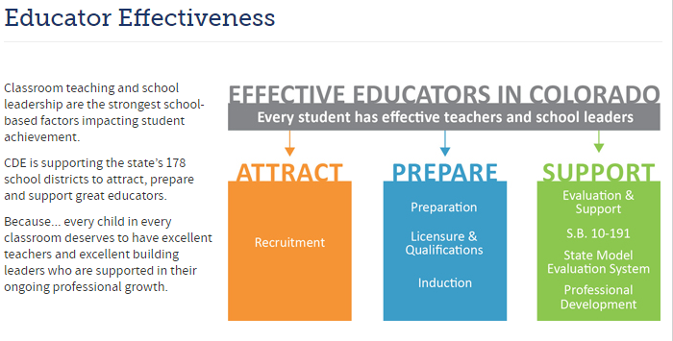
Contact Us
  http://www.cde.state.co.us/educatoreffectiveness/contactus

