Slide 1
MKV Subgrantee Training 2019-2022 Cohort
August 29, 2019

Slide 2
Agenda
TIME | AGENDA ITEM | Presenter
9-9:30 | Welcome and Introductions | Kerry Wrenick
9:30-10:30 | MKV Grant Management | Kerry Wrenick
10:30-11:15 | MKV Grant Fiscal Requirements | CDE Grants Fiscal
11:15-12 | MKV VISTA and support | Ann Marie Tunney
12-12:30 | Lunch/Break | On your own
12:30-1:30 | Subpopulations- Group Work | Kerry Wrenick
1:30-2:30 | Important information relevant to MKV | Kerry Wrenick
2:30-3 | Wrap-up and Announcements | Kerry Wrenick

Slide 3
Welcome and Introductions

Slide 4
Grant Management
Important Dates Document
Monitoring vs. Site Visit vs. Technical Assistance
Performance Measures
Academic
School Supports
Collaboration
Reporting
USDE Survey
End of Year Reporting
Data Custodian
EOY Survey and Continuation Grant

Slide 5
End of Year Reporting
What is working well?
What is not working well?
What is missing (i.e. what data is not being collected that would be beneficial)?
How can we make this report useful to you?
What do you think about pre-set performance measures?

Slide 6
Fiscal Oversight and Management
Managing and Overseeing McKinney-Vento Subgrantee Expenditures
State Coordinators are responsible for ensuring that subgrantees understand what expenses are allowable under their grant and spend their funds appropriately. In addition, subgrant expenditures are subject to the requirements for administration of Federal grants and cost principles in the Uniform Guidance.
Subgrantee Budget Oversight
Part of the SEA’s responsibility for McKinney-Vento subgrants includes oversight of the budget, including approving budget amendments for individual grantees. This oversight entails having access to the SEA’s system for expenditure reports for the subgrants and requiring a budget sheet and/or budget narrative in the subgrantees’ end-of-year reports. You will also need to review the budget of each subgrantee during monitoring.
Discrepancies between proposed expenses and actual expenses must be addressed with the subgrantee. The State Coordinator should require that the subgrantee provide an explanation for any budget amendments so that he or she can review and approve the amendments. This process will likely require coordination with the SEA budget office.
State Coordinators should discourage subgrantees from having significant unobligated funds to be carried over. If a subgrantee has carryover funds, the local program coordinator should provide an explanation in the end-of-year report and submit a plan for how the funds will be spent in the following year. Significant carryover funds could indicate that the LEA overestimated the need for homeless students in the LEA or has had difficulty committing adequate time and effort to the program, potentially impacting subsequent funding.

Slide 7
McKinney-Vento Subgrantee Training Grants Fiscal Updates August 29,2019
Revised RFF process to include workflows
GAL/Budget sharing through Syncplicity
McKinney-Vento Important Fiscal Dates

Slide 8
Formsite RFF Updates-Workflows

Slide 9
The Good News
GF payment processing for the month went from taking 26 hours, to <5 hours
We are still fine tuning everything and hope to get even more efficient = districts get $$ quicker
Frees up more time to support the field in other ways
Positive feedback from the field- you all seem to enjoy the new process!
(we hope)

Slide 10
Definitions
Workflow: Connects two or more forms together, passing data from form to form, as with an approval sequence or follow-up request.
Workflow Basics
The Workflow starts with the first form result, which triggers a Notification email.
The Notification email is sent with the Workflow Link.
The link is clicked, opening the second form that contains data from the first form result.
Person A:
The person who fills out the RFF and completes the first part of the workflow: usually a Grant Accountant, Business Manager, etc.
Has a log in to Formsite, but not a 4 digit authorizer code.
The information they enter into the RFF will be sent to the Authorized Representative (Person B) via a link through e-mail.
Person B:
The person who reviews, approves, and signs off on the RFF, AKA the Authorized Representative
Will not have a log in, but will access the RFF filled out by Person A through a link sent to their e-mail
Has a 4 digit authorizer code given to them by CDE that they enter into the RFF

Slide 11
Best Practices – Internal Controls
2 C.F.R. 200.303 Internal Controls give reasonable assurance that the organization will achieve its objective through
Effective and efficient operations
Reliable reporting
Compliance with applicable laws and regulations (USDE, “Uniform Guidance Goals and Key Take-Aways”)
Segregation of duties is an internal control designed to prevent error and fraud by ensuring that at least two individuals are responsible for the separate parts of any task
It is highly recommended that you have two people acting as Person A, and Person B
This will help to mitigate fraud, and errors when requesting federal funds
Segregation of duties can be difficult for districts with a small staff. Compensating controls, in this case, may include maintaining and reviewing decision making logs and supporting documentation

Slide 12
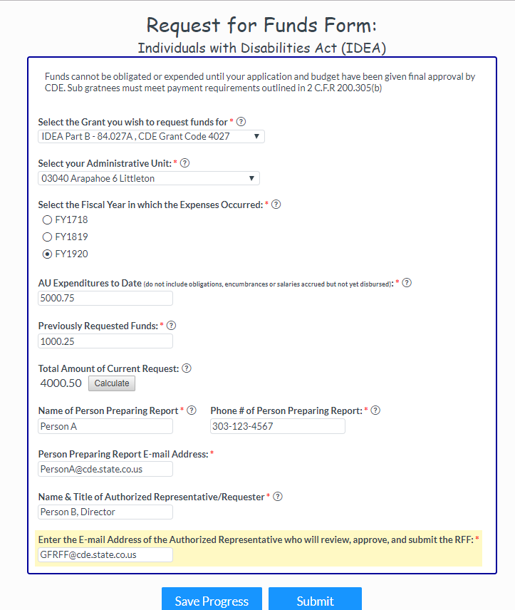
Workflows – RFFs in 2 parts: Part 1
Part 1
Person A will go to the link provided on the Grants Fiscal RFF Webpage: https://www.cde.state.co.us/cdefisgrant/requestforfundsforms
Will create new log-ins for the new links
Have the ability to save and return to their work
They will fill in the RFF and e-mail to the Person B
Their version on the forms, both complete & incomplete will be in their dashboard which they will see at log-in
Since this is the only part on Person A’s form, their dashboard will no longer show the Authorizer’s 4 digit code

Slide 13
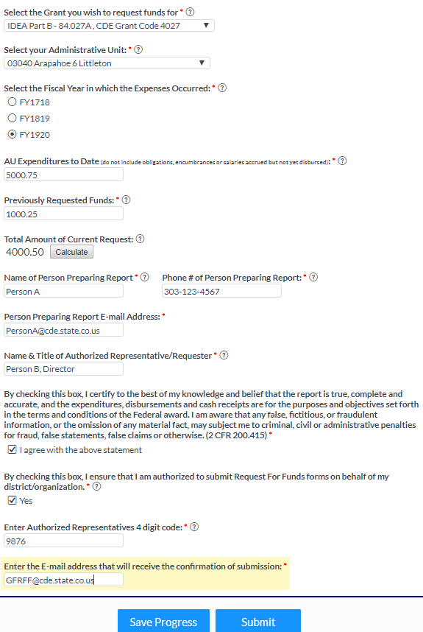
Workflows – RFFs in 2 parts: Part 2
Part 2
Person B will receive an e-mail with a link to the form to the e-mail entered for them by Person A
The link will be active until the form is submitted
Cannot ‘Save & Return’, have no log in
This is the only part Person B will need to fill out, the rest will be populated from Person A
Do not click ‘Save Progress’. It will ask you to create a log in for every single RFF you review

Slide 14
Confirmations
Confirmation of submission will be sent to Person A, and the e-mail address (if any) entered at the end of the form
This last e-mail field is optional. If you only want the confirmation to go to Person A, you do not need to enter another e-mail address in this field
Person A will be able to see any changes that Person B entered in the confirmation e-mail (i.e. – change in amounts)
No changes to how the confirmation looks when it comes through

Slide 15
Timelines
New Links will be posted on the RFF webpage, and in the Walk-through document
Please begin using new links/process on 9/4/19
On September 4, 2019 we will be fully switched to the new process
Requests submitted with the old links prior to 9/4/19 will be processed
If you have pending transactions through the old links, they will be deleted on 9/4/19 and you will not be able to submit them

Slide 16
Syncplicity Folders- GAL & Budget Sharing

Slide 17
How to find your GAL & Budget
Each district will have a GAL folder on Syncplicity
Inside the GAL folder will be a sub-folder titled with the FY
All the GALS and Budgets for all the grants that the district receives will be in this folder
Access to the folder will be given to the program and fiscal manager
You will receive an e-mail from Syncplicity alerting you a folder has been shared with you
When you log in using the e-mail address that the folder has been shared with, you will always be able to access your GALs and Budgets

Slide 18
Syncplicity
Syncplicity is free to use
Your folder will be under the ‘Files’ tab
You will have access to all the documents in the folder, but will not be able to edit/add anything to the folder

Slide 19
McKinney-Vento Important Dates for 2019-2020

Slide 20
Important Fiscal Reporting Dates for McKinney Vento
January 2020
1/10/2020 – Interim financial report (IFR) due to CDE
Show expenditures to date for the 2019-20 award
June 2020
6/30/2020 – Final expenditure deadline for 2019-20 award
Permitted up to 15% carryover until 9/30/2020
September 2020
9/30/2020 – Annual financial report (AFR) due to the Office of Grants Fiscal
Must be a complete account of the 2019-20 grant
The AFR can be found in your approved budget template

Slide 21
Contacts
Formsite Questions or Assistance
Brittany Shores, 303.866.6911
Shores_b@cde.state.co.us
Jennifer Austin, 303.866.6689
Austin_j@cde.state.co.us
Payment Assistance
Joe Shields, 303.866.6034
Shields_j@cde.state.co.us
Fiscal Grant Assistance
Marti Rodriguez 303-866-6769
Rodriguez_m@cde.state.co.us

Slide 22
Meet Ann Marie!
Background and experience
Role and Responsibilities
Objective 1: Provide state-level administrative support within Homeless and Foster Care Education
Objective 2: Create Resource Guides reflective of resources available within communities to be accessed by students and families
Discussion
Objective 3: Create and maintain resources, materials for distribution, and presentations
Discussion
What additional support can she provide to you?

Slide 23
Break

Slide 24
Subpopulations
Subgroups of Enrolled Homeless Students EDFacts data includes information on four subgroups of homeless students:
• students with disabilities as defined by the Individuals with Disabilities Education Act (IDEA, 2004),
• students who are migratory,
• students who are English Learners (previously referred to as students with limited English proficiency), and
• students who are unaccompanied youth
** Birth-5 (not K)

Slide 25
Students with disabilities

Slide 26
Students who are migratory

Slide 27
Students who are English Learners

Slide 28
Students who are unaccompanied

Slide 29
Birth-5 (not K)

Slide 30
Subpopulations- Group Work
Subgroups:
Students with disabilities
Migrant/ELL
Unaccompanied
Birth-5 (not K)
What is working in your district?
What challenges/barriers exist?
Name 5 strategies to increase identification.

Slide 31
Important Information

Slide 32
Attendance Awareness Month- September 2019

Slide 33
Resources for Attendance and Chronic Absenteeism
Back to School PowerPoint
https://www.attendanceworks.org/
https://awareness.attendanceworks.org/resources/count-us-toolkit-2019/what-are-the-key-messages/
https://www.attendanceworks.org/wp-content/uploads/2017/04/Chronic-Elementary-Absenteeism-A-Problem-Hidden-in-Plain-Sight.pdf
http://www.cde.state.co.us/dropoutprevention
Education Week Article- Student Absenteeism

Slide 34
Homeless Awareness Month- November 2019
https://www.1800runaway.org/nrpm/
Education Week – November 4 – 8, 2019 During this week, the National Runaway Safeline will lead an educational series to inform the public about runaway and homeless youth (RHY) issues. This will include providing current statistics, exploring what RHY means and what it can look like for individuals, and discussing the challenges of navigating different systems. Connect with us on Facebook, Twitter, and Instagram ahead of time to the conversation.

Slide 35
Everyone Counts: Census 2020
http://www.cde.state.co.us/communications/us-census-mainpage

Slide 37
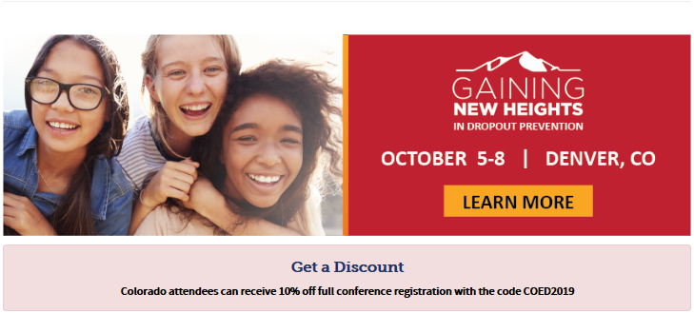
Wrap-up and Announcements
Job Announcement- Director of Dropout Prevention
November
Colorado Report on Youth and Family Homelessness
Call to Action
RTD’s LiVE Program
Professional Development

