Slide 1
You Gotta Keep ‘Em Separated: Navigating Foster Care and ESSA Provisions
Presented by: Kristin Myers and Dana Scott
NAEHCY 2018
Notes:
Icebreaker

Slide 2
Goals of this Pre-Conference
Provide an overview of Colorado’s history in building capacity and intentional partnerships
  Students experiencing homelessness
  Students in the foster care system
Identify how ESSA provisions for both populations are similar and different
Lessons learned and examples of creating statewide capacity in schools and child welfare agencies
  Highly mobile students
  How to be “critical partners” across programs
    At the federal level
    At the state level
    At the local level

Slide 3
Unique Needs of Students
Notes:
What are the unique needs of students experiencing homelessness?
What are the unique needs of students in foster care?
How are they alike? How are they different?

Slide 4
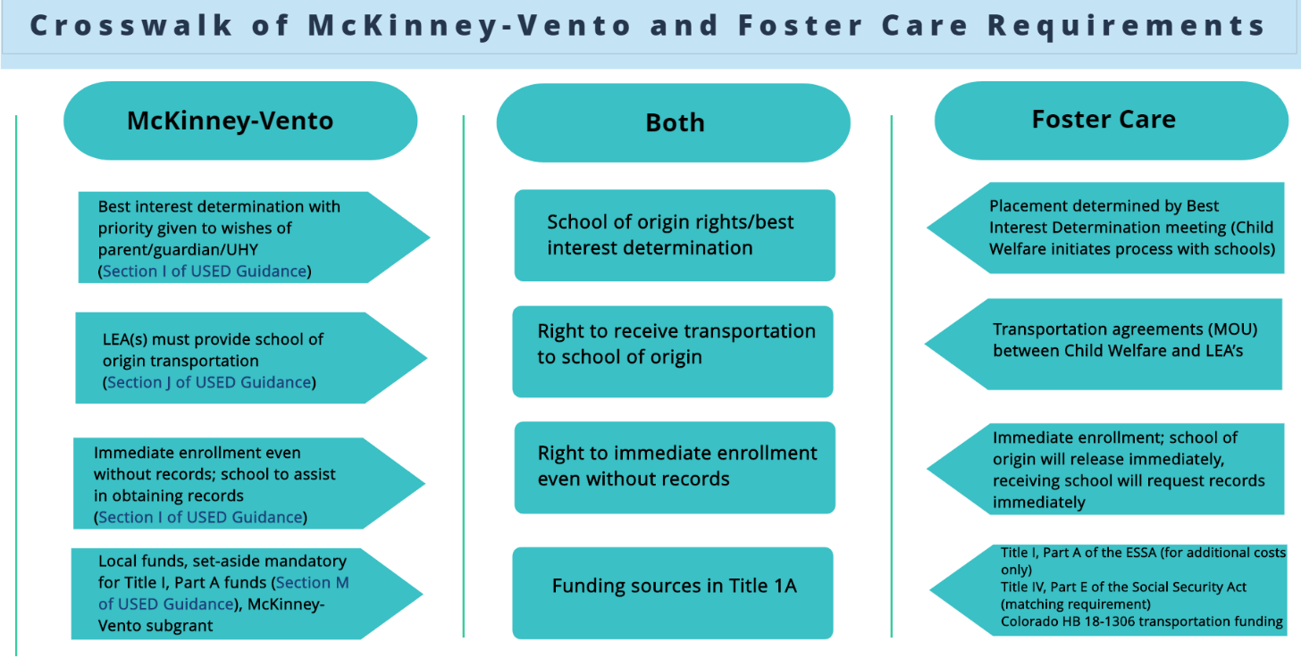

Slide 5
Unique Needs of Points of Contacts
Notes:
What is the role of a homeless liaison? (at the state level, and at the district level)?
What is the role of a foster care point of contact (at the state level, and at the district level)?

Slide 6
Before ESSA: Creating capacity and intentional relationships
History of Homeless Education Program at the Colorado Department of Education
Creating a foundations and breaking down silos
  Internal partnerships
  External partnerships
Points of contacts at LEAs
Creating the foundation for single points of contact (SPOCs)
Promoting two strong programs to support unique student needs
  Students experiencing homelessness
  Students in foster care
  Migrant student

Slide 7
Why is school stability so important?

Slide 8
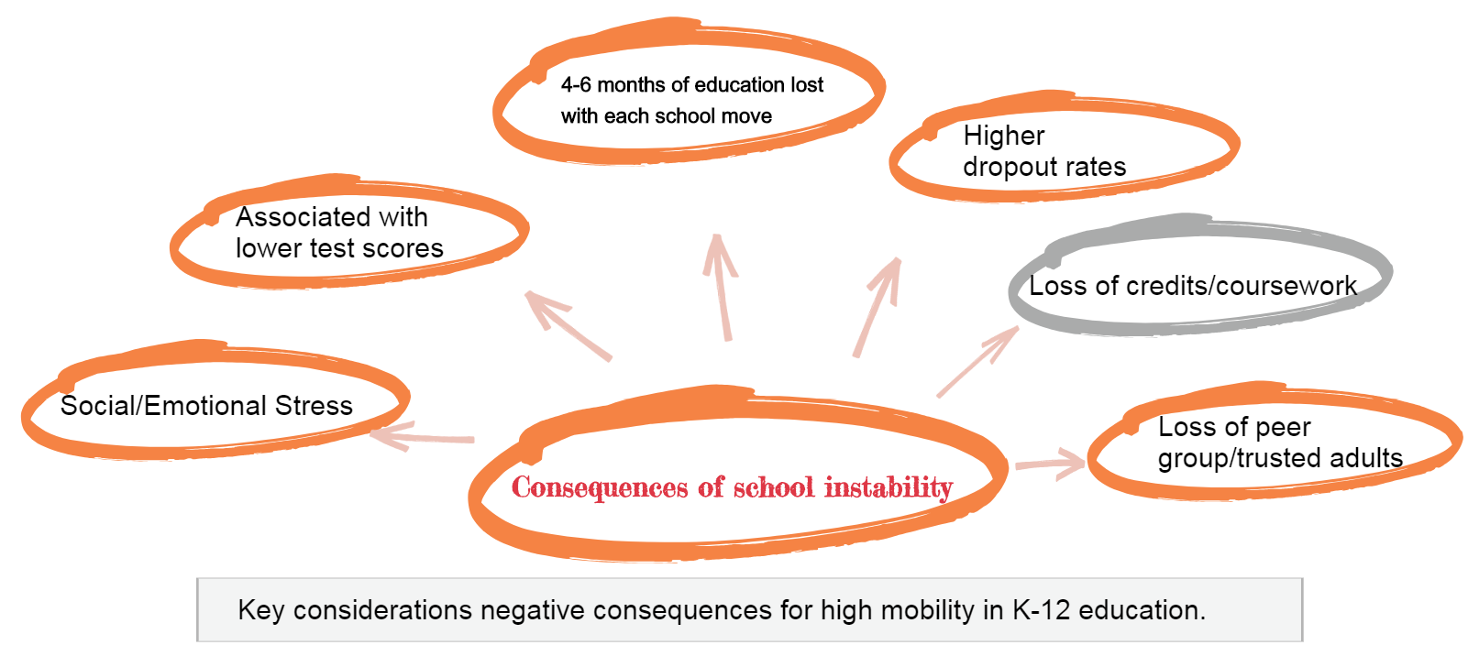

Slide 9
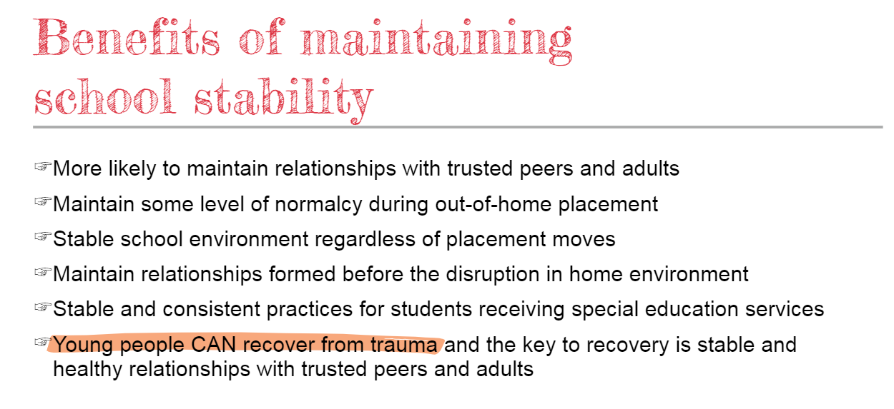

Slide 10
Highly Mobile Students

Slide 11
What is a Highly Mobile Student?
A highly mobile student is defined as a student who experiences (or is at risk of experiencing) multiple school moves during their K-12 education outside of regular grade promotion. This includes (and is not limited to) youth in foster care, those experiencing homelessness, and migrant students.

Slide 12
Highly Mobile Student Populations
Highly mobile student populations include:
  Children and youth in foster care
  Migrant students
  Students experiencing homelessness
Each year there are approx. 30,000 students that are counted within the state’s highly mobile student population
Highly mobile student populations often experience multiple school moves during their K-12 education outside of the regular grade promotion.

Slide 13
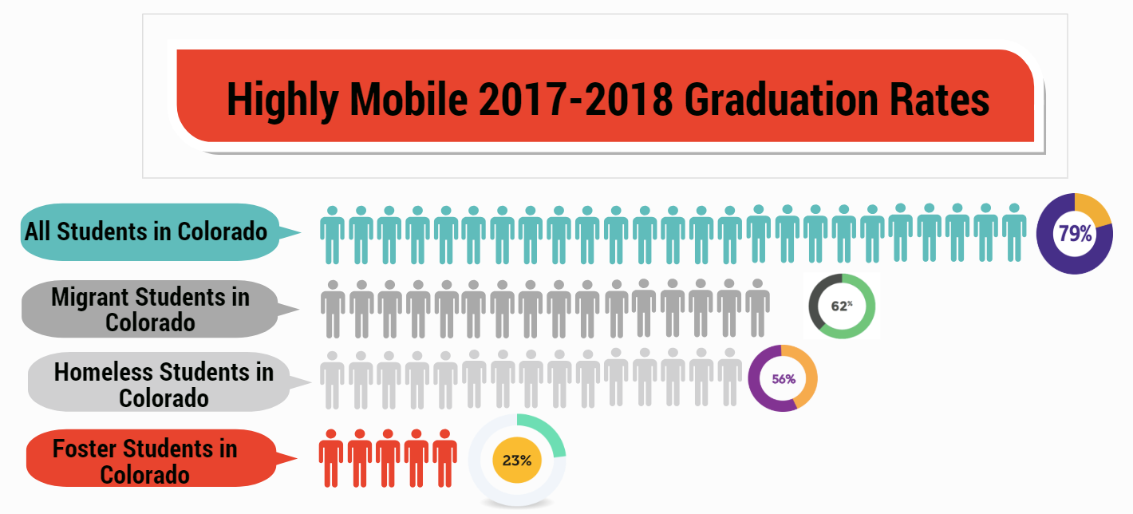

Slide 14

Educational Milestones
Key Considerations/Impact
Maternal Health
Substance abuse, in-utero trauma, premature birth, poverty
Early Education/Preschool
Access to early education programs, trauma, abuse/neglect, parental substance abuse, at-home education.
Read by 3rd Grade
3rd Grade literacy tied to multiple educational outcomes.
Middle School Math
Proficiency tied to predictor of high school success
Course Failure in 9th Grade
Predictor of dropout and high school credential attainment.
Pre-
Birth
Birth-2
Early
Childhood
Kindergarten
3rd Grade
3rd-5th Grade
6th-9th
Grade
9th-12th
Grade
High School Completion
Kindergarten Readiness
Able to write name, county to 100, recognize signs and sounds
Elementary-Middle School Transition
Academic proficiency, attendance, social/emotional health, family support, issues of mobility
8th to 9th Transition
Academic proficiency, attendance, social/emotional health, family support, issues of mobility
Infancy Health
Low birthweight, parental substance abuse, abuse/neglect, trauma, born into poverty
Lack of Credit Accrual
Significant predictor for dropout
Notes:
Educational milestones activity

Slide 15
Foster Care Program Unique Considerations in Colorado and Beyond

Slide 16
What do we know about school stability and students in foster care?

Slide 17
former foster youth who beat the odds
A few words from
https://www.youtube.com/watch?v=oZc2UEPqQiA
Notes:
1:53 to 5:48 then to 6:42
Melton What we hear from young people time and time again is
Education is important to them
They want to stay in their schools
Myers With determination and support from adults, these young women were able to be successful, but we know they are the exception and not the rule.
23% graduation rate

Slide 18
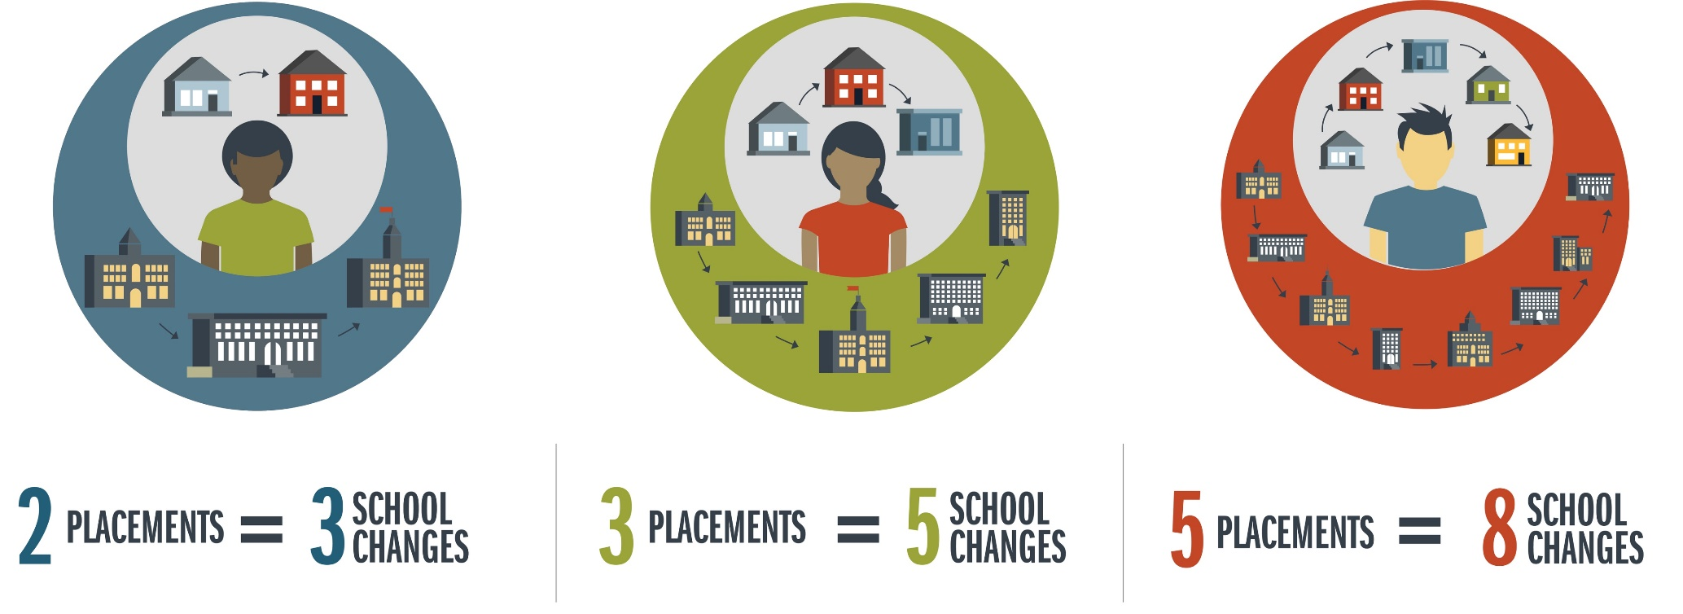
Students change schools even
more than placements
Based on 5 years of Colorado Data
The research reported here was supported by the Institute of Education Sciences, U.S. Department of Education, through Grant R305H150007 to the University of Northern Colorado. The opinions expressed are those of the authors and do not represent the views of the Institute or the U.S. Department of Education.
Notes:
Melton
Through the data sharing agreement
and a federal Institute of Education Sciences grant, we have built a strong partnership with university researchers. In particular Dr. Elysia Clemens who we thank…
Some of what we learned is that students in foster care are an inherently mobile population, they changes schools more than they changes foster placements.
About 2/3 of school changes are directly connected with a change in living arrangements.

Slide 19
Educational Stability is Important Before, During, and After Foster Care
Data Source: Colorado Department of Education, Data Services and Colorado Department of Human Services
With an Average of 3 School Moves, the Odds of Graduating are Smaller than Exiting Without a Credential
The research reported here was supported by the Institute of Education Sciences, U.S. Department of Education, through Grant R305H150007 to the University of Northern Colorado. The opinions expressed are those of the authors and do not represent the views of the Institute or the U.S. Department of Education.
Notes:
Myers
Why school changes matter
Odds of graduating decrease with increases in school moves. Reverse is also true.

Slide 20
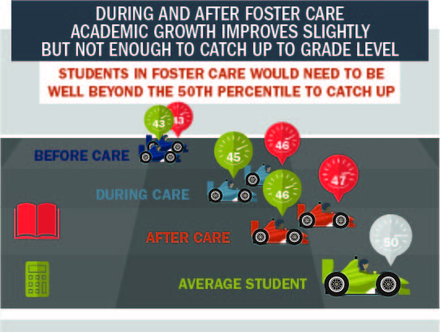
Every Transition Counts
Notes:
Melton
What we learned – not only does it impact likelihood of graduating on time, but every school change negatively impacts academic growth
every change in foster homes/living arrangements slows growth
- not surprisingly, when a child changes schools and foster homes at the same time, their growth slows the most.
On the upshot, after a few months of stability, you see the rates of growth increase.
SO that:
Before care, during care, after care….tells us our intervention is helping. But not helping enough.
- We are benefiting by intervening -
Savings account
This is why its so important that we cannot accept the status quo – we have to try new strategies and prioritize school stability

Slide 21
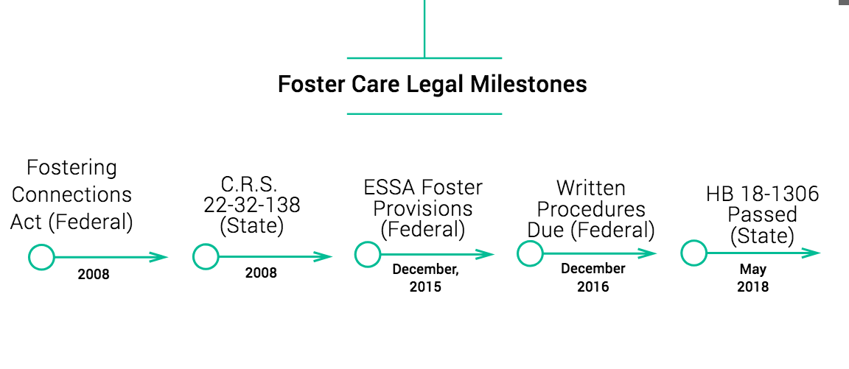
Notes:
District Stats
178 districts
→ 109 of the 178 meet the definition of small rural
→ 39 of the 178 meet the definition of rural
→ These 148 (80 percent of total districts) rural districts comprise only 16 percent (just more than 136,000) of the total student population in the state
→ 88 districts have less than 500 students
226 charter schools serving approximately 108,793 students (PK-12)
Colorado Schools
1,888 schools:
→ 1,091 elementary schools
→ 284 middle schools
→ 513 high schools
Enrollment has grown every year since 1988, when the total enrollment was 560,081.

Slide 22
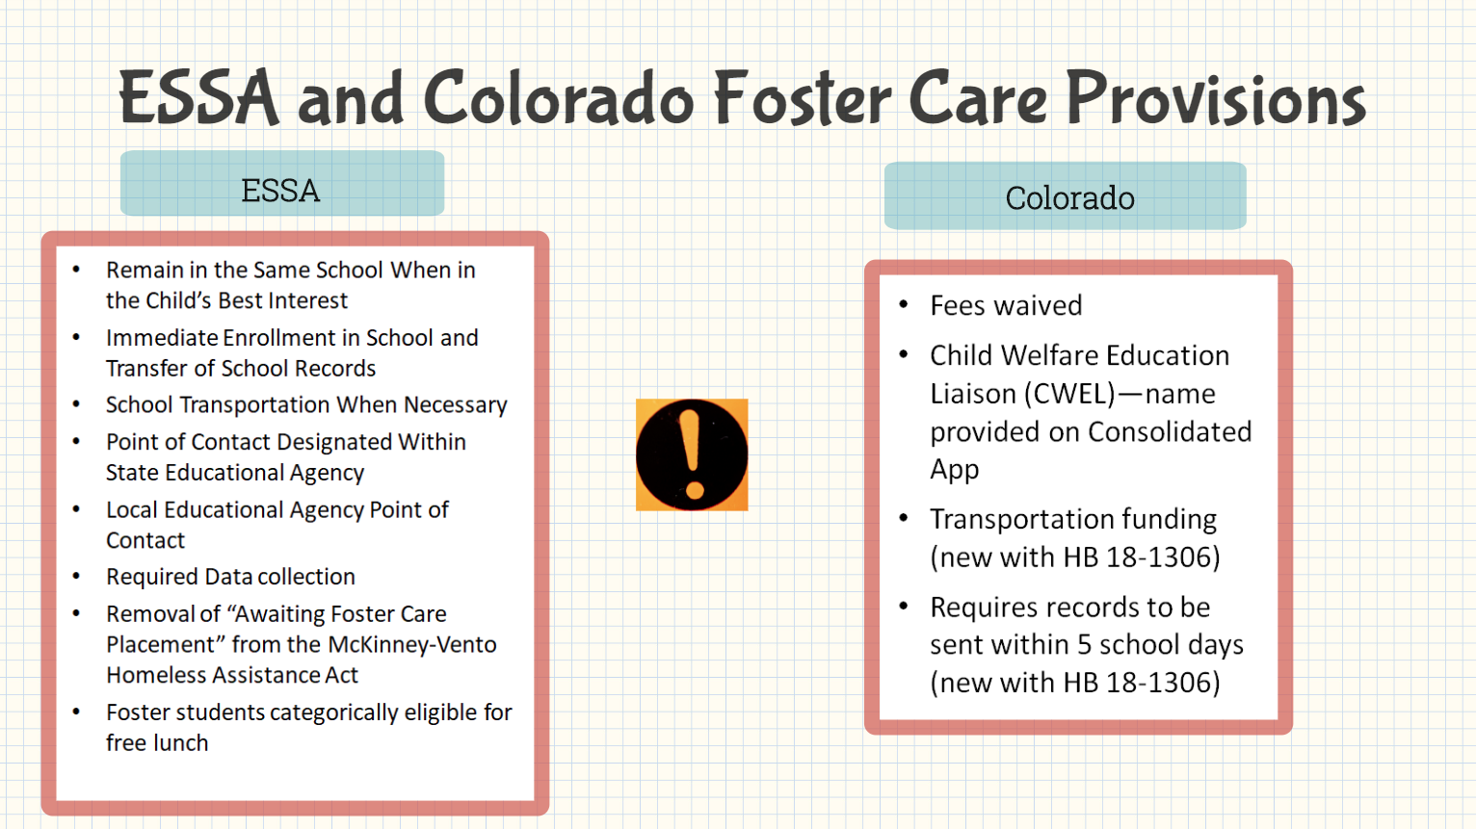

Slide 23
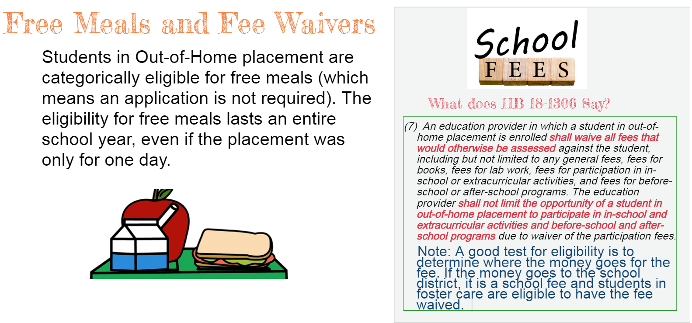

Slide 24
What’s a Child Welfare Education Liaison (CWEL)?
CWELs required at each Local Education Agency
Reporting of CWEL contact information by August 15 of each year (now met through Consolidated Applications)
Participation in Best Interest Determination meetings upon request
Collaborating with county departments of human services to provide, arrange, and fund transportation to the school of origin
Participation in threat assessment teams upon request
Immediate enrollment
Immediate transfer of records
Honoring certified coursework and accepting partial credits
Waiving fees that would otherwise be assessed

Slide 25
Monitoring and CWEL Contacts
“The LEA/BOCES has adopted policies and practices to ensure that children in foster care will remain, if possible, in the school in which the child is enrolled at the time placement. When remaining in such school is not in the best interest of the child, the LEA will provide immediate and appropriate enrollment in a new school, with all of the educational records of the child provided to the new school. The LEA has, or will adopt, policies and practices to ensure that the enrolling school will immediately contact the school last attended by the child in foster care to obtain relevant academic and other records. §

Slide 26
Key Terms and Definitions as Defined in Colorado HB 18-1306

Slide 27
School of Origin
“School of Origin” is defined flexibly to ensure children and youth who might not otherwise have a school of origin can attend the school where they have meaningful connections and to ensure children and youth input is considered when selecting a school. Designating a school as the “school of origin” allows the child or youth to attend there and receive transportation if necessary, even if they live outside the catchment area or transportation would not otherwise be provided.
Id. at § 138(1)(g).
Notes:
In most cases, the school of origin is the school in which a student was enrolled at the time of each placement into foster care. If the student’s foster care placement changes, the school of origin is the school in which the student is enrolled at the time of the change in placement. ‘School of origin’ includes “the designated receiving school at the next grade level for feeder school or zone patterns when the student completes the final grade level served by the school of origin.” This definition allows students to continue with their peers as they move from elementary to middle school or middle to high school.
If the student is “stepping down” from a facility school, including schools in a residential child care facility or secure detention facility, and the student will no longer be enrolled in the facility school, there is flexibility to look back to schools the student has recently attended. The school of origin in these situations is either:
the last school the student attended within the previous two years for at least one complete semester or term prior to entering the facility school; or
another school where the student had a meaningful connection within the previous two years
When there is more than one potential school of origin, the student’s input must be given strong consideration when determining which school to designate as the school of origin.

Slide 28
Education Provider
“Education Provider” means a school, school district, the State Charter School Institute, or a Board of Cooperative Services that operates a school.
“School” means a public school of a school district, a school operated by a Board of Cooperative Services pursuant to Article 5 of this Title 22, an Institute Charter School authorized pursuant to part 5 of Article 30.5 of this Title 22, a State-Licensed Day Treatment Facility, or an approved Facility School as defined in section 22-2-402(1).

Slide 29
Student in Out-of-Home Placement
“Student in Out-of-Home Placement” is defined to include children and youth who, at any time during an academic semester or term, are in placement out of the home as defined by 19-1-103(85), C.R.S. By extending the “out-of-home” status for educational purposes until the end of the semester or term when the child or youth is exits out-of-home placement, transportation services continue until a natural academic break. HB 18-1306 codified at § 22-32-138(1)(h), C.R.S. (2018, eff. August 8, 2018).
Notes:
This provides children and youth school stability during critical times of transition, such as returning home or granting APR to a relative. It also allows families time to plan a school change or arrange their own transportation.

Slide 30
Immediate Enrollment and Immediate Transfer of Records
Records: “Student is enrolled in a new school immediately with transition planning, and that the student’s complete education information and records are requested immediately by the student’s new school upon enrollment.
… “Education provider shall transfer the student’s education information and records to the receiving school as soon as possible but not to exceed five school days after receiving the transfer request.”
Key language in “immediate” is, “as soon as possible but not to exceed five school days”

Slide 31
Best Interest Determinations
According to 12 CCR 2509-4, 7.301.241(D), “The county shall make a best interest determination prior to any school move resulting from a change in placements unless remaining in the school of origin poses a specific, documented threat to the child/youth’s safety.”
The presumption under the Fostering Connections Act and the Every Student Succeeds Act, as well as HB 18-1306, is that children and youth in foster care will remain in their schools of origin. Because of this presumption, there is no formal decision-making process required until there is a consideration of changing schools.
The only timing requirement for best interest determinations is that they occur prior to a school move.
Notes:
The only timing requirement for best interest determinations is that they occur prior to a school move. In other words, the decision must be made (with all required collaboration) prior to taking action. In practice, this means a county will initiate a best interest determination process whenever a school change is under consideration. This may or may not be immediately before or after the placement in foster care.
To initiate this process, the caseworker notifies the school district’s Child Welfare Education Liaison (CWEL). This list is available at: http://www.cde.state.co.us/dropoutprevention/fostercare_index. Note that this list changes as school districts update CWEL contact information and accessing this list through this website ensures the most accurate and up-to-date information.

Slide 32
Best Interest Determinations (BID) and Communication with County Child Welfare

Slide 33

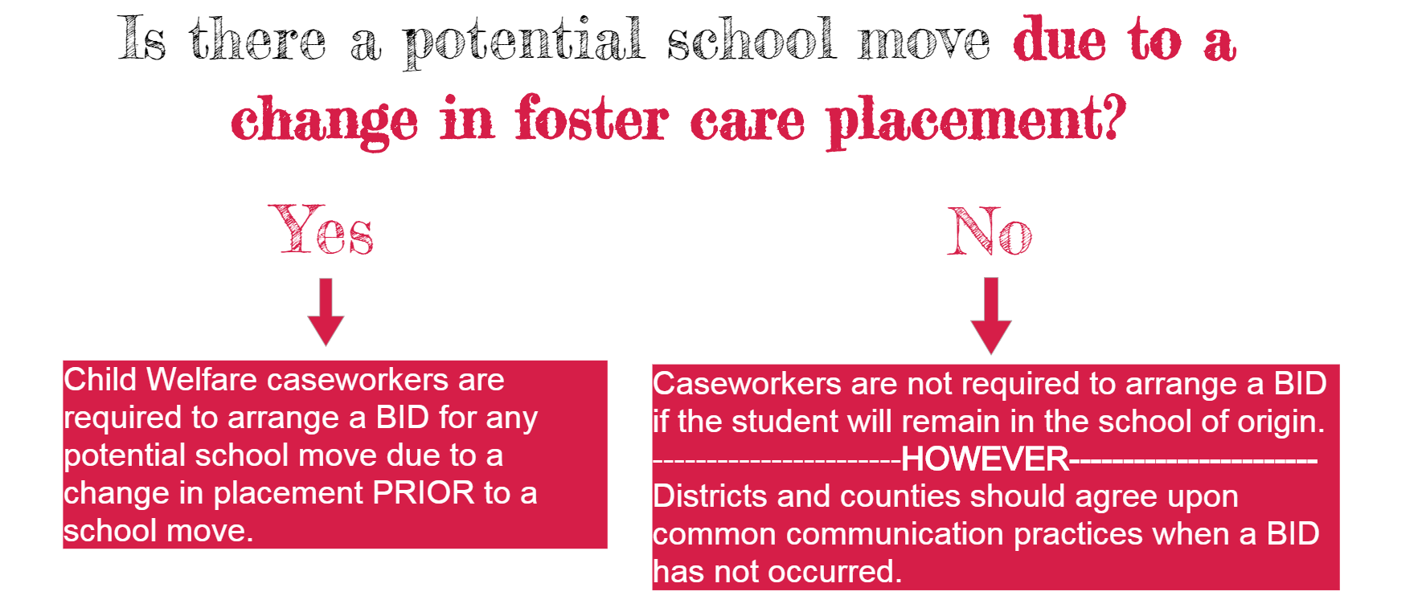

Slide 34
Who is required to attend a BID meeting?
Child/youth (in a developmentally appropriate way)
Parents
Caseworker or appropriate designee
Guardian ad litem (if one is appointed)
Representative from the school of origin who knows the child/youth as determined by the LEA
Educational surrogate parent
Others as relevant and appropriate as determined by the county (e.g. future caregiver, Court Appointed Special Advocate, representatives from potential new school, support person for the child/youth).

Slide 35
What should a school do if a foster parent comes to enroll a student and a BID has not occurred.
If the school is not aware of whether or not the county child welfare department held a BID, the Child Welfare Education Liaison (CWEL) at the school district should:
  Call the county department of human/social services to inquire about the best interest meeting
  If the CWEL does not get an acceptable answer within one business day, call CDE or CDHS for help contacting the county
Schools and counties should work together to develop common communication practices about BIDs and transportation planning.

Slide 36
Enrollment considerations
In the event a school move is warranted through the BID process, a student is enrolled in a new school district NOT in a school.
  Child welfare and ultimately the juvenile courts have ultimate decision-making responsibilities in a BID; however, this only applies to the district where the child is enrolled.
  Example: A child is receiving special education services and the school where the foster home is located does not have the capacity to meet the needs on the IEP—the district will be responsible for placing the student in the appropriate school that will meet their educational needs.

Slide 37
Transportation

Slide 38
Transportation Plan with Counties and School Districts
Collaboration between counties and school districts is essential to providing children and youth school stability. Consistent with the Every Student Succeeds Act, HB 18-1306 requires county departments and school districts to “coordinate…to establish systems-level plans for how necessary transportation to the school of origin is provided, arranged, and funded for the duration of a child’s or youth’s time as a student in out-of-home placement, including the equitable allocation of costs.”

Slide 39
When district does not have prior cost: total cost x .2 x.5 = amount split by county and district
Example: Student changes foster care placements and needs transportation to her school of origin. She did not previously have any special transportation, and there are no pre-existing bus routes she can access, so she will need a new transportation option. Her transportation is $25/day.
Because the district had no prior transportation expense relevant to this student, the entire $25 is subject to the district and county’s transportation plan. Under this plan, the county pays for the transportation out of the child welfare block, coding the expense as school transportation. This expense is reimbursed to the county at the usual 80/20 state/county split, resulting in a cost of $5/day to the county, with the remaining $20/day reimbursed by CDHS. The amount to split between the county and district is $5. The county and district have agreed to split costs 50/50, so each pays $2.50/day.
CDHS: $20/day
County: $2.50/day
District: $2.50/day

Slide 40
When district has prior cost: (total cost – district’s prior obligation) x .2 = amount split by county and district
Example: Student receives special education and has transportation as part of her IEP. Prior the change in foster care placements, the school district was paying $15/day for the student’s transportation. After the change in foster care placements, transportation to the school of origin is $25/day.
The “additional cost” under ESSA is $10/day, so this is the amount subject to the district and county’s transportation plan. Under this plan, the county pays for the transportation out of the child welfare block, coding the expense as school transportation. This expense is reimbursed to the county at the usual 80/20 state/county split, resulting in a cost of $2/day to the county, with the remaining $8/day reimbursed by CDHS. The amount to split between the county and district is $2. The county and district have agreed to split costs 50/50, so each pays $1/day/
CDHS: $8/day
County: $1/day
District: $16/day ($15 prior cost + $1 cost share)

Slide 41
School Collaboration with Child Welfare Agencies

Slide 42
Lessons Learned in Working with Child Welfare
Collaboration between state agencies
Collaboration with LEAs and County Child Welfare
  Always stay child focused…always!
  Remember school stability laws are relatively new
Navigating “Local control”
Templates, templates, templates!
Understanding different systems (child welfare, schools, GALs, foster parents, etc.)
Not all foster care stakeholders will understand the education system
ESSA and IDEA
Dispute resolution

Slide 43
Going Above and Beyond for Foster Care
Consider rights afforded to McKinney-Vento Eligible Youth that are not in ESSA or HB 18-1306 for Foster Care:
Eligible for services for the entire school year
Have a clearly outlined dispute resolution process with the county
Collaborate with neighboring school districts and counties to share costs/resources
Develop a working relationship with facility schools and youth services facilities
  Ensure coursework and credits transfer
  Ask if a school change is really necessary
Provide postsecondary guidance including FAFSA and independent student classification (documentation, processes, additional scholarships, etc.)
How can you use Title II and Title IV?
Building level foster care advocate
  Assisting with BIDs
  Help students get connected to peers, teachers, and extracurricular opportunities
  Work intentionally with foster families, case workers and GALs to provide pertinent education information

Slide 44
Lessons learned and examples of creating statewide capacity in schools and child welfare agencies

Slide 45
Supporting Credit Transfers and Credit Accrual for Highly Mobile Students

Slide 46
HB 18-1306
Credit attainment, progress toward graduation, and competency-based options
“(b)When a student experiences out-of-home placement at any point during high school, an education provider may waive course or program prerequisites or other preconditions for placement in courses or programs under the jurisdiction of the education provider.”

Slide 47
Credit attainment, progress toward graduation, and competency-based options
“(c) An education provider may waive specific courses required for graduation if similar course work has been satisfactorily completed in another jurisdiction or the student has demonstrated competency in the content area. If the school does not grant a waiver to a child who would qualify to graduate from the sending school, the education provider is encouraged to provide an alternative means of acquiring the required course work or competency requirements so a timely graduation may occur. The receiving education provider awarding the diploma may award elective credit for any portion of the student’s certified course work that is not aligned with the curriculum of the receiving education provider or for demonstrated competencies that are not aligned with the receiving education provider.”

Slide 48
Credit attainment, progress toward graduation, and competency-based options
“(d) If a student in out-of-home placement who is transferring at the beginning of or during twelfth grade is ineligible to graduate from the receiving education provider, the education provider may request a diploma from a previously attended education provider, and the previously attended education provider may issue a diploma if the student meets the education provider’s graduation requirement.”

Slide 49
Utilizing Title Funding to Support Highly Mobile Students

Slide 50
Title IA: Reservation of Funds
  Title IA dollars can be reserved for transportation costs for students in foster care
  LEA set-aside amounts may be determined based on a needs assessment that reviews foster student enrollment averages and trends over 2-3 years and multiplies by the average per-pupil cost of providing Title I services.
  Work with county human services to verify numbers
  Contact State Coordinator at CDE for a 3-year average of students in foster care

Slide 51
Other uses of ESEA Funds
Title I, Part A funds may be used to specifically train and engage foster care parents
Title II, Part A funds may be used to focus professional development for district and building staff, teachers, and leaders regarding the needs of foster care students.

Slide 52
Use of Title IV, Part A Funds
Activities to support well-rounded educational opportunities for students may include, but are not limited to:
  STEM programs
  Music and art programs
  Foreign language offerings
  The opportunity to earn credits from institutions of higher learning
  Reimbursing low-income students to cover the costs of accelerated learning examination fees
  Environmental education
  Programs and activities that promote volunteerism and community involvement

Slide 53
Use of Title IV, Part A Funds
Activities to improve the use of educational technology in order to improve the academic achievement and digital literacy of all students may include, but are not limited to:
  Building technological capacity and infrastructure
  Developing or using effective or innovative strategies for the delivery of specialized or rigorous academic courses through the use of technology
  Carrying out blended learning activities (must include ongoing professional development for teachers)
  Providing professional development on the use of technology to enable teachers to increase student achievement in STEM areas
  Providing students in rural, remote, and underserved areas with the resources to take advantage of high-quality digital learning experiences
  Providing educators, school leaders, and administrators with the professional learning tools, devices, content and resources to:
  Personalize learning
  Discover, adapt, and share relevant high-quality educational resources
  Use technology effectively in the classroom
  Implement and support school and districtwide approaches for using technology to inform instruction, support teacher collaboration, and personalize learning

Slide 54
Use of Title IV, Part A Funds
Activities to support safe and healthy students may include, but are not limited to:
  School-based mental health services
  Drug and violence prevention activities that are evidence-based
  Integrating health and safety practices into school or athletic programs
  Nutritional education and physical education activities
  Bullying and harassment prevention
  Activities that improve instructional practices for developing relationship-building skills
  Prevention of teen and dating violence, stalking, domestic abuse, and sexual violence and harassment
  Establishing or improving school dropout and reentry programs
  Training school personnel in effective practices related to the above

Slide 55
Partnering with 21st Century Community Learning Centers (CCLC)

Slide 56
What is the 21st Century Learning Center Grant?
The 21st Century Community Learning Centers (21st CCLC) grant program supports the creation of local out-of-school time (OST) programs to provide students and their families with high-quality academic enrichment opportunities and services. Centers serve students—in particular, those who attend high-poverty and low-performing schools—and provide academic and enrichment services during non-school hours.

Slide 57
Services focus on helping children succeed academically by:
Providing opportunities for academic enrichment, including tutoring services and homework help, to help students meet state and local academic standards.
Offering students a broad array of additional services, programs, and activities that are designed to reinforce and complement the regular academic program of participating students.
Offering families of students served by CCLC’s opportunities for active and meaningful engagement in their children’s education.

Slide 58
Partnering with 21st Century CCLC in supporting Highly Mobile Students

Slide 59
Higher Education Information for Highly Mobile Students

Slide 60
Financial Aid Independent Determination

Slide 61
Foster Youth: 2019-20 FAFSA Question
#53: At any time since you turned age 13, were both your parents deceased, were you in foster care or were you a dependent or ward of the court?
“Yes” if at any time since you turned age 13:
  ◊ had no living parent, even if you are now adopted; or
  ◊ were in foster care, even if no longer in foster care today; or
  ◊ were a dependent/ward of the court, even if no longer
➢ If you are not sure if you were in foster care, check with your state child welfare agency. You can find that agency’s contact information at childwelfare.gov/nfcad.
➢ The financial aid administrator at your school may require you to provide proof that you were in foster care or a dependent or ward of the court.
➢ Someone who is incarcerated is not considered a ward of the court for federal student aid purposes

Slide 62
UHY: 2019-20 FAFSA Question
#56: At any time on or after July 1, 2018, did your high school or school district homeless liaison determine that you were an unaccompanied youth who was homeless or were self-supporting and at risk of being homeless?
#57: At any time on or after July 1, 2018, did the director of an emergency shelter or transitional housing program funded by the U.S. Department of Housing and Urban Development determine that you were an unaccompanied youth who was homeless or were self-supporting and at risk of being homeless?
#58: At any time on or after July 1, 2018, did the director of a runaway or homeless youth basic center or transitional living program determine that you were an unaccompanied youth who was homeless or were self-supporting and at risk of being homeless?

Slide 63
Authorized to determine UHY status
  K-12 District McKinney-Vento Homeless Education Liaison*
  Runaway/Homeless Youth Basic Center/Transitional Living Program (Director/designee)
  Emergency Shelter/Transitional Housing Program funded by HUD (Director or Designee)
  College/University Financial Aid Administrator
* may write subsequent year letters of verification through age 23 for whom they have necessary information for UHY determination

Slide 64
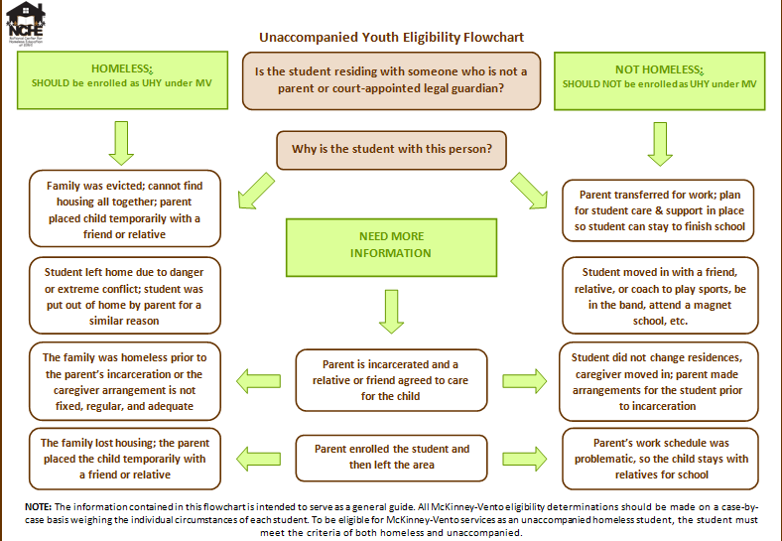

Slide 65
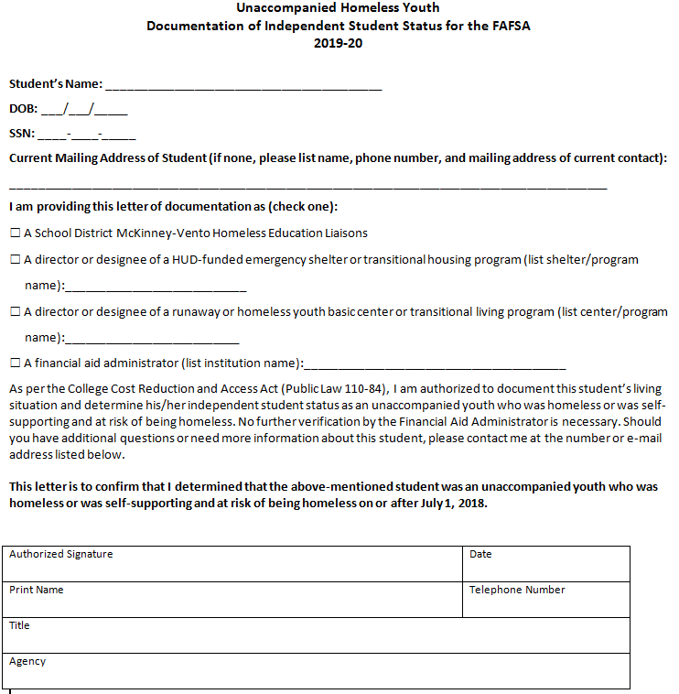
Colorado UHY Verification Form: 2019-20

Slide 66
UHY In-State Tuition Determination for UHY
HB16-1100
Adds unaccompanied homeless youth to the list of persons who are qualified to determine their own domicile for the purpose of establishing in-state tuition at state institutions of higher education

Slide 67
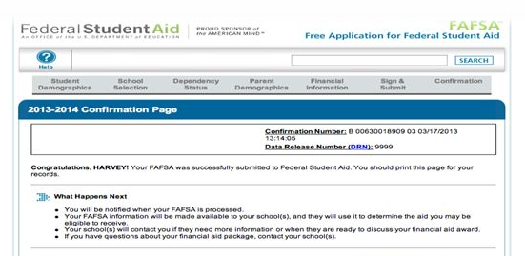
What happens after I submit my FAFSA?
Expected Family
Contribution (EFC)
is a number that
determines a students eligibility
for federal student aid. EFC
formulas use financial information
from FAFSA.
University/college receives FAFSA
  (students can include up to 10 schools)
  Documents may be requested by school
  *Award letter notification

Slide 68

What happens after I submit my FAFSA?
- Expected Family Contribution (EFC) is calculated
EFC = is an index number that is used to determine your eligibility
for federal student financial aid
- Ranges from 0-99,999
University/college receives FAFSA
  (students can include up to 10 schools)
  Documents may be requested by school
  *Award letter notification

Slide 69
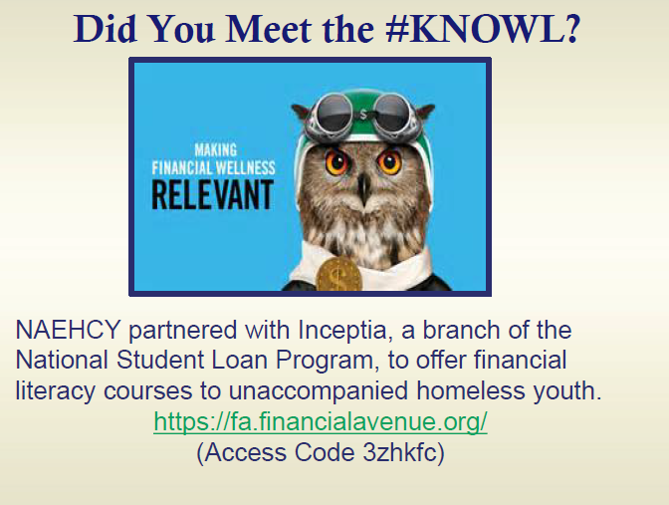

Slide 70
Resources
National Center for Homeless Education
https://nche.ed.gov/ibt/higher_ed.php
National Association for the Education of Homeless Children and Youth (NAEHCY)
www.naehcy.org

Slide 71
Crosswalk Unaccompanied/Foster Youth
High School Counselor | College Admissions | SPOC
Identify students who qualify under McKinney-Vento and refer to your district Homeless Liaison | Be aware of the McKinney-Vento Act, and what qualifies students. | UHY (Unaccompanied Homeless Youth) determination-FAFSA completion/financial aid access-campus/community housing-academic advising-connections on and off campus
Assists unaccompanied youth/students in foster care with FAFSA | Able to educate potential applicants on McKinney-Vento | Determines UHY status officially at the college level
List of SPOC’s available at: http://www.cde.state.co.us/dropoutprevention/homeless_index | Know who the SPOC is at your University | Connects with admissions and high school counselors to coordinate transitions to college
Assist students in foster care with higher ed resources (Education Training Vouchers - ETV’s, Chafee Program): http://www.cde.state.co.us/dropoutprevention/fostercare_resourcesandlinks | Able to educate youth in foster care about higher education resources | Aware of resources for unaccompanied youth (campus/community housing, academic advising on and off campus). Knows about ETV’s and Chafee for qualified youth
Notes:
Kerry

Slide 72
Higher Education and SPOCs

Slide 73
Assistance from Single Points of Contact
  What is a SPOC?
      A supportive college administrator on each campus who is committed to helping homeless youth (and often foster youth) successfully navigate the college-going process on campuses
  What do SPOC’s assist students with?
      UHY determination - FAFSA completion/financial aid access – admissions – campus/community housing - academic advising – connections to on and off campus supports
Notes:
REVISED SPOC TIP SHEET = 2017

Slide 74

Q & A
Notes:
Utilize chat box

Slide 75
Unique Resources for Foster Care
Foster Care Transition Toolkit
Supporting Successful Transitions
Educational Training Vouchers
Foster Care Dependency Form
Bridging the Gap Program
Denver Foundation Scholarships
Forward Steps Scholarship
projectfosterpower@childlawcenter.org

Slide 76
For more information, contact:
Kristin Myers
State Coordinator for Foster Care Education
(303)866-6007
Colorado Department of Education
Myers_K@cde.state.co.us
Dana Scott
21st Century CCLC State Coordinator and Program Supervisor
(303) 866-6791 scott_d@cde.state.co.us

Slide 77
References
42 U.S.C § 675 (1)(G); 20 U.S.C. § 6311 (g)(1)(E) and § 6312(c)(5)(B).
20 U.S.C. § 6312(c)(5)(B).
Clemens, E. V. (2014). Graduation and Dropout Rates for Colorado Students in Foster Care: 5-Year Trend Analysis (2007-08 to 2011-12). Greeley, CO: University of Northern Colorado.
Colorado Department of Education (March 15, 2018). 2017 State Policy Report, Dropout Prevention and Student Engagement at 16.
HB 18-1306 codified at § 22-32-138(1)(h), C.R.S. (2018, eff. August 8, 2018).
Id. at § 138(1)(g).

