Slide 1
Postsecondary Access for Highly Mobile Students
Presented by Colorado Dept of Education

Slide 2
What is a Highly Mobile Student?

Slide 3
Highly Mobile Student Defined
A highly mobile student is defined as a student who experiences (or is at risk of experiencing) multiple school moves during their K-12 education outside of the regular grade promotion.
Impacted populations include (but are not limited to): students experiencing homelessness, children and youth in foster care, migrant students

Slide 4
Research on School Stability
Highly mobile students have lower test scores and lower academic performance than peers who do not change schools.
Mobility also hurts non-mobile students; study found average test scores for non-mobile students were significantly lower in high schools with high student mobility rates.
Students who changed high schools even once during high school were less than half as likely as stable students to graduate, even controlling for other factors.
Source: Foster Care Education Program, Colorado Department of Education

Slide 5
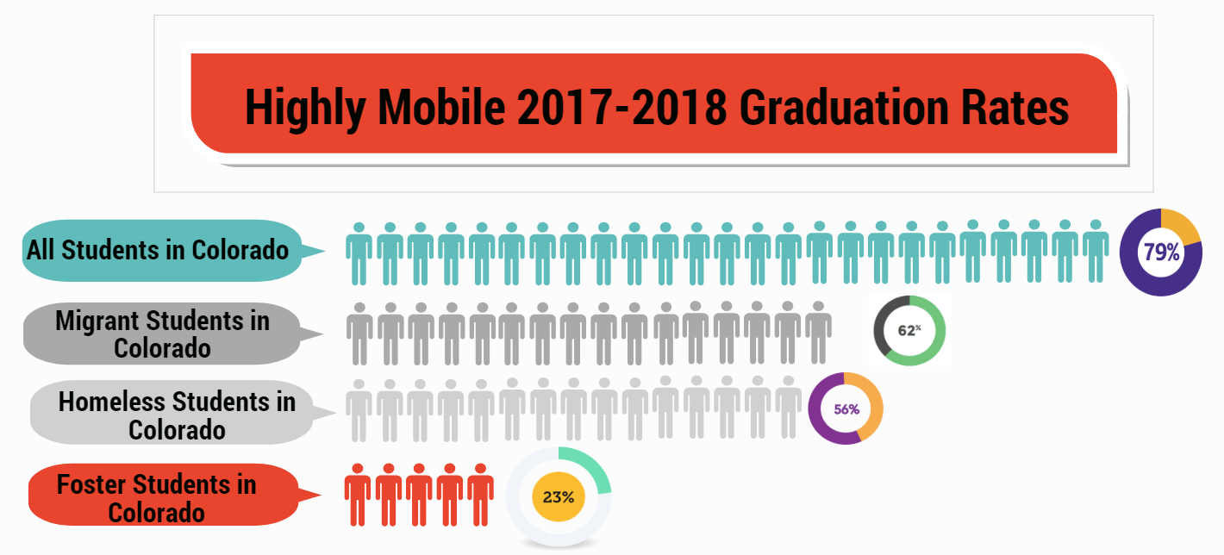
Notes:
Myers

Slide 6
Getting them there: Supporting Credit Transfers and Credit Accrual for Highly Mobile Students

Slide 7
HB 18-1306 Credit attainment, progress toward graduation, and competency-based options
“(b)When a student experiences out-of-home placement at any point during high school, an education provider may waive course or program prerequisites or other preconditions for placement in courses or programs under the jurisdiction of the education provider.”

Slide 8
Credit attainment, progress toward graduation, and competency-based options
“(c) An education provider may waive specific courses required for graduation if similar course work has been satisfactorily completed in another jurisdiction or the student has demonstrated competency in the content area. If the school does not grant a waiver to a child who would qualify to graduate from the sending school, the education provider is encouraged to provide an alternative means of acquiring the required course work or competency requirements so a timely graduation may occur. The receiving education provider awarding the diploma may award elective credit for any portion of the student’s certified course work that is not aligned with the curriculum of the receiving education provider or for demonstrated competencies that are not aligned with the receiving education provider.”

Slide 9
Credit attainment, progress toward graduation, and competency-based options
“(d) If a student in out-of-home placement who is transferring at the beginning of or during twelfth grade is ineligible to graduate from the receiving education provider, the education provider may request a diploma from a previously attended education provider, and the previously attended education provider may issue a diploma if the student meets the education provider’s graduation requirement.”

Slide 10
McKinney-Vento (Homeless Education) Under Title IX, Part A of the Every Student Succeeds Act (ESSA) Sources: NAEHCY http://www.naehcy.org/sites/default/files/dl/legis/NewMV2015clean.pdf US Department of Education https://www2.ed.gov/policy/elsec/leg/essa/160240ehcyguidance072716updated0317.pdf

Slide 11
How many students experience homelessness?
Public schools identified 1.3 million McKinney-Vento students in the 2015–16 school year.
4% increase nationally over previous year.
A 104% increase since 2007.
13% of all poor, school-age children and youth.
30% of all extremely poor, school-age children and youth.

Slide 12
2016-2017 Data
State 4-year Graduation Rate = 79.0%
Graduation Rates for Students Experiencing Homelessness
4-year – 55.8%
5-year - 60.1%
6-year – 63.9%
7-year – 65.2%
These cohort rates represent the number of students receiving a diploma within 4,5,6,or 7 years of completing 8th grade
State Annual Dropout Rate = 2.3%
Annual Dropout Rate for Student Experiencing Homelessness
5.9%
Represents 557 students
(out of 9,459 identified as homeless)
This annual rate refers to the number of students in grades 7-12 who were reported as dropouts and “age outs during the past year.”
Notes:
For more detail visit - http://www.cde.state.co.us/cdereval - see graduation and dropout statistics
The dropout rate for 2016-17 represents a reduction from the previous year.
The graduation rate imporved compared to the previous year.

Slide 13
Support for Academic Success: Transitioning to Higher Education
All McKinney-Vento youth must be able to receive individualized counseling from counselors to prepare and improve their readiness for college, including college selection, application, financial aid, and on-campus supports. 11432(g)(1)(K); Guidance Q1
Liaisons must ensure unaccompanied youth are informed of their status as independent students and obtain verification of that status.
11432(g)(6)(A)(x)(III); Guidance Q2

Slide 14
Higher Education Act: The FAFSA and Homeless Students
Youth who meet the definition of “independent student” can complete the FAFSA without parental income information or signature.
Unaccompanied youth are automatically considered independent students.
Must be determined to be unaccompanied and homeless after July 1 of the prior year.
Youth who are unaccompanied, at risk of homelessness, and self-supporting are also automatically considered independent students.
Must be determined as such during the school year in which the application is submitted.

Slide 15
The FAFSA (cont.)
Determination must be made by:
McKinney-Vento school district liaison (while student is in high school and after, for as long as liaison has information necessary to make the determination),
HUD homeless assistance program director/designee
Runaway and Homeless Youth Act program director or designee, or
a financial aid administrator.
Youth who have been in foster care at any time after age 13 are also automatically independent.
More info and sample letters are available at: http://www.naehcy.org/educational-resources/higher-ed

Slide 16
General Resources
Kerry Wrenick, State Coordinator for Homeless Education
Wrenick_k@cde.state.co.us
Colorado Department of Education
http://www.cde.state.co.us/dropoutprevention/homeless_index
National Association for the Education of Homeless Children and Youth
http://naehcy.org
National Center on Homeless Education
http://center.serve.org/nche/
Liaisons Toolkit
https://nche.ed.gov/ll/ll.php

Slide 17
Foster Care Under the Every Student Succeeds Act (ESSA)

Slide 18
Foster Care Graduation and Completion Rates
 | 4-Year |  | 5-year
Class of | Graduation | Completion | Graduation | Completion
2013 | 27.5% | 41.3% | 32.4% | 49.5%
2014 | 30.0% | 41.8% | 35.1% | 46.9%
2015 | 29.3% | 35.9% | 37.6% | 46.9%
2016 | 33.2% | 37.4% | 40.2% | 46.4%
2017 | 23.6% | 33.6% | Available 2017-18

Slide 19
Matriculation Rates
Matriculation Summary Results: Overall & Foster Only
Type | 2014 |  |  |  | 2015
 | Overall |  | Foster Only |  | Overall |  | Foster Only
 | Rate | Total n | Rate | Total n | Rate | Total n | Rate | Total n
All | 56.8% | 53783 | 23.2% | 690 | 57.4% | 53129 | 26.7% | 619
2-Yr Institutions | 10.3% | 53783 | 10.6% | 690 | 11.1% | 53129 | 10.8% | 619
4-Yr Institutions | 41.7% | 53783 | 10.0% | 690 | 42.3% | 53129 | 12.4% | 619
CTE | 6.0% | 53783 | 2.6% | 690 | 5.4% | 53129 | 3.4% | 619
Note. Matriculation data obtained from NSC/CDHE. Reflects enrollment rates of graduating students in the summer/fall following the identified year of graduation. For questions contact Dan Jorgensen, Ph.D. at: jorgensen_d@cde.state.co.us
Data Source: Colorado Department of Education, Data Services and Colorado Department of Human Services, Colorado Department of Higher Education

Slide 20
Special considerations: Do youth in foster care qualify as unaccompanied youth?
Youth in foster care may “age out” at 18
If youth exit the foster care system at age 18 or after, they are unaccompanied (not in the care of a legal parent or guardian)
Differences in documentation (court documents specific to Colorado)
Qualify as independent on the FAFSA
What if youth exit care and return home to their parents?
Who do I contact if I have questions?

Slide 21
Crosswalk of Services
High School Counselor | College Admissions | SPOC
Identify students who qualify under McKinney-Vento and refer to your district Homeless Liaison | Be aware of the McKinney-Vento Act, and what qualifies students. | UHY determination-FAFSA completion/financial aid access-campus/community housing-academic advising-connections on and off campus
Assists unaccompanied youth/students in foster care with FAFSA | Able to educate potential applicants on McKinney-Vento | Determines UHY status officially at the college level
List of SPOC’s available at: http://www.cde.state.co.us/dropoutprevention/homeless_index | Know who the SPOC is at your University | Connects with admissions and high school counselors to coordinate transitions to college
Assist students in foster care with higher ed resources (ETV’s, Chafee Program): http://www.cde.state.co.us/dropoutprevention/fostercare_resourcesandlinks | Able to educate youth in foster care about higher education resources | Aware of resources for unaccompanied youth (campus/community housing, academic advising on and off campus). Knows about ETV’s and Chafee for qualified youth

Slide 22
Higher Education and SPOCs

Slide 23
Assistance from Single Points of Contact
What is a SPOC?
A supportive college administrator on each campus who is committed to helping homeless youth (and often foster youth) successfully navigate the college-going process on campuses
What do SPOC’s assist students with?
UHY determination - FAFSA completion/financial aid access – admissions – campus/community housing - academic advising – connections to on and off campus supports
Notes:
REVISED SPOC TIP SHEET = 2017

Slide 24
How SPOCs help to serve Unaccompanied Homeless Youth
Understanding the definition of homeless used in the College Cost Reduction and Access Act
Distributing awareness materials
Training, encouraging collaboration and building relationships among offices or programs that can provide support to students in need
Notes:
Collaboration with housing, financial aid, student services, service-learning, campus ministries, student health clinic

Slide 25
Community College Study
Survey of more than 33,000 students at 70 community colleges across the country:
14% were homeless
1-in-3 were going hungry while pursuing a degree
Nearly 1/3 of students going without food or shelter:
received financial aid
many work long hours at low wage/quality jobs
get little sleep
Wisconsin HOPE Lab, March 2017
http://wihopelab.com/publications/hungry-and-homeless-in-college-report.pdf
Notes:
This report presents findings from the largest survey ever conducted of basic needs insecurity among
college students. In 2015, the Wisconsin HOPE Lab published the research report Hungry to Learn, a
study based on a survey of approximately 4,000 students at ten community colleges in seven states.
This study includes more than 33,000 students at 70 community colleges in 24 states. While this is not a
nationally representative sample of students or colleges, it is far greater in size and diversity than prior
samples, and provides information to shed new light on critical issues warranting further research.

Slide 26
Financial Aid Independent Determination

Slide 27
College Cost Reduction and Access Act of 2007
Expanded definition of “independent student” to include Unaccompanied Homeless Youth
Four authorized verifiers
McKinney-Vento Homeless Education Liaison (Colorado UHY Verification Form)
Runaway and Homeless Youth Act Director or Designee*
HUD Director or Designee*
Financial Aid Administrator
* emergency shelter, transitional housing program, runaway or homeless youth basic center can verify that student would have received services (i.e. if room had been available at the time)

Slide 28
Unaccompanied
Not in the physical custody of a parent or guardian
whether asked or chose to leave
can be in legal custody of a parent/guardian, but must be living apart
may have periodic contact with parents/guardians but not supported
before the age of 24 (no lower age limit)

Slide 29
Unaccompanied & Homeless
17-18 FAFSA: Answer “Yes” if you received a determination at any time on or after July 1, 2016, that you were an unaccompanied youth who was homeless or at risk of being homeless.
2-step process to determine eligibility
Does the student’s living arrangement meet the McKinney-Vento Act’s definition of homeless?
Once homelessness is determined, is the student unaccompanied?
Unaccompanied
“not in the physical custody of a parent or guardian”

Slide 30
And then, there was guidance!
Application and Verification Guide (AVG) 17-18 (Chapter 5)
Definition clarification
Confirmation not required – unless conflicting info.
Ask for help when you need it
Dear Colleague Letter, July 29, 2016
Definition
Not required to verify – unless conflicting info.
Avoid unnecessary restrictions to aid - Don’t focus on why but on whether evi­dence shows eligibility based on the legal definitions
OFA must make determination if requested by student
Examples of acceptable documentation
FAFSA mailing address: friends, relative, the school, etc.
Ages 21-24 qualify for UHY & independent determination

Slide 31
Consider sensitive nature of situation
Use discretion when gathering information
Respect student’s privacy
Some information is confidential (i.e. protected by doctor-patient privilege)
Documents such as police or Child Protective Services reports are not necessary

Slide 32
2018-19 FAFSA Changes
remove the definition of “youth” – 22-23 year olds financial aid determination process smoother
changes to online FAFSA for 22-23 year old applicants who indicate they are homeless or at risk of being homeless
all students who indicate they are homeless, regardless of age, will be able to indicate they have received an unaccompanied homeless youth determination

Slide 33
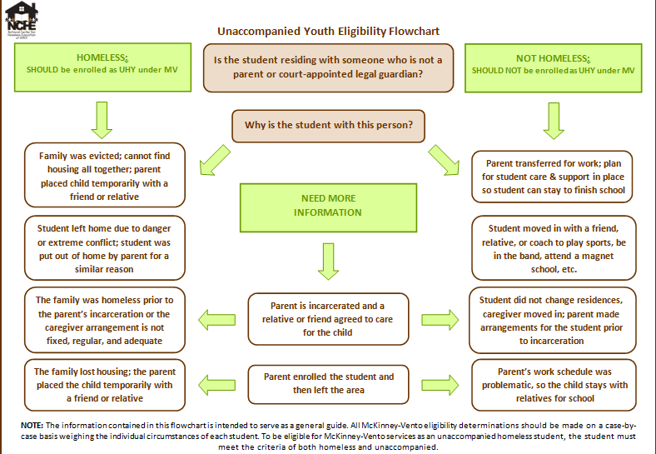

Slide 34
FAFSA and College Readiness
FAFSA Applications available on October 1st
Pell Grants and Scholarships
Independent Status verification
Single Points of Contact (SPOC) https://www.cde.state.co.us/dropoutprevention/homeless_hespocs

Slide 35
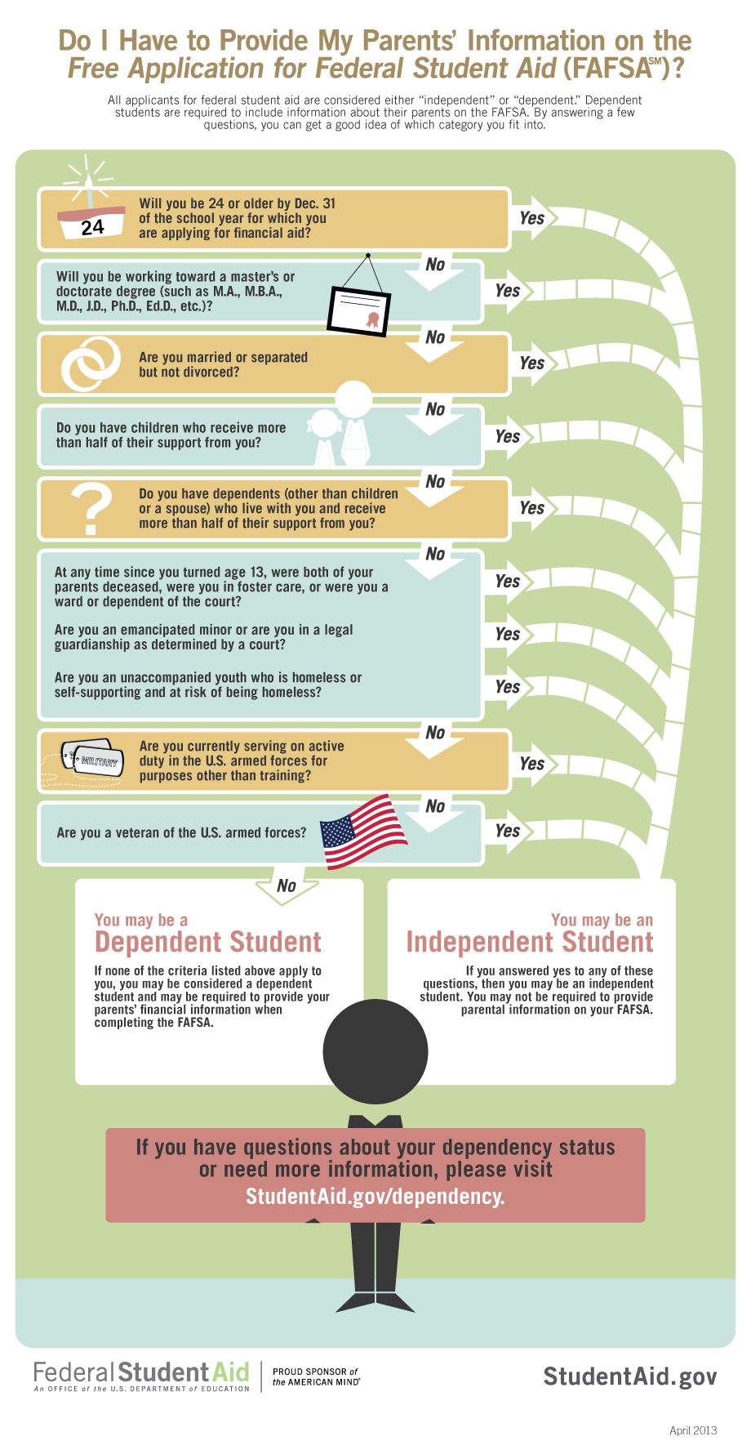

Slide 37
Scholarships
National Center for Homeless Education
https://nche.ed.gov/ibt/scholarships.php

Slide 38
Financial Aid for Highly Mobile Students
Watch a FAFSA and Highly Mobile Students recorded webinar from the Colorado Department of Higher Education and Colorado Department of Education:
Overall FAFSA considerations and recommendations
Financial aid independent determination
Required documentation
Unique Scholarships
https://enetlearning.adobeconnect.com/pjy68395ungm/
Notes:
Myers

Slide 39
Resources
National Center for Homeless Education
https://nche.ed.gov/ibt/higher_ed.php
National Association for the Education of Homeless Children and Youth (NAEHCY)
www.naehcy.org

Slide 40
Foster Care Education Resources
Foster Care Transition Toolkit
Supporting Successful Transitions
Educational Training Vouchers
Foster Care Dependency Form
Bridging the Gap Program
Denver Foundation Scholarships
Forward Steps Scholarship
projectfosterpower@childlawcenter.org
Ontherightpath.org
Notes:
Myers

Slide 41
So students made it to college…now what? Navigating barriers to obtaining a postsecondary degree.
Notes:
A lack of resources: lack of food, lack of work, lack of academic capacity, lack a place to go on breaks, lack understanding of the financial aid systems, lack scholarships—figure it out—connect—help them make a plan for barriers ahead of time

Slide 42
Q & A
Notes:
Utilize chat box

Slide 43
For more information, contact: Kristin Myers State Coordinator for Foster Care Education (303)866-6007 (o) (720)576-8506 (c) Colorado Department of Education Myers_K@cde.state.co.us

