Slide 1
Highly Mobile Students: Resources for School Counselors

Slide 2
What is a Highly Mobile Student?
A highly mobile student is defined as a student who experiences (or is at risk of experiencing) multiple school moves during their K-12 education outside of regular grade promotion. This includes (and is not limited to) youth in foster care, those experiencing homelessness, and migrant students.

Slide 3
Highly Mobile Student Populations
Highly mobile student populations include:
Children and youth in foster care
Migrant students
Students experiencing homelessness
Each year there are approx. 30,000 students that are counted within the state’s highly mobile student population
Highly mobile student populations often experience multiple school moves during their K-12 education outside of the regular grade promotion.

Slide 4
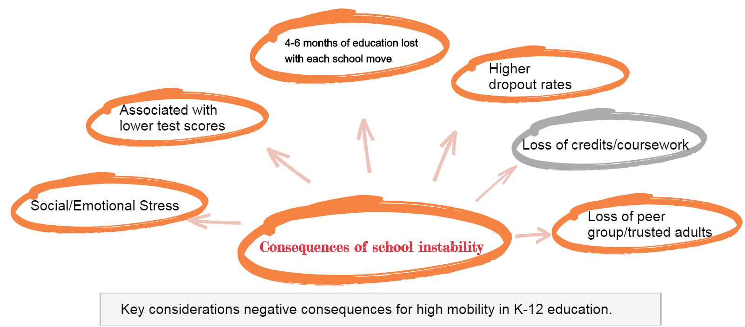

Slide 5
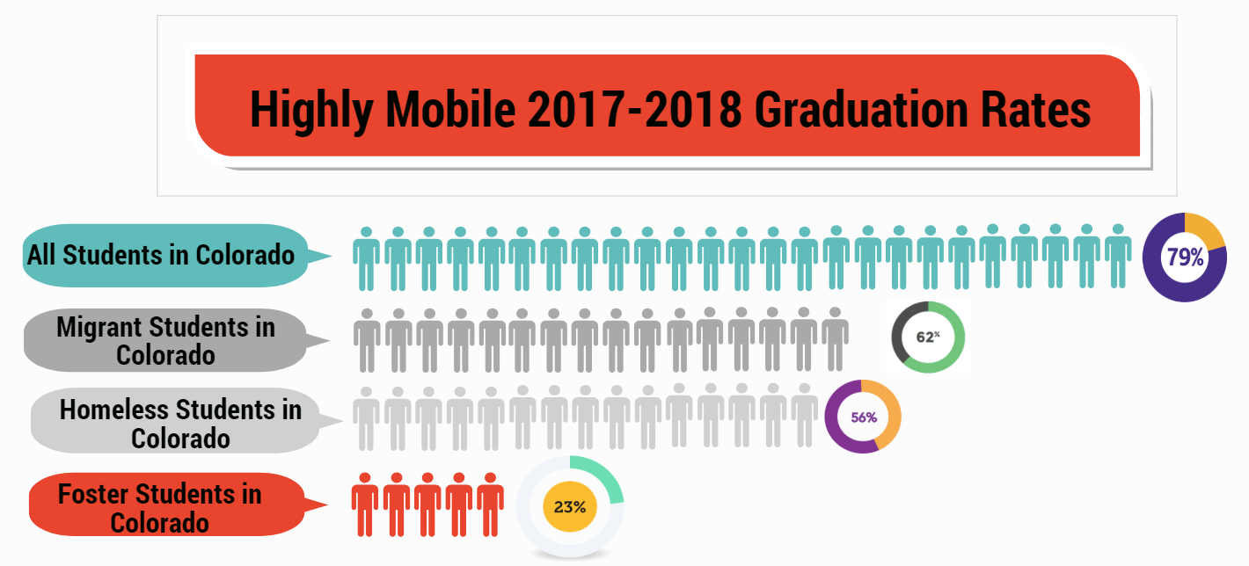

Slide 6
Definitions

Slide 7
McKinney-Vento | Migrant | Foster Care
Children who lack a fixed, regular, and adequate nighttime residence— Sharing the housing of others due to loss of housing, economic hardship, or similar reason. Living in motels, hotels, trailer parks, camping grounds due to lack of adequate alternative accommodations. Living in emergency or transitional shelters. Living in a public or private place not designed for humans to live. Living in cars, parks, abandoned buildings, substandard housing, bus or train stations, or similar settings. Unaccompanied Homeless Youth → A child or youth who meets the McKinney-Vento definition and is not in the physical custody of a parent or guardian. | The Migrant Education Program (MEP) provides supplemental support to eligible migrant children and youth. MEP may serve children from birth to the age of 21 who are eligible for a free public education under State Law. In order to qualify for services, students must have moved within the past three years across state or school district lines to join a migrant parent or guardian who is seeking seasonal employment in agriculture, fishing, or dairy. | “Student in Out-of-Home Placement” is defined to include children and youth who, at any time during an academic semester or term, are in placement out of the home as defined by 19-1-103(85) Key is that county or state has custody Contact your district’s Child Welfare Education Liaison with questions

Slide 8
Identification

Slide 9
McKinney-Vento | Migrant | Foster Care
Raise awareness throughout district schools and the community of the definition of homeless, the rights provided to eligible students under the McKinney-Vento Act, and the role of the local liaison in working with others to identify homeless students Include a housing questionnaire as part of the district’s enrollment packet Posting notices of the rights of McKinney-Vento students in the community in places where families and youth in homeless situations are likely to see them Sharing information about McKinney-Vento eligibility and services in student handbooks, on the school district website, and in brochures. | Identification of families for the Migrant Education Program is essential. Identifying families that may qualify for Migrant services is done through the five local programs via Educational Recruiters. The recruiter identifies families by getting in touch with their local schools, contacting employers that work in an agricultural-related field or through word of mouth. Recruiters meet with the families to discuss whether they qualify for the Migrant Education Program. Families can qualify if they work in an agricultural-related field or if they intended to work in an agricultural-related field. | Identification happens at the county department of human services. County human services contacts the Child Welfare Education Liaison (CWEL) at each district when a student is placed in an out-of-home placement. Note: a student in foster care may be in the custody of a county outside of the county where the school district is located. For example: a student could be in the custody of Mesa County but the foster placement is in Denver and the student is attending Denver Public Schools.

Slide 10
Enrollment

Slide 11
Enrollment Considerations: McKinney-Vento and Foster Care
McKinney-Vento
Continue the student’s education in the school of origin for the duration of homelessness, and until the end of the academic year in which the student becomes permanently housed; OR
Enroll in any public school that housed students living where the student is living are eligible to attend.
Foster Care
It is assumed it is in the student’s best interest to remain in the school of origin. If there is a potential school change due to a change in out-of-home placement, child welfare initiates a best interest determination meeting.
Student remains in the school of origin until best interest determination is made.

Slide 12
Immediate Enrollment
McKinney-Vento
Students do not have required documents, such as school records, immunizations, proof of residency, guardianship, or other documents
Students have missed application or enrollment deadlines during any period of homelessness
“Enrollment” includes attending classes and participating fully in school activities.
Foster Care
Students do not have required documents, such as school records, immunizations, proof of residency, guardianship, or other documents
Records must be requested immediately to the previous school—previous school has no more than 5 school days to send records to new school.

Slide 13
Full Participation

Slide 14
Full participation
McKinney-Vento
States must have procedures to eliminate barriers to academic and extracurricular activities, including magnet school, summer school, career and technical education, advanced placement, online learning, and charter school programs.
LEAs should anticipate and accommodate the needs of McKinney-Vento students to enter these programs and consider giving them priority on waitlists.
SEAs and LEAs should develop policies to expedite full participation in extracurricular activities and work with athletic associations to adjust policies to facilitate participation.
McKinney-Vento students are automatically eligible for free school meals.
Foster Care
No “full participation” written in ESSA or Colorado Statute, best practice is to use McKinney-Vento definition.
All school related fees are waived including extra curricular, before, in, and after school activities/course related fees.
Categorically eligible for free lunch.
Note: All students who receive free lunch (even for one day) are eligible for the entire school year and 30 days into the following school year.

Slide 15
Attendance and Academic Success

Slide 16
ATTENDANCE MATTERS: Be aware of attendance gaps or non-attendance. Intervene early to prevent loss of academic progress and course failure. ASK QUESTIONS: Find out the contributing factors to missing school. How can schools accommodate to the changing needs of students?
Academic Considerations
McKinney-Vento
LEAs must have procedures to ensure McKinney-Vento students receive appropriate full or partial credit, such as: consulting with prior school about partial coursework completed; evaluating students’ mastery of partly completed courses; offering credit recovery.
Foster Care
Colorado HB 18-1306 guidelines:
Partial/elective credit
Demonstration of competency
Course/prerequisite waivers
Graduation from previous school

Slide 17
HB 18-1306 Credit attainment, progress toward graduation, and competency-based options
“(b)When a student experiences out-of-home placement at any point during high school, an education provider may waive course or program prerequisites or other preconditions for placement in courses or programs under the jurisdiction of the education provider.”
Notes:
Myers

Slide 18
Credit attainment, progress toward graduation, and competency-based options
“(c) An education provider may waive specific courses required for graduation if similar course work has been satisfactorily completed in another jurisdiction or the student has demonstrated competency in the content area. If the school does not grant a waiver to a child who would qualify to graduate from the sending school, the education provider is encouraged to provide an alternative means of acquiring the required course work or competency requirements so a timely graduation may occur. The receiving education provider awarding the diploma may award elective credit for any portion of the student’s certified course work that is not aligned with the curriculum of the receiving education provider or for demonstrated competencies that are not aligned with the receiving education provider.”
Notes:
Myers

Slide 19
Credit attainment, progress toward graduation, and competency-based options
“(d) If a student in out-of-home placement who is transferring at the beginning of or during twelfth grade is ineligible to graduate from the receiving education provider, the education provider may request a diploma from a previously attended education provider, and the previously attended education provider may issue a diploma if the student meets the education provider’s graduation requirement.”
Notes:
Myers

Slide 20
Educational Milestones
Key Considerations/Impact
Maternal Health
Substance abuse, in-utero trauma, premature birth, poverty
Early Education/Preschool
Access to early education programs, trauma, abuse/neglect, parental substance abuse, at-home education.
Read by 3rd Grade
3rd Grade literacy tied to multiple educational outcomes.
Middle School Math
Proficiency tied to predictor of high school success
Course Failure in 9th Grade
Predictor of dropout and high school credential attainment.
Pre-
Birth
Birth-2
Early
Childhood
Kindergarten
3rd Grade
3rd-5th Grade
6th-9th
Grade
9th-12th
Grade
High School Completion
Kindergarten Readiness
Able to write name, county to 100, recognize signs and sounds
Elementary-Middle School Transition
Academic proficiency, attendance, social/emotional health, family support, issues of mobility
8th to 9th Transition
Academic proficiency, attendance, social/emotional health, family support, issues of mobility
Infancy Health
Low birthweight, parental substance abuse, abuse/neglect, trauma, born into poverty
Lack of Credit Accrual
Significant predictor for dropout

Slide 21
FAFSA and Postsecondary

Slide 22
FAFSA and Postsecondary
McKinney-Vento
All McKinney-Vento youth must be able to receive individualized counseling from counselors to prepare and improve their readiness for college, including college selection, application, financial aid, and on-campus supports.
Liaisons must ensure unaccompanied youth are informed of their status as independent students and obtain verification of that status.
Foster Care:
Youth work with caseworkers to complete independent living plans beginning at age 14. Work with caseworkers to share ICAPs and other relevant academic information.
Youth in foster care for one day after their 13th birthday are automatically eligible for independent status on the FAFSA (see court verification letter)
Check resource sheet and foster care education website for foster-specific programs and scholarships.

Slide 23
Financial Aid for Highly Mobile Students
Watch a FAFSA and Highly Mobile Students recorded webinar from the Colorado Department of Higher Education and Colorado Department of Education:
Overall FAFSA considerations and recommendations
Financial aid independent determination
Required documentation
Unique Scholarships
https://enetlearning.adobeconnect.com/pjy68395ungm/
Notes:
Myers

Slide 24
Strategies for Supporting Highly Mobile Students

Slide 25
Teaching and Classroom Strategies
Perceptions
Classroom Environment/Culture
Academics
Curriculum
Social
Resource: Research Summary: Teaching and Classroom Strategies for Homeless and Highly Mobile Students, NCHE 2013

Slide 26
Realign your own perceptions
Examine personal beliefs about highly-mobile students to become aware of biases and perceptions. To enhance understanding, take a course, volunteer at a homeless shelter or soup kitchen, or form a discussion group.
Learn about the McKinney-Vento Act and its legal protections for homeless children and unaccompanied youth.
Learn more about Foster Care and Colorado HB 18-1306
Become familiar with available community resources specifically for children and families in order to advocate and network to help meet students’ needs.
Homelessness and high mobility can include peer problems, poor hygiene, frequent absences, inappropriate clothing, and incomplete homework. Learn to
Avoid assuming that HHM children all share common behaviors and attitudes.
Use staff work days to go into neighborhoods and homeless shelters to meet with parents.

Slide 27
Improve Classroom Environment/Culture
Examine the student’s record for grades, attendance, and background information.
Spend some individual time in the first couple of days to encourage students, ensure they are adjusting well, and that they understand your willingness to help.
Offer tutoring or review time before or after school or at lunch.
Watch for indications that the student is struggling to adjust academically, socially, or psychologically.
Create referral procedures for new students who have difficulty adjusting.

Slide 28
Improve Classroom Environment/Culture
Form a “new student” group.
Set up a mentoring or peer buddy program.
Offer a welcome bag or backpack with school supplies and snacks.
Keep snacks in the classroom for students who are so hungry they fall asleep.
Respect students’ right to privacy. Everyone does not need to know about their living arrangements.
Ensure that students do not feel singled out because of their living circumstances.

Slide 29
Improve Academic Performance
Provide clear, achievable expectations. While it is important to consider their challenges and show compassion to HHM students, do not lower academic requirements for them.
Offer tutoring. Thirty or forty minutes a few times a week can dramatically increase a homeless child’s achievement level.
Assemble a packet with information and expectations for each class.
Be aware that each school move can delay academic progress and that many HHM students find it more difficult to engage and learn because of their prior negative school experiences, such as attending schools where transient students were not well supported.
Be flexible with assignments. Some tasks, such as projects requiring materials that students cannot afford, might be difficult or impossible for mobile students to complete. Assignments to write about a summer vacation, conduct a backyard science project, construct a family tree, or bring in a baby picture can be impossible for a child who has moved frequently or suddenly. Instead, offer several alternatives from which all students can choose.

Slide 30
Improve Academic Performance
Allow students to finish assignments independently, or give them the opportunity to complete tasks at their own pace.
Create a portfolio to document the student’s work, personal characteristics, and preferred learning style. If the student must transfer, the portfolio offers the next teacher a quick, easy way to pick up where the former teacher left off.
Rather than interpreting parental absences as a lack of commitment to their children’s education, ask families what you can do to support an ongoing partnership. Phone conferences might be a good alternative. Initiating an interactive journal with the parent about what’s happening at school and at home could help with teacher–parent dialogue.
Offer after-hours (evening or Saturday) and off-site parent meetings.
Talk with parents about class expectations and the challenges of changing schools mid-year.

Slide 31
Improve the Curriculum
Allow a variety of method and topic options for student assignments.
Broaden the diversity of families depicted in the books and materials in the classroom to include homeless, foster, and other mobile family and youth situations.
Consider doing a unit on foster care during May (National Foster Care Month) or on hunger and homelessness in November (National Homeless Youth Awareness month and National Hunger and Homeless Awareness Week).

Slide 32
Increase Social Engagement
Assign a peer mentor or buddy to facilitate an easier adjustment period for new students.
Connect the student with an adult mentor from the school or community. Offer older youth the option of choosing the person.

Slide 33
Q & A
Notes:
Utilize chat box

Slide 34
Thank You
Kerry Wrenick, LMSW
State Coordinator for Homeless Education
wrenick_k@cde.state.co.us
Kristin Myers, LSC, LPCC
State Coordinator for Foster Care Education
Myers_k@cde.state.co.us
Tomas Mejia
Migrant Education State Coordinator
Mejia_t@cde.state.co.us

