Slide 1
Creating Connections for Highly Mobile Students
Colorado School Counselor Association Conference 2018

Slide 2
What is a Highly Mobile Student?

Slide 3
What is a Highly Mobile Student?
A highly mobile student is defined as a student who experiences (or is at risk of experiencing) multiple school moves during their K-12 education outside of regular grade promotion. This includes (and is not limited to) youth in foster care, those experiencing homelessness, and migrant students.
Notes:
Myers

Slide 4
Highly Mobile Student Populations
Highly mobile student populations include:
Children and youth in foster care
Migrant students
Students experiencing homelessness
Each year there are approx. 30,000 students that are counted within the state’s highly mobile student population
Highly mobile student populations often experience multiple school moves during their K-12 education outside of the regular grade promotion.
Notes:
Myers

Slide 5
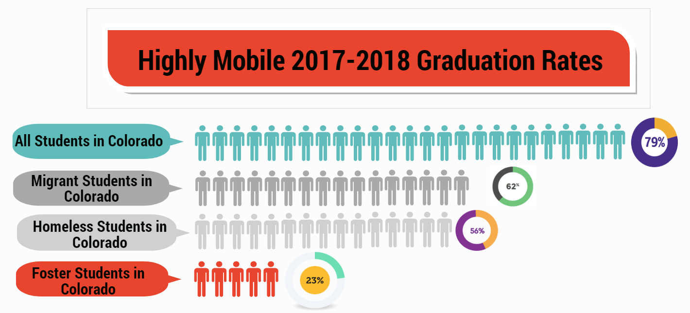
Notes:
Myers

Slide 6
How do I know if someone might be a highly mobile student?

Slide 7
What do these celebrities all have in common?

Slide 8
What about these celebrities?

Slide 9
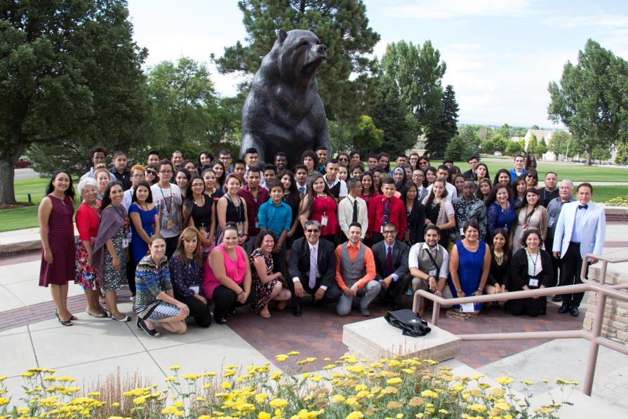

Slide 10
The Basics

Slide 11
Migrant Education Title I C, Migrant Education Program

Slide 12
Overview Educational Rights for Migrant Students
Title I Part C, Purpose:
To ensure that migratory children receive full and appropriate opportunities to meet the same challenging State academic standards that all children are expected to meet.
To help migratory children overcome educational disruption, cultural and language barriers, social isolation, various health-related problems, and other factors that inhibit the ability of such children to succeed in school.

Slide 13
McKinney-Vento (Homeless Education) Under Title IX, Part A of the Every Student Succeeds Act (ESSA)

Slide 14
2016-2017 Data
Unsheltered 1,255
Hotels/ Motels 1,743
Shelters/ 2,695
Transitional Housing
Doubled-up 16,250
TOTAL: 21,943

Slide 15
Eligibility—Who is Covered?
Children who lack a fixed, regular, and adequate nighttime residence—
Sharing the housing of others due to loss of housing, economic hardship, or similar reason.
Living in motels, hotels, trailer parks, camping grounds due to lack of adequate alternative accommodations.
Living in emergency or transitional shelters.

Slide 16
Eligibility (cont.)
Children who lack a fixed, regular, and adequate nighttime residence—
Living in a public or private place not designed for humans to live.
Living in cars, parks, abandoned buildings, substandard housing, bus or train stations, or similar settings.
Unaccompanied Homeless Youth
A child or youth who meets the McKinney-Vento definition and is not in the physical custody of a parent or guardian.
Awaiting foster care placement (removed 12/10/16)

Slide 17
Foster Care

Slide 18
Student in Out-of-Home Placement
“Student in Out-of-Home Placement” is defined to include children and youth who, at any time during an academic semester or term, are in placement out of the home as defined by 19-1-103(85)
Key is that county or state has custody
Who qualifies/who does not qualify
Contact your district’s Child Welfare Education Liaison with questions

Slide 19
What are the common barriers highly mobile students encounter?

Slide 20
Highly mobile students may…
Have multiple school moves on a transcript or cumulative file
Lacking credits due to multiple graduation requirements and/or may have gaps in academic achievement
Miss school frequently
Struggle to have basic needs met (hunger, stable housing, inadequate clothing, etc.)
Be hesitant to make friends or connections at school
Not be involved in extracurricular activities

Slide 21
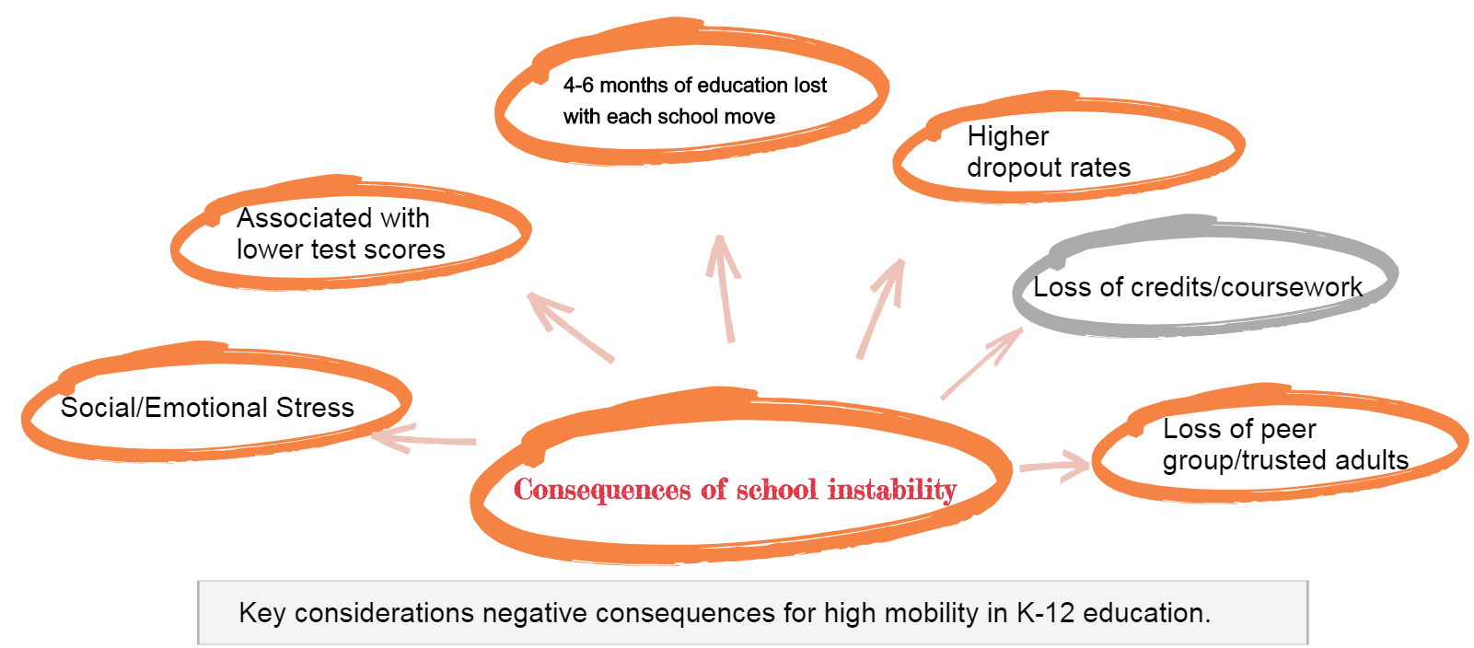
New folder

Slide 22
What can school counselors do to help highly mobile students?

Slide 23
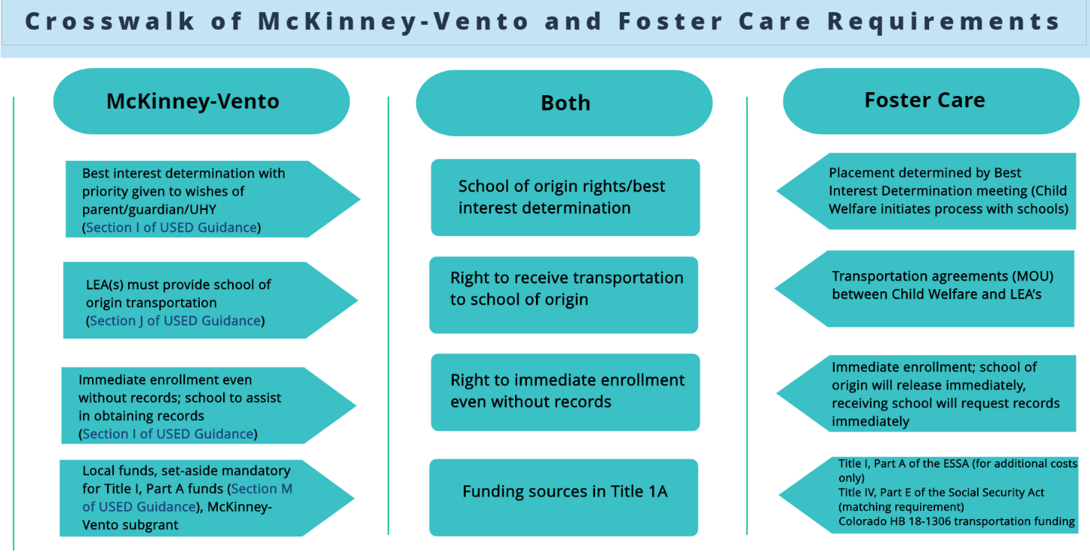

Slide 24
McKinney-Vento Homeless Assistance Act
Main themes:
Identification.
School stability.
School enrollment.
Support for academic success.
Child-centered, best interest decision making.

Slide 25
Notes:
Myers

Slide 26
Notes:
Myers

Slide 27
Credit accrual and graduation requirements: New options under Colorado HB 18-1306
A district can choose to:
Waive course requirements or prerequisites
Waive specific courses for graduation if student demonstrates competency
Provide alternative means of earning credits
Award elective credits based on previously completed work
Work with previous school district to issue a diploma
The bottom line: GET CREATIVE! DO WHAT IS BEST FOR THE STUDENT.

Slide 28
Financial Aid for Highly Mobile Students
Watch a FAFSA and Highly Mobile Students recorded webinar from the Colorado Department of Higher Education and Colorado Department of Education:
Overall FAFSA considerations and recommendations
Financial aid independent determination
Required documentation
Unique Scholarships
https://enetlearning.adobeconnect.com/pjy68395ungm/
Notes:
Myers

Slide 29
Migrant education resources
Title 1 Part C of the Every Students Succeeds Act (ESSA)
Non-regulatory guidance –
Eligibility
Plyler versus Doe

Slide 30
Homeless Education Resources
Colorado Department of Education
http://www.cde.state.co.us/dropoutprevention/homeless_index
National Association for the Education of Homeless Children and Youth
http://naehcy.org
National Center on Homeless Education
http://center.serve.org/nche/
Liaisons Toolkit
https://nche.ed.gov/ll/ll.php

Slide 31
Foster Care Education Resources
Foster Care Transition Toolkit
Supporting Successful Transitions
Educational Training Vouchers
Foster Care Dependency Form
Bridging the Gap Program
Denver Foundation Scholarships
Forward Steps Scholarship
projectfosterpower@childlawcenter.org
Ontherightpath.org
Notes:
Myers

Slide 32
What can I do as a school counselor?
Enrollment and registration practices
Include identification practices on registration forms
Ensure free lunch
Admit without records
Identify the barriers and provide the “hook up”
Food, housing, money for tuition, work/school balance, etc.
Chunk interventions for continuous support
Start with an application and see through to connecting with higher ed institution
Offer to be a constant, even if a student has to move schools
Skype introductions to new school counselor
Research the new school’s academic requirements and extra curricular offerings
In the words of Dr. Joyce Brown—”Act up, show out”

Slide 33
So students made it to college…now what? Navigating barriers to obtaining a postsecondary degree.
Notes:
A lack of resources: lack of food, lack of work, lack of academic capacity, lack a place to go on breaks, lack understanding of the financial aid systems, lack scholarships—figure it out—connect—help them make a plan for barriers ahead of time

