Slide 1

School Counselor’s Role in Colorado HB 18-1306: Improving Educational Outcomes for Foster Youth
Notes:
Introduce ourselves
Thanks for having us

Slide 2
former foster youth who beat the odds
A few words from
https://www.youtube.com/watch?v=oZc2UEPqQiA
Notes:
Myers will start

Slide 3
What do school counselors need to know about working with child welfare agencies?
What happens when I make a child abuse/neglect call?
What if I know a student has an open case with child welfare and is not living at home, does that mean they are in foster care?
What information can I know about a child welfare case as a school counselor?
How can I help?
Notes:
Melton/Myers

Slide 4
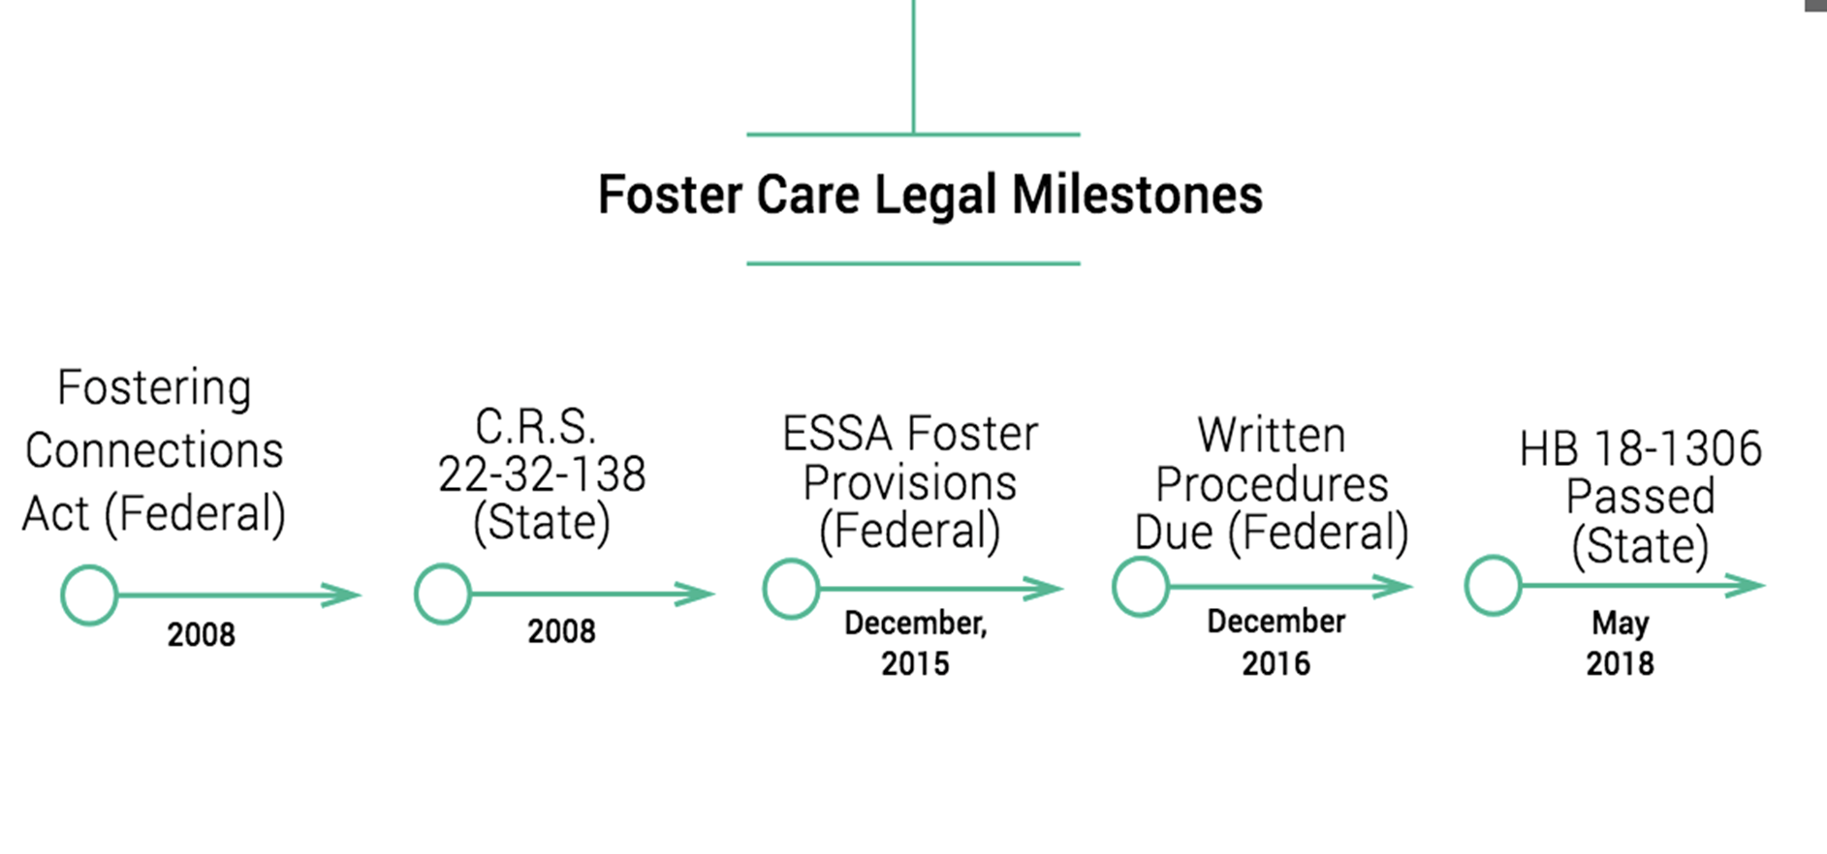
Data sharing begins 2012
Notes:
Melton—overview of laws
Clemens—Overview of Data

Slide 5
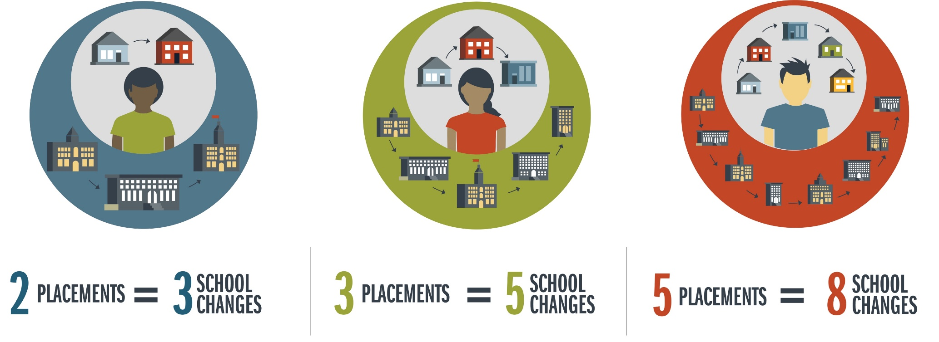
Students change schools even
more than placements
Based on 5 years of Colorado Data
The research reported here was supported by the Institute of Education Sciences, U.S. Department of Education, through Grant R305H150007 to the University of Northern Colorado. The opinions expressed are those of the authors and do not represent the views of the Institute or the U.S. Department of Education.
Notes:
Clemens

Slide 6
Educational Stability is Important Before, During, and After Foster Care
Data Source: Colorado Department of Education, Data Services and Colorado Department of Human Services
With an Average of 3 School Moves, the Odds of Graduating are Smaller than Exiting Without a Credential
The research reported here was supported by the Institute of Education Sciences, U.S. Department of Education, through Grant R305H150007 to the University of Northern Colorado. The opinions expressed are those of the authors and do not represent the views of the Institute or the U.S. Department of Education.
Notes:
Clemens

Slide 7
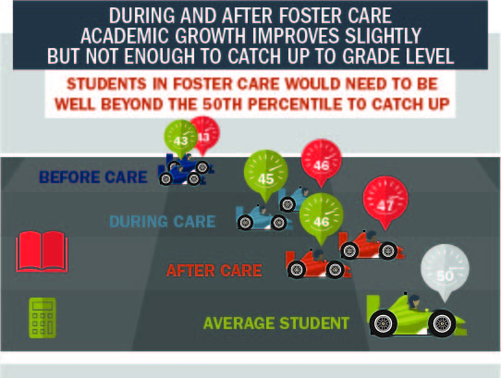
Every Transition Counts
Notes:
Clemens

Slide 8


Consequence is Disengagement
“I wish people would understand that foster care and schooling, it is kind of difficult. It is difficult to go through together and separately. Being in foster care and already not having a consistent family is hard enough, so to not have a consistent school for a kid is more challenging because they don’t have that stable peer group…I knew I’m not going to see you soon, so it made me not want to make friends.”
Notes:
Clemens

Slide 9
Alignment of Curriculum & Graduation Requirements*
“I don't know division or subtraction or addition because I've never had the chance to learn it, because each school I've moved to has taught me just multiplication.”
“My sister moved three schools in one semester and two were in the same school district. And at the end of the semester, all she had was English and math. Those were the only two that translated through all three schools. She was in German and the second school didn’t have German so that didn’t transfer, and it’s like if the school you transfer to doesn’t have that exact class that you were in… Then they can’t count it.”
Notes:
Clemens

Slide 10
Resilience
“They can take my home, they can take my family, they can move me home to home, they can do all of that…but they couldn’t take my education…nobody can take my education. It’s the only thing I have actually been able to hold on to.”
Notes:
Clemens

Slide 11
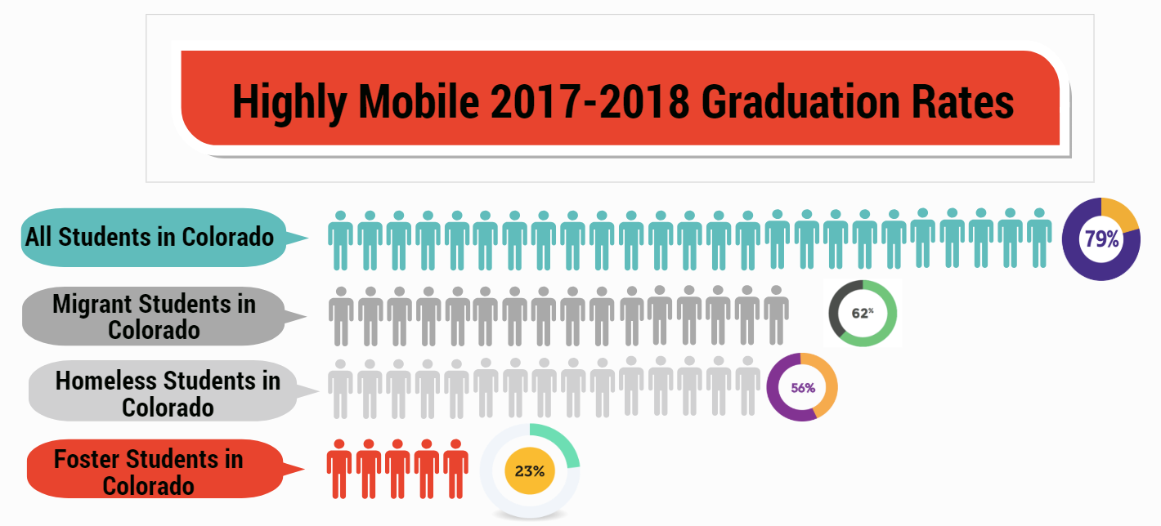
Notes:
Myers

Slide 12

School stability matters! Now what?
Notes:
Myers

Slide 13
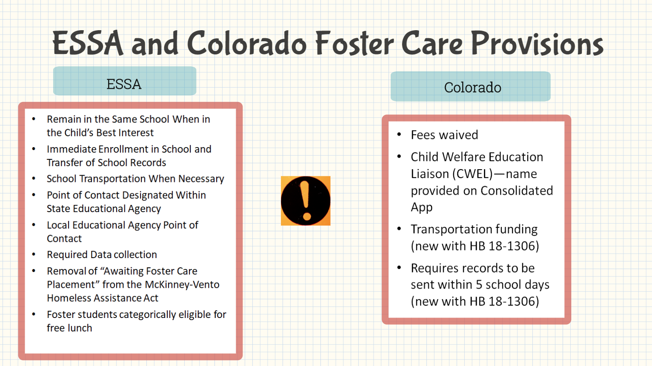
Notes:
Myers

Slide 14
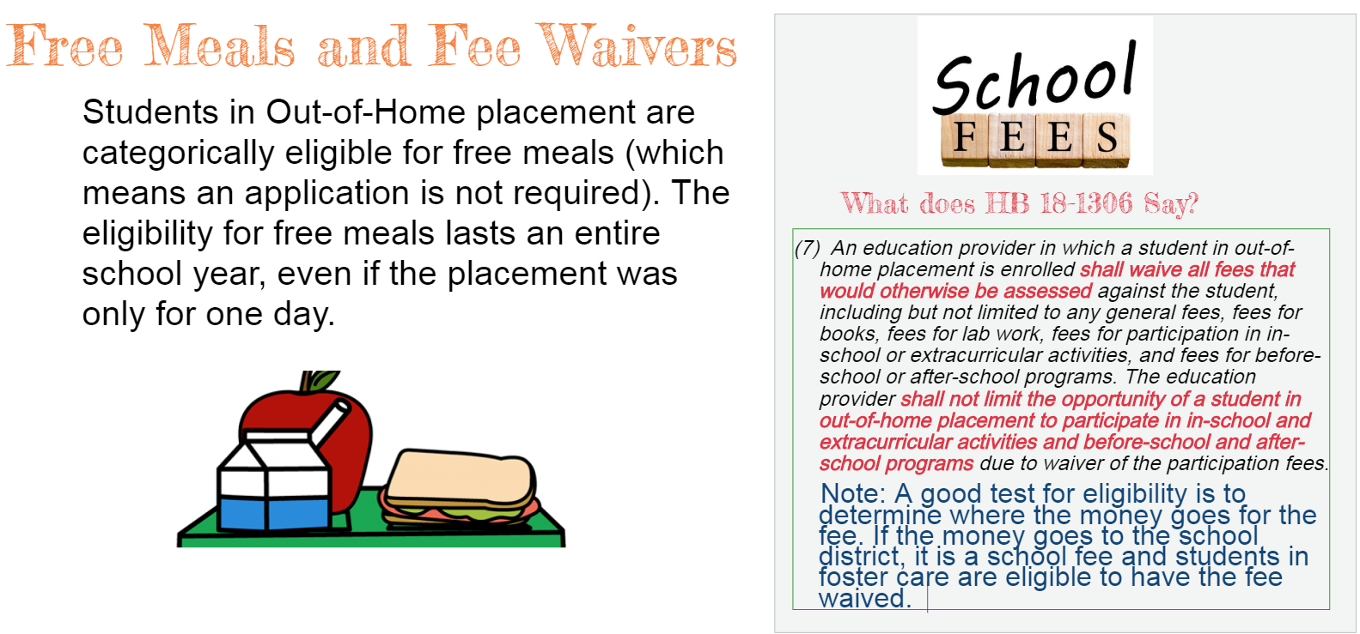
Notes:
Myers

Slide 15
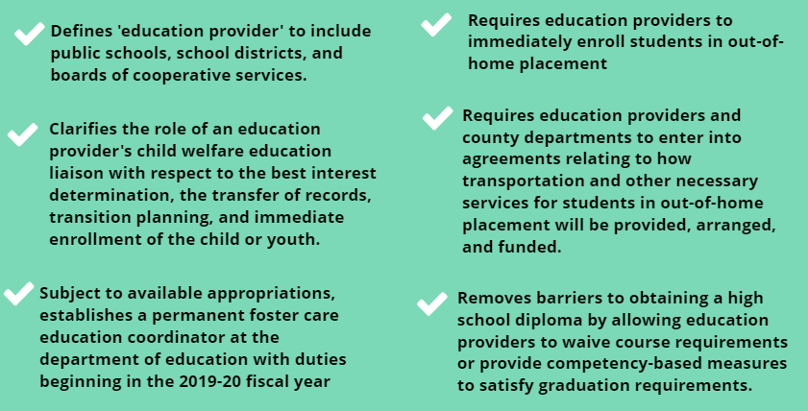
Overview of major updates in HB 18-1306
Notes:
Melton

Slide 16
Support for students during critical transitions
Definition of “student in out-of-home placement” through end of semester
Definition of “school of origin” to include feeder schools and recently attended schools
Notes:
Melton

Slide 17
What is a Highly Mobile Student?
A highly mobile student is defined as a student who experiences (or is at risk of experiencing) multiple school moves during their K-12 education outside of regular grade promotion. This includes (and is not limited to) youth in foster care, those experiencing homelessness, and migrant students.
Notes:
Myers

Slide 18
Highly Mobile Student Populations
Highly mobile student populations include:
  Children and youth in foster care
  Migrant students
  Students experiencing homelessness
Each year there are approx. 30,000 students that are counted within the state’s highly mobile student population
Highly mobile student populations often experience multiple school moves during their K-12 education outside of the regular grade promotion.
Notes:
Myers

Slide 19
HB 18-1306
Credit attainment, progress toward graduation, and competency-based options
“(b)When a student experiences out-of-home placement at any point during high school, an education provider may waive course or program prerequisites or other preconditions for placement in courses or programs under the jurisdiction of the education provider.”
Notes:
Myers

Slide 20
Credit attainment, progress toward graduation, and competency-based options
“(c) An education provider may waive specific courses required for graduation if similar course work has been satisfactorily completed in another jurisdiction or the student has demonstrated competency in the content area. If the school does not grant a waiver to a child who would qualify to graduate from the sending school, the education provider is encouraged to provide an alternative means of acquiring the required course work or competency requirements so a timely graduation may occur. The receiving education provider awarding the diploma may award elective credit for any portion of the student’s certified course work that is not aligned with the curriculum of the receiving education provider or for demonstrated competencies that are not aligned with the receiving education provider.”
Notes:
Myers

Slide 21
Credit attainment, progress toward graduation, and competency-based options
“(d) If a student in out-of-home placement who is transferring at the beginning of or during twelfth grade is ineligible to graduate from the receiving education provider, the education provider may request a diploma from a previously attended education provider, and the previously attended education provider may issue a diploma if the student meets the education provider’s graduation requirement.”
Notes:
Myers

Slide 22
Financial Aid for Highly Mobile Students
Watch a FAFSA and Highly Mobile Students recorded webinar from the Colorado Department of Higher Education and Colorado Department of Education:
  Overall FAFSA considerations and recommendations
  Financial aid independent determination
  Required documentation
  Unique Scholarships
https://enetlearning.adobeconnect.com/pjy68395ungm/
Notes:
Myers

Slide 23
Unique Resources for Foster Care
Foster Care Transition Toolkit
Supporting Successful Transitions
Educational Training Vouchers
Foster Care Dependency Form
Bridging the Gap Program
Denver Foundation Scholarships
Forward Steps Scholarship
projectfosterpower@childlawcenter.org
Ontherightpath.org
Notes:
Myers

Slide 24

Thank you for supporting students in foster care!
Notes:
All

Slide 25
Elysia V. Clemens, PhD, LPC
Deputy Director, Colorado Evaluation and Action Lab
(303)871-6262
Elysia.Clemens@du.edu
Kristin Melton, J.D.
Youth Services Unit Manager
Colorado Department of Human Service
(303) 866-5139
Kristin.melton@state.co.us
Kristin Myers, MA
State Coordinator for Foster Care Education
Colorado Department of Education
(303) 866-6007
myers_k@cde.state.co.us
Contact us!
Notes:
All

