Slide 1
May 22, 2025
Data Pipeline Town Hall
The goal of the webinar is to provide updates on the Data Pipeline, current, and upcoming data collections. These webinars also provide a forum for districts, BOCES, and Administrative Units to have questions answered about Data Pipeline.

Slide 2
Colorado Department of Education
Identity Management (IdM)
Identity Management Site
Frequently Asked Questions
How do I add myself or others to the email listserv for town hall emails and/or a specific collection?
  Email lists are dependent on a person’s access rights in IdM. Contact your LAM to get an account or be assigned to a specific collection.
Where can I find the IdM role mappings for Data Pipeline and other applications?
  Role Mapping (XLS)
I am a LAM. How do I update the user permissions for someone in my district?
  Follow the steps outlined in the IdM Quick Guide for Access Management (DOCX)
Important: Users are not automatically removed from IdM when their email address is no longer active in your district. The LAM must deactivate their IdM account to ensure only designated staff can access CDE’s data reporting system.
Notes:
LAMs, please check the IdM roles for your district. Remove permissions for users who have retired, left your district, or are no longer assigned to a collection. Add roles for new hires and newly assigned respondents for specific collections.

Slide 3

What is PII?
Student and Staff Personally Identifiable Information (PII) is defined by state and federal laws as information that, alone or in combination, personally identifies an individual
  This includes direct identifiers
  (i.e. student and staff names, SASID, EDID, etc.)
  Includes information that when combined is identifiable
Colorado’s Student Data Transparency and Security Act outlines requirements for how Student PII is collected, used and shared
See the Data Privacy and Security website for prepared guidance on how to comply with this and other privacy laws.

Slide 4

Sharing Data
Use secure methods to transfer any PII to CDE
  Contact Data Collection leads with questions about how to transmit PII securely
    Each Data Collection leads maintains their own Syncplicity folders for specific collections, reach out to the collection lead for access
  Use Syncplicity to encrypt emails to CDE
Avoid sending PII via unencrypted email or to unsecured faxes when sharing data between or within districts
  Use Syncplicity to encrypt emails to CDE
Check local policies for restrictions, requirements, etc. regarding PII
  Do not use PII in trainings, presentations, etc.
  Do not share PII with unauthorized individuals
  Do not share passwords
  Follow local policies when transmitting PII to any third party

Slide 5
Today’s Agenda
Agenda Topic | Presenter
Open Data Collections and Upcoming Deadlines in Data Pipeline | Host: Reagan Ward
Student Attendance | Peter Hoffman
Data Pipeline Website: Respondent Training Page | Reagan Ward
Student End of Year | Reagan Ward
SBD Collections | Leon Merker
Staff Evaluation | Dawna Gudka
READ Collections | Tara Rhodes
Summer EBT | Collin Slutzky

Slide 6
Open Collections and
Upcoming Deadlines in
Data Pipeline

Slide 7
Open Collections and Upcoming Dates:
Year-Round & Interchanges
Name | Category | Status | Key Dates
RITS | Year Round | Open | N/A
EDIS | Year Round | Open | N/A
Directory | Year Round | Open | School Code Change Requests: 2/5/2025 to 6/30/2025
Student | Interchange | Open | 6/11/2025 Interim Deadline: Error free DEM, SSA, GGs
At-Risk | Interchange | Closed | N/A
Title I | Interchange | Open | 6/11/2025 Interim Deadline: Error free interchange file
Special Education IEP | Interchange | Open | Special Education EOY Snapshot open now
Staff | Interchange | Open | Staff Evaluation Interchange is NOW OPEN
Discipline Action | Interchange | Open | This interchange file is needed for Student Discipline Snapshot and Special Education Discipline Snapshot Collections
Teacher Student Data Link | Interchange | Open | 6/13/25 Interim Deadline: Error free interchange file
Data Pipeline Resources: Data Pipeline Collection Dates (XLS)

Slide 8
Open Collections and Upcoming Dates:
Snapshots
Name | Category | Status | Final Deadline Date | Next Milestone | Looking Ahead
Teacher Student Data Link | Snapshot | Open | Aug. 29, 2025 | Interim Deadline: 6/13/25, error free TSDL interchange | Interim Deadline: 6/27/25 create at least one snapshot
Staff Evaluation | Snapshot | Open | Oct. 15, 2025 | Staff Evaluation interchange is Now Open | Staff Evaluation Snapshot will open May 28th
Student End of Year: Regular Phase | Snapshot | Open | Sept. 4, 2025 | Interim Deadline: 5/29 create initial SEY snapshot | Interim Deadline: 6/10, 10:30-11:30am June SEY Office Hours
Student Attendance | Snapshot | Open | July 25, 2025 | Interim Deadline: 6/11/25 error free interchange files | Interim Deadline: 6/20/25 submit exceptions for review
Special Education Discipline | Snapshot | Open | Aug. 1, 2025 | Interim Deadline: 6/26/25 Dis and IEP interchanges should be error free and at least one snapshot created | Other Date: June 30, 2025, end of 2024-2025 data reporting period
Student Discipline | Snapshot | Open | July 31, 2025 | Interim Deadline: 6/11/25 error free Student Interchange files (DEM and SSA) | Interim Deadline: 6/21/25 Create at least one student discipline snapshot
Special Education EOY | Snapshot | Open | Oct. 3, 2025 | Interim Deadline: 6/26/25 IEP Interchange files error free and at least one snapshot created | Interim Deadline: 9/4/25 all exception requests submitted to CDE for review
Data Pipeline Resources: Data Pipeline Collection Dates (XLS)

Slide 9
Open Collections and Upcoming Dates:
Periodic
Name | Category | Status | Final Deadline Date | Next Milestone | Looking Ahead
Summer EBT | Periodic | Open | Feb. 28, 2025 | Corrections Period: 5/19/2025 to 9/3/2025
Alternative Education Campus | Periodic | Open | Jun. 27, 2025 | Planned Measures File: 3/19/2025 to 6/27/2025 | Actual Measures File: 5/19/25 to 6/27/25
Prevent Harassment or Discrimination | Periodic | Open | August 1, 2025 | Interim Deadline: Upload Prevent Harassment or Discrimination File at least once by 6/5/25 | Interim Deadline: Error free Prevent Harassment or Discrimination file by 7/3/2025
READ Spring Assessments | Periodic | Open | June 13, 2025 | Other Date: 6/6/25 error free submission target | Report Review: 6/6/25 to 6/13/25
READ Literacy Programs & Assessments | Periodic | Open | June 13, 2025 | Other Date: 6/6/25 error free submission target | Report Review: 6/6/25 to 6/13/25
Data Pipeline Resources: Data Pipeline Collection Dates (XLS)

Slide 10
Student Attendance
Peter Hoffman

Slide 11
Student Attendance Collection Timeline
Date | Event | Event Description
05/09/2025 | Interim Deadline | Upload Student Demographic and Student School Association Files
05/23/2025 | Interim Deadline | Create an initial Attendance Snapshot
06/11/2025 | Interim Deadline | Error free Student Interchange file uploads
06/20/2025 | Interim Deadline | Submit any necessary reporting exceptions for review.
06/27/2025 | Interim Deadline | Error free Attendance Snapshot
07/03/2025 | Report Review | Review Attendance Cognos Reports for data validation. Submit Attendance Snapshot data as soon as review is complete.
07/11/2025 | Deadline | Submit Attendance Snapshot data.
07/25/2025 | Deadline | Collection closes Superintendent Verification (sign-off) form due. Data remains embargoed until the official release in August.
08/21/2025 | Data Release | Official data release
Student Attendance – Peter Hoffman
Attendance@cde.state.co.us

Slide 12
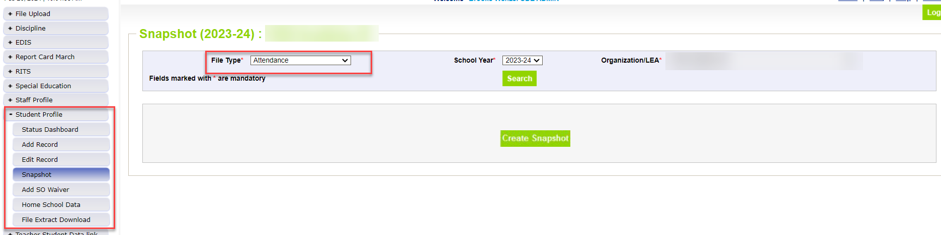
Creating Attendance Snapshot
Attendance Snapshot is located under Student Profile
  Select Student Profile then Snapshot
  Fill out prompts for Attendance (File Type: Attendance, School Year: 2024-25, Organization/LEA should auto-fill)
Student Attendance – Peter Hoffman
Attendance@cde.state.co.us

Slide 13
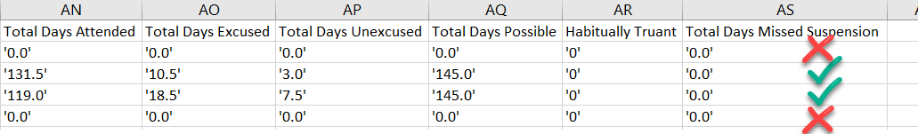
AS020 Error
Student must be in DEM and SSA file (error free!)
Check your Attendance Fields (Student School Association File)
Attendance Fields must be formatted correctly and not NULL
Zero-fill will automatically exclude the student from the snapshot (do not meet Total Days Possible >= 10.0)
  Attendance Snapshot Layout contains criteria to be included in snapshot
Exception Needed?
  Misreported in OCT
  Total Possible Attendance Days is less than 10.0
  Etc..
Student Attendance – Peter Hoffman
Attendance@cde.state.co.us

Slide 14
Questions & Resources:
Student Attendance
Peter Hoffman
Attendance@cde.state.co.us
720-925-8611
Attendance Webpage
Student Interchange Webpage

Slide 15
Data Pipeline Website:
Respondent Training Page
Reagan Ward

Slide 16
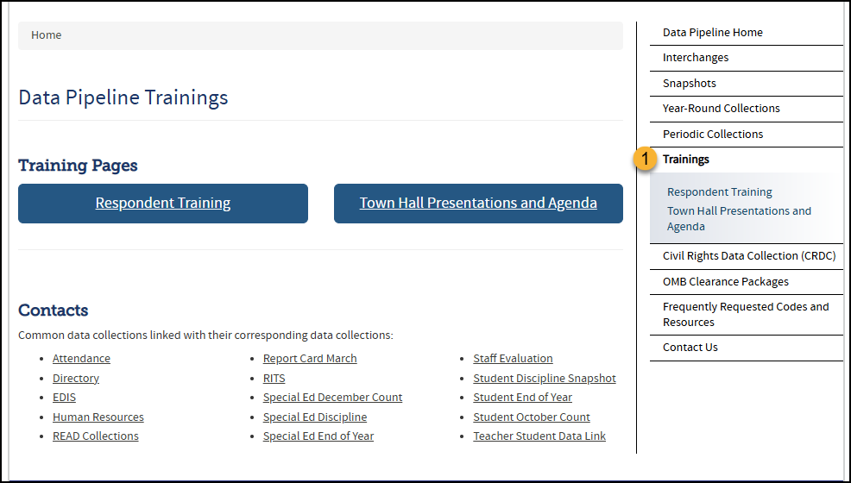
Training Landing Page
Links to both the Respondent Training and Town Hall Pages
Data Pipeline Website
Training Page

Slide 17
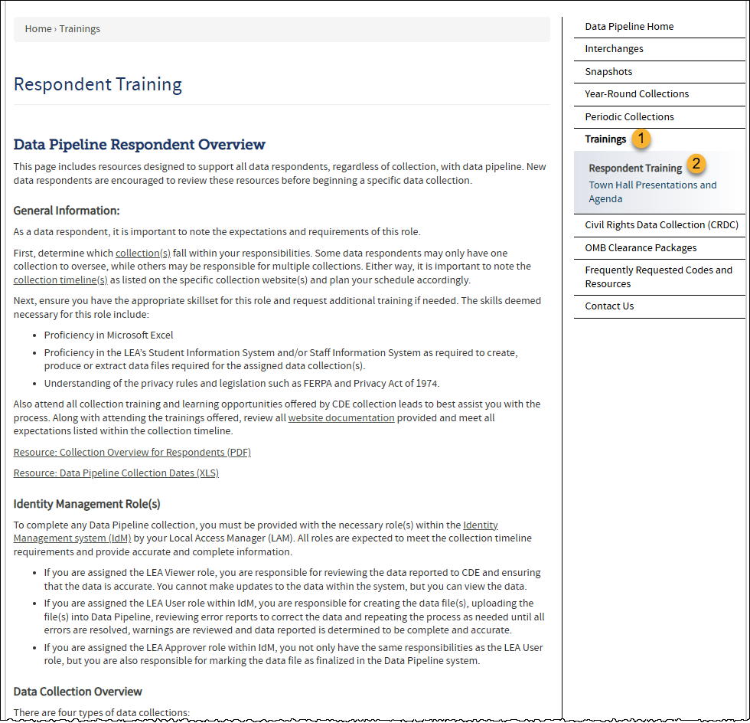
*New* Resources for All Respondents
First training stop for New Respondents
Content includes resources to support all data respondents
Main Topics:
  Data Pipeline Respondent Overview
  Data Pipeline Reporting Process
  Additional Tools/Resources
Growing repository of topic-based directions resources such as Data Pipeline File Upload Directions that apply to all (or most) data collections
Data Pipeline Website
Respondent Training Page

Slide 18
Questions & Resources:
Data Pipeline Website
Data Pipeline Home Page
Data Pipeline Training Landing Page
Data Pipeline Respondent Training Page
Broken link on a Pipeline Page? Email Reagan

Slide 19
Student End of Year
Reagan Ward

Slide 20
SEY Collection Timeline
Date | Event | Event Description
5/29/2025 | Interim Deadline | Create initial SEY snapshot
6/10/2025, 10:30-11:30am | Training Event | June SEY Office Hours: June SEY Office Hours Registration Topic—TBD based upon FAQs from past month
6/11/2025 | Interim Deadline | Error free interchange files – DEM, SSA, GG, TT1
7/15/2025, 10:30-11:30am | Training Event | July SEY Office Hours: July SEY Office Hours Registration Topic—TBD based upon FAQs from past month
7/31/2025 | Interim Deadline | Submit any necessary reporting exceptions for review School level errors will be processed beginning after this date (SE181, SE182, SE183, etc.)
8/12/2025, 10:30-11:30am | Training Event | August SEY Office Hours: August SEY Office Hours Registration Topic—Reviewing Reports and Data Validation
8/14/2025 | Interim Deadline | Error free SEY snapshot
8/14/2025 to 9/4/2025 | Report Review | Validate SEY data using CEDAR/COGNOS reports.
9/4/2025 | State Deadline | Submit SEY snapshot
9/5/2025 to 9/17/2025 | Closed | SEY Snapshot is closed until the start of the Cross LEA phase
9/18/2025 to 10/16/2025 | Cross LEA Phase | See the SEY Website for the detailed timeline
10/23/2025 to 11/18/2025 | Post-Cross LEA Phase | See the SEY Website for the detailed timeline
12/2/2025 | Deadline | Superintendent Verification (Sign-Off) form due. Collection Closes.
Student End of Year
StudentEndOfYear@cde.state.co.us

Slide 21
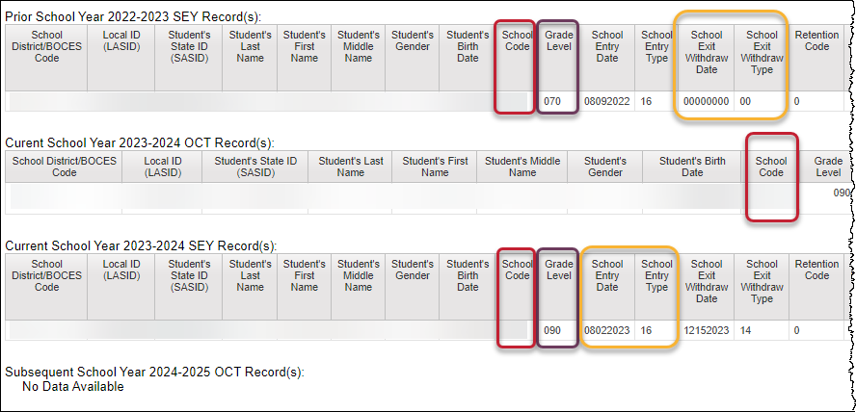
COGNOS Report Highlight:
SASID Lookup: SEY and OCT record (prior, current, subsequent year)
Code | Issue
SE049/ SE057 | Missing SEY record for student with OCT rec in current year
SE102/ SE105/ SE109/ SE115 | Exit type prior year + entry type/school code current year
SE113/ SE117/ SE242/ SE243 | Grade level & retention code prior year + current year grade level
SE064/ SE404/ SE292/ SE293 | Missing Record: Student included in prior year with exit type 00 (or retention 2 or 3) should have record in current year
SE060 | Missing OCT record when SEY shows enrollment on OCT 1st
SE050 | Current year exit type expects another record with matching entry type
… | SPED Transition Coding
… | Postsecondary Program Coding
… | OCT compared to SEY demographic
Best report to research cross collection errors related to prior SEY or OCT data.
During post-cross phase, use to research errors related to next year OCT.
Student End of Year
StudentEndOfYear@cde.state.co.us

Slide 22
School level errors that allow exceptions
Important: These exceptions will be loaded into pipeline beginning 8/1/25
  Any reviewed and approved prior to 8/1 will be held pending a final review on 8/1 before uploading into pipeline
  Once loaded, this rule won’t trigger even if interchange files are incorrect
Rules:
  SE052: All schools with grades PK-12 must have at least one record
    Same as OC101 in Student October
  SE054: No graduates or completers (school exit types 90-96) reported at a school whose grade range includes grade 12.
    Most common if school serves homebased education only (home option school)
    Schools with small populations with few or no grade 12 students in current year
Rules cont.
  SE181/SE182/SE183:
  FRL threshold changes from OCT to SEY (15% or more)
    When a school experiences a significant population increase for all students
    When school is impacted by large number of students reported in OCT based on carry-over status that was removed after OCT due to lack of current year documentation
  SE282/SE283 warnings highlight specific SASIDs with a FRL change between OCT and SEY.
    Helpful when researching SE181, SE182, or SE183 errors
Student End of Year
StudentEndOfYear@cde.state.co.us

Slide 23
Questions & Resources:
Student End of Year
StudentEndOfYear@cde.state.co.us
720-484-9057
  Student End of Year Collection Website
  Student Interchange Website
  Graduation Guidelines (Program) Website

Slide 24
Assessment SBD Reviews
Leon Merker

Slide 25
Introductions
Leon Merker
  SBD Collection Lead, Primary SBD support
  Merker_l@cde.state.co.us
Jasmine Carey
  Back up SBD Collection Lead, SBD support
  Carey_j@cde.state.co.us
Assessment SBDs
sbdsupport@cde.state.co.us

Slide 26
Student Biographical Data (SBD) Timeline
SBD Collections
  SAT is complete, CMAS will be open until next Wednesday May 28th
  DLM will open on May 28th
  Details are in the Periodic Collections on the Data Pipeline page
Assessment and Collection Page Link | Data Pipeline Group | SBD Review Window
Colorado PSAT/SAT DONE! | SAT | May 13 – 21, 2025
Colorado Measures of Academic Success (CMAS): Mathematics, ELA, CSLA, Science and Social Studies Colorado Alternate (CoAlt): Science and Social Studies | CMS | May 15 – 28, 2025
Colorado Alternate (CoAlt): English Language Arts and Mathematics (Dynamic Learning Maps) | DLM | May 28 – June 4, 2025
Assessment SBDs
sbdsupport@cde.state.co.us

Slide 27
Preparing for SBD
Download and review the documentation on the Data Pipeline Collection Pages
  File Layout – describes the data collected and gives directions on how they should be filled out
    SBD Manual – if you have never done an SBD review, please review the step-by-step section of the manual before you start working on the collection
    Business Rules
    Failsafe Template (if needed to move a student to another district)
Review the training PowerPoint, or watch the training webinar once posted
Make sure you have the appropriate groups in IDM and have at least one district data respondent with the LEA Approver role for each collection
  Remove users who are no longer with your district
Assessment SBDs
sbdsupport@cde.state.co.us

Slide 28
Frequently Asked Questions
We are most of the way through the collections but these are the most common issues
  CMAS Parent Excuse coding for students who tested
    The Assessment Unit released the following guidance to DAC during administration
    To clear the error, remove the Parent Excuse from the record, if you think there is an error or you believe the situation should be exempt from the requirements contact SBD Support
  Date First Enrolled in US – ELA Exemption
    Sometimes a student was previously enrolled for a short time which will impact the CDE Calculated date
    If the student didn’t previously participate in the assessment or use the ELA exemption we can allow you to use the exemption by ignoring this error
    If the student has already tested in CO or used the ELA exemption then the invalidation code should be left blank as a Not Attempted and that will resolve the error
Assessment SBDs
sbdsupport@cde.state.co.us

Slide 29
Assessment SBDs:
Contact Information
Contact SBD Support with any questions:
Email: sbdsupport@cde.state.co.us
Phone: 720.696.0185
Please do not use the general CDE Help Desk!
Remember not to send PII by email or on voicemail because an email will be autogenerated.

Slide 30
Staff Evaluation
Dawna Gudka

Slide 31

Collection Timeline
Date | Event | Event Description
04-22-2025 | Training Event | Collection Training Recording PowerPoint Posted on the website under Trainings
05-12-2025 | Interim Deadline | Update and upload Staff Profile Interchange file
05-21-2025 | Open | Staff Evaluation Interchange Open
05-28-2025 | Open | Staff Evaluation Snapshot
06-05-2025 | Interim Deadline | Error free Staff Profile Interchange file
06-19-2025 | Interim Deadline | Error free Staff Evaluation Interchange file
06-26-2025 | Interim Deadline | Create at least one Staff Evaluation Snapshot in Data Pipeline
07-15-2025 | Interim Deadline | Error free Staff Evaluation Snapshot
07-15- 08-15-2025 | Report Review | Final Snapshot Review- This is your opportunity to review reports in detail and make any data corrections you deem necessary to make sure you are reporting valid and reliable data. All data corrections must be completed during this time. If you anticipate that you will not be able to meet this deadline, please contact Dawna Gudka by email: Staff Evaluation
10-15-2025 | State Deadline | Staff Evaluation Snapshot Final Deadline Required to have Staff Evaluation Snapshot data submitted and sign off page signed and emailed to Staff Evaluation
Dawna Gudka
Staff Evaluation Snapshot

Slide 32
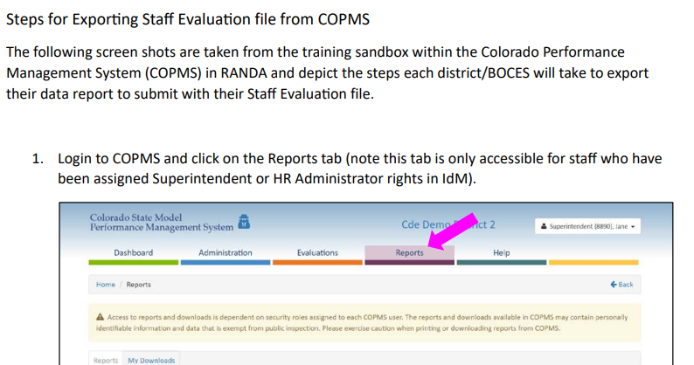
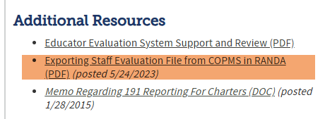
Extract your Staff Evaluation Interchange file from COPMS
Extract staff evaluation interchange file from COPMS (RANDA) Resource document found on staff interchange website, under additional resources
Staff Evaluation Snapshot Collection
StaffEvaluation@cde.state.co.us

Slide 33
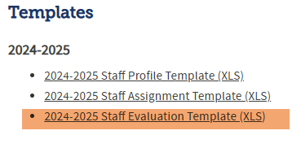
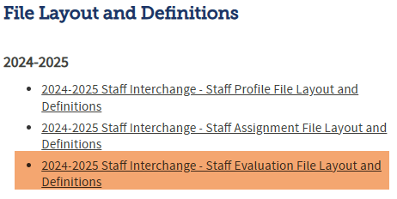
When your LEA does not use COPMS (RANDA)
If your LEA does not use COPMS (RANDA) then extract your staff evaluation data from your staff evaluation system
OR
Use the staff evaluation template to prepare your evaluation file. Staff evaluation template can be found on the staff interchange website, under “Templates”. Reminder the file layout is your key to this file. File layout is found under File Layouts and Definitions on the staff interchange website.
Staff Evaluation Snapshot Collection
StaffEvaluation@cde.state.co.us

Slide 34
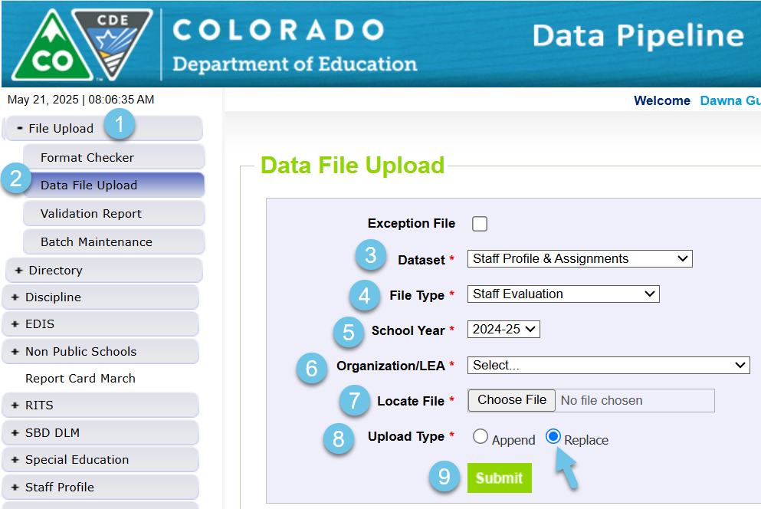
Staff Evaluation Interchange file is now open
Staff Evaluation Snapshot Collection
StaffEvaluation@cde.state.co.us

Slide 35
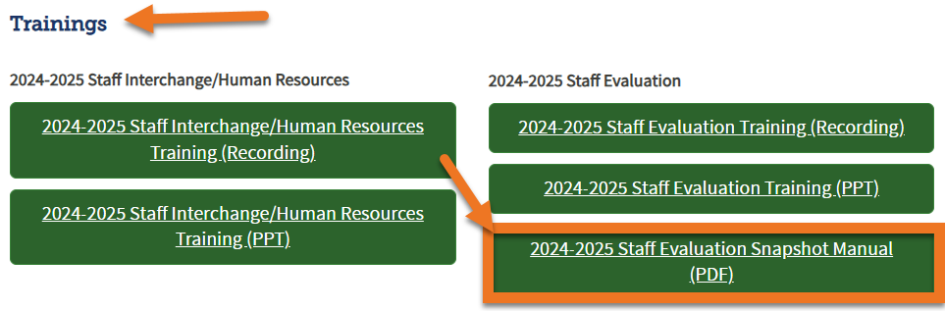
Staff Evaluation Collection Resources
New collection resource, 2024-2025 Staff Evaluation Snapshot Manual can be found on the staff interchange website, and the staff evaluation snapshot website, under trainings.
Staff Evaluation Snapshot Collection
StaffEvaluation@cde.state.co.us

Slide 36
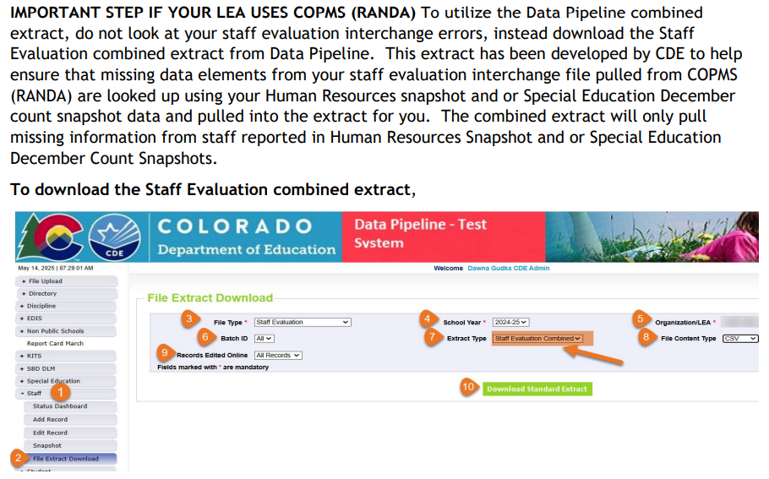
If you use COPMS (RANDA) do not miss this STEP!
Last year our development team worked extremely hard to develop an extract that will pull the missing data elements into the staff evaluation extract. This step can be found starting on page 8 of the collection manual.
Staff Evaluation Snapshot Collection
StaffEvaluation@cde.state.co.us

Slide 37
Questions & Resources:
Staff Evaluation Snapshot Collection
Staff Interchange website
Staff Profile file layout
Staff Evaluation file layout
Staff Evaluation Snapshot website
Staff Evaluation Timeline
Dawna Gudka-Collection lead
(303) 598-7901
StaffEvaluation@cde.state.co.us

Slide 38
READ Collections
Tara Rhodes

Slide 39
Spring READ Assessment

Slide 40
Spring READ Assessment Data Collection
Status Update
Status Update:
Number of Uploads: 72/182 (39.6%)
Number of Completed Submissions: 21/182 (11.5%)
Dates:
Target Date for an Error-Free File: 6/6/2025
This provides time for districts to review any Cognos reports and confirm their SRD count and percentage on the sign-off form before the collection close date of 6/13/2025.
READ Literacy Programs and Assessment
READActData@cde.state.co.us

Slide 41
Spring READ Assessment
READ Cohort Information (1 of 2)
How do students enter the cohort?
  If a student exits 3rd grade with an SRD, they are considered as entering the cohort.
Once a student enters the cohort, how does the cohort work?
  Once a student enters the cohort, an internal flag is set where it marks the student as needing to pull in the Student Extract of 4-12th Graders with an SRD in a Prior Year report each year until the student exits the cohort. This is so that CDE can track the READ Plan status of the student, as required by statute.
How do students exit the cohort?
  Students can exit the cohort when they are no longer on a READ Plan (which means that they have met grade level competency in reading). Technically, this is done by marking the READ Plan field as "0 = No, this student is not currently on a READ plan" in that year's Spring READ Assessment data collection.
Spring READ Assessment
READActData@cde.state.co.us

Slide 42
Spring READ Assessment
READ Cohort Information (2 of 2)
Where can I learn about which students exited 3rd grade with an SRD?
  Students that have entered the cohort can be found in the Student Extract of 4-12th Graders with an SRD in a Prior Year Cognos report. You can access this report by finding the "Cognos Report" gray box in Data Pipeline > READ folder > Student Extract of 4-12th Graders with an SRD in a Prior Year report.
Why does the report title mention "SRD" when the report is looking for an update on the READ Plan field?
  This is because when a student is identified with an SRD, a READ Plan is created to help that student reach grade level reading competency. Essentially, by tracking the READ Plan field, more information is gained as to when that student reaches grade level competency.
Spring READ Assessment
READActData@cde.state.co.us

Slide 43
READ Literacy Programs and Assessment

Slide 44
READ Literacy Programs and Assessment
Status Update
Status Update:
Number of Uploads: 56/182 (30.8%)
Number of Completed Submissions: 39/182 (21.4%)
Please note that this collection runs in the same window as the Spring READ Assessment collection but is a separate upload.
Reminders:
Please do not zero-fill your file. This will create errors.
Please only use the code 00 for any non-published programs (ie., district developed).
READ Literacy Programs and Assessment
READActData@cde.state.co.us

Slide 45
Timeline
Date | Event | Event Description
4/1/2025 | Training Event | Spring READ Assessment Training Event; recording here
4/8/2025 | Training Event | READ Literacy Programs and Assessment Training Event; recording here
4/15/2025 | Collection Open | The Spring READ Assessment and READ Literacy Programs and Assessment data collections open
5/15/2025 | Other Date | Please complete a preliminary upload by this date; this does not have to be error-free
6/6/2025 | Other Date | Please complete an error-free submission by this date
6/6/2025 | Report Review | Assuming an error-free submission has been completed, use this time to review any reports
6/13/2025 | Collection Close | Spring READ Assessment and READ Literacy Programs and Assessment data collections close
Tara Rhodes
READActData@cde.state.co.us

Slide 46
READ Training

Slide 47
READ Training
General Information
READ Training Collection:
Dates: 8/1/2025 - 8/31/2025
The READ Training Export Report is in production with the updated file layout.
Training Opportunities:
July 15 from 1-2pm; more oriented for district data respondents
  More information at this link
READ Training Collection
READActData@cde.state.co.us

Slide 48
Questions & Resources:
READ Act Data Collections
Tara Rhodes
READActData@cde.state.co.us
Phone: 720.601.4125
Websites:
Spring READ Assessment Collection
READ Literacy Programs and Assessment Collection
READ Training Collection

Slide 49
Summer EBT
Collin Slutzky

Slide 50
Summer EBT Corrections Period
Corrections opened May 19th and close on September 3rd.
File layout is unchanged from the regular collection.
Submission is optional but recommended if your district has changes.
Districts have the following options for submitting student records:
  Submit data for all students enrolled in National School Lunch Program sites only.
  Submit data for all students enrolled in NSLP sites and data for any F/R eligible transfer students to non-NSLP sites during the school year (any student that was enrolled at a NSLP site, even for a short period of time, would be eligible for S-EBT benefits)
  Submit data for all enrolled students at both NSLP sites and non-NSLP sites.
Submitting data for all enrolled students will be the easiest option for most districts, as your S-EBT reports from your SIS likely use this option.
Summer EBT
s-ebt@cde.state.co.us
Notes:
Your district schools are most likely receiving calls from families to update their address, make sure you are in contact with the appropriate people to make sure this updated information is being captured in the summer EBTcorrections.

Slide 51
Summer EBT Data Collection:
Additional Notes
Correction: You do not need to email us to submit your initial file.
If you need to submit additional changes after finalizing, contact
s-ebt@cde.state.co.us to unlock your collection.
You may submit multiple files over the Summer as long as your file is finalized by September 3rd, 2025.
Summer EBT
s-ebt@cde.state.co.us

Slide 52
Questions & Resources:
Summer EBT
Collin Slutzky
s-ebt@cde.state.co.us
(720) 760-3569
S-EBT Data Collection Resources

Slide 53

Thank you for Joining Today!
Next Town Hall will be date May 29th
Reminder:
When emailing us, please provide your 4-digit district number or 5-digit AU number.

