Slide 1
Short Bytes
Title I

Slide 2
Overview
States that accept Title I funding must report Title I data to the U.S. Department of Education
October Count and End-of-Year snapshots reflect students receiving Title I services.
Reported at the state and district level; disaggregated by student group and program.
Two Types of Title I, Part A Programs:
Schoolwide (SW)
Targeted Assistance (TA)

Slide 3
Title I Schoolwide vs. Targeted Assistance
Schoolwide (SW) Funded School
Targeted Assistance (TA) Funded School
Do not submit a Title I Interchange File
Schoolwide school list is provided to Data Services and uploaded
All students will be “flagged” code ‘2’ in Student October Snapshot automatically
Submit a Title I Interchange File to Data Pipeline
Title I Interchange file contains list of SASIDs that benefited from Title I services or resources
Students receiving services/resources will be “flagged” code ‘3’ in Student October Snapshot upon Title I Interchange upload
Districts determine which schools within their district will be served with Title I funds each year. Districts identify which schools and grade spans are operating Schoolwide (SW) and Targeted Assistance (TA) programs as part of their Consolidated Application. The final Title I school lists are posted annually on the Title I-A School Lists Webpage.

Slide 4
Title I School List Upload
School Year | District Code | School Code | Low Grade | High Grade | Title I Designation | EMH Level
2023 | 1234 | 5678 | 060 | 080 | NS/SW/TA | M
Low Grade/High Grade
Grades served
Title I Designation
NS – Not Served
SW – Schoolwide
TA – Targeted Assistance
EMH Level
E – Elementary School
M – Middle School
H – High School

Slide 5
Title I Schoolwide (SW)
Comprehensive reform strategy designed to upgrade the entire educational program in a Title I school.
Poverty percentage of 40% or more (or approved waiver).
Data Services is provided a list of all schools and grade spans served as part of a Title I Schoolwide program.
All students enrolled within those grade spans are automatically flagged as receiving Title I services (code '2').

Slide 6
Targeted Assistance (TA)
Designed to provide extra educational assistance beyond the regular classroom to students with the greatest need for additional assistance.
Children that are identified by the school as failing, or most at risk of failing, to meet the State’s challenging student academic achievement standards based on multiple, educationally related, objective criteria established by the school.
Children who are economically disadvantaged, children with disabilities, migrant children, limited English proficient (LEP) children, are eligible for services under this part on the same basis as other children selected to receive services under this part.
Districts are responsible for uploading a Title I Interchange file, indicating which students participated in Title I services within a school that implements a Targeted Assistance program.
All students in the Title I Interchange file are flagged as Title I students (code '3').

Slide 7
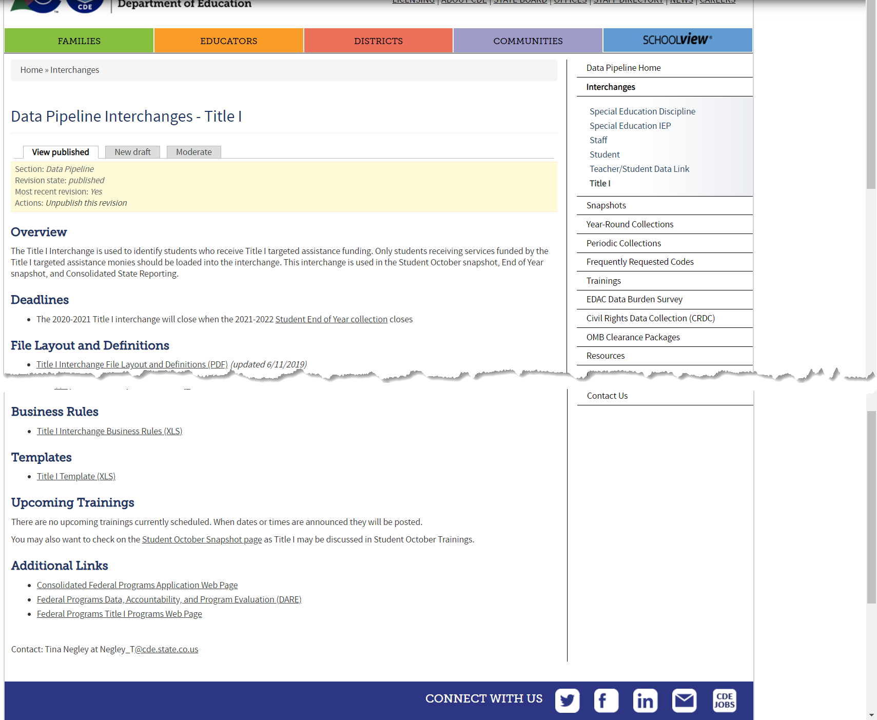
Title I Interchange Website
Title I Interchange Webpage
File Layout
Business Rules
Template for Data Pipeline Upload
Additional Resources

Slide 8
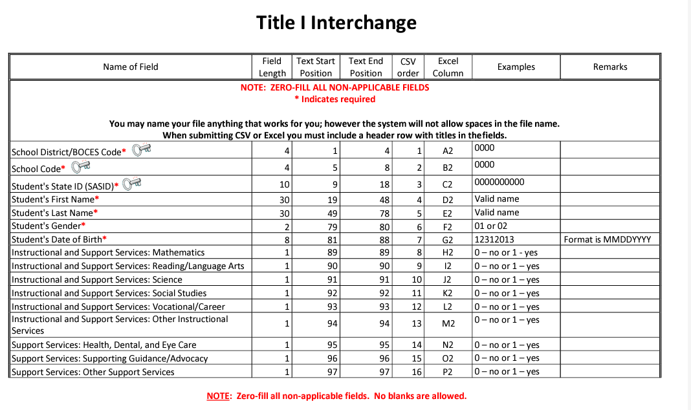
Title I Interchange File Layout
Purpose Statement, Dependencies, Record Expectation
List of Data Elements, followed by definitions below
Zero-fill all non-applicable fields (no blanks allowed)
Typically, an Excel (xlsx, csv) format
Targeted Assistance Schools are required to upload a Title I Interchange File. Failure to upload will result in OC67 error in Student October.

Slide 9
Please contact the Title I Interchange Lead or the Student Interchange Lead for more information!

