Slide 1
Special Education End of Year
Lindsey Heitman

Slide 2
Special Education End of Year Timeline
2023-2024 Special Education EOY Snapshot Timeline
Important to get Participation file up to date and mostly error free before looking into Sped EOY and Sped Discipline Snapshot errors.
May 1, 2024 - SPED EOY Snapshot official open
June 27, 2024 – IEP Interchange files error-free
August 29, 2024 - All Exception requests submitted to CDE
September 5, 2024 – All errors resolved at snapshot/interchange
September 5 -13, 2024 -Initial Report Review
September 16 - 20, 2024 – Resolving duplicates
September 20 - 27, 2024 – Final Report Review
September 27, 2024 - Final approval in Data Pipeline and reports uploaded to DMS
Special Education EOY – Lindsey Heitman
SpedEndofYear@cde.state.co.us

Slide 3
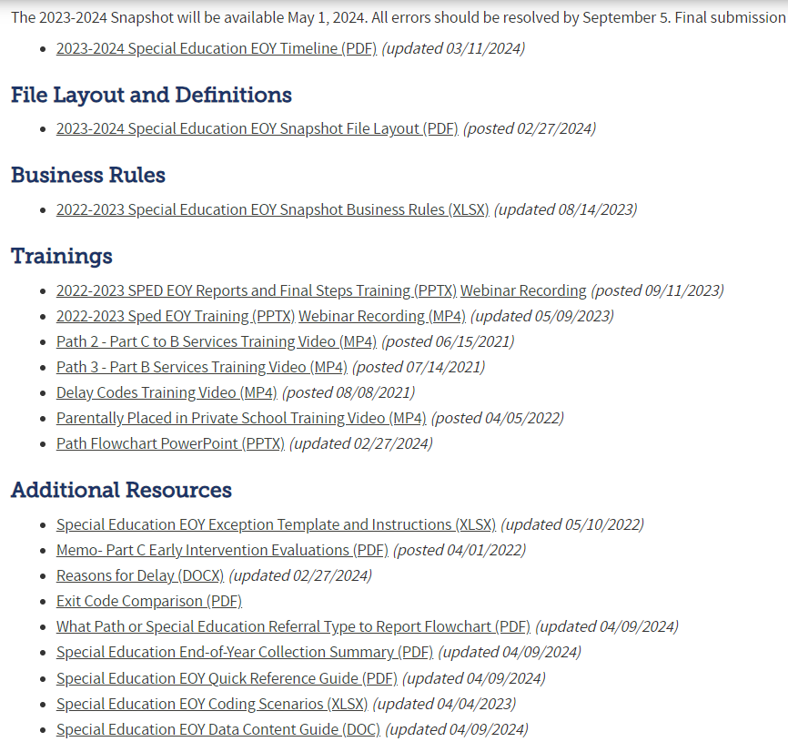
Special Education EOY Snapshot Webpage Resources
Timeline
Snapshot File Layout
Errors/Business Rules
Trainings - Overview of Paths, Delay Codes, etc.
Exception Template
Reasons for Delay – share w/ your internal staff
Path Flowchart
Sped EOY Data Content Guide
Special Education EOY – Lindsey Heitman
SpedEndofYear@cde.state.co.us

Slide 4
Special Education EOY: Reporting Tips
Be sure you are capturing ALL exits from Special Education that occur between 7/1/23 – 6/30/24
If you are working on a manual file, be sure to periodically compare your exits with your SIS up until the final submission in September
Check in with your Special Education staff on any IEP/initial referral information they may need to update or record before they leave for the summer
Enrich Users - Check collection parameters under collection settings to be sure it shows the full collection period of 7/01/23 – 6/30/2024
Wait and report the spring initial referrals that will start school/services in August 2024 in the 24-25 Sped EOY (do not report this year and next year too)
In Enrich – be sure ‘Actual Start Date of Services’ reflects the first day of school in August 2024
An August 2024 start date should automatically “withhold” the record from your 23-24 SPED EOY and report it next year
Special Education EOY – Lindsey Heitman
SpedEndofYear@cde.state.co.us

Slide 5
Special Education EOY: How to Code Student that DNQ/ Staffed Out of Special Education
Primary Disability | School Code | Sped Program Code | Entry Grade Level | District Of Attendance | Pupil Attendance Info
08 | 7500 | 0000 | 050 | 0030 | 01
Sped Funding Status | Educational Environment | Sped Hours Per Week | School Hours Per Week | Extended Year Services | Start Date Of Sped | End Date Of Sped | Reason Exited Sped | Sped Referral Type | Sped Eligibility And Services
50 | 209 | 0036 | 3209 | 0 | 07012023 | 11162023 | 09 | 06 | 02
Student came into school year already in Special Education, had reevaluation during the school year and did not qualify
Special Education Referral Type= 06
Sped Eligibility and Services = 02
Start Date of Sped = beginning of school year/reporting year 07/01/2023
End Date of Sped = date exited 11/16/2023
Report the Primary Disability and Sped Hours
Vendor systems tend to remove Primary Disability, Sped Hours, and switch Eligibility and Services to 04 ( Not Eligible)
Please report student as of their last date of receiving services
SpedEndofYear@cde.state.co.us
Special Education EOY – Lindsey Heitman

Slide 6
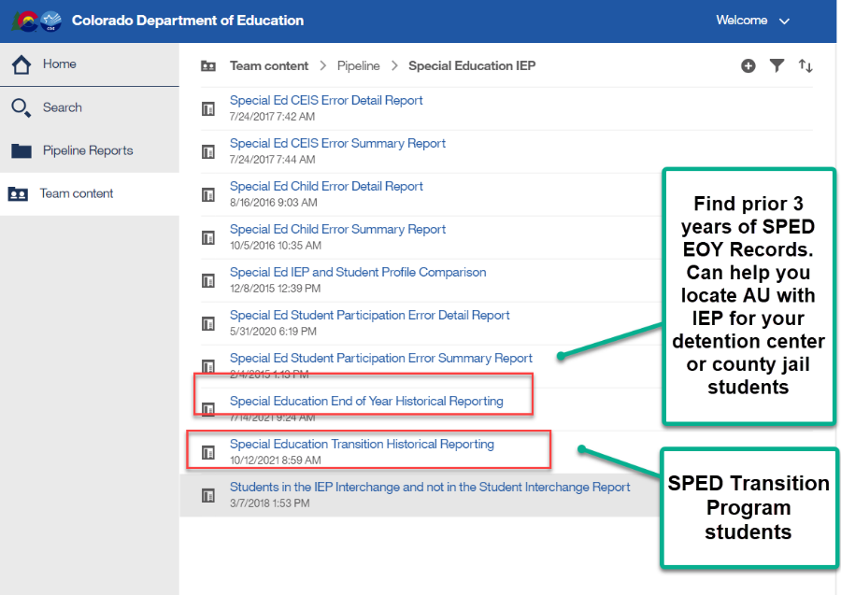
Special Education EOY Sped Transition students, Detention Center students, county jail students
Sped Transition Program Students – warnings or errors for these type of records
SY309: If student is currently in or will begin a Sped transition program next year, the Sped EOY Basis of Exit should be zero-filled.
Check to be sure you are not exiting your students moving to a transition program.
They may be reported with exit code 90 in Student EOY snapshot if they met grad requirements, but should not be exited in Sped EOY until they exit the program or age out
Reference SPED transition Cognos report to see transition students based on district reporting
SY315: Student is reported as completing transition in the Student EOY Snapshot with a School Exit Type of 28, indicating they met graduation requirements in a prior year. Please report a 90 in the Sped Basis of Exit field.
Must have ‘SPE User’ role to access these reports
Records will have a Retention code of 3 and exit code in Student EOY
Sped Transition students who have completed transition and met graduation requirements!

Slide 7
Reasons for Delay Codes
The reasons for delay codes are codes reported when an event happened late or did not happen at all during the initial evaluation process. They explain why an event happened beyond the expected timeline or why the event did not happen at all.
Path 2 Part C to Part B Transition (60-day timeline and 3rd birthday timeline):
Path 2 – Reason for Delay in Completing the Evaluation C to B
Required when the C to B evaluation is completed more than 60 days from the date of parental consent OR if the evaluation was not completed
Path 2 - Reason for Delay in Initial Eligibility Meeting C to B
Required when the initial eligibility meeting for a C to B transition child is held on or after their third birthday or if the initial eligibility meeting was not completed
Path 2 – Reason for Delay in IEP Implementation C to B
Required when the IEP for a C to B transition child is implemented after their third birthday or if the IEP is not implemented at all
Path 3 Part B Initial Evaluation (60-day timeline and 90-day timeline):
Path 3 – Reason for Delay in Completing the Evaluation Part B
Required when the initial Part B evaluation is completed more than 60 days from the date of parental consent OR if the evaluation was not completed
Path 3 – Reason for Delay in Finalizing the Initial IEP Part B
Required when the initial IEP is finalized more than 90 days after parental consent to evaluate was received.
Path 3 – Reason the IEP was Never Implemented Part B
Required when an initial Part B IEP is never implemented for a student who was found eligible and had an IEP finalized.

Slide 8
Reasons for Delay Affect Your AU Indicator 11 and 12 Percentages
Reason for Delay in IEP Implementation C to B
01 - Parent refused to provide consent or revoked consent during the process or child is never enrolled, process ended
03 - Deceased, process ended
41 - Parent chose to extend Part C Services
45 - Parent repeatedly failed or refused to: produce child; give consent, respond to meeting requests; attend scheduled meetings. Includes delays due to illness and any requested meeting delays from parent. Process was delayed but did not end.
46 - Student moved into district after process initiated in another district; current district is making sufficient progress to ensure a prompt completion of the initial referral process by the date which parent and the current district agree.
47 - Student moved out of district after the initial referral process initiated, process ended
49 - Child's 3rd birthday occurred over the summer, parents and district determined the date the IEP services will begin
56 - No educational disability suspected. Prior Written Notice issued.
58 - NOT VALID - Additional evaluations or special evaluations needed
59 - NOT VALID - Other _________________ (provide explanation in exception request)
60 - NOT VALID - Staff missed the timeline
Not all delay codes are available for each delay reason field
Delay code 41 may only be used on students with third birthdays between May – August and parents are choosing to extend Part C services until school starts in the fall when the IEP services begin
Delay code 45 may be reported for parent related delays, including when they wait until the fall to enroll child (report 41 if it fits)
Delay codes that indicate NOT VALID will lower your indicator 11 and 12 percentages
Delay codes 01, 03, 47, 56 indicate process stopped altogether
Delay codes 41, 43, 45, 46, 49, 58, 59, 60 indicate process was delayed but did not stop
Reason the IEP was Never Implemented Part B
01 - Parent refused to provide consent or revoked consent during the process or child is never enrolled, process ended (Path 3 use only if consent revoked or child never enrolled)
03 - Deceased, process ended
47 - Student moved out of district after the initial referral process initiated, process ended
59 - NOT VALID - Other _________________ (provide explanation in exception request)

Slide 9
Medically Necessary Services: Required by all AUs in 23-24
Access to Students for Medically Necessary Services
NEW reporting requirement started in 2023-2024 school year – House Bill 22-1260
AUs must report # of requests for access to students for medically necessary services
Beginning 7/01/2024, the AU must report to CDE the number of requests during the 23-24 school year for access to a student by a private healthcare specialist and whether the access was authorized or denied.
Starting in January 2025, CDE must make this information available online.
Each AU must report to CDE the total counts for the following (no student level information is needed):
# of requests for access to a student for medically necessary services
# of those requests authorized
# of those requests denied
These counts will be collected in a new input screen within the Data Pipeline under the IEP Interchange. ‘SPE User Role’ access. (see next slide for steps)
AU will not be able to approve final SpEd EOY Snapshot until counts have been entered and saved in the Data Pipeline
Counts will not be included in your SpEd EOY Snapshot though
Special Education End of Year – Lindsey Heitman
SpedEndofYear@cde.state.co.us

Slide 10
Medically Necessary Services: Steps to Submit Counts to Data Pipeline
Notes:
Counts must reflect all districts within AU from July 1, 2023 – June 30, 2024
Must be completed by the time Sped EOY is approved – by 9/27/24
AUs are able to modify counts until their final Sped EOY is locked/approved
pop up message will ensure each box is populated with a number
pop up message will ensure total # box (1st box) is the sum of those authorized and denied
Steps
1. Click Special Education tab
2. Click Medically Necessary Services tab
3. Select School Year/AU and click Search button
4. Enter a number in all 3 boxes
5. Click Save button
# Requests Authorized
# Requests Denied
Total # of Requests
Special Education End of Year – Lindsey Heitman
SpedEndofYear@cde.state.co.us

Slide 11
Enrich System Processes

Slide 12
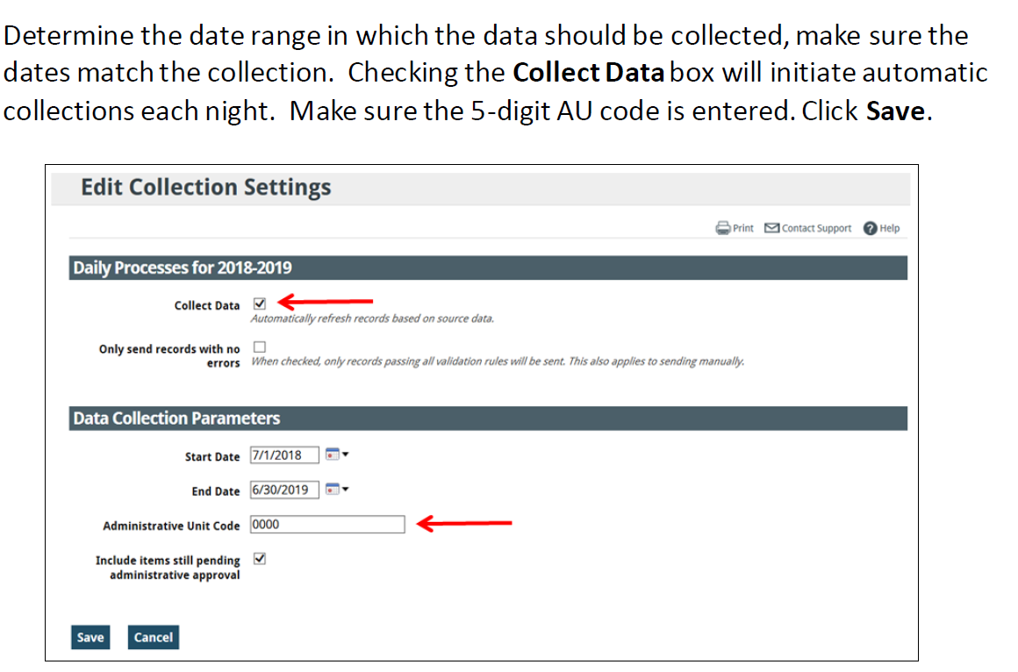
Enrich Collection Settings and 24-25 Rollover
Special Education EOY – Lindsey Heitman
SpedEndofYear@cde.state.co.us

Slide 13
Special Education End of Year - Initial referral record -parents request to wait and start services in the fall
Remember:
Path 2 or 3 referral records should be reported in the school year in which the IEP was implemented.
Implemented means the services have begun and that date should match the Start Date of Services/Date of Entry to Sped.
If you are reporting a ‘Date IEP Implemented’ on an initial referral record, that would indicate services are already being received by the student
How to report an initial evaluation that wrapped up in the spring, student was found eligible, and parents request to wait and start services in the fall when child begins preschool?
Please report the initial referral record next year, school year – 24-25 - if you expect student to start services in the fall.
Nothing should be reported for this student in the 23-24 Sped EOY – they should not have a record in your Child/Participation files this year
The 24-25 record will contain the initial referral code of 02 or 03 and all the evaluation dates that occurred in the spring of 2024, as well as any applicable delay codes.
In Enrich under student’s Program History tab:
Do an Admin Edit and populate ‘Actual Start Date of Services’ with the expected first day of school for the 24-25 school year. Ex: 08/19/2024
If record is a C to B, you will likely be prompted for a delay code (45, 41, or 49 are all codes that might fit= all valid delay reasons)
Next you must recollect the data
After recollecting, the system should automatically withhold the record from the 23-24 EOY files and hold it for the 24-25 EOY files instead.
Once evaluation process has completed and you are certain the parent has decided to not enroll their child or start services, please go ahead and report that record in 23-24 with the delay code ’01’, which indicates child never enrolled

Slide 14
Enrich Process for student who didn’t really start services but have a finalized IEP
Initial Referral record – eval process began in the spring of 2023 and you expected child to start services in the fall of 2023 and adjusted Actual Start Date of Services last year accordingly.
However, student did not end up starting services/school last fall as expected
Still need to report the initial evaluation to CDE with Sped Referral codes 02 or 03
Record will have a Date of Entry to Sped and a Date IEP Implemented (Part B or C to B) of 08/xx/2023 appearing as though they are receiving services from your AU in Enrich
Will cause errors in Sped EOY
End student’s program in Enrich under End Program tab.
Select option 01 Parent Refused Consent or Revoked Consent or Never Enrolled
Recollect data and adjust the following fields in the Enrich Override Screen for the student’s record:
Zero-fill Start Date of Sped and End Date of Sped
Zero-fill Reason Exited Sped
Zero-fill Date IEP Implemented Part B or Date IEP Implemented C to B (depending on which path record falls in)
Adjust IEP Implementation Delay or Reason_IEP_Not_Implemented to 01-never enrolled
Special Education EOY – Lindsey Heitman
SpedEndofYear@cde.state.co.us

Slide 15
Contact Information
Thank you for participating today!
Data Services Contact:
Lindsey Heitman – SpedEndofYear@cde.state.co.us
heitman_l@cde.state.co.us 303-866-5759
Collection manager
Data Pipeline submission
Please include in emails:
AU #
error code # (if applicable)
any school code #’s referenced

