Slide 1
Special Education End-of-Year
Collection Training #3 2024-2025
May 28, 2025
Lindsey Heitman
SpedEndofYear@cde.state.co.us

Slide 2
Welcome and Contact Information
  Welcome and thank you for joining the training!
Data Services Contact:
Lindsey Heitman – SpedEndofYear@cde.state.co.us
  heitman_l@cde.state.co.us 720-456-2033
  Collection manager
  Data Pipeline submission
Business Unit – Exceptional Student Services Unit Contacts:
Orla Bolger – bolger_o@cde.state.co.us ESSU Contact – data content clarification/data requests
Josh Fails – fails_J@cde.state.co.us ESSU Contact – Data Management System/questions on uploading final reports to the DMS
Please include in emails:
  AU #
  error code # (if applicable)
  any school code #’s referenced

Slide 3
Special Education End of Year:
Timeline and Training
  Upcoming Training
  Special Education Discipline Annual Snapshot Training
    Tuesday May 6th 10:00 – 11:30
      Overview of the snapshot data required and process in Data Pipeline
  Upcoming Training
  Special Education Discipline Annual Snapshot Training
    Tuesday May 6th 10:00 – 11:30
      Overview of the snapshot data required and process in Data Pipeline
2024-2025 Special Education EOY Snapshot Timeline
  Posted Trainings
  Tuesday May 13th
    Purpose, content, IEP Interchange, SPED EOY Snapshot, Who to report
  Tuesday May 20th
    Exceptions, Medically Nec Services, Path data (initial referrals and delay codes)
    Special Education EOY Snapshot webpage
  Upcoming Trainings
  Wednesday May 28th
    Coding Initial Referrals, Data Pipeline Process
  Thursday June 5 - 1:00 – 2:00
    Exit coding scenarios
    Join the meeting now
May 1, 2025 - SPED EOY Snapshot official open
June 26, 2025 – IEP Interchange files error-free
September 4, 2025 - All Exception requests submitted to CDE
September 11, 2025 – All errors resolved at snapshot/interchange
September 12 -19, 2025 -Initial Report Review
September 22 - 26, 2025 – Resolving duplicates
September 29 – October 1, 2025 – Final Report Review
October 3, 2025 - Final submission due to CDE

Slide 4
Agenda
Participation Records and Coding DNQ and Initial Referrals – slides 6 - 23
Data Pipeline Process –slides 24-46
Cognos Reports Overview – slides 47-52

Slide 5
Reminder:
Sped EOY Collects Exits from Special Education and
Initial Referrals to Special Education
An exit for Sped EOY purposes is a student who has exited from Special Education services in your AU
Student records may have different Exit Codes in regular EOY
A student record that does not ever begin receiving Special Education Part B Services (i.e. Date of Entry to Special Education is zero-filled) should not contain a Date of Exit or Basis of Exit.
Students (initial referral records) should not be reported with a Date of Entry to SPED, Date of Exit from SPED, or a Sped Basis of Exit if:
  They didn’t start receiving Special Education services
  An evaluation was never completed.
  He/she was evaluated and found not eligible.
  He/she was evaluated and determined eligible, but services were never initiated.

Slide 6
Coding Staffed Out and Initial Referral Records

Slide 7
How to Code Student that DNQ/
Staffed Out of Special Education
Primary Disability | School Code | Sped Program Code | Entry Grade Level | District Of Attendance | Pupil Attendance Info
08 | 7500 | 0000 | 050 | 0030 | 01
Sped Funding Status | Educational Environment | Sped Hours Per Week | School Hours Per Week | Extended Year Services | Start Date Of Sped | End Date Of Sped | Reason Exited Sped | Sped Referral Type | Sped Eligibility And Services
50 | 209 | 0046 | 3209 | 0 | 07012024 | 11162024 | 09 | 06 | 02
Student came into school year in Special Education, had reevaluation during the school year and did not qualify
Special Education Referral Type= 06
Sped Eligibility and Services = 02
Start Date of Sped = beginning of school year/reporting year 07/01/2024
End Date of Sped = date exited 11/16/2024
Report the Primary Disability and Sped Hours
Do not remove the Primary Disability, Sped Hours, or Eligibility and Services=02 (Eligible) on a record that staffed out during the year
The key is to remember to report student as of their last date of receiving services

Slide 8
The Special Education Referral Type field in the Participation File indicates which path should be filled out.
Code | Special Education or Part C Referral Type
02 | Part C to Part B Transition (Path 2 Only) – Use this code for children 2.5 but not 4 years old (at the time of the referral) who were referred for a Part B Evaluation (from a Part C Agency), whether or not they were determined to be eligible for Part B Services. INITIAL REFERRAL
03 | Part B Services (Path 3 Only) – Use this code for all students who are referred for a Part B Evaluation (NOT from a Part C Agency), whether or not they were determined to be eligible for Part B Services. INITIAL REFERRAL
06 | No Initial Referral During Current Reporting Period – Use this code for all students who began receiving services prior to July 1 of the current reporting period or for students who received EIS only.
07 | Part C to Part B Transition & Part B Evaluation (Paths 2 & 3) – Use this code for students who received Part C services and were referred for a Part B evaluation (from a Part C Agency), and were either determined not eligible for Part B services or began receiving Part B services that were discontinued AND were later, in the same reporting period, referred for a Part B evaluation. INITIAL REFERRAL
FIRST STEP when clearing errors is to be sure the ‘Special Education Referral Type’ is correct.
  Determine whether the record has an initial referral in the last year
  If so, determine whether record should be reported in path 2 or path 3 (or path 7) and report the dates and delay codes as applicable in the year the IEP was implemented/services started
Many of the other edits are dependent on this field being correct.
Most records are reported with Sped Referral Type 06 (came into school year already in Sped) and zero-filled path 2 and 3 date fields.

Slide 9
Data Fields in the 2 Paths – Participation File
Path 1 Data Fields (5):
Date Referred for Part C Evaluation
Date of Parental Consent to Evaluate Part C
Date Evaluation Completed Part C
Reason for Delay in Completing the Evaluation Part C
Eligibility and Services Path 1
Sped Referral Type = 02 - Path 2 Data Fields (10):
Date Child is Found Eligible for Part C Services
Date of Referral to Administrative Unit from the Local Community Centered Board
Date of Parental Consent to Evaluate C to B
Date Evaluation Completed C to B
Reason for Delay in Completing the Evaluation C to B
Date of Initial Eligibility Meeting
Reason for Delay in Initial Eligibility Meeting C to B
Date IEP was Implemented C to B
Reason for Delay in IEP Implementation C to B
Eligibility and Services Path 2
Sped Referral Type = 03 - Path 3 Data Fields (9):
Date of Parental Consent to Evaluate Part B
Date Evaluation Completed Part B
Reason for Delay in Completing the Evaluation Part B
Date of Initial Eligibility Meeting Part B
Date Initial IEP was Finalized Part B
Reason for Delay in Finalizing the Initial IEP Part B
Date IEP was Implemented Part B
Reason the IEP was Never Implemented Part B
Eligibility and Services Path 3

Slide 10
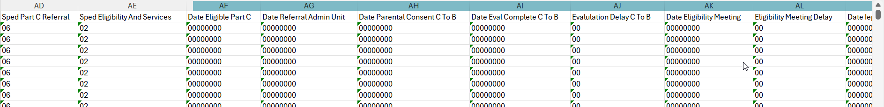
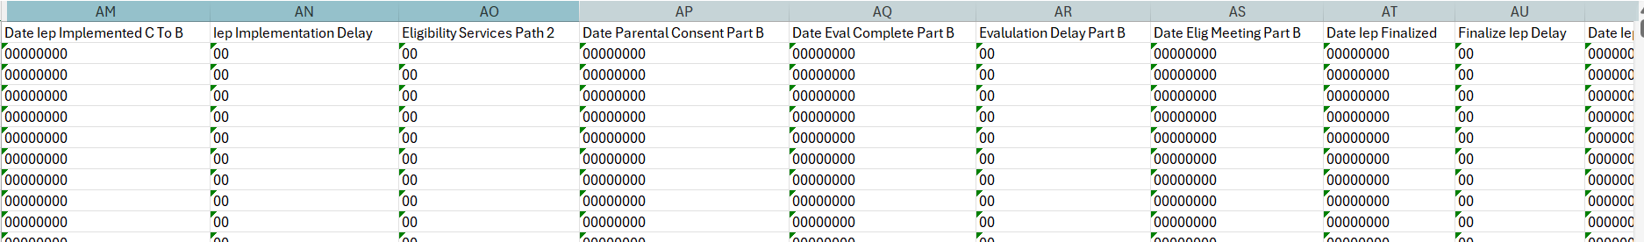
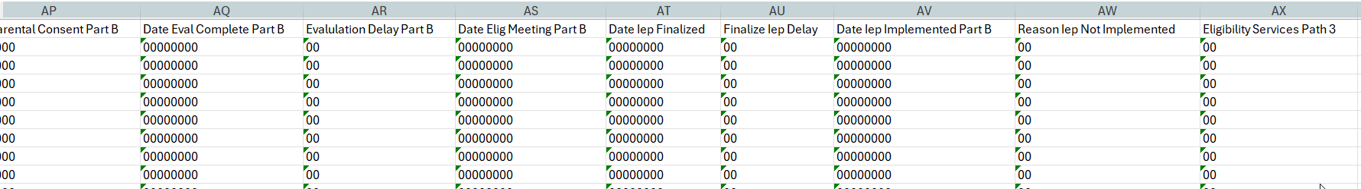
Participation File –
Path 2 fields columns AF – AO
Path 3 fields columns AP – AX

Slide 11
Reasons for Delay Code Data Fields
6 fields – 3 in each path
The reasons for delay codes are codes reported when an event happened late or did not happen at all during the initial evaluation process. They explain why an event happened beyond the expected timeline or why the event did not happen at all.
Path 2 Part C to Part B Transition (60-day timeline and 3rd birthday timeline):
Path 2 – Reason for Delay in Completing the Evaluation C to B
  Required when the C to B evaluation is completed more than 60 days from the date of parental consent OR if the evaluation was not completed
Path 2 - Reason for Delay in Initial Eligibility Meeting C to B
  Required when the initial eligibility meeting for a C to B transition child is held on or after their third birthday or if the initial eligibility meeting was not completed
Path 2 – Reason for Delay in IEP Implementation C to B
  Required when the IEP for a C to B transition child is implemented after their third birthday or if the IEP is not implemented at all
Path 3 Part B Initial Evaluation (60-day timeline and 90-day timeline):
Path 3 – Reason for Delay in Completing the Evaluation Part B
  Required when the initial Part B evaluation is completed more than 60 days from the date of parental consent OR if the evaluation was not completed
Path 3 – Reason for Delay in Finalizing the Initial IEP Part B
  Required when the initial IEP is finalized more than 90 days after parental consent to evaluate was received.
Path 3 – Reason the IEP was Never Implemented Part B
  Required when an initial Part B IEP is never implemented for a student who was found eligible and had an IEP finalized.

Slide 12
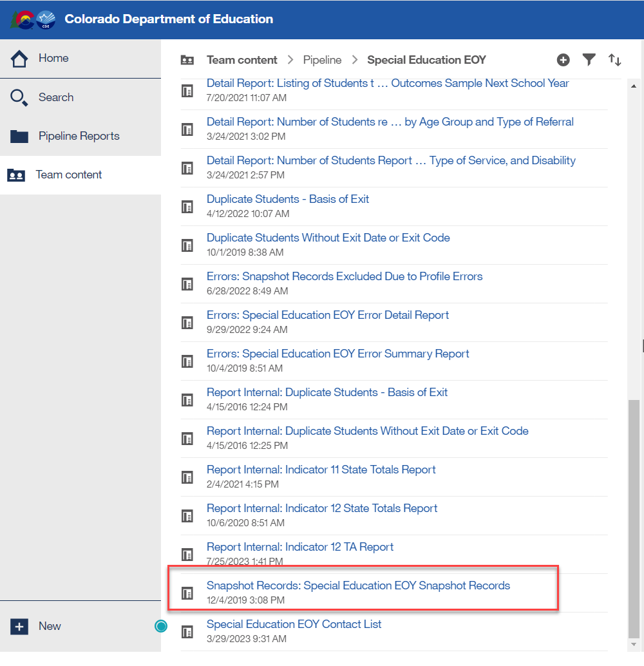
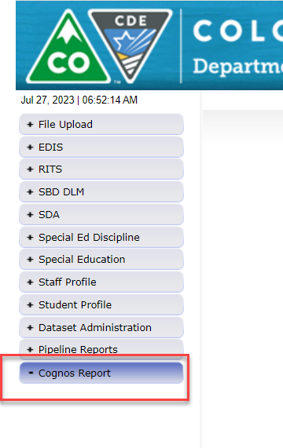
Special Education EOY
Use Prior Year Snapshot Records to Inform Coding
Reporting Tip:
Download your Sped EOY Snapshot records from last year (23-24) to help you determine how to code records for this year
Export report to Excel and sort by various data fields: Sped Referral Codes, Eligibility and Services codes, Exit Types
This will help you see what fields are required in a particular coding scenario

Slide 13
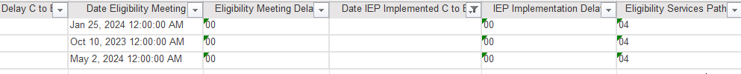
SPED EOY Snapshot Records Report: prior collection year 23-24 – path 2 record evaluated and found not eligible
Use this report to see what fields were reported for different evaluation scenarios:
  Example #1 : C to B path 2 child evaluated and found not eligible for special education Birth Date = 02/01/2021
  Example record row #1:
  Special Education Referral Type = 02
  Sped Eligibility and Services = 04
  Path 2 Date Found Eligible Part C Services= 01/17/2023 - date that comes from the Part C/early intervention services team
  Path 2 Date of Referral to AU from CCB = 09/14/2023
  Path 2 Date of Parental Consent to Evaluate C to B = 12/07/2023
  Path 2 Date Evaluation Completed C to B = 01/25/2024
  Path 2 Reason for Delay in Completing the Evaluation C to B = 00
  Path 2 Date of Initial Eligibility Meeting C to B = 01/25/2024
  Path 2 Reason for Delay in Initial Eligibility Meeting C to B = 00
  Path 2 Date IEP Implemented C to B = 000000
  Path 2 Reason for Delay in IEP Implementation C to B = 00
  Path 2 Eligibility and Services = 04
All Path 3 data fields should be zero-filled!

Slide 14
SPED EOY Snapshot Records Report: prior collection year 23-24 – path 2 record evaluated and found eligible with delays
Use this report to see what fields were reported for different evaluation scenarios:
  Example #2 : C to B path 2 child evaluated and found eligible with delays in both the eligibility meeting and IEP Implementation
  Birth date = 07/07/2020
All path 3 data fields should be zero-filled
  Example record row #1:
  Special Education Referral Type = 02
  Sped Eligibility and Services = 02
  Path 2 Date Found Eligible Part C Services= 05/05/2022 –
  Path 2 Date of Referral to AU from CCB = 03/08/2023
  Path 2 Date of Parental Consent to Evaluate C to B = 07/13/2023
  Path 2 Date Evaluation Completed C to B = 08/17/2023
  Path 2 Reason for Delay in Completing the Evaluation C to B = 00
  Path 2 Date of Initial Eligibility Meeting C to B = 08/17/2023
  Path 2 Reason for Delay in Initial Eligibility Meeting C to B = 45
  Path 2 Date IEP Implemented C to B = 08/21/2023
  Path 2 Reason for Delay in IEP Implementation C to B = 45
  Path 2 Eligibility and Services = 02
Path 3 Date of Parental Consent to Evaluate Part B = 00000000
Path 3 Date Evaluation Completed Part B = 00000000
Path 3 Reason for Delay in Completing the Evaluation Part B =00
Path 3 Date of Initial Eligibility Meeting Part B = 00000000
Path 3 Date Initial IEP was Finalized Part B = 00000000
Path 3 Reason for Delay in Finalizing the Initial IEP Part B = 00
Path 3 Date IEP was Implemented Part B = 00000000
Path 3 Reason the IEP was Never Implemented Part B = 00
Path 3 Eligibility and Services Path 3 = 00

Slide 15
SPED EOY Snapshot Records Report: prior collection year 23-24 – path 3 record evaluated and found eligible with a delay in evaluation
Use this report to see what fields were reported for different evaluation scenarios:
  Example : path 3 student evaluated and found eligible for special education with a delay in evaluation
  Example record row #1:
  Special Education Referral Type = 03
  Sped Eligibility and Services = 02
  Path 2 Date Found Eligible Part C Services= 00000000
  Path 2 Date of Referral to AU from CCB = 00000000
  Path 2 Date of Parental Consent to Evaluate C to B = 00000000
  Path 2 Date Evaluation Completed C to B = 00000000
  Path 2 Reason for Delay in Completing the Evaluation C to B = 00
  Path 2 Date of Initial Eligibility Meeting C to B = 00000000
  Path 2 Reason for Delay in Initial Eligibility Meeting C to B = 00
  Path 2 Date IEP Implemented C to B = 000000
  Path 2 Reason for Delay in IEP Implementation C to B = 00
  Path 2 Eligibility and Services = 00
Path 3 Date of Parental Consent to Evaluate Part B = 08/08/2023
Path 3 Date Evaluation Completed Part B = 10/19/2023
Path 3 Reason for Delay in Completing the Evaluation Part B = 58 (Not Valid – additional evaluations or special evaluation needed)
Path 3 Date of Initial Eligibility Meeting Part B = 10/25/2023
Path 3 Date Initial IEP was Finalized Part B = 10/25/2023
Path 3 Reason for Delay in Finalizing the Initial IEP Part B = 00
Path 3 Date IEP was Implemented Part B = 10/25/2023
Path 3 Reason the IEP was Never Implemented Part B = 00
Path 3 Eligibility and Services Path 3 = 02

Slide 16
Special Education Referral Type 06
Start Date Of Sped | End Date Of Sped | Reason Exited Sped
07012024 | 00000000 | 00
06 | No Initial Referral During Current Reporting Period – Use this code for all students who began receiving services prior to July 1 of the current reporting period or for students who received EIS only.
Path 2 fields:
Sped Referral Type | Sped Eligibility And Services | Date Eligible Part C | Date Referral Admin Unit | Date Parental Consent C To B | Date Eval Complete C To B | Evaluation Delay C To B | Date Eligibility Meeting | Eligibility Meeting Delay | Date IEP Implemented C To B | IEP Implementation Delay | Eligibility & Services Path 2
06 | 02 | 00000000 | 00000000 | 00000000 | 00000000 | 00 | 00000000 | 00 | 00000000 | 00 | 00
Path 3 fields:
Date Parental Consent Part B | Date Eval Complete Part B | Evaluation Delay Part B | Date Elig Meeting Part B | Date IEP Finalized | Finalize IEP Delay | Date IEP Implemented Part B | Reason IEP Not Implemented | Eligibility & Services Path 3
00000000 | 00000000 | 00 | 00000000 | 00000000 | 00 | 00000000 | 00 | 00
Student came into the school year already in Special Education
Special Education Referral = 06
Sped Eligibility and Services = 02
Start Date of Sped = beginning of reporting year (7/1/24, 8/16/24)
All path date and delay fields= zero-filled

Slide 17
Special Education Referral Type 02
Start Date Of Sped | End Date Of Spd | Reason Exited Sped
03122025 | 00000000 | 00
02 | Part C to Part B Transition (Path 2 Only) – Use this code for children 2.5 but not 4 years old (at the time of the referral) who were referred for a Part B Evaluation (from a Part C Agency), whether or not they were determined to be eligible for Part B Services.
Path 2 fields:
Sped Referral Type | Sped Eligibility And Services | Date Eligible Part C | Date Referral Admin Unit | Date Parental Consent C To B | Date Eval Complete C To B | Evaluation Delay C To B | Date Eligibility Meeting | Eligibility Meeting Delay | Date IEP Implemented C To B | IEP Implementation Delay | Eligibility Services Path 2
02 | 02 | 07112024 | 07212024 | 02152025 | 02152025 | 00 | 02152025 | 00 | 03122025 | 00 | 02
Path 3 fields:
Date Parental Consent Part B | Date Eval Complete Part B | Evaluation Delay Part B | Date Elig Meeting Part B | Date Iep Finalized | Finalize Iep Delay | Date IEP Implemented Part B | Reason IEP Not Implemented | Eligibility Services Path 3
00000000 | 00000000 | 00 | 00000000 | 00000000 | 00 | 00000000 | 00 | 00
Student had an initial to referral Special Education, was receiving Part C services at time of referral, found eligible, no delays
Special Education Referral Type= 02
Sped Eligibility and Services = 02
Start Date of Sped = Date IEP Implemented C to B = 03/12/2025
Path 2 date fields reported, path 3 date fields zero-filled

Slide 18
Special Education Referral Type 03
03 | Part B Services (Path 3 Only) – Use this code for all students who are referred for a Part B Evaluation (NOT from a Part C Agency), whether or not they were determined to be eligible for Part B Services.
Start Date Of Sped | End Date Of Spd | Reason Exited Sped
10252024 | 00000000 | 00
Sped Referral Type | Sped Eligibility And Services | Date Eligible Part C | Date Referral Admin Unit | Date Parental Consent C To B | Date Eval Complete C To B | Evaluation Delay C To B | Date Eligibility Meeting | Eligibility Meeting Delay | Date IEP Implemented C To B | IEP Implementation Delay | Eligibility Services Path 2
03 | 02 | 00000000 | 00000000 | 00000000 | 00000000 | 00 | 00000000 | 00 | 00000000 | 00 | 00
Date Parental Consent Part B | Date Eval Complete Part B | Evaluation Delay Part B | Date Elig Meeting Part B | Date Iep Finalized | Finalize Iep Delay | Date IEP Implemented Part B | Reason IEP Not Implemented | Eligibility Services Path 3
10032024 | 10152024 | 00 | 10152024 | 10152024 | 00 | 10252024 | 00 | 02
Student had an initial referral to Special Education, was not receiving Part C services at time of referral, found eligible, no delays
Special Education Referral Type= 03
Sped Eligibility and Services = 02
Start Date of Sped = Date IEP Implemented Part B = 10/25/2024
Path 2 date fields zero-filled, path 3 date fields reported

Slide 19
Special Education Referral Type 07
Start Date Of Sped | End Date Of Spd | Reason Exited Sped
02102025 | 00000000 | 00
07 | Part C to Part B Transition & Part B Evaluation (Paths 2 & 3) – Use this code for students who received Part C services and were referred for a Part B evaluation (from a Part C Agency) and were either determined not eligible for Part B services or began receiving Part B services that were discontinued AND were later, in the same reporting period, referred for a Part B evaluation.
Sped Referral Type | Sped Eligibility And Services | Date Eligible Part C | Date Referral Admin Unit | Date Parental Consent C To B | Date Eval Complete C To B | Evaluation Delay C To B | Date Eligibility Meeting | Eligibility Meeting Delay | Date IEP Implemented C To B | IEP Implementation Delay | Eligibility Services Path 2
07 | 02 | 08152023 | 09272024 | 09272024 | 09272024 | 00 | 09272024 | 00 | 00000000 | 00 | 04
Date Parental Consent Part B | Date Eval Complete Part B | Evaluation Delay Part B | Date Elig Meeting Part B | Date IEP Finalized | Finalize IEP Delay | Date IEP Implemented Part B | Reason IEP Not Implemented | Eligibility Services Path 3
01252025 | 01252025 | 00 | 01252025 | 01252025 | 00 | 02102025 | 00 | 02
Child referred to Path 2 (from path 1) and either determined not eligible or received services for awhile. Then services stopped, then they were referred to Path 3 again in same year.
Special Education Referral Type= 07
Sped Eligibility and Services = 04 – path 2, 02 – path 3
Start Date of Sped = Date IEP Implemented Part B = 02/10/2025
Path 2 date fields reported, path 3 date fields reported

Slide 20
Reporting Initial Evaluations/Referrals
If a record was reported as a Path 2 or Path 3 referral last year, those same path events should not be reported again this year. If an IEP was implemented, the record would be a referral 06 this year.
Remember:
  Only Initial Evaluations need to be reported in one reporting year
  No need to report the reevaluation dates to CDE
  Referrals and any delays affects your indicator percentages
Check for these errors and warnings for repeat referrals reported:
  Error SY262: This record was reported in Path 2 last year. If student is on an IEP as a result of last year's initial evaluation, they should be reported as a Referral 06 this year.
  Warning SY263: This Path 3 student was reported in your Administrative Unit last year as a Path 3 student, please verify whether your current reporting is correct.

Slide 21
Special Education End of Year -
Initial referral record -parents decide to wait and start preschool and services in the fall
Path 2 or 3 referral records should be reported in the school year in which the IEP was implemented.
  Implemented means the services have begun and child is attending school.
    That date should match the Start Date of Services/Date of Entry to Sped.
  If you are reporting a ‘Date IEP Implemented’ on an initial referral record, that would indicate services are already being received by the student
How to report an initial evaluation that wrapped up in the spring or summer, child was found eligible, and parents request to wait and start services in the fall when child begins preschool?
  If you expect services to start in the fall (per parent), please hold and report an initial referral record next year, school year – 25-26
  Nothing should be reported for this student in the 24-25 Sped EOY – they should not have a record in your Child/Participation files this year
  The 25-26 record will contain the Special Education Referral Type code of 02 or 03 and all the evaluation dates that occurred in the spring of 2025, as well as any applicable delay codes for the initial evaluation timeframe.
If Initial evaluation process is completed prior to 6/30/2025 and parent decides to NOT enroll their child or start services in your AU
  please go ahead and report that initial referral record in 24-25 with the delay code ’01’, which indicates child never enrolled

Slide 22
Special Education EOY
Enrich Process for Initials that Start in the Fall
In Enrich under student’s Program History tab:
  Do an Admin Edit and populate ‘Actual Start Date of Services’ with the expected first day of school for the 25-26 school year. Ex: 08/16/2025
    If record is a C to B, you will be prompted for a delay code if the student will have turned 3 by then
      45, 41, or 49 are all codes that might fit= all valid delay reasons
    Next you must recollect the data
    After recollecting, the system should automatically withhold the record from the 24-25 EOY files and hold it for the 25-26 EOY files instead.
    In 25-26 collection year, someone will need to revisit these records and adjust according to the final outcome.
      Ex: Did they really enroll and start services, did they end up not enrolling after all
        Adjustments to the student’s record will be needed in the state reporting Override screen

Slide 23
Special Education EOY:
Common Error Question
Part C services are the early intervention services for the 0-3 years olds. The services end at age 3 and the goal is to transition the child to Part B Special Education services on an IEP by age 3, if they are eligible.
SY281: Date Child is Found Eligible for Part C [path 2] is less than 45 days before or after the 3rd birthday. Only students transitioning from Part C to Part B should be reported in Path 2. Students who are not transitioning from Part C should be reported in Path 3. First, double check whether the "Date Child is Found Eligible for Part C [path 2] is correct on this record. If so, please contact CDE for assistance in determining which Path this record should be reported.
  How to Fix?
  First consult with your Child Find Coordinator to figure out which of the below is the case
    Either adjust the ‘Date Child Found Eligible for Part C’ to an earlier date OR
    Move the record to path 3 (this would be the case if the child hadn’t been receiving Part C/EI services at the time of referral to Part B) OR
    Submit an exception request for SY281 stating the data is correct and child was found eligible for Part C services within 45 days of turning age 3.
      This may be the case if parents choose to extend Part C services until child starts preschool in the fall
*This error triggers on a path 2 data field, but pertains to “path 1” data (Part C/Early Intervention services)

Slide 24
Data Pipeline Process
Data Pipeline Process

Slide 25
Data Pipeline Process Overview
Extract files from SIS/update data files
Upload files under Data File Upload
Check Batch Maintenance screen/wait for confirmation email
Correct data in source system
Review error reports
Create Snapshot – pulls in error free interchange records

Slide 26
Data Pipeline Process Overview – IEP Interchange
Steps can take place throughout the school year
1. Extract Child File and Participation File from SIS and upload files to Data Pipeline
  Enrich system uses web transfer to send both files at once to Data Pipeline (no manual upload necessary in Pipeline)
    Enrich users select ‘Child Count 24-25’ option when working on December Count Snapshot
    Enrich users select ‘EOY 24-25’ option when working on Sped EOY Snapshot
2. Check Batch Maintenance for file upload status and wait for a confirmation email from Data Pipeline system
  The email will show you the number of errors in your upload
    NOTE: If the file didn’t process, the email should show you which row of data contains a formatting “error”
3. Check and resolve interchange errors in each file
  Many of the same IEP Interchange file errors are found in both the Enrich system and the Data Pipeline system
    NOTE: Data Pipeline system is the official error source!
  Ideally data field corrections are made in SIS (Enrich, IC, PowerSchool, or other IEP systems used)
    Extract revised files and upload revised files to Data Pipeline. Repeat steps 1-3 until interchange errors are resolved.

Slide 27
Data Pipeline Process Overview – Snapshot, Report Review, Final Approval
Steps 4 and 5 can take place once snapshot opens
4. Create Snapshot
  It is not required to have ALL interchange errors resolved when you start taking snapshots, but it is recommended. Any records with interchange errors will not be pulled into your snapshot.
5. Check and resolve snapshot errors (review warnings too)
  Changes made in SIS (Enrich or other IEP systems) and files reloaded to interchange
  Go back to steps 1 and 3 – check for new interchange errors before taking a new snapshot
6. Review reports and make any changes necessary
  Go back and redo steps 1 – 4 until all errors are resolved and data is accurate
7. Print reports, sign, and upload signed reports to the Data Management System
8. Approve and finalize snapshot in Data Pipeline

Slide 28
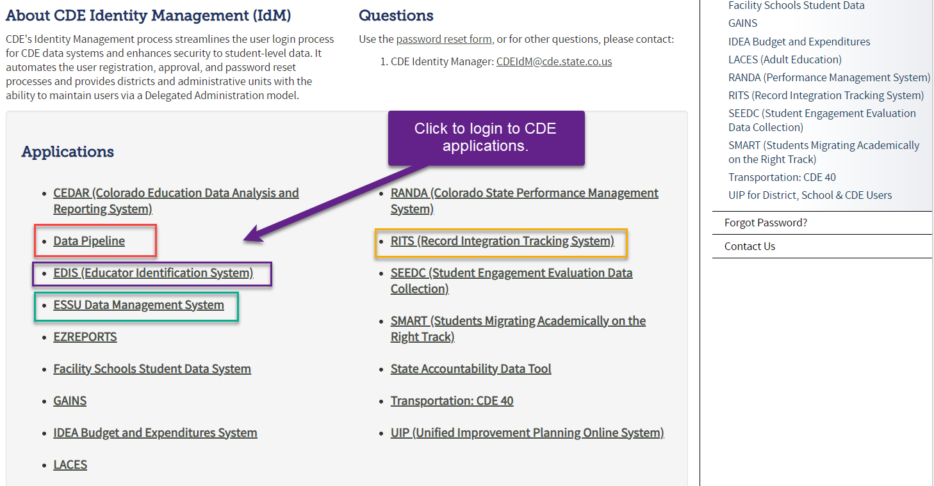
Accessing the Data Pipeline
IdM home page
Bookmark this link to access the CDE systems
Single sign-on used for all CDE applications
Access is based on the roles assigned to your user account

Slide 29
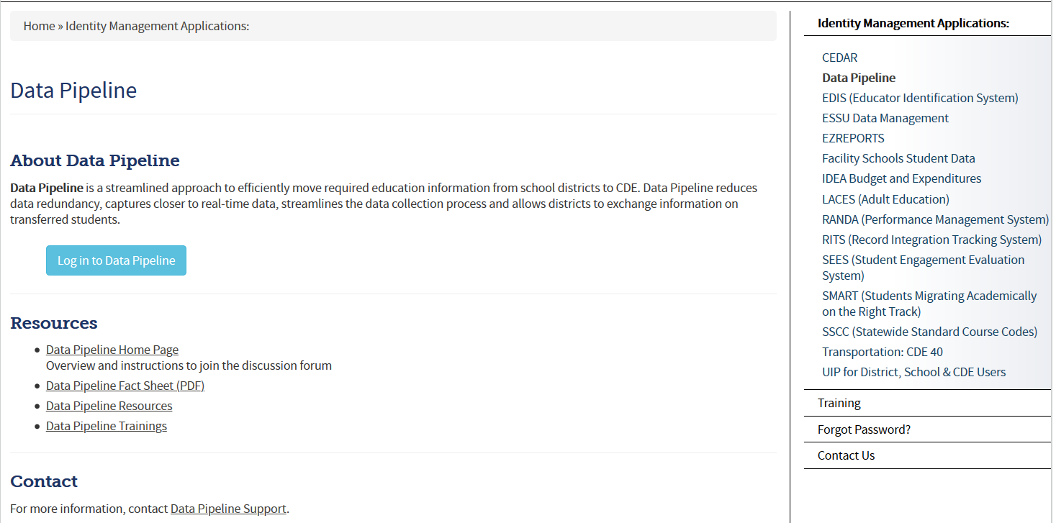
Accessing the Data Pipeline System
Recommended page to bookmark for accessing the system - CDE Identity Management Home Page
From IdM home page click Data Pipeline bullet to get to this screen below.
Next click the blue login button.
*your single sign-on login may be used for all CDE applications listed here that you have access to

Slide 30
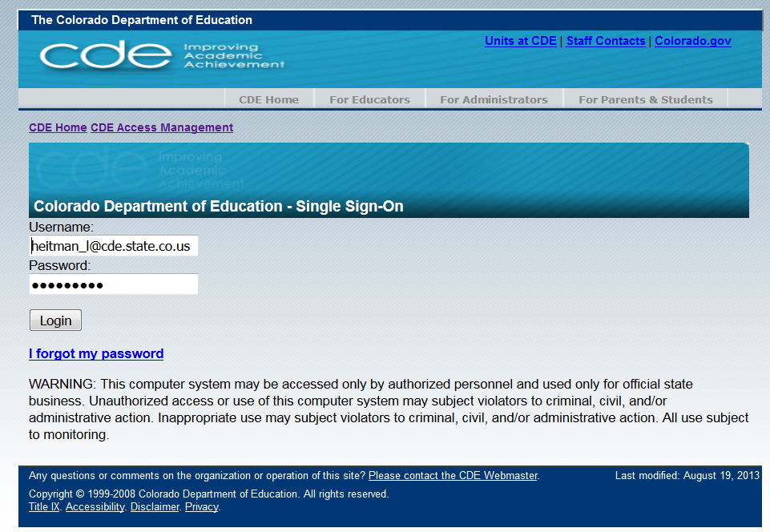
Single Sign On
Username is the email address associated with your IdM account
Password specified by you

Slide 31
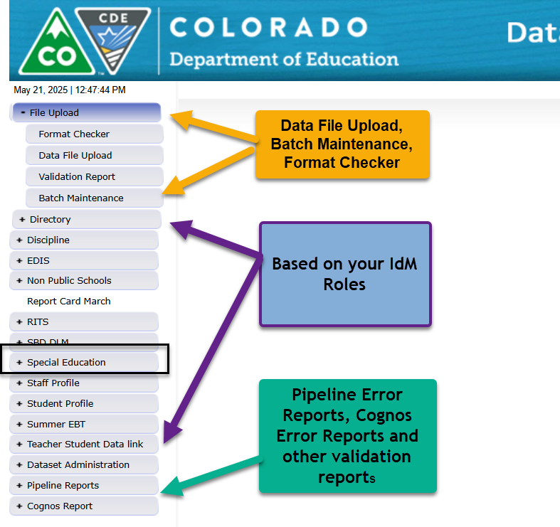
Data Pipeline System Screen
These tabs will vary depending on your LEA and level of access. An AU respondent should always see a Special Education tab.
Many AU respondents will not see a Staff Profile or Student Profile tab.

Slide 32
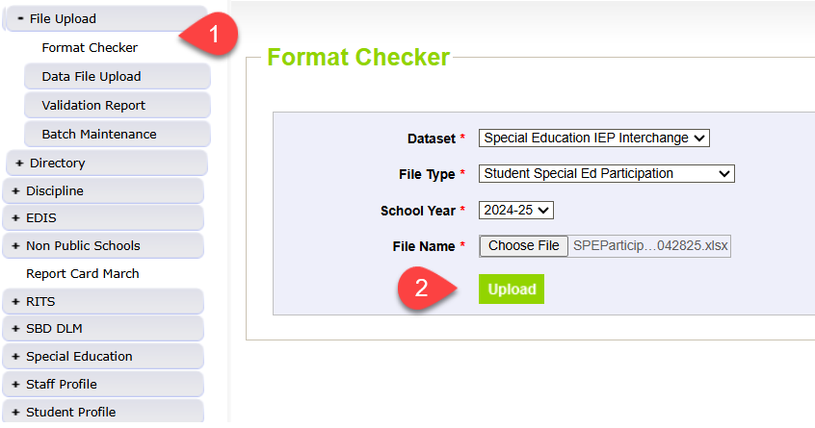
Step 1: Format Checker *optional
Once your file is created, you have the option to run it through the Format Checker to check the file format
The system only checks the first row of data within your file
Only data fields that have too many bytes will error (those with too few will not)
All fields PASS = Ready to upload
Select appropriate Dataset, File Type, School Year, and click ‘Choose File’ to upload your file to the Format Checker
Find the IEP Interchange file templates on the Special Education IEP webpage under the Templates section

Slide 33
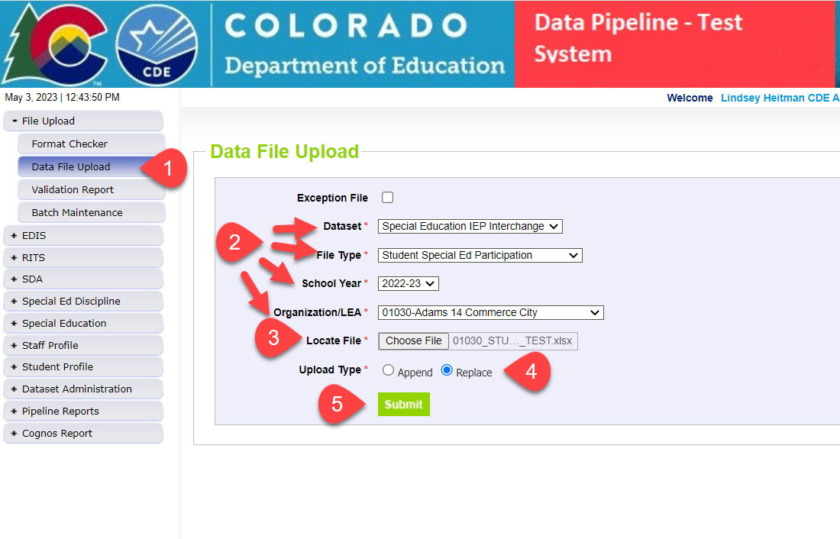
Step 2: Uploading the Child File and Participation File to the IEP Interchange
1. Click on File Upload/Data File Upload
2. Select Dataset, File Type, School Year, and Organization/LEA
3. Click on Choose File to locate your Child file or Participation file
4. Select Replace
5. Click Submit message in green will display across the top indicating file submission has been attempted and a Batch ID will be created
6. Check Batch Maintenance Screen to verify file processed
*Email confirmation will be sent once complete
APPEND – adds to existing data files. Allows for multiple files to be uploaded at one time. Records on all files uploaded that meet the criteria will pull into snapshot.
REPLACE – deletes any prior uploaded data and replaces it with new file. *Most AUs use replace

Slide 34
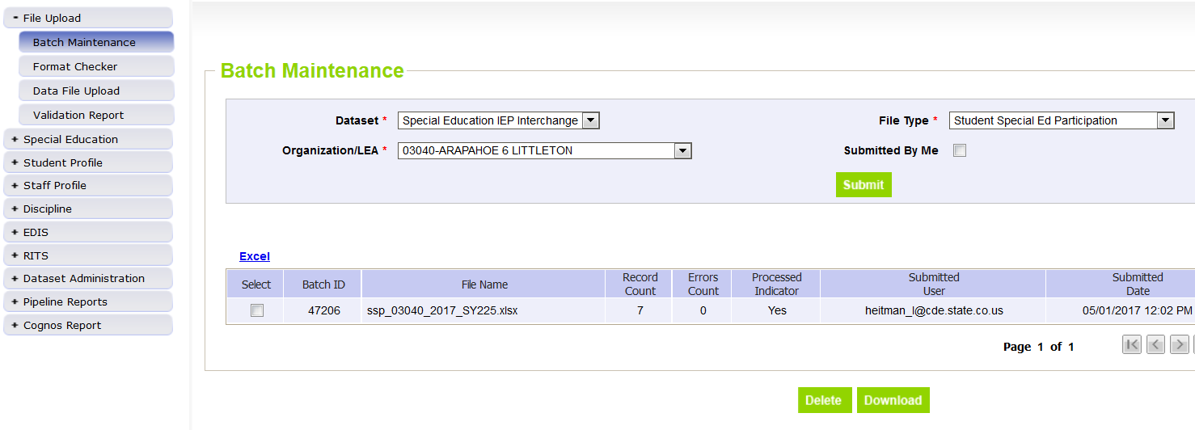
Step 3: Batch Maintenance – Important Step (don’t forget to check this screen after every upload or transfer from Enrich)
For Enrich Users this is the first step within the Data Pipeline system
Check Batch Maintenance to ensure files have processed successfully
Processed Indicator will say “YES”. If blank or “No”, file did not upload
Check Record Count, Error Count, and make sure submitted date and time look accurate
Option to download or delete last uploaded file from this screen. Check the ‘select’ box and click ‘Download’ or ‘Delete’
AFTER EVERY FILE UPLOAD - Verify Record Count, Error Count, Processed Indicator = Yes, Submitted Date!

Slide 35
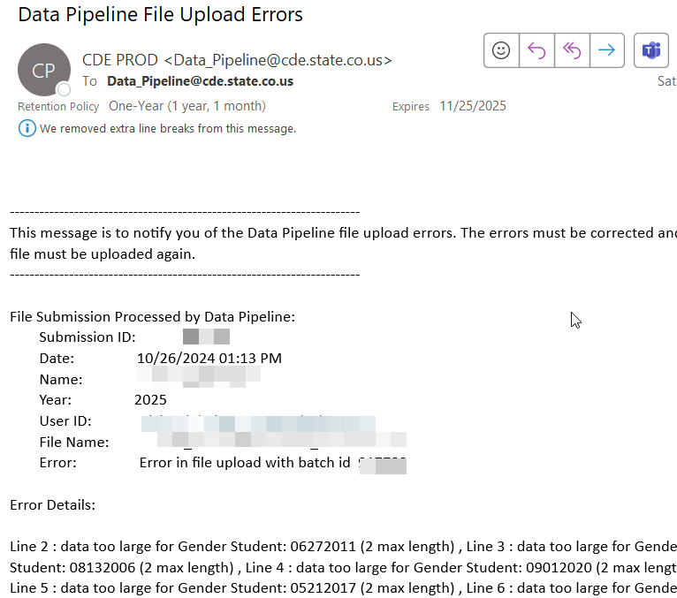
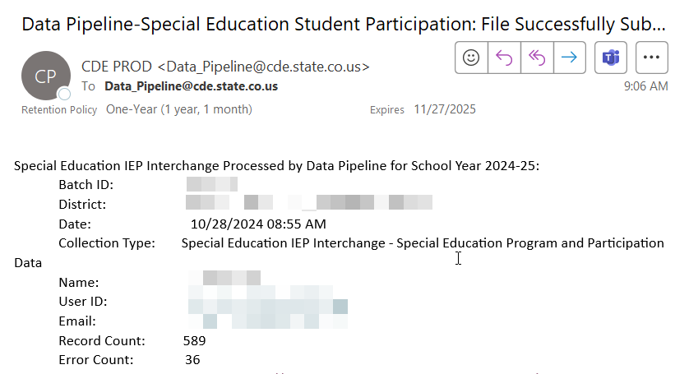
File Upload: Email Confirmation
Check email to ensure file was successfully uploaded – you should receive a confirmation email for each file uploaded or snapshot taken.
Email when file does NOT upload successfully
Email when file uploads successfully

Slide 36
Step 4: Check and Resolve IEP Interchange Errors
Two options for reviewing errors-both have a summary report and a detail report:
  Pipeline Reports - Error Reports/Special Education IEP Interchange
    Faster access and more user friendly
    Only exports the first 1000 errors to Excel
  Cognos Reports – Special Education IEP
    Will show all errors
    Can produce strange error screens - requires you to clear your browser cache periodically
The list of all Special Education Child File and Participation File Business rules (also known as edits, errors and warnings) can be found on the Special Education IEP Interchange webpage under the ‘Business Rules’ section.

Slide 37
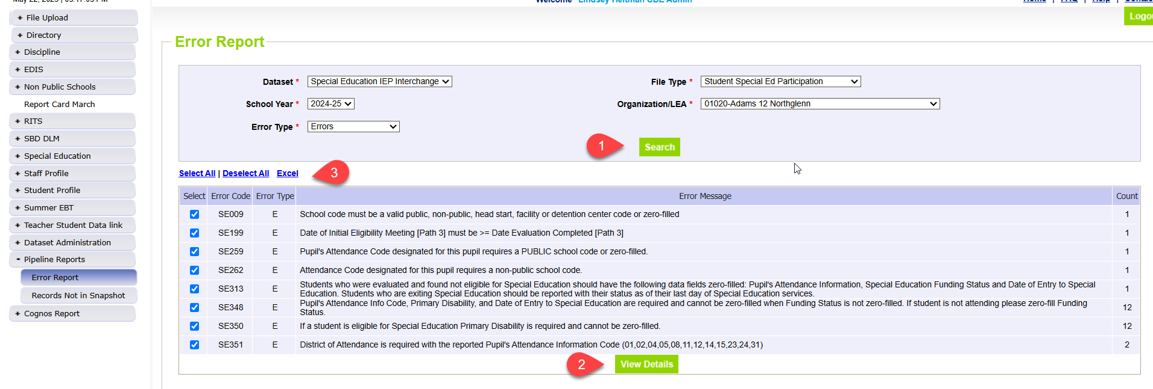
Step 4: Checking IEP Interchange File Errors in Pipeline Error Reports
Click Pipeline Reports → Error Report
Select Dataset: Special Education IEP Interchange
Select File Type: Special Education Child or Student Special Ed Participation
Select School Year and Organization/LEA
Select Error Type: Errors or Warnings or Errors and Warnings
Click Search
To see student level details, click View Details. To view in Excel, click Excel butt

Slide 38
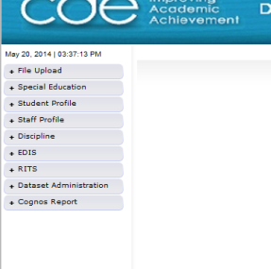
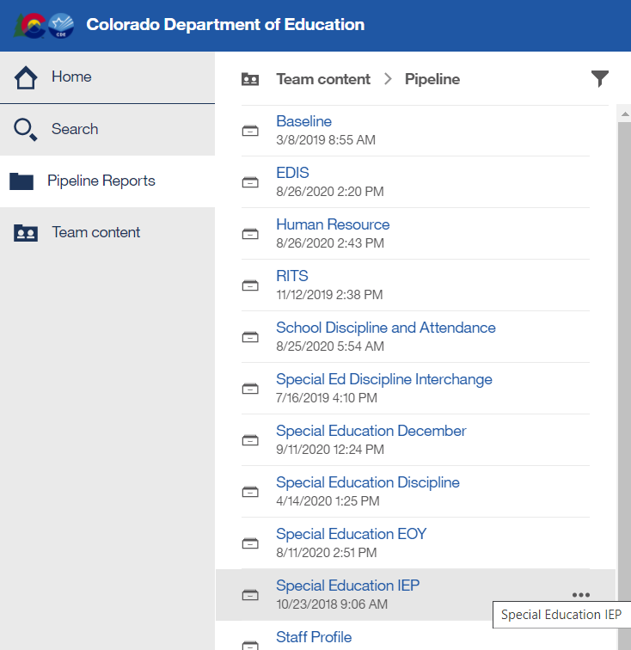
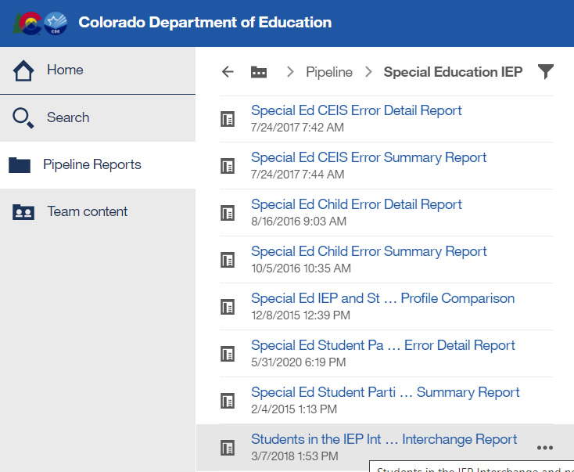
Checking IEP Interchange Errors under Cognos Reports
  In Data Pipeline click Cognos Reports tab and a new application will open with a list of folders.
  Next double click on the Special Education IEP folder which should bring up a list of reports.
  There is a Detail and Summary Error Report for each File. Double click on the name of the report to open it.

Slide 39
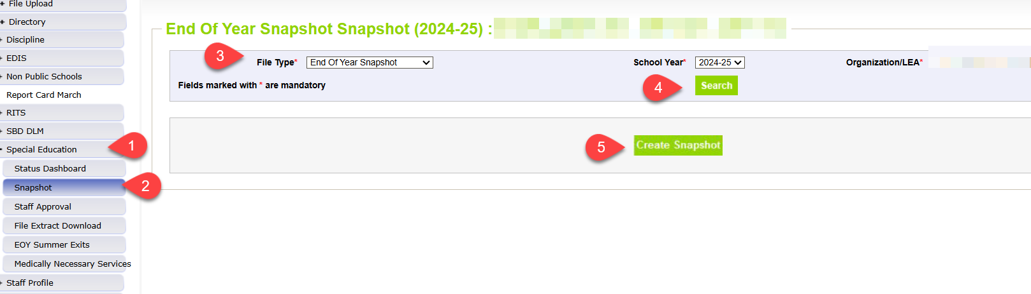
Step 5: Create SPED EOY Snapshot
  1. Click the Special Education tab
  2. Click Snapshot tab
  3. Select File Type: End of Year Snapshot
  4. Click Search to bring up the Create Snapshot button in green
  5. Click ‘Create Snapshot’ button and watch for green message to flash across the top of the screen
  *Wait for Data Pipeline confirmation email before checking errors
Helpful to have most Interchange errors cleared before starting on your snapshot errors
Why? Because records with errors at Interchange level will not pull into snapshot validations

Slide 40
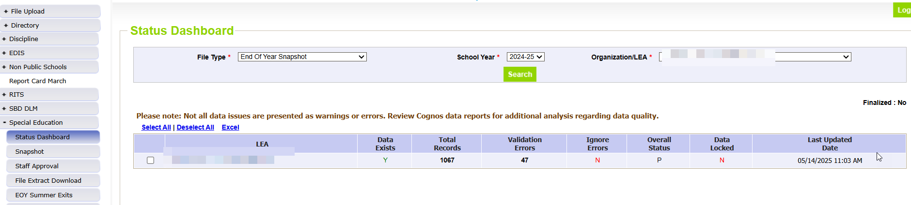
Step 6: Status Dashboard-
Check Status of Snapshot
Once you have received the snapshot confirmation email confirm Status Dashboard details:
  Be sure that Data Exists = Y
  Check Last Updated Date
  Check # of Total Records, # of Validation Errors

Slide 41
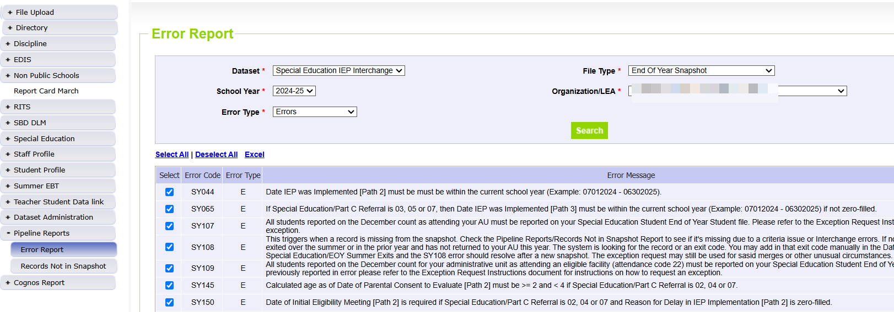
Step 7:
Check Snapshot Errors under Pipeline Reports
Pipeline Reports-Error Reports
This error report will only
show the first 1000 errors!

Slide 42
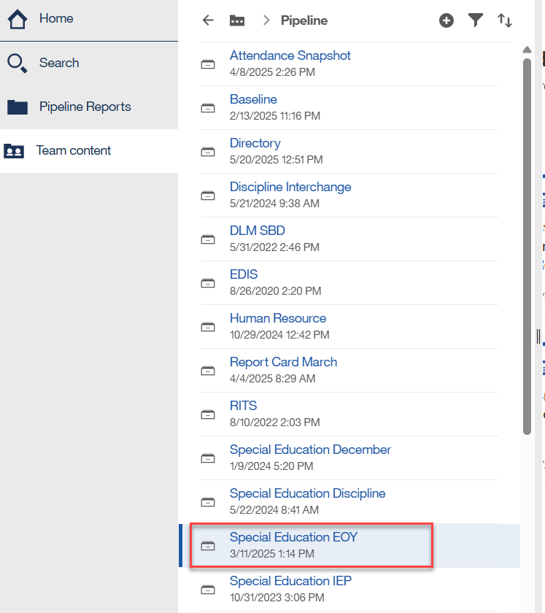
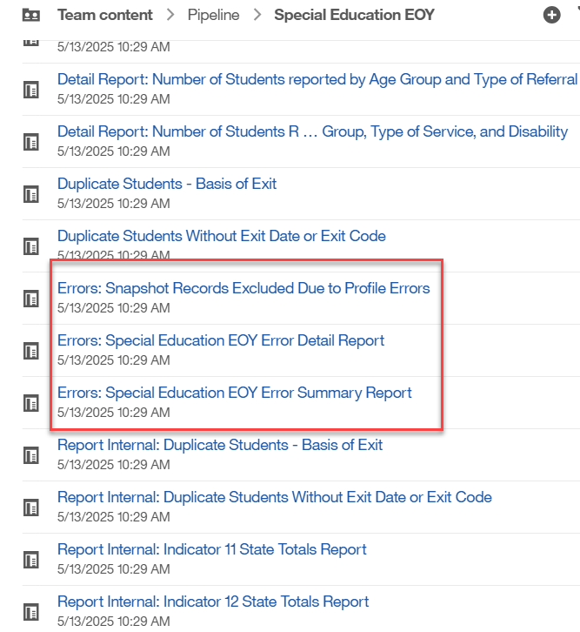
OR find errors under Cognos Reports
Click Cognos Reports and then Special Education EOY:
  records with errors at Interchange
  snapshot error details – some error codes are broken out at the bottom in separate section
  snapshot error summary

Slide 43
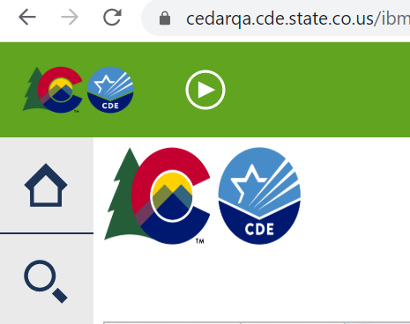
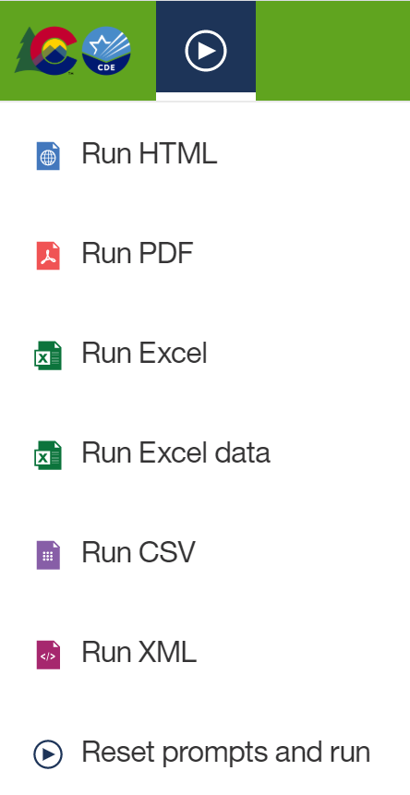
Exporting Cognos Report to Excel
Click on ‘Play’ Button
(available when a report is showing)

Slide 44
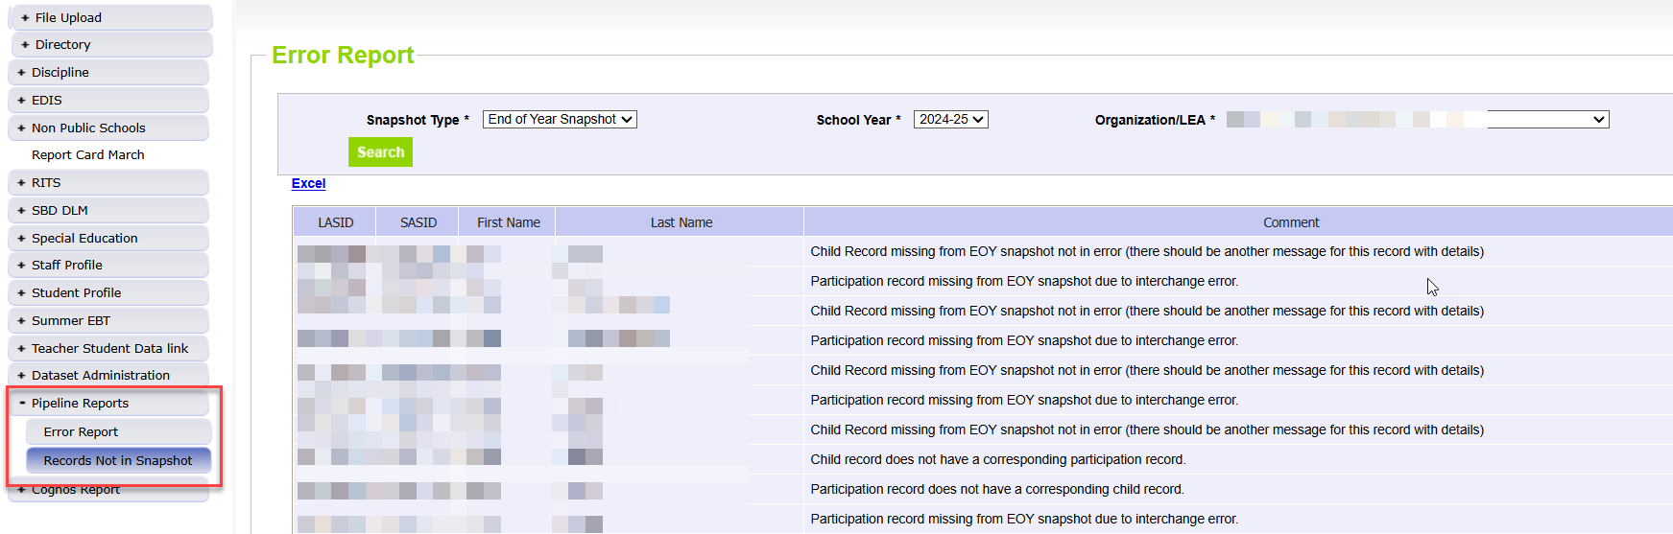
Special Education End of Year
– Missing Snapshot Records
Missing Snapshot Records Report- Must Check!
Identify records missing from snapshot due to:
  Interchange errors
  Criteria issues such as excluded PAI (Pupil Attendance Information) codes or mismatched SASIDs or LASIDs
  Records missing from either Child or Participation file
  These record also show up under the 500 level warnings

Slide 45
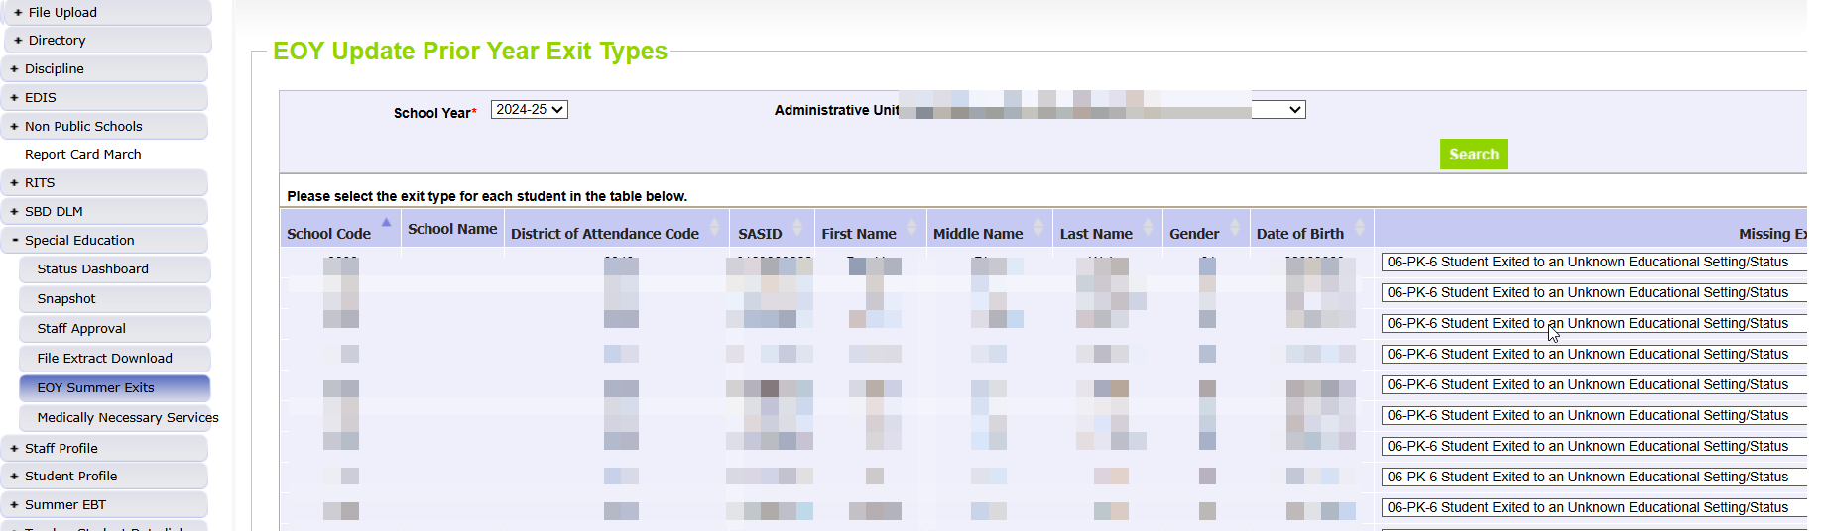
  EOY Summer Exits Screen – students that exited over the summer or didn’t return in the fall
Click Special Education →EOY Summer Exits. Select 2024-25 School Year and click “Search”. This will bring up your list of records that are missing from prior year.
  Pipeline will not include any records in the screen that are on your Child or Participation file (whether they’ve made it to snapshot yet).
Enter the “Missing Exit Type” and click “Save”. You don’t have to do them all at once. They will stay visible in this screen through the end of the collection.
Once you create a new snapshot, the saved records will be added to your 24-25 snapshot with a “Date of Entry to Sped” and “Date of Exit from Sped” of 07/01/2024 and the “Basis of Exit” reason you chose. This will resolve SY108 when you create a new Snapshot.
  In the COGNOS report “Snapshot Records: Special Education EOY Snapshot Records” you will see records that were added through the EOY Summer Exits screen in column B “EOY Summer Exit” = Y.
  You’ll notice the record count between the Participation file will be different than the EOY Snapshot with the addition of these records.

Slide 46
Special Education EOY
Summer/Missing Exits Reporting Concern
Reporting Concern:
Several AUs have had a large number of “EOY Summer Exits” - records with 7/1 SPED entry and exit date that didn’t attend at all in the reporting year, and are not included in your files and generate under your EOY Missing Exits screen in the Data Pipeline
Reminder that all SPED students who exit the AU by the end of the school year are expected to be reported in the 24-25 SPED EOY with appropriate exit type
EOY Summer Exits screen should only be used for students that left over the summer
These “missed exits” affect your indicator 14 sample, indicator 1 graduates, Indicator 2 dropout percentage, etc.
If you pull your Participation file early in the spring from your SIS and don’t continue to take nightly updates from your SIS, you may be missing valid exits that need to be reported in 24-25.
Reporting Tips:
Be sure to reconcile the exits with your district(s) records/exits up until the due date in September.
  Compare your exits from Special Education to the Student EOY exits being reported
Be sure to check your warnings

Slide 47
Cognos Validation Reports Overview

Slide 48
Reviewing Data Reports
Once All Errors are corrected, review your Cognos validation/detail reports for accuracy. Errors do not catch everything!
If after reviewing, you notice something that needs to be fixed:
  IEP Interchange File(s) will need to be resubmitted
  Special Education EOY Snapshot will need to be re-created
    Reports are created from your last snapshot so any changes to files will change your reports.
Final Reports Submission and Data File Approval within Data Pipeline are the last steps (this step occurs in late September after we complete the duplicate process):
  Once you’ve reviewed the reports and made all changes:
    Submit the 9 reports required for signature and the flag explanations document if necessary to the ESSU Data Management System
    Then in Data Pipeline, click the “SUBMIT TO CDE” button. Only the Sped EOY Approver will have ability to do this
    Finalizes the data for CDE to begin their validation process before submission to the federal government

Slide 49
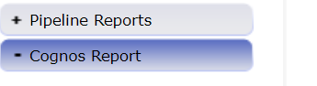
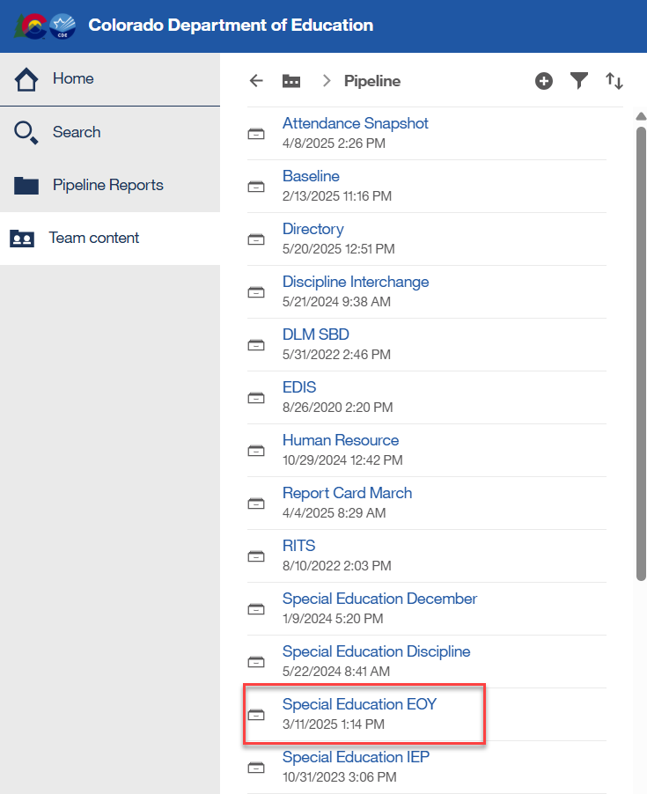
Cognos Reports – Special Education EOY
This screen is what you will see after clicking the ‘Cognos Reports’ tab. Double click on the Special Education EOY folder to open the list of validation reports for the snapshot.

Slide 50
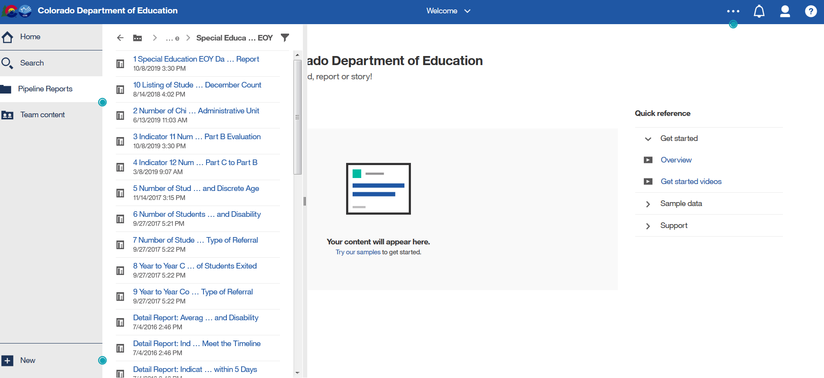
Sped EOY Cognos Validation Report List
Scroll down to see full report list
Expand screen to the right to see full report name
*Ignore the date and time listed under the report (internal use)

Slide 51
Exporting to Excel
Click on ‘Play’ Button
(available when a report is showing)

Slide 52
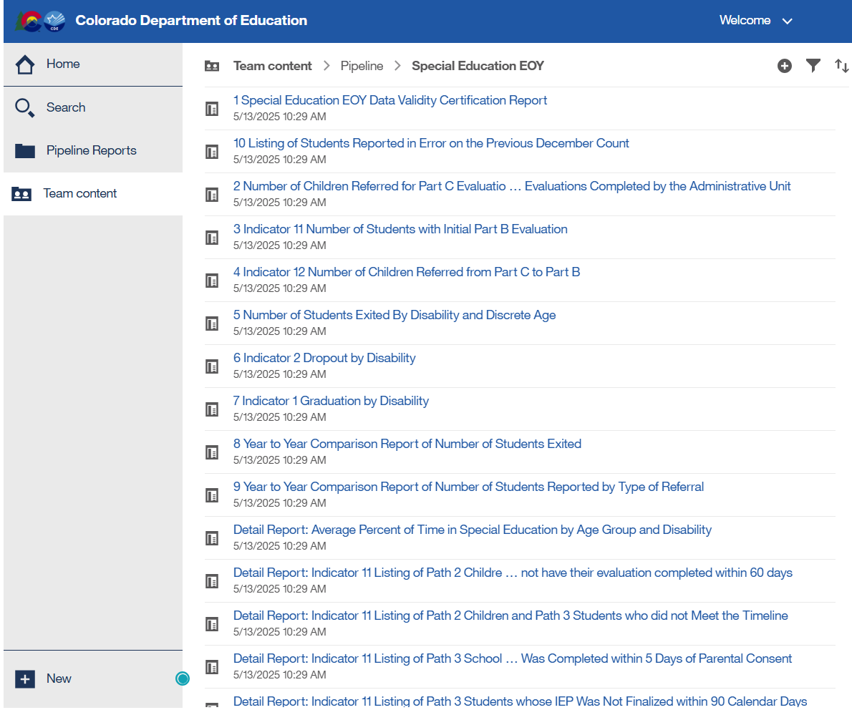
Special Education EOY Cognos Validation Reports
Use the Year to Year Exits and Referral Reports as well as well the detail reports to track reporting!

Slide 53

Thank you!

