Slide 1
Special Education End-of-Year Coding Scenarios
June 12, 2025
Lindsey Heitman
SpedEndofYear@cde.state.co.us

Slide 2
Welcome and Contact Information
Welcome and thank you for joining the training!
Data Services Contact:
Lindsey Heitman – SpedEndofYear@cde.state.co.us
heitman_l@cde.state.co.us 720-456-2033
Collection manager
Data Pipeline submission
Business Unit – Exceptional Student Services Unit Contacts:
Orla Bolger – bolger_o@cde.state.co.us ESSU Contact – data content clarification/data requests
Josh Fails – fails_J@cde.state.co.us ESSU Contact – Data Management System/questions on uploading final reports to the DMS
Please include in emails:
AU #
error code # (if applicable)
any school code #’s referenced

Slide 3
Special Education End of Year: Timeline and Training
Upcoming Training
Special Education Discipline Annual Snapshot Training
Tuesday May 6th 10:00 – 11:30
Overview of the snapshot data required and process in Data Pipeline
Upcoming Training
Special Education Discipline Annual Snapshot Training
Tuesday May 6th 10:00 – 11:30
Overview of the snapshot data required and process in Data Pipeline
2024-2025 Special Education EOY Snapshot Timeline
Posted Trainings:
Special Education EOY Snapshot webpage
Tuesday May 13th
Purpose, content, IEP Interchange, SPED EOY Snapshot, Who to report
Tuesday May 20th
Exceptions, Medically Nec Services, Path data (initial referrals and delay codes)
Wednesday May 28th
Coding Initial Referrals, Data Pipeline Process
May 1, 2025 - SPED EOY Snapshot official open
June 26, 2025 – IEP Interchange files error-free
September 4, 2025 - All Exception requests submitted to CDE
September 11, 2025 – All errors resolved at snapshot/interchange
September 12 -19, 2025 -Initial Report Review
September 22 - 26, 2025 – Resolving duplicates
September 29 – October 1, 2025 – Final Report Review
October 3, 2025 - Final submission due to CDE

Slide 4
Agenda
Exits from Special Education
Snapshot criteria logic
SY108 errors
Summer/missing exits
“new” errors (old warnings)
How to process summer exit records
Transition and other records – helpful cognos reports
Outside placement reporting

Slide 5
Reminder: Sped EOY Collects Exits from Special Education
An exit for Sped EOY purposes is a student who has exited from Special Education services in your AU
Records may need different exit codes in Sped EOY compared to what was reported in Student Interchange/EOY
A student record that does not ever begin receiving Special Education Part B Services (i.e. Date of Entry to Special Education is zero-filled) should not contain a Date of Exit or Basis of Exit.
Students (initial referral records) should not be reported with a Date of Entry to SPED, Date of Exit from SPED, or a Sped Basis of Exit if:
They didn’t start receiving Special Education services.
An evaluation was never completed.
He/she was evaluated and found not eligible.
He/she was evaluated and determined eligible, but services were never initiated.

Slide 6
SPED EOY Snapshot Criteria
For a record to be added to the Special Education EOY Snapshot it must:
be included in both the Child and Participation Files
contain a matching SASID and/or LASID in both the Child and Participation Files
be error free in both the Child and Participation Files
All records that meet the above criteria will be pulled into the snapshot EXCEPT those with a PAI code of 23, 24, 31, or 32 or a Special Education Part C Referral code of 00.
Data pulled from the Student Profile Interchange will be the untagged data
Note: if records are missing from your snapshot, it is likely they have one of the following:
errors at the Interchange level
contain one of the excluded PAI codes above (which may be correct if student has already been exited)
an incorrect SASID or LASID on one file
missing a record altogether from one file

Slide 7
ERROR CODE SY108
SY108 Triggers when a record that was on last year’s snapshot is missing from the current year snapshot
This error can trigger for the following reason(s) that do not need an exception:
Student exited over the summer or in the prior year and has not returned to your AU this year (more information on next two slides regarding this)
An error exists at the IEP Interchange
An IEP Interchange file (child or participation) didn’t successfully process
Criteria Issue (i.e. mismatched SASID or LASID between files, interchange error, etc)
Check the Pipeline Report - Records Not in Snapshot for details
Only reason an exception would be used for this error:
Merged SASID or school closings/unusual circumstances

Slide 8
Excluded from Snapshot: PAI Code 31 – on Tuition Contract w/ another AU
Records triggering an SY108 errors
Excluded from the snapshot due to a 31 PAI Code
If student exited to receive services from another AU on a tuition contract, they need to be exited in your Participation file for Sped EOY in the year they transfer to the program.
After the initial exit to the attending AU, resident AU does not need to report this student in Sped EOY in future years. Record will correctly stay excluded from snapshot with a PAI Code 31.
Student should have been reported on Dec Count for funding but should be exited for Sped EOY reporting requirements at this point in time.
How to Report and clear error SY108:
“Back date” the school enrollment info to what it was as of the last date of attendance in your AU. Adjust:
PAI Code
School Code
District of Attendance
Add a Date of Exit and Reason Exited
This change should bring the record into you snapshot and clear error SY108
Note: student only needs to be exited from your AU once, so if they have been attending the program for a couple of years and you exited them to the program the first year, leaving them excluded from the snapshot with a 31 PAI code is correct

Slide 9
Special Education EOY Summer/Missing Exits Reporting Concern
Reporting Concern:
Several AUs have had a large number of “EOY Summer Exits” - records with 7/1 SPED entry and exit date that didn’t attend at all in the reporting year, and are not included in your files and generate under your EOY Missing Exits screen in the Data Pipeline
Reminder that all SPED students who exit the AU by the end of the school year are expected to be reported in the 24-25 SPED EOY with appropriate exit type
EOY Summer Exits screen should only be used for students that left over the summer
These “missed exits” affect your indicator 14 sample, indicator 1 graduates, Indicator 2 dropout percentage, etc.
If you pull your Participation file early in the spring from your SIS and don’t continue to take nightly updates from your SIS, you may be missing valid exits that need to be reported in 24-25.
Reporting Tips:
Be sure to reconcile the exits with your district(s) records/exits up until the due date in September.
Compare your exits from Special Education to the Student EOY exits being reported
Be sure to check your warnings (errors)

Slide 10
Business Rule Changes: Errors or Warnings
Both of these warnings will switch to an error this year:
SY309: If student is currently in or will begin a Sped transition program next year, the Sped EOY Basis of Exit should be zero-filled
SY295: Student is being reported with an exit type of 01, 02, 05, 06, 14, 40, 70, 90, 92, 93, or 94 in the regular EOY collection. Please confirm and exit the record in Special Education EOY.
Switched from a warning to an error and more exit codes added to the check
Logic: Trigger an error if Student EOY Snapshot School Exit Type = 01, 02, 05, 06, 14, 40, 70, 90, 92, 93, or 94; UNLESS Retention Code is 3.
Still in progress – not in production yet

Slide 11
EOY Summer Exits Screen – students that exited over the summer or didn’t return in the fall
Click Special Education →EOY Summer Exits. Select 2024-25 School Year and click “Search”. This will bring up your list of records that are missing from prior year.
Pipeline will not include any records in the screen that are on your Child or Participation file (whether they’ve made it to snapshot yet).
Enter the “Missing Exit Type” and click “Save”. You don’t have to do them all at once. They will stay visible in this screen through the end of the collection.
Once you create a new snapshot, the saved records will be added to your 24-25 snapshot with a “Date of Entry to Sped” and “Date of Exit from Sped” of 07/01/2024 and the “Basis of Exit” reason you chose. This will resolve SY108 when you create a new Snapshot.
In the COGNOS report “Snapshot Records: Special Education EOY Snapshot Records” you will see records that were added through the EOY Summer Exits screen in column B “EOY Summer Exit” = Y.
You’ll notice the record count between the Participation file will be different than the EOY Snapshot with the addition of these records.

Slide 12
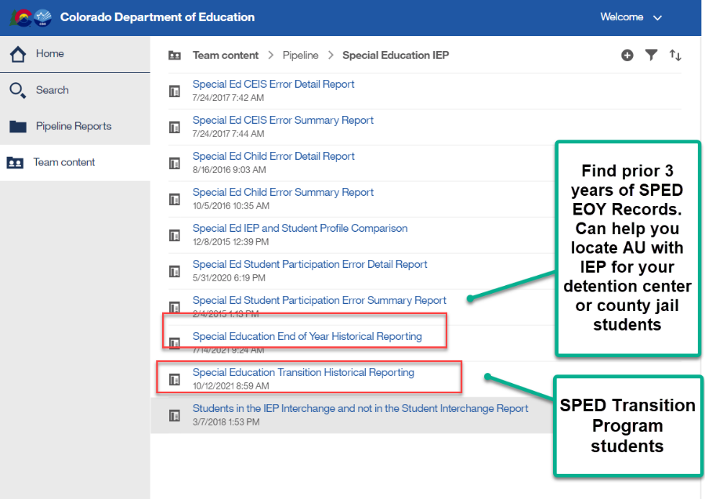
Special Education EOY Sped Transition students, Detention Center students, county jail students
Sped Transition Program Students – error checks
SY309: If student is currently in or will begin a Sped transition program next year, the Sped EOY Basis of Exit should be zero-filled.
Check to be sure you are not exiting your students moving to a transition program.
They may be reported with exit code 90 in Student EOY snapshot if they met grad requirements, but should not be exited in Sped EOY until they exit the program or age out
Reference SPED transition Cognos report to see transition students based on district reporting
SY315: Student is reported as completing transition in the Student EOY Snapshot with a School Exit Type of 28, indicating they met graduation requirements in a prior year. Please report a 90 in the Sped Basis of Exit field.
Must have ‘SPE User’ role to access these reports

Slide 13
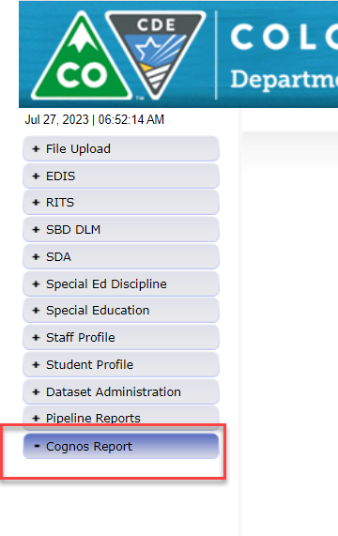
Special Education EOY Use Prior Year Snapshot Records to Inform Coding
Reporting Tip:
Download your Sped EOY Snapshot records from last year (23-24) to help you determine how to code records for this year
Export report to Excel and sort by various data fields: Sped Referral Codes, Eligibility and Services codes, Exit Types
This will help you see what fields are required in a particular coding scenario

Slide 14
Special Education EOY: Reporting Outside Placement Records- Facility Schools, Detention Center, SOP, Program Students
The term “Facility” is used throughout the state for different types of schools/entities. In Colorado we have:
1. Approved Facility Schools - “facility” students for reporting purposes means this one! *PAI Code 22
2. Special Education Programs - run by districts or AUs – these are not private
3. Detention Centers - student is detained in one of the 8 Colorado detention centers statewide
4. State Operated Programs – student is committed and should be reported by Department of Corrections (66070) or Division of Youth Services (66080)
5. Non-public schools
6. Private Facilities
NOTE: These 6 scenarios are reported differently.
Helpful codes documents:
http://www.cde.state.co.us/datapipeline/org_orgcodes. Approved Facility Schools and Other Agency Codes
SPED PAI Coding Guide
How to Code for Sped EOY:
Report the student’s last attendance at a school within your AU.
Report an exit if student transfers out of your AU at any point (even if you report them for December Count).
Reporting for Sped EOY is different than December Count for these types of records. There are different reporting requirements for each. Sped EOY should include all students that your AU physically serves, along with resident students in Approved Facility School.

Slide 15
Contract Agreement Students
Entity (facility type) | Who Reports for Sped EOY | School Code | PAI Code | Exit From Sped EOY Required?
CDE Approved Facility School located anywhere in the state (tuition contract) | AU of residence | Valid Facility Code | PAI code 22 | No. If an AU resident student transfers to a CDE Facility School located anywhere in the state, no exit is necessary
Special Education Program (tuition contract) | AU where program is located and exiting AU in the year of the exit | Report a valid SPED Program Code. School code of enrollment may be reported or zero-filled. | Exiting AU: PAI code 01 or code that reflects last attendance in AU Attending AU: PAI code 12 (likely the same info reported for Dec Count) | Yes. For Sped EOY, the AU of residence must exit this student with code 13 and report the student’s last enrollment information within their AU. This will likely require you to “backdate” the following fields: school code, PAI Code, District of Attendance, and add Date of Exit, Basis of Exit
Detention Center (detained student) | AU where DT Center is located reports detained students and exiting AU in the year of the exit | Detention Center Code | Exiting AU: PAI code 01 or code that reflects last attendance in AU Attending AU: PAI code 11 Resident AU: PAI code 24 | Yes. For Sped EOY, the AU of residence must exit this student with a code 13 and report the student’s last enrollment information within their AU.
State Operated Program (committed student) | SOP reports committed students and the exiting AU in the year of the exit | SOP School Code | Exiting AU: PAI code 01 or code that reflects last attendance in AU Attending SOP: PAI code 19 Resident AU: optional PAI code 32 | Yes. For Sped EOY, the AU of residence must exit this student with a code 21 and report the student’s last enrollment information within their AU.
Contract Agreement Students Reporting Guide
Posted on the
Student EOY snapshot webpage

Slide 16
CDE Approved Facility School Contract
How record was reported in December Count:
Resident AU: Group B SPED PAI code 22
How to report record in SPED EOY:
Resident AU: Group B SPED PAI Code 22
No exit in Sped EOY necessary. AU of residence is responsible for reporting their SPED students in approved facility schools, regardless of where the facility school is located.

Slide 17
Special Education Program Records
How record was reported in December Count:
Resident and Attending Districts are both within the AU:
Sped Program is located within the AU
Report Group A PAI code (example 01, 02)
Resident District and Attending District are in different AUs:
Sped Program is located outside the resident AU
Resident AU: Group B SPED PAI Code 31
Attending AU: Group A SPED PAI Code 12
How to report record in SPED EOY:
Resident and Attending Districts are both within the AU:
Sped Program is located within the AU
Report Group A PAI code
Resident District and Attending District are in different AUs:
Sped Program is located outside the resident AU
Resident AU:
Year of Transfer:
Group A SPED PAI code and SPED Basis of Exit 13 to reflect the transfer.
Year 2 of Contract until Contract Ends:
• Group B SPED PAI code 31 to capture contract (no record – automatically excluded).
Attending AU:
Group A SPED PAI Code 12

Slide 18
Detention Center Records
How record was reported in December Count:
AU with Detention Center:
Resident of AU: Group A SPED PAI Code 08
No Group B record
Non-resident of AU: Group A SPED PAI Code 11
Resident AU: Group B SPED PAI Code 24
How to report record in SPED EOY:
AU with Detention Center:
Resident of AU: Group A PAI code 08
No Group B record
Resident AU:
Year of Transfer to detention center in another AU:
Group A SPED PAI code and SPED Basis of Exit 13 to reflect the transfer to the detention center.
Year 2 of Contract until Scenario Ends:
Group B SPED PAI code 24 (no record – automatically excluded).

Slide 19
Non-Public School or Private Facility Contract
How record was reported in December Count:
Resident AU: Group B SPED PAI code 27
How to report record in SPED EOY:
Resident AU:
Year of Transfer:
Group A SPED PAI code and SPED Basis of Exit 15 to reflect the transfer.
Year 2 of Contract until Contract Ends:
Group B SPED PAI code 27 to capture contract (no record – automatically excluded).

Slide 20
County Jail
How record was reported in December Count:
AU with County Jail:
Resident of AU: Group A SPED PAI Code 08
No Group B record
Non-resident of AU: Group A SPED PAI Code 05
Resident AU: Group B SPED PAI Code 23
How to report record in SPED EOY:
AU with County Jail:
Resident of AU: Group A PAI code 08
Non-resident of AU: Group A PAI code 05
Resident AU:
Year of Transfer to County Jail in another AU:
Group A SPED PAI code and SPED Basis of Exit 13 to reflect the transfer to the county jail.
Year 2 until Scenario Ends:
Group B SPED PAI code 23 (no record – automatically excluded).
School Code = 0006

Slide 21
Outside of Colorado Facility Contract
How to report record in December Count or SPED EOY:
Resident AU: Group B SPED PAI Code 28 or 29
PAI 28 = attending public agency outside of state
PAI 29 = attending non-public school or facility outside of state
School Code = 0000
Sped Program Code = 0001 (out of state)
District of Attendance = 0000
State of Attendance = KS (state abbreviation code)

Slide 22
Your participation is appreciated!

