Slide 1
Student End of Year
Office Hours
September 2024

Slide 2
Agenda
Timeline Review
Cross LEA Phase
  Overview
  New 2023-2024
  Steps
  Important Data to Review
  Business Rules
  Brief look at Adequate Documentation
  Adjustments (Prior Year)
Cross LEA: CEDAR/COGNOS Reports
FYI - GG 2024-2025: SAT Math Cut Score Change
Questions

Slide 3
Timeline
Date | Event | Event Description | Notes
9/19/2024 | Cross LEA Open | Districts may begin creating snapshots as soon as they receive a ‘snapshot unlocked’ notification from data pipeline. | New business rules trigger (SE700 series) Final opportunity to correct most data fields, especially student demographic information.
10/07/2024 | Interim Deadline | Error free SEY snapshot | Some business rules require LEAs to communicate regarding student coding. Begin working with them early in the Cross LEA window.
10/08/2024 to 10/17/2024 | Report Review | • Validate Student End of Year data using CEDAR/COGNOS reports. • Submit snapshot as soon as review is complete | Collaborate with schools to review student lists. Student List: Dropouts Student List: AYG Cohort Student List: District and School Mobility Review rates. Graduation: 3-,4-,5-,6-,7-year rates by School Year Graduation Rates: District and School by AYG Dropout: District and School Rates Mobility: District and School Rates
10/17/2024 | Deadline | Submit SEY Snapshot | Only users with the LEA Approver role for the SEY collection can submit the snapshot.
10/24/2024 to 11/19/2024 | Collection Phase | Post-Cross LEA Phase | Final clean-up phase focused on data validation (SE900 series rules). Cross references Student October 2024-2025. Extremely limited changes, mostly school exit type/date.
11/22/2024 to 12/3/2024 | Collection Phase | Final report review and sign-off forms due | Final review of graduation/completion, dropout, and mobility/stability rates. Collection lead works with LEAs impacted by CDE’s final review.
1/14/2025 | Data Release | SEY Public Data Release | All SEY data is embargoed until CDE’s press release on this date. Data respondents will receive notification when the embargo lifts.

Slide 4
Cross LEA Phase

Slide 5
Cross LEA Phase Overview
What is the Cross-LEA Phase?
Required LEA Tasks
Second phase of SEY collection
CDE runs a process to cross validate student educational history across all school districts/BOCES
  SE700 series errors/warnings are triggered
Ensures accuracy of education statistics
  Graduate/completers
  Dropouts
  Exit one district and recovered by another
  Completed HSED
Review errors/warnings
Create at least one SEY snapshot (even if error free)
Submit data by October 17, 2024
Review data, making updates as needed
  All data fields may be corrected during this phase
  Last chance to correct any miscoded student demographic information
Reminder: The upcoming Post-Cross Phase allows very limited updates to specific data fields

Slide 6
New in 2023-2024
Business Rules
CEDAR/COGNOS Reports
SE800 series (static) rules have been deactivated
New warnings (SE725, SE726, SE727)
New SE500 error
  Custom error based upon individual LEA data
  Requires LEA to communicate with SEY Collection lead to clear the error, even if required data has been updated
Updated language for existing SE700 series errors and warnings
Ensured logic on SE700 warnings that predict SE900 errors for the Post-Cross LEA phase accurately aligns between the two phases
Cross LEA List – Students Removed from AYG Cohort
  Replaces the deactivated report EOY Cross LEA Edit Report
Cross LEA List – Students with SE700 errors or warnings
  Replaces the deactivated report EOY Cross LEA Edit Report
SASID Lookup: Cross LEA
  This report was new in 2023, but remains a critical resource
  Formerly known as EOY Cross LEA Lookup by SASID
Student List: AYG Cohort Adjustments
  Renamed
  Formerly known as EOY All Membership Base Adjustments made for the AYG

Slide 7
Cross LEA Phase Steps
Review errors and warnings
  SE700 series and any remaining SE001-SE500 series
Update interchange files as needed to resolve errors/warnings
  Any data field may be changed during this phase
  Final opportunity to address demographic updates
Upload Adjustment file
  If needed to address SE700 errors
Create SEY snapshot, repeating steps 1 through 4 as needed
Review SEY Data using CEDAR/COGNOS reports
Submit error-free SEY snapshot
  LEA Approver role required
Note: Steps 1, 4, 5, and 6 are required for all LEAs, even if they are error free at the beginning of this phase

Slide 8
Important Data to Review
Summer Graduate/Completers
  School exit types 90-96 may be used with school exit dates up through 08/31/2024
Retention Codes
  Retained K-11 students should have retention code 1 in 2024 and begin the 2025 school year in the same grade they ended in 2024
  ASCENT/PTECH years 5-6/TREP
    Retention code 2/exit code in 2024 compared to 2025 enrollment
    SE233 & SE239 warnings
  SPED Transition
    Retention code 3/exit code in SEY 2023-2024 compared to 2025 enrollment
    SPED EOY basis of exit compared to SEY school exit type 2024
Dual Enrolled or Late Exits
  SE137 Warning (exit 13 after May 1)
  SE138 Warning (exit 00 in multiple LEAs)
Exit 13 without another LEA claiming student
  SE722 grades 7-12
  SE727 grades K-6
Address SASID merges
  SE722 and SE727 often uncover the need for SASID merges when COA shows student is attending another CO district
Student Demographic Information
  Homeless, English Learner, Immigrant, Military Enlisted, Military Connected, etc.

Slide 9
Business Rules
Current Year
Prior Year
Based on the interplay between current year student records across CO districts
Updates take place on current year SSA and DEM files
Any SE001 through SE500 series business rule
Some SE700 series rules
  SE702, SE703, SE707, SE708, SE710, SE711, SE712, SE720, SE721, SE722, SE724, SE725, SE726, SE727
Some warnings become errors in post-cross phase if not addressed
  SE720, SE721, SE722, SE724
Based on information related to a student’s final reported status in a previous SEY collections
  These students are not included in the 2023-2024 SEY collection or related interchange files
Most of these errors are cleared using an adjustment record
Some may be cleared using a one-day record in the current year
Only SE700 series rules
  SE704, SE710

Slide 10
Checking Errors/Warnings
Step 1 Preferred Method:
Data Pipeline Error Report
Select ‘errors and warnings’
Reflects all SEY business rules
Can check/uncheck specific business rules before choosing to ‘View More Details’
  Note: Does not display more than 1000 student records when viewing more details
Note: For this collection, leave the Tag dropdown set to ‘All’
Step 1 Alternate Method:
CEDAR Report SEY Error Summary and Details
Use when more than 1000 student records in error/warning
Select ‘errors and warnings’
Updated report options ‘phase’ dropdown menu
  Regular Phase = SE001 through SE500 rules
  Cross LEA = SE700 rules
  Post-Cross LEA = SE900 rules
Will likely need to ‘page down’ many times since this report has multiple sections OR extract the data as an excel file
  SASID level errors
  Missing Record (Might be seeing ‘No Data Available’ instead of this section right now)
  School/Collection Level
  Summary
Step 2 (both methods):
CEDAR report Cross LEA List – Students with SE700 Errors or Warnings
  Shows the ‘other’ district reporting the student related to the SE700 error or warning

Slide 11
Brief look at Adequate Documentation
Adequate documentation is the documentation maintained by districts/schools when students transfer out of their district
  Details and sample forms available on the adequate documentation website
    Confirmation of Enrollment/Attendance is the most common and must include the student’s full name, date of birth, and SASID
    RITS is not considered adequate documentation of transfer
Requirements are outlined in state rule, as seen here: 1 CCR 301-1 Rules for the Administration of the Accreditation of School Districts
  Colorado Public Schools and local education agencies are required to send transcripts or to confirm attendance when requested from another Colorado Public School or local education agency within two weeks of receiving the request with the exception of students in out of-home placements whose records must be transferred within five (5) days pursuant to sections 22-32-138(2)(a)(II) and (3)(a), C.R.S
  When a student withdraws, districts are authorized to request information from the parent or guardian about the specific type of educational enviornment that a student is transferring to in order to monitor compliance with the School Attendance Law. [section 22-33-104 (1), C.R.S.]
Notes:
For students who are withdrawing from a Public School, Districts and the Institute are authorized to request information from the parent or guardian about the specific type of educational environment to which the student will be transferring, in order to monitor compliance with the School Attendance Law, section 22-33-104 (1), C.R.S.

Slide 12
Adjustment File: Correct prior year exit
7th-12th grade students only
Adjusts the final exit type for a student in a prior school year who did not attend your district in the current year.
Only used to adjust students with very specific exit scenarios
  Dropout (Exit 40)
  Expulsion (Exit 50)
  HSED transfer (Exit 70)
  Did not Exit (Exit 00)
  Other special circumstance (Exits 18, 19, 21, 30)
Record is loaded in the current year using an adjustment file
Student does not have a record on your DEM or SSA file in the current year
Adjustment goes into effect after you create a SEY snapshot

Slide 13
Methods to add adjustment records
Adjustment File Upload
Manually Add Record in Pipeline
Preferred method
Functions like a student interchange upload
File layout and business rules posted on SEY website
Note: Most student information systems do not have a file extract for the adjustment file. Instead, use the template on the SEY website to manually build your file.
Uses same adjustment justification codes as a file upload
Step-by-step: Adjustment File Directions
File layout and business rules posted on SEY website

Slide 14
Adjustment File
File upload that functions like a student interchange upload
  Dataset: Student Profile
  File Type: Adjustments
Template
Directions
Important Note: Most student information systems do not have a file extract for this file.
Name of Field | Length | Excel Column | Examples | Notes
District Code | 4 | A | 0000
SASID | 10 | B | 0000000000 | Must match RITS
First Name Student | 30 | C | Valid name | Must match RITS
Last Name Student | 30 | D | Valid name | Must match RITS
Gender Student | 2 | E | 01 or 02 | Must match RITS
Birth Date Student | 8 | F | 12312013 | MMDDYYYY
Adjustment Justification Code | 2 | G | 00
Adjustment School Code | 4 | H | 0000 | Last school attended in your district Matches the SEY error detail report for SE700 series errors/warnings
Adjustment Year | 4 | I | 2017 | Last school year (spring semester) the student attended in your district. For example, an exit date in the 2021-2022 school year is Adjustment Year 2022.

Slide 15
Adjustment Justification Codes
Code | Description | Prior Year Exit | AYG Cohort Impact
00 | Not Applicable | any | AYG Cohort status remains intact
40 | No Documentation of Reenrollment | 00 | Remains in AYG cohort
41 | Request for transcripts received | 40 or 00 18, 19, 21, 26, 30 | Removed from cohort
42 | Student received HSED from an educational program not administered by reporting district | 40 or 00 18, 19, 21, 26, 30 | Counted as an HSED recipient (completer)
51 | Request for transcripts received | 50 | Removed from cohort
52 | Student received HSED from an educational program not administered by reporting district | 50 | Counted as an HSED recipient (completer)
71 | Request for transcripts received | 70 | Removed from cohort
77 | Student received HSED from an educational program not administered by reporting district | 70 | Counted as an HSED recipient (completer)
90 | Misreported Graduate Note: Do not use for SPED Transition or Postsecondary Program Participants. In most cases, it is better to include a one-day record to count the student as a graduate. | 00 | Counted as a graduate AYG 2021 + requires graduation guidelines
96 | Misreported Graduate, Postsecondary Program Note: In most cases, it is better to include a one-day record to count the student as a graduate. | 00 with retention 2 | Counted as a graduate AYG 2021 + requires graduation guidelines

Slide 16
Cross LEA: CEDAR/COGNOS Reports

Slide 17
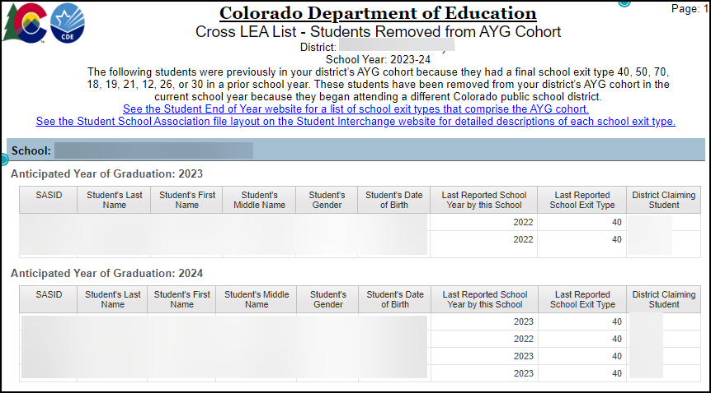
Cross LEA List – Students Removed from AYG Cohort
*NEW 2023-2024*
Replaces SE800 series static warnings and related CEDAR report
Also reflects students who have a SE701, SE705, or SE709 warnings
  Expect these warnings to be deactivated in 2024-2025 since this report shows the same information
Students previously part of the LEA’s AYG cohort, by school, and have been removed during the current SEY collection because they began attending another CO LEA in the current year.

Slide 18
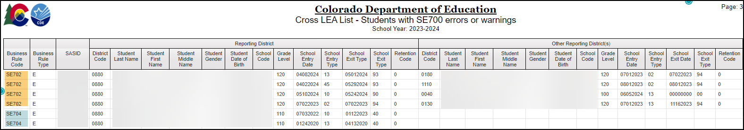
Cross LEA List – Students with SE700 errors or warnings
*NEW 2023-2024*
Replaces the deactivated report EOY Cross LEA Edits
Shows both your LEA and the other reporting LEA for any student with a SE700 error or warning.
Second step to reviewing SE700 errors/warnings after using pipeline error report
Reminders:
Not all SE700 series rules will have an ‘other reporting district’
Some SE700 rules require districts to collaborate to resolve the issue

Slide 19
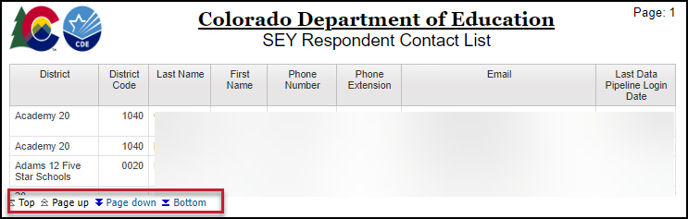
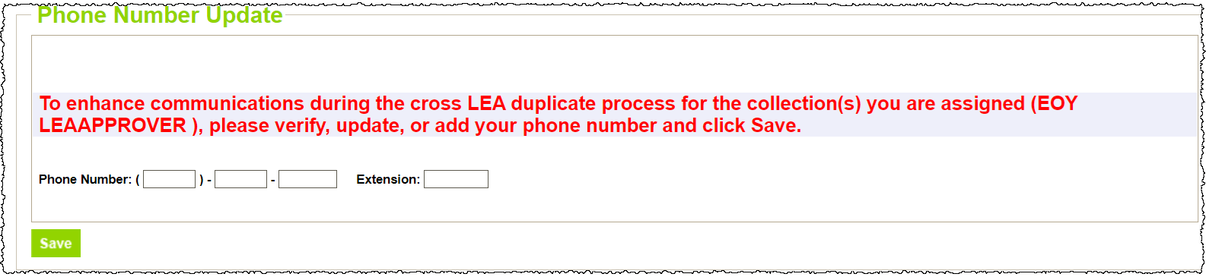
SEY Respondent Contact List
Former report name: EOY Contact List
Lists all IdM users with SEY~LEA Approver or SEY~LEA User permissions
Email address reflects IdM account
Phone number reflects the number entered into pipeline through the on-screen prompt in pipeline
  If you don’t have the on-screen prompt and your phone number is incorrect on this report, email StudentEndOfYear@cde.state.co.us to have it updated
Use:
Find contact information for the ‘other district’s’ SEY respondent when resolving SE700 errors and warnings or investigating SE137 & SE138 warnings

Slide 20
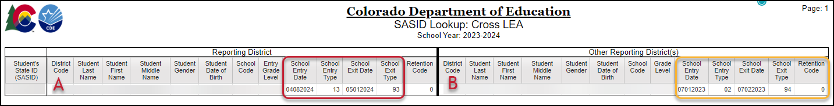
SASID Lookup: Cross LEA
Available throughout the entire collection
Designed to help research SE700 business rules, SE900 business rules, and some regular phase business rules (SE137, SE138, etc.)
In the example above, District A is the last district of attendance. We’d expect District B to update their exit type to show exit type 13.
Former Report Name EOY Cross LEA Lookup by SASID

Slide 21
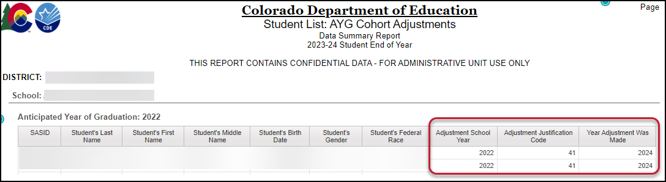
Student List: AYG Cohort Adjustments
Review adjustment records entered for an AYG cohort
Former Report Name: EOY All Membership Base Adjustments made for the AYG

Slide 22
FYI: Graduation Guidelines 2024-2025
SAT Math cut score change

Slide 23
What we know now and what is on the horizon
September State Board of Education meeting; SBE adjusted cut score for digital SAT math on the GG menu
  News Release Site
  Due to the changes with the digital SAT, the board unanimously approved moving the digital SAT math cut score for graduation guidelines to 480 from 500 for students graduating in 2025 and 2026 and directed CDE to work with the Colorado Commission of Higher Education to determine a proficiency level for future years.
Visit the PWR Graduation Guidelines site for more information
  PWR Contacts: Michelle Romero and Robin Russel
No change to GG data reporting.
Change impacts the use of the GG data in SEY 2025 and SEY 2026.
Coming Soon: Technical Information
  Technical explanation of impacted AYG cohorts, completion year of SAT, etc.
  Updating CEDAR/COGNOS GG reports to reflect new cut score
  Ensure SEY 2025 and SEY 2026 utilize the new cut score for SE301 business rule
Notes:
More information expected in:
PWR News, The SCOOP, and October CDE Update

Slide 24
Questions

