Slide 1
Student End of Year
Office Hours
October 2024

Slide 2
Agenda
Timeline Review
Post-Cross LEA Phase
  Overview
  Steps
  Phase Mechanics
  Superintendent Verification (Sign-Off)
  Exceptions and Post-Cross Change Request
Business Rules
SASID Merges in Post-Cross
New CEDAR/COGNOS Report
Q&A

Slide 3
Timeline
Date | Event | Details
10/24/2024 | Post Cross LEA Open | LEAs may update snapshots to address post-cross LEA errors Note: Only records receiving SE900 series errors may be updated without an approved post-cross change request or exception request.
11/13/2024 | Interim Deadline | Error free SEY Snapshot and responses provided to any request for adequate documentation by another LEA
11/13/2024 | Training Event | November SEY Office Hours: Final Dates and Data Release
11/14/2024 to 11/19/2024 | Report Review | Validate Student End of Year data using CEDAR/COGNOS reports. Begin submitting Superintendent Verification (sign-off) forms. Superintendent Verification forms will not be accepted prior to 11/14/2024 and are due 12/03/2024.
11/19/2024 (noon) | Deadline | Post-Cross Phase Ends LEAs must have error-free SEY snapshot
11/22/2024 to 11/16/2024 | Final Report Review | Final review of rates. Reconcile any issues found in CDE’s final review process (if receive notification from SEY collection lead)
12/03/2024 | Deadline | Superintendent Verification (Sign-Off) Form Due Collection Closes Data embargoed until official release in January
01/14/2025 | Data Release | Planned official data release and embargo lifts.

Slide 4
Post-Cross LEA Phase

Slide 5
Overview
Third and final phase of the Student End of Year data collection
Focus:
  Grades 7-12 school exit types (enrollment records) to ensure accurate graduation, completion, and dropout rates
  Interplay between SEY 2024 Retention Codes and October 2025 records
Initiated by a process run by CDE after districts submit their data for the Cross LEA Phase
  Triggers SE900 series errors/warnings
  Any SE001-SE700 errors that arise must also be addressed
During this phase, snapshots are not unlocked, only ‘updated’
  All districts must ‘update’ their snapshot at least once during this phase, even if no SE900 business rules were triggered.
Limited Data Updates
  Independent: School exit types for students with SE900 series errors
  Supported: Updates to correct SE001-SE700 series errors, correcting SEY retention codes in response to 2024-2025 October errors, correcting SEY data fields in response to SE900 warnings
Final opportunity for districts to validate their SEY data

Slide 6
Steps
Review errors and warnings
  SE900 series and any remaining SE001-SE700 series
Edit SSA records as needed (Data Pipeline > Edit Record Screen)
  Notes:
    Contact SEY collection lead before making Student Demographic changes
    Graduation Guidelines and Adjustment Files still use the ‘file upload’ option
Update SEY snapshot, repeating steps 1 through 3 as needed
Review SEY Data using CEDAR/COGNOS reports
Submit Superintendent Sign-Off Form
  LEA Approver role required to download form
  Forms accepted November 14th through December 3rd only
  Email signed forms to StudentEndOfYear@cde.state.co.us or upload signed form to Syncplicity and notify StudentEndOfYear@cde.state.co.us
Note: Steps 1, 3, 4, and 5 are required for all LEAs, even if they are error free at the beginning of this phase

Slide 7
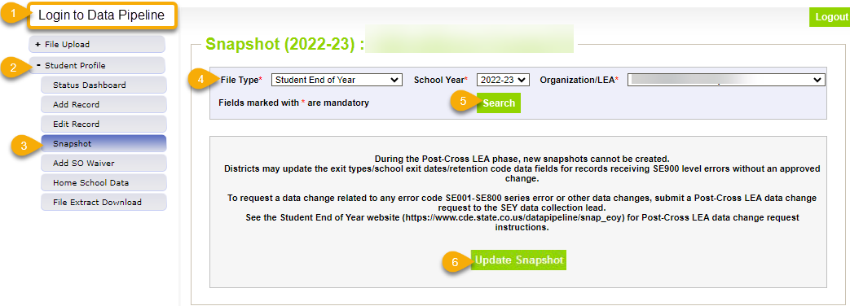
Phase Mechanics
Snapshots are NOT unlocked, only updated
Limited Data Changes
  School exit types for SASIDs with SE900 errors
  Approved post-cross LEA data changes
SSA updates completed manually through the edit record screen in pipeline
DEM updates: Talk to SEY collection lead first
GG & Adj files: continue to use the file upload screen in pipeline
Update Snapshot:
  Pulls in exit types to clear SE900 errors
  Recognizes approved exceptions for SE900 errors
  Recognizes approved exceptions for other rules
  Pulls in data changes for approved post-cross changes
  Checks SE900 warnings against most recent OCT snapshot
  Rechecks all business rules
  Rechecks AYG

Slide 8
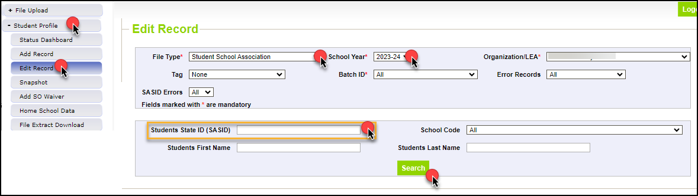
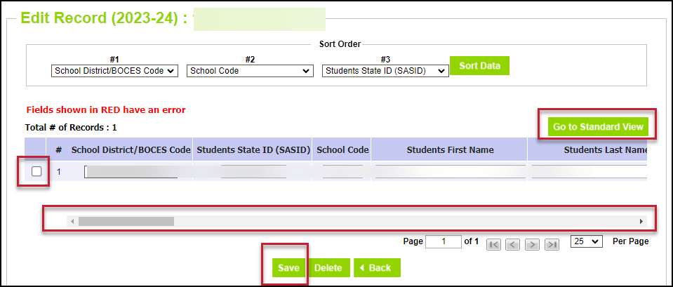
Editing SSA Records in Data Pipeline
Login to Data Pipeline
Select Student Profile
Select Edit Record
Complete drop-down menus
  File Type: Student School Association
  School Year: 2023-2024
  SASID: enter applicable SASID
Select Search
Tips:
  Select ‘go to standard view’ to see more data fields
  Don’t forget to press the check box at the beginning of the student’s row of data before saving
  Use scroll bar at the bottom to scroll across data fields

Slide 9
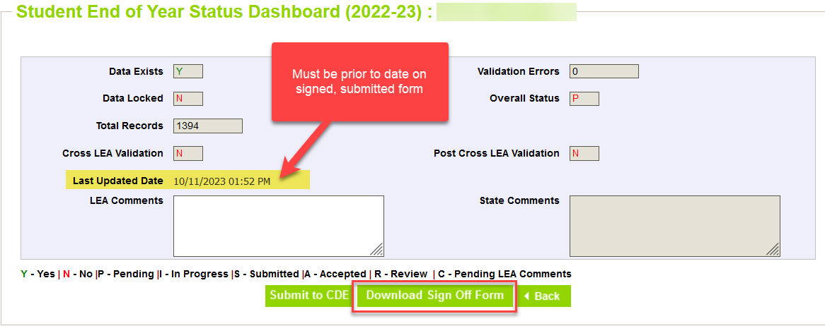
Superintendent Verification (Sign-Off)
Downloaded from data pipeline ‘Status Dashboard’ screen by LEA Approver
  Must be error free
  Must have updated snapshot at least once during Post-Cross Phase
  Cannot have a snapshot update in process
Signed by Superintendent
  Certifies SEY and Graduation Guidelines data is accurate and complete
  Acknowledgment that this data is used in district/school accountability frameworks
  Dated after the last updated date of your SEY snapshot as shown on the SEY status dashboard
    New sign-off form required if snapshot updated after it has been signed
Scan and email to SEY Collection lead, StudentEndOfYear@cde.state.co.us OR upload to your LEA’s student Syncplicity folder
Begin submitting 11/14/24
*will not be accepted early*
Due 12/3/2024

Slide 10
Exception Requests & Data Change Requests
Data Issue
SE900 error
Submit Post-Cross LEA Data Change Request
Data is accurate as reported
Data is incorrect and must be updated
Manually edit SSA data field
(DEM updates, contact SEY first)
Submit Exception Request
Note: SE900 errors require a copy of the student’s adequate documentation to be included as supporting evidence
Manually edit school exit type on SSA file
Update SEY Snapshot

Slide 11
Exception Request
Data does not change
Error/warning clears because the business rule has been overridden
Submit completed exception request template to Syncplicity
SE900 exceptions require LEAs to upload a copy of the adequate documentation (confirmation of enrollment & attendance) in addition to the exception request template
Email StudentEndOfYear@cde.state.co.us to notify request has been placed in Syncplicity for review
Exception Request Template and Exception Request Directions are available on the SEY Website

Slide 12
Post-Cross LEA Data Change Request
Unique to Post-Cross LEA phase of SEY Collection
Data is changed, manually edited in pipeline using the edit record tool
  School Exit Type
  School Exit Date
  Retention Code
  Other data fields in rare circumstances
Error/warning clears due to corrected data
Email StudentEndOfYear@cde.state.co.us to notify request has been placed in Syncplicity for review
Post-Cross LEA Data Change Request Template and Post-Cross LEA Data Change Request Directions are available on the SEY Website

Slide 13
SASID Merges in Post-Cross Phase
LEA will receive a SE500 error indicating the old and new SASIDs when a SASID merge is required
  Rare situations, typically found when researching SE903 errors
Must be handled precisely as directions provided by SEY collection lead dictate due to unique nature of this phase
  Post-Cross SASID merge directions posted on SEY Website in the Post-Cross LEA Phase section
General Steps:
  Upload a single ‘append’ record to the DEM file for the single impacted SASID
    DO NOT delete or alter the original ‘old’ SASID record for this student
    DO NOT use the ‘replace’ function, this overwrites your entire DEM file
  Manually edit the SSA file to reflect the updated SASID
  Correct GG records
    Correct source GG file and upload, replace, GG file containing all student records
  Submit Post Cross Data Change Request
  After receive notification from SEY Collection Lead, update snapshot and use CEDAR/COGNOS report SASID Lookup: SEY and OCT record (prior, current, subsequent year) to verify new SASID has pulled into snapshot

Slide 14
Adding Records in Post-Cross Phase
LEA will receive a SE500 error indicating they may need to add a record for a missing student, or they may determine this through their own data review
  Rare situations, typically found when researching SE903 errors
Must be handled precisely as directions provided by SEY collection lead dictate due to unique nature of this phase
  Post-Cross adding records directions posted on SEY Website in the Post-Cross LEA Phase section
General Steps:
  Upload a single ‘append’ record to the DEM file for the single impacted student
  Upload a single ‘append’ record to the SSA file for the single impacted student
  Correct GG records
    Correct source GG file and upload, replace, GG file containing all student records
  Submit Post Cross Data Change Request
  After receive notification from SEY Collection Lead, update snapshot and use CEDAR/COGNOS report SASID Lookup: SEY and OCT record (prior, current, subsequent year) to verify new SASID has pulled into snapshot

Slide 15
Business Rules

Slide 16
General Information
SE900 errors
  LEAs can clear these by manually updating the school exit type on their SSA file then updating their snapshot.
  These are the only errors that can be addressed independently by LEAs during this phase.
SE900 warnings
  Some will clear when subsequent OCT snapshot is created and then SEY snapshot is updated
  If a change to the SEY data is needed, LEAs must request a Post-Cross LEA Data Change
Any SE001-SE700 series errors
  LEAs may request a Post-Cross LEA Data Change if they need to update student data to clear this rule.
  LEAs may request an exception if the student is accurately coded, and the business rule needs to be ignored for this situation.
October 2024-2025 errors, OC173 or OC185
  LEAs should request a Post-Cross LEA Data Change to correct the retention code in 2023-2024 SEY.

Slide 17
SE901 Error
Sending LEA: Student has school exit type
  40 dropped out
  50 expelled
  70 transfer to HSED prep program
Student reported attending a CO public LEA after leaving sending district (receiving LEA)
Sending LEA: Change to school exit type 13
Impact: If 9th-12th grade, student now belongs to AYG cohort of receiving LEA for graduation/completion rates.

Slide 18
SE902 Error
Sending LEA: Student has school exit type
  18 transfer to CTE/Vocational program not run by a CO public school district
  19 transfer to facility school/state operated program
  21 transfer to CO department of corrections or Division of youth corrections
  30 illness/injury
Student reported attending a CO public school district after leaving sending district (receiving LEA)
Sending LEA: Change to school exit type 13
Impact: If 9th-12th grade, student now belongs to AYG cohort of receiving LEA for graduation/completion rates.
Note: If changing to exit type 13 causes a SE711 error, request an exception to clear the SE711 error.

Slide 19
SE903 Error
Sending District: Student has school exit type 13, transfer to CO public school
No other district has claimed the student after they left the sending district
Sending District: Determine which outcome below is true of the student
  Student transferred to a different educational setting. Update their school exit type accordingly.
  No adequate documentation. Change to school exit type 40, dropped out.
  Adequate documentation proves student attended another CO public school and student was reported by the receiving district with a different SASID. Contact RITS and SEY regarding a potential SASID merge.
  Adequate documentation shows student attended another CO school in 2023-2024 school year, but a SASID merge is not suspected. Upload copy of adequate documentation to Syncplicity and request an exception to keep student coded with exit type 13
Impact: School exit type will determine if student remains in AYG cohort, is counted as a dropout, or transfers out of AYG cohort for the sending district.
Resources:
2023-2024 List of Colorado School Codes public, non-public, detention, DYS, facility
SEY Adequate Documentation Site
National – Public School Lookup (out of state)
National – Private School Lookup (out of state)

Slide 20
SE904 Error
Sending LEA: Student has school exit type 26, transfer to CO detention center
No detention center reported the student after they left the sending LEA
Sending LEA: Determine which outcome below is true of the student
  Adequate documentation shows student transferred to a different educational setting. Update their school exit type accordingly.
    Often, student transferred to DYS or facility school instead
  No adequate documentation. Change to school exit type 40, dropped out.
  Adequate documentation proves student attended CO detention center and student was reported by the receiving detention center with a different SASID. Contact RITS and SEY regarding a potential SASID merge.
  Adequate documentation shows student attended CO detention center in 2023-2024 school year, but a SASID merge is not suspected. Upload copy of adequate documentation to Syncplicity and request an exception to keep student coded with exit type 26
Impact: School exit type will determine if student remains in AYG cohort, is counted as a dropout, or transfers out of AYG cohort for the sending LEA.
Resources:
2023-2024 List of Colorado School Codes public, non-public, detention, DYS, facility
SEY Adequate Documentation Site

Slide 21
SE905 Error
Sending LEA: Student has school exit type 13, transfer to CO public school
No other LEA has claimed the student after they left the sending LEA
Student is on HSED list, indicating they received their HSED in 2023-2024
Sending LEA: Change school exit type to one of the following
  93 HSED recipient, program administered by reporting LEA
  94 transferred to program not run by the LEA and received HSED
Impact: Student remains in the AYG cohort for sending LEA and is counted as a completer for completion rates.

Slide 22
SE907 Error
Sending LEA: Student has school exit type
  40 dropped out
  50 expelled
  70 transfer to HSED prep program
Student reported attending a CO detention center after leaving sending LEA (receiving LEA/detention center)
Sending LEA: Change to school exit type 26
Impact: If 9th-12th grade, student remains in AYG cohort sending LEA for graduation/completion rates. Student is not counted as a dropout if changing from school exit type 40 to 26.

Slide 23
SE906, SE908, SE912 Warnings
New:
SE912
12th grade student has retention code in SEY 2023-2024 but does not have a record in the same LEA for October 2024-2025.
  SE906 = any retention (grade 12 only)
  SE908 = retention 2, postsecondary
  SE912 = retention 3, SPED transition
Possible outcomes and actions:
  Student should not have been marked retained because they completed their education in 2023-2024 and are not returning in 2024-2025.
    Scenarios: Summer graduates/completers. Or students who planned to participate in a postsecondary program or SPED transition, then changed plan over the summer and accepted diploma instead.
    Action: Submit post-cross data change request to remove retention code in SEY 2024 and ensure correct school exit type/date.
  Student was retained and met requirements to be included in OCT 2025.
    Action: Update OCT 2025 snapshot to include the student, then update SEY 2024 to clear warning.
  Student was retained but did not meet requirements to be included in OCT 2025 (enrollment record with school exit date prior to 10/01/2024).
    Action: Ignore warning.

Slide 24
SE909, SE910, SE911 Warnings
New:
SE909, SE910, SE911
Designed to highlight specific anticipated year of graduation (AYG) circumstances.
  AYG is set as part of the SEY collection
  Once set, AYG does not change
  AYG has implications for students who wish to participate in postsecondary programs in a future year as it determines if a student is eligible (5th or 6th year students depending on program)
Scenarios:
  SE909 – Student’s AYG was reconciled across two or more enrollment records, set based upon the highest reported grade level on or after 10/1 this year.
  SE910 – Student in grade K-8 reported as receiving an AYG.
  Note: This is only expected in rare circumstances where a grade reassignment has occurred.
  SE911 – Grade 10, 11, 12 student with entry type 05 or 14. AYG is set based upon current school year.
Action:
  Review student’s enrollment records in CEDAR/COGNOS
    SASID Lookup: SEY and OCT record (prior, current, subsequent year) to review grade level within the LEA
    SASID Lookup: Cross-LEA to review grade level in another LEA
  Contact SEY if you believe reported grade level in your LEA is incorrect, or if you have questions/concerns.

Slide 25
Adequate Documentation Reminders
Adequate documentation is the documentation maintained by districts/schools when students transfer out of their district
  Documentation necessary to avoid incorrectly coding students as dropouts.
  Documentation supports selecting the appropriate exit type for ‘verified transfers out’ of your AYG graduation cohort
Requirements are further outlined in state rule, as seen here:
1 CCR 301-1 Rules for the Administration of the Accreditation of School Districts
Colorado Public Schools and local education agencies are required to send transcripts or to confirm attendance when requested from another Colorado Public School or local education agency within two weeks of receiving the request with the exception of students in out of-home placements whose records must be transferred within five (5) days pursuant to sections 22-32-138(2)(a)(II) and (3)(a), C.R.S
More information and sample forms available on SEY Adequate Documentation site
Notes:
When a student withdraws, districts are authorized to request information from the parent or guardian about the specific type of educational enviornment that a student is transferring to in order to monitor compliance with the School Attendance Law. [section 22-33-104 (1), C.R.S.]

Slide 26
CEDAR/COGNOS Reports

Slide 27
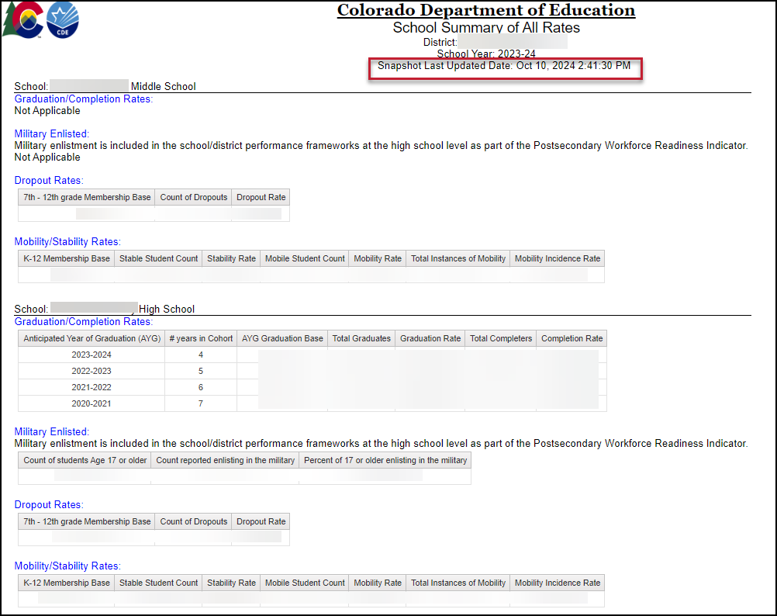
School Summary of All Rates
District level and School Level
Mirrors sign-off form as a high-level overview of rates
  Only includes ‘all students’, not student groups
Displays ‘not applicable’ message under that rate heading when a school does not include the grade range required for a specific type of rate
Shows the last updated date of the SEY snapshot

Slide 28
Q & A

