Slide 1
Student End of Year
Office Hours
November 2024

Slide 2
Agenda
Timeline Review
AYG Overview and Assignment Logic
Superintendent Verification
January Data Release
SEY Privacy Guidelines

Slide 3
Timeline
Date | Event | Details
11/14/2024 to 11/19/2024 | Report Review | Validate Student End of Year data using CEDAR/COGNOS reports. Begin submitting Superintendent Verification (sign-off) forms. Superintendent Verification forms will not be accepted prior to 11/14/2024 and are due 12/03/2024.
11/19/2024 (noon) | Deadline | Post-Cross Phase Ends LEAs must have error-free SEY snapshot
11/22/2024 to 11/26/2024 | Final Report Review | Final review of rates. Reconcile any issues found in CDE’s final review process (if receive notification from SEY collection lead)
12/03/2024 | Deadline | Superintendent Verification (Sign-Off) Form Due Collection Closes Data embargoed until official release in January
01/14/2025 | Data Release | Planned official data release and embargo lifts.

Slide 4
Anticipated Year of Graduation (AYG)
Assigned in the school year a student is first reported as entering high school in Colorado through the Student End of Year collection (grades 9-12)
  AYG is automatically assigned during the SEY collection process
  Once assigned, AYG does not change
  Based upon the student’s highest grade level as of October 1st
If reported in multiple districts, will base AYG on the highest grade level as of 10/1
  EXAMPLE:
    District A reports 10th grade with an exit date on/after October 1st
    District B reports 9th grade with an exit date on/after October 1st
    Student’s AYG will be calculated based on the 10th grade record in District A
  Post-Cross Phase includes mechanics to reconcile AYG across districts
The following data fields are all set in the year that a student’s AYG is assigned
  Starting Year for Graduation Cohort
  Starting Grade for Graduation Cohort
  Starting District for Graduation Cohort
  Anticipated Year of Graduation
Grade Level | AYG Calculation | Example (Current Year 2023-2024)
9th | Current Year + 3 | AYG 2027
10th | Current Year + 2 | AYG 2026
11th | Current Year + 1 | AYG 2025
12th | Current Year | AYG 2024
Notes:
Verified Transfer Out: School Exit Types 02, 05, 13, 14, 15, 16
Exit Types that Comprise the AYG Cohort: 00, 01, 40, 12, 26, 18, 19, 21, 30, 50, 70, 90, 92, 93, 94, 95, 96

Slide 5
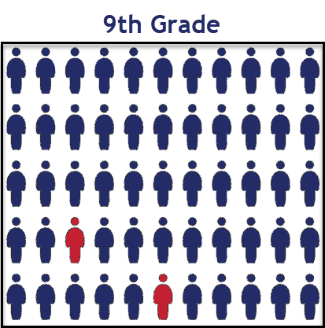
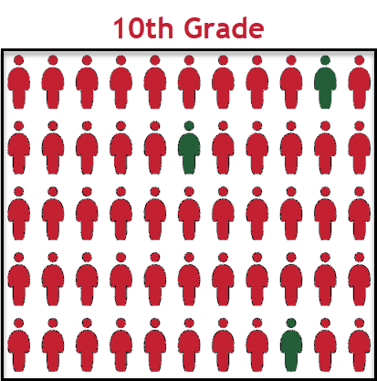
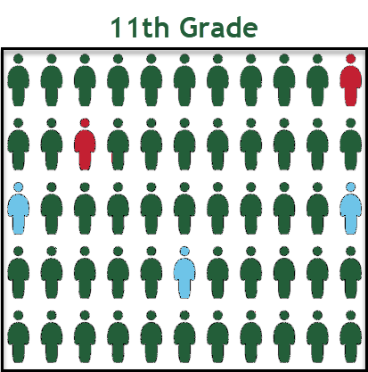
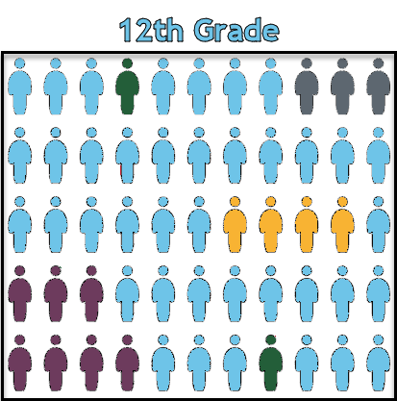
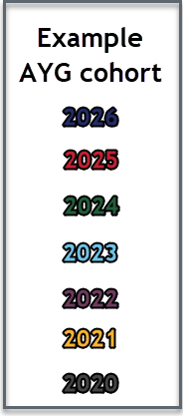
AYG represented in a High School Population
Once a student is assigned an AYG, that AYG remains constant.
Students who experience grade reassignments (acceleration or retention) remain in their original AYG cohort.

Slide 6
SE909, SE910, SE911 Warnings
New:
SE909, SE910, SE911
Designed to highlight specific anticipated year of graduation (AYG) circumstances.
  AYG is set as part of the SEY collection
  Once set, AYG does not change
  AYG has implications for students who wish to participate in postsecondary programs in a future year as it determines if a student is eligible (5th or 6th year students depending on program)
Scenarios:
  SE909 – Student’s AYG was reconciled across two or more enrollment records, set based upon the highest reported grade level on or after 10/1 this year.
  SE910 – Student in grade K-8 reported as receiving an AYG.
  Note: This is only expected in rare circumstances where a grade reassignment has occurred. Typically for an 8th grade record.
  SE911 – Grade 10, 11, 12 student with entry type 05 or 14. AYG is set based upon current school year.
Action:
  Review student’s enrollment records in CEDAR/COGNOS
    SASID Lookup: SEY and OCT record (prior, current, subsequent year) to review grade level within the LEA
    SASID Lookup: Cross-LEA to review grade level in another LEA
  Contact SEY if you believe reported grade level in your LEA is incorrect, or if you have questions/concerns.

Slide 7
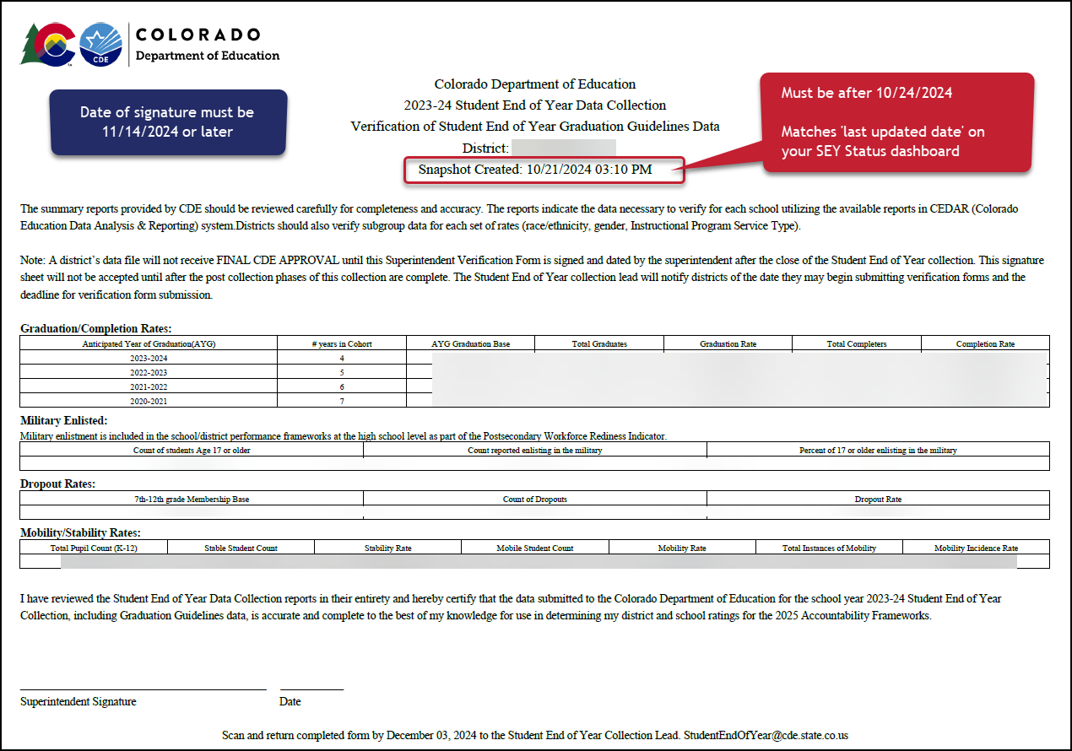
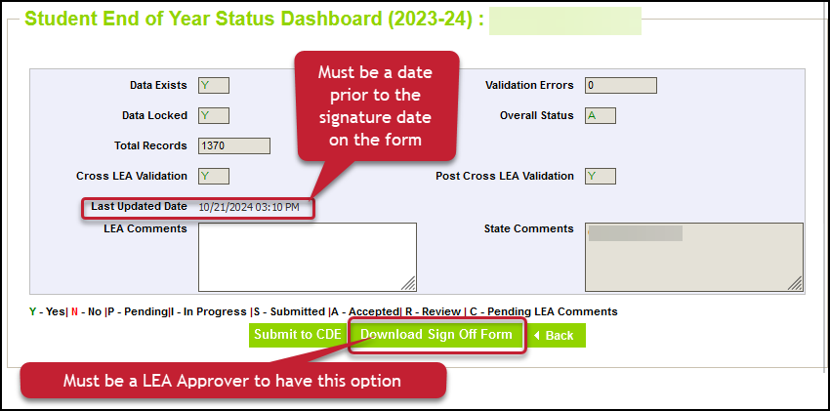
Superintendent Verification Form
Checklist before submitting form:
Snapshot Updated at least once (10/24/24 date or later)
Error Free
All additional changes addressed
Data Validated
Form contains rates for all categories
Signature date after the ‘last updated date’ on your status dashboard
Snapshot created date on top of form matches last updated date on status dashboard
Signature Date 11/14/2024 or later
Email completed forms to StudentEndOfYear@cde.state.co.us
Or upload to Syncplicity and notify StudentEndOfYear@cde.state.co.us

Slide 8
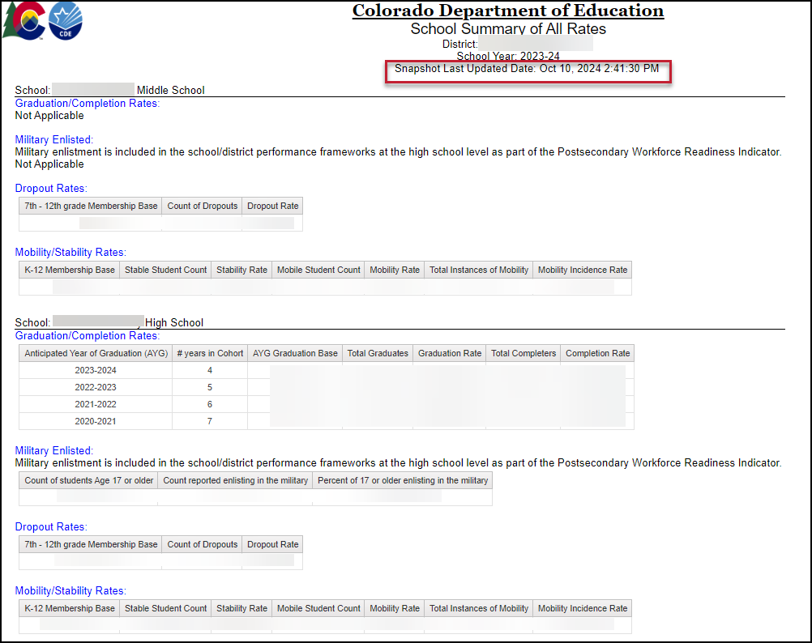
School Summary of All Rates
District level and School Level
Mirrors sign-off form as a high-level overview of rates
  Only includes ‘all students’, not student groups
Displays ‘not applicable’ message under that rate heading when a school does not include the grade range required for a specific type of rate
Shows the last updated date of the SEY snapshot

Slide 9
SEY Public Data Release
Scheduled Date – January 14, 2025
Education statistics based upon the 2023-2024 SEY data are embargoed until the public data release in January 2025
  District data available through COGNOS/CEDAR reports
Districts receive a preview of the state-wide data a few days prior to the public data release
  Sent to SEY Data Respondents from the SEY Collection Lead
  SEY Data Respondents should share with applicable administrative staff within their district (i.e. superintendent, accountability contact, etc.)
CDE sends out a press release and notifications through their communication department when this data is publicly released
  SEY Data Collection lead will send an email to data respondents when the embargo has lifted and data has been publicly released as well
Mobility/Stability Rates & Statistics
  Annual calculation
  Reflect students in grades K-12
Dropout Rates & Statistics
  Annual calculation
  Reflect students in grades 7-12
  Annual Instructional Program Service Type (IPST) status
Graduation/Completion Rates & Statistics
  Cohort based calculation
  Reflect students in given Anticipated Year of Graduation (AYG) cohort
  IPST cohort based upon qualifying IPST status at some point during
  9-12th grade

Slide 10
SEY Privacy Guidelines: District & School Level Data
Privacy Methods: blurring of cohort/membership base sizes with small populations (all students & subgroups), top & bottom masking of rates, and limited suppression
  Using a mix of methods ensures student data is protected while providing transparent information regarding rates
Graduation/Completion and Mobility/Stability use the same rules
Dropout has the same methods, but different membership base size groups and top/bottom masking
More Information: Graduation, Dropout Mobility Rates – Aggregate Data Privacy Guidelines Site
AYG Cohort/ Membership Base Size | Student Group Notes | Top/Bottom Masking
Graduation/Mobility: When 51 or greater, reflect specific size Dropout: 201 or greater | Subgroups with a size of 0-50 (0-200) students shown as “50 or less” (200 or less) Subgroups with a size of 51 (201) or greater are shown as the specific size when doing so does not directly disclose a complementary subgroup size of 50 or less. (200 or less) If a subgroup of 50 (200) or less would be disclosed, the complementary larger subgroup will be shown as “51 or greater” (201 or greater) | Graduation/Mobility: ≥ 98% and ≤ 2% Dropout: ≥ 99.5% and ≤ 0.5%
Graduation/Mobility: 16-50 Dropout: 16-200 | All subgroup cohorts shown as “50 or less” (200 or less) | Graduation/Mobility: ≥ 98% and ≤ 2% Dropout: ≥ 99.5% and ≤ 0.5%
15 or less | All subgroup cohorts shown as (-) | ≥ 90% and ≤ 10%
N/A (0 students) | All subgroups shown as “N/A” | All rates shown as “N/A”

Slide 11
Privacy Guidelines: Graduation Example
Old Method
2021-2022 and prior
School | All Students: AYG Cohort | All Students: Graduate Count | All Students: Graduation Rate | Subgroup A: AYG Cohort | Subgroup A: Graduate Count | Subgroup A: Graduation Rate
School A | 0 | 0 | 0.0% | 0 | 0 | 0.0%
School B | 12 | 11 | 91.7% | 5 | 4 | 80.0%
School C | 50 | 48 | 96.0% | 31 | 31 | 100.0%
School D | 85 | 82 | 96.5% | 21 | 20 | 95.2%
School E | 433 | 415 | 95.8% | 351 | 334 | 95.2%
School F | 99 | 98 | 99.0% | 55 | 55 | 100.0%
Privay Guidelines
2022-2023 forward
School | All Students: AYG Cohort | All Students: Graduation Rate | Subgroup A: AYG Cohort | Subgroup A: Graduation Rate | Subgroup B: AYG Cohort | Subgroup B: Graduation Rate
School A | N/A | N/A | N/A | N/A | N/A | N/A
School B | 15 or less | ≥ 90% | (-) | (-) | (-) | (-)
School C | 16-50 | 96.0% | 50 or less | ≥ 98.0% | 50 or less | 85.0%
School D | 85 | 96.5% | 50 or less | 95.2% | 50 or less | ≥ 98.0%
School E | 433 | 95.8% | 351 | 95.2% | 50 or less | ≤ 2%
School F | 99 | ≥ 98.0% | 51 or greater | ≥ 98.0% | 50 or less | 97.7%

Slide 12
Q & A

