Slide 1
Student End of Year
Office Hours
May 2024

Slide 2
Agenda
Timeline Review
Collaborating with Program Staff
FRL Business Rules
BOCES Schools vs BOCES Programs
Capturing Enrollment Status Changes
Investigating Errors with the report
SASID Lookup: SEY and OCT (prior, current, subsequent year)

Slide 3
Regular Phase Timeline
Date | Event | Event Description | Notes
05/30/2024 | Interim Deadline | Create initial SEY snapshot | Begin working through the errors that require the most collaboration between data staff and program staff in the district. (SE301, SE170, SE209, SE181, SE182, SE183, SE284, SE293, SE300) Collaborate with SPED staff regarding students who have or will participate in SPED Transition Services. Collaborate with High School staff regarding students who will participate in a Postsecondary Program (ASCENT, P-Tech 5 or 6, TREP) next year.
06/12/2024 | Interim Deadline | Error free interchange files. Student Demographic (DEM) Student School Association (SSA) Graduation Guidelines (GG) Title 1 (TA schools only) | Errors on the SSA or DEM file prevent the student’s record from pulling into the SEY snapshot. These may cause ‘missing record’ errors.
7/25/2024 | Interim Deadline | Submit any necessary reporting exceptions for review. | Especially critical for English Learner exceptions as these are a time-intensive review and may required additional documentation.
8/8/2024 | Interim Deadline | Error free SEY Snapshot | Critical date as the SEY collection is time intensive.
8/9/2024 to 9/5/2024 | Report Review | • Validate Student End of Year data using CEDAR/COGNOS reports. • Submit snapshot as soon as review is complete | Collaborate with schools to review student lists. Student List: Dropouts Student List: AYG Cohort Student List: District and School Mobility
9/5/2024 | State Deadline | Submit SEY snapshot | Only users with the LEA Approver role for the SEY collection can submit the snapshot.

Slide 4
Collaborating with Program Staff
District Accountability Staff
  Dropouts
    Student List: Dropout
  Graduate/Completer
    Graduation Guidelines
    Potential Summer Grad/Completers
      August 31, 2024, cut-off for students to be considered grad/completer of 2023-2024 school year
    Student List: AYG Cohort
  Mobility
    Student List: District and School Mobility
Postsecondary Programs
  Students who participated in ASCENT/P-Tech/TREP in 2023-2024
  Students returning in 2024-2025
SPED Transition
  Students who participated in Transition in 2023-2024
  Students returning in 2024-2025 for Transition
Homeless Status
  SE284 & SE308 errors
Migrant Status
Free Reduced Lunch
  Homeless, Migrant, or Foster + FRL errors
  SE181/SE182/SE183 errors
  SE282 & SE283 warnings
English Learners
  SE170 & SE209 errors
    Mid-Year Change form required if 2+ years of EL History
  SE309 – new error checks students who took ACCESS must be NEP/LEP in the current year
New Resource from Accountability Unit: Use of Data Pipeline & Assessment Collections…

Slide 5
FRL Business Rules
School Level
SASID Level
SE181/SE182/SE183 – 10% change or more from OCT to SEY
  Request exception if FRL status for all students in the school is reported accurately
  May trigger when significant population change occurs for small schools
  Exception request only includes error code, error type, district code, school code, reason for request fields
Categorical Eligibility + FRL status
  SE234 & SE235: No exceptions
OCT to SEY change warnings
  SE282 & SE283
  Useful when researching school level errors
  Reasons a change may occur:
    FRL variance wavier allowed use of carry-over status through OCT count then Free/Reduced status elapsed without family submitting paperwork for 2023-2024 year
    FRL verification window in November revealed student is not Free/Reduced

Slide 6





BOCES Schools/Programs
Contract with a BOCES or another School District?
School: BOCES/other district has their own school code
Program: BOCES/other district does NOT have a school code
Home District:
no SEY record,
Group B PAI = 31 or 33
Contract District: SEY record,
Group A PAI = 02 or 04
Home District: SEY Record with Group A PAI 01-08 and Non-School Program Code 03
BOCES Program: no state reporting, including SEY
Home District:
OCT record,
Group B PAI = 31 or 33,
Funding Code = Applicable
Contract District: OCT record,
Group A PAI = 02 or 04,
Funding Code = not funded
Home District: OCT Record with Group A PAI 01-08 and Non-School Program Code 03
BOCES Program: no state reporting, including OCT
Notes:
PAI Codes (on the SSA file):
Group A = Pupils attending an educational program operated by the reporting district
Group B = Resident Pupils attending an educational program not operated by the reporting district
Special Education PAI Codes:
See the Special Education IEP Interchange – Child Participation file layout for information
Based upon students within the Administrative Unit (AU) – which means codes may vary from the PAI codes used on the SSA file since those are based upon district level information
District providing educational services is the district accountable to the student for graduation/completion & dropout rates
OCT coding ensures district of residence is funded because they are paying the Contract BOCES/District school for the services. Contract/BOCES district is not receiving funding.

Slide 7
Exiting to BOCES School Example
Home District
Current Year SSA | School Code | PAI | Entry Type | Entry Date | Exit Type | Exit Date
Attending district school (SEY/Attendance) | 1234 | 01-08 | 02 | 08/15/2023 | 13 | 02/01/2024
Attending BOCES School (OCT/DEC) | 1234 | 31 or 33 | 11* | 02/02/2024 | 00 | 00/00/0000
Subsequent Year SSA | School Code | PAI | Entry Type | Entry Date | Exit Type | Exit Date
Attending BOCES School (OCT/DEC) | 1234 | 31 or 33 | 02* | 08/16/2024 | 00 | 00/00/0000
*Any entry type is permissible since entry type for SSA records with group B PAI codes does not pull into any collection.
BOCES District
Current Year SSA | School Code | PAI | Entry Type | Entry Date | Exit Type | Exit Date
BOCES School Record | 5678 | 01-08 | 13 | 02/02/2024 | 00 | 00/00/0000
Subsequent Year SSA | School Code | PAI | Entry Type | Entry Date | Exit Type | Exit Date
BOCES School Record | 5678 | 01-08 | 02 | 08/16/2024 | 00 | 00/00/0000

Slide 8
Capturing Enrollment Status Changes
Scenario: student remains enrolled in the same school code, but one of the SSA enrollment fields has changed mid-year
  Non-school program, homebased education, postsecondary program enrollment, ILOP, expelled education (may be exit/entry 56 instead)
Using back-to-back exit/entry dates at the same school code ensures this is not considered an instance of mobility
SSA Record | School Code | Entry Date | Entry Type | Exit Date | Exit Type | Homebased Education | PAI
#1: Point ___ status changes | 8765 | 08/15/2023 | 02 | 10/15/2023 | 11 | 1 | 01 – 08
#2: new ___ status | 8765 | 10/16/2023 | 11 | 00/00/0000 | 00 | 0 | 01 – 08
Note: Postsecondary Program Enrollment newly moved to SSA file in 2023-2024. Best practice is to have enrollment records showing status change when PS status changes but may require some transition for districts. 2023-2024 business rules only check for ASCENT/PTECH/TREP in OCT compared to SEY.

Slide 9
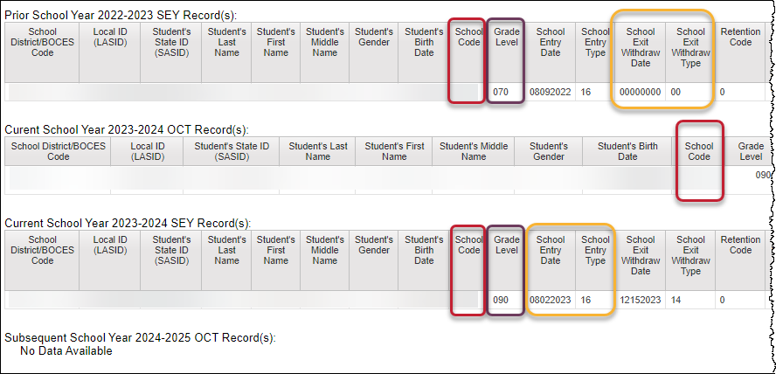
Investigating Errors
SASID Lookup: SEY and OCT record (prior, current, subsequent year)
Code | Issue
SE049/ SE057 | Missing SEY record for student with OCT rec in current year
SE102/ SE105/ SE109/ SE115 | Exit type prior year + entry type/school code current year
SE113/ SE117/ SE242/ SE243 | Grade level & retention code prior year + current year grade level
SE404/ SE292/ SE293 | Missing Record: Student included in prior year with exit type 00 (or retention 2 or 3) should have record in current year
SE060 | Missing OCT record when SEY shows enrollment on OCT 1st
SE050 | Current year exit type expects another record with matching entry type
… | SPED Transition Coding
… | Postsecondary Program Coding
… | OCT compared to SEY demographic
Best report to research cross collection errors related to prior SEY or OCT data.
During post-cross phase, use to research errors related to next year OCT.

Slide 10
Q & A

