Slide 1
Student End of Year Office Hours
August 2024

Slide 2
Agenda
Timeline Review
Completing the Regular Phase: Submitting Snapshot
Looking ahead to the Cross-LEA Phase
CEDAR/COGNOS Basics
Operational Reports (Student Lists)
Reports to Preview Rates
Questions

Slide 3
Timeline
Date | Event | Event Description | Notes
8/9/2024 to 9/5/2024 | Report Review | • Validate Student End of Year data using CEDAR/COGNOS reports. • Submit snapshot as soon as review is complete | Collaborate with schools to review student lists. Student List: Dropouts Student List: AYG Cohort Student List: District and School Mobility Review initial rates. Graduation: 3-,4-,5-,6-,7-year rates by School Year Graduation Rates: District and School by AYG Dropout: District and School Rates Mobility: District and School Rates
9/5/2024 | State Deadline | Submit SEY snapshot | Only users with the LEA Approver role for the SEY collection can submit the snapshot.
9/19/2024 to 10/17/2024 | Collection Phase | Cross LEA Phase | First of two clean-up phases focused on data validation (SE700 series rules). Final opportunity to correct most data fields, especially student demographic coding.
10/24/2024 to 11/19/2024 | Collection Phase | Post-Cross LEA Phase | Final clean-up phase focused on data validation (SE900 series rules). Cross references Student October 2024-2025. Extremely limited changes, mostly school exit type/date.
11/22/2024 to 12/3/2024 | Collection Phase | Final report review and sign-off forms due | Final review of graduation/completion, dropout, and mobility/stability rates. Collection lead works with LEAs impacted by CDE’s final review.
1/14/2025 | Data Release | SEY Public Data Release | All SEY data is embargoed until CDE’s press release on this date. Data respondents will receive notification when the embargo lifts.

Slide 4
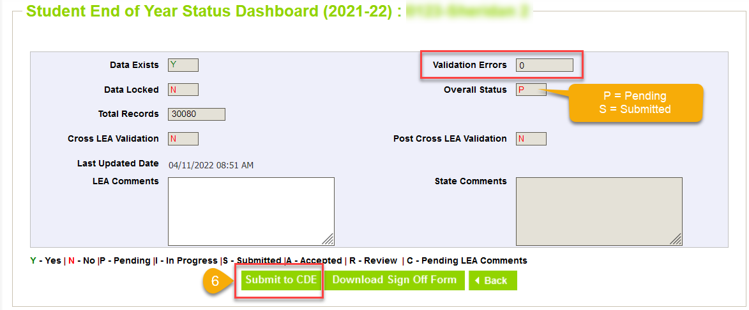
Timeline Review: Complete the Regular Phase
LEA Approvers: Submit your SEY Snapshot
Is your data error free?
Have you updated the exit type for any summer graduate/completers?
Have you checked for any newly retained or unanticipated retained students and updated their 2023-2024 retention code accordingly?
Have you reviewed your rates?

Slide 5
Looking ahead to the Cross-LEA Phase
Purpose
Required LEA Tasks
Second phase of SEY collection
CDE runs a process to cross validate student educational history across all school districts/BOCES
SE700 series errors/warnings are triggered
Ensures accuracy of education statistics
Graduate/completers
Dropouts
Exit one district and recovered by another
Completed HSED
Expect updated CEDAR/COGNOS report for Cross LEA errors/warnings
Review errors/warnings
Create at least one SEY snapshot
Resubmit by October 17, 2024
Review data, making updates as needed
All data fields may be corrected during this phase
Last chance to correct any miscoded student demographic information
Notes:
Some districts will receive new errors/warnings to address
SE700/SE800 series are the primary focus
Any SE001-SE400 series error that arises must also be addressed
Districts with errors/warnings to address make modifications to student records as needed

Slide 6
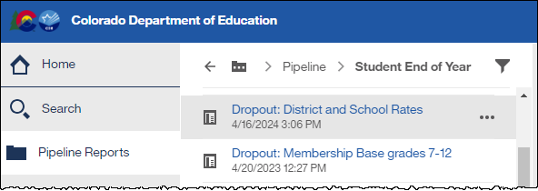
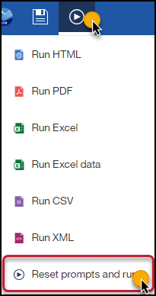
CEDAR/COGNOS Basics
The Colorado Education Data Analysis and Reporting system, CEDAR, is also known as COGNOS
Based on IdM permissions, aligned to data pipeline roles
Access via link on IdM website or from the cognos report link on the bottom of your left menu bar when logged into Data Pipeline
Navigate reports using the left menu bar while in CEDAR
Pipeline Reports Folder
Select desired reports category
Student Profile
Student End of Year
Select desired report
Tip: download reports to excel

Slide 7
Operational Reports

Slide 8
Student List: District and School Mobility Instances
Lists all students with their mobility status at the district and school level
One record per school attended during the year
Includes count of mobility incidents
School Mobility: movement in/out of a school with a gap of 10+ days after 10/1
District Mobility: movement in/out of the LEA with a gap of 10+ days after 10/1

Slide 9
Student List: Dropouts
List of students counted as dropouts for the given school year
Pending update: Students with the summer district dropout coding pattern listed under school code ‘0000’
School Exit Type (40 or 01)
Adjustment Justification Code (40)

Slide 10
Student List: AYG Cohort
Lists all students in an AYG Cohort (Graduation Base) for a given AYG and IPST category
Applicable lists for SEY 2024
AYG 2025, 3 years in cohort
AYG 2024, 4 years in cohort
AYG 2023, 5 years in cohort
AYG 2022, 6 years in cohort
AYG 2021, 7 years in cohort
Last Reported School Year
School Exit Type/Adjustment Justification Code
Status (Graduate, HSED Recipient, Other Transfer, etc.)
Reminder: Students indicated as alternate assessment participants who are also shown as graduates on this report are counted as completers for FEDERAL graduation rate purposes

Slide 11
Exit Types that remain in the AYG Cohort
Code | School Exit Type Description
00 | Student did not exit
01 | Reached maximum age for services
40 | Dropped Out
12 | Transfer to a detention center within district
26 | Transfer to a detention center (out of district)
18 | Transfer to a Career and Technical (vocational) Education program not administered by a CO district/BOCES
19 | Transfer to a Licensed Eligible Approved Facility School or State Operated Program
21 | Transfer to a facility operated by the Colorado Department or Division of Youth Corrections
30 | Illness/Injury
50 | Expulsion (not receiving educational services and did not return before end of the reported year)
70 | HSED Transfer
Code | School Exit Type Description
90 | Graduated with a regular high school diploma
92 | Other Completer (non-diploma certificate)
93 | High School Equivalency Diploma (HSED)
94 | Transferred to non-district HSED program AND received HSED certificate
95 | Received regular diploma in the current year after being reported as a HSED recipient by the reporting district in a prior year
96 | Graduated and completed a Postsecondary Program (ASCENT, P-TECH, TREP)
Notes:
The graduation base represents all students with the same AYG assignment in a given calculation group (state/district/school)
AYG Cohort initially built based upon students entering 9th grade
Transfers in are added to the AYG cohort
Verified transfers out are removed from the AYG Cohort
Graduation & Completion rates use the AYG cohort as the denominator when calculating rates for a given group (state/district/school)
Verified Transfer Out: A Student who has left your district and transferred to another educational enviornment that is providing educational services that lead to a regular high school diploma
Requires adequate documentation
Exit Types:
02 – Death
05 – Transfer to another country
13 – Transfer to another Colorado district
Student enters the AYG cohort for their new district/school
14 – Transfer to another state
15 – Transfer to a non-public school
16 – Transfer to home-based education (homeschool)

Slide 12
Student List: AYG Cohort Adjustments
List students with an adjustment record for in the selected school year
Only LEAs who have uploaded an Adjustment file will have data in this report
AYG cohort impacted
Adjustment School Year
Adjustment Justification Code
Year Adjustment Made (reported)

Slide 13
Adjustment Justification Codes
Code | Short Description | Impact to AYG Cohort
40 | Dropout: No documentation of reenrollment | Remain in AYG cohort
41 | Prior Dropout: Requests for transcripts received | Removed from AYG cohort
42 | Prior Dropout: Received HSED | Remain in AYG cohort, counted as completer
51 | Prior Expulsion: Requests for transcripts received | Removed from AYG cohort
52 | Prior Expulsion: Received HSED | Remain in AYG cohort, counted as completer
71 | Prior HSED Transfer: Request for transcripts received | Removed from AYG cohort
77 | Prior HSED Transfer: Received HSED | Remain in AYG cohort, counted as completer
90 | *Misreported Graduate | Remain in AYG cohort, counted as graduate
96 | *Misreported Graduate Postsecondary Program | Remain in AYG cohort, counted as graduate
*It is better (and easier) to include a one-day record to count a student as a graduate than use the adjustment file to handle misreported graduates because of the graduation guidelines error checks.

Slide 14
Reports to Preview Rates

Slide 15
Mobility: District and School Rates
Preview mobility and stability rates that will be publicly posted on Mobility/Stability Statistics site in January 2025.
SEY 2024 update:
Moved to a wide report in similar format as publicly posted spreadsheets
Former Report Name:
EOY Mobility Rates by School, Grade, Race/Ethnicity, Gender, and IPST
UNSUPPRESSED
Note: All publicly posted rates will have data privacy applied
Student Groups
All students
Gender
Race/Ethnicity
IPST category

Slide 16
Dropout: District and School Rates
Preview dropout rates that will be publicly posted on Dropout Statistics site in January 2025.
SEY 2024 update:
Moved to a wide report in similar format as publicly posted spreadsheets
Consolidated dropout reports
Former Report Name:
EOY Students Dropout Rates by School and IPST
EOY Student Dropout Counts by School and Grade
UNSUPPRESSED
Note: All publicly posted rates will have data privacy applied
Student Groups
All students
Gender
Race/Ethnicity
IPST category
Grade level (internal use only)

Slide 17
Graduation: 3-,4-,5-,6-,7- year Rates by School Year
Preview dropout rates that will be publicly posted on Graduation/Completion Statistics site in January 2025.
SEY 2024 update:
Moved to a wide report in similar format as publicly posted spreadsheets
Consolidated graduation reports
Former Report Name:
EOY On-Time Graduation and Completion Rates
EOY On-Time Graduation Rate by IPST Category for the Current AYG
EOY On-Time Graduation Rates by Race/Ethnicity and Gender or the Current AYG
EOY On-Time High School Graduates and Other Completers by Race/Ethnicity and Gender for the Current AYG
UNSUPPRESSED
Note: All publicly posted rates will have data privacy applied
All applicable AYG cohorts for given school year in one report
Student Groups
All students
Gender
Race/Ethnicity
IPST category

Slide 18
Graduation Rates: District and School by AYG
Review graduation rates for a specific AYG
Shows data over time
0.0% shown when an AYG cohort has not yet reached this year in high school or if the student group
Former Report Name:
EOY All Graduation and Completion Rates for AYG
UNSUPPRESSED
Note: All publicly posted rates will have data privacy applied
Student Groups
All students
Gender
Race/Ethnicity
IPST category

Slide 19
Still Enrolled Rates: District and School by AYG
Only 4-year still enrolled rates (AYG 2024) will be publicly available on the Graduation/Completion Statistics site in January 2025.
Former Report Name:
EOY Students Still Enrolled in Current AYG Cohort Group
Number of students with Exit Type 00 divided by AYG cohort size
Student Groups
All students
Gender
Race/Ethnicity
IPST category

Slide 20
Q & A

