Slide 1
Collaborative Webinar:
Secondary Transition & Student End of Year Data
April 2024
Notes:
Reagan & Erica intro

Slide 2
Agenda
Special Education 18-21 Transition Services Overview
Student End of Year Coding
  Data Fields
  Recommended Coding Patterns
  Transfer Student Coding
  Business Rules
  CEDAR/COGNOS Reports
Resources & Contacts

Slide 3
Special Education 18-21 Transition Services
Overview

Slide 4
Free Appropriate Public Education (FAPE)
Under the IDEA, the state must ensure that FAPE is made available to all children residing in the state between the ages of 3 and 21, inclusive, including children with disabilities who have been suspended or expelled from school. 34 CFR 300.101 (a).
The obligation to provide a FAPE does not apply to students who “have graduated from high school with a regular high school diploma.”
Id. at § 300.102(a)(3)(i).
OR
Students who age out of services at age 21

Slide 5
When Does Secondary Transition Begin?
Beginning with the first IEP developed at age 15, but no later than the end of ninth grade, an IEP is required to include a transition plan. ECEA Rule 4.03(6)(d).
Such plan must identify “appropriate measurable postsecondary goals based upon age-appropriate transition assessments related to training, education, employment and, where appropriate, independent living skills,” as well as the transition services, including a course of study, the student needs to reach those goals. Id.; see also 34 C.F.R. § 300.320(b).

Slide 6
Transition Services: A coordinated set of activities
The coordinated set of activities shall be based upon the individual student's needs, taking into account the student’s strengths, preferences and interests and shall include:
  Instruction
  Related services
  Community experiences
  Development of employment
  Development of other post school adult living activities
  Acquisition of daily living skills (when appropriate)
  Functional vocational evaluation (when appropriate)
  Independent living

Slide 7
What are 18-21 Services? Who are they for?
18-21 services are a part of the continuum of transition services offered by local AUs
Any student with an IEP is eligible for 18-21 services
Students may have met graduation requirements but continue to have transition service needs
Students are counted as graduates in the year they meet graduation requirements (H.B. 19-1066)
Students participate in social graduation
The AU retains the diploma until the student exits 18-21 services
The diploma is awarded in the year that the student exits

Slide 8
H.B. 19-1066 implications
Colorado Graduation Rates
Diploma Issued (FAPE ends)
H.B. 19-1066 allows students who return to participate in 18-21 transition services may be counted as a graduate for graduation rate purposes at the point they have met local and state graduation requirements and return for 18-21 transition services (+ receive funding).
Students participating in 18-21 transition services receive their high school diplomas at the end of their corresponding program.
Diplomas & Transcripts reflect a student’s final exit from K-12 education as the graduation date.
FAPE ends when the student receives their high school diploma.
Note: H.B. 19-1066 does not impact students who will receive non-diploma certificates of completion and counted as an ‘other completer’ with school exit type 92 for completion rate purposes.
Notes:
HB 19-1066 Prevents students participating in 18-21 transition services from negatively affecting the 4-year on time graduation rate for the district/school.
May be counted at the end of the 4th, 5th, or 6th year depending on student’s progress towards local/state graduation requirements. In this instance, counting a student for CO graduation rates is not the same as a student graduating and receiving their diploma.

Slide 9
Student End of Year Coding

Slide 10
Data Collections
Student End of Year
Special Education End of Year
Acronym: SEY
Sometimes referred to as ‘regular’ end of year
Captures student school/district enrollment history
Generates Graduation/Completion rates, Dropout rates, Mobility/Stability rates posted on the Colorado education statistics site.
Data used for federal reporting
Acronym: SPED EOY
Captures students receiving special education services throughout the school year within an Administrative Unit (AU)
Generates Colorado special education data posted here.
Data used for federal reporting

Slide 11
Data Fields

Slide 12
Field: Special Education Transition
Source File: Student Demographic
Field Definition: Specifically designed for 12th grade Special Education students aged 18-21 to move students educational environments to life skills and/or vocation.
  Note: 4th year would apply when student’s 21st birthday falls after the school year begins (based on district’s adopted calendar) and the student will complete the semester in which they turn 21.
Field Values:
Code | Description
0 | No
1 | Year 1 of Transition
2 | Year 2 of Transition
3 | Year 3 of Transition
4 | Year 4 of Transition

Slide 13
Field: Retention Code
Source File: Student School Association
Field Definition: Indicates a student is being retained at the current grade level for the next school year.
Expected Field Value:
  3 – Yes, 12th grader with an IEP who will return to participate in 18-21 transition services in the next year.
Notes:
  Only used on the final record (latest exit date) within a school year
  Do not use retention code 3 in student’s final year of transition services
  Retention code 3 must be paired with one of the following School Exit Types:
    00 – Did Not Exit
    90 – Graduated with regular diploma
    27 – Previously counted as Graduate and will participate in special education 18-21 transition services next year

Slide 14
Field: School Exit Type
Source File: Student School Association
Field Definition: The circumstances under which the student exited from membership.
Expected Field Value: As applicable for a student participating in Transition
Code | Short Description | Notes
00 | Did not exit | Used when student will return the following year and has not yet met graduation requirements.
90 | Graduated with Regular Diploma | Used when student has met graduation requirements. Student may or may not be returning the next year.
27 | Prior Graduate who is returning to participate in transition services next year | Must be paired with school entry type 90 and retention code 3
28 | Prior graduate AND completed Transition | New in 2023-2024. Must be paired with school entry type 90.
92 | Other Completer | Used when student has met local completion criteria for a non-diploma certificate of completion (not a regular diploma) and will not return the following school year (transition services complete).
Notes:
93 HSED Recipient in district program
94 HSED Recipient out of district program

Slide 15
Field: SPED Basis of Exit
Source File: Special Education IEP Interchange – Participation File
Collection Use: Special Education End of Year (SPED EOY)
Field Definition: Indicate the circumstances under which the student exited from Special Education services in your AU. If student is still receiving Special Education services in your AU, this field must be zero filled.
Important Note: When a student receiving 18-21 transition services is counted as a Colorado graduate in the Student End of Year collection per H.B. 19-1066 their SPED Basis of Exit may not match their School Exit Type in the same collection year. These data collections have different purposes and rules.
  See the Special Education End of Year site for information regarding the SPED EOY collection.

Slide 16
Recommended Coding Patterns

Slide 17
Transition Student:
Graduated with regular diploma
Special Education Transition (DEM) | Entry Grade Level (SSA) | School Entry Type (SSA) | School Exit Type (SSA) | Retention Code (SSA) | SPED Basis of Exit
0 | 120 | 02 or 11 | 90 | 3 | 00
1 | 120 | 90 | 27 | 3 | 00
2 | 120 | 90 | 27 | 3 | 00
3 | 120 | 90 | 27 | 3 | 00
4 | 120 | 90 | 28 | 0 | 90
Notes:
School Exit Type 90 is used when a student has met state and local graduation requirements.
School Exit Type 27 is used when a student will continue in transition services the following year.
School Exit Type 28 is used when a student will not continue in transition services the following year.
A student will have School Exit Type 00 (did not exit) with Retention 3 if they have yet not met local/state graduation. In this instance, their subsequent School Entry Type will be 02 or 11.
Coding Guide: Section 5 of the SEY Collection Manual

Slide 18
Transition Students:
Other Completer (non-diploma certificate)
Special Education Transition (DEM) | Entry Grade Level (SSA) | School Entry Type (SSA) | School Exit Type (SSA) | Retention Code (SSA) | SPED Basis of Exit
0 | 120 | 02 or 11 | 00 | 3 | 00
1 | 120 | 02 | 00 | 3 | 00
2 | 120 | 02 | 00 | 3 | 00
3 | 120 | 02 | 00 | 3 | 00
4 | 120 | 02 | 92 | 0 | 92
Notes:
School Exit Type 92 is used when student will not continue in transition services the following year AND is receiving a non-diploma certificate of completion.
SPED Basis of Exit and School Exit Type should match each collection year as these students are not impacted by H.B. 19-1066
Coding Guide: Section 5 of the SEY Collection Manual

Slide 19
Transition Student:
HSED Recipient
Special Education Transition (DEM) | Entry Grade Level (SSA) | School Entry Type (SSA) | School Exit Type (SSA) | Retention Code (SSA) | SPED Basis of Exit
0 | 120 | 02 or 11 | 00 | 3 | 00
1 | 120 | 02 | 00 | 3 | 00
2 | 120 | 02 | 00 | 3 | 00
3 | 120 | 02 | 00 | 3 | 00
4 | 120 | 02 | 93 or 94 | 0 | 93 or 94
Notes:
School Exit Type 93 or 94 is used when student will not continue in transition services the following year AND received their HSED.
SPED Basis of Exit and School Exit Type should match each collection year as these students are not impacted by H.B. 19-1066
Coding Guide: Section 5 of the SEY Collection Manual

Slide 20
Transition Students:
Reached Maximum Age for Services without receiving Diploma or Non-Diploma Certificate
Special Education Transition (DEM) | Entry Grade Level (SSA) | School Entry Type (SSA) | School Exit Type (SSA) | Retention Code (SSA) | SPED Basis of Exit
0 | 120 | 02 or 11 | 00 | 3 | 00
1 | 120 | 02 | 00 | 3 | 00
2 | 120 | 02 | 00 | 3 | 00
3 | 120 | 02 | 00 | 3 | 00
4 | 120 | 02 | 01 | 0 | 01
Notes:
School Exit Type 01 is used when student will not continue in transition services the following year AND did not receive a regular diploma or a non-diploma certificate of completion
Students with School Exit Type 01 are counted as dropouts for dropout rate calculations
SPED Basis of Exit and School Exit Type should match each collection year
Coding Guide: Section 5 of the SEY Collection Manual

Slide 21
Transfer Student Coding

Slide 22
Transfer from another educational environment
Student transferred to a public LEA, does not have a high school diploma, and IEP team has placed student in transition services
  Examples:
    Entry Type 14 (transfer from out of state)
    Entry Type 15 (transfer from non-public school)
Receiving district must review transcripts upon entry and determine the coursework needed for the student to meet local & state graduation requirements
Indicate year of Special Education Transition services on the DEM file
Student may be counted as a Colorado Graduate at the point they meet local & state graduation requirements
  Or, be counted as an ‘other completer’ at the end of their services if applicable
Coding Guide: Section 5 of the SEY Collection Manual

Slide 23
Colorado District Transfers (School Entry Type 13)
Students receiving a regular high school diploma
Districts must work together to determine which district will count the student as a graduate and issue a diploma upon completion of transition services.
Districts are strongly encouraged to ensure parents understand which district will be issuing a high school diploma for the student upon completion of transition services.
Student must meet local & state graduation requirements in the district that will count the student as a graduate.
If the sending district will count the student (school exit type 90), then a one-day record at the end of the student’s transition services will be needed to show student returning to the sending district and transition services ending/diploma issued (school exit type 28).
If the receiving district will count the student (school exit type 90), then the receiving district must review transcripts upon entry and determine if coursework is needed for the student to meet local & state graduation requirements.
Coding Guide: Section 5 of the SEY Collection Manual

Slide 24
Colorado District Transfers (School Entry Type 13)
Students receiving non-diploma certificate of completion
Student counted as an ‘other completer’ in the receiving district upon completion of transition services.
Student must meet receiving district’s local requirements for a non-diploma certificate of completion.
Student coded as ‘other completer’ (School Exit Type 92) in their final year of transition services.
Coding Guide: Section 5 of the SEY Collection Manual

Slide 25
Business Rules

Slide 26
Business Rules & Reporting Exceptions
Business Rules are the list of errors and warnings that are checked when an interchange file is uploaded, or snapshot is created designed to support accurate data reporting
  List available on the SEY Website & Student Interchange Website
Errors: Must be addressed to submit data during a data collection
  Errors on the DEM or SSA files prevent record from pulling into the SEY Snapshot
  GG errors may prevent graduating students from passing the related SEY error checks
Warnings: Indicate possible data inconsistencies (data may be submitted with warnings present)
Reporting Exceptions: used to clear the associated errors (without changing the data) in unique circumstances where a student’s record has accurate information, but their educational history does not follow the anticipated coding patterns outlined in the business rules for an interchange file or snapshot

Slide 27
Business Rule Checks for Transition Students
Grade Level check (grade 120) for students with SPED Transition 1, 2, 3, or 4
Primary Disability must be something other than ’00’ N/A for students with SPED Transition 1, 2, 3, 4
School Entry Type 90 required if student was counted as a graduate (Exit Type 90) in a prior year
  If receiving district has SE240 error for incoming transfer student, request an exception
School Exit Type checks to ensure student is only counted as a CO graduate once
  Includes use of appropriate School Exit Type for students previously counted as graduates
Retention Code 3 agreement with School Exit Type
School Exit Type 27 can only be used by students with SPED Transition 1, 2, 3, 4

Slide 28
CEDAR/COGNOS Reports

Slide 29
CEDAR/COGNOS Overview
The Colorado Education Data Analysis and Reporting system (CEDAR) is a private, secure system which provides student level data to authorized users. Access to student-level data is limited to educators who have need for such data.
  Access based upon Identity Management (IdM) user roles
Reports in CEDAR/COGNOS have multiple purposes. Some are used as operational reports to assist data respondents in looking up specific information on students, file/snapshot errors, and students missing from a snapshot due to profile errors. Other reports are used to validate data when finalizing a data collection. Many reports also provide districts with a preview of data that will be published based upon specific data collections. (i.e., graduation statistics)
SEY CEDAR Report Guide

Slide 30
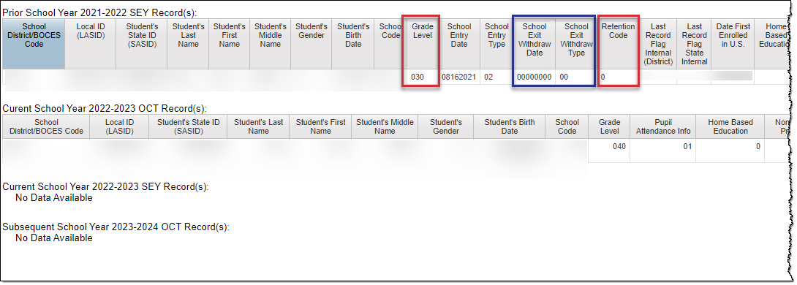
Student End of Year
SASID Lookup: SEY and OCT Record (prior, current, subsequent year)
Available to SEY Approvers, Users, and Viewers
Single SASID lookup
Reflects reported data by your school district only
Updates as snapshots are created
Designed to support business rules that cross check prior year, current year, and subsequent year data

Slide 31
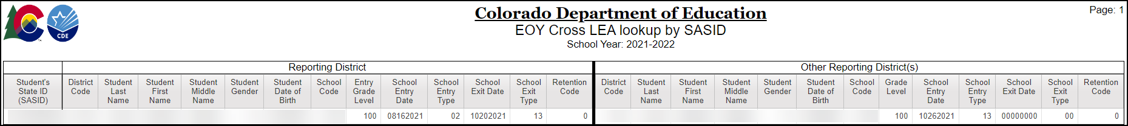
Student End of Year
SASID Lookup: Cross LEA
Available to SEY Approvers, Users, and Viewers
Single SASID lookup
Only reflects data for students in your district who also have a SEY record in another district
  Updates as districts create snapshots
Designed to support districts with business rules that cross check data between districts
  Exit 13/Entry 13
  Graduation/Completer in only one district

Slide 32
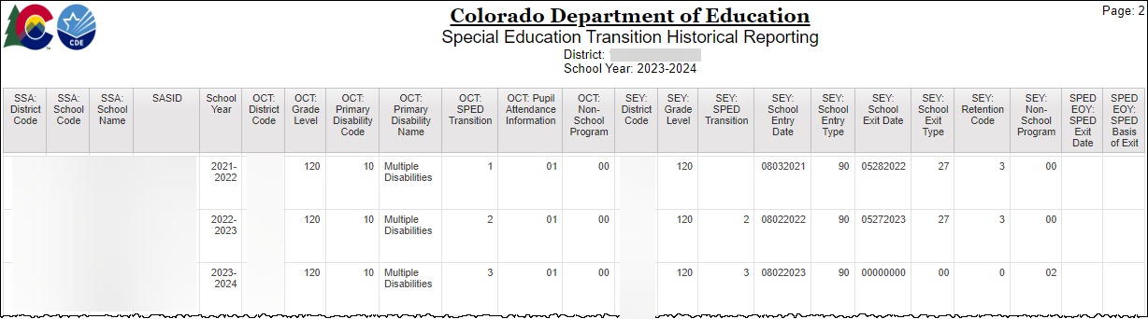
Student Profile
Special Education Transition Historical Reporting
List of students on current SSA file with prior OCT and SEY coding indicating SPED Transition
  Updates with SEY Collection
Includes prior school year records for students in year 2+ of transition
Includes SEY fields to support entry/exit coding

Slide 33
Resources & Contacts

Slide 34
Resources & Contact
Student End of Year Website
  Training Section – PPT & Recording from this webinar
  SEY Collection Manual
Student Interchange Website
  Student Demographic (DEM), Student School Association (SSA), and Graduation Guidelines (GG) file layouts and resources
Secondary Transition
  Resources Page – Technical Assistance Documents, Past Webinars
  Requirements Page
Reagan Ward – SEY Collection Lead
StudentEndOfYear@cde.state.co.us
720-484-9057
Dr. Gail Lott – Secondary Transition Specialist
lott_g@cde.state.co.us
303-501-0347

