Slide 1
Student End of Year
Collection Overview
2023-2024

Slide 2
Agenda
Collection Introduction
SEY Collection Cycle & Timeline
SEY Changes & Training
General Information
  Identity Management (IdM)
  Communication & PII
  Interchange Files
  Snapshot Process
  Status Dashboard
  Business Rules: Errors & Warnings
  Reporting Exceptions & Post Cross Change Requests
  SASID Merges
Regular Phase
Cross LEA Phase
  Adjustment File
Post Cross LEA Phase & Final Dates
  Adequate Documentation
COGNOS (CEDAR) Reports
Published Rates & Reporting
Frequently Asked Questions
  One-Day Records & Exit Type 00
  Retention
  Instances of Mobility
  Anticipated Year of Graduation (AYG)
  English Learner Coding/Exceptions
Bookmark/Resource List

Slide 3
Collection Introduction

Slide 4



Purpose and Use
Capture Enrollment & Outcome Information
Derive Rates & Statistics
Uses
  Demographic
  Education History (entry/exit from schools)
  Graduation/Completion
  Dropout
  Mobility/Stability
  School/District Accountability Measures
  Inform state and federal policy
  Public Information; used in official reports and news articles
  EDFacts reporting (Federal)

Slide 5
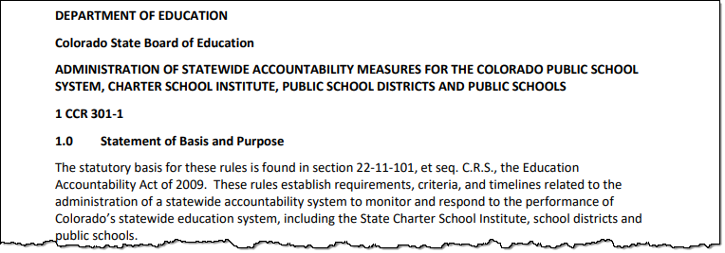
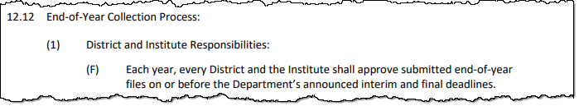
State Board Rule:
SEY Collection Parameters & Timeline
1 CCR 301-1 Rules for the Administration of the Accreditation of School Districts
More Information: Statute, Regulations, Policy regarding State Accountability

Slide 6
Snapshot (collection): Source Files
A data snapshot begins with uploading the corresponding interchange files. These interchange files become the source of information, or source file for specific data fields on a snapshot.
Source File A
Contains multiple columns of data/information as outlined on the file layout for this source file.
Source File B
Contains multiple columns of data/information as outlined on the file layout for this source file.
File A: Element 1
File A: Element 2
File B: Element 1
File B: Element 2
File A: Element 4
File A: Element 3
File A: Element 5
File B: Element 3
File B: Element 4

Slide 7
Snapshot (collection): Creation
When a snapshot is triggered, it pulls needed information from the source (interchange) files into a new file called the snapshot.
Source File A
Source File B
File A: Element 1
File A: Element 4
File B: Element 1
File B: Element 4
File A: Element 2
File A: Element 3
File A: Element 5
File B: Element 2
File B: Element 3
Snapshot

Slide 8
Snapshot (collection): Internal Flags
Snapshots typically won’t use every data element on a source file.
Snapshots often pull in information called “internal flags.” These are calculated pieces of data from information provided on the interchange files or from other internal data in data pipeline.
Source File A
Source File B
Internal Flags
File A: Element 2
File A: Element 5
File B: Element 3
Internal Flag: 1
Internal Flag: 2
Internal Flag: 3
Snapshot
File A: Element 1
File B: Element 1
File A: Element 3
File A: Element 4
File B: Element 2
File B: Element 4

Slide 9
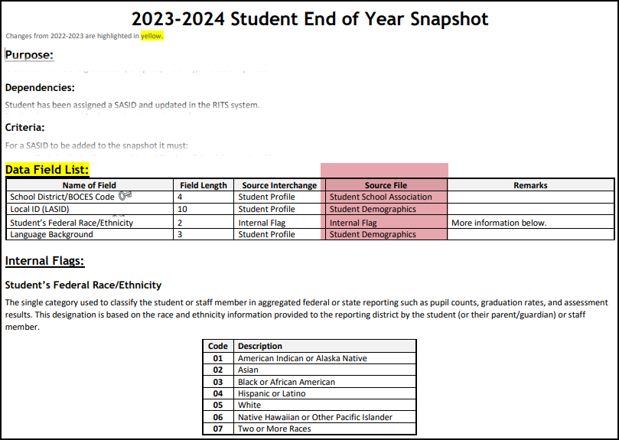
Snapshot (collection): File Layout
Interchange File Layout
  Provides a list of each data field included on an interchange (source) with detailed descriptions and codes.
Snapshot File Layout
  Dependencies: List of source interchange files needed for the snapshot
  Criteria: Rules regarding the types of records pulled from a source file into a snapshot
  Data Fields: Includes a list of specific source files for each data field or indicates the field is an internal flag.
  Internal Flag Definitions: Provides detailed descriptions of each internal flag data field and codes.

Slide 10
SEY Snapshot Dependencies
Student has been assigned a SASID and updated in the RITS system
Student has a record in the student interchange for:
  Student Demographics
  Student School Association (may have multiple records)
  Graduation Guidelines (only required for graduating students)
  Adjustment File (only required if adjusting prior year data)
Student has a record in the Title 1 interchange if:
Internal Flag
  Student has received Targeted Assisted Services/Funding (as of Oct. 1)
Student has a record in the IEP interchange if:
Internal Flag
  Student is a special education student

Slide 11
SEY Snapshot Criteria
Error free interchange records
Enrollment records on the Student School Association file where…
  Primary School = 1 (Yes)
  School Code is a valid public school
  Pupil Attendance Information is between 01 and 08 (Group A records only)
  Grade Level is not ‘002’ infant
Matched records from other source files
  Student Demographic (SASID, District Code, School Year)
  Graduation Guidelines (SASID)
  Other data sources such as Title I Interchange, SPED Interchange, & internal lists (SASID)
All students in grades PK-12 counted in membership at any time between July 1 and June 30 of the reported school year including students who left the LEA during that time or attended a non-school program (i.e., BOCES Program, Institute of Higher Education)

Slide 12
SEY Collection Cycle & Timeline

Slide 13
SEY Collection Cycle
Apr. 1 to Apr. 26
*Optional*
May 2 to Sept. 5
Primary collection phase
Many interim deadlines throughout the phase
Sept. 19 to Oct. 24
Oct. 24 to Nov. 19
Limited changes allowed
Nov. 22 to Nov. 26 final report review
Dec. 3 Superintendent Verification Due
Jan. 14, 2025, Data Release
Soft Open
Regular Phase
Cross LEA Phase
Post-Cross LEA Phase
Final Dates
Note: The SEY data collection overlaps with many student data collections throughout the cycle. Data respondents who are responsible for multiple collections are encouraged to review the Data Pipeline Collection Dates document posted on the Data Pipeline Resources page to plan accordingly.

Slide 14
Key Dates: Soft Open Phase
Date | Event | Event Description
04/01/2024 | Open | Districts may begin creating snapshots.
04/03/2024 1:00-2:30pm | Training Event | Collection Overview Training 1 of 2: This training covers all elements of the Student End of Year collection. It is being offered in two identical sessions to provide the opportunity for all SEY data respondents to attend a live session. Click here to register for this training event.
04/11/2024 | Interim Deadline | Upload initial Graduation Guidelines (GG) interchange file. Districts are expected to have an upload date 01/01/2024 or later to meet this interim deadline.
04/22/2024 1:00-2:00pm | Training Event | Collaborative Webinar – Special Education 18-21 Transition Services This webinar is designed for data respondents and district special education staff who support 18-21 transition services. Click here to register for this training event.
04/26/2024 | Closed | Soft open phase ends and snapshots are closed until the next phase.
Note: Creating snapshots during this phase is optional. Business rules and documentation will continue to be updated throughout this phase. Districts are expected to meet the Interim Deadline for uploading the graduation guidelines file during this phase.

Slide 15
Key Dates: Regular Phase
Date | Event | Event Description
04/29/2024 | Training Event | Collection Overview Training 2 of 2
05/02/2024 | Open | Collection officially opens. Districts may create snapshots. Adjustment (ADJ) interchange file opens.
05/09/2024 | Interim Deadline | Upload the remaining initial end of year interchange files. Student Demographic (DEM) Student School Association (SSA) Title 1 (Targeted Assistance schools only) Districts are expected to have an upload date 04/01/2024 or later to meet this interim deadline.
05/15/2024 | Training Event | May SEY Office Hours
05/30/2024 | Interim Deadline | Create initial SEY snapshot
06/12/2024 | Interim Deadline | Error free interchange files. Student Demographic (DEM) Student School Association (SSA) Graduation Guidelines (GG) Title 1 (Targeted Assistance schools only)
06/12/2024 | Training Event | June SEY Office Hours
07/17/2024 | Training Event | July SEY Office Hours
07/25/2024 | Interim Deadline | Submit any necessary reporting exceptions for review
08/08/2024 | Interim Deadline | Error free SEY Snapshot
08/09/2024 – 09/05/2024 | Report Review | Validate Student End of Year data using CEDAR/COGNOS reports. Submit snapshot as soon as review is complete.
09/05/2024 | State Deadline | Submit Student End of Year Snapshot
Note: This is the primary data collection and clean-up phase for the SEY Collection. LEAs are encouraged to work on this collection early as errors that require input from program staff in your district may be more difficult to reconcile over the summer due to vacation/breaks.

Slide 16
Key Dates: Cross LEA Phase
Date | Event | Event Description
09/18/2024 | Training Event | September SEY Office Hours: Focus – Cross LEA Phase
09/19/2024 | Open | Districts may begin creating snapshots as soon as they receive a ‘snapshot unlocked’ notification from data pipeline; typically mid-day.
10/07/2024 | Interim Deadline | Error free Cross LEA SEY Snapshot
10/08/2024 – 10/17/2024 | Report Review | Validate Student End of Year data using CEDAR/COGNOS reports. Submit snapshot as soon as review is complete.
10/17/2024 | Deadline | Resubmit Student End of Year Snapshot
CDE runs a process to cross validate data across all school districts/BOCES.
  Cross references student educational history across school districts; focused on transfer students
  SE700 and SE800 series errors/warnings
Ensures validity of education statistics
  Students may only count as a graduate/completer in one district and one year
  Students who dropout are attributed to their final district of attendance during the school year.
  Students who left a district and were recovered by another district or completed a HSED are reconciled
All data fields may be corrected during this phase.
All districts must create at least one SEY snapshot during this phase and resubmit an error-free snapshot.

Slide 17
Key Dates: Post-Cross LEA Phase
Date | Event | Event Description
10/23/2024 | Training Event | October SEY Office Hours: Focus – Post-Cross LEA Phase
10/24/2024 | Open | Districts may begin updating their snapshot to address post-cross LEA business rules. Note: Only records receiving SE900 series errors may be updated without an approved post-cross change request or exception request.
11/13/2024 | Interim Deadline | Error free Student End of Year snapshot and responses provided to any request for adequate documentation by another district/BOCES.
11/13/2024 | Training Event | November SEY Office Hours: Focus – Final Dates & Data Release
11/14/2024 – 11/19/2024 | Report Review | Validate Student End of Year data using CEDAR/COGNOS reports. Begin submitting Superintendent Verification (sign-off) forms. Superintendent Verification forms will not be accepted prior to 11/14/2024 and are due 12/03/2024.
11/19/2024 (noon) | Deadline | Post-cross phase ends. Districts must have error free Student End of Year snapshots and have addressed any necessary post-cross change.
CDE runs a process to cross validate data across all school districts/BOCES.
  SE900 series errors/warnings
Final opportunity for districts to validate their SEY data.
Districts can only update select data for select students based upon SE900 series errors/warnings.
During this phase, snapshots are not unlocked, only ‘updated’.
  All districts must ‘update’ their snapshot at least once during this phase, even if no SE900 business rules were triggered.

Slide 18
Key Dates: Final Dates
Date | Event | Event Description
11/22/2024 – 11/26/2024 (noon) | Report Review | Final review of graduation/completion, dropout, and mobility/stability rates. Reconcile any issues found in CDE’s final review process. SEY Collection lead will notify impacted districts/BOCES directly 11/20/2024 – 11/21/2024. Reminder: Any changes will require a new Superintendent Verification Form.
12/3/2024 | Deadline | Collection closes. Superintendent Verification (sign-off) form due. Data remains embargoed until the official release in January.
01/14/2025 | Data Release | Official data release and embargo lifts. Graduation/completion, dropout, and mobility rates posted on the CDE website and released to the public.
Superintendent Verification Form:
Download from data pipeline ‘status dashboard’ screen
Signed by Superintendent
  Certifies SEY and Graduation Guidelines data is accurate and complete
  Acknowledgment that this data is used in district/school accountability frameworks
Dated after the last updated date of your SEY snapshot as shown on the SEY status dashboard
Scan and email to SEY Collection lead
Final Data:
Embargoed until the official release January 14, 2025
Districts may use COGNOS/CEDAR reports internally, but may not share graduation/dropout/mobility rates publicly

Slide 19
SEY Changes & Training

Slide 20
*New*
2023-2024
Data Fields
Innovative Learning Opportunities Pilot (ILOP)
  From SSA file
  Pulled in to mirror Student October fields for analysis by CDE program staff
Last Record School Internal
  Existing internal flag that identifies the final enrollment record for a student in a given school
  Newly visible to districts on snapshot extract
Complete file layout available on SEY Website

Slide 21
*New* 2023-2024:
Cross Collection Business Rules
New
Updated
Students who took WIDA Access must be coded with Language Proficiency 1 or 2 (NEP/LEP)
  SASID level Assessment to SEY
Date First Enrolled in US
  Assessment to SEY
Homeless status check by SASID
  October to SEY
  Assessment to SEY
Title 1 Targeted Assistance by SASID
  October to SEY
Free Lunch by SASID (Warning)
  October to SEY
Post-Cross: SPED Transition in next October without retention 3 in SEY (Warning)
Military Connected (SE026)
  October to SEY
Language Proficiency (SE209)
  October to SEY
FRL % Change from OCT to SEY
  Moved from District to School Level
  SE181, SE182, SE183
Missing record PK Student (SE057)
  Reported in OCT with PAI 01-08
  No record in SEY

Slide 22
On-Going Upgrades:
CEDAR/COGNOS
New Planned Reports
Planned Upgrades
Student List: Students excluded due to snapshot criteria
  Use in place of some SE400 warnings
Cross LEA List: Students Removed from AYG Cohort
  Use in place of some SE800 and SE700 warnings
Cross LEA List: Students with SE700 errors or warnings
  Improve workflow of Cross LEA phase
School Summary of All Rates
  Mirrors sign-off form but at the school level
Deactivate outdated reports
Update or consolidate existing graduation rate reports to increase ease of use
Rename reports to help differentiate between operational reports and reports designed to mirror posted rates

Slide 23
Training
Collection Overview
  Offered in two identical sessions
    4/3/2024, 4/29/2024
    Recording Posted by 4/30/24
  Primary training for SEY collection
  Strongly suggest that all SEY respondents attend one of the two sessions
Collaborative Webinars
  Designed for program staff and data staff to attend together
    Postsecondary Programs
      3/6/2024, Recording Posted
    Special Education 18-21 Transition
      4/22/2024, Recording Posted
Monthly Office Hours
  Ongoing support throughout collection
  Select Wednesdays 2:30-3:30pm
    5/15, 6/12, 7/17, 8/14, 9/18, 10/23, 11/13
  Agenda varies based upon questions from respondents and information pertinent to the specific point in the collection
Short Byte Videos
  Pre-recorded topic-based videos
  5-15 minutes long
Registration Links & Detailed Schedule available on SEY Website

Slide 24
General Information

Slide 25
Data Pipeline Weekly Maintenance
Data Pipeline has a weekly maintenance window on Tuesday afternoons, during which time users may not be able to access file uploads and snapshots.
What does this mean for you?
  Avoid taking a SEY Snapshot on Tuesdays between 4pm-8pm.
  If you are attempting to do a file upload and are locked out of pipeline, try again in about an hour.

Slide 26
Collection Roles:
Identity Management

Slide 27
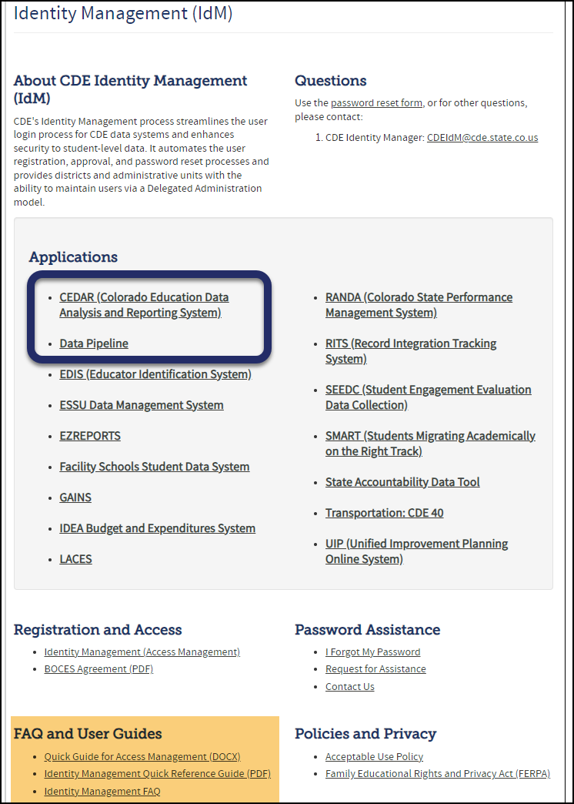
Identity Management (IdM)
Bookmark: Identity Management Site
District Local Access Manager (LAM) assigns account/privileges
  LAMs: IdM Quick Guide for Access Management (DOCX)
Provides access to the various CDE tools
Data Pipeline permissions are needed to complete data collections
CEDAR/COGNOS permissions are based upon the user’s data pipeline permissions
Users can only have one role per data collection

Slide 28
SEY IdM Roles
Application | Collection | User Role | Access & Notes
Pipeline | Student Interchange | LEA User | Required for SEY data respondents. Upload and edit records for DEM, SSA, & GG files.
Pipeline | Student End of Year | LEA Approver | At least one required per LEA. Create snapshot, submit snapshot, download sign-off form.
Pipeline | Student End of Year | LEA User | Additional support for SEY within the LEA. Create snapshot.
Pipeline | Any | LEA Viewer | View CEDAR/COGNOS reports related to the assigned collection but cannot edit data. Useful role for district support staff who help validate data but do not actively complete the collection.
A user can only have one role for each Collection
IdM user roles are used by CDE to create email lists & grant collection specific access
  Collection emails – typically only LEA Approvers and LEA Users
  Data Pipeline Town Hall – all data pipeline users
  Syncplicity access (does not auto update, but is monitored by collection leads)

Slide 29
Communication & PII

Slide 30
SEY Collection Lead
Here to answer questions and assist where possible
  Student End of Year collection
  Student Interchange 2023-2024 questions
Don’t get frustrated, reach out!
To best assist you, please help me with the following
  Include your 4-digit district code in emails and voicemails
  Leave voicemails or send follow-up emails if I miss your call
  Ensure your phone number is accurate in IdM (ask your LAM to help if it needs to be updated)
Email: StudentEndofYear@cde.state.co.us
Phone: 720-484-9057

Slide 31
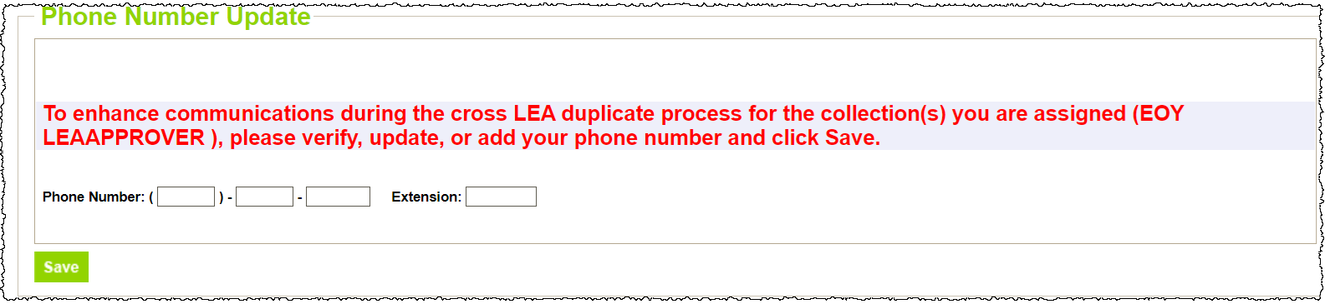
Data Respondent Phone Numbers
Data respondents are asked to maintain current phone numbers in Data Pipeline.
  On-screen prompt when login to pipeline if no phone number has been entered.
  Check existing phone number using CEDAR/COGNOS report EOY Contact List.
    Email StudentEndofYear@cde.state.co.us if phone number is incorrect on the EOY Contact List but no prompt shows on the data pipeline screen when you login.

Slide 32
Personally Identifiable Information (PII)
Personally Identifiable Information (PII) is defined by state and federal laws as information that alone, or in combination, personally identifies an individual
  Includes direct identifiers (i.e. SASID, student names)
  Includes information when combined is identifiable
Colorado’s Student Data Transparency and Security Act outlines requirements for how Student PII is collected, used and shared
See CDE’s data security and privacy site for more information

Slide 33


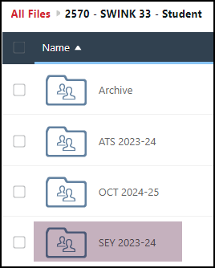
Communicating PII – Syncplicity
At times data respondents may need to communicate PII with the SEY collection lead, this must be done through secure methods. DO NOT EMAIL PII
  Phone call is secure method; 720-484-9057
  Please do not leave PII in voicemail but rather request a return call to discuss PII
Syncplicity
  Secure file transfer site used to communicate PII with CDE collection leads
  Each collection lead maintains their own Syncplicity folder and can assign rights to that folder
    Student End of Year, Student October, and Attendance all utilize the same primary folder with subfolders to organize the collections
      Primary Syncplicity Folder: District Code – DISTRICT NAME – Student
      Subfolder: SEY 2023-24
  Email CDE collection lead when a file
  has been uploaded to syncplicity for review
    StudentEndOfYear@cde.state.co.us

Slide 34
Interchange Files

Slide 35





Student Interchange Files
Student Demographic File
  One record per student
  Upload this file first
Student School Association File
  May include multiple records per student
  Only records meeting the snapshot criteria will pull into SEY
Student Interchange
Graduation Guidelines File
  Secondary students only
  Expect multiple records per student
Adjustment File
  As needed for SEY Collection

Slide 36


Other Interchanges
Title 1
  Targeted Assistance schools only
SPED Participation File
  Students with an IEP only
Note: Partner with the person responsible for these files in your LEA as these files are often overseen by someone other than the SEY data respondent in a LEA.

Slide 37
Interchange Preparation
Get SASIDs for your new students
  Through RITS or Data Pipeline
  Visit the RITS Website for resources and instructions regarding SASIDs
Create Extracts from your Student Information System
  Pull data for the Student Demographic/Profile file and Student School Association
    Data Pipeline accepts .csv, .xls, .xlsx formats
      .xls & .xlsx are the recommended formats
  If opening file in Excel, please make sure you don’t lose leading zeros
    The newest version of excel has a pop-up asking if you want to keep leading zeros
    CDE has a guide to keeping leading zeros on Student Interchange website
  CDE recommends using a file naming convention:
    Example: 0110_DEM_EOY_04052024.xls
    Spaces in the file name are not allowed

Slide 38
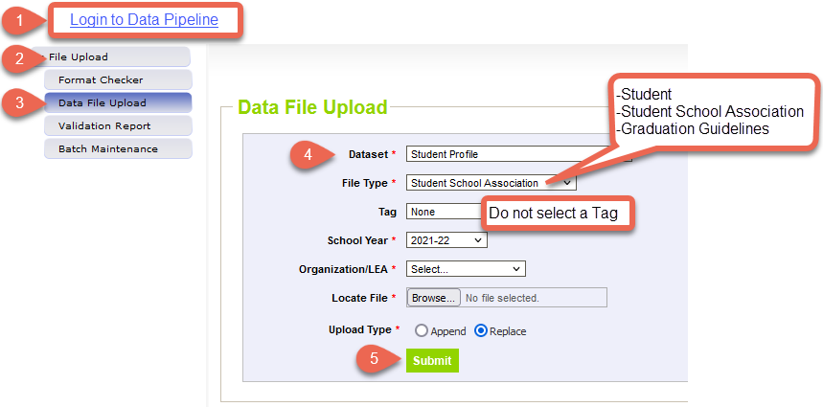
Data File Upload
Update your Interchange files to address errors
  Preferred: Update in SIS → Extract → Upload to Pipeline
  Alternate Method: Edit Record Tool (Data Pipeline)
    Not encouraged during the Regular Phase or Cross LEA Phase
    This method is required for the Post-Cross LEA Phase
Wait for a Confirmation Email from the Pipeline System
  The email will show you the number of errors in your upload
  Use Pipeline or CEDAR reports to review errors and warnings

Slide 39
Snapshot

Slide 40
Snapshot Process
Regular Phase & Cross LEA Phase
Once snapshot is error free…
6. Review COGNOS/CEDAR reports to validate data
  Error free ≠ Accurate
7. Submit snapshot
  LEA Approver Only
  Data Pipeline → Status Dashboard → Submit to CDE
  Regular Phase Deadline: September 5th
  Cross LEA Deadline: October 17th
1. Create Snapshot
5. Review Student Interchange Errors and address as needed
2. Review Snapshot Errors and Warnings
4. Upload corresponding Student Interchange file
3. Update student records in SIS to address errors/warnings

Slide 41
Snapshot Process
Post-Cross LEA Phase
Once snapshot is error free…
Post-Cross Error Free Deadline: November 19th
5. Review COGNOS/CEDAR reports to validate data
  Error free ≠ Accurate
6. Download Sign-Off Form
  LEA Approver Only
  Data Pipeline → Status Dashboard → Download Sign-Off Form
  Email signed form to SEY collection lead
  Deadline: December 3rd
    Forms will not be accepted prior to November 14th
1. Update Snapshot
  Only SE900 errors can be updated without a data change request or exception request
4. Update student records in SIS to reflect manual changes
2. Review Snapshot Errors and Warnings
3. Edit student records manually in data pipeline
  Ensure Student Interchange file is still error free
  Submit data change or exception request for all updates outside of SE900 errors
  May need to update subsequent Student October data for some warnings

Slide 42
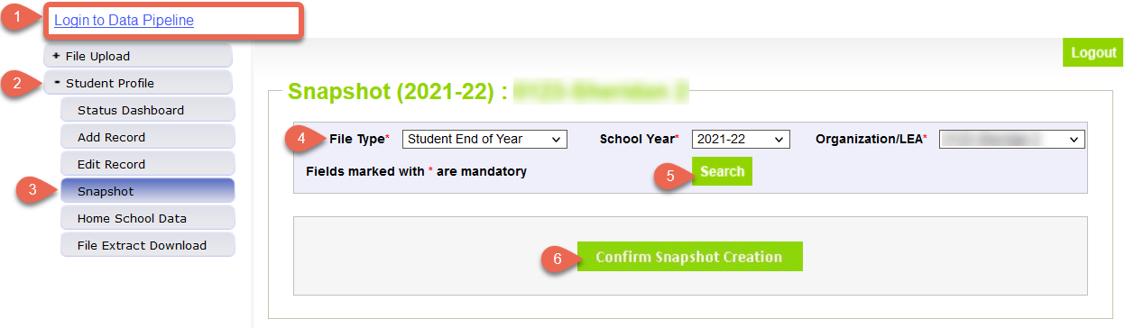
Create Snapshot
Regular Phase & Cross LEA Phase
The message “Snapshot creation triggered and processing. A notification email will be sent upon completion” will appear at the top of the screen after you press the confirm snapshot creation button
Wait for the notification email before reviewing errors/warnings
Creating a new snapshot will replace all the records from your previous snapshot

Slide 43
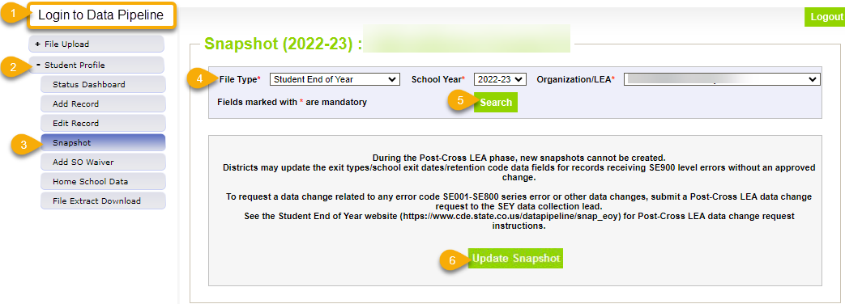
Update Snapshot
Post-Cross LEA Phase
The message “Snapshot creation triggered and processing. A notification email will be sent upon completion” will appear at the top of the screen after you press the confirm snapshot creation button
Data is only updated for records with SE900 series errors or approved data change request
Clears errors for approved exception requests
All districts should ‘update’ their snapshot at least once during the Post-Cross LEA phase even if they do not make any changes to student records

Slide 44
Status Dashboard

Slide 45
Status Dashboard Information
Allows you to review the status of a submitted interchange file or snapshot
  Quantity of errors
  Data Exists ‘Y’ means successful snapshot creation
  Data Locked ‘Y’ means snapshot creation is not available
    Post-Cross LEA updates can be completed in this status
  Overall Status
    ‘P’ Pending
    ‘S’ Submitted
  Last Updated Date
    This date/time should be more recent on your SEY snapshot than on the related student interchange files
Used to submit snapshot to CDE
Used to download the superintendent verification (sign-off) form during the final phase of data collection
  Last Updated Date on the status dashboard must be prior to the date on the sign-off form for the form to be accepted

Slide 46
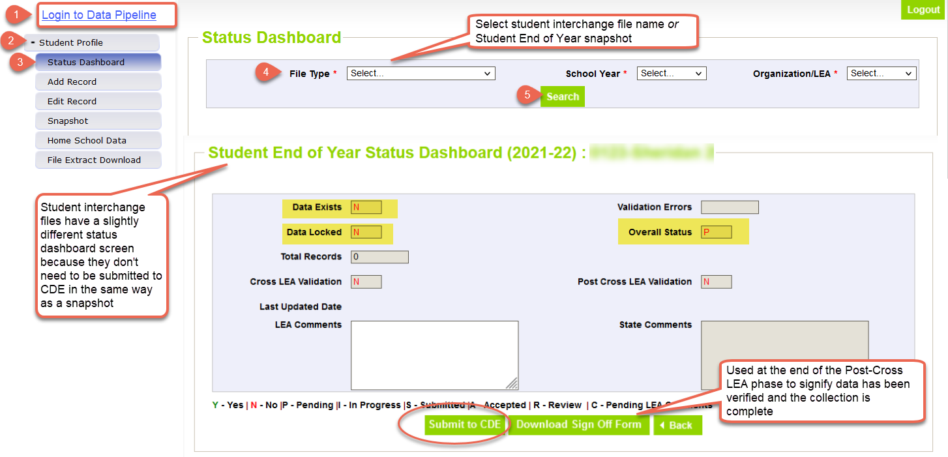
Status Dashboard Screen

Slide 47
Business Rules:
Errors & Warnings

Slide 48
Business Rules
Business Rules are the list of errors and warnings that are checked when an interchange file is uploaded, or snapshot is created
Available on the SEY Website
  Note: Business Rules will continue to be updated through the official open on May 2nd
Kinds of information checked:
  Demographic information (some fields typically do not change from Student October to Student End of Year)
  Valid student entry/exit types, internally and across districts
  Graduating/completing/dropout student coding to ensure accuracy of reporting
    Cohort groups
    Student movement between districts
    Students retained (academic, postsecondary programs, transition programs)
    Identify dropouts from prior years showing up in other districts
    Identify students for whom an HSED certificate has been reported

Slide 49
Errors/Warnings:
Overview
Errors
Warnings
Must be addressed
  Update data fields to clear
  Request reporting exception if student data is accurate but does not follow the typical coding pattern as indicated by the error message
Snapshot cannot be submitted if there are any errors
Indicate possible data inconsistencies/coding issues
Some SEY warnings indicate issues that will turn into errors in the post collection phases if not addressed
Snapshot can be submitted even if warnings are present
Pro Tip: Review warnings to look for patterns/areas where district data could be documented in a more accurate manner

Slide 50
Errors/Warnings:
Interchange vs Snapshot
Interchange
Snapshot
Address data inconsistencies that apply to multiple data collections (snapshots)
Errors on the student demographics and student school association interchange files prevent the student from being included on the SEY snapshot
Errors on the graduation guidelines file prevent that measure from being associated with a graduating student’s SASID
Business Rules: Student Interchange Website
Address data inconsistencies that apply to SEY data collection specifically
Focused on the student’s educational history to ensuring accuracy when deriving graduation, dropout, mobility, and stability rates
Business Rules: Student End of Year Website

Slide 51
Addressing Snapshot Errors/Warnings
Data fields must be updated on the corresponding student interchange file
  Regular Phase & Cross LEA Phase: Upload a new interchange file
    Student Demographic
    Student School Association
    Graduation Guidelines
    Adjustments
  Post-Cross Phase: Manually edit the interchange file in data pipeline
    Student Demographic
    Student School Association
Must create a new snapshot to clear snapshot level errors
  Snapshot creation causes pipeline to run the data through the business rules again

Slide 52
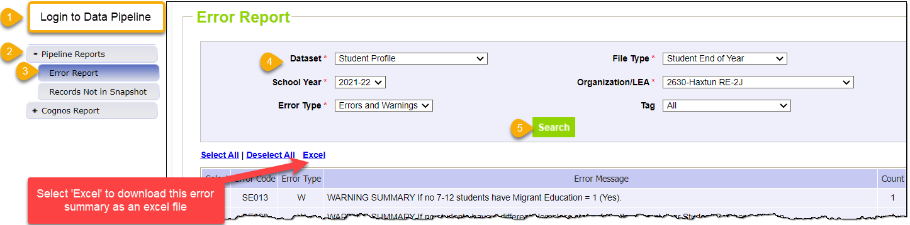
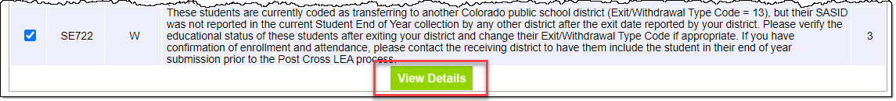
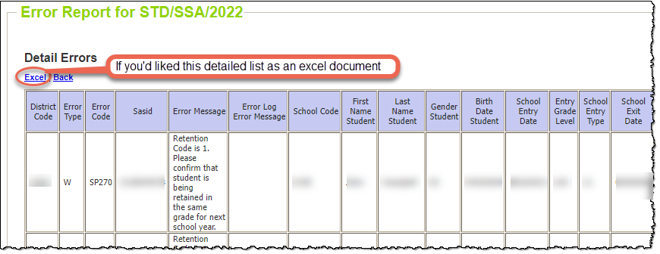
Checking Errors/Warnings:
Pipeline Error Report
Preferred method for checking errors/warnings
Pro Tip: Use check boxes to select a specific error/warning code before reviewing error details as it may be simpler to focus on one business rule topic at a time
To view specific student records that are triggering an error/warning,
select View Details at the bottom of the screen.

Slide 53
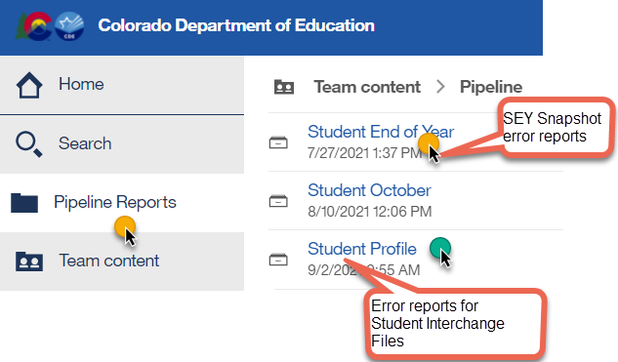
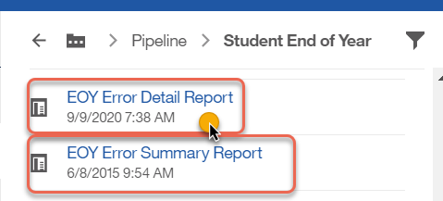
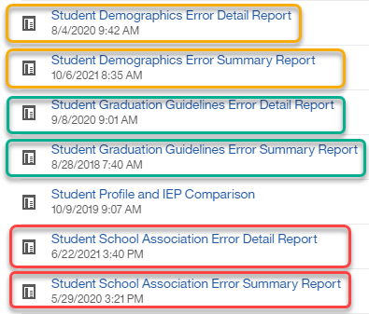
Checking Errors/Warnings:
COGNOS/CEDAR
Alternative method for checking errors/warnings
  Login to COGNOS/CEDAR using the link in Data Pipeline or the IdM webpage
COGNOS/CEDAR is best used to validate data using the various topic specific reports

Slide 54
Reporting Exceptions &
Post-Cross Data Change Request

Slide 55
When are reporting exceptions needed?
Reporting exceptions are used to clear the associated errors (without changing the data) in unique circumstances where a student’s record has accurate information, but their educational history does not follow the anticipated coding patterns outlined in the business rules for an interchange file or snapshot
Data respondents must work with the data collection lead for a given file/snapshot to request an exception be granted
Some reporting exceptions require additional supporting documentation and may be reviewed by other CDE staff

Slide 56
Reporting Exception Process
Complete exception request template
  Available on SEY Website
Upload exception request template to your district’s Syncplicity student folder
  Folder: 1234 – DISTRICT NAME – Student
  Subfolder: SEY 2023-24
Notify the SEY collection lead that you’ve uploaded a document for review
  StudentEndofYear@cde.state.co.us
  Include the date in name of your exception request file
  as you may upload more than one exception during the collection cycle
Collection lead will review your request and notify you of the outcome
  Approved requests – reupload interchange file and/or create a new SEY snapshot
  Denied requests – collection lead will provide next steps for clearing the error
  Additional information needed – collection lead will request information

Slide 57
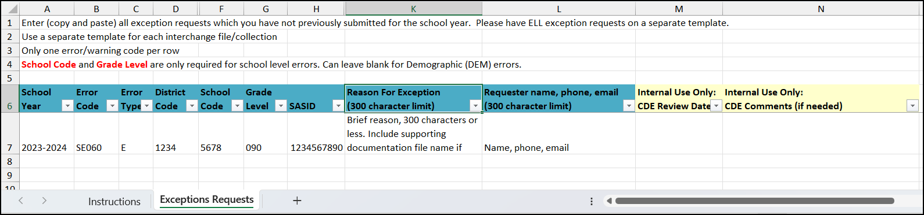
Exception Request Template
Required for all reporting exceptions, even when additional documentation is also being provided
Uploaded to Syncplicity for Review
  Pro Tip: Include district code, date, and file type in the file name
    1234_5.23.24_SEY_exceptions
Do not combine requests for different interchange files or SEY snapshot into one form
Do not delete tabs or columns from this form.
  Hidden columns exist on the exception request tab required for accurate processing.
  Instructions tab includes information that the exceptions request tab validates against.
Submit a new exception request form when additional exceptions are needed
  CDE Collection Lead inputs date request is reviewed to let you know it has been processed. After this point a new form is needed for new requests.

Slide 58
What types of exceptions might need additional information?
If the reason given for the exception doesn’t make sense with the coding pattern, clarification may be requested
SASID merge situations
  Work with the RITS coordinator (RITS@cde.state.co.us) to resolve
  Once merge is complete, then any follow-up SEY errors are cleared with an exception
English Learners whose status changed mid-year
  Students with > 2 years of English Learner history in the same district whose status is changing mid-year (3 OCT, 2 SEY collections)
  Mid-Year English Learner Change Form
Post-Cross LEA SE903 errors
  Proof of adequate documentation required for student to remain coded as Exit 13 (transfer to a public school in another CO district)

Slide 59





Post-Cross Phase:
Exception Requests & Data Change Requests
Post-Cross Error or Data issue
SEY Data Incorrect and must be updated
SEY Data is Accurate as Reported
Submit a Post-Cross LEA Data Change Request
Submit an Exception Request

Slide 60
What is a Post-Cross data change request?
Unique to Post-Cross LEA phase of SEY Collection
Used to request a change to a student’s record under the following circumstances:
  Updating data to clear any regular phase or Cross-LEA business rule (SE001-SE800s)
  Updating exit type/date/retention code to clear a SE900 series warning
  Adding a missing student record to resolve a SE400 error or as directed by SEY collection lead.
  If instructed to update records due to a SASID merge. When SASID merges occur during the Post-Cross phase, email the SEY Collection lead BEFORE making any changes to your data.
Update data in pipeline using the edit record screen
  School Exit Type
  School Exit Date
  Retention Code
  Other data fields in rare circumstances
Complete a data change request form
Submit form to Syncplicity using the same folder as exception requests
Notify StudentEndOfYear@cde.state.co.us that a request has been placed in Syncplicity for review
Collection lead will review the request and notify you of the outcome or any next steps

Slide 61
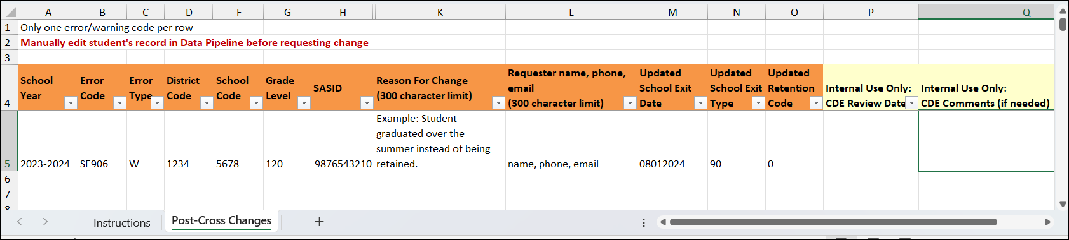
Post-Cross Data Change Request Template
Required for any post-cross data change outside of the SE900 series errors
Must include the new school exit date, school exit type, and retention code
  If other data field changes are requested, include this information in the reason for change request
Do not delete tabs or columns from this form.
  Hidden columns exist on the post-cross changes tab required for accurate processing.
  Instructions tab includes information that the post-cross changes request tab validates against.
Submit a new change request form when additional changes are needed
  CDE Collection Lead inputs date request is reviewed to let you know it has been processed. After this point a new form is needed for new requests.

Slide 62
SASID Merges

Slide 63
SASID Merge Overview
When a single student is found to have multiple assigned SASIDs in the RITS system, a SASID merge is need.
Why does this happen?
  Student transferred between LEAs and the receiving LEA requested a new SASID rather than claiming the existing RITS record
    Most often found during the Cross LEA & Post-Cross LEA phases of the SEY collection
  Typos in student’s name, date of birth, or gender data in RITS leading to a LEA to accidentally request a new SASID rather than claiming the existing RITS record
  Student with hyphenated middle or last names
How is it corrected?
  Reach out to the RITS Coordinator at RITS@cde.state.co.us to request a merge. Additional documentation supporting the SASID merge may be requested via Syncplicity.
    Note: The RITS Coordinator has their own Syncplicity folders and does not use the same folder as the SEY collection

Slide 64
SASID Merge resolution
Regular & Cross LEA Phases
Post-Cross LEA Phase
Update all interchange files to reflect the correct SASID, name, date of birth, and gender for the student
  SASID indicated by RITS coordinator
Reupload the interchange files
Create a SEY snapshot
Verify student included in the SEY collection with the correct SASID using the CEDAR/COGNOS report EOY and OCT (prior, current, subsequent year) – SASID lookup
If another district is waiting on your update: Notify the SEY data respondent in the other district that your data has been updated
  Most common during the Cross LEA Phase
Email SEY Collection lead for additional directions BEFORE making any changes to your data
  Special handling is required during this phase and is handled on a case-by-case basis
Verify student included in the SEY collection with the correct SASID using the CEDAR/COGNOS report EOY and OCT (prior, current, subsequent year) – SASID lookup
If another district is waiting on your update: Notify the SEY data respondent in the other district that your data has been updated

Slide 65
Regular Phase

Slide 66
What is the Regular phase?
Primary data collection and clean-up phase for the SEY Collection
Districts are encouraged to work on this collection early as errors that require input from program staff in your district may be more difficult to reconcile over the summer due to vacation/breaks
Business rules SE001 through SE400 series
  SE700 rules may trigger as warnings to provide advance notice to districts regarding possible Cross LEA errors – these are not the primary focus of this phase and are most accurate after the Cross LEA phase begins
Please be mindful of interim deadlines as these are designed to help districts stay on track for this collection

Slide 67
What happens during the Regular Phase?
All districts upload student interchange files and create SEY snapshots
All districts address interchange and SEY errors/warnings
All districts review and validate their data, making updates as needed
  Note: All data fields may be corrected during this phase
All districts create at least one SEY snapshot
All districts submit their initial data by September 5, 2024

Slide 68
Regular Phase Steps
Upload interchange files (DEM, SSA, GG)
  Title 1 Interchange if LEA has targeted assistance schools
  SPED Child Participation if LEA has students with an IEP
  Adjustment file if prior year exit adjustments are needed
Resolve interchange errors
  Records with errors on the DEM or SSA file will not pull into the SEY snapshot
  Records with errors on the GG file may cause errors on the SEY snapshot for graduating students
Create SEY Snapshot
Resolve SEY Snapshot Errors
  Update student information system and extract new interchange files
Repeat steps 1-4 as needed
  Request exceptions if needed (Interim Deadline: July 25, 2024)
Validate data
  Graduation/Completion/Dropout/Mobility/Stability
Submit error-free snapshot
  SEY~LEAApprover role in IdM required

Slide 69
Important Resources
SEY Collection Manual
Enrollment Record Guide
Instructions for completing SEY collection
Frequently Asked Questions
Common Coding Patterns
Available on SEY Website
Supports all student collections
Details regarding all types of movement between schools
  Standard Progression (returning students)
  Movement between LEAs
  Movement in/out of Colorado LEAs
  Movement within LEAs
Available on Student Interchange and SEY Websites
SEY CEDAR/COGNOS Guide
Details regarding all SEY related CEDAR reports
Available on SEY Website

Slide 70
Special Coding Circumstances
Many business rules are designed to support specific coding scenarios
Section 5 of the SEY Training Manual covers many common coding patterns
  Postsecondary Programs (i.e., ASCENT, PTECH, TREP)
  Special Education Transition
  Facilities
  Expelled Students
  BOCES Schools and BOCES Programs
  Non-School Programs
  Part-Time Home-based Education Receiving Educational Services
  Grade Reassignment
  Summer Dropout

Slide 71
Missing Record Business Rules
Issue: Student expected to have a record in SEY for a given reason, but does not
Fix: Include an error free DEM & SSA record for the student
Alternate Fix: May include an adjustment record for students in 7th-12th grade with adjustment justification code 40 to indicate they dropped out over the summer
Examples
  SE049: K-12 student with a record in October 2023-2024 (PAI 01-08) should have a record in SEY
  SE057: PK student with a record in October 2023-2024 (PAI 01-08) should have a record in SEY
  SE064 & SE404: K-12 student with exit type 00 in the prior year must have a record in the current year
  SE401 & SE405: Interchange errors preventing record from pulling into SEY snapshot
  SE402 & SE403: Issue with school entry date in an excluded SSA record compared to the record included on the SEY snapshot

Slide 72
Cross LEA Phase

Slide 73
What is the Cross LEA Phase?
First of two validation phases for the SEY data collection
CDE runs a process to cross validate data across all school districts/BOCES.
  Cross references student educational history across school districts; focused on transfer students
  SE700 and SE800 series errors/warnings
Ensures validity of education statistics
  Students may only count as a graduate/completer in one district and one year
  Students who dropout are attributed to their final district of attendance during the school year.
  Students who left a district and were recovered by another district or completed a HSED are reconciled

Slide 74
What happens during the Cross LEA Phase?
All districts review errors/warnings
  Some districts will receive new errors/warnings to address
    SE700/SE800 series are the primary focus
    Any SE001-SE400 series error that arises must also be addressed
  Districts with errors/warnings to address make modifications to student records as needed
All districts review and validate their data, making updates as needed
  Note: All data fields may be corrected during this phase
All districts create at least one SEY snapshot
All districts resubmit data by October 17, 2024

Slide 75
Cross LEA Phase Steps
Review Cross LEA Errors & Warnings
  SE700 & SE800
  Any SE001-SE400 series errors that arise
Edit student records as needed to address business rules
  Update student information system
  Extract and upload new interchange files
Load adjustment records if needed
  Used to correct prior year exits
Create SEY Snapshot (repeating steps 1-4 as needed)
  Also ensures all internal flags associate with the snapshot
Validate data
  Graduation/Completion/Dropout/Mobility/Stability
Resubmit error-free snapshot
  SEY~LEAApprover role in IdM required

Slide 76
SE700 & SE800 series business rules
SE700s
SE800s
Dynamic Errors & Warnings
Will clear as data is updated during this phase
Some warnings indicate coding that will become an error in the Post-Cross LEA phase if the record is not corrected during the Cross LEA phase
Static Warnings
Do not clear when data is updated
Planned to be deactivated in 2023-2024 after implementation of new CEDAR reports

Slide 77
Cross LEA Error Types
Current Year Errors
  Based on the interplay between current year student records across CO districts
  Updates take place on current year Student School Association File
Prior Year Errors
  Based on information related to a student’s final reported status in a previous student end of year collection for your district
    These students are not currently included in the 2023-2024 SEY collection
  Most of these errors are cleared using an adjustment record
  Some may be cleared using a one-day record in the current year

Slide 78
Cross LEA Warnings
Some SE700 warnings indicate ‘for your records’ as part of the business rule message
  Do not require action, but are helpful information related to graduation/completion rates
  SE701, SE705, SE709, SE712
  May be deactivated once new CEDAR reports are implemented
Some SE700 warnings ask districts to verify records
  Update records if needed
  SE707, SE708
Some SE700 warnings will become errors during the Post-Cross LEA phase if not addressed
  Districts are highly encouraged to attempt to resolve these warnings during the Cross LEA phase
  SE722, SE724

Slide 79
Cross LEA Errors
May require an Adjustment record to be uploaded to data pipeline via the Adjustment file
  Correcting Prior Year Exits
  SE704, SE706, SE710
Often indicate the ‘REQUIRED ACTION’ to clear the error in the error message
May require districts to work together to determine which district will count the student as a graduate and which will use Exit 13 to transfer the student out
  SE702
May require districts to update the exit type for a student in the current year records (SSA file)
  SE710, SE711, SE720

Slide 80
Adjustment File

Slide 81
Adjustment File Overview
7th-12th grade students only
Adjusts the final exit type for a student in a prior school year who did not attend your district in the current year.
Only used to adjust students with very specific exit scenarios
  Dropout (Exit 40)
  Expulsion (Exit 50)
  HSED transfer (Exit 70)
  Did not Exit (Exit 00)
  Other special circumstance (Exits 18, 19, 21, 26, 30)
Record is loaded in the current year using an adjustment file
Student does not have a record on your DEM or SSA file in the current year

Slide 82
Methods to add adjustment records
Adjustment File Upload
Manually Add Record in Pipeline
Best when multiple adjustment records need to be entered
Functions like a student interchange upload
  See Section 2 of the SEY Collection manual for step-by-step file upload directions
File layout and business rules posted on Student Interchange & SEY websites
Best when few adjustment records need to be entered
Uses same adjustment justification codes as a file upload
See Section 2 of the SEY Collection manual for step-by-step directions for the add record screen
File layout and business rules posted on Student Interchange & SEY websites

Slide 83
Adjustment File Layout
Name of Field | Field Length | Excel Column | Examples | Notes
District Code | 4 | A | 0000
SASID | 10 | B | 0000000000 | Must match RITS
First Name Student | 30 | C | Valid name | Must match RITS
Last Name Student | 30 | D | Valid name | Must match RITS
Gender Student | 2 | E | 01 or 02 | Must match RITS
Birth Date Student | 8 | F | 12312013 | MMDDYYYY
Adjustment Justification Code | 2 | G | 00
Adjustment School Code | 4 | H | 0000 | Last school attended in your district, matches the SEY error detail report for SE700 series errors/warnings
Adjustment Year | 4 | I | 2017 | Last school year the student attended in your district. Always reflects the Spring semester. For example, an exit date in the 2021-2022 school year is Adjustment Year 2022.

Slide 84
Adjustment Justification Code
Correlate to the final exit type in a prior year being adjusted and the circumstances of the adjustments
  Request for transcripts received
  Student received HSED
Adjustments for Dropouts (prior year exit 40 or 00)
  40 (prior year exit 00)
  41, 42 (prior year exit 40)
  Also used for students with prior year exit 18, 19, 21, 26, 30 who returned to public education (SE706 error)
Adjustments for Expulsions (prior year exit 50)
  51, 52
Adjustments for External HSED Program Enrollees (prior year exit 70)
  71, 77
Adjustments for misreported graduates (prior year exit 00)
  90, 96
  Students with Anticipated Year of Graduation (AYG) 2022 and beyond must have corresponding graduation guidelines measures reported

Slide 85
Post Cross LEA Phase & Final Dates

Slide 86
What is the Post-Cross LEA Phase?
Second and final validation phase of the SEY data collection
Final opportunity for districts to validate their SEY data
Initiated by a process run by CDE after districts submit their data for the Cross LEA Phase
  Triggers SE900 series errors/warnings
  Any SE001-SE700 errors that arise must also be addressed (requires an exception request)
Districts can only independently update select data for select students based upon SE900 series errors
  Submit a post-cross data change request for any updates needed outside the SE900 series errors
During this phase, snapshots are not unlocked, only ‘updated’.
  All districts must ‘update’ their snapshot at least once during this phase, even if no SE900 business rules were triggered.

Slide 87
What is the focus on the Post-Cross LEA Phase?
Focused on very specific coding scenarios
  Students with Exit Types (40, 50, 70, 18, 19, 21, 30) that have been recovered by another district
  Students with Exit 13 (transfer to another CO Public school) that have not been reported by another CO district
  Students with Exit 13 who have received their HSED in the current year
  Students retained in SEY without a record in the subsequent Student October
  Students with a record in the subsequent Student October with a postsecondary code indicating ASCENT, TREP, PTECH without a retention code in SEY.
  Students with a record in the subsequent Student October with a SPED transition code but do not have a retention code in SEY

Slide 88
Post-Cross LEA Phase Steps
Review post-cross validation errors and warnings
  SE900s
  Any SE001-SE700 series errors that arise
Edit student records as needed to address business rules
  Data Pipeline → Edit Record
  Request exceptions as needed
  Request post-cross data changes as needed
Update SEY Snapshot
  Repeating steps 1-3 as needed
Validate data
  Graduation/Completion/Dropout/Mobility/Stability
Submit Superintendent Sign-Off form to CDE
  SEY~LEAApprover role in IdM required to download form
  Email completed forms to StudentEndOfYear@cde.state.co.us
  Nov. 14 through Dec. 3

Slide 89
Final Dates Overview
Final Report Review Window:
  Nov. 22nd to Nov. 26th is the final review window for SEY data
    SEY Collection lead will notify respondents directly if any issues are found during CDE’s final review process (Nov. 20th & Nov. 21st)
    Contact the SEY Collection Lead if any data updates are needed during this window
Superintendent Verification Form:
  Download from data pipeline ‘status dashboard’ screen
  Signed by Superintendent
    Certifies SEY and Graduation Guidelines data is accurate and complete
    Acknowledgment that this data is used in district/school accountability frameworks
  Dated after the last updated date of your SEY snapshot as shown on the SEY status dashboard
  Scan and email to StudentEndOfYear@cde.state.co.us
  Due Dec. 3, 2024
  Will not be accepted prior to Nov. 14, 2024
Final Data:
  Embargoed until the official release January 14, 2025
  Districts may use COGNOS/CEDAR reports internally, but may not share graduation/dropout/mobility rates publicly

Slide 90
Adequate Documentation

Slide 91
Adequate Documentation Overview
Adequate documentation is the documentation maintained by districts/schools when students transfer out of their district
  Documentation necessary to avoid incorrectly coding students as dropouts.
  Documentation supports selecting the appropriate exit type for ‘verified transfers out’ of your AYG graduation cohort
Adequate documentation is maintained year-round and should be readily available upon request by SEY collection
  Reviewed by SEY collection lead on a case-by-case basis
  Typically used when addressing SE903 errors in the Post-Cross LEA Phase

Slide 92
1-CCR-301 Highlights/Reminders
When a student withdraws, districts are authorized to request information from the parent or guardian about the specific type of educational enviornment that a student is transferring to in order to monitor compliance with the School Attendance Law. [section 22-33-104 (1), C.R.S.]
Colorado Public Schools and local education agencies are required to send transcripts or to confirm attendance when requested from another Colorado Public School or local education agency within two weeks of receiving the request with the exception of students in out of-home placements whose records must be transferred within five (5) days pursuant to sections 22-32-138(2)(a)(II) and (3)(a), C.R.S

Slide 93
SEY Adequate Documentation Website
SEY Adequate Documentation Site
  Sample forms and templates
  List of documentation required for each school exit type
All documentation should include the student’s SASID and full name
Types of documentation
  Written records request
  Confirmation of enrollment and attendance
    Provided by receiving district when student has begun attending the receiving school
    Must include date of enrollment and date of attendance
  Certificate of enrollment
  Signed parent/guardian letter
  Written confirmation from school administrator

Slide 94
Exit 13 – Transfer to a public school in a different CO District
Documentation Required:
Confirmation of enrollment and attendance
  Provided by receiving district when student has begun attending the receiving school
  Must include date of enrollment and date of attendance
  Must include student’s SASID and full name
  If a SASID merge has taken place or student is found to have two different SASIDs, include both SASIDs on the form
No other documentation is accepted
  RITS system is not adequate because a student may have enrolled but never attended
Sending district should request this form if they lack documentation
Districts must respond to records requests within two weeks
  Records requests for out of home placements must be responded to within 5 days

Slide 95
COGNOS (CEDAR) Reports

Slide 96
CEDAR/COGNOS Reports Overview
The Colorado Education Data Analysis and Reporting system (CEDAR) is a private, secure system which provides student level data to authorized users. Access to student-level data is limited to educators who have need for such data.
Reports in CEDAR/COGNOS have multiple purposes. Some are used as operational reports to assist data respondents in looking up specific information on students, file/snapshot errors, and students missing from a snapshot due to profile errors. Other reports are used to validate data when finalizing a data collection. Many reports also provide districts with a preview of data that will be published based upon specific data collections. (i.e., graduation statistics)
SEY CEDAR/COGNOS Reports Guide
Notes:
Often CEDAR is referred to as COGNOS since COGNOS is the software currently powering the Colorado Education Data Analysis and Reporting system (CEDAR).

Slide 97
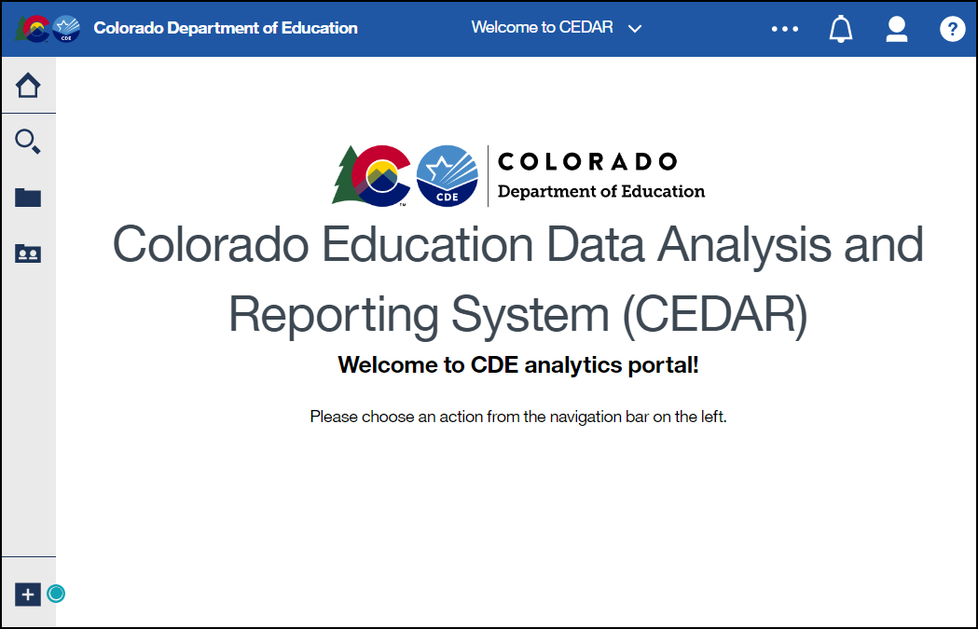
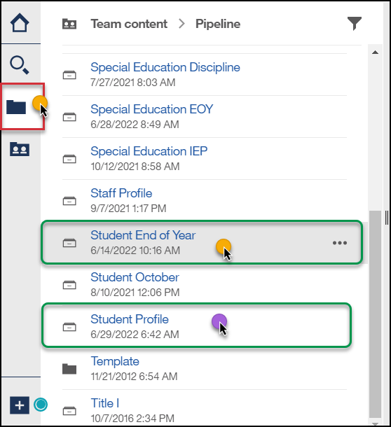
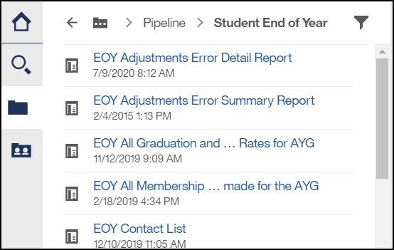
Accessing Reports
Identity Management Landing Page → CEDAR Link
Data Pipeline →

Slide 98
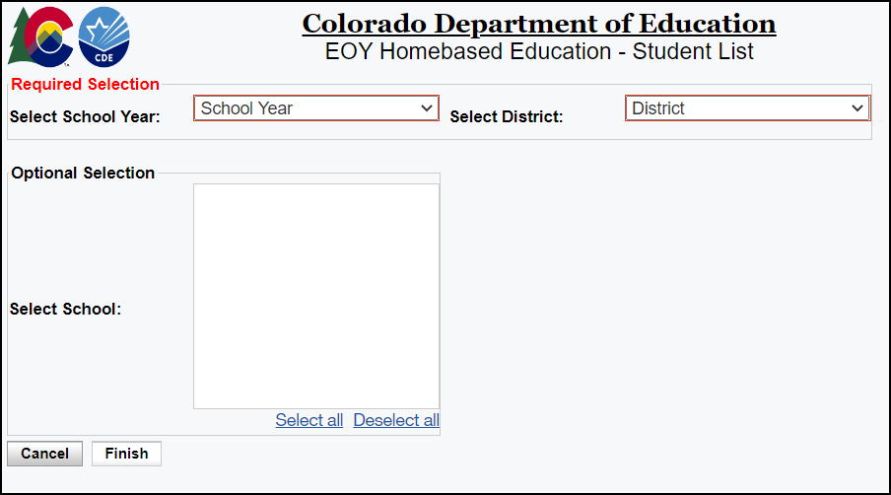
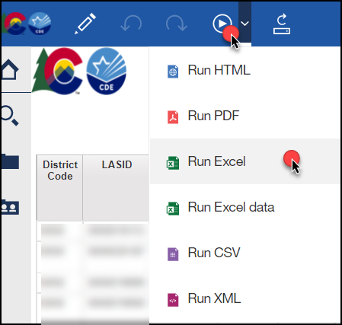
Report Screen & Download
Use dropdown menus to select desired information
Reports can be downloaded as an excel file for easier sorting/filtering of information.

Slide 99
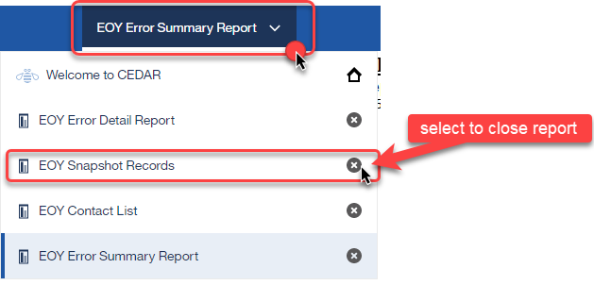
Moving between reports
Toggle between reports using the recent reports dropdown
Close an open report using the recent reports dropdown

Slide 100
Student Profile Reports
Individuals with permissions to the Student Interchange in IdM have access to student profile reports
  STD~LEAVIEWER
  STD~LEAUSER
These reports are operation in nature, assisting districts with reporting accurate data on these fields and providing historical information when helpful
They are connected to information from the student interchange files:
  Student Demographics
  Student School Association
  Graduation Guidelines

Slide 101
Student End of Year Reports
Available to individuals with permissions to Student End of Year in IdM
  SEY~LEAVIEWER
  SEY~LEAUSER
  SEY~LEAAPPROVER
Some reports are operational in nature, designed to assist with the data collection
Some reports are designed to provide districts with a preview of their education statistics data prior to the public release of data in January
  Graduation/Completion Rates
  Dropout Rates
  Mobility/Stability Rates

Slide 102
Published Rates & Reporting

Slide 103
SEY Public Data Release
Scheduled Date – January 14, 2025
Education statistics based upon the 2023-24 SEY data are embargoed until the public data release in January 2025
  District data available through COGNOS/CEDAR reports
Districts receive a preview of the state-wide data a few days prior to the public data release
  Sent to SEY Data Respondents from the SEY Collection Lead
  SEY Data Respondents should share with applicable administrative staff within their district
  (i.e. superintendent, accountability contact, etc.)
CDE sends out a press release and notifications through their communication department when this data is publicly released
  SEY Data Collection lead will send an email to data respondents when the embargo has lifted and data has been publicly released

Slide 104
Education Statistics
Mobility/Stability Rates & Statistics
  Annual calculation
  Reflect students in grades K-12
Dropout Rates & Statistics
  Annual calculation
  Reflect students in grades 7-12
  Annual Instructional Program Service Type (IPST) status
Graduation/Completion Rates & Statistics
  Cohort based calculation
  Reflect students in given Anticipated Year of Graduation (AYG) cohort
  IPST cohort based upon qualifying IPST status at some point during
  9-12th grade

Slide 105
SEY Privacy Guidelines:
District & School Level Data
Why: Protect student data privacy in aggregate public data in alignment with FERPA & Colorado’s Student Data Transparency & Security Act
Impact:
  Yes: CDE’s publicly posted data based upon the SEY collection such as the Education Statistics Webpages
  No: Individual district CEDAR/COGNOS reports available to SEY Data Respondents
Privacy Methods: blurring of cohort/membership base sizes with small populations (all students & subgroups), top & bottom masking of rates, and limited suppression
  Using a mix of methods ensures student data is protected while providing transparent information regarding rates
More Information: Graduation, Dropout Mobility Rates – Aggregate Data Privacy Guidelines Site

Slide 106
Frequently Asked Questions

Slide 107
Exit Type 00 & One-Day Records

Slide 108
School Exit Type 00
School Exit Type 00 = did not exit
Used for any student who completes the school year, regardless of their anticipated enrollment the next year
  Per the Colorado Code of Regulations (1-CCR-301-1), “students shall be counted as completing (finishing) the school year if they leave school within three weeks of the last day of school…”
Must be paired with school exit date ‘00000000’
Students with school exit type 00 in the prior year (2022-2023) must have a record in the current year (2023-2024)

Slide 109
One-Day Record
Used to reconcile student enrollment records
  Transfer out of the district over the summer
  Summer dropouts
  Grade reassignments
Typically occur in the summer before the start of a LEA’s school calendar
  Best practice: 07/01 entry and exit date
  Could be sequential days (07/01 entry, 07/02 exit) if your LEA’s student information system does not allow the use of an entry/exit on the exact same day
Occasionally used at the end of the school year to reconcile a student in the AYG cohort who has an updated final exit status from an LEA
  Best practice: 06/30 entry and exit date
Must have a valid school code
  Matriculating students who transfer out of the district: Use the school code for the school the student would have attended unless a dropout. Then, use the summer district dropout coding pattern.
Grade Level reflects the grade the student would have been in if enrolled in the current year
Language Proficiency reflects the EL proficiency a student would have if enrolled in the current year. Moving the student along the EL progression if needed.

Slide 110
Retention

Slide 111
Retention Codes
Retention Code always indicates the expected grade level for the student in the following school year.
  A retention code in 2023-2024 SEY indicates the student will be in the same grade level again in 2024-2024.
Retention Code = 1 may be used for any student K-12
  Must have school exit type 00 with school exit date 00000000
Retention Codes 2 and 3 are reserved for 12th grade students with special circumstances only
Code | Definition
0 | No/Not Applicable
1 | Yes – student will repeat this grade the next school year
2 | Yes – 12th grader who will return to participate in an approved postsecondary program in the next year (i.e. ASCENT, P-TECH, and TREP).
3 | Yes – 12th grader with an IEP who will return to participate in 18-21 transition services in the next year.

Slide 112
Retention Codes: 12th graders
1
2
3
Also known as an Academic Retention
Postsecondary Program
  ASCENT
  PTECH years 5-6
  TREP
SPED 18-21 Transition Services
School Exit Type 00
See coding guides in section 5 of the SEY collection manual
See coding guides in section 5 of the SEY collection manual
Record required in following year
Record expected in following year
Record required in following year

Slide 113
Instances of Mobility

Slide 114
Mobility Calculation
Mobility Instance: each time a student experiences an unanticipated movement within the academic year such as entering or leaving a school or district.
Mobility rates are based upon movement occurring after October 1st
  Entry/exit from a school (school instance of mobility)
  Entry/exit from a LEA (district instance of mobility)
  Oct. 1st date means the one-day records at the beginning of the year to show summer transfers out of a school/LEA do not negatively impact mobility rates
Students must have a gap in attendance of 10 days or more for a move to be considered mobile
  Allows students to have enrollment ‘status’ changes that require multiple enrollment records at the same school code without impacting mobility (e.g., postsecondary program enrollment, home based education, etc.)

Slide 115
Instances of Mobility:
Reporting extended absences
Per state board rule, districts should indicate an instance of mobility for a student after ten consecutive days of absence as part of the Student End of Year (SEY) collection.
Used to calculate mobility rates
Also has implications for Attendance collection
  Impacts total days possible, attended, excused, and unexcused
  Time frame between enrollment records (instance of mobility) not part of attendance data, impacting chronic absenteeism rate
Requires multiple enrollment records
  School Exit/Entry 25 used if student’s absence is 10+ days to 6 weeks
  School Exit/Entry 45 used if student’s absence is 6+ weeks
  School exit date indicates last date of attendance
  School entry date indicates date student began attending district again
Record | School Code | School Entry Date | School Entry Type | School Exit Date | School Exit Type
#1: Mobility instance | 1234 | 08152023 | 02 | 02012024 | 25
#2: Return to school | 1234 | 04012024 | 25 | 00000000 | 00

Slide 116
Anticipated Year of Graduation (AYG)

Slide 117
AYG Assignment Logic
Assigned in the school year a student is first reported as entering high school in Colorado through the Student End of Year collection (grades 9-12)
  AYG is automatically assigned during the SEY collection process
  Once assigned, AYG does not change
  Based upon the student’s highest grade level as of October 1st
If reported in multiple districts, will base AYG on the highest grade level as of 10/1
  EXAMPLE:
    District A reports 10th grade with an exit date on/after October 1st
    District B reports 9th grade with an exit date on/after October 1st
    Student’s AYG will be calculated based on the 10th grade record in District A
  Post-Cross Phase includes mechanics to reconcile AYG across districts
The following data fields are all set in the year that a student’s AYG is assigned
  Starting Year for Graduation Cohort
  Starting Grade for Graduation Cohort
  Starting District for Graduation Cohort
  Anticipated Year of Graduation
Grade Level | AYG Calculation | Example (Current Year 2023-2024)
9th | Current Year + 3 | AYG 2027
10th | Current Year + 2 | AYG 2026
11th | Current Year + 1 | AYG 2025
12th | Current Year | AYG 2024
Notes:
Verified Transfer Out: School Exit Types 02, 05, 13, 14, 15, 16
Exit Types that Comprise the AYG Cohort: 00, 01, 40, 12, 26, 18, 19, 21, 30, 50, 70, 90, 92, 93, 94, 95, 96

Slide 118
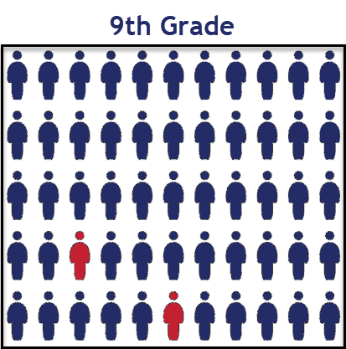
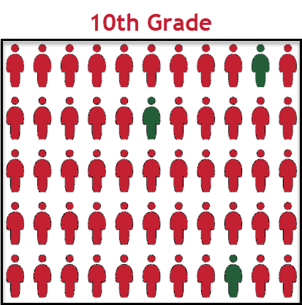
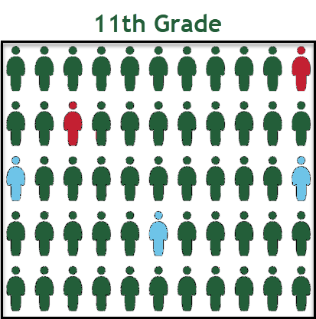
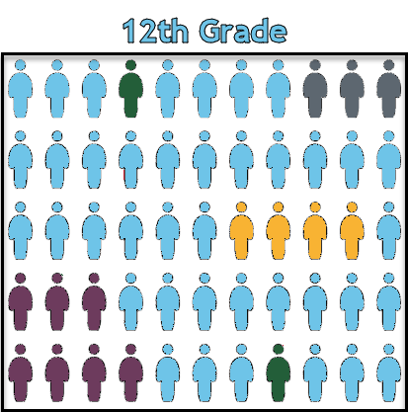
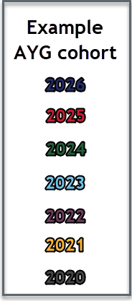
AYG represented in a High School Population
Once a student is assigned an AYG, that AYG remains constant.
Students who experience grade reassignments (acceleration or retention) remain in their original AYG cohort.

Slide 119
AYG Q&A
Q: A student is transferring into the LEA from out of state or out of country whose age does not align with their number of transferrable high school credits. What grade level should they be placed in?
A: LEAs determine appropriate grade level based upon their local policies. LEAs are encouraged to consider the following:
  Student’s current transfer credits and instructional needs
  If placed in ___ grade, can they reach 12th grade before they reach the maximum age for educational services?
  AYG is based upon the first record for a student in a CO high school.
    The grade level of that record will determine the AYG.
    Once set, AYG does not change.
  Some postsecondary programs have restrictions related to AYG (ASCENT, PTECH, TREP)
Q: What is the AYG Reconciliation Process?
A: In the reporting year a student first enters a CO high school, a process is run during the Post-Cross phase to reconcile the student’s AYG if they have multiple enrollment records (in an LEA or across CO) at different grade levels. Student’s AYG is set based upon the highest grade level as of Oct. 1st.

Slide 120
English Learner Coding/Exceptions

Slide 121
Language Proficiency
Annual Coding Cycle
Reminder: Districts should maintain copies of Screener & WIDA ACCESS scores
Site: CDE ELL Funding Factor Count & Audit Resource Guide
Site: CDE Standardized Procedures for English Learner Redesignation
Site: Student Interchange File Layout and Definitions-Student Demographic
WIDA ACCESS administered
  NEP/LEP students only
  Parent opt-out students take WIDA ACCESS
October
  Student moves along progression based on WIDA ACCESS scores and BOE
End of Year
  Coding remains same as October
Summer
  Review WIDA ACCESS Scores and BOE
  Plan for next year, follow Colorado’s Standardized Procedures when making EL redesignation decisions
Student End of Year
Is the summation of the current school year
Is not the status of the student for next year
Notes:
Errors:

Slide 122

English Learner
State Language Proficiency Progression
Redesignation:
Annual ELP Assessment Scores & BOE
SCREENER & BOE
NEP (1)/ LEP (2)
FEP Monitor Year 1
(6)
FEP Monitor Year 2
(7)
FEP Exited Year 1
(8)
FEP Exited Year 2
(9)
FELL
(5)
All identified NEPs & LEPs must take the annual ELP assessment, ACCESS/Alternate ACCESS
  Language Proficiency Code = ‘1’ or ‘2’
Students entering a district without known EL history but who have a language background other than English
  Screened and found to be an English Learner → Indicate NEP or LEP as applicable
  Screened and found to be English Proficient → Indicate PHLOTE (4)
Students entering a district with known EL history:
  Screened and found to be an English Learner → Indicate NEP or LEP as applicable
  Screened and found to be English Proficient → Indicate the applicable step on the state language proficiency progression.

Slide 123
Mid-Year EL Coding Changes within the same district (Clerical Error)
Errors trigger at both the interchange level (DEM) and snapshot level (SEY) when a student’s language proficiency does not follow the expected progression
  DEM compares prior year OCT (2022-2023) to current year (2023-2024)
  SEY compares current year OCT (2023-2024) to current year SEY for the same LEA
    SEY warning if current year OCT and current year SEY do not match, but the LEA has changed
Student was mis-coded (clerical error) in Student October
  <2 years EL history in the same district
    Regular Exception Template
  >2 years EL history in the same district (3 October, 2 SEY)
    Regular Exception Template & Mid-year Coding Change Form required
Example: Student was redesignated over the summer per the standard coding cycle, but Student October did not show the updated status.
  If approved, will require follow-up exception request in the subsequent OCT collection (2024-2025) to fully resolve the misaligned EL progression coding

Slide 124
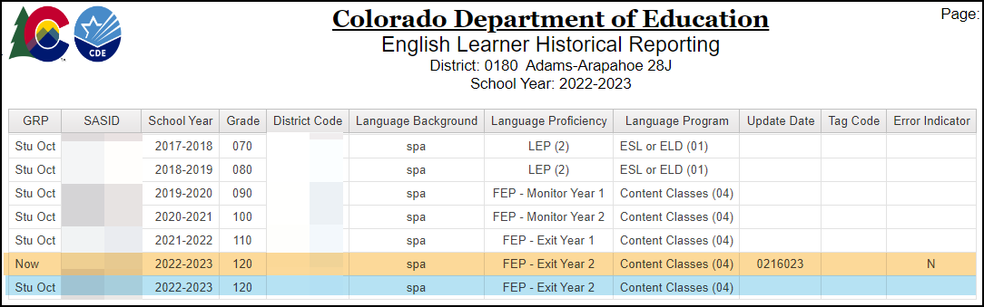
CEDAR/COGNOS: English Learner Historical Reporting
Reminder: This report is a tool to review EL coding, it does not determine a student’s current Language Proficiency. Follow the State’s standardized identification procedures and redesignation procedures.
Site: CDE Standardized Procedures for English Learner Identification
Site: CDE Standardized Procedures for English Learner Redesignation
Operational report to help districts check the English Learner history for a student by SASID
Reflects data from prior OCT collections and current DEM file
Available to data pipeline users with STD~LEAViewer or STD~LEAUser access

Slide 125
Bookmark/Resource List

Slide 126
Resources/Helpful Webpages
Site Name/Link | Information/Uses
Student End of Year | Primary site for SEY Collection information Collection Timeline Collection Manual Training
SEY Adequate Documentation | List of required adequate documentation for each exit type. Sample forms/templates.
Student Interchange | Contains file layouts, templates, business rules, training materials, and resources Student Demographic file Student School Association file Graduation Guidelines file
Identity Management (IdM) | This is the landing page with login links to the various CDE data platforms. Data Pipeline COGNOS/CEDAR Reporting RITS
Frequently Requested Codes | Includes list of school codes, facility schools, detention centers, etc.
Syncplicity | Secure file transfer site used to communicate personally identifiable information with CDE if you have questions on specific students during reporting or have exception requests.
Education Statistics | Landing page for all Colorado Education Statistics. From here, navigate to graduation/completion, dropout, or mobility/stability statistics.
Graduation Guidelines | Information for program staff regarding the graduation guidelines menu of options.

