Slide 1
Special Education End-of-Year
Training 2017-2018
Lindsey Heitman
Heitman_l@cde.state.co.us
(303) 866-5759

Slide 2

Special Education End of Year
  Welcome to the Special Education EOY new(er) respondent training!
  URL https://cdeinfotech.adobeconnect.com/data_services/
  Dial in number is 1-855-397-4421
  *Please mute your phone
Collection Coordinator
  Lindsey Heitman
    Heitman_l@cde.state.co.us
    (303) 866-5759

Slide 3
Table of Contents
Glossary of Date Pipeline Terms: slide 6
Collection Process Overview: slide 7
Purpose and Content: slides 8-9
Identity Management: slides 10-11
Special Ed. IEP Interchange: slides 13-17
Special Ed. EOY Snapshot: slides 19-20
Who to Report: slides 22-23
Summary of 3 paths: slides 25-26
When/What path to report in: slides 27-29
Special Ed or Part C Referral field: slide 30
Keys to reporting path data: slide 31
Data Pipeline Process: slides 33- 52
Accessing Data Pipeline: slides 33-34
Format Checker: slide 35
File Upload: slides 36- 37
Batch Maintenance: slides 38-39
IEP Interchange Errors: slides 40-41
Special Ed EOY Snapshot/errors: slides 43-51
Reports and Final Approval: slides 52-53
Syncplicity: Slide 55
Snapshot Exceptions: slides 56- 63
Timeline: slide 65
Resources: slides 66-67

Slide 4
TRAINING TOPICS
General Overview
Purpose
Data Pipeline Processes
Accessing the Data Pipeline
Important Dates
Data Pipeline Access – IdM
File Upload
Fixing Errors
Timeline
Reports
Resources
Special Education IEP Interchange
Special Education EOY Snapshot

Slide 5
Overview

Slide 6
Glossary of Terms
Term | Definition
Cognos | A type of report in which the user can view applicable reports that are formatted in a user friendly environment
Data Pipeline | A streamlined approach to efficiently move required education information from school districts to the CDE
ESSU Data Management System | Statewide system for students receiving Special Education and other services
Interchange | The method of providing data to CDE in which LEA’s may choose from multiple file formats to submit data transactions throughout the year.
LAM | Local Access Manager responsible for assigning the appropriate access to CDE applications
LEA | Local Education Agencies
IdM | Identity Management. A single sign on system, allowing the user to navigate between the applications without entering user ID information a second time.
Snapshot | A date in time when data is pulled from the appropriate interchanges, validated by additional business rules, and approval given that signifies it was accurately reported for a specific point in time by an LEA

Slide 7


Collection Process Overview
Schools
Track data throughout school year
Admin Unit/SOP
Combines data from schools. Determines the appropriate coding for each record.
Reports data to CDE
CDE via Data Pipeline
Provide data to Admin Unit/SOP
Verifies accuracy, corrects and approves data.
Checks data for accuracy
Collects data from Admin Unit/SOP
Edits data, all errors must be corrected
Federal Government
CDE Reviews and validates data and submits to U.S. Department of Education
Allows approval once passed all edits
Notes:
Admin Unit/SOPs collect data from schools and/or member districts. Data is compiled at the AU level and submitted to the CDE via the Data Pipeline.

Slide 8


Purpose and Content
Exits
SPP Indicators
State Performance Plan APR Indicators 2, 11, and 12
Part C Evaluations
Indicator 2: Dropout – percentage of youth w/ IEPs dropping out
Indicator 11: % of children evaluated for Part B Services within 60 days
Indicator 12: Part C to B Transition - % of children with IEP by 3rd birthday
Children ages 0-3 evaluated for Part C Services - AUs receive reimbursement money for evaluations completed
Children with Disabilities Exiting Special Education as required by IDEA statute 34 CFR §300.618
  Special Education Fiscal Advisory Committee (SEFAC) CRS 22-20-114
Fiscal

Slide 9
Reporting Period
The Special Education End of Year Snapshot reporting period is July 1, 2017 through June 30, 2018.
The purpose of the Special Education End of Year Snapshot is to obtain data on students who were referred, evaluated, and or received Special Education services during the specified reporting period.

Slide 10
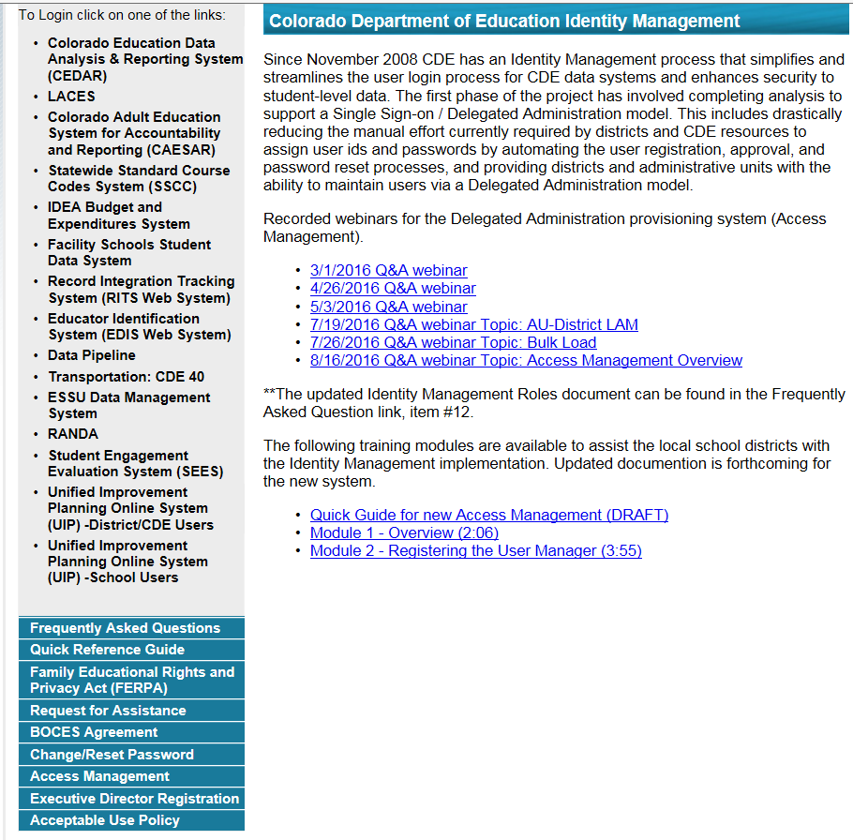
https://cdeapps.cde.state.co.us/index.html
*single sign-on used for all CDE applications listed here
*LAMS: Click Access Management to add or modify IdM accounts
*Special Education Directors click Executive Director Registration to register as AU User Manager in IdM.

Slide 11
Identity Management: Special Education EOY
Special Education IEP group is: SPE
Example: 16010-SPE~LEAUSER Role
*Access to any CDE application, as well as capability within that application, is based upon the roles assigned to your account.
*Assigned by LAM (Local Access Manager)
*Important: only 1 role per group/account
*Can have as many Viewers, Users, and Approvers as you need
Special Education EOY group is: EOY
16010-EOY~LEAVIEWER Read-Only
16010-EOY~LEAUSER Submit and Modify
16010-EOY~LEAAPPROVER Approver (AU must have at least 1)
INTERCHANGE ROLES *1 per account | ENABLES USER TO:
Viewer | read-only access
User *only option for IEP Interchange | upload files, view interchange level errors
SNAPSHOT ROLES *1 per account | ENABLES USER TO:
Viewer | read-only access
User | create snapshots and view snapshot level errors
Approver *Need at least 1 | create snapshots, view snapshot level errors, AND can approve data (Submit final snapshot to CDE)

Slide 12
Special Education IEP Interchange

Slide 13


Special Education IEP Interchange – 2 Files
Child File
Demographic information
1 record per student
Participation File
Special Education services information
1 record per student
IEP Interchange Resources located here: http://www.cde.state.co.us/datapipeline/inter_sped-iep
  Deadlines
  File Layouts and Definitions
  Business Rules
  Trainings
  Templates
  Additional Resources

Slide 14
Authoritative Source
Student’s Demographic Data
  1st comes from the Student Demographic File
  If the student is not submitted by a district, the data will be pulled from the IEP Child file (Part C, Facility, and Parentally Placed in Private School records)
  Student’s Grade
    1st comes from the School Association File
    If the student is not submitted by a district, the data will be pulled from the IEP Participation file

Slide 15
Special Education IEP Interchange: Child File
Admin Unit/SOP Code | Student's Race: American Indian or Alaska Native
Student's State ID (SASID) | Student's Race: Asian
Local ID (LASID) | Student's Race: Black or African American
Student's First Name | Student's Race: White
Student's Middle Name | Student's Race: Native Hawaiian or Other Pacific Islander
Student's Last Name | Student's District of Residence
Student's Gender | State of Parent's Residence for Non-Residence Students
Student's Date of Birth | District of Parent's Residence for Non-Residence Students
ELL Status
* The primary source of this information is the Student Interchange Student Profile File
* Each record must have a valid SASID and/or a LASID
* Each record must have matching record (SASID and/or LASID) on the Participation File

Slide 16
Special Education IEP Interchange: Participation File
Admin Unit/SOP Code | Pupil's Attendance Information | Secondary Service Provider EDID 3 | Reason for Delay in Completing Evaluation Part C | Reason for Delay in IEP Implementation C to B
Student's State ID (SASID) | State of Attendance | Secondary Service Provider EDID 4 | Eligibility and Services Path 1 | Eligibility and Services Path 2
Local ID (LASID) | Educational Orphan | Hours of Special Education Services per Week | Date Child is Referred to the Part C System *may be zero-filled | Date of Parental Consent to Evaluate Part B
Student's First Name | Parentally Placed in a Private School | Total School Hours per Week | Date Child is Found Eligible for Part C Services | Date Evaluation Completed Part B
Student's Last Name | Special Education Funding Status | Extended School Year Services | Date of Referral to Administrative Unit from the Local Community Centered Board | Reason for Delay in Completing the Evaluation Part B
Student's Gender | Date of Entry to Special Education | Basis of Exit | Date of Parental Consent to Evaluate C to B | Date of Initial Eligibility Meeting Part B
Student's Date of Birth | Date of Exit from Special Education | Special Education/Part C Referral | Date Evaluation Completed C to B | Date Initial IEP was Finalized Part B
Primary Disability | Educational Environment | Current Eligibility and Services | Reason for Delay in Completing Evaluation C to B | Reason for Delay in Finalizing the Initial IEP Part B
School Code | Primary Service Provider's EDID | Date Referred for Part C Evaluation | Date of Initial Eligibility Meeting C to B | Date IEP was Implemented Part B
Program Code | Secondary Service Provider EDID 1 | Date of Parental Consent To Evaluate Part C | Reason for Delay in Initial Eligibility Meeting C to B | Reason the IEP was Never Implemented Part B
Entry Grade Level | Secondary Service Provider EDID 2 | Date Evaluation Completed Part C | Date IEP was Implemented C to B | Eligibility and Services Path 3
District of Attendance
Special Education IEPs Interchange
* The primary source of the Entry Grade Level field is the Student Interchange Student School Association File
* Each record must have a valid SASID and/or a LASID
* Each record must have matching record (SASID and/or LASID) on the Child File
** Record should reflect a student’s latest Sped status within the reporting period **

Slide 17
File Tips
Excel, CSV, or Text formats are accepted
Simple Excel template for Child and Participation Files posted online http://www.cde.state.co.us/datapipeline/inter_sped-iep under Templates (however, it is not necessary to use a template if your file already extracts in one of the accepted formats)
No spaces in file name
No blank fields (file may not upload successfully if there are blanks)
Be sure the file is not open when uploading
Be sure you haven’t lost all your leading zeros on a CSV file or it won’t upload (steps for saving them posted online)
1 record per student and should reflect the student’s latest Sped status within the reporting year
Be sure your SASIDs and LASIDs match between the record on Child and on Participation

Slide 18
Special Education EOY Snapshot

Slide 19

Where does the Special Education EOY Snapshot extract data from?
Special Education EOY Snapshot
IEP Interchange
Child File
Participation File
Student Interchange
Demographic info
Student Profile File
Entry Grade Level
Student School Association File
*a snapshot is a point in time “picture” of your data extracted from the Interchange files
*may begin creating snapshots once the required files are successfully uploaded and as many times as needed
*records with errors at the interchange level will not pull into your level 2 snapshot validations

Slide 20
Snapshot Criteria
Pull all error-free records from the Participation and Child
files (except those with a PAI code of 23, 24, 31, and 32 or Special Education Part C Referral code of 00) and match them with records in the Student Profile interchange (Student Demographic file and School Association file).
If the record is not submitted to the Student Interchange, the demographic fields will be pulled from the Special Education Child file.
The Special Education Child, Participation, and Student Interchange files will be joined based on the following criteria: SASID, LASID, school year, Admin Unit (or district), and error free records.
Data pulled from the Student Profile Interchange will be the non-tagged data
*Note: if records are missing from your snapshot it is likely they have one of the following:
errors at the Interchange level
contain one of the excluded PAI codes above
an incorrect SASID or LASID on one file

Slide 21
Who to Report

Slide 22

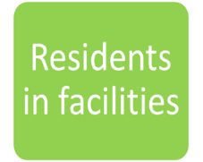

Who to Report
PART B SPECIAL EDUCATION SERVICES and PART C EVALUATIONS
AU
Served
Referred and Evaluated
Detained at Detention Center in your AU

Slide 23
Report All Students Who:
Received services in your Administrative Unit (or a detention center within your AU) at any point during this reporting period (July 1-June 30)
Had an initial evaluation for Part C or Part B services:
  were birth to age 3 and were evaluated for Part C services (path 1)
  were 2.5 but not 4 years old when they were referred from Part C to Part B (path 2)
  were referred for a Part B special education Initial Evaluation (path 3)
Were placed in an Allowed Eligible Facility and you are the Administrative Unit of residence
Were detained at a Detention Center located within your AU boundaries
Were on an IEP and received services at a private school on a tuition basis or parentally placed in a private school, have an ISP and receive Sped services from the AU
*more specific details on who should be reported can be found on the Special Education EOY Data Content Guide pages 1 and 2. Posted here under Additional Resources: http://www.cde.state.co.us/datapipeline/snap_sped-eoy

Slide 24
What and When to Report – Content

Slide 25
Summary of the 3 Paths
Part C Evaluations
Path 1: children ages 0 – 3 who were evaluated for Part C services (not yet on an IEP)
Part B Special Education Services
Path 2 – children ages 2.5 but not yet 4 who were referred from Part C to Part B services.
Path 3 – children ages 2.5 through 21 who were not receiving Part C services at time of referral to Part B.

Slide 26
Data Fields in the 3 Paths
Path 3 Data Fields (9):
Date of Parental Consent to Evaluate Part B
Date Evaluation Completed Part B
Reason for Delay in Completing the Evaluation Part B
Date of Initial Eligibility Meeting Part B
Date Initial IEP was Finalized Part B
Reason for Delay in Finalizing the Initial IEP Part B
Date IEP was Implemented Part B
Reason the IEP was Never Implemented Part B
Eligibility and Services Path 3
Path 1 Data Fields (5):
Date Referred for Part C Evaluation
Date of Parental Consent to Evaluate Part C
Date Evaluation Completed Part C
Reason for Delay in Completing the Evaluation Part C
Eligibility and Services Path 1
Path 2 Data Fields (11):
Date Child is Referred to the Part C System (no longer required-may be zero-filled)
Date Child is Found Eligible for Part C Services
Date of Referral to Administrative Unit from the Local Community Centered Board
Date of Parental Consent to Evaluate C to B
Date Evaluation Completed C to B
Reason for Delay in Completing the Evaluation C to B
Date of Initial Eligibility Meeting
Reason for Delay in Initial Eligibility Meeting C to B
Date IEP was Implemented C to B
Reason for Delay in IEP Implementation C to B
Eligibility and Services Path 2

Slide 27

When to Report?
Path 1 Part C records
report in school year in which the Part C evaluation took place
Paths 2 & 3 Part B records
report in school year in which the IEP was implemented
*If path events span 2 school years, use this rule to determine which school year to report the record

Slide 28
Special Education EOY: Reporting Rules of Thumb
*Only report INITIAL referrals/evaluations*
*Report Path 1 children in school year they were evaluated
*Report Path 2 and 3 students in school year the IEP was implemented
Path 1
Includes ages 0-3 evaluated for Part C
Path 2
Includes ages 2.5-3.9 referred from Part C to Part B services
Path 3
Includes ages 2.5-21 referred to Part B services

Slide 29
What Path to Report in?
What services is the student being evaluated for?
Part C Services
Part B Services
It is possible a student will be reported in more than one path.
Was the student receiving Part C services immediately prior to this Part B evaluation?
Yes
No
Path 1
Students in this Path are 0 to 3 years old.
Path 2
Students in this Path are 2.5 but not yet 4 years old.
Path 3
Students in this Path are 2.5 to 21 years old.
Notes:
This chart is also posted on the Data Pipeline website. It is a good chart to have handy while working on the collection to help you decide what Path a student should be reported in.

Slide 30
The Special Education or Part C Referral field indicates which path should be filled out.
Code | Special Education or Part C Referral Type
01 | Part C Evaluation (Path 1 Only) – Use this code for children 0-3 years old who were referred for and/or had a completed Part C evaluation during the reporting period, whether or not they were determined to be eligible.
02 | Part C to Part B Transition (Path 2 Only) – Use this code for children 2.5 but not 4 years old (at the time of the referral) who were referred for a Part B Evaluation (from a Part C Agency), whether or not they were determined to be eligible for Part B Services.
03 | Part B Services (Path 3 Only) – Use this code for all students who are referred for a Part B Evaluation (NOT from a Part C Agency), whether or not they were determined to be eligible for Part B Services.
04 | Part C Evaluation & Part C to Part B Transition (Paths 1 & 2) – Use this code for children 2.5 but not 4 years (at the time of the referral) who had a Part C evaluation, received Part C Services AND were referred for a Part B Evaluation (from a Part C Agency), whether or not they were determined to be eligible for Part B Services.
05 | Part C & Part B Evaluation (Paths 1 & 3) – Use this code for students who had a Part C and a Part B Evaluation on the same day; OR for students who had a Part C Evaluation during the reporting period and were determined not to be eligible for Part C Services and later, in the same reporting period, were referred for a Part B Evaluation.
06 | No Initial Referral During Current Reporting Period – Use this code for all students who began receiving services prior to July 1 of the current reporting period or for students who received EIS only.
07 | Part C to Part B Transition & Part B Evaluation (Paths 2 & 3) – Use this code for students who received Part C services and were referred for a Part B evaluation (from a Part C Agency), and were either determined not eligible for Part B services or began receiving Part B services that were discontinued AND were later, in the same reporting period, referred for a Part B evaluation.

Slide 31

Keys to Reporting
Know who to report
  Students your AU physically served or evaluated (initial evaluations only)
  Students that reside in your AU and attend an Allowable Eligible Facility anywhere in the state
  Students attending a Detention Center located within your AU
Know when to report
  Path 1 Part C records - report in school year the evaluation took place
  Paths 2 & 3 Part B records - report in school year the IEP was implemented
Know which path(s) record fits into
  Path 1 – ages 0 to 3 evaluated for Part C Services
  Path 2 – ages 2.5 to yet 4 referred from Part C to Part B services
  Path 3 – ages 2.5 to 21 referred/evaluated for Part B services

Slide 32
Data Pipeline Process

Slide 33
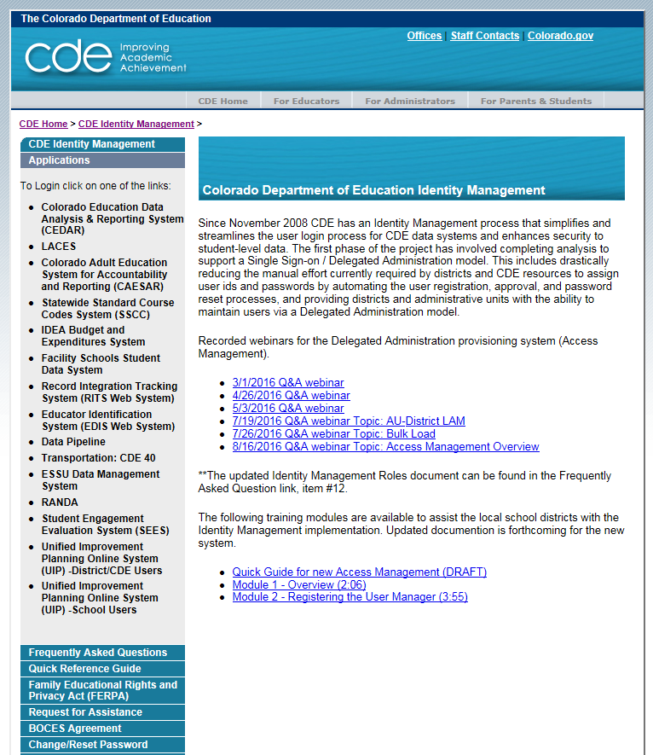
Accessing the Data Pipeline
https://cdeapps.cde.state.co.us/index.html
*single sign-on login used for all CDE applications listed here

Slide 34
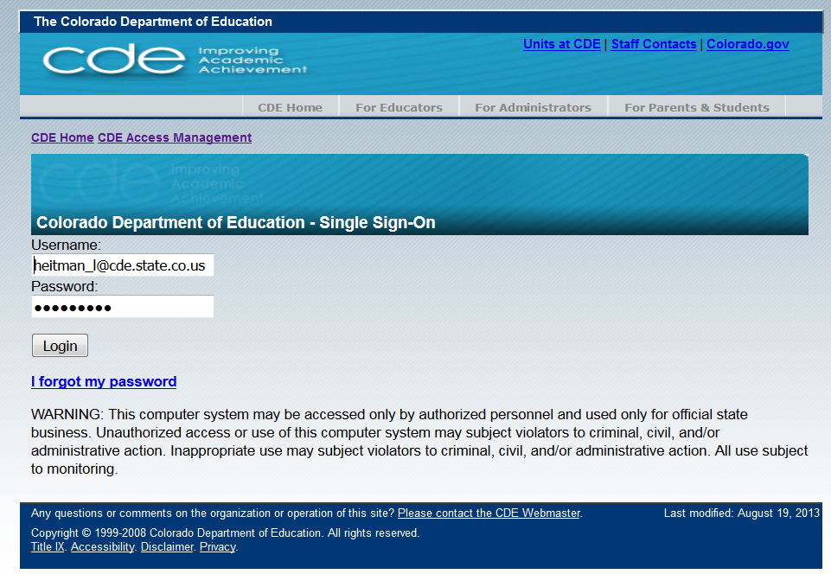
Single Sign On
Username is the email address associated with your IdM account
Password specified by you

Slide 35
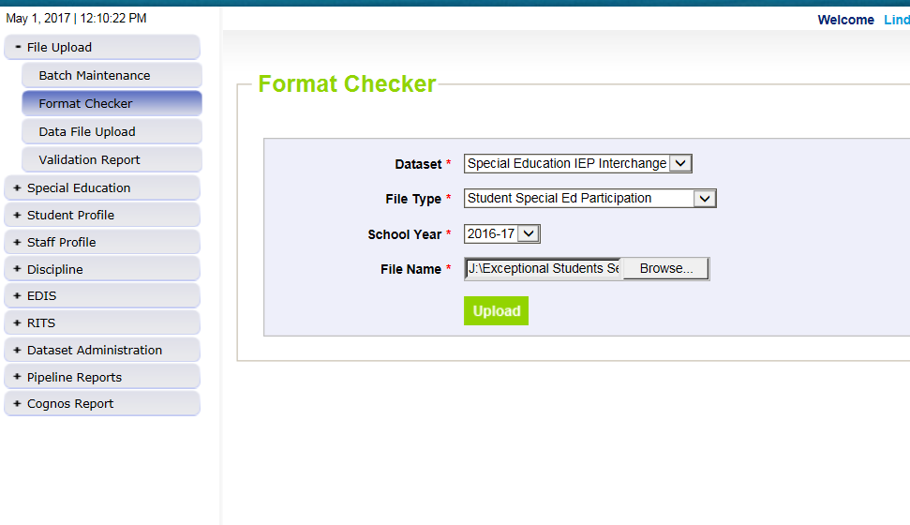
1st Step: Format Checker *optional
Once the file is created, you have the option to run it through the Format Checker to ensure all the bytes are correct.
The system checks the first row of data only.
All fields PASS = Ready to upload

Slide 36
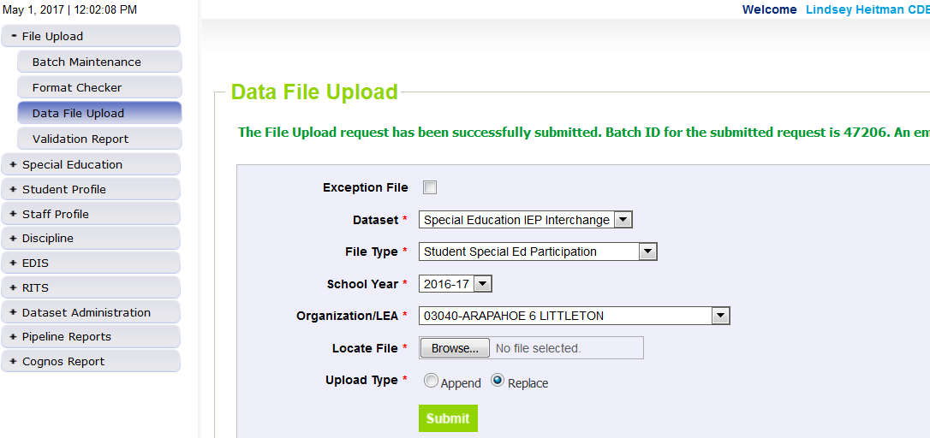
Step 2: Data File Upload
Click on File Upload/Data File Upload
Choose File Type and School Year. Organization should populate with your AU.
Click on Browse to locate File
Choose Replace
Hit Submit
Note message in green below. A Batch ID will be created.

Slide 37
File Upload: Email Confirmation
Check email to ensure file was successfully uploaded
Below is an email in a case where the file didn’t successfully upload. Additional details are provided
-----------------------------------------------------------------------
This message is to notify you of the Data Pipeline file upload errors. The errors must be corrected and the file must be uploaded again.
-----------------------------------------------------------------------
File Submission Processed by Data Pipeline:
Submission ID: 46765
Date: 05/02/2017 03:18 PM
Name: Lindsey Heitman
Year: 2017
User ID: heitman_l@cde.state.co.us
File Name: Participation_1617.xlsx
Error: Error in file upload with batch id : 46765

Slide 38
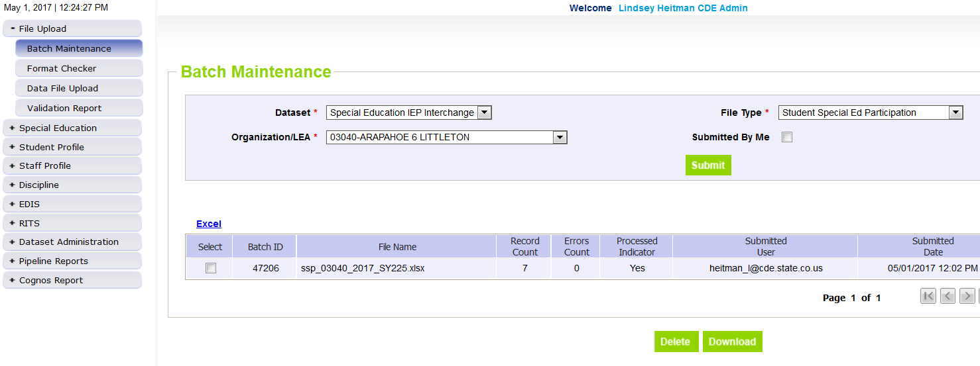
Step 3: Batch Maintenance – Very Important Step
Check Batch Maintenance to ensure files have processed successfully.
Processed Indicator will say “YES”. If blank or “No”, file did not upload
Check Record Count, Error Count, and make sure submitted date and time look accurate.

Slide 39

File Did Not Process
If this happens be sure:
there are no spaces in the name of the file
the file isn’t open when you upload it
the bytes/fields are accurate and there are no blank fields
Run file through Format Checker again. If file Passes re-upload to Data File Upload

Slide 40
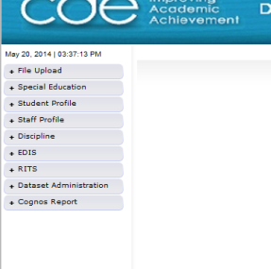
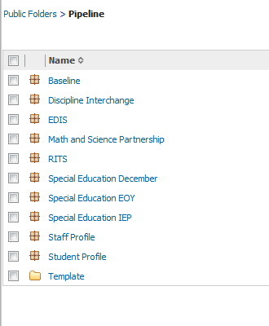
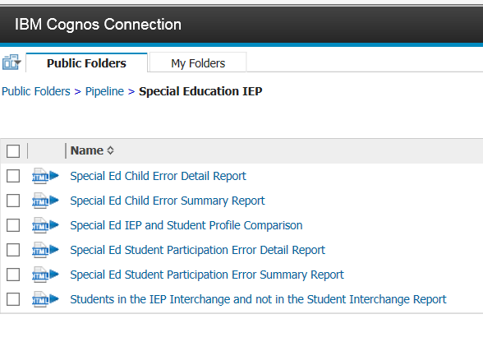
Checking IEP Interchange Errors – 2 places
  1. Data Pipeline-Cognos Reports-Special Education IEP:
    Detail and Summary Error Report for each File
    All errors located here so be sure to check before final submission

Slide 41
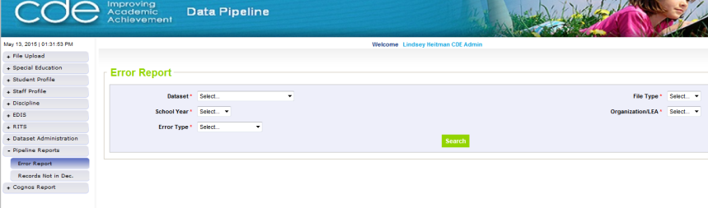
Pipeline Error Reports
2. Pipeline Reports- Error Reports
Another option for accessing Interchange and Snapshot level error reports
Dataset: Special Education IEP
File Type: choose the file name for Interchange errors and “End of Year” for Snapshot errors
Export to Excel to view errors in detail

Slide 42
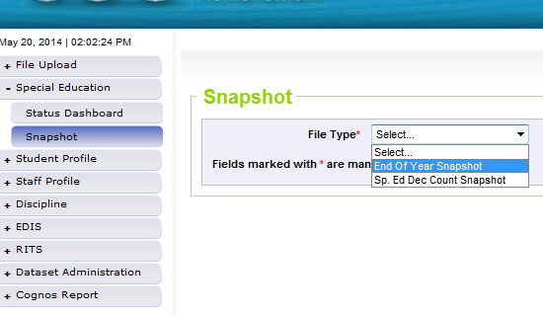
Special Education EOY Snapshot
Step 5: Create Snapshot
  Select “End of Year Snapshot” as the File Type
It’s helpful to have most Interchange errors cleared before starting on your snapshot errors
Records with errors at Interchange level will not pull into snapshot validations

Slide 43
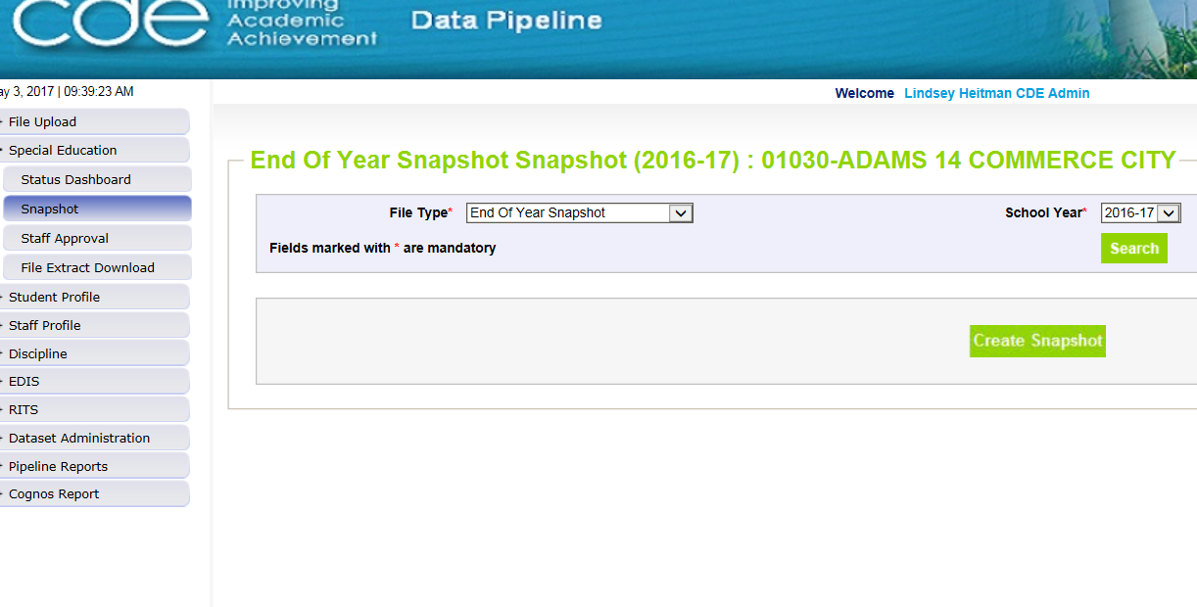
Creating a Snapshot
Select school year and organization
Click “Create Snapshot”
A message will display in green once it’s processing:
“Snapshot creation triggered and processing. A notification email will be sent upon completion.”

Slide 44
Snapshot process
Select from the drop-downs:
  File Type: End of Year Snapshot
  School Year ( 2017-2018 )
  Organization/LEA: automatically populated based on Log In
Click the Search Button
Then Click “Create Snapshot”
Email confirmation will come from Data Pipeline once Snapshot has completed.

Slide 45
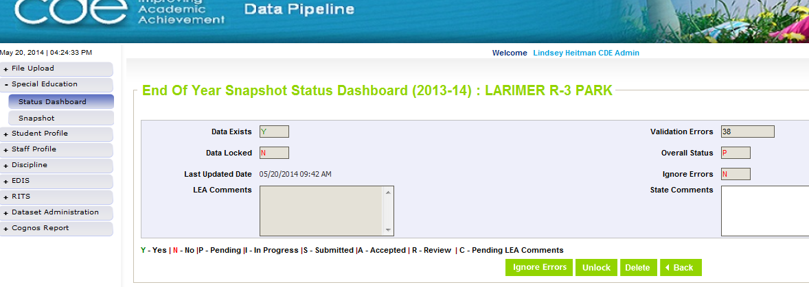
Checking Status of Snapshot
Be sure that Data Exists (Y)
Check to see that Last Updated Date is the most recent snapshot created
View and resolve your Snapshot Errors (these are your level 2 snapshot errors)

Slide 46
Correcting Snapshot Errors
View errors in the Detail Error Reports (Pipeline Error Reports or Cognos)
Option to export the report to Excel if you’d like
Correct the errors in the appropriate Interchange File (preferably Enrich or your source system) (Student files-will need to contact district respondent for these errors)
Re-upload your corrected files to the IEP Interchange. If errors only exist in 1 of the files, you can resubmit only the 1 file containing corrections.
Re-Create the Snapshot
Repeat as Needed

Slide 47
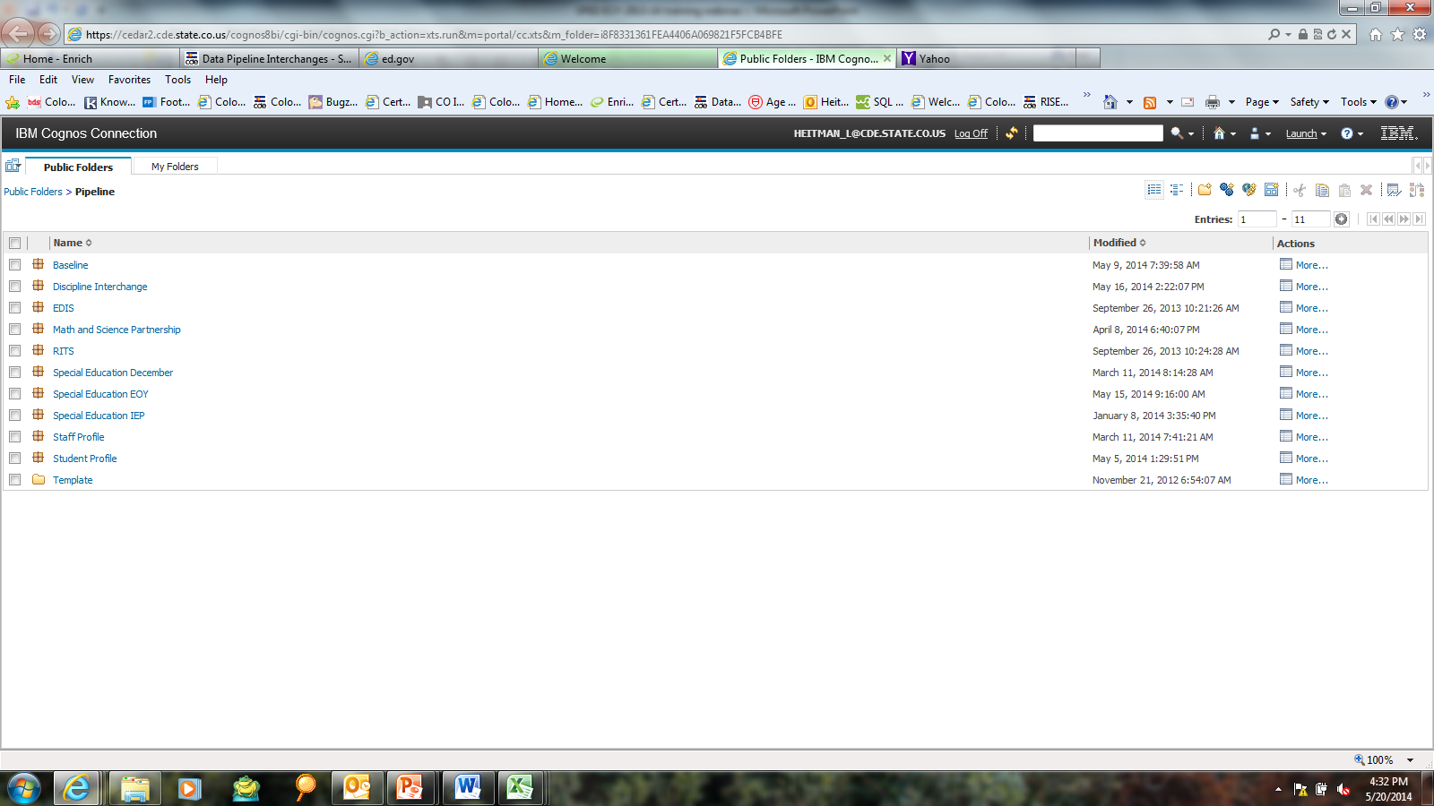
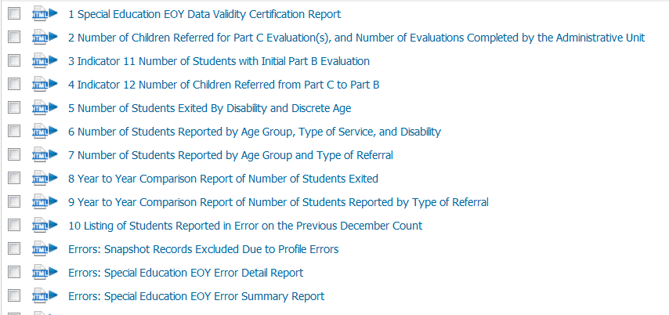
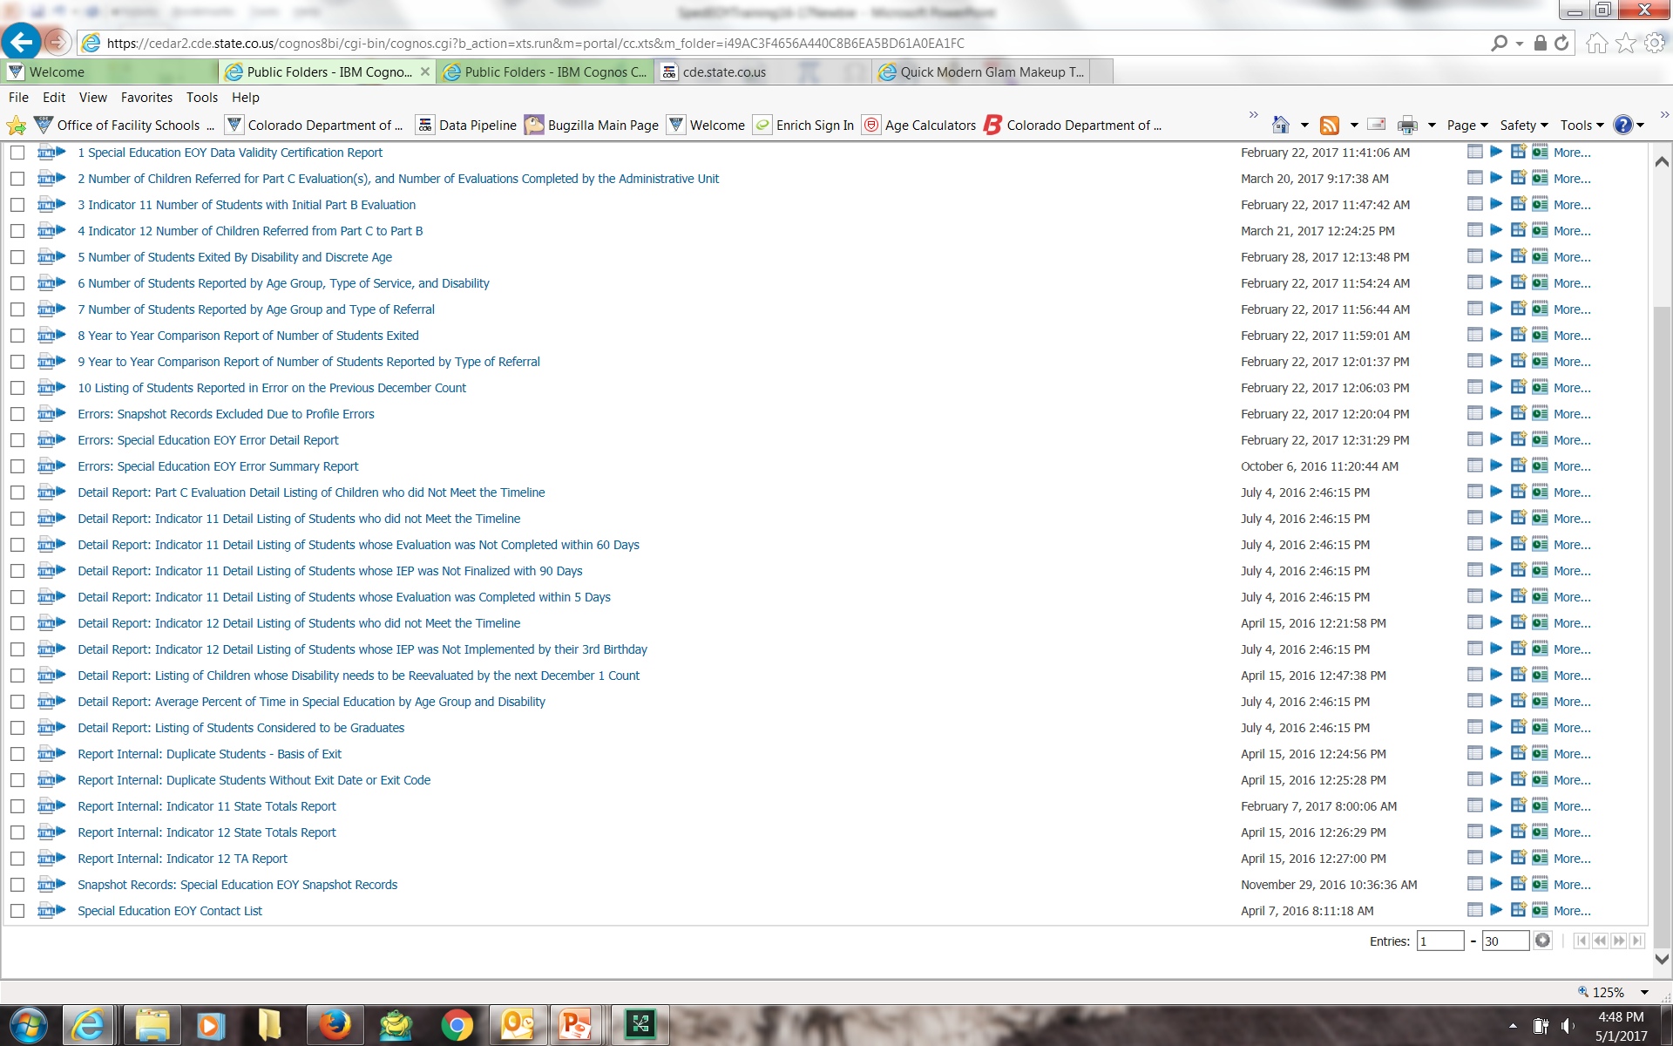
Where to Find Snapshot Errors and Snapshot Records Report
Click Cognos Reports and then Special Education EOY:
Records with errors at Interchange
Snapshot error details
Snapshot error summary
re
snapshot records

Slide 48
Special Education EOY Snapshot Records Report
Records included in this report do not have errors at the Interchange; but could have level 2 snapshot errors.
  Check the Special Education EOY Summary/Detail Error Reports for those level 2 errors.
  Check the SPED EOY Snapshot status dashboard for error count too. Once errors are resolved, you can review your reports.

Slide 49
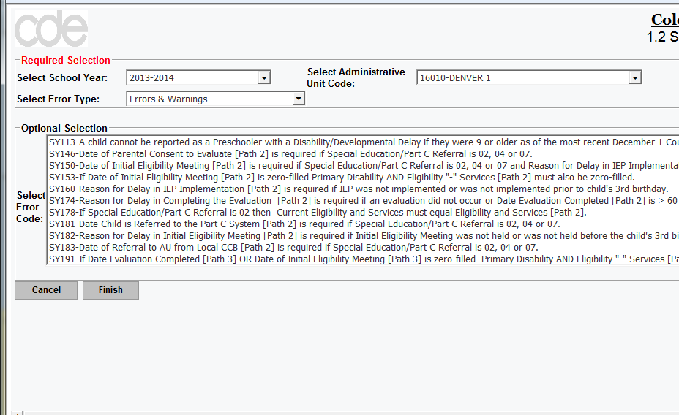
Viewing Cognos Detail Error Report
Option to view selected errors by highlighting individually, or just click Finish to view ALL errors.

Slide 50
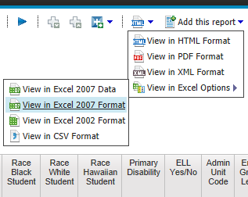
Error Viewing
Errors SY107, SY108, SY109 – to view error details be sure to choose second Excel option (Excel 2007 Format) when exporting to Excel.

Slide 51
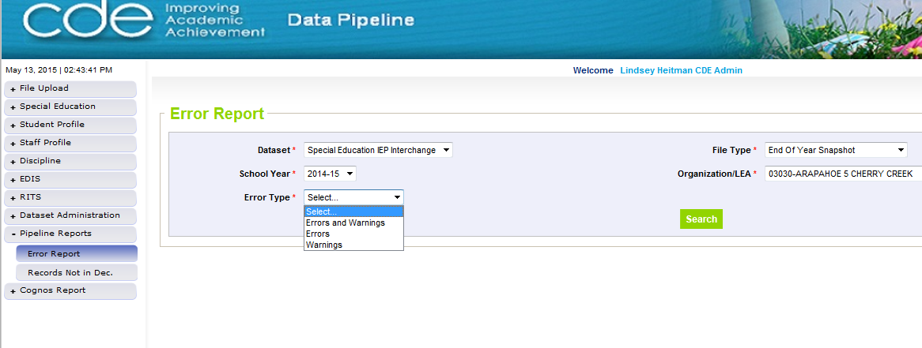
OR Pipeline Error Reports
Pipeline Reports-Error Reports

Slide 52
Reviewing Data Reports
Once All Errors are corrected, review Cognos Reports for accuracy. Errors do not catch everything!
If after reviewing, you notice something that needs to be fixed:
  IEP Interchange File(s) will need to be resubmitted
  Special Education EOY Snapshot will need to be re-created
    Reports are created from your last snapshot so any changes to files will change your reports.
Final Reports Submission and Data File Approval within Data Pipeline are the last steps:
  Once you’ve reviewed the reports and made all changes:
    Submit the 10 reports required for signature to the ESSU Data Management System
    Then in Data Pipeline, click the “SUBMIT TO CDE” button. Only the Sped EOY Approver will have ability to do this
    Finalizes the data for CDE to begin their validation process before submission to the federal government

Slide 53
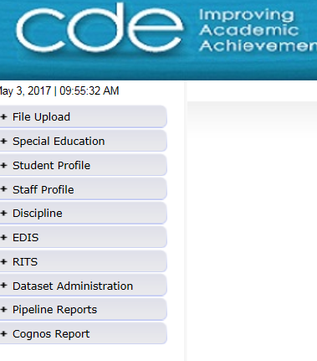
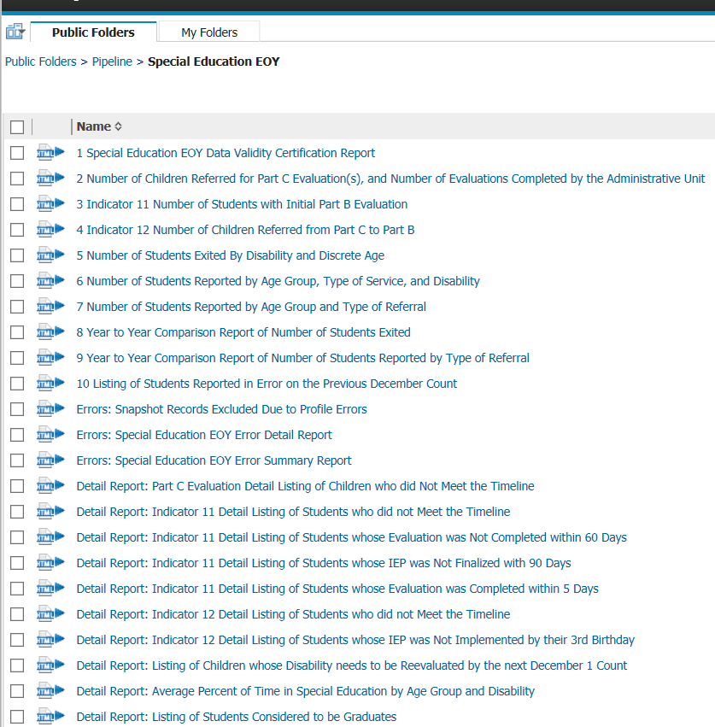
*10 signature reports required for submission upon final approval

Slide 54
Exceptions

Slide 55
Sharing Personally Identifiable Information
Syncplicity – online platform used for secure file sharing
Let us know if you do not yet have a folder. We will send you email with a link to set it up
File name is your AU code
Used for Exception requests, questions that include PII, facility students information
Email CDE to notify us you’ve placed something in the folder. We don’t get notification
User Guide: http://www.cde.state.co.us/datapipeline/syncplicityinstructions

Slide 56
Exception Table
EXCEPTION TYPE
ERROR CODE (S)
INFORMATION NEEDED IN "COMMENTS AND EXPLANATION"
Grade to Age
SY250
Please provide student's age and details of why student is not
in an age appropriate grade. EXAMPLE:
Please provide the
Date of Birth, Date of Exit, and an
Student Dropped
SY247
explanation of details regarding the student's drop out prior to
Out Prior to Age 17
the age of 17 and attempts made to retain the student in
school. EXAMPLE:
Primary Disability
of 11 or 12 and
SY111, SY112,
Please provide the
Date of Birth, The Sped Part C Referral Code
outside acceptable
SY113
being reported, and an explanation of why the student's
age range
disability has not been updated. EXAMPLE:
Student Reported
Please provide the
Date of Exit, Basis of Exit and the reason the
in Error on Previous
SY108
student was reported in error on the previous SPED EOY.
SPED EOY
EXAMPLE:
Student Reported
Please provide the
Date of Exit, Basis of Exit, and reason the
in Error on
SY107, SY109
student was reported in error on the previous December Count.
December Count
EXAMPLE:

Slide 57
SPED EOY Exceptions
5 Exception types for SPED EOY
If you receive one of the following 5 error codes, you will need to save an exception request spreadsheet in your Syncplicity folder and email CDE letting us know it’s there, in order to resolve these errors. Exception template/instructions posted at this link: http://www.cde.state.co.us/datapipeline/snap_sped-eoy
Posted under Snapshots/Special Education End of Year- Additional Resources.
  *Use Syncplicity to share exceptions

Slide 58
Grade to Age Exception
1. Grade to Age: SY250 error - Calculated age is outside of the expected range for grade level. Please verify that the grade and birth date is correct.
Use Grade to Age Table posted under Interchanges/Special Education IEP-Additional Resources: http://www.cde.state.co.us/datapipeline/inter_sped-iep

Slide 59
Grade to Age Table
Grade/Age |  |  | Warning |  | Error
Grade Level | Description | Expected Age | Minimum Age | Maximum Age | Minimum Age | Maximum Age
002 004 006 007 010 020 030 040 050 060 070 080 090 100 110 120 | Infant Preschool 1/2 Day Kindergarten Full Day Kindergarten Grade 1 Grade 2 Grade 3 Grade 4 Grade 5 Grade 6 Grade 7 Grade 8 Grade 9 Grade 10 Grade 11 Grade 12 | 0 - 2 3 - 5 5 - 6 5 - 6 6 - 7 7 - 8 8 - 9 9 - 10 10 - 11 11 - 12 12 - 13 13 - 14 14 - 15 15 - 16 16 - 17 17 - 18 | NA 2 4 4 5 6 7 8 9 10 11 12 13 14 15 16 | NA 6 7 7 8 9 10 11 12 13 15 16 17 18 20 21 | NA < 2 < 4 < 4 < 5 < 6 < 7 < 8 < 9 < 10 < 11 < 12 < 13 < 14 < 15 < 16 | > 4 > 7 > 8 > 8 > 9 >10 >11 > 12 > 13 > 14 > 16 > 17 > 18 > 19 > 21 > 22

Slide 60
Primary Disability Exception
2. Primary Disability of 11 or 12 and outside acceptable age range: errors SY111, SY112, SY113
Primary Disability 12 – Infant/Toddler with a Disability (ages birth through 2)
Primary Disability 11 – Developmental Delay (ages 3 through 8 )
SY111: A child cannot be reported as an Infant/Toddler with a Disability if they were 3 or older as of the most recent December 1 Count. Please refer to the Exception Request Instructions document for instructions on how to request an exception.
SY112: A child cannot be reported as Developmental Delay if they were younger than 3 as of the date their IEP was implemented. Please refer to the Exception Request Instructions document for instructions on how to request an exception.
SY113: A child cannot be reported as Developmental Delay if they were 9 or older as of the most recent December 1 Count. Please refer to the Exception Request Instructions document for instructions on how to request an exception.

Slide 61
Drop Out Exception
3. Student dropped out prior to age 17: error SY247
Students exiting as dropped out should be at least 17 years old. Please refer to the Exception Request Instructions document for instructions on how to request an exception. Please include an explanation of this student's dropout prior to age 17.
Basis of Exit code 40

Slide 62
Reported in Error on December Count
4. Student reported in error on December Count: errors SY107, SY109
SY107: All students reported on the December count as attending your AU must be reported on your Special Education Student End of Year Student file. Please refer to the Exception Request Instructions to request an exception.
SY109: All students reported on the December count for your administrative unit as attending an eligible facility (PAI code 22) must be reported on your Special Education Student End of Year file. If a student was previously reported in error please refer to the Exception Request Instructions document for instructions on how to request an exception.
    This is the exception for a student that you reported on December Count, but shouldn’t have (i.e. they actually exited your AU before Dec 1 and you hadn’t received that info until after December Count closed)

Slide 63
Reported in Error on Previous SPED EOY
5. Student reported in error on previous Sped End of Year: error SY108
SY108: All students reported on last year’s snapshot should be reported this year unless they were exited in the file last year.
You’ll get this exception on any records reported last year without an exit code, and are NOT reported this year
New this year: please report the record and exit the them as of 07/01 instead of submitting an exception request
Had the option for this before but also had the exception option as well. Going forward, we would like every record to be reported on the snapshot so that all exits are being included in what is submitted to EdFacts
This exception type will remain for SASID merges or changes

Slide 64
Timeline and Resources

Slide 65

DATES TO REMEMBER Special Education EOY 2017-2018
Tuesday May 1, 2018
Snapshot official opening
Wednesday July 11, 2018
IEP Interchange errors resolved
At least 1 Special Education EOY Snapshot created by this date
Thursday Sept. 6, 2018
All exception requests received by CDE
Tuesday Sept. 11, 2018
All errors resolved: Interchange and Snapshot
Tuesday Sept. 11 – Friday Sept. 14, 2018
Report Review
Review exit information in preparation for duplicate checks
Wed. Sept. 19 – Wed. Sept. 26, 2018
AUs make changes to resolve duplicates
Thursday Oct. 3, 2018
Final Report Review September 27 – October 3
ALL Final signed reports received by CDE
Submit and finalize data – COLLECTION CLOSES

Slide 66
Resources
Website demo
May want to bookmark:
Special Education IEP Interchange Resources:
http://www.cde.state.co.us/datapipeline/inter_sped-iep
Special Education EOY Snapshot Resources:
http://www.cde.state.co.us/datapipeline/snap_sped-eoy

Slide 67
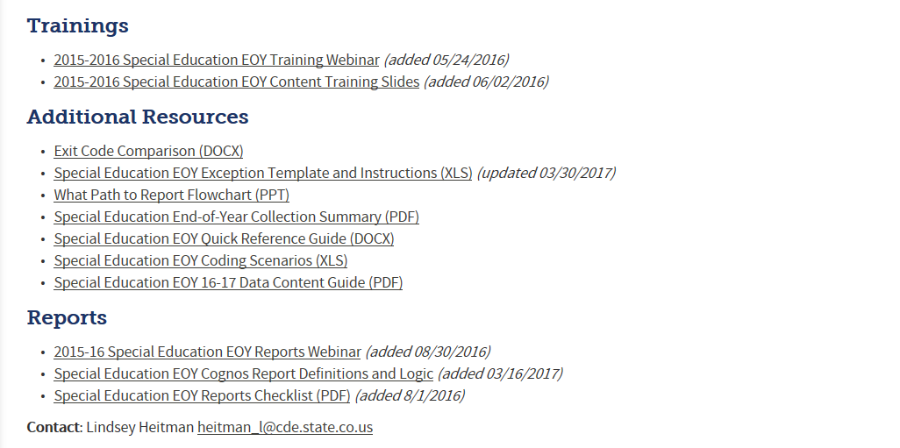
Special Education EOY - Resources
Data Pipeline Documentation Website Home – Snapshots – Special Education End-of-Year
http://www.cde.state.co.us/datapipeline/snap_sped-eoy

Slide 68
Special Education EOY: Questions?
Special Education EOY contact information
Lindsey Heitman – heitman_l@cde.state.co.us 303-866-5759 (Primary contact)
Kristi Gleason – gleason_k@cde.state.co.us 303-866-4620
Orla Bolger – bolger_o@cde.state.co.us 303-866-6896
*Please include your AU #, Error code # (if applicable), and phone number in emails

Slide 69

Happy Data Reporting!

