Slide 1
Data Respondent Training for Staff Collections
Human Resources Collection lead-Dawna Gudka

Slide 2
Today’s Agenda
Identity Management System (IdM)
Townhall
What is the difference of an Interchange file and a snapshot?
Who gets reported
Purchase Service Staff
Staff Interchange Website
File Layouts
Templates

Slide 3
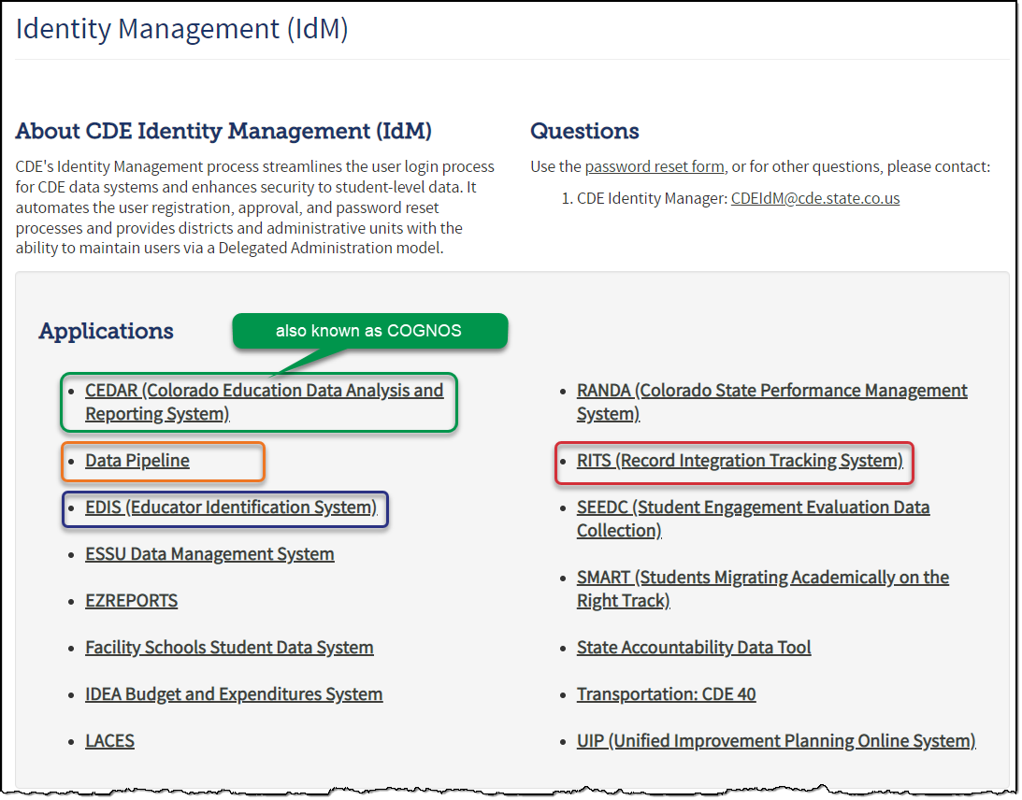
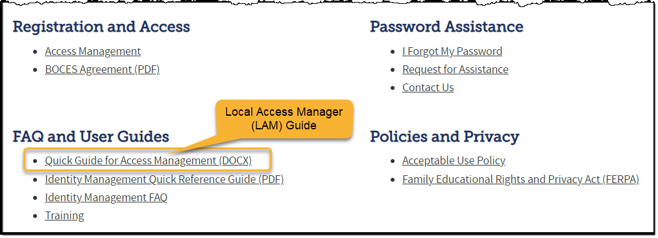
Identity Management System
Identity Management Site
Frequently Asked Questions
How do I add myself or others to the email listserv for town hall emails and/or a specific collection?
  Email lists are dependent on a person’s access rights in IdM. Contact your LAM to get an account or be assigned to a specific collection.
Where can I find the IdM role mappings for Data Pipeline and other applications?
  Role Mapping (XLS)

Slide 4
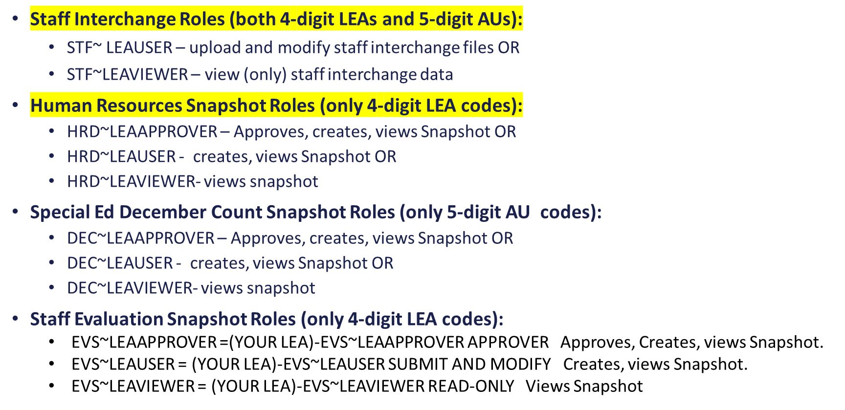
Identity Management System
IdM Roles for Staff Collection

Slide 5
Townhall
Every Thursday from 9-10AM Data Services Unit host Townhall
  Upcoming Townhalls and Trainings
  Archived Townhall Presentations
Email DATASERVICES-subscribe-request@cdelist.cde.state.co.us to sign up for weekly town hall email reminders.

Slide 6
Difference between Interchanges and Snapshots
Interchanges
  Files that contain your staff data
    Staff Profile-Your staff and purchase service staff
    Staff Assignment-This is your staff and purchased service staff’s job assignments
Snapshot
  Creating a snapshot is not something that you upload
    Once your interchange files are uploaded into Data Pipeline you create a snapshot
    Creating a snapshot is a matter of clicking on a create snapshot button. This merges your Staff Profile and Staff Assignment interchange files together. This makes up the snapshot. The snapshot data is what gets reported to CDE
Staff Profile Interchange file
Staff Assignment Interchange file
Human Resources Snapshot

Slide 7


Interchange files
Staff Profile
  General information of staff
  Only 1 record per staff
  Staff Profile file must be uploaded first
  Staff Assignment
    Provides specifics to actual duties and locations
    Multiple records per staff allowed
    One record for every assignment

Slide 8
Staff Profile-Who gets reported? ALL STAFF employed and or providing services to your students
All staff employed and or servicing LEA (district students) as of December 1st are included in the Human Resources Collection
  ALL Employed STAFF
    Full & Part time staff
    General Education staff
    Special Education staff
      Districts report their Special Ed Staff as part of their staff interchange files OR
      Administrative Unit reports special education staff for all member districts and the districts exclude them
    Charter School staff
    Active assignment on December 1st
    District (LEA) staff
      District level staff are reported with School Code 9980 for ‘District Wide’
  Purchased Staff servicing LEA students
    Purchased staff resource documentation

Slide 9
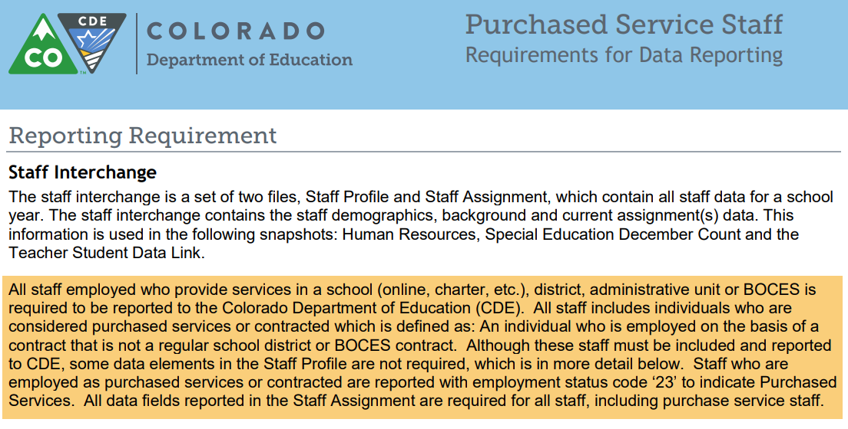
Purchased Service Staff

Slide 10
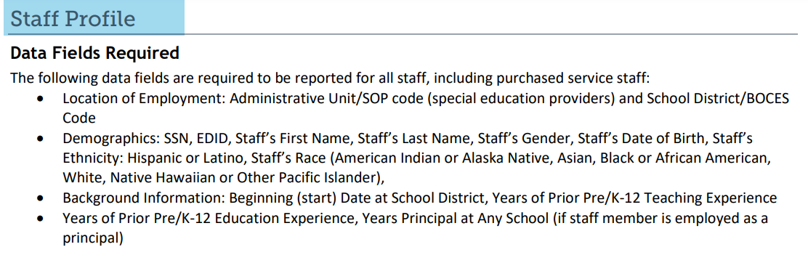
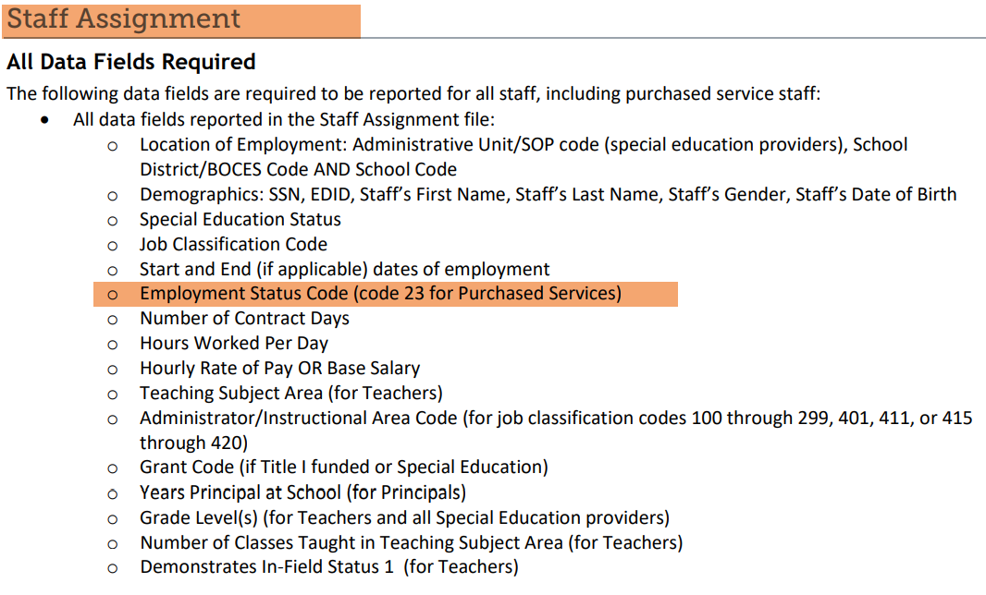
Purchased Staff
What data elements are required to be in the interchange files?

Slide 11
Website Resources
Timeline
File Layout
Templates
Business Rules
Resources

Slide 12
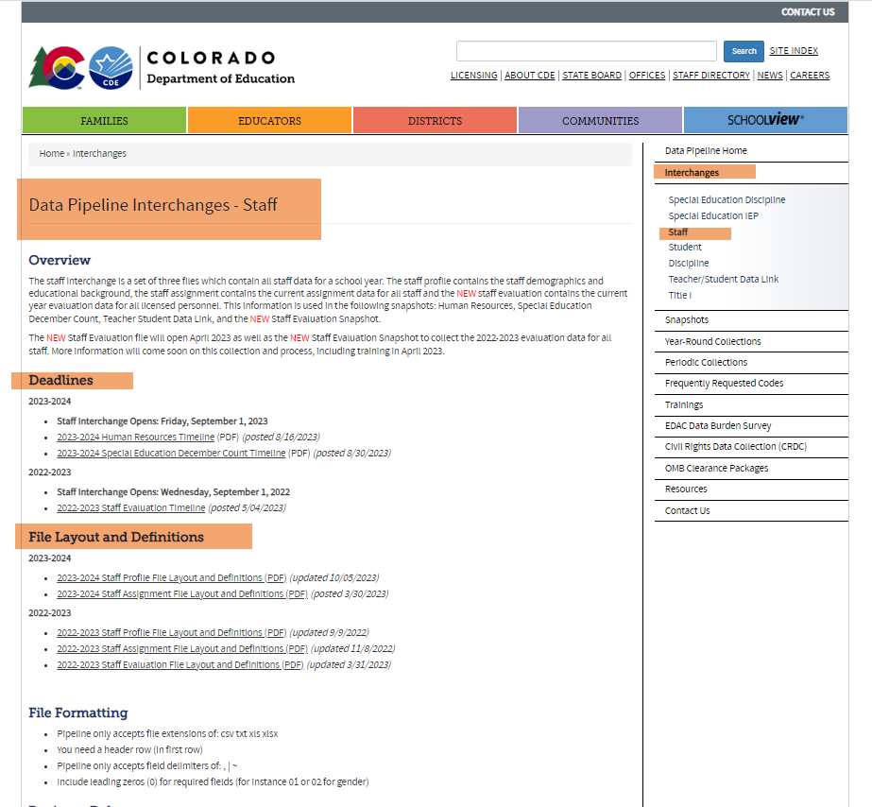
Staff Interchange Website
Bookmark-Staff Interchange website

Slide 13
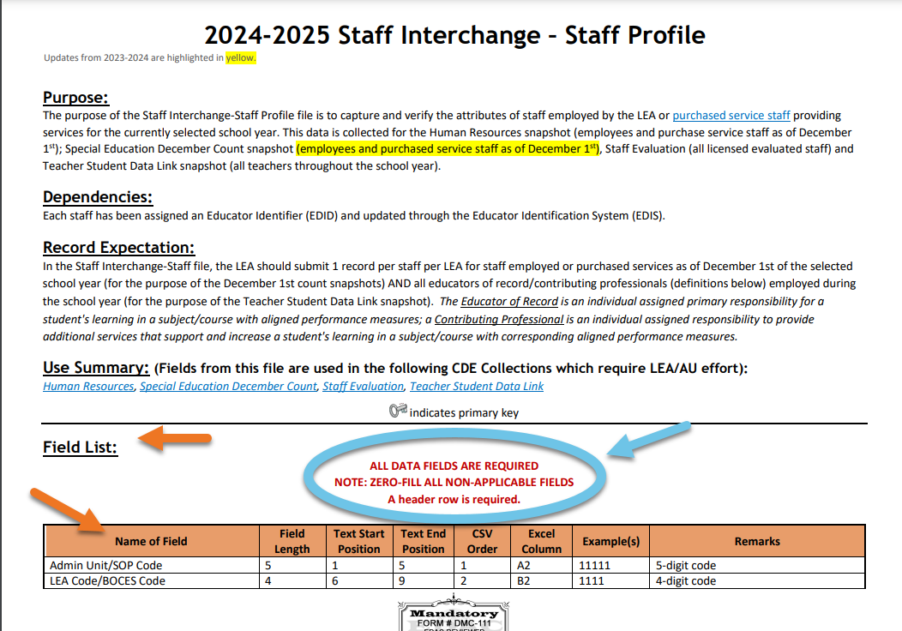
File Layouts

Slide 14
Templates

Slide 15
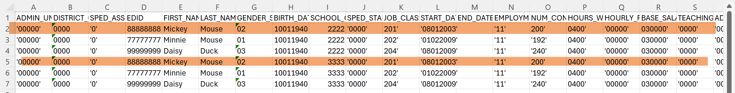
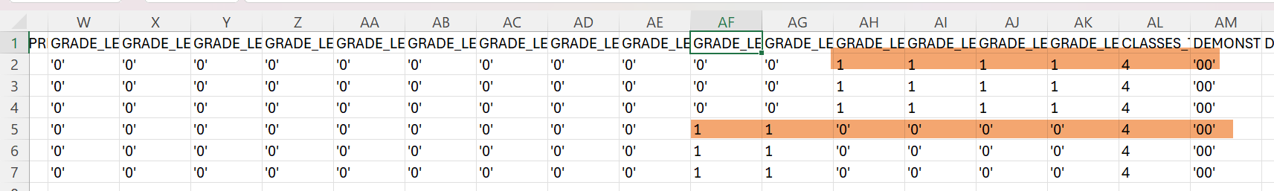
Staff Profile and Staff Assignment samples
Staff Profile interchange file
Staff Assignment interchange file

Slide 16
Staff Interchange files are used for other collections
Staff Interchange files are used in the following snapshots:
  Human Resources Snapshot
  Special Education December Count
  Teacher Student Data Link (TSDL)
  Staff Evaluation Snapshot
Notes on the Snapshot Process:
  Human Resources and Special Education December Count Snapshots pull the records from Staff Assignment and Staff Profile files matching the criteria set for each snapshot
  Snapshots are not automatically updated when interchange files are uploaded- a new snapshot must be created within the system to pull in the updated records

Slide 17

Multiple Assignments-Staff Profile
One record for every staff member
Example Teacher, teaching Language Arts to 7th and 8th Grade students at district’s the middle school in the morning and teaching Math to 9th and 10th Grade students at district’s high school in the afternoon
Teacher has B.A. in Language arts
Staff Profile file: One record

Slide 18
Multiple Assignments-Staff Assignment file
One record for every assignment in district
Example Teacher, teaching Language Arts to 7th and 8th Grade students at district’s the middle school in the morning and teaching Math to 9th and 10th Grade students at district’s high school
Staff Assignment file: For every assignment, a staff member must a record in assignment file
Splitting the assignments by school and hours, pay and teaching subject areas
Reporting the grade at each school
Classes taught at each school and demonstrates in field status

Slide 19
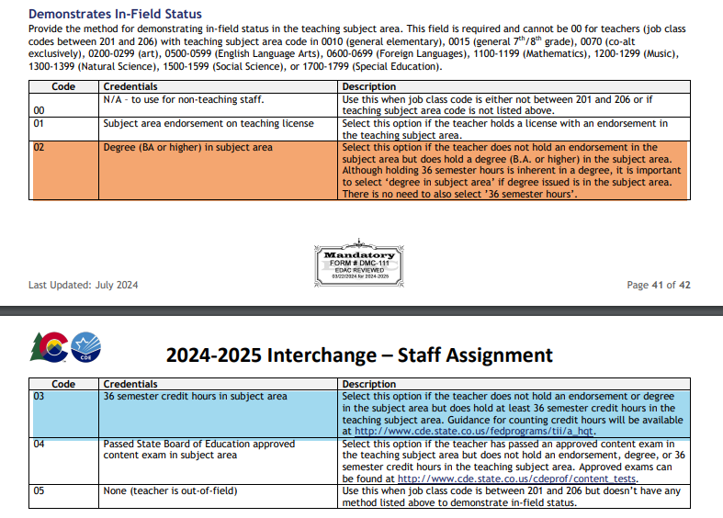
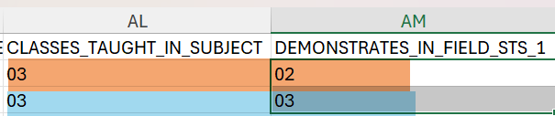
Multiple Assignments-Staff Assignment
Classes taught at each school and Demonstrates in-field status
Classes taught at each school and demonstrates in field status
Teacher has a CDE alternative license and holds
a B.A. in Language Arts, and has 36 hours in
Math courses: middle School assignment meets
02 demonstrates in field status
High school assignment meets 03 in field status

Slide 20





Superintendents that wear many hats-How do I report them?
Superintendent is the one job that can not be split. Superintendents can wear many hats but are only reported as the Superintendent in the staff assignment file

Slide 21
Examples of Coding EL and GT Teaching Staff
Teaching EL
Job Code 201 (Teacher, Regular)
Teaching Subject Area 0510 Language Skills
Administrator/Instructional Area 0050 Language Instruction Education Program
Teaching GT
Job Code 201
Teaching Subject Area depends on what GT class they are teaching
Administrator/Instructional Area 0012 Gifted and talented

Slide 22





New Job Code 225
Job Code 225 CTE Instructor CTE Instructors instruct students in various technical and career subjects, such as auto repair, aeronautics, healthcare, culinary arts, etc. Some courses take place in the evenings or weekends. CTE instructors typically have industry based experience and non-traditional certification or licensure. CTE Instructors partner with local university/colleges to help students earn certifications, diplomas or AA degrees specific to a particular career area.

Slide 23
The importance of reporting complete Staff Data
Complete picture of the staff providing services to your students
Data is Published
Student teacher ratio
Student special service providers ratio

Slide 24
Data Pipeline Process

Slide 25
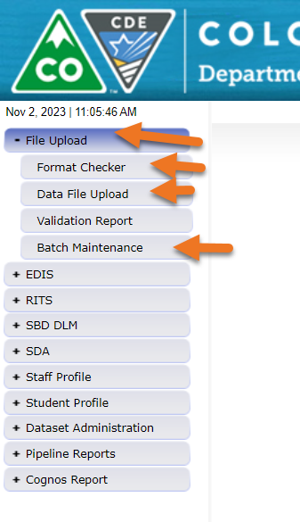
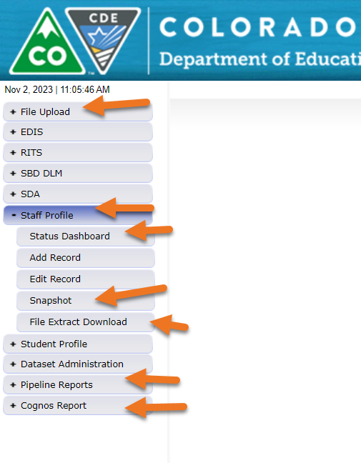
Data Pipeline Overview

Slide 26
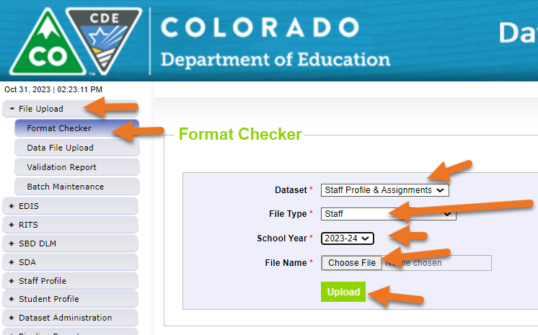
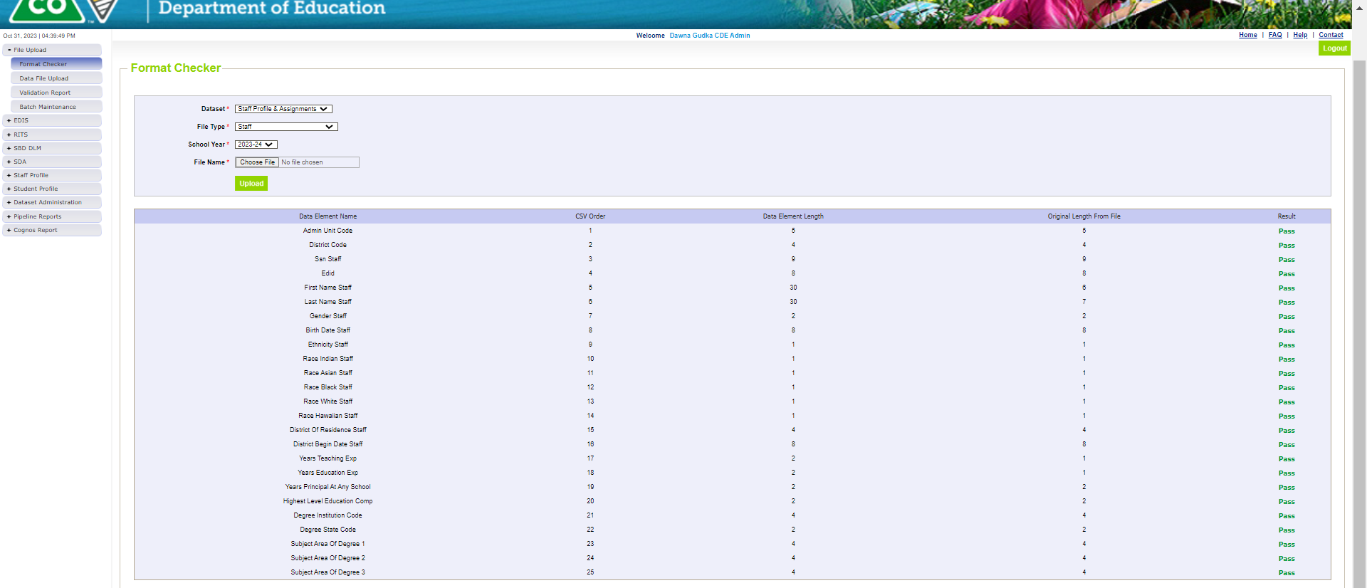
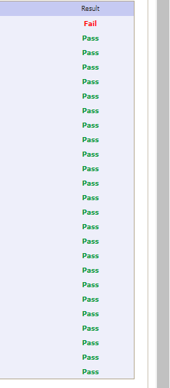
Using format checker

Slide 27
Using Format Checker
File Not Processed-Next Steps
Ensure file has all green ‘pass’ in format checker
Format checker only checks the first record
  YES?
    Open file and review all records are formatted the same as the 2nd row
    Be sure all codes and dates have leading zeros included
  NO?
    Review file layout posted online and re-format the file
For further assistance, contact Dawna Gudka (Staff Interchange/Human Resources or Lindsey Heitman (Special Education December Count)
  DO NOT INCLUDE THE FILE IN ANY EMAILS – if needed we can send a syncplicity folder to share the file(s) securely

Slide 28
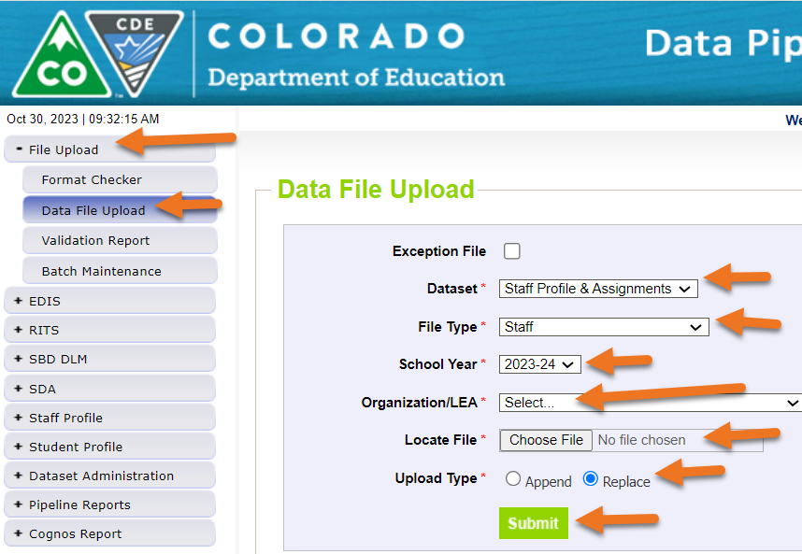
Data Pipeline Process-Upload Staff Profile

Slide 29
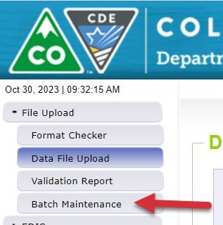
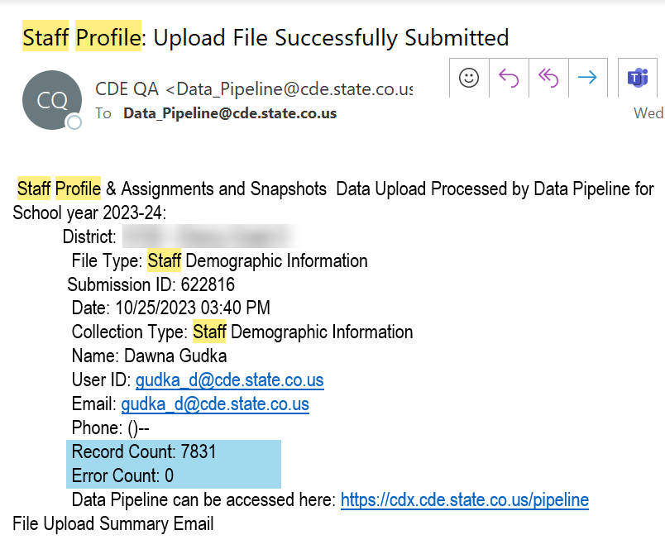
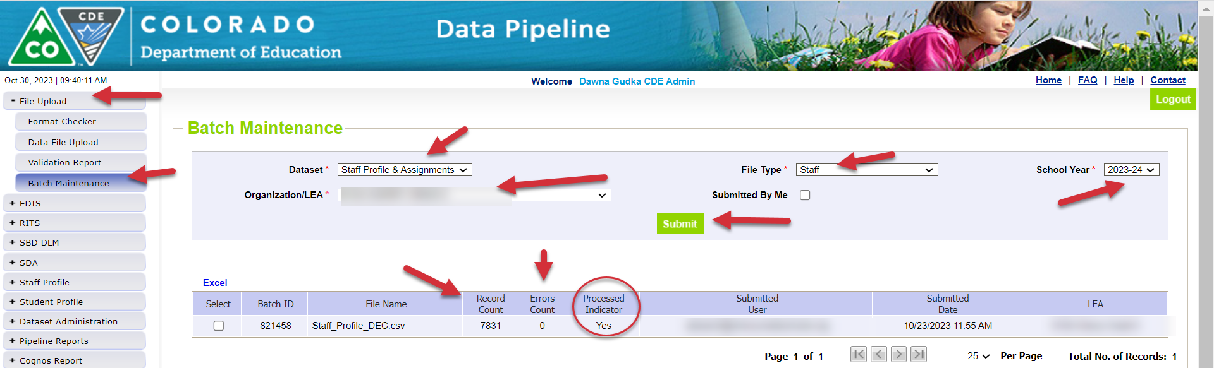
Data Pipeline Process-Checking the file process
Once your file has processed you will receive an email
Another way to check your files status

Slide 30
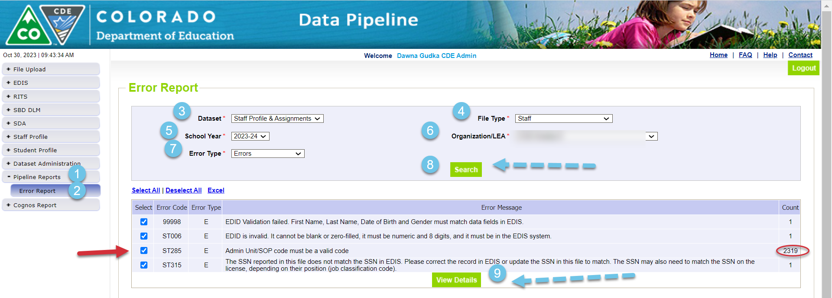
Data Pipeline Process-checking for errors
Checking for errors in Data Pipeline Error Report
Click on View Details to see the error in detail

Slide 31
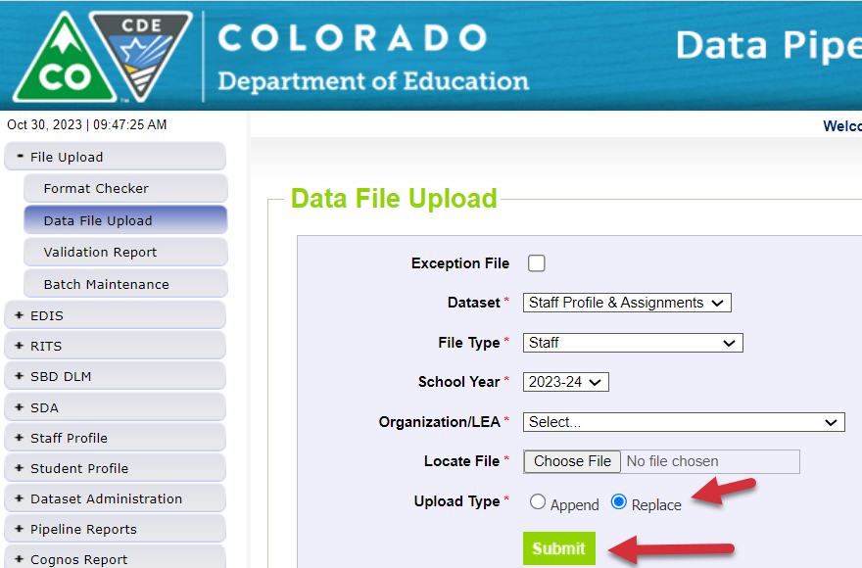
Data Pipeline Process-correcting the errors
Always correct your errors in your staff information system
  Then extract the staff profile file again, and reupload into Data Pipeline replacing your file:
Repeat the steps to check your file processing status then check for errors and warnings, correct if any errors then reupload by replacing your file again until you are error free

Slide 32
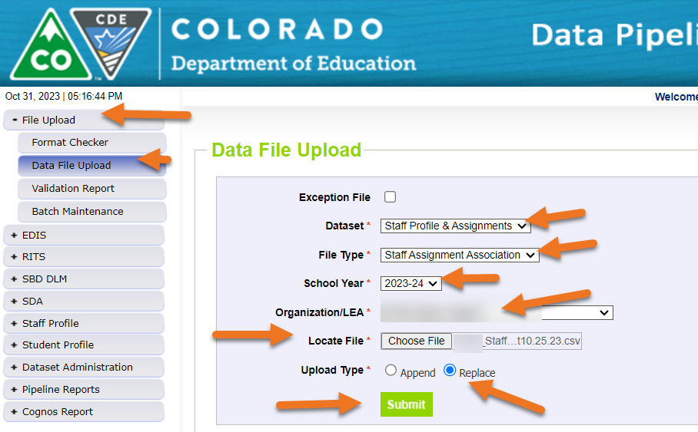
Data Pipeline Process-Uploading Staff Assignment Interchange file

Slide 33
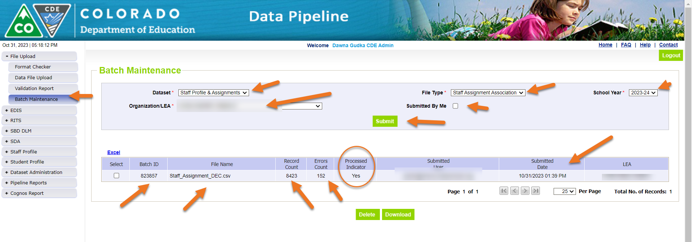
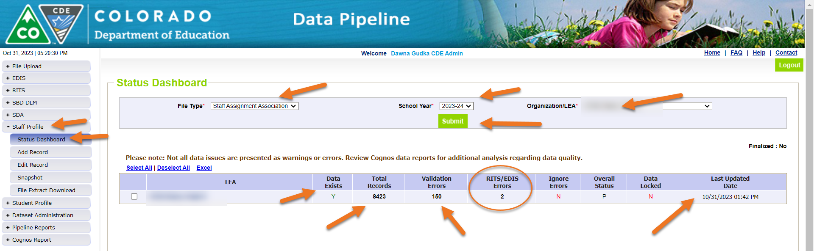
Data Pipeline Process-File Processing
Checking batch maintenance or status dashboard

Slide 34
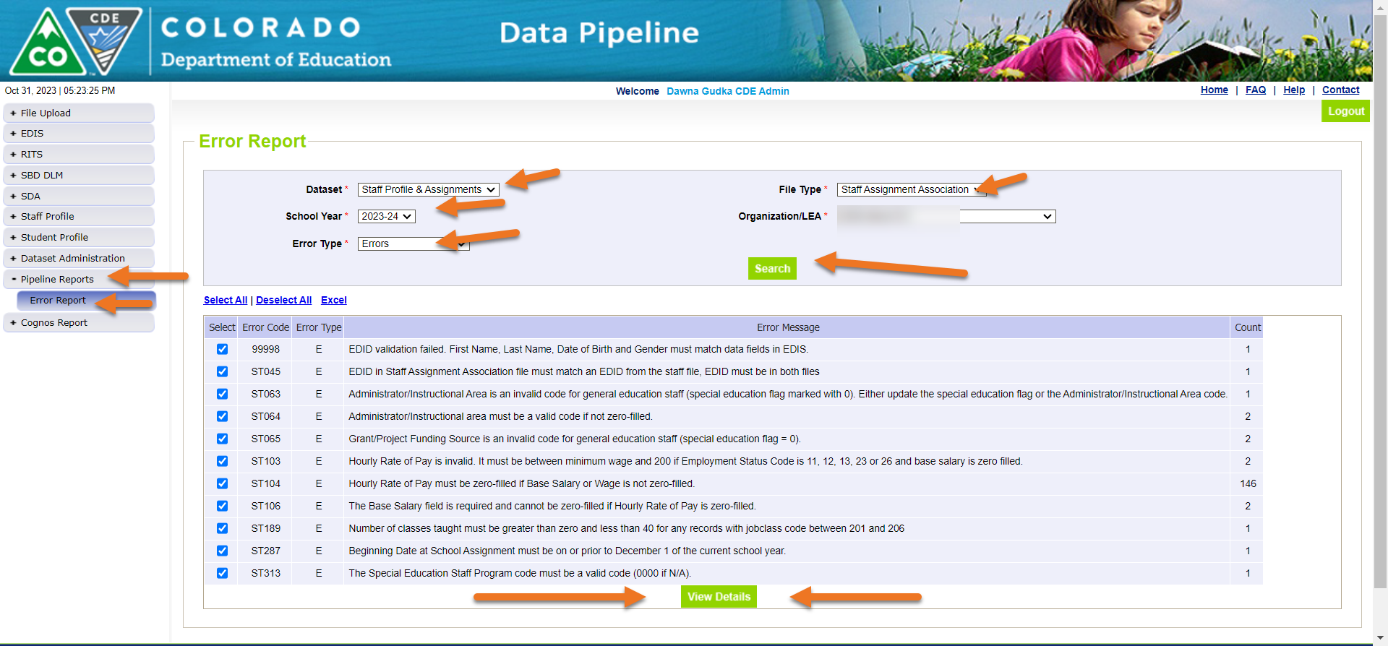
Data Pipeline Process-Checking for Staff Assignment interchange errors and correcting the errors

Slide 35
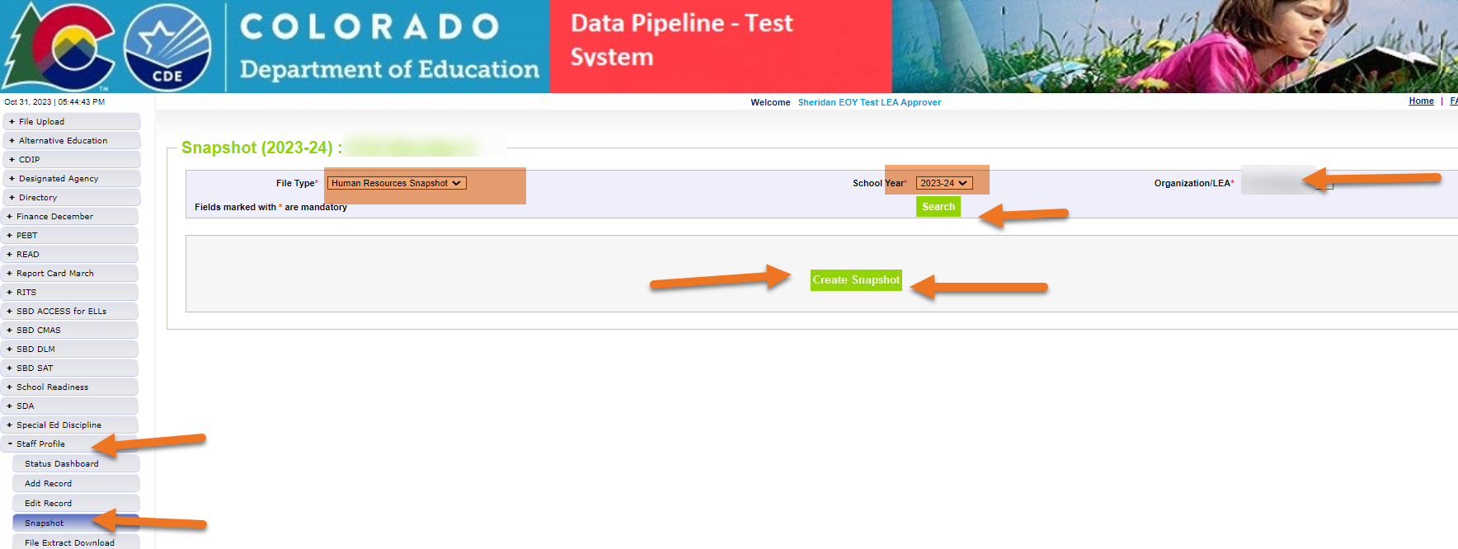
Data Pipeline Process-Human Resources Snapshot
Creating a Snapshot Data Pipeline merges the interchange files together
Staff Profile = Processed and Zero Error Count
Staff Assignment File = Processed and Zero Error Count
Create Snapshot
  Districts/BOCES create Human Resources Snapshot
  Administrative Units create Special Education December Count Snapshot

Slide 36
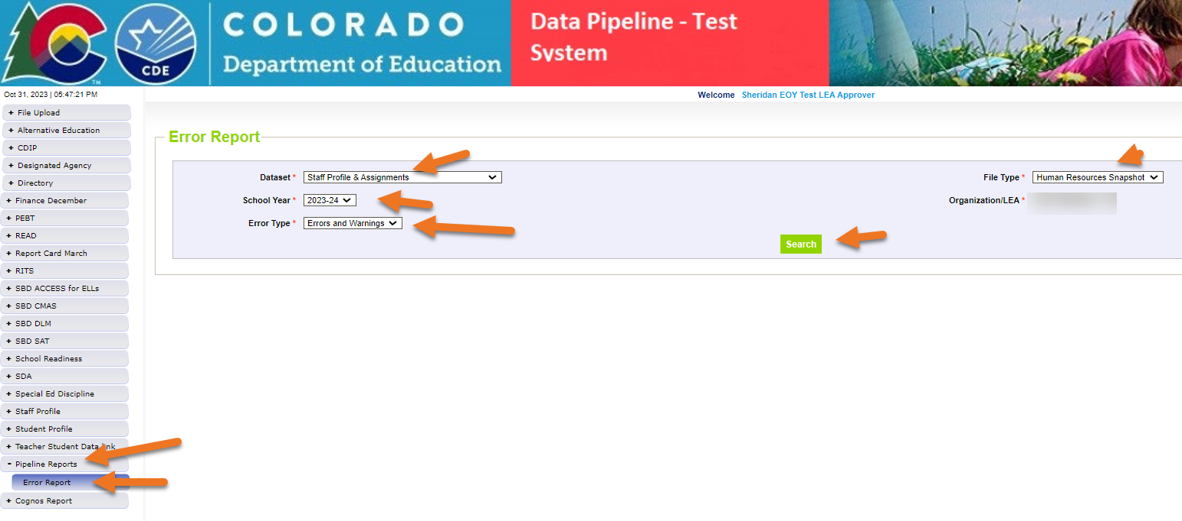
Data Pipeline Process-Human Resources Snapshot-checking for errors
Once you click search, you can see your errors, then click on view details to see your errors in detail

Slide 37
Data Pipeline Process-Human Resources Snapshot-errors
Correct the errors in the file:
  May have to fix errors in both Staff Profile and Staff Assignment files
  Keep file versions – in case updated file causes even more errors, you can re-start using a prior file version
Resubmit your data records using the same process and replacing your existing data file using the Data File Upload tool
All errors must be corrected, all warnings should be reviewed

Slide 38
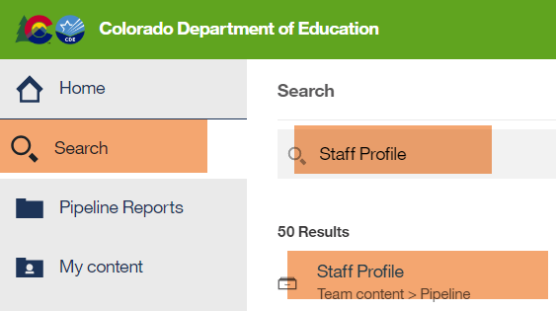
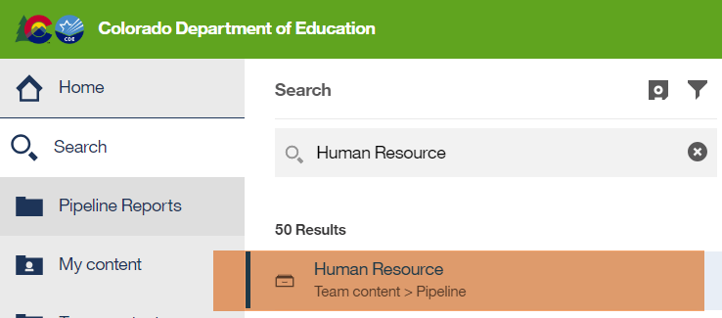
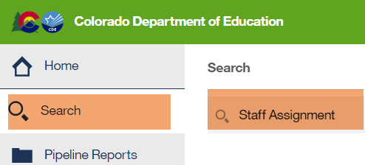
Data Pipeline Process-Human Resources Snapshot
Validate your data
How to validate your data? Using Cognos Reports

Slide 39
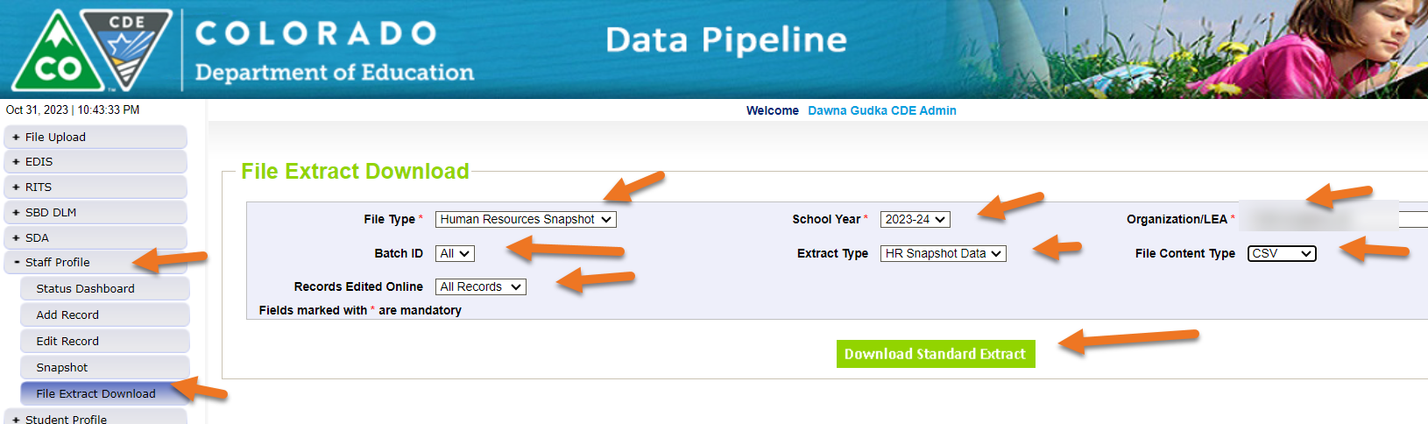
Pulling your Human Resources Snapshot Records
Snapshot Records review

Slide 40
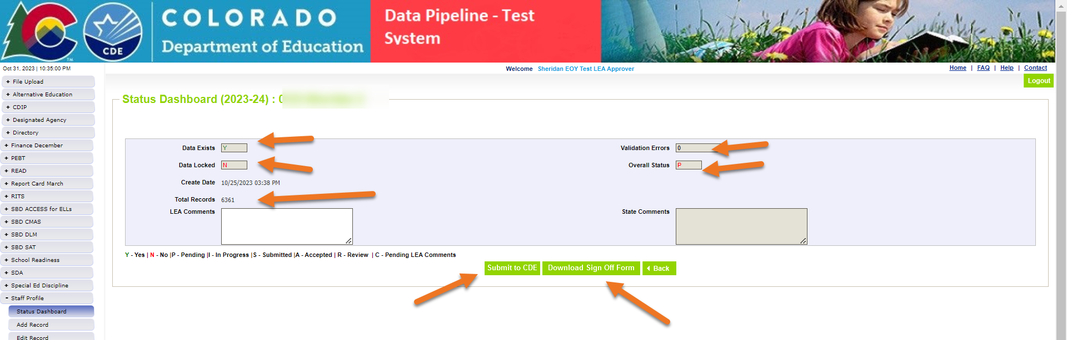
Data Pipeline Process-Correcting your errors in your interchange files then create a new snapshot to pull in the new data
Once your interchange files are error free and your Human Resources Snapshot is error free you can submit your data to CDE,

Slide 41

Sharing Data
Use secure methods to transfer any PII to CDE
  Contact Data Collection leads with questions about how to transmit PII securely
    Each Data Collection leads maintains their own Syncplicity folders for specific collections, reach out to the collection lead for access
  Use Syncplicity to encrypt emails to CDE
Avoid sending PII via unencrypted email or to unsecured faxes when sharing data between or within districts
  Use Syncplicity to encrypt emails to CDE
Check local policies for restrictions, requirements, etc. regarding PII
  Do not use PII in trainings, presentations, etc.
  Do not share PII with unauthorized individuals
  Do not share passwords
  Follow local policies when transmitting PII to any third party

Slide 42
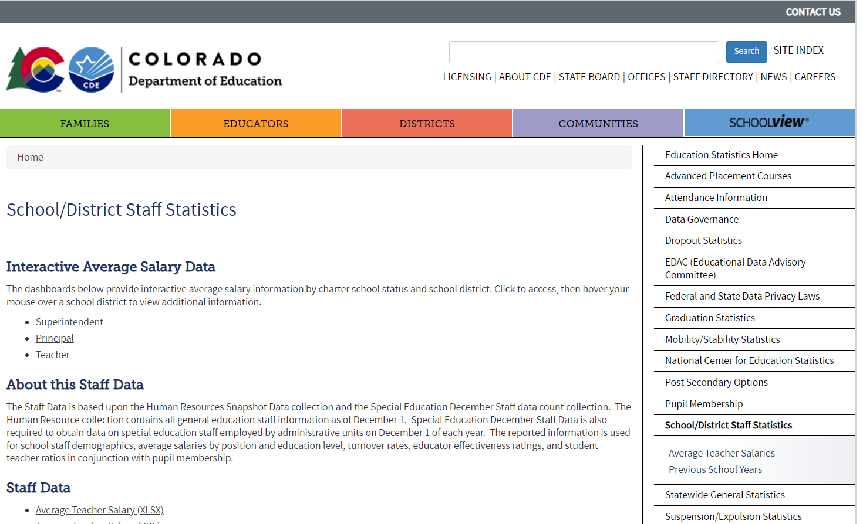
Published Staff Data

Slide 43

Thank you for joining today
Questions:
HumanResourcesData@cde.state.co.us
Dawna Gudka (303) 598-7901

