Slide 1
Graduation Guidelines: Students Graduating in 2020-2021
Jesse Cooper Data Services Unit Senior Data Analyst/Statistician cooper_j@cde.state.co.us

Slide 2
Agenda
Overview
Data Reporting
Timeline/Deadlines
How to Report: Class of 2021
Resources
Contacts

Slide 3
Overview

Slide 4
Graduation Guidelines
Colorado Graduation Guidelines are a road map to help students and their families plan for success after high school.
In order to graduate from high school, students choose from a Menu of Options - adopted at the local school board level - to demonstrate Postsecondary and Workforce Readiness (PWR) in English and math.
The guidelines go into full implementation for the Class of 2021 or 2022.
Students graduating in 2020-2021 are still required to report Graduation Guidelines, but they may use the Local Measure option

Slide 5
Graduation Guidelines
Graduation Guidelines is a file in the Student Interchange
Graduation Guidelines matches with the Student School Association File and Student Demographic file based on SASID.
Any graduating student (exit type code 90) must have at least 2 records (i.e., rows) in the Graduation Guidelines file
At least one in English (Guideline Type = 0)
At least one in math (Guideline Type = 1)

Slide 6
Graduation Guidelines and Student End of Year
Graduation Guidelines is incorporated into the Student End of Year Collection
The file serves as a validator to check to make sure any student marked as a graduate (exit type code 90) in Student End of Year also has met Graduation Guidelines (at least one in English and at least one in math).

Slide 7
Error Checking
Graduation Guidelines Errors
Invalid score values
i.e., if Guideline name is ACT score must be between 1 and 5
Guideline names that must use specific guideline type
i.e., if Guideline Name is QAS, Guideline Type must be math
Accommodation errors
A student may only be IEP Accommodation = 1 if the student has a record in the SPED interchange.
A student may only be EL Accommodation = 1 if the student is IPST_COHORT_LEP = 1 in Student End of Year.
A student may only be GT Accommodation = 1 if the student is IPST_COHORT_GT = 1 in Student End of Year.

Slide 8
Error Checking
Student End of Year Error
This student was reported with an exit type of 90 (graduating with a regular diploma). However, this student does not have a record of meeting graduation guidelines in English and/or math in the Graduation Guidelines file (GG). Please add this student to your Graduation Guidelines file or change the school exit type.
Data Checks:
Any student with exit type code 90,
Who has an AYG ≥ 2020-2021
Who has not met Gg in English and math (must have one GG record with 0 as Guideline Type and one record with 1 as Guideline Type) with a passing score
DOES NOT flag for ASCENT students

Slide 9
Data Reporting

Slide 10
Program People & Data Respondents
Both sides (program/policy & data) must work together to report GG accurately and effectively.
Best practice suggestion:
Data people print a list of students who are likely to graduate in the current school year
Program people check which students have met GG
Repeat as necessary
Helpful Cognos Reports to Assist You
Notes:
Perhaps we open up the floor for districts to share how they are handling GG reporting?

Slide 11
Graduation Guidelines - Reporting
All graduating students must have at least one GG met in English and at least one GG met in math.
A student’s GG records should capture any and all GGs attempted
School District/BOCES Code | SASID | SCHOOL_CODE | STUDENT_FIRST_NAME | STUDENT_LAST_NAME | STUDENT_GENDER | STUDENT_DATE_OF_BIRTH | GUIDELINE_TYPE | GUIDELINE_NAME | GUIDELINE_SCORE | SCHOOL_YEAR_OF_COMPLETION | IEP_ACCOMMODATION | EL_ACCOMMODATION | GT_ACCOMMODATION | DISTRICT_OF_COMPLETION
1234 | 123456789 | 1234 | Test | Test |  | 01012000 | 0 |  |  | 2018 | 0 | 0 | 0 | 1234
1234 | 123456789 | 1234 | Test | Test |  | 01012000 | 1 |  |  | 2019 | 0 | 0 | 0 | 1234
This is YOUR district code/ reporting district
This is the reporting school
Every student must have one GG reported in English (0) and math (1)
Based on GG menu of options – more examples on following slide
The year the student met a GG – not necessarily the reporting school year
Where student met GG – not necessarily your district – important for tracking transfer students

Slide 12
Accepted Guideline Scores vs. Benchmark Scores
Graduation Guidelines File Layout
Graduation Guidelines Menu of Options
Guideline Name and Description | Guideline Name Code | Accepted Guideline Score Values | Benchmark Scores
ACT ACT is a national college admissions exam. It measures four subjects – English, reading, math and science. The highest possible score for each subject is 36. | ACT | 1-36 | Benchmark English – 18 on ACT English Benchmark Math – 19 on ACT Math
This is the score a student must meet or exceed to use ACT as their English/math GG requirement
*A student with exit code 90 and ACT for GG must have at least an 18 reported in English and 19 reported in math to pass error checking*
These are all of the possible score values for students who take the ACT
*You can use any of these score values without getting an error in Pipeline*

Slide 13
GG Case Studies
A student meets one English and one math requirement, without using the Local Measure guideline type.
A student attempts, and passes, more than the required one GG in math and one GG in English.
GUIDELINE_TYPE | GUIDELINE_NAME | GUIDELINE_SCORE
0 | ACT | 21
1 | ACT | 24
0 | CAP | 1
1 | AP | 5
GUIDELINE_TYPE | GUIDELINE_NAME | GUIDELINE_SCORE
0 | SAT | 480
1 | AP | 4

Slide 14
GG Case Studies
A student attempts multiple GGs but did not meet any benchmark guideline scores.
A student meets both English and math requirements through the Local Measure guideline type. *Only accepted for students graduating in 2020-2021*
GUIDELINE_TYPE | GUIDELINE_NAME | GUIDELINE_SCORE
0 | ACT | 17
0 | AP | 1
1 | ACT | 18
GUIDELINE_TYPE | GUIDELINE_NAME | GUIDELINE_SCORE
0 | LM | 1
1 | LM | 1

Slide 15
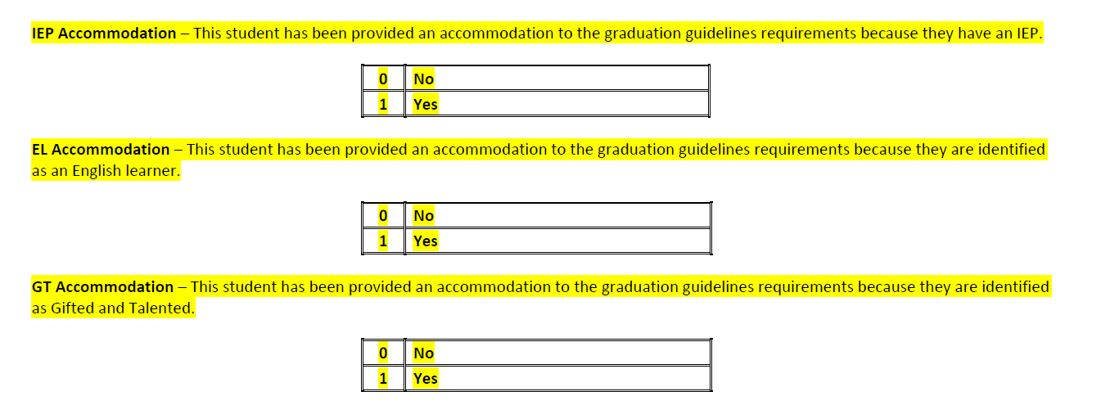
Students with Accommodations
There are 3 types of accommodation for GG:
English Learners (EL)
Gifted Students
Students with Disabilities
Student must have record in SPED Interchange to use this accommodation.
Student must be in IPST_COHORT_LEP (in Student End of Year) to use this accommodation.
Student must be in IPST_COHORT_GT (in Student End of Year) to use this accommodation.

Slide 16
Timeline/Deadlines

Slide 17
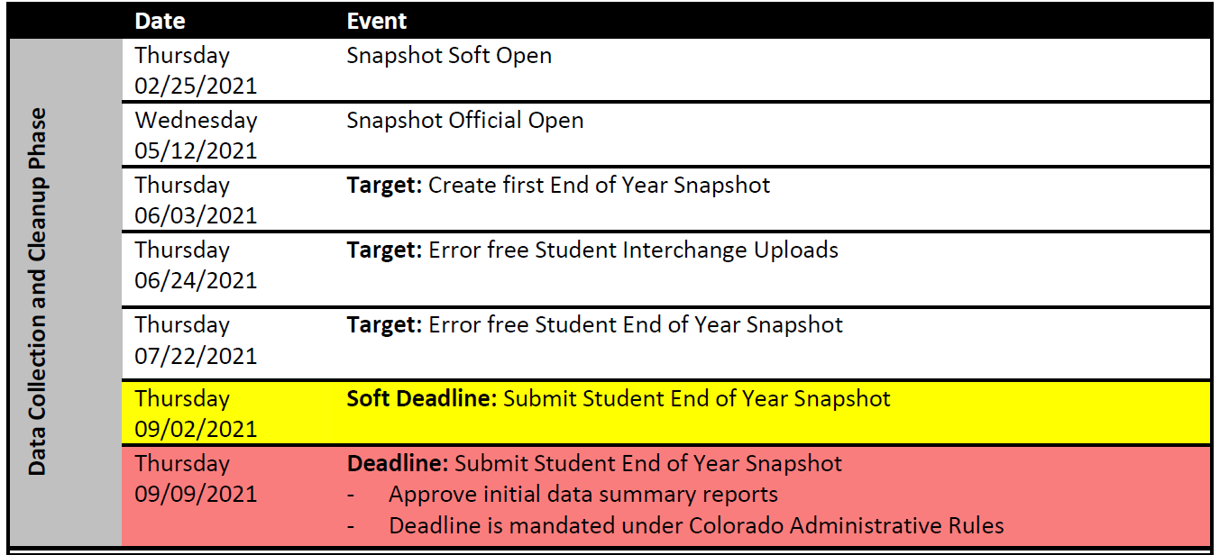
Graduation Guidelines Reporting Timeline
GG reporting will follow the Student End of Year timeline for 2020-2021
*This is when you can begin uploading the 20-21 GG file*
*This is when your GG file should be error free*

Slide 18
2020-2021 Timeline/Deadlines Continued
*Unless required by error-checking in the post-cross phase, this is the final date you can modify your GG file*

Slide 19
Timeline: 2021-2022 (and beyond)
Full implementation of Graduation Guidelines is expected to go into effect for the Class of 2022.
The Graduation Guidelines file for 2021-2022 will open with the other Student Interchange files.
You will be able to begin uploading GG for 2021-2022 in July 2021.
Reminder: GG is not required for Student October
It is best practice to be uploading/updating GG frequently throughout the school year, as students meet Graduation Guidelines
VERY important for students who transfer!

Slide 20
How to Report: Class of 2020-2021

Slide 21
Flexibility
Flexibility: The State Board of Education approved flexibility for Graduation Guidelines for the Class of 2021. For 2020-2021, local education providers (LEPs) may graduate students according to district determined graduation requirements that include the Menu of Options and/or local options, such as courses. LEPs can decide if they would like to implement Graduation Guidelines for the Class of 2021 or delay full implementation until the class of 2022.
Reporting: The legislated requirement to report Graduation Guidelines in 2021 is still in place (22.11.204 (4) C.R.S). So, for 2021, LEPs must report how each student has graduated in English and math. The Graduation Guidelines reporting file is a Student Interchange File and part of the Student End of Year Collection. It includes all of the Graduation Guidelines measures - should you choose to report those - and a new category for 2021 only called “Local Measure,” where you can report your district-determined graduation requirements.

Slide 22
Flexibility vs. Reporting
Students graduating in 2020-2021 have flexibility on which measure they meet
They may use the normal menu of options (i.e., ACT, SAT, Capstone, etc.)
Or they may use the Local Measure option
Any graduating student is required to meet and report at least one GG in English and at least one GG in math.

Slide 23
Local Measure Option – Using the Flexibility
A student meets both English and math requirements through the Local Measure guideline type. *Only accepted for students graduating in 2020-2021*
GUIDELINE_TYPE | GUIDELINE_NAME | GUIDELINE_SCORE
0 | LM | 1
1 | LM | 1

Slide 24
Resources

Slide 25
Graduation Guidelines FAQs
Will accountability be linked to GG for 2021? No. Graduation Guidelines data will not be used for any official accountability purposes or decision-making in 2021.
What is the last date by which a student may complete graduation requirements to be considered a graduate of the class of 2021? In order to count as a graduate in the class of 2021, students must meet local graduation requirements by August 31, 2021. Students may complete graduation requirements over the summer, if necessary. Consider counting summer courses, online courses, jobs, internships, apprenticeships, earned industry certificates, or other assessments/opportunities.
Can students receive an exception to Graduation Guidelines in 2020-2021? No. Exceptions to Graduation Guidelines are not permitted for the 2020-2021 school year. Any student who has exit type code ‘90’ should have met local graduation requirements (in the definition for ‘90’ exit type code). Therefor, all students qualify to use Local Measure (LM) as their Guideline measure, negating the need for exceptions.

Slide 26
Graduation Guidelines FAQs
How will a district know if a student has met GG at another school/district?
Districts are encouraged to use the Cognos Report: Graduation Guideline Student History Report to search for a student’s SASID to see if they have met GG in another district. Alternatively, districts may work together to share GG information.
What are the reporting expectations for students with anticipated year of graduation (AYG) prior to 2021?
Students with an AYG prior to 2020-2021 are not required to meet Graduation Guidelines. Students with AYG prior to 2021, but who will graduate in school year 2020-2021 should use Local Measure (LM) as their Guideline. Students with AYG prior to 2021 and who graduate after 2021, may be granted an exception to the GG requirement.
How are ASCENT students expected to report GG?
Any and all students who use exit type code 90 (graduate with regular diploma) in Student End of Year are required to have met Graduation Guidelines in both English and math. However, according to ASCENT law, students do not have to meet graduation requirements to continue in their ASCENT program for their 5th year. This is a district decision. Further, districts may count ASCENT students in their 4-year graduation rate if they have met local graduation requirements and GG prior to their ASCENT year.

Slide 27
Graduation Guidelines Resources
Student End of Year
Reporting timeline
SEY business rules – finalized by May 12th
Training Schedules GG and SEY
Student Interchange
File layout
GG business rules – finalized by May 12th
Templates
FAQ (short version) (full version)
Data Pipeline
Date file uploads
Cognos reports

Slide 28
Contacts

Slide 29
Contacts
Name | Area of Expertise | Contact Info
Jesse Cooper | Student End of Year/Graduation Guidelines | Cooper_j@cde.state.co.us
Brooke Wenzel | Student Interchange/ GG Backup | Wenzel_b@cde.state.co.us
Robin Russell | Graduation Guidelines Manager | Russel_r@cde.state.co.us
Andy Tucker | Director Postsecondary and Workforces Readiness | Tucker_a@cde.state.co.us
Michelle Romero | Concurrent Enrollment Coordinator | Romero_m@cde.state.co.us

Slide 30
Questions? Jesse Cooper COOPER_J@CDE.STATE.CO.US

