Slide 1
November 7, 2024
Data Pipeline Town Hall
The goal of the webinar is to provide updates on the Data Pipeline, current, and upcoming data collections. These webinars also provide a forum for districts, BOCES, and Administrative Units to have questions answered about Data Pipeline.

Slide 2
Colorado Department of Education
Identity Management (IdM)
Identity Management Site
Frequently Asked Questions
How do I add myself or others to the email listserv for town hall emails and/or a specific collection?
  Email lists are dependent on a person’s access rights in IdM. Contact your LAM to get an account or be assigned to a specific collection.
Where can I find the IdM role mappings for Data Pipeline and other applications?
  Role Mapping (XLS)
I am a LAM. How do I update the user permissions for someone in my district?
  Follow the steps outlined in the IdM Quick Guide for Access Management (DOCX)
Important: Users are not automatically removed from IdM when their email address is no longer active in your district. The LAM must deactivate their IdM account to ensure only designated staff can access CDE’s data reporting system.
Notes:
LAMs, please check the IdM roles for your district. Remove permissions for users who have retired, left your district, or are no longer assigned to a collection. Add roles for new hires and newly assigned respondents for specific collections.

Slide 3

What is PII?
Student and Staff Personally Identifiable Information (PII) is defined by state and federal laws as information that, alone or in combination, personally identifies an individual
  This includes direct identifiers
  (i.e. student and staff names, SASID, EDID, etc.)
  Includes information that when combined is identifiable
Colorado’s Student Data Transparency and Security Act outlines requirements for how Student PII is collected, used and shared
See the Data Privacy and Security website for prepared guidance on how to comply with this and other privacy laws.

Slide 4

Sharing Data
Use secure methods to transfer any PII to CDE
  Contact Data Collection leads with questions about how to transmit PII securely
    Each Data Collection leads maintains their own Syncplicity folders for specific collections, reach out to the collection lead for access
  Use Syncplicity to encrypt emails to CDE
Avoid sending PII via unencrypted email or to unsecured faxes when sharing data between or within districts
  Use Syncplicity to encrypt emails to CDE
Check local policies for restrictions, requirements, etc. regarding PII
  Do not use PII in trainings, presentations, etc.
  Do not share PII with unauthorized individuals
  Do not share passwords
  Follow local policies when transmitting PII to any third party

Slide 5
Today’s Agenda
Agenda Topic | Presenter
Open Data Collections and Upcoming Deadlines in Data Pipeline
School Board Updates | Jessica Tribbett
Kindergarten School Readiness | Tara Rhodes
Human Resources | Dawna Gudka
Special Education December Count | Lindsey Heitman
School Auditing Updates | Rebecca McRee
Student October | Annette Severson (Brooke Wenzel)
Civil Rights Data Collection | Annette Severson
Student End of Year | Reagan Ward

Slide 6
Open Collections and
Upcoming Deadlines in
Data Pipeline

Slide 7
Open Collections and Upcoming Dates:
Year-Round & Interchanges
Name | Category | Status | Key Dates
RITS | Year Round | Open | N/A
EDIS | Year Round | Open | N/A
Directory | Year Round | Open | N/A
Student | Interchange | Open | 2023-2024 and 2024-2025 are open
At-Risk | Interchange | Open | 2024-2025 open
Title I | Interchange | Open | 2024-2025 open
Special Education IEP | Interchange | Open | 2024-2025 open
Staff | Interchange | Open | 2024-2025 are open
Data Pipeline Resources: Data Pipeline Collection Dates (XLS)

Slide 8
Open Collections and Upcoming Dates:
Snapshots
Name | Category | Status | Final Deadline Date | Next Milestone | Looking Ahead
Student October | Snapshot | Closing Tomorrow | Nov. 8, 2024 | State Deadline: 11/8/2024 Submit Student October Snapshot | Deadline: 11/12/2024 Duplicate funding documentation due to School Auditing Office
Student End of Year | Snapshot | Open | Nov. 19, 2024 | Interim Deadline: 11/13/2024 Error Free SEY Snapshot | Report Review: 11/14/2024 to 11/19/2024; Begin submitting Sign-Off Forms
Special Education December Count | Snapshot | Soft Open | Feb. 21, 2025 | Official Snapshot Open: 11/01/2024 | Interchange Files Uploaded: 11/13/2024
Human Resources | Snapshot | Open | Feb. 21, 2025 | Interim Deadline: 10/31/2024 Upload at least one staff profile interchange file | Snapshot is Now Open
Data Pipeline Resources: Data Pipeline Collection Dates (XLS)

Slide 9
Open Collections and Upcoming Dates:
Periodic
Name | Category | Status | Final Deadline Date | Next Milestone | Looking Ahead
Non-Public Schools Fall Enrollment Count | Periodic | Open | Dec. 2, 2024 | N/A | N/A
Kindergarten School Readiness | Periodic | Open | Dec. 11, 2024 | Collection Opens: 10/23/2024 | N/A
Data Pipeline Resources: Data Pipeline Collection Dates (XLS)

Slide 10
School Board Member Updates
Jessica Tribbett

Slide 11
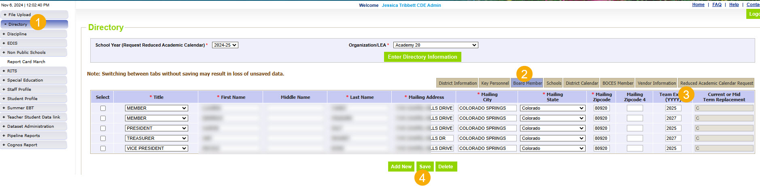
School Board Member Update Directory
Directory – School Board Member Updates
directorydata@cde.state.co.us

Slide 12
Questions and Resources
School Board Member Updates
directorydata@cde.state.co.us

Slide 13
Kindergarten School Readiness
Tara Rhodes

Slide 14
KSR: Background Information
Assessment Domains
As required by Colorado law (Section 22-7-1004 (1)(b) C.R.S.), school readiness includes the following domains:
Physical well-being and motor development
Social and emotional development
Language and comprehension
Cognition
Math
Literacy
The assessment tools linked here have been approved by the State Board of Education for use.
Data reported to CDE is from the initial fall assessment window for school readiness, which is the first 60 calendar days of the school year, as required by HB15-1323.
Kindergarten School Readiness (KSR)
KSRData@cde.state.co.us

Slide 15
Kindergarten School Readiness (KSR)
Important Dates and Changes for 24-25 Collection
Important Dates:
11/19/2024: Target upload date
12/11/2024: KSR Data Collection Due Date (~5 weeks to go!)
  Please note that this information is part of the CAP4K Legislative Report that is due in February to the legislature. Consequently, I will need all submissions in by the deadline so that analysis can be completed in January, along with executive leadership review prior to publication.
Changes for the 24-25 Collection:
One additional column was added to the file layout to denote the assessment used. This replaced the front-end screen in Data Pipeline.
This change was made to accommodate the State Board's approval of single-domain assessment tools.
A short tutorial (~6min) of how to add and populate this column has been posted here.
Kindergarten School Readiness (KSR)
KSRData@cde.state.co.us

Slide 16
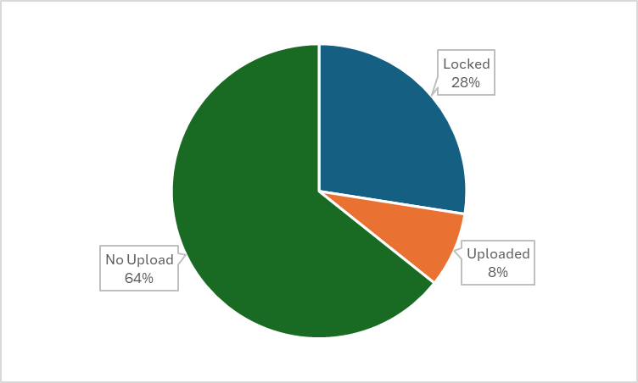
Kindergarten School Readiness (KSR)
Collection Status
Kindergarten School Readiness (KSR)
KSRData@cde.state.co.us

Slide 17
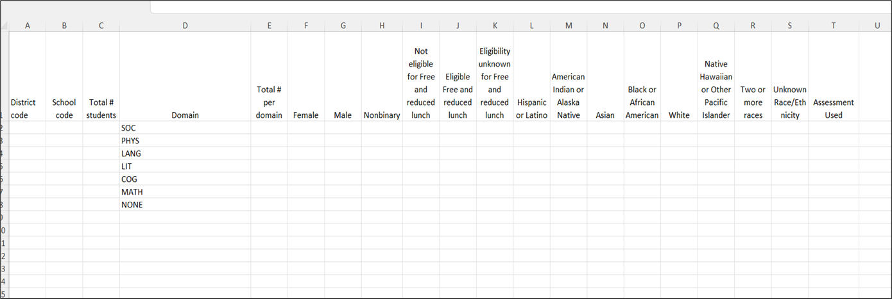
Kindergarten School Readiness (KSR)
File Template
Kindergarten School Readiness (KSR)
KSRData@cde.state.co.us

Slide 18
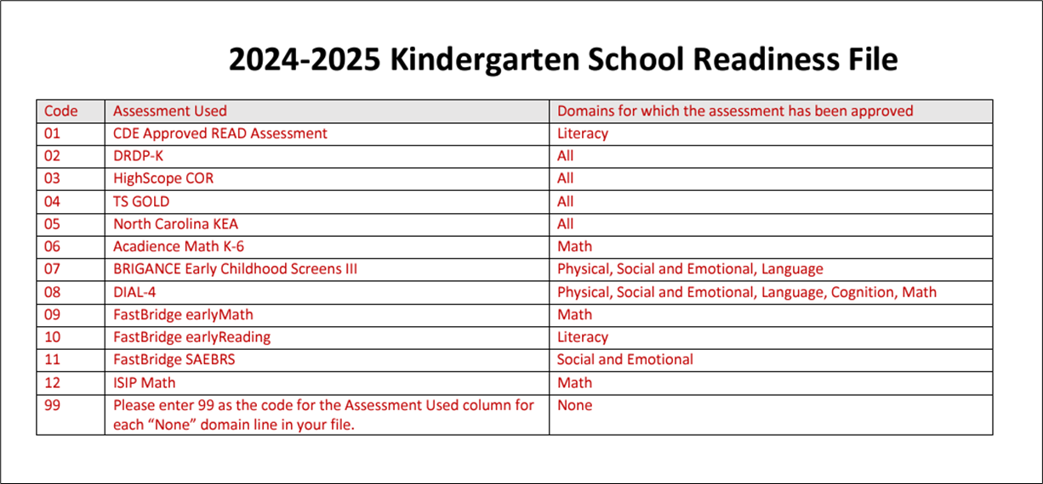
Kindergarten School Readiness (KSR)
Codes for New Assessment Used Column
Kindergarten School Readiness (KSR)
KSRData@cde.state.co.us

Slide 19
Reminders and Current To-Do's
Kindergarten School Readiness (KSR)
Reminders:
Please make sure that the Assessment Used code for the NONE lines in your file is 99.
Current To-Do's:
Watch recordings of trainings posted here
Watch the tutorial of how to add the additional column, if needed
Talk with your School Readiness contact
  Learn which assessment tool is being used
  Learn whether manual aggregation of data will be required
  Learn the status of the assessment
  Begin uploads and resolving errors
Kindergarten School Readiness (KSR)
KSRData@cde.state.co.us

Slide 20
Questions & Resources
Kindergarten School Readiness (KSR)
Contact: Tara Rhodes
Email: KSRData@cde.state.co.us
Phone: 720.601.4125
Kindergarten School Readiness Website

Slide 21
Human Resources
Dawna Gudka

Slide 22
Human Resources Timeline
Date | Event | Event Description
10/31/24 | Interim Deadline | Upload at least one Staff Profile file
11/1/24 | Open | Human Resources Snapshot Opens
11/7/24 | Interim Deadline | Upload at least one Staff Assignment file
12/1/24 | Count Day | Official Annual Staff Count Day
12/18/24 | Interim Deadline | Interchange files error free
1/10/25 | Interim Deadline | Create at least one Human Resources Snapshot
1/24/25 | Interim Deadline | Human Resources Snapshot Error Free
1/24-1/31/25 | Report Review | Review Special Education Staff Report via Cognos in the Human Resources folder) for accuracy to ensure all special education staff reported within your district is appropriate. Collaborate with your LEA’s Administrative Unite during this process. Verify that all staff are accurately reported
2/14/25 | Interim Deadline | Staff Profile and Staff Assignment interchange files, and Human Resources Snapshot Error Free
2/21/25 | Deadline | Human Resources Snapshot must be submitted to CDE and verification emailed to Human Resources Snapshot
Human Resources Snapshot Collectionmailto:HumanResourcesData@cde.state.co.us

Slide 23


Staff Interchange files
Staff Profile
  General information of staff
  Only 1 record per staff
  Staff Profile file must be uploaded first
  Staff Assignment
    Provides specifics to actual duties and locations
    Multiple records per staff allowed
    One record for every assignment
Human Resources Snapshot Collection
HumanResourcesData@cde.state.co.us

Slide 24
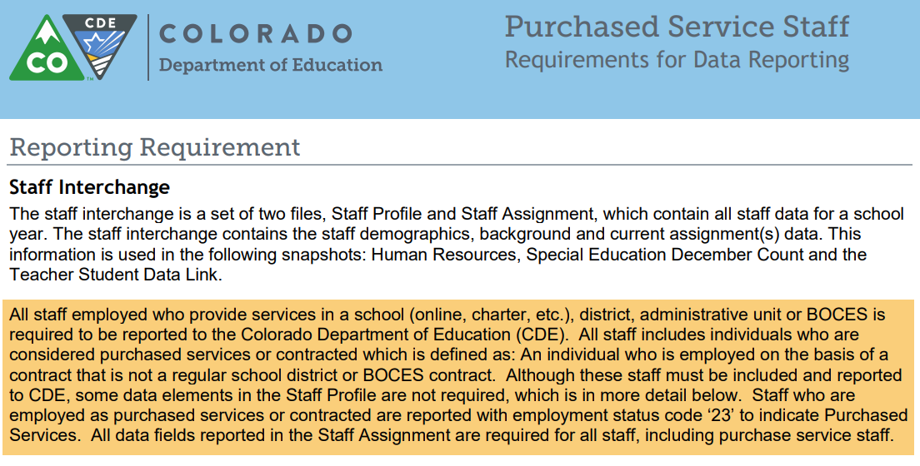
Purchase Service Staff
Purchased Service staff resource document
Employment status 23 Purchased Services
Staff Profile required fields
AU Code, District Code
Demographics (SSN, EDID, Name, Gender, DOB, Ethnicity)
Background Information: Start Date, Years Teaching Experience
Years Education Experience, Years principal if staff is a principal
Staff Assignment required fields
All data fields for the assignment are required
Human Resources Snapshot Collection
HumanResourcesData@cde.state.co.us

Slide 25
Examples of Coding EL and GT Teaching Staff
Teaching English Language Learners
Job Code 201 (Teacher, Regular)
Teaching Subject Area 0510 Language Skills
Administrator/Instructional Area 0050 Language Instruction Education Program
Teaching Gifted and Talented
Job Code 201
Teaching Subject Area depends on what GT class they are teaching
Administrator/Instructional Area 0012 Gifted and talented
Human Resources Snapshot Collection
HumanResourcesData@cde.state.co.us

Slide 26
Human Resources Snapshot Collection
Staff Interchange website
Human Resources Snapshot website
Questions contact: Dawna Gudka-collection lead
Email HumanResourcesData@cde.state.co.us
(303) 598-7901

Slide 27
Special Education
December Count Snapshot
Lindsey Heitman

Slide 28
Special Education December Count:
2024 -2025 Timeline
November Due Dates
December Due Dates
January Due Dates
30th - Thursday - All errors resolved – complete snapshot
February Due Dates
10th – 18th - Monday – Tuesday - Resolving Duplicates
1st - Sunday - Official count date (or last date prior your school was in session)
30th - Feb 7th Thursday – Friday - Report Review
18th – 21st - Tuesday - Friday - Final Report Review
21st - Friday - Final Submission Due
1st - Friday – Sped December Count Snapshot available in Data Pipeline
13th – Wednesday - Interchange files uploaded - Sped Child, Sped Participation, Staff Profile, Staff Assign
18th - Wednesday: Interchange files error free and at least one snapshot created
Please download the full 24-25 Timeline from the Special Education December Count Snapshot webpage.
Special Education December Count
SpedDecCount@cde.state.co.us

Slide 29
Special Education December Count:
Trainings
NEW RESPONDENTS -
Introduction to Special Education IEP Interchange – slides and video posted on the Special Education IEP Interchange webpage under the Trainings section. Please listen and review before the snapshot training.
Upcoming Trainings
Special Education December Count Snapshot Annual Collection Training
  Wednesday, November 13th from 10:00 – 11:30 (rescheduled from November 6th)
  This training will focus on snapshot data content and the process within the Data Pipeline
  Microsoft Teams Meeting Join the meeting now
  Training will be recorded and posted online shortly after the live webinar
Special Education December Count Office Hours
  Wednesday, November 20th from 10:30 – 11:30
  Topics to be determined
  Microsoft Teams Meeting Join the meeting now
Special Education December Count – Lindsey Heitman
SpedDecCount@cde.state.co.us

Slide 30
December Count Staff and Student
Staff and Student Snapshot Criteria
Staff records will be included in the snapshot when:
Records are error-free in the Staff Interchange
Special Education Flag = 1
AU code is populated in both Staff files
Start date of Assignment is <= 12/01
End Date of Assignment is blank or > 12/01
Employment Status Code = 11, 12, 13, 23, 25 or 26
The Staff Profile and Staff Assignment Association File will be joined based on the following criteria: School year, EDID, Sped Assignment Flag = 1, District (or Admin Unit), and error-free records.
Student records will be included in the snapshot when:
Date of Entry to SPED is <= 12/01
Date of Exit from SPED is zero-filled or > 12/01
OR Parentally Placed in Private School is 02
Pull all error-free records meeting above criteria from the SPED Participation file and match them with records in the Student Interchange. Student Interchange is the authoritative source for: SASID, LASID, First Name, Middle Name, Last Name, Gender, Date of birth, Ethnicity, Race and Grade level.
Data from the Student Interchange will pull primarily from a DEC tagged file. If the district has not tagged a file for DEC, it will pull from the latest student DEM file uploaded and the grade will pull from the SSA file and record with the latest School Entry Date.
If student record is not required to be submitted in the Student Interchange, the demographic data and grade level will pull from the Child and Participation files.
The Child file, Participation file and Student DEM files will be joined based on the following criteria: SASID, LASID, school year, district (or Admin Unit), and error free records.
Special Education December Count – Lindsey Heitman
SpedDecCount@cde.state.co.us

Slide 31
December Count Snapshot Fields Sourced
Primarily from Student Interchange Files
SPED Snapshots- District Sourced Fields
Student Demographic File
*LASIDs must match for these fields to pull primarily from Student Interchange
SASID
LASID
Student First Name
Student Middle Name
Student Last Name
Student Gender
Student Date of birth
Student Ethnicity
Student Race
Student School Association File
*Grade will pull primarily from Student Interchange if record is included in the SSA file
Grade Level
Data from the Student Interchange will pull primarily into the December snapshot from a DEC tagged file. If the district has not tagged a file for DEC, it will pull from the latest Student DEM file uploaded and the SSA file record with the latest School Entry Date.
Tagging a file for OCT or DEC is not required! An Untagged file works for both snapshots.
*Student’s LASID must match between the Student Interchange and IEP Interchange for the demographic data to be pulled from the Student Interchange into the December Count Snapshot.

Slide 32
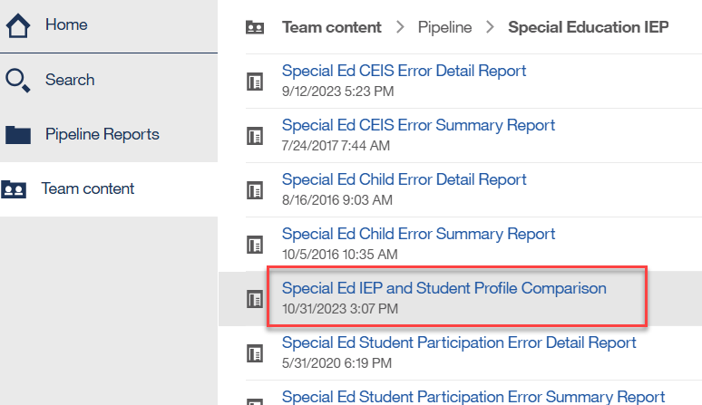
Matching District LASIDs – Why is this so important?
Districts are the authoritative source for race and other demographic fields
If student race is different on December Count vs the race reported in the Student October Snapshot, it can affect risk ratios for Significant Disproportionality
Utilize the Student Interchange and Special Education IEP Interchange Comparison Report – found in Special Education IEP Interchange cognos folder to compare differences in race between the interchanges
Special Education December Count – Lindsey Heitman
SpedDecCount@cde.state.co.us

Slide 33
Questions & Resources:
Special Education December Count
Lindsey Heitman
SpedDecCount@cde.state.co.us
(720) 456-2033
Special Education IEP Interchange Webpage
Special Education December Snapshot Webpage

Slide 34
School Auditing Office
Rebecca McRee

Slide 35
Duplicate Count
All duplicate count audit documentation must be uploaded to the “Duplicate Count” subfolder found within the district’s audit Syncplicity folder.
  Document Upload Deadline: Tuesday, November 12, 2024 at 12 pm
  Uploading sooner benefits everyone!!!!!!!!!!!!!!!!!!
  Data Services will send out an email if this deadline is adjusted for any reason.
Check whether you have access to your district’s audit Syncplicity folder!
  If not, email the School Auditing Office at audit@cde.state.co.us
  In the subject line of the email, please include your district number, district name and “Duplicate Count Contact”
    For example: “0010_Mapleton 1_Duplicate Count Contact”
School Auditing Office
Audit@cde.state.co.us

Slide 36
Documentation: Labeling
For each student, please upload one assembled document using the following naming convention:
  District Number_SASID_Student Last Name_Student First Name
  For example: 0010_9999999991_Smith_John.pdf
Each assembled document should contain all required documents necessary to support funding.
If necessary, a single folder or zip file for each student may be used.
School Auditing Office
audit@cde.state.co.us

Slide 37
Documentation for Conceded Students
If your district is conceding funding for a student (i.e., your district submitted the student for funding in error), you must still upload a document for a student, with the following naming convention:
  District Number_SASID_Student Last Name_Student First Name_Concede
  For example: 0010_9999999991_Smith_Jane_Concede.pdf
School Auditing Office
audit@cde.state.co.us

Slide 38
Annual Audit Review
Starting with the 2024-2025 fiscal year, the School Auditing Office will be shifting its audit approach.
All districts and BOCES (that operate their own schools and/or submit data during the Student October data collection) will participate in the Annual Audit Review.
No later than December 11, 2024, all districts and BOCES must:
  Complete all funded count audit questionnaires (pupil, at-risk, and ELL), and
  Upload initial audit documentation (as described in the corresponding questionnaires) to Syncplicity.
The School Auditing Office anticipates that the new audit approach will evolve over the next few years - questionnaires and initial audit documentation will also update each year as needed.
Training: Preparing for the New Annual Audit Review (PDF) (Recording)
School Auditing Office
Audit@cde.state.co.us

Slide 39
Annual Audit Review (continued)
Between December 2024 and March 2025 the School Auditing Office will be reviewing each district/BOCES (1) submitted Student October Count data, (2) responses provided on the audit questionnaires, and (3) the initial audit documentation provided as outlined on the questionnaires to determine which districts/BOCES/schools will be engaged for one of the following expanded audits:
Focused Audit Review
Comprehensive Audit Review
Next step communication regarding expanded audits is expected to be sent via email no later than April 1, 2025.
School Auditing Office
audit@cde.state.co.us

Slide 40
Questions & Resources:
Duplicate Count/ Annual Audit Review
audit@cde.state.co.us
Pupil Count website
2024 Student October Audit Resource Guide

Slide 41
Civil Rights Data Collection (CRDC)
Annette Severson

Slide 42
Overview
The U.S. Department of Education conducts the Civil Rights Data Collection (CRDC)
Collects data on key education and civil rights issues in our nation's public schools. The CRDC collects a variety of information including, student enrollment and educational programs and services, disaggregated by race/ethnicity, sex, limited English proficiency and disability.
Information collected by the CRDC is also used by other ED offices as well as policymakers and researchers outside of ED.

Slide 43
2023-24 CRDC Timeline
Opening December 9, 2024
Deadline March 7, 2025 – CRDC Resources

Slide 44
CDE’s Role
CDE will pre-populate as much data as possible prior to Dec 9th
CRDC file layout with CDE field logic is available online for review
Opt-Out Form is also available online if you do not want CDE to pre-populate data for your LEA
Information is posted on the CRDC tab for Data Pipeline

Slide 45
LEA’s Role
Log into CRDC reporting tool
Review pre-populated data to verify accuracy
Input additional data required
Finalize data submission on or before the deadline of March 7th

Slide 46
Other Items to Note on CDE Pre-Population Data
Student Retention Fields will not be pre-populated by CDE due to the timing of collections
Home Based Options students are excluded from CDE pre-populated student counts
All student counts are based on those students reported as enrolled in the 2023-24 Student October snapshot
If there were 0 non-binary students reported in 2023-24 Student October for your district (gender code = 03), then the non-binary CRDC fields will be reported as null based on provided guidance

Slide 47
Questions & Resources:
Civil Rights Data Collection
CRDC Resource Center
CRDC Partner Support Center - crdc@aemcorp.com
CDE Contact: Annette Severson – Severson_a@cde.state.co.us

Slide 48
Student October
Annette Severson (Brooke Wenzel)

Slide 49
Student October Timeline
Regular Phase
Date | Event | Event Description
11/08/2024 12:00 p.m. | State Deadline | Submit Student October Snapshot data
Duplicate Phase
Date | Event | Event Description
11/12/2024 12:00 p.m. | Deadline | Duplicate funding documentation due to School Auditing Office
11/18/2024 | Other Date | School Auditing makes decisions on funding duplicates
11/27/2024 | Deadline | Resubmit Student October Snapshot data to CDE based on decisions from School Auditing
12/06/2024 | Deadline | Collection closes Sign-off form due. Data remains embargoed until the official release in January.
01/15/2025 | Data Release | Official data release
Student October – Brooke Wenzel
StudentOctober@cde.state.co.us

Slide 50
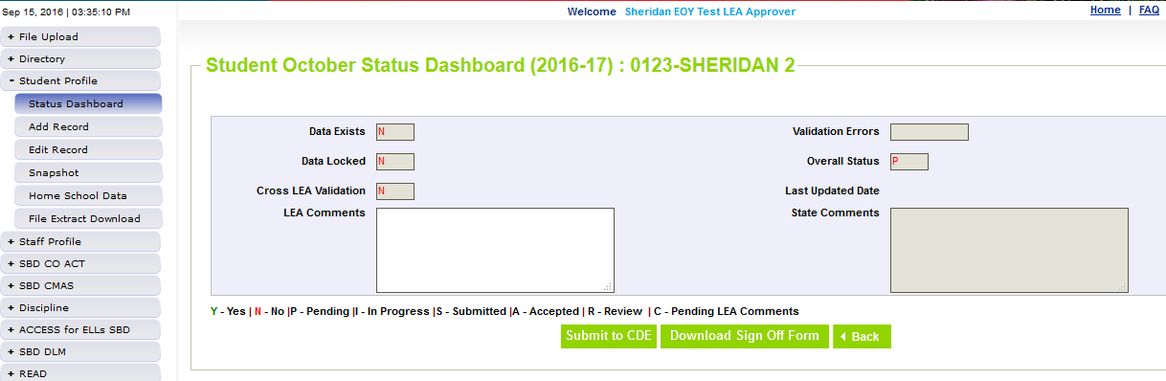
Ready to Submit
Once you have verified the data, submit the snapshot to CDE. Go to:
  Student Profile -> Status Dashboard and click ‘Submit to CDE’
  Must have LEAAPPROVER role in IDM to complete this step
  Once data is submitted it will be locked, must request unlock to make changes (email me to request)
Student October – Brooke Wenzel
StudentOctober@cde.state.co.us

Slide 51
Questions & Resources:
Questions & Resources:
Student October
Brooke Wenzel
StudentOctober@cde.state.co.us
720-441-7963
Student October Webpage
Student Interchange Webpage

Slide 52
Student End of Year
Reagan Ward

Slide 53
SEY Collection Timeline:
Upcoming Events
Date | Event | Event Description
11/13/2024 | Interim Deadline | Error free SEY snapshot
11/13/2024 2:30-3:30pm | Training Event | November SEY Office Hours: Final Dates and Data Release 11/13 Registration Link
11/14/2024 to 11/19/2024 | Report Review | Validate SEY data using CEDAR/COGNOS reports Begin submitting Superintendent Verification (sign-off) forms
11/19/2024 (noon) | Deadline | Post-Cross phase ends. Districts must have error free SEY snapshot and have addressed any necessary post-cross changes.
12/3/2024 | Deadline | Collection closes. • Superintendent Verification (sign-off) form due. • Data remains embargoed until the official release in January
1/14/2024 | Data Release | Planned official data release. Data is embargoed until notified by SEY lead that data has been released and is posted on the Education Statistics Website.
Visit the SEY Website to download the complete SEY Collection Timeline with Training Dates
Student End of Year – Reagan Ward
StudentEndOfYear@cde.state.co.us

Slide 54
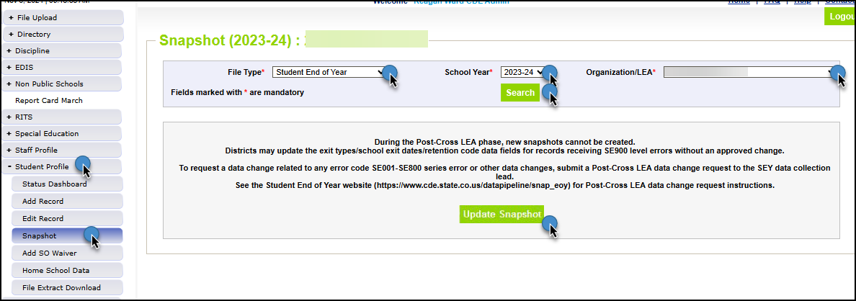
Reminders and Snapshot Status as of 8am on 11/7
Snapshots are NOT unlocked, only updated
  All LEAs must update snapshot at least once during this phase
Limited Data Changes
  School exit types for SASIDs with SE900 errors
  Approved post-cross LEA data changes
SSA updates completed manually through the edit record screen in pipeline
DEM updates: Talk to SEY collection lead first
GG & Adj files: continue to use the file upload screen in pipeline
Student End of Year – Reagan Ward
StudentEndOfYear@cde.state.co.us

Slide 55
Exception Requests & Data Change Requests
Data Issue
Independent Change:
SE900 error
Submit Post-Cross LEA Data Change Request
No Change:
Data is accurate as reported
Supported Change:
Data is incorrect and must be updated
Manually edit SSA data field
(DEM updates, contact SEY first)
Submit Exception Request
Note: SE900 errors require a copy of the student’s adequate documentation to be included as supporting evidence
Manually edit school exit type on SSA file
Update SEY Snapshot
Resources:
Exception Request Directions (PDF)
Exception Request Template (XLS)
Post-Cross Change Request Directions (PDF)
Post-Cross Change Request Template (XLS)
SASID merges in Post-Cross (PDF)
Adding Records in Post-Cross (PDF)
Student End of Year – Reagan Ward
StudentEndOfYear@cde.state.co.us

Slide 56
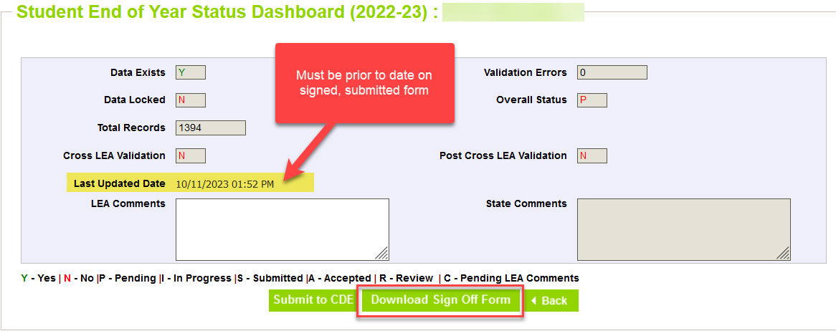
Superintendent Verification (Sign-Off)
Downloaded from data pipeline ‘Status Dashboard’ screen by LEA Approver
  Must be error free
  Must have updated snapshot at least once during Post-Cross Phase
  Cannot have a snapshot update in process
Signed by Superintendent
  Certifies SEY and Graduation Guidelines data is accurate and complete
  Acknowledgment that this data is used in district/school accountability frameworks
  Dated after the last updated date of your SEY snapshot as shown on the SEY status dashboard
    New sign-off form required if snapshot updated after it has been signed
Scan and email to SEY Collection lead, StudentEndOfYear@cde.state.co.us OR upload to your LEA’s student Syncplicity folder
Begin submitting 11/14/24
*will not be accepted early*
Due 12/3/2024
Student End of Year – Reagan Ward
StudentEndOfYear@cde.state.co.us

Slide 57
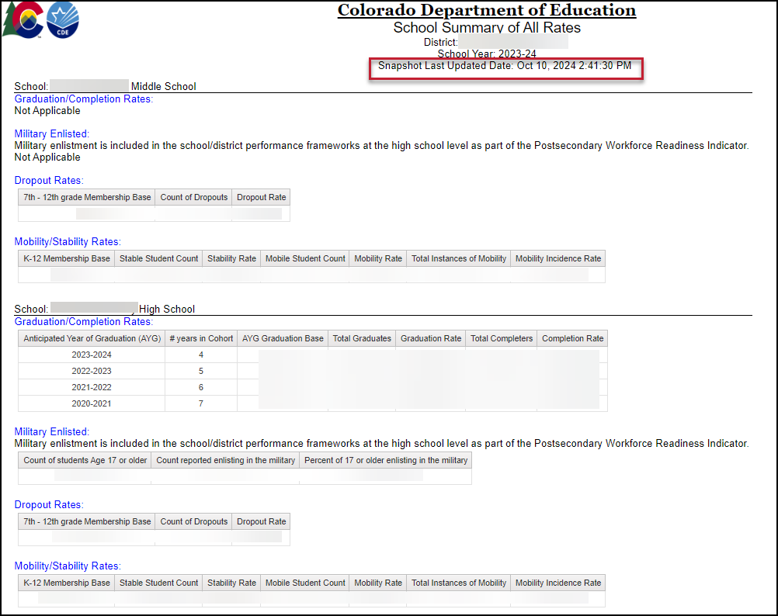
*New 2024* COGNOS/CEDAR Report:
School Summary of All Rates
District level and School Level
Mirrors sign-off form as a high-level overview of rates
  Only includes ‘all students’, not student groups
Displays ‘not applicable’ message under that rate heading when a school does not include the grade range required for a specific type of rate
Shows the last updated date of the SEY snapshot
Student End of Year – Reagan Ward
StudentEndOfYear@cde.state.co.us

Slide 58
Questions & Resources:
Student End of Year
StudentEndOfYear@cde.state.co.us
720-484-9057
Student End of Year Website
Student Interchange Website
Graduation Guidelines Website

Slide 59
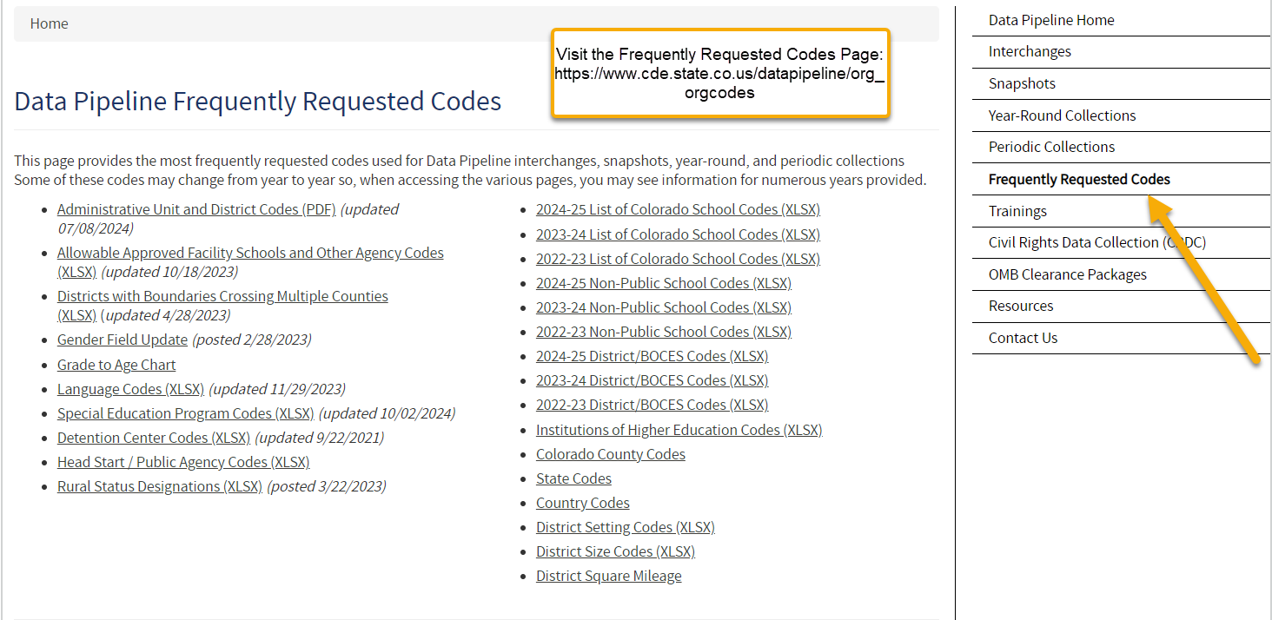
Thank you for joining today!
Next Town Hall will be November 14th
Reminder:
The Frequently Requested Codes Page has school codes, language codes, special education program codes and more!

