Slide 1
June 5, 2025
Data Pipeline Town Hall
The goal of the webinar is to provide updates on the Data Pipeline, current, and upcoming data collections. These webinars also provide a forum for districts, BOCES, and Administrative Units to have questions answered about Data Pipeline.

Slide 2
Colorado Department of Education
Identity Management (IdM)
Identity Management Site
Frequently Asked Questions
How do I add myself or others to the email listserv for town hall emails and/or a specific collection?
  Email lists are dependent on a person’s access rights in IdM. Contact your LAM to get an account or be assigned to a specific collection.
Where can I find the IdM role mappings for Data Pipeline and other applications?
  Role Mapping (XLS)
I am a LAM. How do I update the user permissions for someone in my district?
  Follow the steps outlined in the IdM Quick Guide for Access Management (DOCX)
Important: Users are not automatically removed from IdM when their email address is no longer active in your district. The LAM must deactivate their IdM account to ensure only designated staff can access CDE’s data reporting system.
Notes:
LAMs, please check the IdM roles for your district. Remove permissions for users who have retired, left your district, or are no longer assigned to a collection. Add roles for new hires and newly assigned respondents for specific collections.

Slide 3
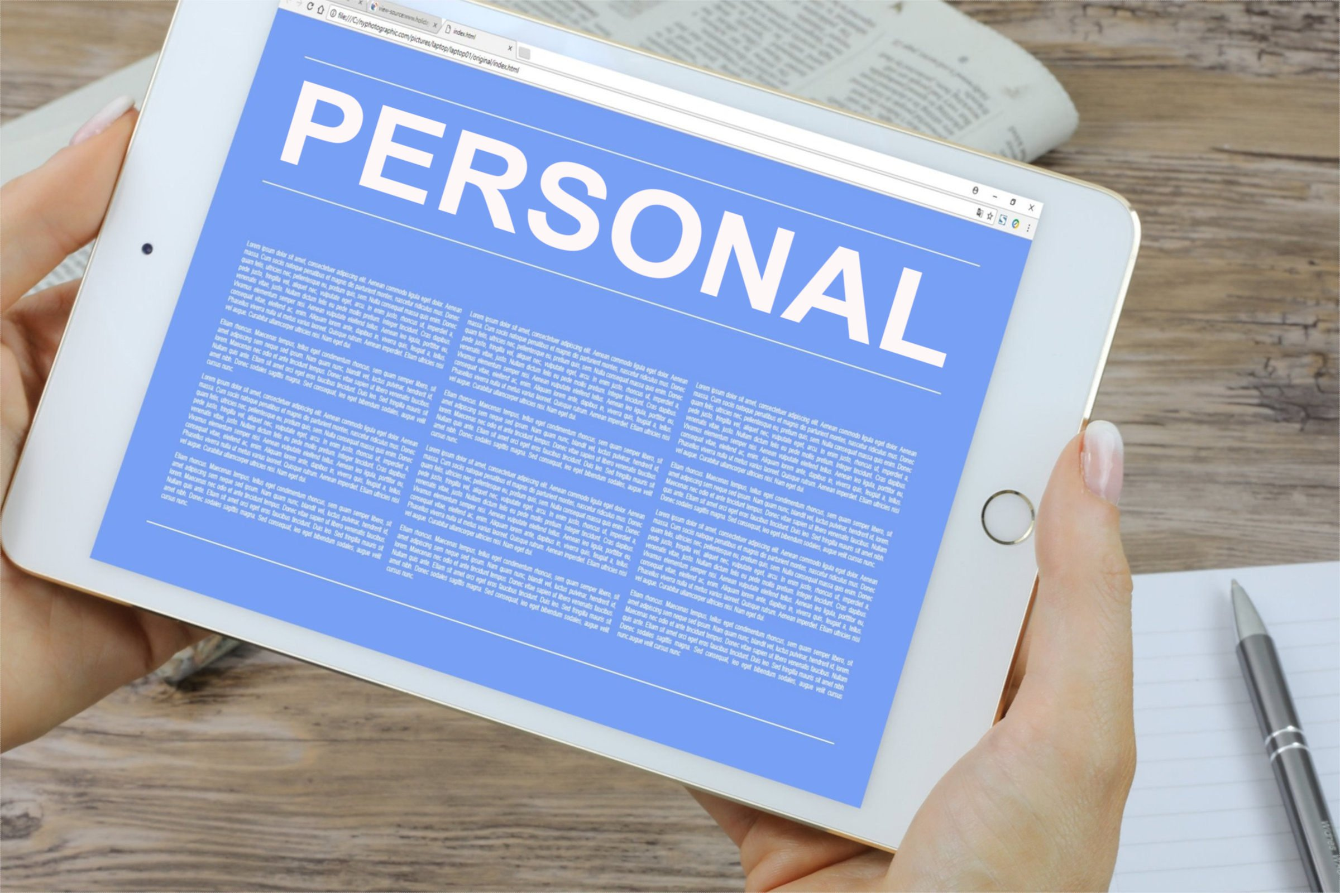
What is PII?
Student and Staff Personally Identifiable Information (PII) is defined by state and federal laws as information that, alone or in combination, personally identifies an individual
  This includes direct identifiers
  (i.e. student and staff names, SASID, EDID, etc.)
  Includes information that when combined is identifiable
Colorado’s Student Data Transparency and Security Act outlines requirements for how Student PII is collected, used and shared
See the Data Privacy and Security website for prepared guidance on how to comply with this and other privacy laws.

Slide 4

Sharing Data
Use secure methods to transfer any PII to CDE
  Contact Data Collection leads with questions about how to transmit PII securely
    Each Data Collection leads maintains their own Syncplicity folders for specific collections, reach out to the collection lead for access
  Use Syncplicity to encrypt emails to CDE
Avoid sending PII via unencrypted email or to unsecured faxes when sharing data between or within districts
  Use Syncplicity to encrypt emails to CDE
Check local policies for restrictions, requirements, etc. regarding PII
  Do not use PII in trainings, presentations, etc.
  Do not share PII with unauthorized individuals
  Do not share passwords
  Follow local policies when transmitting PII to any third party

Slide 5
Today’s Agenda
Agenda Topic | Presenter
Open Data Collections and Upcoming Deadlines in Data Pipeline | Host: Collin Slutzky
READ Collections | Tara Rhodes
Student Reporting Exceptions | Reagan Ward
Prevent Harassment or Discrimination | Carrie Martin
Student Discipline | Carrie Martin
School Code Changes | Jessica Tribbett
Instructional Days and Hours | Jessica Tribbett

Slide 6
Open Collections and
Upcoming Deadlines in
Data Pipeline

Slide 7
Open Collections and Upcoming Dates:
Year-Round & Interchanges
Name | Category | Status | Key Dates
RITS | Year Round | Open | N/A
EDIS | Year Round | Open | N/A
Directory | Year Round | Open | School Code Change Requests: 2/5/2025 to 6/30/2025
Student | Interchange | Open | 6/11/2025 Interim Deadline: Error free DEM, SSA, GG
At-Risk | Interchange | Closed | N/A
Title I | Interchange | Open | 6/11/2025 Interim Deadline: Error free interchange file
Special Education IEP | Interchange | Open | Special Education EOY Snapshot open now
Staff | Interchange | Open | Staff Profile and Staff Evaluation interchange files are needed for the Staff Evaluation Snapshot
Discipline Action | Interchange | Open | This interchange file is needed for Student Discipline Snapshot and Special Education Discipline Snapshot Collections
Teacher Student Data Link | Interchange | Open | 6/13/25 Interim Deadline: Error free interchange file
Data Pipeline Resources: Data Pipeline Collection Dates (XLS)

Slide 8
Open Collections and Upcoming Dates:
Snapshots
Name | Category | Status | Final Deadline Date | Next Milestone | Looking Ahead
Teacher Student Data Link | Snapshot | Open | Aug. 29, 2025 | Interim Deadline: 6/13/25, error free TSDL interchange | Interim Deadline: 6/27/25 create at least one snapshot
Staff Evaluation | Snapshot | Open | Oct. 15, 2025 | 6/5 Interim Deadline Error free Staff Profile Interchange file | 06/19 Interim Deadline Error free Staff Evaluation Interchange file
Student End of Year: Regular Phase | Snapshot | Open | Sept. 4, 2025 | Interim Deadline: 6/10, 10:30-11:30am June SEY Office Hours | Interim Deadline: 6/11/2025 Error free interchange files (DEM, SSA, GG, Title 1)
Student Attendance | Snapshot | Open | July 25, 2025 | Interim Deadline: 6/11/25 error free interchange files | Interim Deadline: 6/20/25 submit exceptions for review
Special Education Discipline | Snapshot | Open | Aug. 1, 2025 | Interim Deadline: 6/26/25 Dis and IEP interchanges should be error free and at least one snapshot created | Other Date: June 30, 2025, end of 2024-2025 data reporting period
Student Discipline | Snapshot | Open | July 31, 2025 | Interim Deadline: 6/11/25 error free Student Interchange files (DEM and SSA) | Interim Deadline: 6/21/25 Create at least one student discipline snapshot
Special Education EOY | Snapshot | Open | Oct. 3, 2025 | Interim Deadline: 6/26/25 IEP Interchange files error free and at least one snapshot created | Interim Deadline: 9/4/25 all exception requests submitted to CDE for review
Data Pipeline Resources: Data Pipeline Collection Dates (XLS)

Slide 9
Open Collections and Upcoming Dates:
Periodic
Name | Category | Status | Final Deadline Date | Next Milestone | Looking Ahead
Summer EBT | Periodic | Open | Feb. 28, 2025 | Corrections Period: 5/19/2025 to 9/3/2025
Alternative Education Campus | Periodic | Open | Jun. 27, 2025 | Planned Measures File: 3/19/2025 to 6/27/2025 | Actual Measures File: 5/19/25 to 6/27/25
Prevent Harassment or Discrimination | Periodic | Open | August 1, 2025 | Interim Deadline: Upload Prevent Harassment or Discrimination File at least once by 6/5/25 | Interim Deadline: Error free Prevent Harassment or Discrimination file by 7/3/2025
READ Spring Assessments | Periodic | Open | June 13, 2025 | Other Date: 6/6/25 error free submission target | Report Review: 6/6/25 to 6/13/25
READ Literacy Programs & Assessments | Periodic | Open | June 13, 2025 | Other Date: 6/6/25 error free submission target | Report Review: 6/6/25 to 6/13/25
Data Pipeline Resources: Data Pipeline Collection Dates (XLS)

Slide 10
READ Collections
Tara Rhodes

Slide 11
Spring READ Assessment

Slide 12
Timeline
Date | Event | Event Description
4/1/2025 | Training Event | Spring READ Assessment Training Event; recording here
4/8/2025 | Training Event | READ Literacy Programs and Assessment Training Event; recording here
4/15/2025 | Collection Open | The Spring READ Assessment and READ Literacy Programs and Assessment data collections open
5/15/2025 | Other Date | Please complete a preliminary upload by this date; this does not have to be error-free
6/6/2025 | Other Date | Please complete an error-free submission by this date
6/6/2025 | Report Review | Assuming an error-free submission has been completed, use this time to review any reports
6/13/2025 | Collection Close | Spring READ Assessment and READ Literacy Programs and Assessment data collections close
Tara Rhodes
READActData@cde.state.co.us

Slide 13
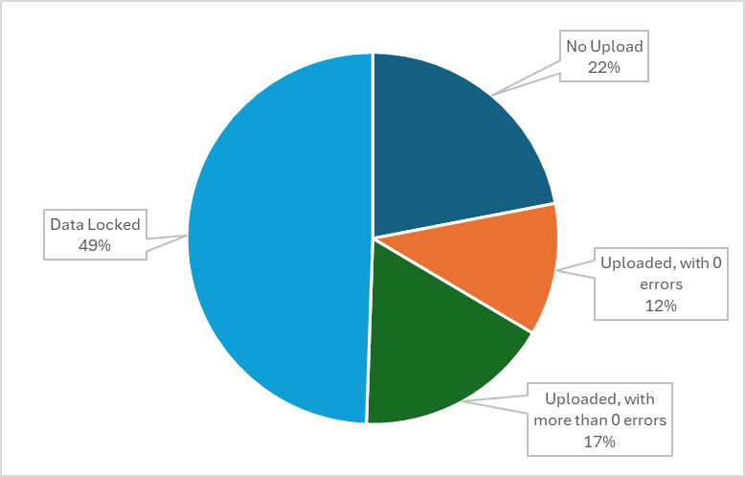
Spring READ Assessment Data Collection
Status Update
Status Update:
About half of the state has locked their file. Thank you!
Dates:
Target Date for an Error-Free File: 6/6/2025
Collection Close Date: 6/13/25 (Next Friday!)
Duplicate Phase: 6/16-6/20
Please use the week between 6/6 and 6/13 to confirm your SRD count and percentage.
Spring READ Assessment
READActData@cde.state.co.us

Slide 14
READ Literacy Programs and Assessment

Slide 15
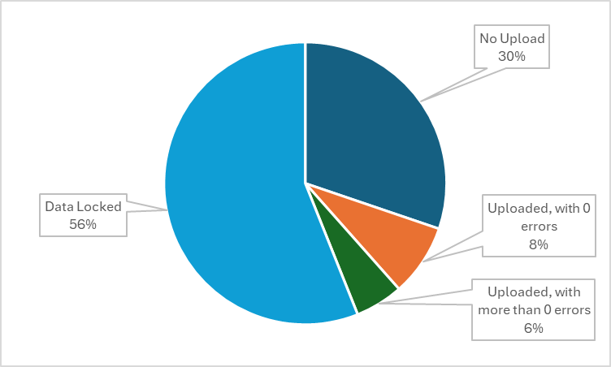
READ Literacy Programs and Assessment
Status Update
Status Update:
More than half the state has locked their file. Thank you!
Dates:
Collection Close Date: 6/13/25 (Next Friday!)
Target Date for an Error-Free File: 6/6/2025
Please note that this collection runs in the same window as the Spring READ Assessment collection but is a separate upload.
READ Literacy Programs and Assessment
READActData@cde.state.co.us

Slide 16
READ Training

Slide 17
READ Training
General Information
READ Training Collection:
Dates: 8/1/2025 - 8/31/2025
The READ Training Export Report is in production with the updated file layout.
Training Opportunities:
July 15 from 1-2pm; more oriented for district data respondents
  More information at this link
READ Training Collection
READActData@cde.state.co.us

Slide 18
Questions & Resources:
READ Act Data Collections
Tara Rhodes
READActData@cde.state.co.us
Phone: 720.601.4125
Websites:
Spring READ Assessment Collection
READ Literacy Programs and Assessment Collection
READ Training Collection

Slide 19
Student Reporting Exceptions
Reagan Ward

Slide 20

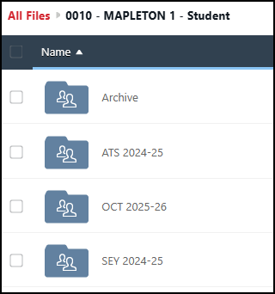
Student Exception Request Process
Process
Download exception request template
Select and complete the applicable tab of the request document
Save the exception to your computer with a unique name
Upload the complete request to your LEA’s student Syncplicity folder using the applicable subfolder for the collection/time of year
Email the applicable collection lead to notify them a request is ready for review
Syncplicity Folder & Collections
Student Interchange, Student October, Student End of Year, and Student Attendance utilize the same Syncplicity folder
  District Code – DISTRICT NAME – Student
Subfolders indicate the collection
  Example: SEY 2024-25
Student Interchange (DEM & SSA)
  July through December:
  Contact StudentOctober@cde.state.co.us
  January through following December:
  Contact StudentEndOfYear@cde.state.co.us
Student Collections (Interchange, OCT, SEY, ATS)
StudentEndOfYear@cde.state.co.us

Slide 21
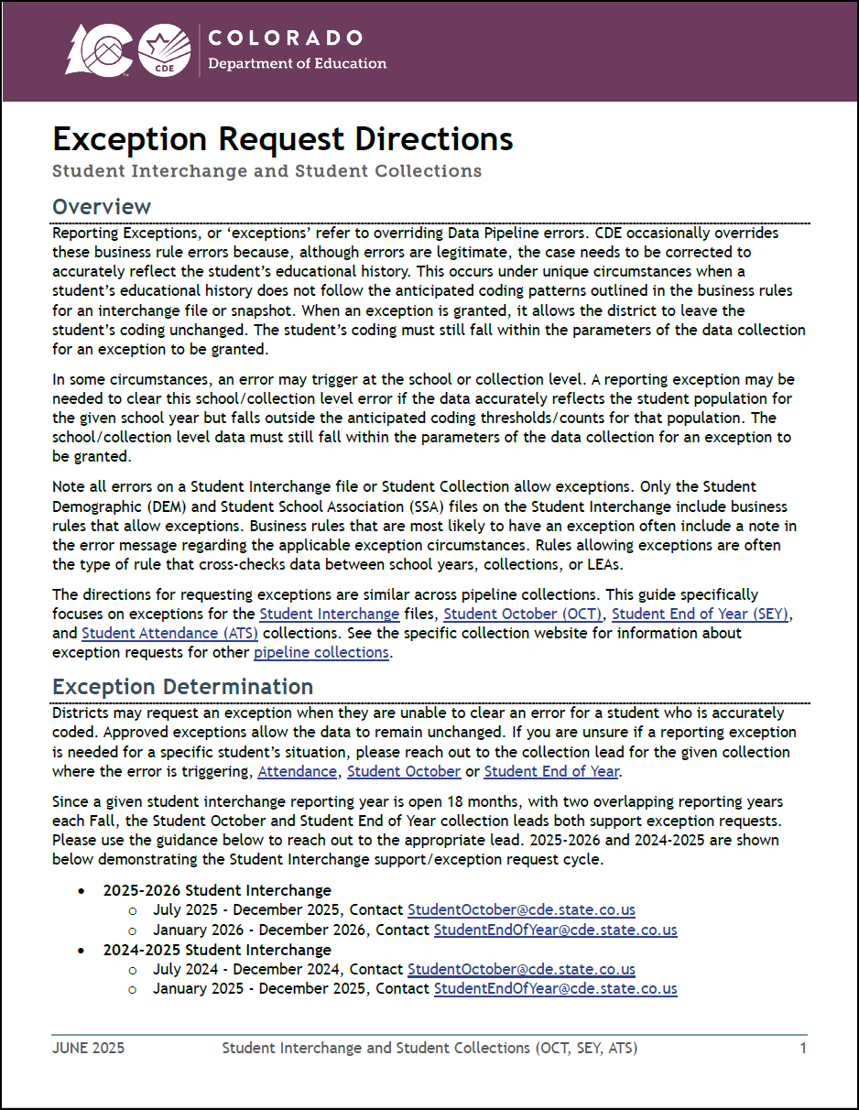
Updated Exception Request Directions
Provides information regarding all student collections using the same template and process (Student Interchange, OCT, SEY, ATS)
Shows required information for different exception types
  DEM, SSA, Snapshot SASID-Student Level, Snapshot School-Collection Level
Syncplicity instructions
Details regarding situations that require ‘additional information’ forms
Collection/File Specific Notes
Student Collections (Interchange, OCT, SEY, ATS)
StudentEndOfYear@cde.state.co.us

Slide 22
Updated Exception Request Template
Requests may be submitted with information on multiple tabs.
Copy and paste all information directly from the error detail report.
  This will ensure that you have the correct error code, error type, school code, grade level, and SASID.
  The exception will not process correctly (will not clear the error) if the request form information is not accurate.
Each error code requires a separate row on the exception request.
Multiple rows of exceptions may be included on each sheet/tab of the workbook.
The reason for exception must be concise but detailed enough to explain the reason behind the exception. (300 characters or less)
Leading zeros are required. (district code, school code, grade level)
Some exception requests require additional documentation/ forms to be included with the request. These forms should also be uploaded to Syncplicity and referenced in the reason for exception.
Student Collections (Interchange, OCT, SEY, ATS)
StudentEndOfYear@cde.state.co.us

Slide 23
Questions & Resources:
Student Reporting Exceptions
Student Interchange Website
2024-2025 Student Interchange & Student End of Year
StudentEndOfYear@cde.state.co.us
Student Attendance
Attendance@cde.state.co.us
Student October
StudentOctober@cde.state.co.us
2025-2026 Student Interchange
July 2025-Dec 2025: StudentOctober@cde.state.co.us
Jan 2026-Dec 2026: StudentEndOfYear@cde.state.co.us

Slide 24
Prevent Harassment or Discrimination
Carrie Martin

Slide 25
Prevent Harassment or Discrimination
Collection Timeline
Date | Event | Event Description
6/5/2025 | Interim Deadline | Upload Prevent Harassment or Discrimination File at least once
7/3/2025 | Interim Deadline | Error free Prevent Harassment or Discrimination File
7/7-7/25/2025 | Report Review | LEAs should use this time to review reports prior to the deadline. Typically, one week prior to the deadline.
8/1/2025 | State Deadline | PHD Collection Closes- All LEAs must have Prevent Harassment or Discrimination submitted in Data Pipeline.
8/8/2025 | State Deadline | Signature page emailed to Prevent Harassment or Discrimination
PHD Collection
PreventHD@cde.state.co.us

Slide 26
Business Rule Reminder
Prevent Harassment or Discrimination File
  Error PH024-No incidents have been reported for this school. If this is accurate, please refer to the Exception Request Instructions.
    Exception Request Template and Exception Request Instructions are available on the website
  Error PH028-Bias type no bias cannot be zero when all other biases are zero. Must select a bias for the record.
    In other words, if the investigation determined a bias was found, at least one bias type must be selected
Prevent Harassment or Discrimination Collection
PreventHD@cde.state.co.us

Slide 27
Questions & Resources:
Prevent Harassment or Discrimination
Prevent Harassment or Discrimination Site
PHD Training Manual, Exception Request Template , Exception Request Instructions
PreventHD@cde.state.co.us
Carrie Martin-Collection lead
(720) 665-4456
Additional Resources and CDE contacts for Harassment, Discrimination, Title IX, and Bullying
Prevention of Harassment, Discrimination, and Bullying in Colorado Schools Site

Slide 28
Student Discipline
Carrie Martin

Slide 29
Student Discipline
Collection Timeline
Date | Event | Event Description
6/11/2025 | Interim Deadline | Error free Student Demographics and Student School Association Interchange files
6/21/2025 | Interim Deadline | Create at least one student discipline snapshot
7/08/2025 | Interim Deadline | Student Discipline Snapshot records error free
7/08-7/26/2025 | Report Review | LEAs should use this time to review reports prior to the deadline. Typically, one week prior to the deadline.
7/31/2025 | State Deadline | All LEAs must have a Student Discipline Snapshot submitted in Data Pipeline
8/9/2025 | State Deadline | Signature page emailed to Student Discipline Snapshot
8/31/2025 | Data Release | Data published
StudentDiscipline@cde.state.co.us

Slide 30
Exceptions
LEAs will need to submit an Exception Request in the proper format for schools with no reportable discipline
  Example: 2 of 12 schools in LEA had no reportable behaviors during the 2024-2025 school year
  Exception Request Template and Exception Request Instructions are available on the Student Discipline Snapshot website.
Student Discipline Snapshot Collection
StudentDiscipline@cde.state.co.us

Slide 31

Office Hours
  Student Discipline Office Hours
    Monday June 9th 10:00 – 10:45
    Bring your Student Discipline reporting questions
Student Discipline Snapshot Collection
StudentDiscipline@cde.state.co.us

Slide 32
Questions & Resources:
Student Discipline
Student Discipline Snapshot Site
Student Discipline Snapshot Timeline
Discipline Interchange Website
Discipline Action File Layout
StudentDiscipline@cde.state.co.us
Carrie Martin-Collection lead
(720) 665-4456

Slide 33
School Code Changes
Jessica Tribbett

Slide 34
School Code Changes Reminders
DUE NO LATER THAN 6/30/25
School Code Changes Include
Closing or merging school codes
Adding or removing grades served
Changing a school name
Requesting a new school code
School Change Request Forms
School Code Change - Directory
Tribbett_Jessica@cde.state.co.us

Slide 35
School Code Change Resources
Tribbett_Jessica@cde.state.co.us

Slide 36
Instructional Days and Hours
Jessica Tribbett

Slide 37
Instructional Days and Hours – HB24-1063
HB24-1063 - the department shall collect from schools of a school district, district charter schools, school districts, institute charter schools, and the state charter school institute, at a minimum, the following data:
Instructional hours for elementary and secondary schools
Days of instruction for elementary and secondary schools
Estimated non-instructional hours, school closures, snow days, and time spent on lunch and passing between classes
Instructional Days and Hours
DirectoryData@cde.state.co.us

Slide 38
Instructional Days and Hours:
Timeline and Reminders
NEW! Collection Timeline
OPEN: Tuesday, September 2nd
CLOSE: Friday, December 5th
Where to start
Find your District's School Board Policy on instructional time to know if recess and/or passing is considered instructional time.
Collect planned calendars and bell schedules from all the schools in your district.
Instructional Days and Hours
DirectoryData@cde.state.co.us

Slide 39

Instructional Days and Hours – Relation to finance
Different data definitions for similar fields.
DO NOT mistake for October Count Audit data requirement.
Instructional Days and Hours
DirectoryData@cde.state.co.us

Slide 40
Questions & Resources:
Instructional Days and Hours Resources
Periodic Data Collection: Instructional Days and Hours Website
File Layout
FAQ's
Developing Resources
Office Hours?
DirectoryData@cde.state.co.us

Slide 41
Thank you for Joining Today!
Next Town Hall will be June 12th
Reminder:
Do not send PII (Personally Identifiable Information) via email. This includes exception requests!

