Slide 1
March 14, 2024 Data Pipeline Town Hall
The goal of the webinar is to provide updates on the Data Pipeline, current, and upcoming data collections. These webinars also provide a forum for districts, BOCES, and Administrative Units to have questions answered about Data Pipeline.

Slide 2
Colorado Department of Education Identity Management (IdM)
Identity Management Site
Frequently Asked Questions
How do I add myself or others to the email listserv for town hall emails and/or a specific collection?
Email lists are dependent on a person’s access rights in IdM. Contact your LAM to get an account or be assigned to a specific collection.
Where can I find the IdM role mappings for Data Pipeline and other applications?
Role Mapping (XLS)
I am a LAM. How do I update the user permissions for someone in my district?
Follow the steps outlined in the IdM Quick Guide for Access Management (DOCX)
Important: Users are not automatically removed from IdM when their email address is no longer active in your district. The LAM must deactivate their IdM account to ensure only designated staff can access CDE’s data reporting system.

Slide 3
What is PII?
Student Personally Identifiable Information (PII) is defined by state and federal laws as information that, alone or in combination, personally identifies an individual
This includes direct identifiers (i.e. student and staff names, SASID, EDID, etc.)
Includes information that when combined is identifiable
Colorado’s Student Data Transparency and Security Act outlines requirements for how Student PII is collected, used and shared
See the Data Privacy and Security website for prepared guidance on how to comply with this and other privacy laws.

Slide 4
Sharing Data
Use secure methods to transfer any PII to CDE
Contact Data Collection leads with questions about how to transmit PII securely
Each Data Collection leads maintains their own Syncplicity folders for specific collections, reach out to the collection lead for access
Use Syncplicity to encrypt emails to CDE
Avoid sending PII via unencrypted email or to unsecured faxes when sharing data between or within districts
Use Syncplicity to encrypt emails to CDE
Check local policies for restrictions, requirements, etc. regarding PII
Do not use PII in trainings, presentations, etc.
Do not share PII with unauthorized individuals
Do not share passwords
Follow local policies when transmitting PII to any third party

Slide 5
Today’s Agenda
Agenda Topic | Presenter
Open Data Collections and Upcoming Deadlines in Data Pipeline
Civil Rights Data Collection (CRDC) | Annette Severson
Student End of Year | Reagan Ward
ACCESS SBD | Tara Rhodes
Summer EBT | Madeleine Breza & Rachael Burnham
Reduced Academic Calendar | Jessica Tribbett

Slide 6
Open Collections and Upcoming Deadlines in Data Pipeline

Slide 7
Open Collections and Upcoming Dates
Name | Category | Status | Key Dates
RITS | Year Round | Open
EDIS | Year Round | Open
Directory | Year Round | Open | Reduced Academic Calendar Applications 3/6/2024 to 5/10/2024 School Code Change Requests 2/5/2024 to 6/28/2024
Student | Interchange | Open | Interim Deadline: 4/11/24 upload initial GG file
Title I | Interchange | Open
Special Education IEP | Interchange | Open
Staff | Interchange | Open
TSDL | Interchange | Open
Data Pipeline Resources: Data Pipeline Collection Dates (XLS)

Slide 8
Open Collections and Upcoming Dates cont.
Name | Category | Status | Final Deadline Date | Deadline Milestone | Looking Ahead
Human Resources | Snapshot | Open | Feb. 23, 2024
TSDL | Snapshot | Open | Aug. 30, 2024
Attendance | Snapshot | Coming Soon | July 12, 2024 |  | Opens 4/17/2024
Student End of Year | Snapshot | Coming Soon | Nov. 19, 2024 | Interim Deadline: Upload initial GG file by 4/11/2024 | Soft Open 4/1/2024
Report Card March | Periodic | Open | Apr. 12, 2024
ACCESS for ELLs | Periodic | Coming Soon | Mar. 20, 2024 |  | Opens 3/11/2024
S-EBT | Periodic | Coming Soon | Apr. 30, 2024 |  | Opens 4/1/2024
Data Pipeline Resources: Data Pipeline Collection Dates (XLS)

Slide 9
Civil Rights Data Collection (CRDC)
Annette Severson

Slide 10
Current Status
CRDC deadline extended until March 18th
Issues with their data system have been resolved
For questions or assistance with the collection process, please contact the CRDC Partner Support:
CRDC Partner Support Center
Email: CRDC@aemcorp.com
Phone: (855) 255-6901
Civil Rights Data Collection
CRDC@aemcorp.com

Slide 11
Overall District Status – Great Job!!
Civil Rights Data Collection
CRDC@aemcorp.com

Slide 12
Questions & Resources: CRDC
CRDC Partner Support Center
Email: CRDC@aemcorp.com
Phone: (855) 255-6901

Slide 13
Student End of Year
Reagan Ward

Slide 14
SEY Collection Timeline: Soft Open Phase
Date | Event | Event Description
04/01/2024 | Open | Districts may begin creating snapshots.
04/03/2024 1:00-2:30pm | Training Event | Collection Overview Training 1 of 2: This training covers all elements of the Student End of Year collection. It is being offered in two identical sessions to provide the opportunity for all SEY data respondents to attend a live session. Click here to register for this training event.
04/11/2024 | Interim Deadline | Upload initial Graduation Guidelines (GG) interchange file. Districts are expected to have an upload date 01/01/2024 or later to meet this interim deadline.
04/22/2024 1:00-2:00pm | Training Event | Collaborative Webinar – Special Education 18-21 Transition Services This webinar is designed for data respondents and district special education staff who support 18-21 transition services. Click here to register for this training event.
04/26/2024 | Closed | Soft open phase ends and snapshots are closed until the next phase.
Visit the SEY Website to download the complete SEY Collection Timeline with Training Dates
Student End of Year – Reagan Ward
StudentEndOfYear@cde.state.co.us

Slide 15
SEY Website Updates
Postsecondary Programs collaborative webinar recording posted
SEY Business Rules posted
Will continue to be updated throughout the soft open
This version mostly reflects updates to the language of business rule messages to provide clarity for existing rules
SEY Training Manual
One-stop for the majority of collection information
Multiple sections (overview and phases, data pipeline, CEDAR Basics, Syncplicity, Common Coding Patterns, Frequently Asked Questions)
May have additional updates this Spring to include some of the additional resource information currently posted on the SEY website
Student End of Year – Reagan Ward
StudentEndOfYear@cde.state.co.us

Slide 16
FRL Status Reminders
General expectation for SEY
Student’s FRL status is cumulative, reflecting the highest level of service provided at any point during the school year.
Scenarios where a change from OCT to SEY is reasonable:
Carryover status from 2022-2023 caused student to be indicated as Free or Reduced in OCT 2023-2024, but once the carryover window elapsed the student was found to be Paid.
November Income Verification process determined student did not meet eligibility and the student’s status was updated accordingly
New Cross-Collection Checks
WARNING if a student was indicated free lunch in OCT and is not in SEY
WARNING if a student was indicated reduced lunch in OCT and is not reduced or free in SEY
Planned Revision SE181, SE182, SE183
SCHOOL level threshold check (+/- 10%) if a significant change occurred from Student October to SEY
Exceptions required if LEA verifies data and finds significant change truly occurred to provide context to the significant change.
Student End of Year – Reagan Ward
StudentEndOfYear@cde.state.co.us

Slide 17
Questions & Resources: Student End of Year
Reagan Ward
StudentEndOfYear@cde.state.co.us
720-484-9057
Student End of Year Webpage Student Interchange Webpage Graduation Guidelines Webpage

Slide 18
ACCESS for ELLs SBD
Tara Rhodes

Slide 19
Student Biographical Data (SBD) Timeline
SBD Collections
There are four collections, one for each assessment vendor
Details are in the Periodic Collections on the Data Pipeline page
Documents will be updated closer to the collection openings
Timelines are subject to change; please make sure you have users in each collection group to receive emails about the specific collection
 | Assessment | Data Pipeline Group | SBD Review Window
1 | ACCESS for ELLs® ACCESS for ELLs Alternate | ACC | March 11 – 20, 2024
2 | Colorado PSAT/SAT | SAT | May 15 – 22, 2024
3 | Colorado Measures of Academic Success (CMAS): Mathematics, ELA, CSLA, Science and Social Studies Colorado Alternate (CoAlt): Science and Social Studies | CMS | May 16 – 29, 2024
4 | Colorado Alternate (CoAlt): English Language Arts and Mathematics (Dynamic Learning Maps) | DLM | May 29 – June 5, 2024
ACCESS SBD
sbdsupport@cde.state.co.us

Slide 20
WIDA ACCESS for ELLs SBD
WIDA ACCESS for ELLs is the English Language Proficiency assessment.
Students classified as Non-English Proficient (NEP) or Limited English Proficient (LEP) are required to take WIDA ACCESS. No other students take this assessment.
The assessment is offered in all grades, K-12.
There is an alternate version (Alt-ACCESS) used for students with significant cognitive disabilities.
The testing window starts in January, so the data clean up is earlier than other state assessments.
ACCESS SBD
sbdsupport@cde.state.co.us

Slide 21
Updates for 23-24 Collection Window
If you are hitting CS080:
Please make sure that the language proficiency is correct
Please put in "11" in the Not Tested Reason field- this should lift the error.
If you are hitting CS162-165:
The grade clusters were updated by the vendor for Kindergarten to 2nd grade for Alternate testers for 23-24.
CS162-165 have now been adjusted to allow for this change.
If you were hitting this business rule before, please try again.
Please remember that the clusters are not updateable and changes made to clusters will not be saved.
So please don't work around this error or ignore the warnings that pop up related to CS162-165
ACCESS SBD
sbdsupport@cde.state.co.us

Slide 22
ACCESS for ELLs SBD Collection Documentation
All documentation is on the Data Pipeline Collection page here.
File Layout and Definitions Section:
There were three main changes to the file layout from the 22-23 collection year.
Business Rules Section:
There was the addition or modification of six business rules for the 2023-24 collection year.
Link to the SBD Manual:
This links to the manual that is applicable for all SBDs and lays out the SBD process step-by-step.
Templates:
The District Transfers Failsafe Form: This is the document used to move students between districts. There was no change from the 22-23 collection year.
This should only be used for students who are in your district’s SBD file but moved out of your district before or during the testing window and DID NOT TEST in your district.
Do not use the Failsafe form to report any students who tested in your district and moved afterward. If they moved after testing, the student data should remain in the district where the student tested.
The Add a Newly Arrived to the U.S. Student Failsafe Form: Please use this form to submit students to CDE who: 1. were not included in the Colorado October 1 Count collection, 2. recently arrived to the United States and, 3. enrolled in your district as their first enrollment in the US.
Training Recording:
Here's a link to the recording of the training that was held earlier last week.
ACCESS SBD
sbdsupport@cde.state.co.us

Slide 23
ACCESS for ELLs SBD Tips
Tips for Completing the SBD Process:
If you are new to the SBD collections, please review the SBD manual before beginning any of the collections.
Please also read the SBD File Layout and Definitions document before you begin the SBD Review Process.
Changes from the previous year are highlighted
Not all of the fields in the SBD file layouts are updateable. Please review the file layout to learn which ones are.
The file layout also provides the position, format, and length of fields for the SBD collection as well as valid values.
The business rules document lists all the business rules, but also provides some information on how to fix errors and warnings.
ACCESS SBD
sbdsupport@cde.state.co.us

Slide 24
ACCESS SBD: Contact Information
Please contact SBD Support with any questions:
Email: sbdsupport@cde.state.co.us
Phone: 720.696.0185
ACCESS SBD Website

Slide 25
Summer EBT Program
Madeleine Breza

Slide 26
Permanent Summer-EBT
New, permanent federal program that helps ensure Colorado children can access adequate, healthy foods during summer break
$120/eligible student, EBT card to purchase groceries
Administrative funding for SFAs
State Legislation passed in November 2023 (SB23B-002)
CDHS lead agency, CDE partner agency
Similar to P-EBT: data collection, CDHS disbursement
Major Differences: mandatory data collection, ability to use family contact info, community-based organizations support
Summer EBT
s-ebt@cde.state.co.us
Notes:
The Summer Electronic Benefit Transfer (S-EBT) Program is a new, permanent federal program that helps ensure Colorado children can access adequate, healthy foods during summer break when school is out of session.
The program will go in to effect this summer, 2024, and families with school aged children that are eligible for free or reduced-priced school meals may receive $40/month ($120 total) per child during the summer months to purchase groceries. Funds will be placed on EBT cards and received via mail. This program will operate alongside the summer meals program.

Slide 27
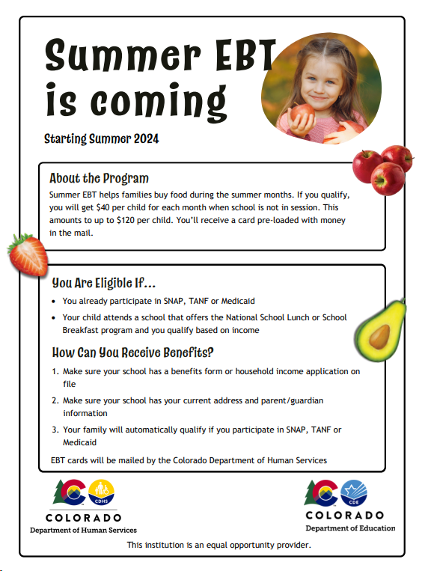
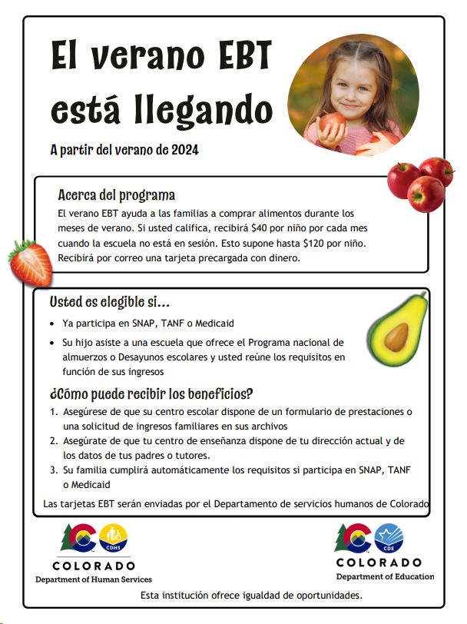
Currently…
CDHS & CDE submitted state plan and waiting for USDA approval
Encourage families to submit household income information through nutrition income applications
Connect with your district’s nutrition team to start conversations around submission
Ensure all student eligibility is received and up to date
Additional outreach materials, FAQs and training resources coming soon!
Summer EBT
s-ebt@cde.state.co.us
Notes:
To ensure families receive these benefits, continue to encourage families to submit household income information and update their mailing address using your district’s communication channels this school year. Household income information may be collected through free and reduced lunch applications, a combo form or the Family Economic Data Survey (FEDS) form.
Make sure that

Slide 28
Data Collection
Collection will open April 1 through April 30
All districts required to submit student level data by due date
All enrolled students must be included in collection
Office hours will be available once collection is open
Utilize file layout to start building collection
Verify current student enrollment for missing information and up to date eligibility
Submit student data in data pipeline
Summer EBT
s-ebt@cde.state.co.us

Slide 29
File Layout
Summer EBT
s-ebt@cde.state.co.us

Slide 30
Questions & Resources: Summer EBT
Websites:
School Nutrition Summer-EBT
Data Pipeline S-EBT
Email:
s-ebt@cde.state.co.us

Slide 31
Reduced Academic Calendar
Jessica Tribbett

Slide 32
Reduced Academic Calendar: Requests
Reduced Academic Calendar Requests*
Fewer than 160 contact days
3/6/2024 – 5/10/2024
*Formally the 4 Day School Week
The general process is the same:
Complete Reduced Academic Calendar Request form in Data Pipeline.
If your district is on a district wide improvement plan, you will need to extra documentation to field services via this webform.
Field services and the commissioner will approve by 6/30/2024 and districts will be notified
Reduced Academic Calendar – Jessica Tribbett
DirectoryData@cde.state.co.us

Slide 33
Reduced Academic Calendar: Request form field updates
Field Name | Previous Location | New Location
Reduced Academic Calendar (Y/N) | Previously named 4 Day Week Y/N - school level data | Name change – school level data
4 Day School Week | School level data | School level data
Day Not in Session | District level data | School level data
# of Days is Session | District level data | School level data
# of Elem. Hours Scheduled | District level data | School level data
#of Secondary Hours Scheduled | District level data | School level data
Reduced Academic Calendar – Jessica Tribbett
DirectoryData@cde.state.co.us

Slide 34
Reduced Academic Calendar: Request form
If blank email me
District Accreditation Rating
Previously district level data
Reduced Academic Calendar – Jessica Tribbett
DirectoryData@cde.state.co.us

Slide 35
Questions & Resources: Reduced Academic Calendar
Questions & Resources DirectoryData@cde.state.co.us

Slide 36
Thank you for joining today!
Next Town Hall will be March 21st
LAMs, please review your district’s list of data pipeline users.
Remove staff who have left your district.
Ensure appropriate staff are assigned to Spring data collections.

Slide 37
Collection Email Addresses
Additional support has been added to help manage emails for the CDE Team
Some emails may be signed as "Technical Help Support"
The data collection leads you know, and trust are:
Still responding and signing their names as needed
Training & assisting the Technical Help Support staff
Note: These email addresses are also posted on the Data Pipeline website and Contact list for reference
Data Collection | Email Addresses
Attendance | Attendance@cde.state.co.us
Directory | DirectoryData@cde.state.co.us
EDIS | EDIS@cde.state.co.us
Human Resources | HumanResourcesData@cde.state.co.us
READ Collections | ReadActData@cde.state.co.us
Report Card March | ReportCard@cde.state.co.us
RITS | RITS@cde.state.co.us
Special Ed December Count | SpedDecCount@cde.state.co.us
Special Ed Discipline | SpedDiscipline@cde.state.co.us
Special Ed End of Year | SpedEndOfYear@cde.state.co.us
Staff Evaluation | StaffEvaluation@cde.state.co.us
Student Discipline Snapshot | StudentDiscipline@cde.state.co.us
Student End of Year | StudentEndOfYear@cde.state.co.us
Student October Count | StudentOctober@cde.state.co.us
Teacher Student Data Link | TeacherStudentDataLink@cde.state.co.us

