Slide 1
January 18th, 2024 Data Pipeline Town Hall
The goal of the webinar is to provide updates on the Data Pipeline, and current or upcoming data collections. These webinars also provide a forum for districts, BOCES, and Administrative Units to have questions answered about Data Pipeline.

Slide 2
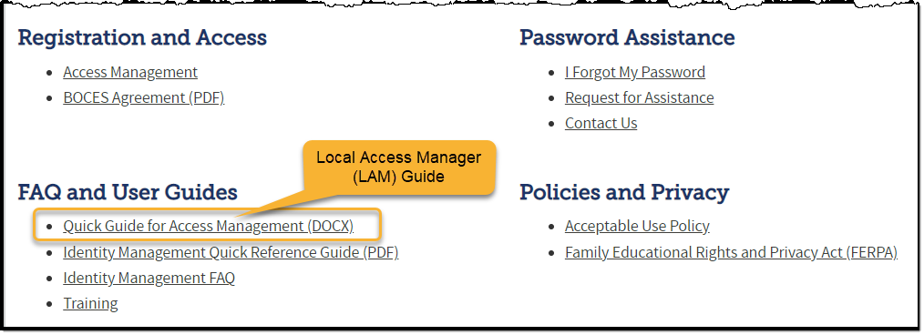
Colorado Department of Education Identity Management (IdM)
Identity Management Site
Frequently Asked Questions
How do I add myself or others to the email listserv for town hall emails and/or a specific collection?
Email lists are dependent on a person’s access rights in IdM. Contact your LAM to get an account or be assigned to a specific collection.
Where can I find the IdM role mappings for Data Pipeline and other applications?
Role Mapping (XLS)

Slide 3
Collection Email Addresses
Additional support has been added to help manage emails for the CDE Team
Some emails may be signed as "Technical Help Support"
The data collection leads you know, and trust are:
Still responding and signing their names as needed
Training & assisting the Technical Help Support staff
Data Collection | Email Addresses
Attendance | Attendance@cde.state.co.us
Directory | DirectoryData@cde.state.co.us
EDIS | EDIS@cde.state.co.us
Human Resources | HumanResourcesData@cde.state.co.us
READ Collections | ReadActData@cde.state.co.us
Report Card March | ReportCard@cde.state.co.us
RITS | RITS@cde.state.co.us
Special Ed December Count | SpedDecCount@cde.state.co.us
Special Ed Discipline | SpedDiscipline@cde.state.co.us
Special Ed End of Year | SpedEndOfYear@cde.state.co.us
Staff Evaluation | StaffEvaluation@cde.state.co.us
Student Discipline Snapshot | StudentDiscipline@cde.state.co.us
Student End of Year | StudentEndOfYear@cde.state.co.us
Student October Count | StudentOctober@cde.state.co.us
Teacher Student Data Link | TeacherStudentDataLink@cde.state.co.us
These email addresses are also posted on the Data Pipeline website and Contact list for reference

Slide 4
What is PII?
Personally Identifiable Information (PII) is defined by state and federal laws as information that, alone or in combination, personally identifies an individual
This includes direct identifiers (i.e. student and staff names, SASID, EDID, etc.)
Includes information that when combined is identifiable
Colorado’s Student Data Transparency and Security Act outlines requirements for how Student PII is collected, used and shared
CDE has prepared guidance on how to comply with this and other privacy laws which can be found here.

Slide 5
Sharing Data
Use secure methods to transfer any PII to CDE
Contact Data Collection leads with questions about how to transmit PII securely
Each Data Collection leads maintains their own Syncplicity folders for specific collections, reach out to the collection lead for access
Use Syncplicity to encrypt emails to CDE
Avoid sending PII via unencrypted email or to unsecured faxes when sharing data between or within districts
Use Syncplicity to encrypt emails to CDE
Check local policies for restrictions, requirements, etc. regarding PII
Do not use PII in trainings, presentations, etc.
Do not share PII with unauthorized individuals
Do not share passwords
Follow local policies when transmitting PII to any third party

Slide 6
Today’s Agenda
Agenda Topic | Presenter
Open Data Collections and Upcoming Deadlines in Data Pipeline
Civil Rights Data Collection (CRDC) | Annette Severson
Human Resources | Dawna Gudka
Special Education December Count | Lindsey Heitman
Student Interchange 2023-2024 | Reagan Ward
Reduced Academic Calendar | Jessica Tribbett
School Code Change Requests | Jessica Tribbett

Slide 7
Open Collections and Upcoming Deadlines in Data Pipeline

Slide 8
Open Collections and Upcoming Dates – 1 of 2
Name | Category | Status | Key Dates
RITS | Year Round | Open
EDIS | Year Round | Open
Directory | Year Round | Open
Student | Interchange | Open
Title I | Interchange | Open
Special Education IEP | Interchange | Open
Staff | Interchange | Open
TSDL | Interchange | Open
Data Pipeline Resources: Data Pipeline Collection Dates (XLS)

Slide 9
Open Collections and Upcoming Dates – 2 of 2
Name | Category | Status | Final Deadline Date | Deadline Milestone | Looking Ahead
SPED December | Snapshot | Open | Feb. 23, 2024 | Deadline: 1/25/2024 complete error-free snapshot | 1/25/24 – 02/02/24 December Count Staff and Student Reports Review
Human Resources | Snapshot | Open | Feb. 23, 2024 | Collection goal: 1/12/24 Create at least one HR Snapshot | 2/15/24 must have a complete Human Resources Snapshot
Data Pipeline Resources: Data Pipeline Collection Dates (XLS)

Slide 10
Civil Rights Data Collection 2021-2022 School Year Data
Annette Severson

Slide 11
Overview
The U.S. Department of Education [ED] conducts the Civil Rights Data Collection (CRDC)
Collects data on key education and civil rights issues in our nation's public schools. The CRDC collects a variety of information including, student enrollment and educational programs and services, disaggregated by race/ethnicity, sex, limited English proficiency and disability.
Information collected by the CRDC is also used by other ED offices as well as policymakers and researchers outside of ED.
CRDC 2021-22
Severson_a@cde.state.co.us

Slide 12
CRDC Phases
MAY 15 – JUNE30 2023
SUMMER/FALL 2023
DEC 11 – FEB 26 2023 - 2024
DEC 11 – FEB 26 2024
SPRING/SUMMER 2024
REGISTRATION
Update and verify contact information and list of schools Update and verify contact information and list of schools
Use tools to review list of data elements and to prepare for the collection School/LEA forms Flat file submission Survey tool guides Excel templates Data elements
REVIEW & SUBMIT DATA
Review and submit data via file upload or manual entry
CERTIFY DATA
COLLECTION TOOLS
Review submitted data and resolve errors and warnings Action plans Reviewing data
DATA QUALITY
Review the data for quality Data quality manuals
PRE-COLLECTION
PRE-COLLECTION
COLLECTION
COLLECTION
POST-COLLECTION
CRDC 2021-22
Severson_a@cde.state.co.us

Slide 13
CDE Status
List of Data Elements pre-populated by CDE is posted online
https://www.cde.state.co.us/datapipeline/crdc-cde-data-provision
CRDC 2021-22
Severson_a@cde.state.co.us

Slide 14
Contact Information
Additional resources: please visit the CRDC Resource Center at https://crdc.communities.ed.gov.
Questions? Contact the CRDC Partner Support Center (PSC):
CRDC Partner Support Center
Telephone: 855-255-6901
E - mail: crdc@aemcorp.com
CRDC Resource Center: https://crdc.grads360.org
CRDC 2021-22
Severson_a@cde.state.co.us

Slide 15
Human Resources
Dawna Gudka

Slide 16
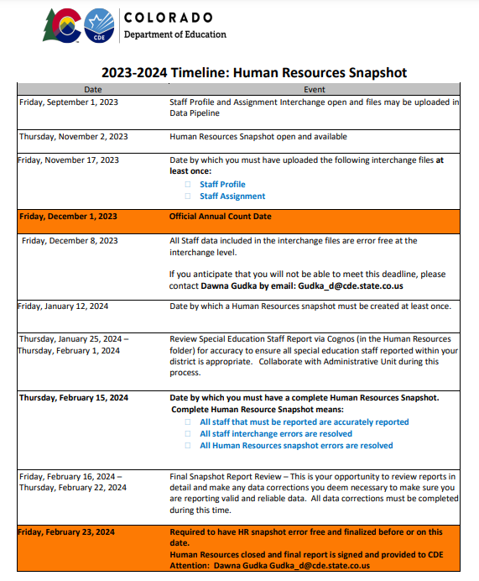
Human Resources Collection Timeline
Interchange files should be error free and LEA's should be working on Snapshot errors. Then files should be reviewed for data accuracy.
Human Resources Snapshot Collection
Gudka_d@cde.state.co.us

Slide 17
Human Resources Collection Common Errors
HR200 A matching endorsement for the teaching subject area code and grade level reported was not found for this teacher in the license database. Please update the field 'Demonstrates In-Field Status 1' to another code (02= Degree; 03=36 Semester Hours; 04=Passed Exam; or 05=Out of Field)
Human Resources Snapshot Collection
Gudka_d@cde.state.co.us

Slide 18
Human Resources Collection Common Errors cont.
HR033 If Subject Area of Degree 1, 2 or 3 is valid then Highest Level of Education must be 16 or higher.
Subject Area of Degree 1 - A broad description of each degree(s) a middle, junior, or high school teacher has received (bachelors, masters or doctorate). For teachers without a bachelor’s degree or higher (highest level of education code 16 or higher), the code ‘2100’ would be reported for ‘No Degree’.
HR230 The Educator Shortage Survey has not yet been indicated as completed. This will be updated every Thursday evening. To complete the Educator Shortage Survey
Human Resources Snapshot Collection
Gudka_d@cde.state.co.us

Slide 19
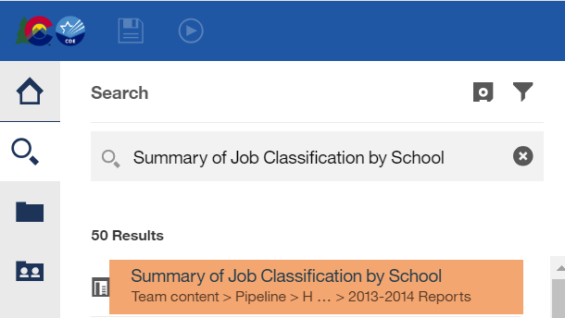
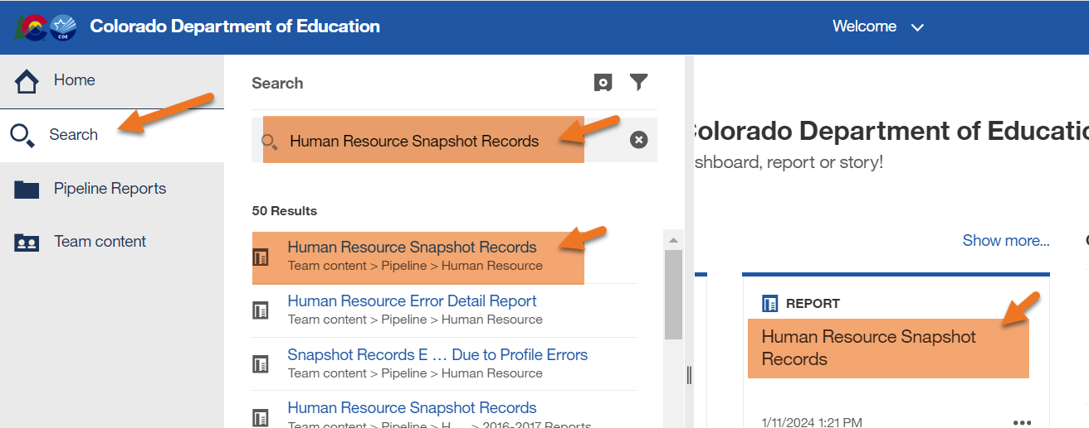
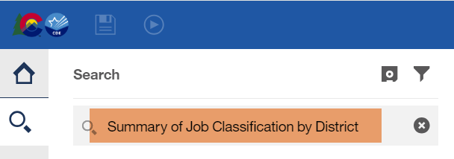
Human Resources Collection Using Cognos to validate data
Human Resources Snapshot Collection
Gudka_d@cde.state.co.us

Slide 20
Human Resources Collection Submit your data to CDE
Human Resources Snapshot Collection
Gudka_d@cde.state.co.us

Slide 21
Questions & Resources for Human Resources Collection
Collection Resources
Staff Interchange
Staff Profile File Layout
Staff Assignment File Layout
Human Resources Snapshot
Questions
Email: Human Resources
Dawna Gudka (303) 598-7901

Slide 22
Special Education December Count
Lindsey Heitman

Slide 23
Special Education December Count: Collection Status
Next interim deadline is Thursday, January 25th
Date to have a complete Special Education December Count Snapshot:
All Child file and Participation file errors (interchange errors) resolved
All Dec Staff Snapshot errors resolved (this requires all Sped staff Interchange errors to be resolved)
All Dec Student Snapshot errors resolved
Create December Count Snapshots and work with your staff data respondent until all errors are resolved
AU respondent should check both Dec Staff and Dec Student snapshot error reports:
Pipeline Reports/Error Report
Sp. Ed December Count Staff
Sp. Ed December Count Student
OR Cognos Reports/Special Education December folder
Errors: Staff Detail Report of errors to correct
Errors: Student Detail Report of errors to correct
Staff respondent may access the Special Education December Staff error report under the Staff Profile Cognos folder
Special Education December Count- Lindsey Heitman SpedDecCount@cde.state.co.us

Slide 24
Special Education December Count: Student Data Checks and Warnings
Facility School Students – be sure to check for any resident AU students that your district(s) is paying to attend a facility school
Approved Facility School Code list found here and Facility Schools Directory found here
Detention Center Students – check for these warnings
DC155: There is a Detention Center within the boundaries of your AU and you have not reported any students there. Please check with the Detention Center for a list of DETAINED students and notify the resident AUs that their student was Detained on the count date and that they are reporting the student correctly.
DC156: You have reported the following students at the Detention Center within the boundaries of your AU. Please notify the resident AUs that their student was Detained on the count date and verify that they are reporting the student correctly.
Reference ‘Detention Center Students: December Count Guidance’ document from December Count Snapshot webpage under Additional Links for help with which AU claims funding for these students
Duplicate Students – check for these warnings
DC154: Another AU is also claiming a Funding Status of 50 for this student. Please verify attendance and enrollment records for December 1st. If your record is correct you may leave it the same.
DC214: Another AU is reporting that this student is attending in their AU. Please verify attendance and enrollment records for December 1st. If your record is correct you may leave it the same and ignore this warning.
The other reporting AU is now included in the far right column of the error report
Reference ‘Pupils Attendance Information Codes’ document from December Count Snapshot webpage under Additional Links for help with PAI and Funding Status Codes.
Special Education December Count- Lindsey Heitman SpedDecCount@cde.state.co.us

Slide 25
Special Education December Count: Unresolved SAM Warnings
December Staff Snapshot Warnings DC208, DC209, DC210, DC211
SAM Warnings will not prevent you from finalizing your December Count staff data.
If SAM Warnings remain unresolved at collection close, staff will display in the final SAM: 1.5 Non-Qualified Personnel Status report.
All non-qualified staff are included in the post December Count Correction Tracker accountability process.
Special Education December Count- Lindsey Heitman SpedDecCount@cde.state.co.us

Slide 26
Special Education December Count: Post Collection Personnel Status Report Tracker
Unresolved staff issues who display in the SAM: 1.5 Non-Qualified Personnel Status Report will generate, post December Count collection, a Personnel Status Report Tracker identifying the staff and non-compliant issue.
The Tracker is an accountability process between CDE and the AU documenting how the non-compliant issue is either resolved, or how it will be resolved.
The Tracker is signed, submitted, and uploaded in the Compliance Tab in the Data Management System (DMS).
If clarification is needed, Special Education Directors will be contacted by the ESSU’s General Supervision and Monitoring team.
Special Education December Count- Lindsey Heitman SpedDecCount@cde.state.co.us

Slide 27
Questions & Resources: Special Education December Count
Lindsey Heitman
SpedDecCount@cde.state.co.us
(303) 866 - 5759
Special Education IEP Interchange Webpage
Special Education December Count Snapshot Webpage

Slide 28
2023-2024 Student Interchange
Reagan Ward

Slide 29
Spring 2023-2024 Reminders
Student Interchange questions & exception requests should be directed to StudentEndOfYear@cde.state.co.us January 2024 through December 2024
Use the exception request template posted on the Student Interchange website
Mid-Year English Learner Changes may require additional documentation
EL coding changing after October count in the same district & school year with an EL history > 2 years
See the Student Interchange site for my helpful resources
Student Interchange – Reagan Ward
StudentEndOfYear@cde.state.co.us

Slide 30
Spring 2023-2024 Reminders cont.
Districts are encouraged to upload DEM, SSA, & GG files regularly
Prepare for Spring collections that use student interchange data
Student End of Year
Attendance
Student Discipline
SPED End of Year & Discipline
Spring READ Assessment
Assessment SBDs (WIDA, CMAS, DLM, PSAT/SAT)
Updates data in Student Profile CEDAR/COGNOS reports
Graduation Guidelines List of Students – Summary
Graduation Guidelines Student Completion List
Foster Care Student List
Migrant Student List
Student Interchange – Reagan Ward
StudentEndOfYear@cde.state.co.us

Slide 31
2022-2023 Student Interchange
Student Interchange Website
Reagan Ward
StudentEndOfYear@cde.state.co.us
720-484-9057

Slide 32
Reduced Academic Calendar
Jessica Tribbett

Slide 33
Reduced Academic Calendar
Reduced Academic Calendar Requests*
2/26/2024 – 5/10/2024
*Formally the 4 Day School Week
The general process is the same:
Complete Reduced Academic Calendar Request form in Data Pipeline.
If your district is on a district wide improvement plan, you will need to extra documentation to field services via this webform.
Field services and the commissioner will approve by 6/30/2024 and districts will be notified.
Contact me at Tribbett_Jessica@cde.state.co.us

Slide 34
Reduced Academic Calendar
Request form field updates:
Field Name | Previous Location | New Location
Reduced Academic Calendar (Y/N) | Previously named 4 Day Week Y/N - school level data | Name change – school level data
4 Day School Week | School level data | School level data
Day Not in Session | District level data | School level data
# of Days is Session | District level data | School level data
# of Elem. Hours Scheduled | District level data | School level data
#of Secondary Hours Scheduled | District level data | School level data

Slide 35
Questions & Resources DirectoryData@cde.state.co.us

Slide 36
School Code Request Jessica Tribbett

Slide 37
School Code Request
School Code Changes for 2024-2025 opens on February 5th, 2024
School Code Changes considered are:
New School Code
School Name Change
School Grade Change
Request for Closing/Merging Schools
These request require the School Code Change Request Forms to be submitted for approval. The form requires your superintendents/directors' signature before the request can be reviewed.
Contact me at Tribbett_Jessica@cde.state.co.us

Slide 38
School Code Request
Contact me at Tribbett_Jessica@cde.state.co.us

Slide 39
School Code Request
The process for a school code change request is as follows:
Request is submitted
School Code Review Committee reviews request
School Code Review Committee votes to approve or deny the request
District notified of approval or SCRC's suggestions for moving forward
Signature page is received
Contact me at Tribbett_Jessica@cde.state.co.us

Slide 40
Questions & Resources Jessica Tribbett Tribbett_Jessica@cde.state.co.us 720-693-6035

Slide 41
Thank you for joining today!
Next Town Hall will be January 25th, 2024
Reminder: When emailing or calling CDE, please include your 4-digit LEA or your 5-digit AU code. This will help us answer your questions.

