Slide 1
January 4th, 2024 Data Pipeline Town Hall
The goal of the webinar is to provide updates on the Data Pipeline, and current or upcoming data collections. These webinars also provide a forum for districts, BOCES, and Administrative Units to have questions answered about Data Pipeline.

Slide 2
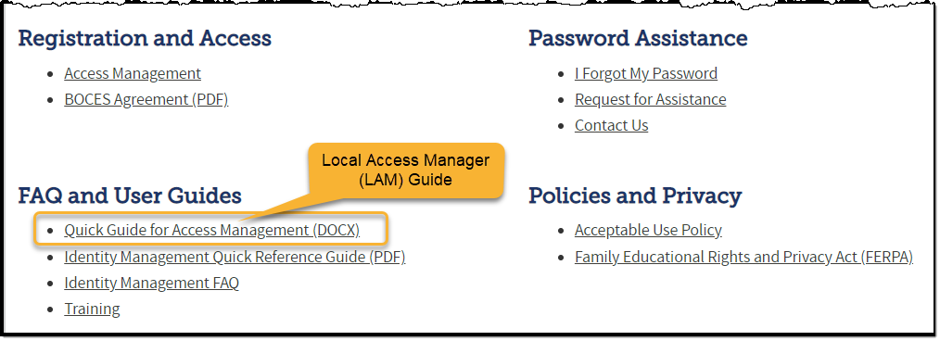
Colorado Department of Education Identity Management (IdM)
Identity Management Site
Frequently Asked Questions
How do I add myself or others to the email listserv for town hall emails and/or a specific collection?
Email lists are dependent on a person’s access rights in IdM. Contact your LAM to get an account or be assigned to a specific collection.
Where can I find the IdM role mappings for Data Pipeline and other applications?
Role Mapping (XLS)

Slide 3
What is PII?
Personally Identifiable Information (PII) is defined by state and federal laws as information that, alone or in combination, personally identifies an individual
This includes direct identifiers (i.e. student and staff names, SASID, EDID, etc.)
Includes information that when combined is identifiable
Colorado’s Student Data Transparency and Security Act outlines requirements for how Student PII is collected, used and shared
CDE has prepared guidance on how to comply with this and other privacy laws which can be found here.

Slide 4
Sharing Data
Use secure methods to transfer any PII to CDE
Contact Data Collection leads with questions about how to transmit PII securely
Each Data Collection leads maintains their own Syncplicity folders for specific collections, reach out to the collection lead for access
Use Syncplicity to encrypt emails to CDE
Avoid sending PII via unencrypted email or to unsecured faxes when sharing data between or within districts
Use Syncplicity to encrypt emails to CDE
Check local policies for restrictions, requirements, etc. regarding PII
Do not use PII in trainings, presentations, etc.
Do not share PII with unauthorized individuals
Do not share passwords
Follow local policies when transmitting PII to any third party

Slide 5
Collection Email Addresses
Additional support has been added to help manage emails for the CDE Team
Some emails may be signed as "Technical Help Support"
The data collection leads you know, and trust are:
Still responding and signing their names as needed
Training & assisting the Technical Help Support staff
Data Collection | Email Addresses
Attendance | Attendance@cde.state.co.us
Directory | DirectoryData@cde.state.co.us
EDIS | EDIS@cde.state.co.us
Human Resources | HumanResourcesData@cde.state.co.us
READ Collections | ReadActData@cde.state.co.us
Report Card March | ReportCard@cde.state.co.us
RITS | RITS@cde.state.co.us
Special Ed December Count | SpedDecCount@cde.state.co.us
Special Ed Discipline | SpedDiscipline@cde.state.co.us
Special Ed End of Year | SpedEndOfYear@cde.state.co.us
Staff Evaluation | StaffEvaluation@cde.state.co.us
Student Discipline Snapshot | StudentDiscipline@cde.state.co.us
Student End of Year | StudentEndOfYear@cde.state.co.us
Student October Count | StudentOctober@cde.state.co.us
Teacher Student Data Link | TeacherStudentDataLink@cde.state.co.us
These email addresses are also posted on the Data Pipeline website and Contact list for reference

Slide 6
Today’s Agenda
Agenda Topic | Presenter
Open Data Collections and Upcoming Deadlines in Data Pipeline
Civil Rights Data Collection (CRDC) | Annette Severson
Teacher Student Data Link | Peter Hoffman
2023 Student End of Year Data Release | Reagan Ward
Human Resources | Dawna Gudka

Slide 7
Open Collections and Upcoming Deadlines in Data Pipeline

Slide 8
Open Collections and Upcoming Dates – 1 of 2
Name | Category | Status | Key Dates
RITS | Year Round | Open
EDIS | Year Round | Open
Directory | Year Round | Open
Student | Interchange | Open
Title I | Interchange | Open
Special Education IEP | Interchange | Open
Staff | Interchange | Open
TSDL | Interchange | Open
Data Pipeline Resources: Data Pipeline Collection Dates (XLS)

Slide 9
Open Collections and Upcoming Dates – 2 of 2
Name | Category | Status | Final Deadline Date | Deadline Milestone | Looking Ahead
Student End of Year | Snapshot | Closed |  |  | Public Data Release: 01/09/2024
Student October | Snapshot | Closed |  |  | Public Data Release: 01/17/2024
SPED December | Snapshot | Open | Feb. 23, 2024 | Deadline: 12/20/2023 Interchange files error-free | 01/25/2024 December Count Staff and Student Snapshot errors resolved
Human Resources | Snapshot | Open | Feb. 23, 2024 | Collection goal: interchange files-error free | Goal: 1/12/24 Create at least one HR Snapshot
Data Pipeline Resources: Data Pipeline Collection Dates (XLS)

Slide 10
Civil Rights Data Collection 2021-2022 School Year Data
Annette Severson

Slide 11
Overview
The U.S. Department of Education [ED] conducts the Civil Rights Data Collection (CRDC)
Collects data on key education and civil rights issues in our nation's public schools. The CRDC collects a variety of information including, student enrollment and educational programs and services, disaggregated by race/ethnicity, sex, limited English proficiency and disability.
Information collected by the CRDC is also used by other ED offices as well as policymakers and researchers outside of ED.
CRDC 2021-22
Severson_a@cde.state.co.us

Slide 12
CRDC Phases
MAY 15 – JUNE30 2023
SUMMER/FALL 2023
DEC 11 – FEB 26 2023 - 2024
DEC 11 – FEB 26 2024
SPRING/SUMMER 2024
REGISTRATION
Update and verify contact information and list of schools Update and verify contact information and list of schools
Use tools to review list of data elements and to prepare for the collection School/LEA forms Flat file submission Survey tool guides Excel templates Data elements
REVIEW & SUBMIT DATA
Review and submit data via file upload or manual entry
CERTIFY DATA
COLLECTION TOOLS
Review submitted data and resolve errors and warnings Action plans Reviewing data
DATA QUALITY
Review the data for quality Data quality manuals
PRE-COLLECTION
PRE-COLLECTION
COLLECTION
COLLECTION
POST-COLLECTION
CRDC 2021-22
Severson_a@cde.state.co.us

Slide 13
CDE Status
CDE has uploaded data
Districts can review and update data
List of Data Elements pre-populated by CDE is posted online
https://www.cde.state.co.us/datapipeline/crdc-cde-data-provision
CRDC 2021-22
Severson_a@cde.state.co.us

Slide 14
Contact Information
Additional resources: please visit the CRDC Resource Center at https://crdc.communities.ed.gov.
Questions? Contact the CRDC Partner Support Center (PSC):
CRDC Partner Support Center
Telephone: 855-255-6901
E - mail: crdc@aemcorp.com
CRDC Resource Center: https://crdc.grads360.org
CRDC 2021-22
Severson_a@cde.state.co.us

Slide 15
Teacher Student Data Link (TSDL)
Peter Hoffman

Slide 16
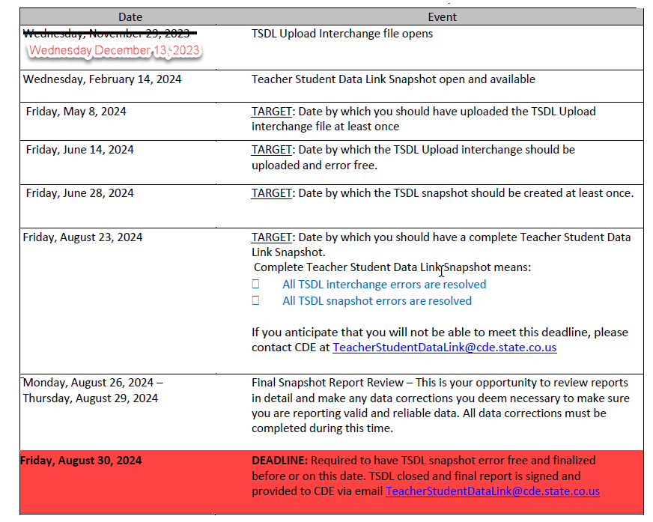
TSDL 2023-2024 Timeline
File layouts and information can be found here:
Teacher Student Data Link Interchange
Utilize first half of the year data to determine what errors you may have come June 2024.
Peter Hoffman
TeacherStudentDataLink@cde.state.co.us

Slide 17
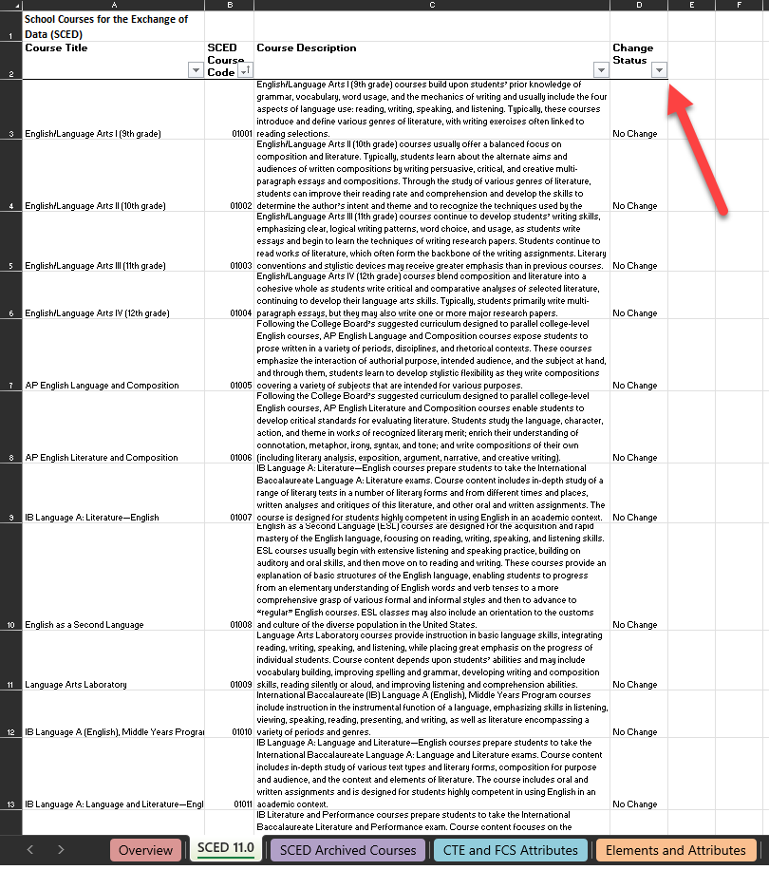
TSDL SCED Codes
Reminder: TSDL uses NCES SCED codes for State Course Codes
SCED 11 has 26 new courses!
The latest SCED code file can be found at either:
Teacher Student Data Link Interchange or
NCES SCED Codes
Peter Hoffman
TeacherStudentDataLink@cde.state.co.us

Slide 18
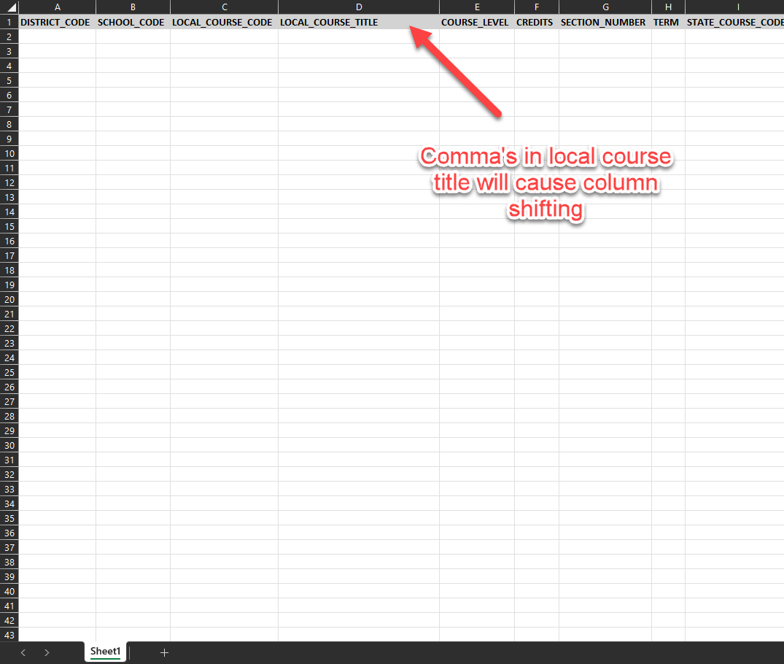
Common Errors
Archived SCED course code
Commas in the Local Course Title
Leading Zeros - if you must manually edit file after extract from SIS, help with keeping leading zeros can be found here.
Peter Hoffman
TeacherStudentDataLink@cde.state.co.us

Slide 19
Questions & Resources: TSDL
Peter Hoffman
720-925-8611
Teacher Student Data Link
TeacherStudentDataLink@cde.state.co.us

Slide 20
2023 Student End of Year Data Release
Reagan Ward

Slide 21
SEY 2022-2023 Data Release
Embargoed: Sent via email to SEY LEA Approvers and Users today (January 4, 2024)
May share this data internally with appropriate staff (e.g. Superintendent, District Accountability Contact, other administrative staff).
Public Release: Tuesday, January 9, 2024
CDE Communication office will issue a press release
SEY Respondents receive follow-up email from me
Data will be posted on the following websites:
Graduation/Completion Statistics Site
Dropout Statistics Site
Mobility/Stability Statistics Site
Student End of Year – Reagan Ward
StudentEndOfYear@cde.state.co.us

Slide 22
Wrapping up SEY 2022-2023
Thank you all for your hard work on this collection!
A survey to SEY Respondents is coming tomorrow (1/5/2024). I value your feedback!
How can we make the Student End of Year collection easier for you?
Update error/warning messages?
Automated emails misleading?
Training topics?
COGNOS report upgrades?
Please share your ideas with me! StudentEndofYear@cde.state.co.us
Student End of Year – Reagan Ward
StudentEndOfYear@cde.state.co.us

Slide 23
Looking ahead to SEY 2023-2024
Coming Soon: 2023-2024 Student End of Year
Timeline & Training Schedule: February 2024
Soft Open: March 2024
Initial Graduation Guidelines Upload Target Date: April 4, 2024
SEY Website Updates: February 2024 – May 2024
Official Open: May 2024
What can you do before the collection opens?
Regularly load student interchange files
Review COGNOS Reports
Review SEY Website Resources
DEM
SSA
GG
FAQs
General Information
Adequate Documentation
Graduation Guidelines Reports
Foster Student List
Migrant Student List
Short Byte Videos
Student End of Year – Reagan Ward
StudentEndOfYear@cde.state.co.us

Slide 24
Questions & Resources: Student End of Year
Reagan Ward
StudentEndOfYear@cde.state.co.us
720-484-9057
Student End of Year Webpage Student Interchange Webpage Graduation Guidelines Webpage

Slide 25
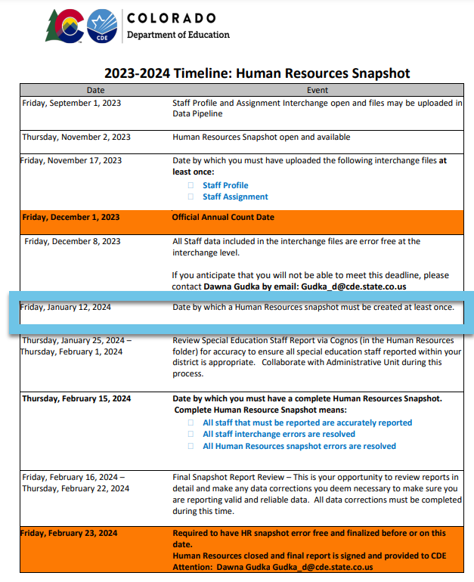
Human Resources Collection Timeline
Human Resources Snapshot Collection
Gudka_d@cde.state.co.us

Slide 26
Human Resources
Dawna Gudka

Slide 27
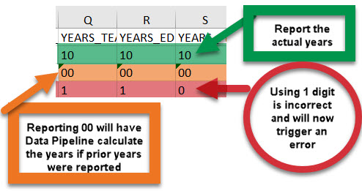
Human Resources Collection Staff Profile Interchange file
MUST CONTAIN TWO DIGIT NUMBER
Human Resources Snapshot Collection
Gudka_d@cde.state.co.us

Slide 28
Questions & Resources for Human Resources Collection
Collection Resources
Staff Interchange
Staff Profile File Layout
Staff Assignment File Layout
Human Resources Snapshot
Questions
Email: Human Resources
Dawna Gudka (303) 598-7901

Slide 29
Thank you for joining today!
Next Town Hall will be January 11th, 2024
Reminder: Please use our collection lead email addresses when reaching out with questions!

