Slide 1
2021 SBD Review Process Training
CDE Assessment Unit 2020

Slide 2
Outline
Overview of SBD review process
SBD step-by-step
Additional resources
Q/A

Slide 3
SBD Manual
Please download the SBD Manual! https://www.cde.state.co.us/assessment/trainings

Slide 4
Student Biographical Data Review Process
The SBD Review Process provides districts with an opportunity to verify the accuracy of student data after testing but prior to reporting and accountability calculations
Vendors provide portals for districts to use to validate data prior to testing.
Data used in the SBD review process comes from the vendor system after testing.
The exception is College Board (CO PSAT/SAT). College Board does not have a data portal. The SBD review process is the ONLY opportunity for a district to verify the accuracy of student data before or after testing.
The SBD review process can be used to validate/update student information that is not in the vendor portal. One example is SASID validation.
The SBD review process is not required BUT is highly recommended.
Requests for performance framework reconsideration or AMAO appeals will only be considered for districts that participate in the SBD review process.

Slide 5
SBD Collection Timeline
Access to the Data Pipeline SBD collections is controlled by the district Local Access Manager (LAM)
If you are unable to access Data Pipeline or do not see a SBD collection that you should have access to, contact your LAM
CDE cannot provide access for district users
The table below shows the dates and group code for each SBD Collection
Assessment |  | Tentative Dates | Data Pipeline Group
1 | ACCESS for ELLs | 4/12/21 – 4/21/21 | ACC
2 | CO PSAT/SAT | 6/8/21 – 6/17/21 | SAT
3 | CMAS ELA/Math (including CSLA) and Science/Social Studies CoAlt Science/Social Studies | 6/3/21 – 6/11/21 | CMS
4 | CoAlt DLM | 6/15/21 – 6/23/21 | DLM

Slide 6
SBD Support
SBD support is available by phone or email
CDE has a team that responds to emails and to phone calls. Please use the SBD Support phone number and email address. Do not contact a specific person at CDE.
Provides a single point of contact for all collections
Emails create support tickets that can be tracked to ensure that questions are answered quickly – Remember not to send student PII by email!
Members of multiple CDE units are available to answer different questions (Assessment, Accountability, and Information Management Systems)
Phone Number: 720-696-0185
Email address: sbdsupport@cde.state.co.us

Slide 7
SBD Review: Step-by-Step Guide

Slide 8
Step 1: Download Collection Specific Information
Find the collection on the Data Pipeline Website under Periodic Collections
http://www.cde.state.co.us/datapipeline
Download and review the SBD File Layout and Definitions
Provides the SBD file layout and collection specific instructions for each field
Download and review the Business Rules
Describes errors and warnings for the collection

Slide 9
Step 2: Log in to Data Pipeline
On the Identity Management website (https://cdeapps.cde.state.co.us/index.html), select Data Pipeline under Applications on the left side of the screen.
Enter your username and password
Check:
There is no red banner at the top of the screen
Your user role is correct
The collection you are working on appears on the left side of the screen
Most log in issues must be handled by your LAM

Slide 10
Step 3: Download a Vendor SBD Extract
Select File Extract Download for the appropriate assessment
File Type: Vendor File
Extract Type:
SBD Extract – Vendor demographic data (WIDA ACCESS and CMAS only)
SBD Extract using Student Profile – Student Interchange demographics
File Content Type:
Excel: If you are using Excel for data review use this
CSV: Comma delimited
Text: Fixed format (not available for all collections)

Slide 11
Step 4: Upload Vendor SBD Data Extract
Upload prior to editing the file
Allows access to COGNOS reports
Error Summary
Error Detail
The number of errors found can help guide data clean up and give a sense of how much work needs to be done on the file
Activates the Edit Records screen
Select File Upload -> Data File Upload
Choose file and submit
Emails:
Submission Notification
File Upload Summary

Slide 12
Step 5: Review Errors and Warnings
The number of errors and warnings are available in three places
Validation Report
Pipeline Report
COGNOS Error Summary Report
Identifying specific records with errors can be done in three places
COGNOS Error Detail Report
Download as an excel file to review
Pipeline Report – View Details
Same layout as the Error Detail Report
Edit Records Page
Choose records with errors and warnings
Fields with errors will be red, warnings will be yellow

Slide 13
Step 6: Correct Data Errors
Correcting errors using the Vendor SBD Extract File
Open the vendor file in your chosen program
Update data in records with errors
Start with SASID errors
SAT/PSAT Missing SASID report
Use the Data File Layout and Field Definitions and Business Rules document to figure out how to correct the data
Business rules will explain errors, for example “Date First Enrolled US cannot be blank”
Upload the file periodically to check your progress
Once you are down to just a few errors it may be faster to use the Edit Records screen

Slide 14
Step 6: Correct Data Errors (Continued)
Correcting errors using the Edit Records page
On the Edit Records page select the appropriate drop downs
Check the box next to record you would like to edit
Correct the data in the fields highlighted in red
Click Save to save the edits

Slide 15
Step 7: Data Validation
Data Pipeline can only check for certain types of errors
It cannot check that your demographic data is accurate (i.e., that a student is actually Hispanic or not)
It cannot validate that students have the correct invalidation codes
The Data File Layout will have instructions for how to select the appropriate invalidation
Do not change/make up data just to clear errors!
If you have a lot of missing data, check a different extract
Maybe the interchange data or vendor data is better
Making up data can cause issues with reporting and accountability
If you have an error that cannot be cleared, but the data is correct contact SBD Support
Warnings
Warnings are used to inform users of situations that may indicate errors but not necessarily (more than 10% Native American)
Warnings do not prevent data submission

Slide 16
Step 7: Data Validation (Continued)
Download the COGNOS SBD Summary Report
Compare your district summary numbers to last year’s final data
Large changes in the number of students in a category could indicate a coding error or incorrect data submitted to the Interchange or vendor system
Review Invalidations
Check for students who were invalidated who may have scores
Check that Parent Excuses are correctly applied
CMAS has a calculated invalidation code to combine all the different fields that go in to determining the invalidation
College Board assessments have invalidations bubbled by the schools so it is important to double check that they have been correctly applied
DLM - Some districts have chosen not to apply Parent Excuses in the vendor system, make sure you review with your DAC if you are expected to add these during SBD

Slide 17
Step 8: Submit SBD Data
Download your final SBD extract for your records
This is especially important if you use the Edit Records page
Select Status Dashboard under the appropriate assessment collection
Review the data on the Status Dashboard to make sure you are ready to submit
Validation Errors and RITS Errors must be zero unless SBD Support has ignored errors
If errors are ignored you must submit without making any additional changes or uploading a new file or it will reset the ignore errors status
Click Submit to CDE and Yes in the pop-up window
If you need to make additional changes after submission SBD Support can unlock your data

Slide 18
Moving Students
All SBD collections allow a district to move students between schools within their district
Moving between districts is collection specific
WIDA ACCESS and CMAS – submit a Failsafe document to CDE through Syncplicity
CO PSAT/SAT - Do Not send a Failsafe
The SBD layout will include the Pre-ID and Testing District and School
If these do not match, the Responsible District and School will be filled in with your district
Both districts will see the student records and have a chance to review the data and agree on the appropriate Responsible District and School (CDE will monitor students submitted with conflicting Responsible Districts and will contact the data respondents)
DLM – Do Not send a Failsafe
The SBD layout includes the Responsible and the Testing School
Responsible school is updateable
If you are moving a student out of your district, contact the receiving district to make sure that they are aware of the student and agree to the move (CDE will also verify moves against RITS and Interchange data)

Slide 19
COGNOS Reports

Slide 20
Troubleshooting
See the SBD Manual for common issues and trouble shooting techniques
Users generally have issues at three different points in the SBD process
Logging in to Data Pipeline
Generally these issues must be resolved by the district LAM
CDE cannot change or grant user permissions
Uploading a Data file
This is usually an issue with the file format, see the manual for common issues and how to identify them
Clearing Errors
Usually the Data File Layout and Definitions and Business Rules documents are enough to identify why an error is occurring
If you think an error is triggering incorrectly, contact SBD Support

Slide 21
Additional Resources

Slide 22
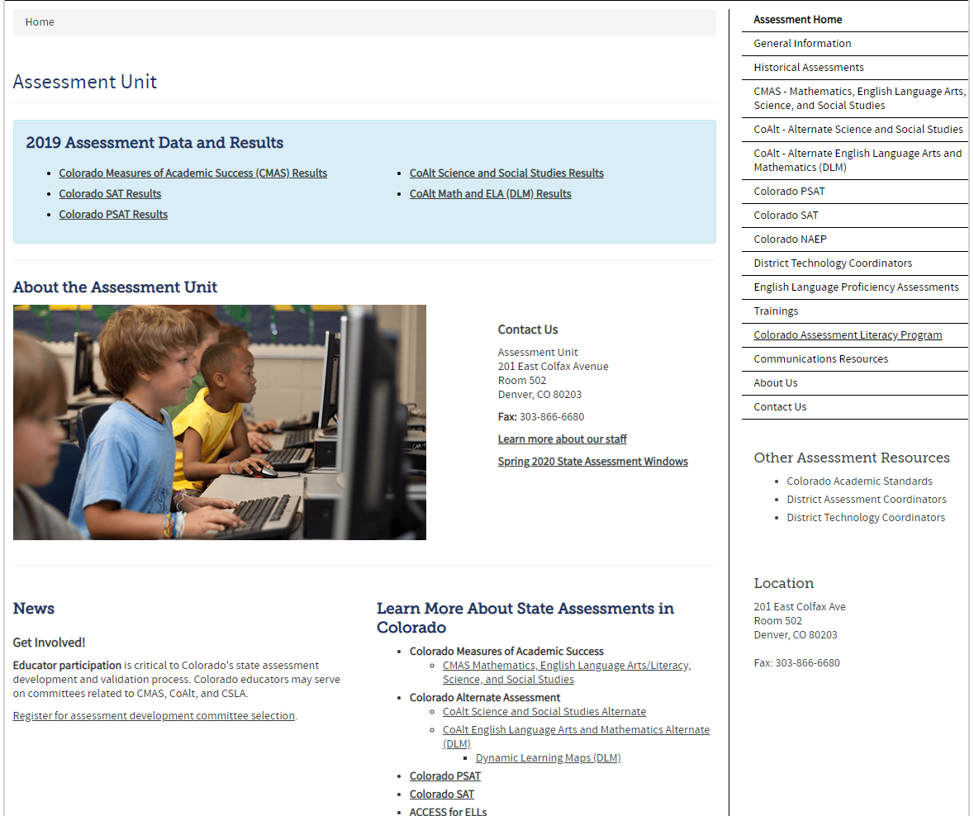
Assessment Unit Homepage
https://www.cde.state.co.us/assessment

Slide 23
Invalidation Instructions
Instructions for applying invalidations during SBD are in the File Layout and Definitions documents
There are also instructions for applying invalidations in the assessment materials with details on the appropriate uses of each code
ACCESS for ELLs – Colorado Specific Information
http://www.cde.state.co.us/assessment/coloradospecificaccessinformation1118
CMAS Procedures Manual
http://www.cde.state.co.us/assessment/cmas_coalt_proceduresmanual_sp21
CO SAT/PSAT – School Day Supervisor Manual
https://collegereadiness.collegeboard.org/pdf/co-sat-sd-coordinator-manual.pdf
DLM – DLM Special Circumstance Codes
http://www.cde.state.co.us/assessment/dlmspecialcircumstancecodes

Slide 24
COVID-19 Invalidations
For 2020-2021 school year we have added an invalidation code for students who did not test due to COVID-19
It should only be used for students who did not test because they were not attending school in-person either due to school not being in-person or the family choosing not to attend in person
Students who only stay home for the test would be considered standard Parent Opt-outs

Slide 25
Questions?
Questions?
If you have questions before the SBD Window opens please contact:
Jasmine Carey (carey_j@cde.state.co.us)
During the window please use the SBD Support contact:
sbdsupport@cde.state.co.us, 720-696-0185

