Slide 1
March 20th, 2024
Student Discipline Training
Dawna Gudka-Collection Lead

Slide 2
Today's agenda, March 20th, 2024
Townhall
Discipline Resources
Collection Timeline
How file layouts work
Behavior Codes
Data Pipeline Process
Collection Resources
Why the change

Slide 3
Townhalls
Every Thursday from 9-10AM Data Services Unit host Townhall
Upcoming Townhalls and Trainings
Archived Townhall Presentations
Email DATASERVICES-subscribe-request@cdelist.cde.state.co.us to sign up for weekly town hall email reminders.

Slide 4
Student Discipline Snapshot Collection-HB22-1376 passing
The Discipline Interchange updates the Special Education Discipline Interchange file with data fields required per HB22-1376 which includes data previously collected in the periodic files for the School Discipline files (Discipline by Action, Discipline by Demographics and Firearm Data). The updated Discipline Interchange file process will start in the 2023-2024 school year and will contain one file: the Discipline Action File. In the file, all students who were disciplined during the reporting school year will be reported. This information is used in the Student Discipline Snapshot for all students and Special Education Discipline snapshot for students with an active IEP.

Slide 5
Student Discipline Changes
2023-2024 Discipline is now collected at the Student level
This collection is now a Snapshot collection
What does that mean?
One discipline interchange file 2023-2024 Student Discipline File Layout
Plus, the student demographics interchange file 2023-2024 Student Demographics File Layout
And the Student School Association file 2023-2024 Student School Association File Layout
will make up the Student Discipline Snapshot Collection
Student Discipline
Student Discipline Snapshot

Slide 6
Student Discipline collection
The purpose of the Discipline Action File is to capture the students disciplined, including the type of behavior and the resulting disciplinary action taken for each disciplinary incident.
Only report the incidents occurring for the current school year
2023-2024 is scheduled as a reporting year for the Office of Civil Rights collection (Civil Rights Data Collection aka CRDC)

Slide 7
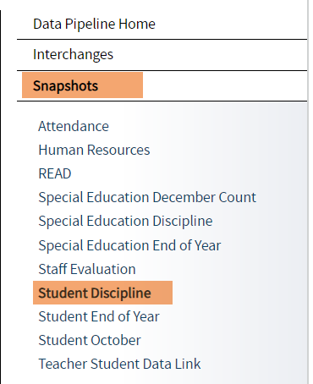
Student Discipline websites
2023-2024 Discipline Interchange Website
2023-2024 Student Discipline Snapshot Website
Student Discipline
Student Discipline Snapshot

Slide 8
Student Discipline Snapshot Collection Process at a Glance
Discipline Interchange file
Student Demographics file
Student School Association
Student Discipline Snapshot

Slide 9
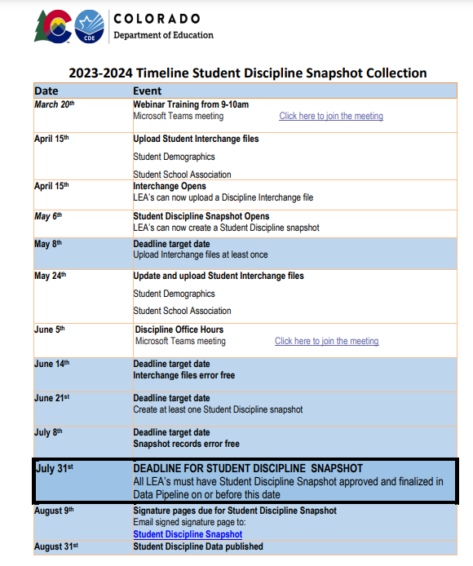
Student Discipline Timeline
Student Discipline
Student Discipline Snapshot

Slide 10
Staff Interchange-website
Discipline Interchange File layout

Slide 11
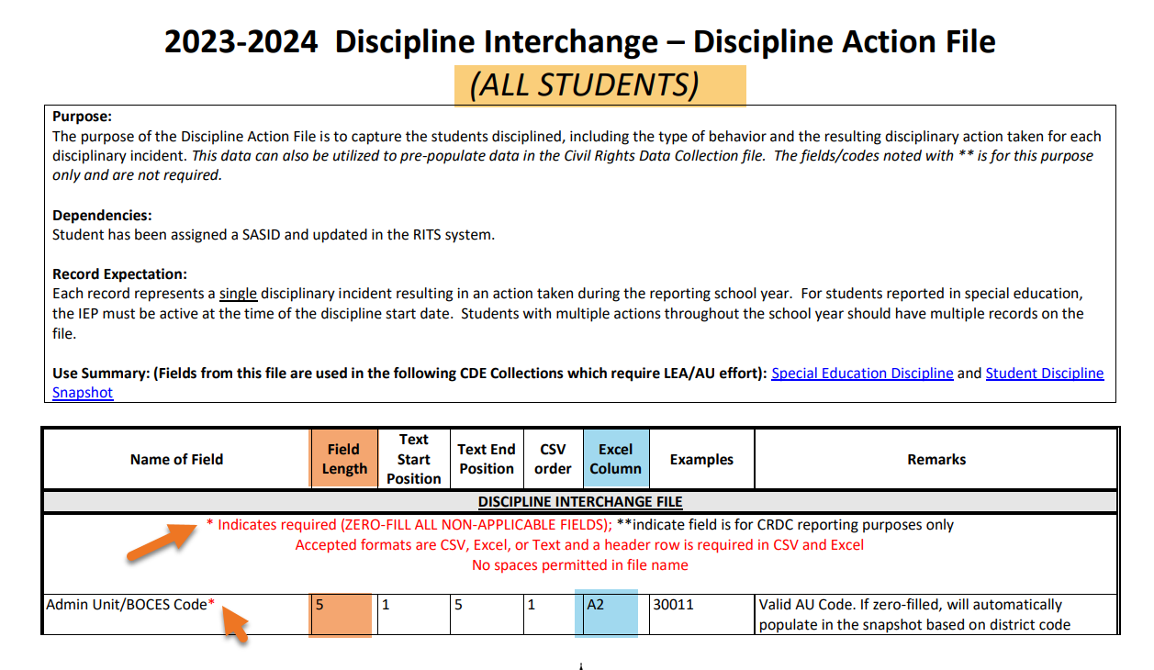
Discipline Action Interchange file layout
Discipline Interchange File layout

Slide 12
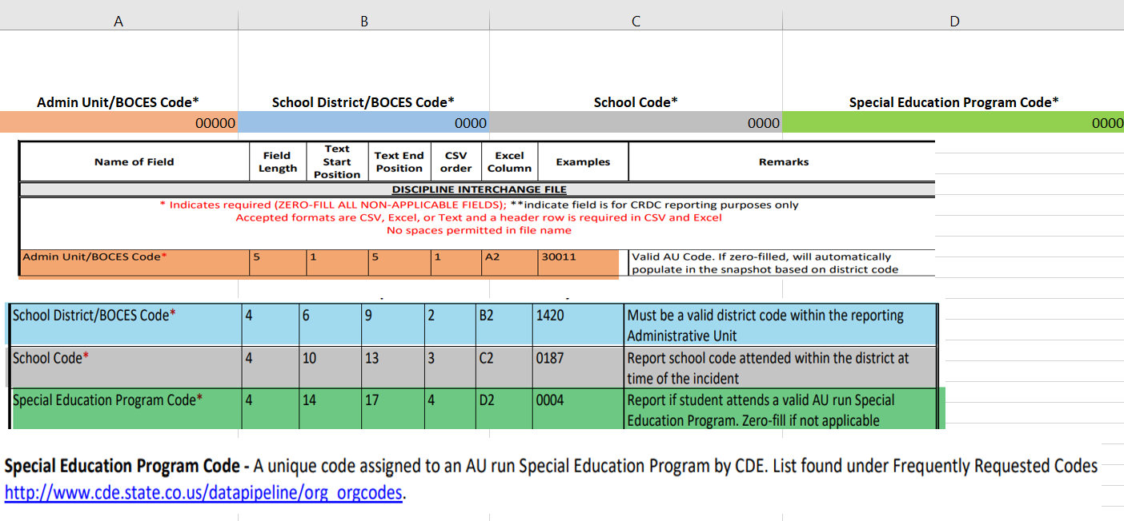
Discipline Action Interchange file layout What data elements are needed
Discipline Interchange File layout

Slide 13
Discipline Action Interchange file layout data needed
Discipline Interchange File layout

Slide 14
Student Discipline Behavior Codes
01 Drug Violation Use
02 Alcohol Violation Use
03 Tobacco Violation Use
04 1st, 2nd Degree or Vehicular Assault
05 Dangerous Weapons Carrying
06 Robbery
07 Other Felony
08 Disobedience/ Defiant or Repeated Interference
09 Detrimental Behavior
10 Destruction of School Property
11 Bullying
12 Other Violation of Code of Conduct
13 3rd Degree Assault/Disorderly Conduct
14 Marijuana Violation
15 Sexual Violence/ Battery (other than Rape)
16 Rape or Attempted Rape

Slide 15
Student Discipline Behavior Codes- CRDC Codes This data can also be utilized to pre-populate data in the Civil Rights Data Collection file. The fields/codes noted with ** is for this purpose only and are not required.
17 Threats of Physical Attack**
18 Allegations of harassment or bullying on the basis of sex**
19 Allegations of harassment or bullying on the basis of race, color or national origin**
20 Allegations of harassment or bullying on the basis of disability**
21 Allegations of harassment or bullying on the basis of sexual orientation**
22 Allegations of harassment or bullying on the basis of religion**
31 Reported as Harassed or Bullied on the basis of Sex**
32 Reported as Harassed or Bullied on the basis of Race or Color or National Origin**
33 Reported as Harassed or Bullied on the basis of Disability**
41 Disciplined for Bullying or Harassment on the basis of Sex**
42 Disciplined for Bullying or Harassment on the basis of Race or Color or National Origin**
43 Disciplined for Bullying or Harassment on the basis of Disability**

Slide 16
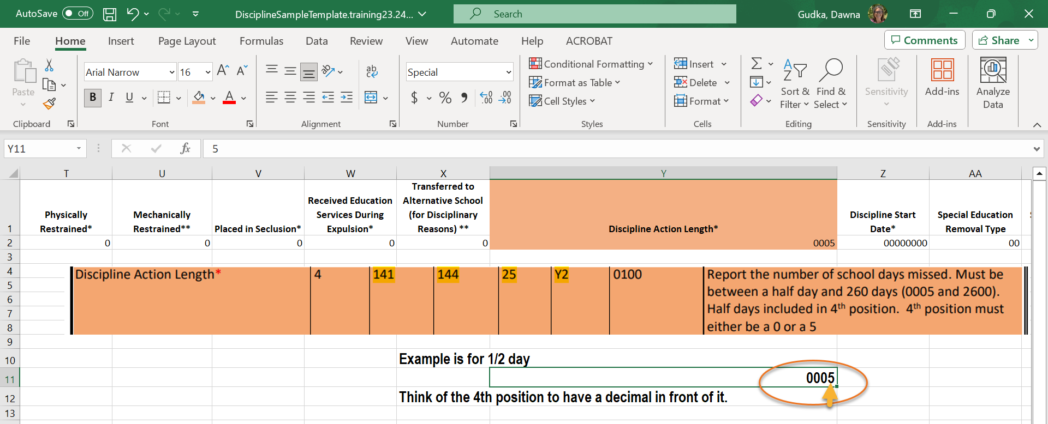
Student Discipline-Discipline Action Length

Slide 17
Data Pipeline Process

Slide 18
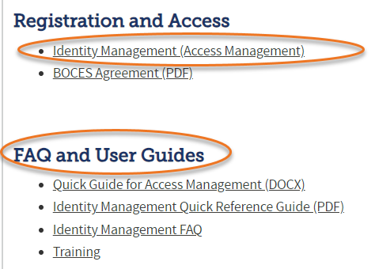
Data Pipeline Roles in the Identity Management (idM) Roles
Identity Management (IdM)
Student Interchange Roles
STD-VIEWER
STD-LEAUSER
Discipline Interchange Roles
DIS-LEAVIEWER
DIS-LEAUSER
Discipline Snapshot Roles
STU-LEAVIEWER
STU-LEAUSER
STU-LEAAPPROVER
*Note: can only have 1 role under each role category
or you will get locked out of Data Pipeline

Slide 19
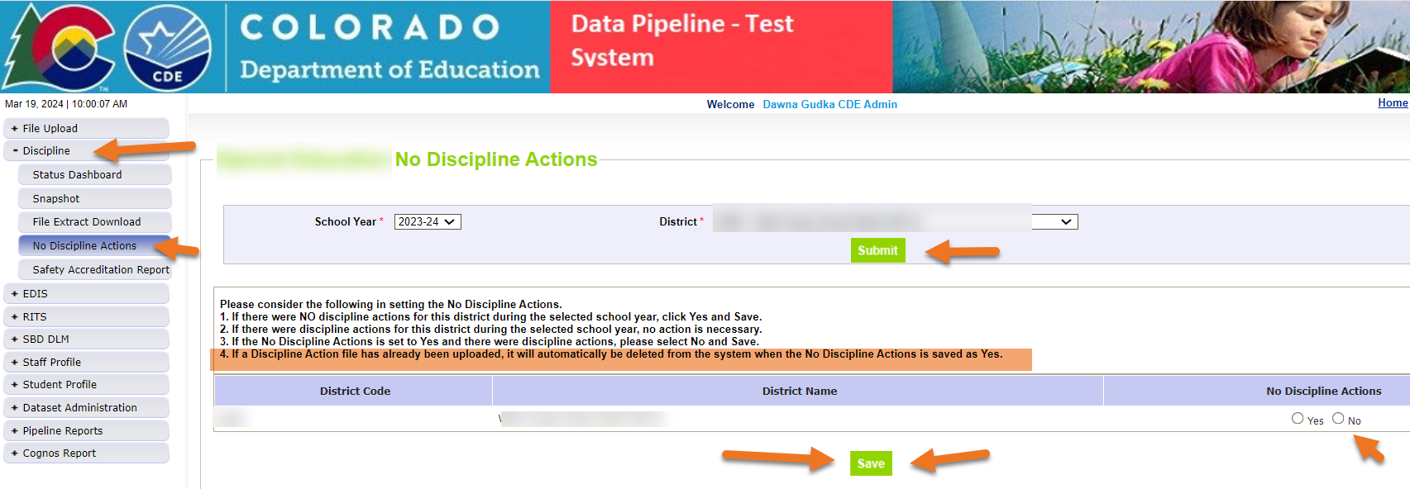
Data Pipeline Process If there are no incidents to report, the corresponding file(s) are NOT uploaded into pipeline

Slide 20
Interchange files need to be uploaded into Data Pipeline
Student Demographics interchange file
Student School Association interchange file
Discipline Interchange file

Slide 21
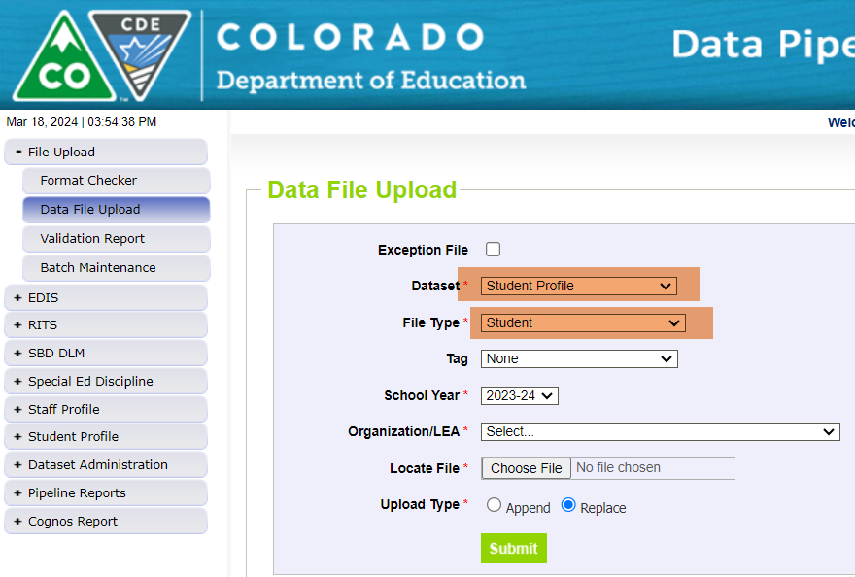
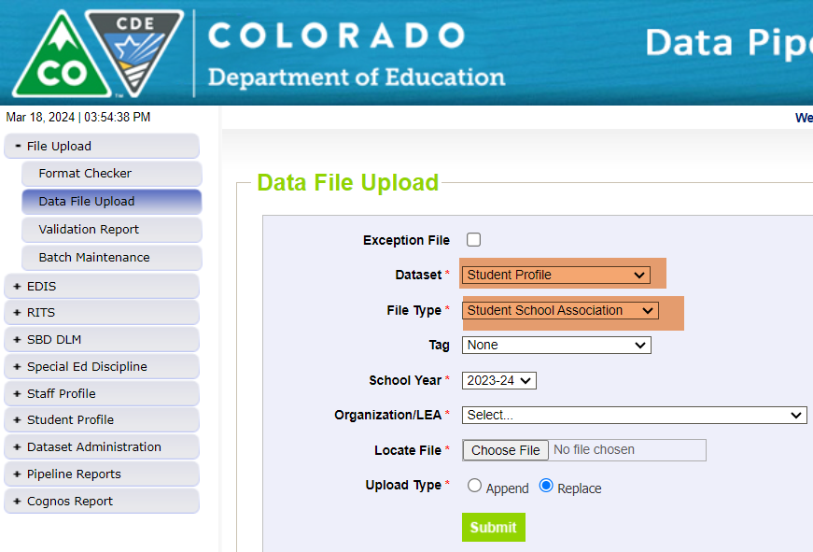
Interchange files need to be uploaded into Data Pipeline Student Profile Demographics and School Association file

Slide 22
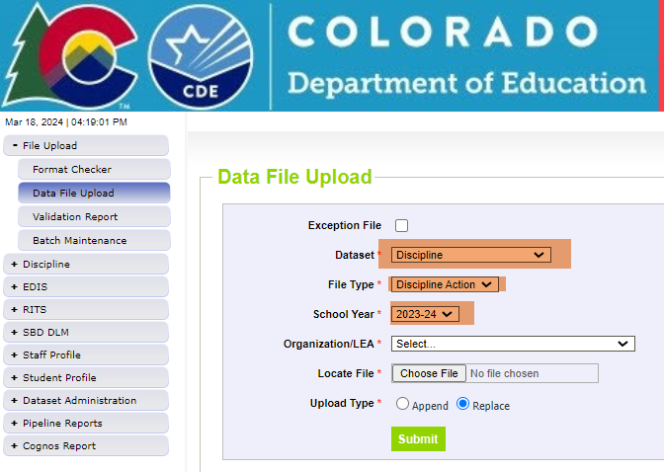
Interchange files need to be uploaded into Data Pipeline Discipline Interchange file

Slide 23
Discipline Action Interchange file Checking for Student Discipline Interchange errors
Then click on View Details to see the errors in Detail

Slide 24
Creating a Student Discipline Snapshot
Creating a snapshot in Data Pipeline-by clicking on the create snapshot button Data Pipeline merges all 3 interchange files together pulling in the Snapshot records

Slide 25
Interchange files Checking status of snapshot

Slide 26
Data Pipeline Checking for Student Snapshot errors
Then click on View Details to see the errors in Detail

Slide 27
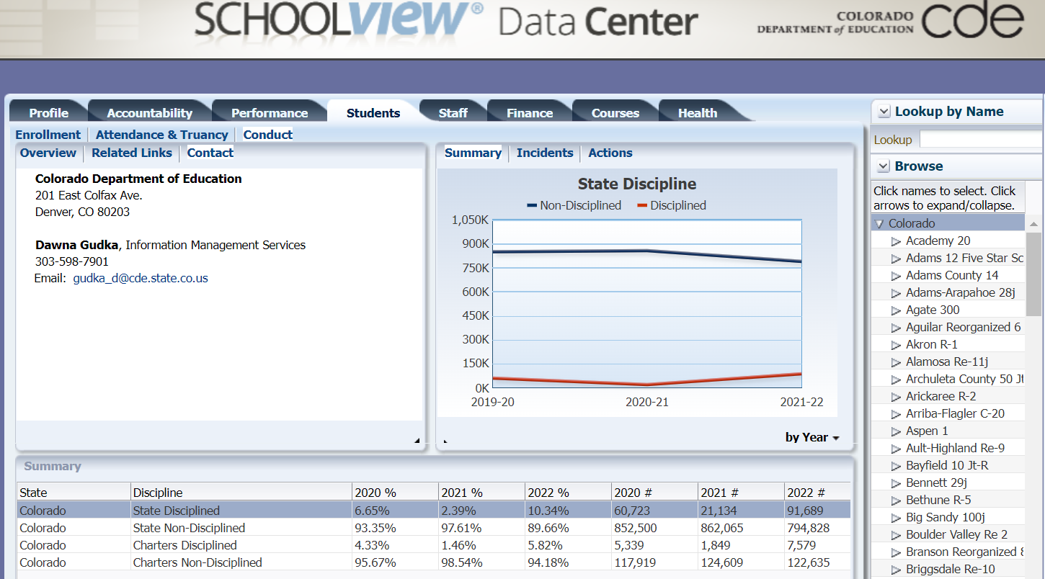
Published Staff Data-School View, Data Center
School View

Slide 28
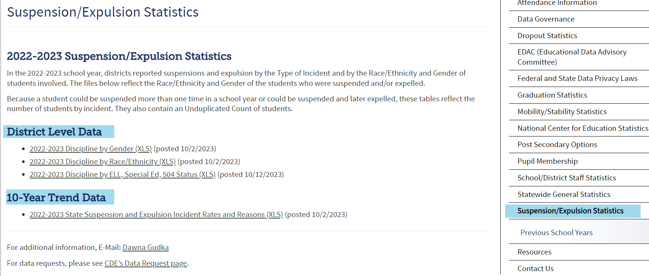
Published Staff Data-published reports
Posted Data

Slide 29
What is PII?
Student Personally Identifiable Information (PII) is defined by state and federal laws as information that, alone or in combination, personally identifies an individual
This includes direct identifiers (i.e. student and staff names, SASID, EDID, etc.)
Includes information that when combined is identifiable
Colorado’s Student Data Transparency and Security Act outlines requirements for how Student PII is collected, used and shared
CDE has prepared guidance on how to comply with this and other privacy laws which can be found here.

Slide 30
Sharing Data
Use secure methods to transfer any PII to CDE
Contact Data Collection leads with questions about how to transmit PII securely
Each Data Collection leads maintains their own Syncplicity folders for specific collections, reach out to the collection lead for access
Use Syncplicity to encrypt emails to CDE
Avoid sending PII via unencrypted email or to unsecured faxes when sharing data between or within districts
Use Syncplicity to encrypt emails to CDE
Check local policies for restrictions, requirements, etc. regarding PII
Do not use PII in trainings, presentations, etc.
Do not share PII with unauthorized individuals
Do not share passwords
Follow local policies when transmitting PII to any third party

Slide 31
QUESTIONS
Student Discipline Collection Questions
Email assistance Student Discipline Snapshot Collection Support
(303) 598-7901
Dawna Gudka-Collection Lead
Special Education Discipline Questions
Email assistance SPED Discipline Snapshot
Lindsey Heitman- Collection Lead

