Slide 1
Special Education Discipline Office Hours 2023-2024
May 23, 2024
Lindsey Heitman
SpedDiscipline@cde.state.co.us

Slide 2
Welcome
Welcome and thank you for joining today!
Data Services Contacts:
Lindsey Heitman – SpedDiscipline@cde.state.co.us
heitman_l@cde.state.co.us 303-866-5759
Sped Discipline Snapshot Collection manager
Data Pipeline submission for Sped Discipline Snapshot
Please include the below items in emails and thank you ☺
District code #/AU code #
Any error code #’s that you have questions about
Any school code #’s referenced
Slides and recording will be posted under the Trainings section on both webpages:
Discipline Interchange
Special Education Discipline Snapshot

Slide 3
Updates/Reminders
If you created a snapshot between 5/14-5/21, you may see invalid SD005 and SD009 errors. Please create a new snapshot as of 5/22 to fix!
Small Change this week- if incident took place at a Sped Program, please report both the Sped Program Code AND the student’s School Code where they are enrolled.
The School Code is needed for the Student Discipline Snapshot because they do not collect the Sped Program Code field.
Use District Activity Report and Discipline Action status screen to help you determine Interchange file status
The timing of activity related to this collection can cause lots of errors, so it’s important to know where you can check the status of the various files!

Slide 4
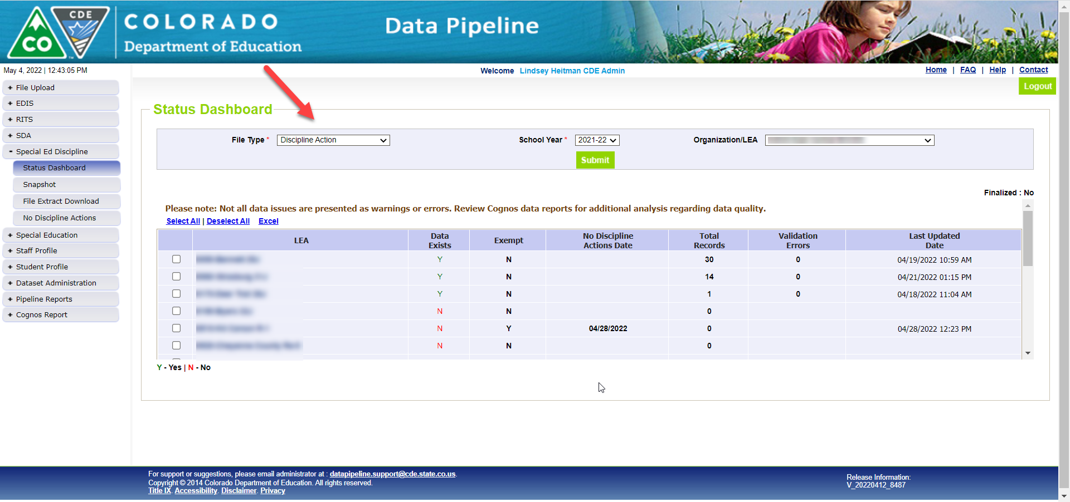
Helpful status screen for AU respondent to see file upload status of their district(s)
AUs can see the file status of all their member districts under:
Special Ed Discipline/Status Dashboard by filtering on File Type: Discipline Action

Slide 5
District Activity Report – Helpful for AUs to determine status of Interchange files

Slide 6
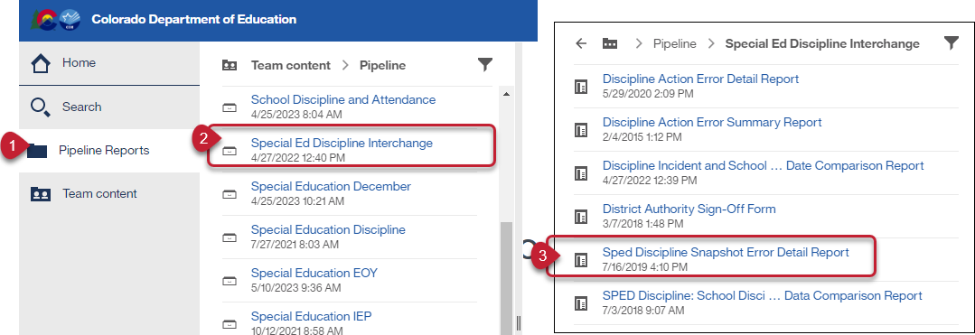
Special Education Discipline: District Report For Viewing Snapshot Level Errors (DIS role)
This report allows the district respondent to see the Sped Discipline Snapshot errors.

Slide 7
Special Education Discipline Snapshot: Snapshot Edits
The edits at the snapshot level contain data extracted from multiple interchanges and generally mean the data is missing from or needs to be adjusted in the interchange file.
Error Code | Error Type | Message
SD024 | Error | The Discipline Date in the Sped Discipline Action file must fall between the Dates of Entry and Exit of Special Education in the IEP Participation file. If this was the case at one point but the student's circumstances changed later in the school year, please submit an exception request.
SD017 | Error | The Grade Level field pulls from the Student Interchange-Student School Association (SSA) file and is missing from your snapshot. It is missing because either a record with a School Code matching the one reported in your Discipline Action file could not be found in the SSA file OR the Incident Date does not fall between the School Entry and Exit Date in the SSA file. Please check the Cognos Sped Incident and School Enrollment Date Comparison Report for details and adjust your file(s) as necessary.
SD009 | Error | At least one racial category must be selected for each student in the Student Interchange - Student Demographic File.
SD005 | Error | LASID must be included in the snapshot. This field is blank because a matching student record could not be found in the Student Interchange -Student Demographic File.
SD018 | Error | Primary Disability must be included in the snapshot. This field is blank because a matching student record could not be found in the Participation file in the Special Education IEP Interchange.
Record may be missing from Participation file OR Discipline Start Date does not fall between the Sped entry/exit dates in that file. The data may need to be adjusted in that file OR an exception request may be needed if dates are correct, and student left AU and returned later in the year.
Record may be missing from Student Dem file OR last untagged Student Dem file was processing OR file didn’t process successfully
Record may be missing from Participation file OR last Participation file didn’t process successfully
SpedDiscipline@cde.state.co.us
Special Education Discipline – Lindsey Heitman

Slide 8
Special Education Discipline Snapshot Error Code SD017
Troubleshooting Snapshot Error SD017 – snapshot needs a valid grade level to pull from district SSA file. Error indicates misalignment with the School Codes, Entry Dates, or Incident Date. First Check this Cognos Report:
This error will trigger until district untagged SSA file is uploaded and successfully processed
Use ‘District Activity Report’ to verify interchange file status.
Report found in Special Ed Discipline cognos folder
This cognos report can help you determine what the issue is. Report will only contain data IF you have error SD017. You will not see your district code listed in the filter box as an option if you don’t have error SD017 at the snapshot level.
School code must match between Student School Association file and Discipline Action file
Incident Date must fall between the School Association file School Entry and Exit dates
The school code reported should be the school where the incident took place
SpedDiscipline@cde.state.co.us
Special Education Discipline – Lindsey Heitman

Slide 9
Special Education Discipline Snapshot Timeline
Timeline:
May 1, 2024 - SPED Discipline Snapshot official open
May 23, 2024 - All Interchange files that feed into snapshot uploaded or updated at least once
June 27, 2024 - Interchange errors resolved – Discipline Action File, Child File, Participation File
August 15, 2024 - All Exception requests submitted to CDE processing
August 22, 2024 - Snapshot error-free
Aug. 22 – Aug. 29, 2024 - Report Review
August 29, 2024 - Final Submission approval in Data Pipeline and reports uploaded to DMS.
SpedDiscipline@cde.state.co.us

Slide 10
Questions or Concerns
If you have any questions about the Special Education Discipline Data Collection, please reach out!
Lindsey Heitman SpedDiscipline@cde.state.co.us Sped Discipline Snapshot Collection Manager
heitman_l@cde.state.co.us
(303) 866-5759
Dawna Gudka StudentDiscipline@cde.state.co.us Student Discipline Snapshot Collection Manager

