Slide 1
Special Education IEP Interchange: Data Pipeline
Lindsey Heitman
Data Services Unit
Special Education December Count and EOY Collection Contact

Slide 2
Topics Covered
Overview of terms, website, town hall details, Syncplicity- slides 3-7
Special Ed IEP Interchange– slides 8-17
What’s New – slides 18-19
Special Ed December Count and EOY Snapshots – slides 20-26
Who to Report – slides 27-32
Accessing the Data Pipeline – slides 32-39
Data Pipeline Process –slides 40-52
December Count Timeline – slide 53
December Count Reminders – slides 55-56

Slide 3
Glossary of Terms
Term | Definition
Cognos | A type of report in which the user can view applicable reports that are formatted in a user-friendly environment
Data Pipeline | A streamlined approach to efficiently move required education information from school districts to the CDE
ESSU Data Management System | The Data Management System (DMS) is a single sign on system that assists AUs in meeting accountability requirements for Special Education and Gifted Education.
Interchange | The data holding place in the Data Pipeline. A method of providing data to CDE in which LEA’s may choose from multiple file formats to submit data throughout the year.
LAM | Local Access Manager responsible for assigning the appropriate access to CDE applications
LEA | Local Education Agencies
IdM | Identity Management. A single sign on system, allowing the user to navigate between the applications without entering user ID information a second time.
Snapshot | A date in time when data is pulled from the appropriate interchanges, validated by additional business rules, and approval given that signifies it was accurately reported for a specific point in time by an LEA

Slide 4
Website Overview - https://www.cde.state.co.us/datapipeline
IEP Interchange Resources
Special Education December Count and EOY Resources
To Login to the Pipeline System
click here:
Codes – frequently used codes found here (AU codes, school codes, Special Education program codes, Allowed Eligible Facility codes)
All collection dates, Mandatory Collections- legislation and uses, converting csv files to excel, etc.

Slide 5
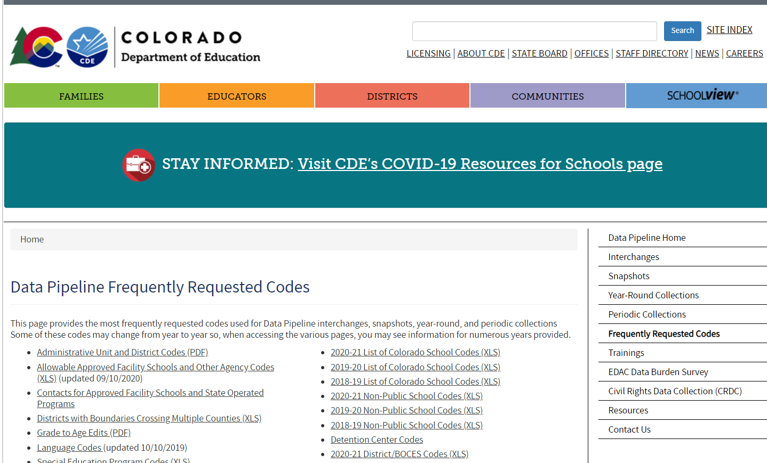
Frequently Requested Codes: School Codes, AU Codes, Sped Program Codes, Approved Facility School Codes, etc.
Found at this link:
http://www.cde.state.co.us/datapipeline/org_orgcodes

Slide 6
Weekly Data Pipeline Town Hall Webinars
Every Thursday from 9-10 am during the school year and every other Thursday during the summer
Updates on open and upcoming data collections
Ask questions via chat
Find archived town hall slides and recordings here: http://www.cde.state.co.us/datapipeline/datapipelinetownhallpresentations
Login Information:
Microsoft Teams meeting
Click here to join the meeting

Slide 7
Syncplicity – How to Share Personally Identifiable Information
Syncplicity is an online platform used for secure file sharing. A web browser is all that is needed to access and securely share files. Districts should always follow local policies when distributing secure files. Any communications that contain sensitive student or educator data or personally identifiable information (PII), including but not limited to student/educator name, State Assigned Student Identifier Numbers (SASID) and State Assigned Educator Identifier Numbers (EDID), and demographics, should be sent to CDE through Syncplicity. This information must not be emailed.
http://www.cde.state.co.us/datapipeline/syncplicityinstructions
Submit exception requests and error questions that contain PII to Syncplicity –
Let us know if you do not yet have a folder. We will send you email with a link to set it up.
Once a file has been shared you can access Syncplicity at: my.syncplicity.com
File name is your AU code
Used for Exception requests, questions that include PII, facility student information, etc
Please email CDE to notify us you’ve placed something in the folder. We aren’t automatically notified when you’ve saved something in your Syncplicity folder.

Slide 8
Interchanges
An interchange is a holding place for your data in which you may continually upload and validate your data files throughout the year.
There are 6 Interchanges
Special Education Discipline
Special Education IEP
Staff
Student
Teacher/Student Data Link
Title 1
http://www.cde.state.co.us/datapipeline/inter_interchanges
Data from the Interchanges in orange are included in the Special Education December Count Collection.

Slide 9
December Count: Special Education IEP Interchange Resources
http://www.cde.state.co.us/datapipeline/inter_sped-iep
At this link you will find:
Timelines
File Layouts
Templates
Business Rules
Training Slides/ Webinars
Additional Resources

Slide 10
Special Education IEP Interchange – 2 Files
Child File
Demographic information
1 record per student
The primary source of this information is the Student Interchange Student Demographic File -Untagged File
If student is not required to be submitted in the Student Interchange (Part C, private school, or facility students) the demographic data is pulled from this file into the snapshot
Participation File
Special Education services information
1 record per student
Record should reflect a student’s latest Sped status within the reporting period
The primary source of the Entry Grade Level field is the Student Interchange Student School Association File- Untagged File
If student is not required to be submitted in the Student Interchange (Part C, private school, or facility students) the Grade Level is pulled from this file
Each record must have a valid SASID and/or a LASID
Each record must have matching record/SASID and/or LASID combo on both files
LASIDs should match district

Slide 11
Special Education IEP Interchange
The Special Education IEP Interchange is a set of two files which contain Special Education data for the school year:
Special Education Child File
Student demographic information
The demographic data pulls primarily from the Student Demographic File
If student is not required to be submitted in the Student Interchange (i.e. Part C, private school, or facility students) the demographic data is pulled from this file into the snapshot
Special Education Participation File
Special Education services and referral information
Grade Level is included in this file but pulls into each snapshot primarily from the Student School Association file
If student is not required to be submitted in the Student Interchange (i.e. Part C, private school, or facility students) the Grade Level is pulled from this file

Slide 12
Screen Shot of the Participation File Layout
PLEASE NOTE:
Student’s LASID should match the LASID reported by the district for that student in the Student Interchange
Each record’s sasid/lasid combo must match the Participation file record in order to be pulled into the snapshot(s)

Slide 13
Participation File Layout Screenshot Continued
What’s included in the file layout?
Dependencies and record expectation
Name and Order (format) of the fields
Number of characters in each field
Examples and remarks that help clarify
Data field name, definition, and applicable codes for each field provided below the ordered format
Changes listed at bottom of layout and highlighted or crossed out in the name and definitions

Slide 14
Special Education Participation File Layout
Field Name
Field Definition
All applicable codes and their definitions for the field

Slide 15
Screen Shot of the Child File Layout
PLEASE NOTE:
Student’s LASID should match the LASID reported by the district for that student in the Student Interchange
Each record’s sasid/lasid combo must match the Participation file record in order to be pulled into the snapshot(s)

Slide 16
Child File Layout Screenshot- Continued
What’s included in the file layout?
Dependencies and record expectation
Name and Order (format) of the fields
Number of characters in each field
Examples and remarks that help clarify
Data field name, definition, and applicable codes for each field provided below the ordered format
Changes listed at bottom of layout and highlighted or crossed out in the name and definitions

Slide 17
File Upload Tips
Refer to the File Layout and Definitions document for details on each file
Excel, CSV, or Text formats are accepted
Excel templates for Child and Participation Files posted on the IEP Interchange page under Templates (if needed)
No blank fields (it likely won’t upload if there are blanks)
Be sure the file is not open when uploading it
Be sure each field has the correct number of bytes
PLEASE BE AWARE OF THIS ISSUE WITH CSV Files
CSV files lose leading zeros within a data field after opening. A file will not upload/process successfully unless the field has the correct number of bytes so any field that could start with a zero will not have the correct number of bytes unless you format it to text in order to retain those leading zeros. Find steps for converting it to text posted here.
Create a folder to save your files in.
Use a simple versioning process to keep track of the files uploaded.
Create an email folder for handling the Data Pipeline System Generated Emails as you will need to refer to them throughout the Data Pipeline Process.

Slide 18
Special Education IEP Interchange 2023-2024 Changes
Participation File Changes:
Remove Path 1 data/referral fields:
Date Referred for Part C Evaluation
Date of Parental Consent to Evaluate Part C
Date Evaluation Completed Part C
Reason for Delay in Completing Evaluation Part C
Eligibility and Services- Path 1
Remove Special Education or Part C Referral Codes of 01, 04, and 05
Remove Primary Disability code 12 – Infant/Toddler with a Disability
Add new Gender code 03 (non-binary) and adjust current codes 01 and 02 definitions
Adjust “Basis of Exit” field name to “Sped Basis of Exit”
Adjust “Pupils Attendance Information” field name to “Sped Pupils Attendance Information”
Adjust “Special Education or Part C Referral” field name to “Special Education Referral Type”
Child File Changes:
Add new Gender code 03 (non-binary) and adjust current codes 01 and 02 definitions.
Special Education EOY - Lindsey Heitman - heitman_l@cde.state.co.us (303) 866-5759

Slide 19
New AU Reporting Requirement for 23-24 School Year
Medically Necessary Services Access
AUs must report # of requests for access to students for medically necessary services
Beginning 7/01/2024, the AU must report to CDE the number of requests during the 23-24 school year for access to a student by a private healthcare specialist and whether the access was authorized or denied.
Starting in January 2025, CDE must make this information available online.
Each AU must report to CDE the total counts for the following (no student level information is needed):
# of requests for access to a student for medically necessary services
# of those requests authorized
# of those requests denied
These counts will be collected in a new input screen (ready by July 2024) within the Data Pipeline under the IEP Interchange. ‘SPE User Role’ access.
The 2023-2024 reporting year totals may be reported to CDE starting in July of 2024. These data fields will not be added to a file layout or snapshot but will be associated with the Sped EOY Snapshot timeline only in the sense that an AU will not be able to finalize their 23-24 snapshot until they have entered these counts in the Data Pipeline input screen. The counts will not be included in the Sped EOY snapshot records and will be housed in a separate data table.

Slide 20
Snapshots
A snapshot is a point in time “picture” of your data extracted from the Interchange files.
Attendance
End of Year
Human Resources
READ
Special Education December Count
Special Education Discipline
Special Education End of Year
Student October
Teacher Student Data Link
http://www.cde.state.co.us/datapipeline/snap_snapshots
The snapshots in orange are the three snapshots (collections) required by Administrative Units.

Slide 21
IEP Interchange and Snapshot Uses
Special Education IEP Interchange files are used in the following snapshots:
Special Education December Count
Special Education EOY
Special Education Discipline
Notes on the Snapshot Process:
Snapshots pull the records from Child and Participation files matching the criteria set for each snapshot
Snapshots are not automatically updated when interchange files are uploaded- a new snapshot must be created within the system to pull in the updated records

Slide 22
Special Education December Count Snapshot
1. Student Snapshot
2. Staff Snapshot
Special Education Child
Special Education Participation
Staff Profile
Staff Assignment
Data is pulled from these Data Pipeline Interchange files:
Student School Association
Student Demographic
STUDENT
STUDENT
STUDENT
STUDENT
District Responsibility:
Student Interchange
Staff (include Sped staff if AU is not uploading staff data)
AU Responsibility:
Special Education IEP Interchange
Sped Staff (ONLY if district is not uploading Sped staff)
STAFF
STAFF

Slide 23
December Count Student Snapshot Criteria
For IEP Interchange records to be included in the Special Education December Count Snapshot, the following must be true:
In the Participation file, the Date of Entry to Special Education is December 1st or prior to December 1st of the reporting school year OR Parentally Placed in Private School is 02. A record with a Date of Exit from Special Education prior to December 1st would not be included in the December Count.
Pull all error-free records meeting above criteria from the Special Education Participation file and match them with records in the Student Interchange. The Student Interchange is the authoritative source for (SASID, LASID, Student First Name, Student Middle Name, Student Last Name, Student Gender, Student Date of birth, Student Ethnicity, Student Race and Grade level).
Data from the Student Interchange will pull primarily from a DEC tagged file. If the district has not tagged a file for DEC, it will pull from the latest student file uploaded.
If student is not required to be submitted in the Student Interchange, the demographic data and grade level will pull from the Child and Participation files.
The Special Education Child file, the Special Education Participation file and the Student Profile file will be joined based on the following criteria: SASID, LASID, school year, district (or Admin Unit), and error free records.

Slide 24
December Count Staff Snapshot Criteria
In order for a staff record to be included in the Special Education December Count Data Collection the following must be true:
Must be Error free at the Staff Interchange
Special Education Flag = 1
AU code must be populated in both Staff files
Start date is December 1st or prior to December 1st of reporting school year
End Date is either blank (not ended) or post December 1st of the reporting school year
EDID is reported in both Staff Profile & Assignments Interchange
Records with the following Employment Status Codes will be included: 11, 12, 13, 23, 25 or 26
The Staff Profile and Staff Assignment Association File will be joined based on the School year, the teachers EDID, the sped assignment flag = 1, the district (or Admin Unit), and the records being error free.

Slide 25
From where does the Special Education EOY Snapshot extract data?
*An Interchange is the data holding place where your data files may be uploaded and validated throughout the school year
Special Education EOY Snapshot
IEP Interchange
Child File
Participation File
Student Interchange
Student Dem File
Student School Association File
*A snapshot is a point in time “picture” of your data extracted from the Interchange files
You may begin creating snapshots once the required files are uploaded
Records with errors at the interchange level will not pull into your level 2 snapshot validations

Slide 26
Special Education EOY Snapshot Criteria
Pull all error-free records from the Participation and Child files (except those with a PAI code of 23, 24, 31, and 32 or Special Education Part C Referral code of 00) and match them with records in the Student Profile interchange (Student Demographic file and School Association file).
If the record is not submitted to the Student Interchange, the demographic fields will be pulled from the Special Education Child file.
The Special Education Child, Participation, and Student Interchange files will be joined based on the following criteria: SASID, LASID, school year, Admin Unit (or district), and error free records.
Data pulled from the Student Profile Interchange will be the non-tagged data
*Note: if records are missing from your snapshot, it is likely they have one of the following:
errors at the Interchange level
contain one of the excluded PAI codes above (which may be correct if student has already been exited)
an incorrect SASID or LASID on one file
missing a record altogether from one file

Slide 27
Who to Report in the IEP Interchange Child and Participation Files

Slide 28
Who to Report: December Count Snapshot Purposes
Students in Special Ed who were receiving services per an IEP as of 12/01/2022
Parentally Placed Private School Students with a disability – those receiving services per an ISP and those not receiving services from the AU
Please Include:
all AU residents, regardless of where they attend
all students who attend your AU, regardless of where they live
residents in approved facilities
any possible educational orphans in a residential facility within your AU
Special Education December Count - Lindsey Heitman - heitman_l@cde.state.co.us

Slide 29
Who to Report: Sped EOY Snapshot Purposes
Received services in your Administrative Unit (or a detention center within your AU) at any point during this reporting period (July 1-June 30)
Had an initial evaluation for Part C or Part B services:
were birth to age 3 and were evaluated for Part C services (path 1)
were 2.5 but not 4 years old when they were referred from Part C to Part B (path 2)
were referred for a Part B special education Initial Evaluation (path 3)
Were placed in an Allowed Eligible Facility and you are the Administrative Unit of residence
Were detained at a Detention Center located within your AU boundaries
Were on an IEP and received services at a private school on a tuition basis or parentally placed in a private school, have an ISP and receive Sped services from the AU
*more specific details on who should be reported can be found on the Special Education EOY Data Content Guide pages 1 and 2. Posted here under Additional Resources: http://www.cde.state.co.us/datapipeline/snap_sped-eoy

Slide 30
An Initial Evaluation includes students:
who were not eligible at the time of evaluation – student may have received Special Education Services in the past but had returned to regular education prior to this evaluation.
for whom parents revoked consent for services – student received Special Education Services for a period of time prior to parent deciding to cease services. When child is again referred/re-evaluated, please report them as an initial evaluation.
who have never been evaluated for Part B Services - these students have never had an evaluation in your Administrative Unit/State Operated Program , another Administrative Unit/State Operated Program, or an Eligible Facility in Colorado.
who received Special Education Services in another state, for whom it was determined that an initial evaluation was needed.
who are parentally placed in a private school and had a Part B Initial Evaluation during the current reporting period (these students are reported by the Administrative Unit in which the private school is located).
Who were educated in a non-public home-based educational program (i.e., homeschooled) and had a Part B initial evaluation during the reporting period.

Slide 31
Also, report students who:
were on an IEP (not an ISP) and received services at a private school on a tuition basis (these students are placed at a private school by the IEP team and should be reported by the Administrative Unit of Residence).
received services outside of the State of Colorado and are the responsibility of your Administrative Unit (these students are placed out of state per their IEP and should be reported by the Administrative Unit of Residence).
were parentally placed in a private school, have an ISP and received services from the Administrative Unit (these students must be reported by the Administrative Unit where the private school is located).
were evaluated, even if they were found not eligible. Check your data extracts to make sure students found not eligible are being reported too!

Slide 32
Accessing the Data Pipeline

Slide 33
Accessing the Data Pipeline
Identity Management (IdM)
CDE provides Local Education Agencies (LEAs) a means of administering and maintaining user access to CDE applications.
IdM ensures protection of data received, collected, developed, and used by CDE in compliance with the Family Educational Rights and Privacy Act as well as other privacy mandates.
IdM Website: https://cdeapps.cde.state.co.us/index.html

Slide 34
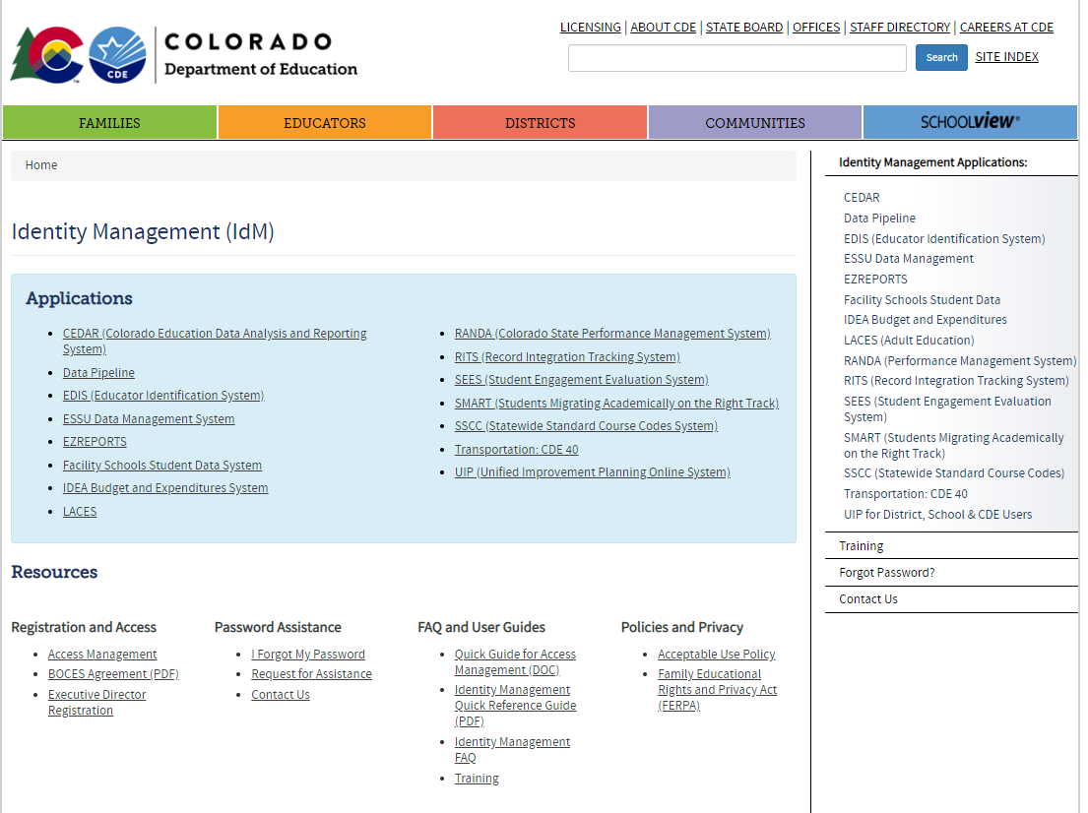
https://cdeapps.cde.state.co.us/index.html
*single sign-on used for all CDE applications listed here
LAM Help Guide and resource modules
*LAMS: Click Access Management to add or modify IdM accounts

Slide 35
Identity Management
Responsibilities
District Superintendent or Special Education director
Responsible for creating and managing a user or a group of users known as the Local Access Managers (LAMs)
Local Access Manager (LAM)
Responsible for approving and administering access to CDE systems for all users within their organization.
District and Administrative Unit LAMs (access to assign 4-digit or 5-digit group roles)
User - employee of a local education agency (LEA) who has been granted CDE application access by either the District or the Administrative Unit LAM
Data Pipeline Groups (for the purpose of this training)
Interchanges
SPE – Special Education IEP
Snapshot
DEC – Special Education December Count

Slide 36
December Count: Identity Management Roles
DATA PIPELINE ROLES NEEDED TO COMPLETE DECEMBER COUNT:
Special Education IEP Role:
SPE~LEAUSER – upload and modify Special Education IEP Interchange Files
Special Education December Count Snapshot Roles:
DEC~LEAAPPROVER – Approves, creates, views Snapshot OR
DEC~LEAUSER - creates, views Snapshot OR
DEC~LEAVIEWER- views snapshot
Staff Interchange Roles:
STF~ LEAUSER – upload and modify staff interchange files OR
STF~LEAVIEWER – view (only) staff interchange data
*EACH LEA MUST DETERMINE WHO WILL REPORT THE SPED STAFF- DISTRICT OR AU RESPONDENT?
AU respondent does not have to have an STF role if district is uploading ALL staff.
*Important: ONLY 1 role per Group
December Count - Lindsey Heitman - heitman_l@cde.state.co.us (303) 866-5759

Slide 37
Where to access the Data Pipeline
https://cdeapps.cde.state.co.us/index.html *recommended link to bookmark
*single sign-on login used for all CDE applications listed here

Slide 38
Where to Access the Data Pipeline
From bookmarked link, click Data Pipeline to get to this screen. Next click
the blue login button shown below.

Slide 39
Single Sign On
Username is the email address associated with your IdM account
Password specified by you

Slide 40
Data Pipeline Process

Slide 41
Interchange Process Overview
Create/Update Data Files
Upload files in Data File Upload
Review Batch Maintenance Screen
Review Error Reports in Cognos
Correct Data Files in Source System
Upload files in Format Checker
Once No Errors in All Files Needed -> Create Snapshot

Slide 42
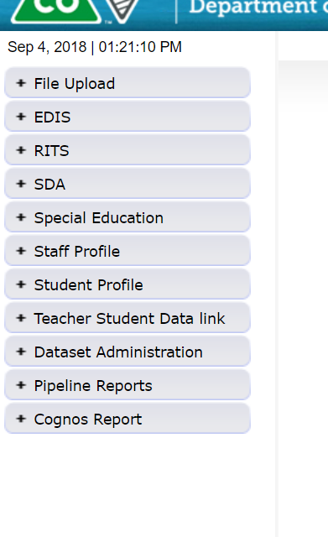
Pipeline System
Batch Maintenance, Format Checker and Data File Upload
These tabs will vary depending on your LEA and level of access. Many AU respondents will NOT see a Staff Profile or Student Profile tab. An AU respondent should always see a Special Education tab.
Based on your Identity Management Roles
Error reports and other validation reports

Slide 43
Step 1: Format Checker
Once the file is created, you have the option to run it through the Format Checker to help confirm the format is correct.
Format Checker ONLY checks the first row of data (2nd row on the file because you must have a header).
A field will only fail if there are too many characters in the field (too few will pass).
All fields PASS = Ready to upload but doesn’t mean it’s completely correct. You must have the correct number of characters in each field and it will only fail if there’s too many vs too few.
Find the IEP Interchange file templates on the Special Education IEP webpage under the Templates section.

Slide 44
Step 2: Data File Upload
Click on File Upload/Data File Upload
Choose File Type and School Year. Organization should populate with your AU.
Click on Browse to locate File
Choose Replace
Click Submit
Note message in green below. A Batch ID will be created.
APPEND – adds to existing data. Allows for multiple files to be uploaded at one time. Records on all files uploaded that meet the criteria will pull into snapshot.
REPLACE – deletes any prior uploaded data and replaces it with new file. *Recommended

Slide 45
File Upload: Email Confirmation
Check email to ensure file was successfully uploaded – you should receive a confirmation email for each file uploaded or snapshot taken.
Below is an email in a case where the file didn’t successfully upload. Additional details are provided
-----------------------------------------------------------------------
This message is to notify you of the Data Pipeline file upload errors. The errors must be corrected and the file must be uploaded again.
-----------------------------------------------------------------------
File Submission Processed by Data Pipeline:
Submission ID: 46765
Date: 05/02/2017 03:18 PM
Name: Lindsey Heitman
Year: 2017
User ID: heitman_l@cde.state.co.us
File Name: Participation_1617.xlsx
Error: Error in file upload with batch id : 46765

Slide 46
Step 3: Batch Maintenance – Important Step
After every file upload, check Batch Maintenance to ensure files have processed successfully
Processed Indicator will say “YES”. If blank or “No”, file did not upload
Check Record Count, Error Count, and make sure submitted date and time look accurate
Check this screen once email is received or check here if email was not received at all.

Slide 47
File Did Not Process
Things to check:
Are you losing leading zeros? Csv formatted files lose leading zeros and columns must be changed to text: http://www.cde.state.co.us/datapipeline/convertcsvtoexcel
Be sure there are no spaces in the name of the file
Be sure the file isn’t open when you upload it
Verify # of bytes/fields are accurate and there are no blank fields
If none of these help, try Copy/Paste Special Values the cells with data into a new spreadsheet/template.

Slide 48
Reviewing IEP Interchange Errors
2 options for reviewing errors:
Pipeline Reports - Error Reports/Special Education IEP Interchange
Cognos Reports – Special Education IEP
The list of all Special Education Child and Participation File Business rules (errors and warnings) can be found at: http://www.cde.state.co.us/datapipeline/inter_sped-iep under the ‘Business Rules’ section.

Slide 49
Checking IEP Interchange Errors under Pipeline Error Reports
Option for reviewing Interchange and Snapshot level error reports under Pipeline Reports. First click ‘Error Report’ and then filter on the following:
Dataset: Special Education IEP Interchange
File Type: select which file errors you want to view
Choose Error Type: Errors and Warnings, or just Errors, or just Warnings
Click Search
To see student level details, click View Details. To view in Excel, click Excel button.

Slide 50
Checking IEP Interchange Errors under Cognos Reports
Option for reviewing Interchange and Snapshot level error reports under Cognos Reports.
In Data Pipeline click Cognos Reports and a new tab will open with a list of folders.
Next double click on the Special Education IEP folder which should bring up a list of reports.
There is a Detail and Summary Error Report for each File.

Slide 51
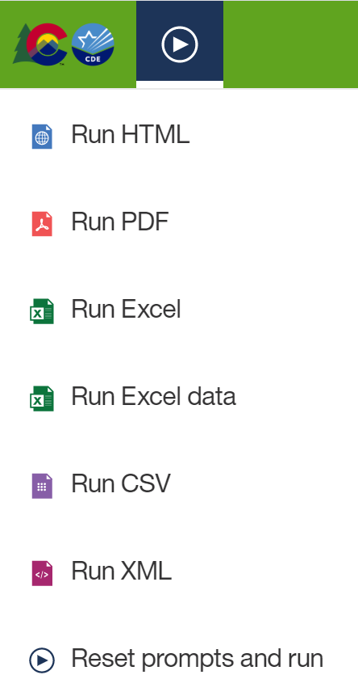
Exporting Cognos Report to Excel
Click on ‘Play’ Button
(available when a report is showing)

Slide 52
Fixing Errors
Ideally, errors should be corrected in your Student Information System
If you are working in a flat file, a versioned naming convention is important! Be sure to save a copy of all versions of both your Child and Participation Files on your own computer/network.
If updated files cause even more errors, you can upload a prior file version
Resubmit your data records using the same process and replacing your existing data file using the Data File Upload tool
All errors must be corrected, all warnings should be reviewed

Slide 53
Special Education December Count Snapshot Important Dates
November 2 | December Count Snapshot Opens
November 17 | All 4 interchange files uploaded at least once
December 1 | Official Count Date
December 8 | Interchange files error free and at least one snapshot created
January 25 | All errors resolved (interchange and snapshot)
January 25 – February 2 | Review Staff and Student Reports
February 7 – 15 | Resolve Student Duplicates
February 23 | Final Snapshot and signature reports due to CDE

Slide 54
December Count Reminders

Slide 55
December Count – Proactively Find Expired Licenses
Find expired or expiring teacher (Job Code 202) licenses before the December Count date
Renewal applications must be submitted to Educator Licensing before December 1st
Cognos Reports -> Pipeline Reports -> Staff Profile -> Staff Licensing Status
Export the report to Excel or Excel Data
Sort records by “Credential Expiration Date”
Follow up with any teacher employed in your AU or district whose license or credential will expire before 12/1/23 and ask them to submit their renewal application as soon as possible and before 12/1/23
Special Education December Count - Lindsey Heitman - heitman_l@cde.state.co.us

Slide 56
Special Education December Count: Find Students Whose Disability Needs to be Reevaluated by 12/01
Special Education December Count - Lindsey Heitman - heitman_l@cde.state.co.us

Slide 57
Special Education IEP Interchange: Contact Info
If you have any questions about the Special Education IEP Interchange, please use the snapshot email address that you’re working on. If it’s a general question, feel free to send to me directly.
December Count Snapshot email address SpedDecCount@cde.state.co.us
Special Ed EOY Snapshot email address SpedEndofYear@cde.state.co.us
Lindsey Heitman (303) 866-5759 heitman_l@cde.state.co.us
Email protocol – please include:
Administrative Unit #
error code # or school code # if applicable
Phone number
THANK YOU!

