Slide 1
Special Education Discipline 2023-2024
May 9, 2024
Lindsey Heitman
SpedDiscipline@cde.state.co.us

Slide 2
Welcome and Contact Information
Welcome and thank you for joining this webinar!
Data Services Contacts:
Lindsey Heitman – SpedDiscipline@cde.state.co.us
heitman_l@cde.state.co.us 303-866-5759
Sped Discipline Snapshot Collection manager
Data Pipeline submission for Sped Discipline Snapshot
Dawna Gudka – StudentDiscipline@cde.state.co.us
Student Discipline Snapshot Collection Manager
Data Pipeline submission for Student Discipline Snapshot
Exceptional Student Services Unit Contacts:
Orla Bolger – bolger_o@cde.state.co.us ESSU Contact – data content expert/data requests
Josh Fails – fails_J@cde.state.co.us ESSU Contact – Data Management System/questions on uploading final reports to the DMS
Slides and recording will be posted under the Trainings section on both webpages:
Discipline Interchange
Special Education Discipline Snapshot
Please include the below items in emails and thank you ☺
District code #/AU code #
Any error code #’s that you have questions about
DSU collection leads can see your errors, data files, and anything in Data Pipeline that you are able to see
Any school code #’s referenced
We research your questions by codes, usually not names

Slide 3
Agenda
Purpose/Collection Overview - slides 5-9
Timeline - slides 10-11
Data Pipeline Access/IdM - slide 12
Discipline Interchange/Data Collected for this Snapshot - slides 14-19
Sped Discipline Snapshot - slides 21-27
Exceptions - slides 28-30
Data Pipeline Process - slides 32-49
Quick Recap of District and AU Processes for this Collection - slides 51-53

Slide 4
Frequently Used Terms and Acronyms
Term | Definition
LEA | Local Education Agency
AU | AU stands for Administrative Unit and means a school district, board of cooperative services, multi-district administrative unit, a charter school network, a charter school collaborative, or the State Charter School Institute, that is providing educational services to exceptional children and that is responsible for the local administration of services.
IdM | Identity Management. A single sign on system, allowing users to navigate between most CDE applications with the same login.
LAM | Local Access Manager. The individual with your LEA that is responsible for assigning the appropriate access to CDE applications.
Interchange | The data holding place within the Data Pipeline. A method of providing data to CDE in which LEA’s may choose from multiple file formats to submit data throughout the year.
Snapshot | A date in time when data is pulled from the appropriate interchanges, validated by additional business rules, and approval given that signifies it was accurately reported for a specific point in time by an LEA.
Cognos Reports/Cedar | Colorado Education Data Analysis and Reporting System (CEDAR). A type of report in which the user can view applicable reports that are formatted in a user-friendly environment.
DMS | The ESSU Data Management System (DMS) is a single sign on system that assists AUs in meeting accountability requirements for Special Education and Gifted Education.

Slide 5
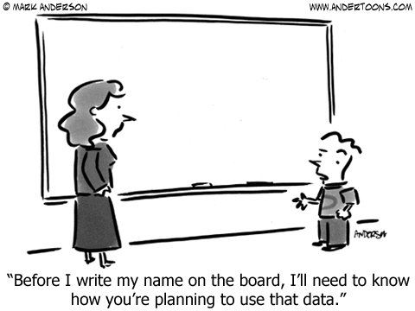
Purpose
Find Colorado AU Special Education data here and State Performance Plan and Annual Performance Reports here
Indicator 4 Suspension/Expulsion
4A. Percent of local educational agencies (LEA) that have a significant discrepancy, as defined by the State, in the rate of suspensions and expulsions of greater than 10 days in a school year for children with IEPs
4B. Percent of LEAs that have: (a) a significant discrepancy, as defined by the State, by race or ethnicity, in the rate of suspensions and expulsions of greater than 10 days in a school year for children with IEPs; and (b) policies, procedures or practices that contribute to the significant discrepancy, as defined by the State, and do not comply with requirements relating to the development and implementation of IEPs, the use of positive behavioral interventions and supports, and procedural safeguards.
(20 U.S.C. 1416(a)(3)(A); 1412(a)(22))
U.S. Department of Education federal requirements (next slide)

Slide 6
Content
Section 618(a)(I)(A)(vii) of IDEA requires that states report to the federal government the number of children with disabilities by race, ethnicity, and disability category who are removed to an interim alternative educational setting or are subject to long-term suspensions or expulsion.
Students with disabilities who were subject to:
1. DISCIPLINE ACTION TYPE- Suspensions
in-School
out-of-School
2. DISCIPLINE ACTION TYPE - Expulsions
with services
without services
3. SPED REMOVAL TYPE - Unilateral Removal by School Personnel to an IAES for one of the following reasons
drugs
weapons
serious bodily injury
4. SPED REMOVAL TYPE- Unilateral Removal based on a Hearing Officer Determination based on the hearing officer’s determination that maintaining the child’s current placement is substantially likely to result in injury to the child or others.
IMPORTANT NOTE: only records that were active in Special Education at the time of the Discipline Action Start Date will be included in the federal reporting dataset. If student exited Sped prior to that date, an exception will be needed.

Slide 7
What Changed in 23-24 in relation to the Sped Discipline Snapshot?
Discipline Interchange 2023-2024
‘Special Education Discipline Interchange’ changed to ‘Discipline Interchange’
Discipline Action File layout changed significantly
Combined the data elements from the 3 School Discipline files and the Special Ed Discipline Interchange file into ONE FILE
District respondents upload one Discipline Action file that includes ALL students at the student level
Must have DIS User Role to upload the file
File should include all disciplinary incidents and resulting actions that occurred between 7/1/2023 – 6/30/2024
record for each action and associated incident
Discipline Action Type Codes for ISS, OSS, and Expulsion have changed from codes 01, 02, 03 to 11, 12, 13
Cannot mark ‘No Discipline Actions’ for Sped students in Data Pipeline (adding warnings for this at both interchange and snapshot levels)
What hasn’t changed?
Special Education Discipline Snapshot
AUs will need the SPI Approver or SPI User role and may start creating snapshots once the district has begun uploading the Discipline Action file
No change in the data fields that are pulled into this snapshot from the Discipline Action File

Slide 8
Discipline Interchange and Snapshots
District Respondent Responsibilities:
Upload Student Interchange files
Upload Discipline Action file
Complete Student Discipline Snapshot
Discipline Interchange- Discipline Action File
Student Discipline Snapshot
Special Education Discipline Snapshot
For Student Discipline questions, email StudentDiscipline@cde.state.co.us
Collection lead is Dawna Gudka Gudka_d@cde.state.co.us
AU Respondent Responsibilities:
Upload IEP Interchange file
Completes the SPED Discipline Snapshot
For Special Education Discipline questions, email SpedDiscipline@cde.state.co.us
Collection lead is Lindsey Heitman Heitman_l@cde.state.co.us

Slide 9
Special Education Discipline Snapshot
Data pulls from these interchanges to make up the snapshot:
Special Education Discipline Snapshot
Discipline Interchange:
Discipline Action File
Student Interchange:
Student Demographic File
Student School Association File
Special Education IEP Interchange:
Child File
Participation File
AU Responsibility
District(s) Responsibility
*An interchange is the data holding place where your data files may be uploaded and validated throughout the school year
*A snapshot is a point in time “picture” of your data extracted from the Interchange files

Slide 10
Special Education Discipline Snapshot: Opened on 5/1
Timeline:
May 1, 2024 - SPED Discipline Snapshot official open
May 23, 2024 - All Interchange files that feed into snapshot uploaded or updated at least once
June 27, 2024 - Interchange errors resolved – Discipline Action File, Child File, Participation File
August 15, 2024 - All Exception requests submitted to CDE processing
August 22, 2024 - Snapshot error-free
Aug. 22 – Aug. 29, 2024 - Report Review
August 29, 2024 - Final Submission approval in Data Pipeline and reports uploaded to DMS.
Please download the full Timeline from the Discipline Interchange or Special Education Discipline Snapshot webpages. You will find more details and a breakdown of what is required by the district respondent and the Sped respondent.
Keep in mind:
July 31st, 2024 Student Discipline Snapshot due by this date!

Slide 11
Overview of Collection Process
District Respondents – need DIS User role
AU Respondents – need SPI Approver or User SPI role
Upload and validate Discipline Action File containing discipline actions given to ALL students between 7/01/2023 – 6/30/2024
Record for each student with a reportable disciplinary incident and resulting action
Records containing Sped Flag=1 will pull into the Sped Snapshot for the following:
ISS (11), OSS (12), Expulsion (13), Sped Unilateral Removals (01 or 02)
Timeline
At least one file uploaded by May 8th
Resolve Interchange errors by June 14th
Work with AU respondent to resolve Sped Disc Snapshot errors by end of July
Upload and validate Special Education IEP Child and Participation Files for current reporting period 7/01/2023 – 6/30/2024
Create Special Education Discipline Snapshots and work with district respondent to validate data and resolve errors
Timeline
IEP files uploaded at least once by May 23rd with data to reflect full school year (files need to be uploaded with Sped EOY focused data, at least once by this date)
IEP files error-free by June 27th
Sped Discipline Snapshot errors resolved by end of July if possible
Submit final Sped Disc Snapshot and signed reports to CDE by no later than August 29th
Collaboration

Slide 12
Special Education Discipline Identity Management: Data Pipeline Access
DISTRICT RESPONDENT – DIS GROUP
Data Pipeline responsibility breakdown:
INTERCHANGE ROLE OPTIONS | ENABLES USER TO:
DIS~LEAVIEWER | read-only access
DIS~LEAUSER *Need at least 1 | upload files, view interchange level errors
Districts (DIS role) upload Discipline Action File
Districts (DIS role) research and resolve Discipline Action File errors and upload corrected file
AUs (SPI role) create Special Education Discipline Snapshot
AUs (SPI) work with districts (DIS) to resolve snapshot errors
AU RESPONDENT – SPI GROUP
SNAPSHOT ROLE OPTIONS | ENABLES USER TO:
SPI~LEAVIEWER | read-only access
SPI~LEAUSER | create snapshots and view snapshot level errors
SPI~LEAAPPROVER *Need at least 1 | create snapshots, view snapshot level errors, AND approve the final snapshot in Pipeline
Process ongoing until all interchange and snapshot errors are resolved
Roles assigned by Local Access Manager (LAM)
Only 1 role per group per account!

Slide 13
Special Education Discipline Interchange (District-DIS Role)

Slide 14
Discipline Interchange: Contains 1 File
Discipline Action File – should include all students with reportable discipline information - district wide
Record Expectation:
Each record represents a single Discipline Action Type and the associated incident/behavior type.
Record should be reported in the school year in which the discipline action took place
An action that spans two school years should be reported in both collection years with the number of days removed reported in each year.
Each record must have a 10-digit Incident Identifier #
May be duplicated in cases where a student has more than one action associated with an incident
May be duplicated in cases where more than one student is involved in an incident
Each record must have a *unique 10-digit Action Identifier #
Action Identifier may not be duplicated *EXCEPT in the case of a Unilateral Removal with more than one removal reason (i.e. weapons and bodily injury)

Slide 15
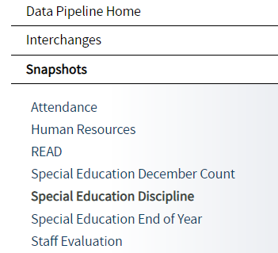
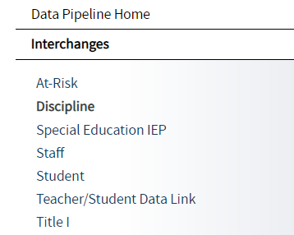
Resource Webpages
Bookmark this link for quick access to the Data Pipeline Collection Resources
Data Pipeline Homepage
Special Education Discipline Snapshot Link
Discipline Interchange Link
The snapshot File Layout is where you will find all the data fields that pull into the snapshot and which Interchange and file they pull from.
The interchange File Layout and Definitions is where you will find all of the data fields collected, their definitions, and code options and definitions.

Slide 16
Special Education Discipline Snapshot Data Breakdown
Discipline Action
Suspensions:
In-school (11)
Out of School (12)
Expulsion: (with or without services)
(13)
Sped Removal
Unilateral Removal to an *IAES by school personnel for up to 45 days
(01)
Removal by a hearing officer to an *IAES for up to 45 days
(02)
OR
Special Education Removal Reason required-
Incident involving drugs (01), weapons (03), or serious bodily injury (02)
*IAES – Interim Alternative Educational Setting
Received Services During Expulsion (0- No, 1- Yes)
Each record should contain a Discipline OR a Removal. Not both!

Slide 17
Discipline Action Types – Suspensions & Expulsions
Suspensions and Expulsions:
In-School Suspension – child is temporarily removed from regular classroom for disciplinary purposes but remains under the direct supervision of school personnel.
Out-of-School Suspension – child is temporarily removed from regular school for disciplinary purposes to another setting (e.g. home, behavior center).
Expulsion - An action taken by the LEA removing a child from his/her regular school for disciplinary purposes for the remainder of the school year or longer in accordance with local educational agency policy.

Slide 18
Special Education Removal Type
Special Education Removal Type- temporary change in placement to an IAES (determined by IEP team)
01 - Unilateral Removal By School Personnel – school personnel order the removal of child with disabilities from their current educational placement to IAES for not more than 45 school days for drugs, weapons, or serious bodily injury.
- extreme situation, school personnel made decision without parent consent for a change in placement for typically 45 days.
02 - Unilateral Removal Based on a Hearing Officer’s Determination – impartial hearing officer orders the removal of child with disabilities from current educational placement to IAES for not more than 45 school days.
Interim Alternative Educational Setting (IAES) – An appropriate setting determined by the child’s IEP team or hearing office in which the child is placed for no more than 45 school days. This setting enables the child to continue to receive educational services and participate in the general education curriculum (although in another setting) and to progress toward meeting the goals set out in the IEP.

Slide 19
Discipline Action Length Field
Discipline Action Length must be between a half day and 260 days
Field not required and may be zero-filled on these Discipline Action Types:
10- Classroom Removal
14- Any other form Discipline
Field must end in 0 or 5
should reflect number of school days missed from regular classroom within the reporting period of 7/1 – 6/30
Examples:
½ day =0005
1 days = 0010
10 days = 0100
60 days = 0600
260 days = 2600

Slide 20
Special Education Discipline Snapshot (AU-SPI Role)

Slide 21
Special Education Discipline How are records pulled into the snapshot?
Criteria:
pull error-free records from Discipline Action file where Special Education Action Flag = 1 AND Discipline Action Type = 11, 12, 13 OR Special Education Removal Type = 01 or 02
Dependencies:
Student has been assigned a SASID and updated in the RITS system
Student has a record in the Discipline Interchange:
Discipline Action File
Student has a record in the Student Interchange:
Student Demographic (demographic data) *file must be untagged
Student School Association (grade level, school code) *file must be untagged
Student has a record in the Special Education IEP Interchange:
Participation File – Primary Disability, Dates of Entry/Exit to Special Education
Child File – demographics pulled in rare case that student is missing from Student Interchange
Notes:
The records selected will be joined with data from the Student Interchange- Demographic and Student School Association Files and the Special Education IEP Interchange- Participation file.
All of these snapshot edits are based on the Interchange(s) data being there and aligning with the Sped Discipline Action file data.
Edits dependent on Student and IEP Interchange data: SD005, SD009, SD017, SD018, SD024, SD026, SD027
This is why it’s important that your untagged Student Dem/SSA files and Sped IEP files are updated and error free by the end of June.

Slide 22
Snapshot Error Codes
The edits placed at the snapshot level contain data extracted from multiple interchanges and generally mean the data is missing from or needs to be adjusted in that interchange.
Examples:
SD017 – grade level comes from Student School Association file IF School Code matches between Discipline Action file and SSA file AND school entry/exit dates align.
SD018 – Primary Disability is pulled from Participation File. Record may be missing from Participation file.
Error Code | Error Type | Message
SD024 | Error | The Discipline Date in the Sped Discipline Action file must fall between the Dates of Entry and Exit of Special Education in the IEP Participation file. If this was the case at one point but the student's circumstances changed later in the school year, please submit an exception request.
SD017 | Error | The Grade Level field pulls from the Student Interchange-Student School Association (SSA) file and is missing from your snapshot. It is missing because either a record with a School Code matching the one reported in your Discipline Action file could not be found in the SSA file OR the Incident Date does not fall between the School Entry and Exit Date in the SSA file. Please check the Cognos Sped Incident and School Enrollment Date Comparison Report for details and adjust your file(s) as necessary.
SD009 | Error | At least one racial category must be selected for each student in the Student Interchange - Student Demographic File.
SD005 | Error | LASID must be included in the snapshot. This field is blank because a matching student record could not be found in the Student Interchange -Student Demographic File.
SD018 | Error | Primary Disability must be included in the snapshot. This field is blank because a matching student record could not be found in the Participation file in the Special Education IEP Interchange.

Slide 23
Special Education Discipline Snapshot Error Code SD026
Troubleshooting error SD026:
If Type of Suspension/Expulsion is 04 (expulsion without services), the Special Education End of Year Basis of Exit code should be 50 (expulsion without services). If student was expelled and then re-entered later in the school year, an exception may be necessary, please contact CDE.
Triggers if you’re reporting an expulsion with no services in the Sped Discipline Snapshot, but NOT in the Sped EOY snapshot. If student truly had an expulsion without services, an exit code of 50 should be reported in the Participation file record/Sped EOY Snapshot.
First, verify whether student had an expulsion with or without services.
If it was an expulsion with services, adjust the ‘Received Services During Expulsion’ field to a 1 (yes) in the Discipline Action file and SD026 should resolve after next snapshot.
If it was an expulsion without services, follow these steps to resolve:
1. Add exit code 50 to Participation file record and upload a new file
2. Create a new Sped EOY Snapshot and verify this record is pulling into the snapshot
3. Create a new Sped Discipline Snapshot

Slide 24
Special Education Discipline: Snapshot Error Code SD024
SD024: Discipline Start Date should fall between Start and End Date of SpEd. Verify student's record is included in your Participation file with the latest dates of SpEd and is error free. If so, did the student exit your AU after this discipline event and then re-enter later in the school year? If yes, please submit an exception request. If no and student exited Special Education after the incident occurred but before the Discipline Start Date, please email SpedDiscipline@cde.state.co.us
Many times this error can be resolved without an exception and the Participation file OR the Discipline Action file can be modified instead.
Exception may not be necessary:
Be sure the record has been added to your Participation file and is error free
Be sure the Sped Entry and Exit dates are correct and reflect the student’s latest attendance in your AU in the school year
Both of these examples require you to reload the IEP Participation file, resolve any errors, and then create a new Sped Discipline Snapshot in order to resolve SD024
Exception is Necessary:
If student’s Discipline Start Date was during an attendance early in the school year and then student exited and later returned to attending in your AU, this is when an exception would be necessary because the Discipline Start Date will not be between the dates of Entry and Exit to Sped. The Date of Entry to Sped will be LATER than the Discipline Start Date, in this case.

Slide 25
Special Ed Discipline Snapshot Error Code SD017
Troubleshooting Snapshot Error SD017 – snapshot needs a valid grade level from district SSA file. Error indicates misalignment with the School Codes, Entry Dates, or Incident Date. First Check this Cognos Report:
This cognos report can help you determine what the issue is. Report will only contain data IF you have error SD017. You will not see your district code listed in the filter box as an option if you don’t have error SD017 at the snapshot level.
*Be sure your district SSA (untagged) file has uploaded successfully. A file that did not process causes this error to trigger. I can check this for you if you email me!
School code must match between Student School Association file and the Discipline Action file
Incident Date must fall between the School Association file School Entry and Exit dates
The school code reported should be the school where the incident took place

Slide 26
SPED Incident and School Enrollment Date Comparison Report – snapshot folder report

Slide 27
Reasons SD017 error will trigger
1. Problem with record below:
School Codes don’t match ☹
SASID | Discipline Action School Code | Incident Date | School Association School Code | Entry Date | Exit Date
1234567891 | 1234 | 01/21/2023 | 4321 | 08/13/2022 | 00000000
2. Problem with record below:
Incident Date is not between the Entry and Exit date of the Student at the school ☹
SASID | Discipline Action School Code | Incident Date | School Association School Code | Entry Date | Exit Date
1234567891 | 1234 | 01/21/2023 | 1234 | 02/28/2023 | 00000000

Slide 28
Exceptions to the Rule
There are business rules at both the Interchange and Snapshot level that may require an exception request in order to clear the error.
Submit exception requests to Syncplicity – online platform used for secure file sharing
Please email me if you do not yet have a folder. I will send you an email with a link to set it up.
Once a file has been shared you can access syncplicity at: my.syncplicity.com
File name is your AU code or District code
Used for Exception requests, questions that include PII, facility student information, etc
Please email CDE to notify us you’ve placed something in the folder. We aren’t automatically notified when you’ve saved something in your Syncplicity folder.

Slide 29
Snapshot Exceptions
Exception Template found here: http://www.cde.state.co.us/datapipeline/snap_sped-discipline
EXCEPTION TYPE | ERROR CODE (S) | INFORMATION NEEDED IN "COMMENTS AND EXPLANATION"
Grade to Age | SD020 | Please provide student's age and details of why student is not in an age appropriate grade.
Discipline Date | SD024 | Please provide a reason why the Discipline Date is not between the Date of Entry to Special Education or Date of Exit from Special Education.
Expulsion Without Services > 10 days | SD025 | Please provide a reason why the student did not receive offered services during an expulsion.
Expulsion Without Services - EOY? | SD026 | Please provide the reason an Expulsion Without Services was reported for this student in the Sped Discipline Snapshot, but not the Sped EOY Snapshot. [i.e. Special Education End of Year Exit is not 50 and you believe the data is correct, an exception is required.]
Expulsion Without Services - Sped Discipline? | SD027 | Please provide the reason an Expulsion Without Services was reported for this student in the Sped EOY Snapshot, but not the Sped Discipline Snapshot. [i.e. Special Education End of Year Exit is 50 but an Expulsion without services was not reported on Sped Discipline and you believe the data is correct, an exception is required.]
SD024 example explanation:
“Student was enrolled in district, left during the year and then returned. The start date of Special Education was picked up as the most recent re-enrollment, not the initial start date of special education. Student was enrolled in the district at the time of each behavioral incident.”

Slide 30
Special Education Discipline Snapshot Resources
http://www.cde.state.co.us/datapipeline/snap_sped-discipline
Exception template found here

Slide 31
Data Pipeline Process

Slide 32
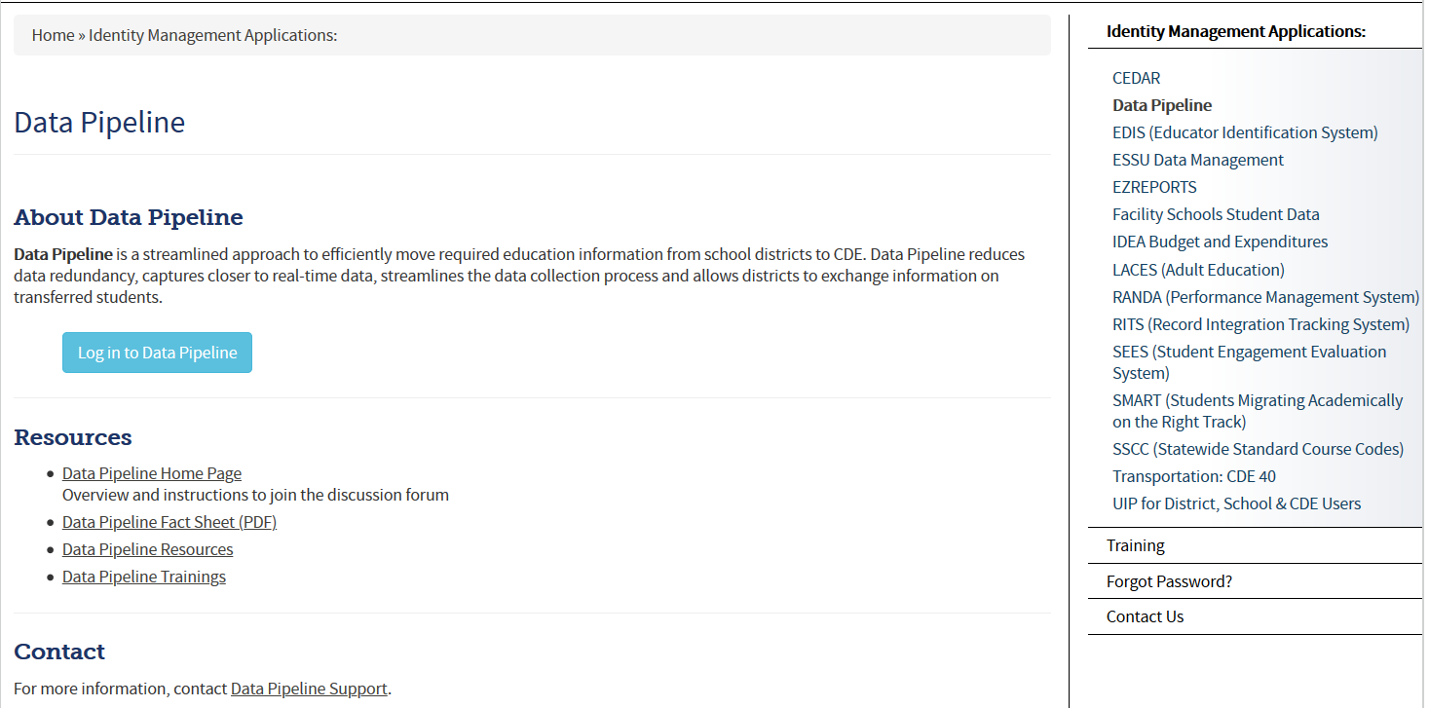
Accessing the Data Pipeline
Recommended *page to bookmark for accessing the system - CDE Identity Management Home Page
From IdM home page click Data Pipeline bullet to get to this screen below.
Next click the blue login button.
*your single sign-on login may be used for all CDE applications listed here that you have access to

Slide 33
Single Sign On
Username is the email address associated with your IdM account
Password specified by you

Slide 34
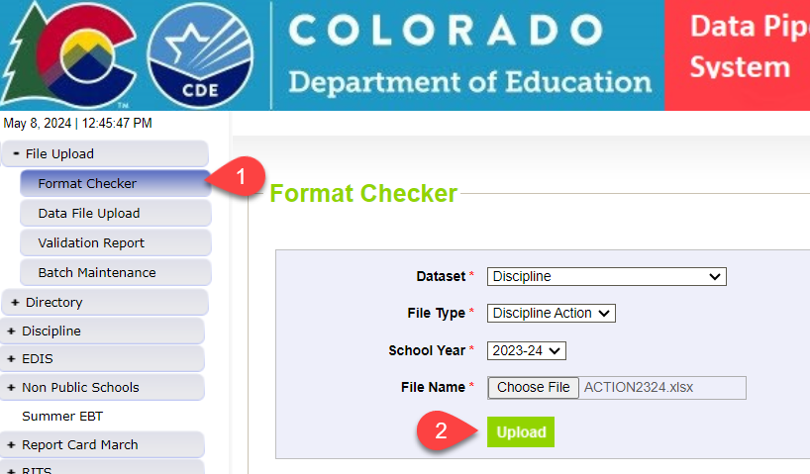
Step 1. Format Checker *optional
Once your file is created, you have the option to run it through the Format Checker to check the file format
The system only checks the first row of data within your file
Only data fields that have too many bytes will error (those with too few will not)
All fields PASS = Ready to upload
Choose appropriate Dataset/File Type/School Year

Slide 35
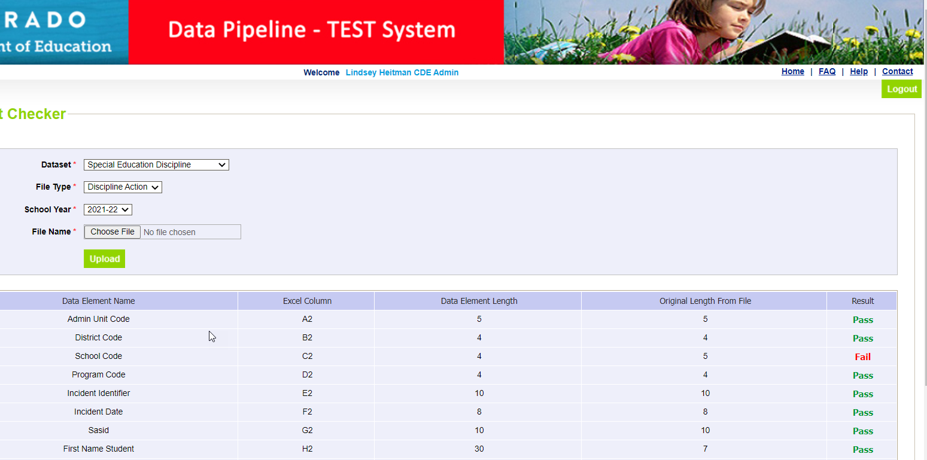
Format Checker Results
Pass Result – Proceed to Step 2: Data File Upload
Fail Result – compare field bytes to file layout expected # of bytes
School Code is 4 bytes. File shows 5 bytes.

Slide 36
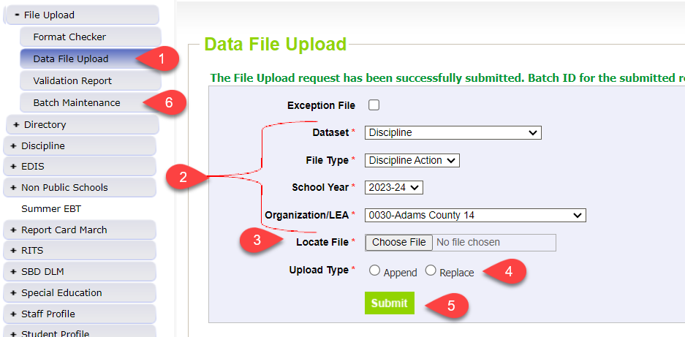
Step 2. Upload Discipline Action File (District - DIS role)
1. Click on File Upload/Data File Upload
2. Select Dataset, File Type, School Year, Org/LEA
3. Click on Choose File to locate file
4. Select Replace
5. Click Submit
Message in green will display across the top indicating file submission has been attempted and a Batch ID will be created
6. Always check Batch Maintenance Screen to verify file processed
*Email confirmation will be sent once complete

Slide 37
Step 3: Check Batch Maintenance Screen (District - DIS role)
Check Batch Maintenance to ensure files have processed successfully.
Processed Indicator will say “YES”. If blank or “No”, file did not upload
Check Record Count, Error Count, and make sure submitted date and time look accurate.
Option to download or delete last uploaded file from this screen. Check the ‘select’ box and click ‘Download’ or ‘Delete’
AFTER EVERY FILE UPLOAD - Verify Record Count, Error Count, Processed Indicator = Yes, Submitted Date!

Slide 38
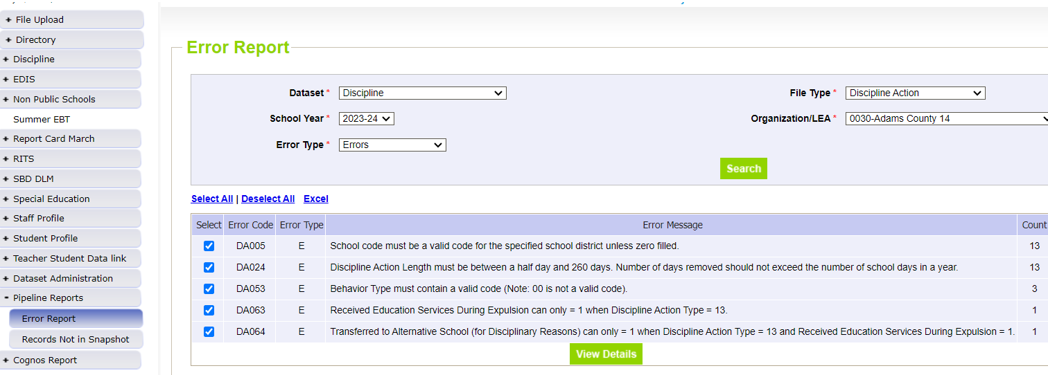
Step 4. Check for interchange/file errors (District-Dis Role) Reviewing Errors Under Pipeline Reports
Click Pipeline Reports and then Error Report
Select Dataset, File Type, School Year, Org/LEA, and Error Type
Click Search
*For Interchange errors (DIS role), select Discipline Action

Slide 39
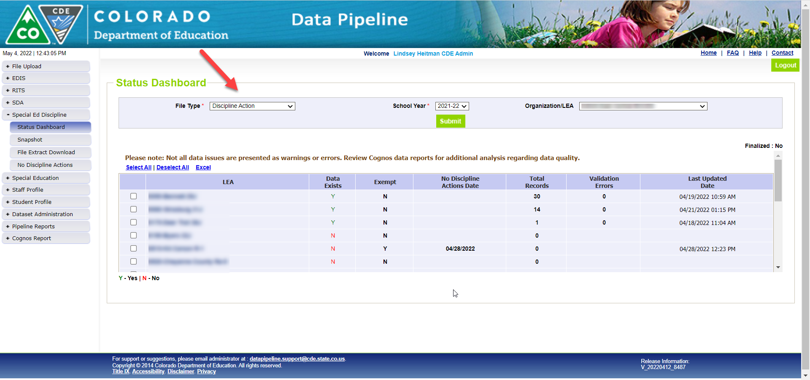
Helpful status screen for AU respondent to see file upload status of their district(s)
AUs (SPI role) can see file status of all member districts under Special Ed Discipline/Status Dashboard by filtering on File Type: Discipline Action
Another option – ‘District Activity Report’ found under Cognos Reports/Special Education Discipline

Slide 40
Step 5. Create a Snapshot (AU- SPI role)
Click Discipline tab
Click Snapshot tab
Select File Type Special Education Discipline/School Year/Organization
Click Search button
Click Create Snapshot
Expected Message: Snapshot creation triggered and processing. A notification email will be sent upon completion.
*Confirmation email will be sent once snapshot has completed

Slide 41
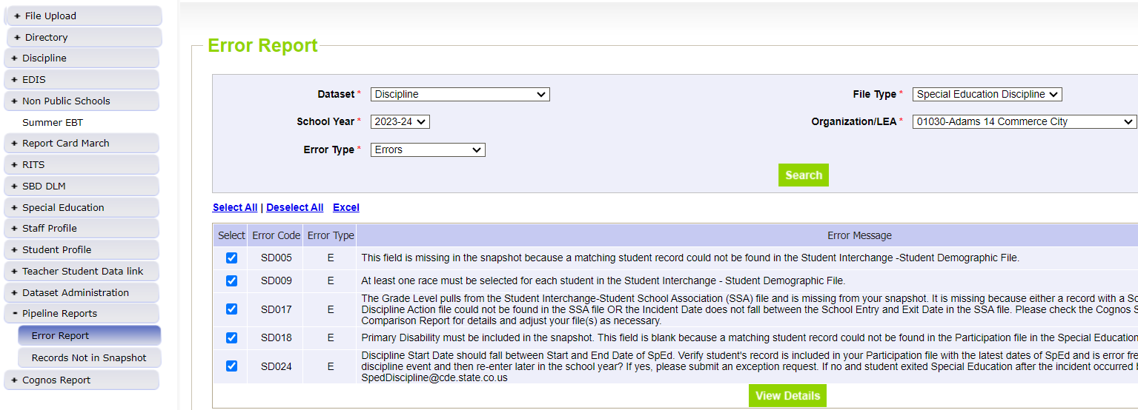
Step 6. Check for snapshot errors (AU- SPI role) Reviewing Errors Under Pipeline Reports
Click Pipeline Reports and then Error Report
Select Dataset, File Type, School Year, Org/LEA, and Error Type
Click Search
For snapshot errors (SPI role), select Special Education Discipline

Slide 42
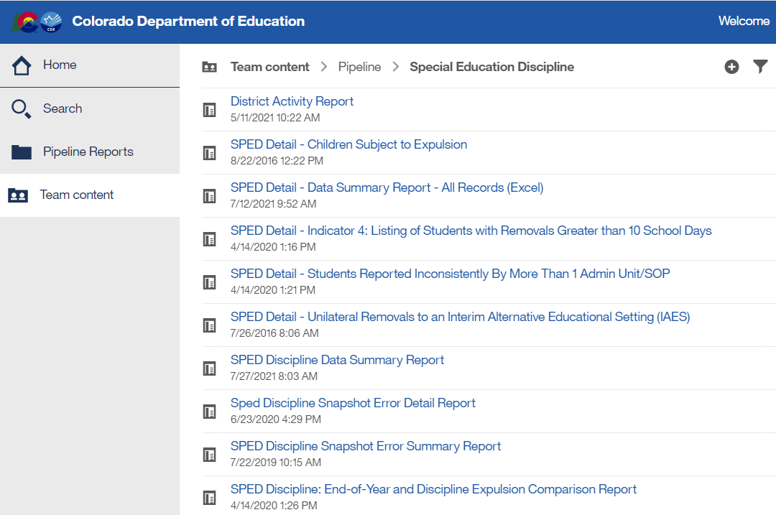
Reviewing Errors Under Cognos Reports
Click Cognos button at the bottom of the Screen
Another window will open
Click Discipline Interchange (DIS role) OR Special Education Discipline (SPI role) and double click on the error report name to open it
Interchange Reports
Snapshot Reports

Slide 43
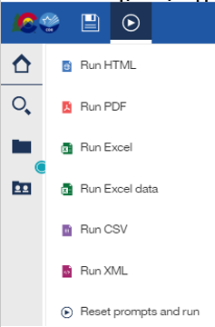
Reviewing Error Reports in COGNOS
To export error report to Excel click the “Play” button in the upper left of the screen and then double click “Run Excel” or “Run Excel Data”.
From this screen you can choose to view only Errors, only Warnings, or Errors & Warnings. Select All at once or highlight specific codes. Click Finish.
Includes all errors
Allows for filtering

Slide 44
Special Education Discipline – Snapshot Validation Reports (SPI role-AUs)
Select Special Education Discipline folder to see the Sped Discipline Snapshot validation reports
This is the report that shows all records in your snapshot

Slide 45
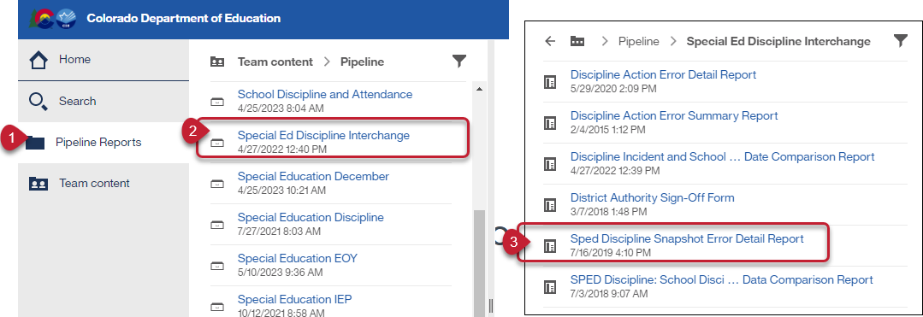
Special Education Discipline: District Report For Viewing Snapshot Level Errors (DIS role)
This report allows the district respondent to see the Sped Discipline Snapshot errors.

Slide 46
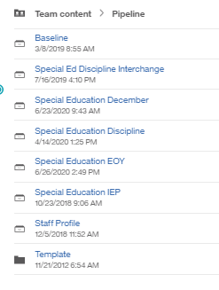
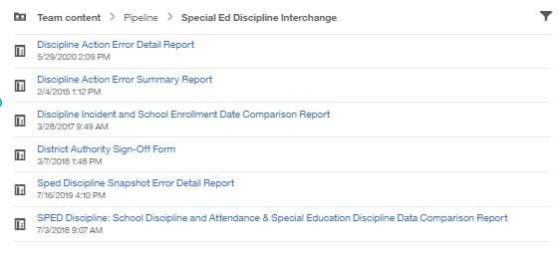
District Sign-Off Form: Where to Find the Form in Data Pipeline
District responsibility (DIS role)
Found under Cognos Reports/Discipline Interchange
Form should be sent by each district respondent to AU/BOCES respondent by the closing date in August. No need to send to CDE!

Slide 47
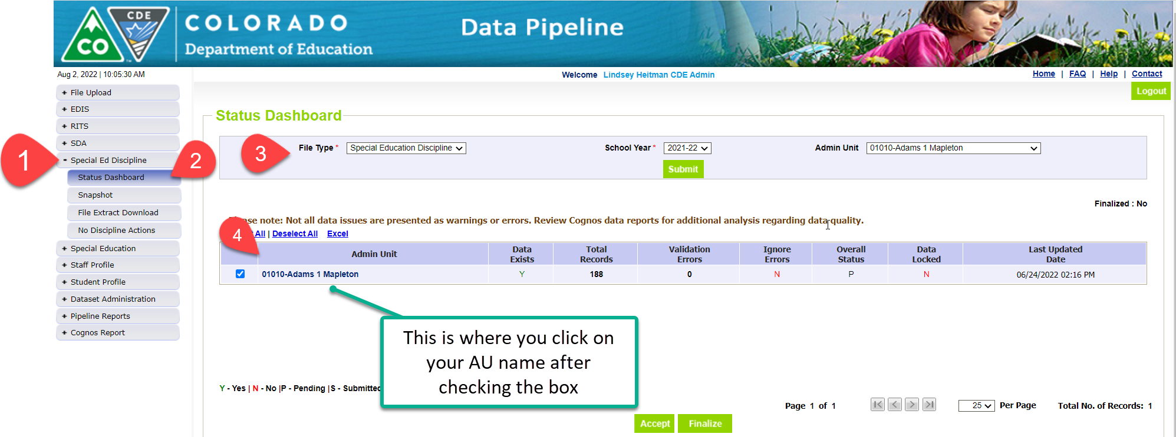
Final Snapshot Approval Steps Within Data Pipeline (AU – SPI Approver Role): 1. Click Special Ed Discipline on the left menu 2. Click Status Dashboard 3. Use the drop downs to select the appropriate values for 2023-2024 4. Check the box next to your Admin Unit name and number and then hover over and click on your actual Admin Unit number and name to get to the next screen which contains the ‘Submit to CDE’ button. *This is the extra step that is often times missed when trying to find the submit screen
This step should not be done until the reports have been validated and signed by the Sped Director!

Slide 48
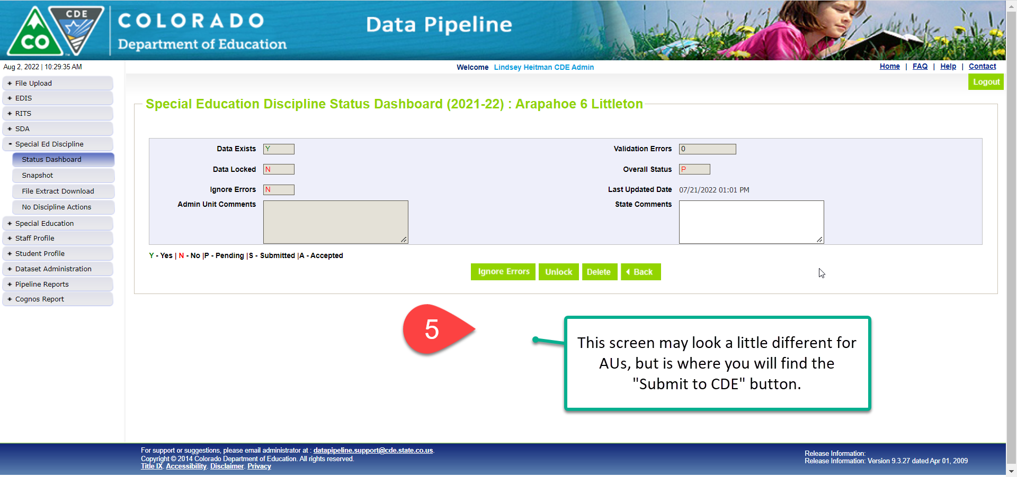
Final snapshot approval in Data Pipeline (AU – SPI role)
5. Click the Submit to CDE button (Only SPI-APPROVERS will have this ability) *must have 0 errors 6. Click OK

Slide 49
Signature Reports due by the close of collection
ADMINISTRATIVE UNIT
Special Education Director must approve and sign these reports
SPED Discipline Data Summary Report (10 Pages)
SPED Discipline Year-to-Year Comparison Type of Disciplines Report (1 Page)
Year-to-Year Flag Explanation Document (Word) if applicable
Found in the Special Education Discipline Cognos folder and uploaded to the ESSU Data Management System
DISTRICT
Superintendent or local designee must approve and sign this report
District Authority Sign-Off Form –
Requested by Special Education Directors for data assurance purposes and found in the Discipline Interchange Cognos folder
*No need to send to CDE – for your LEA records!

Slide 50
Quick Recap of District Process and AU Process

Slide 51
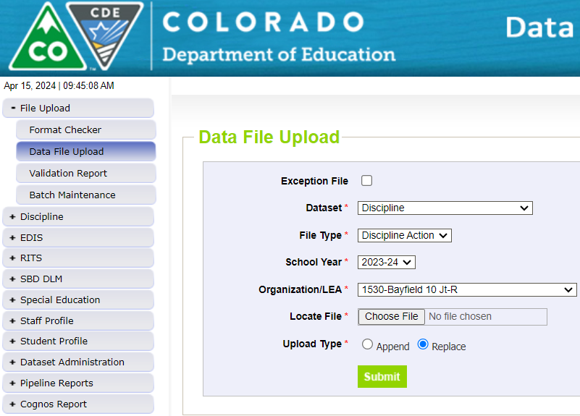
Discipline Interchange Process – District Respondent
District respondents (DIS User Role) upload the files
Click Date File Upload tab →Select Dataset Discipline/File Type Discipline Action to upload the Discipline Action File
Click Pipeline Reports/Error Report to find Discipline Action File Error Detail Report
District respondent (DIS User role)

Slide 52
Special Education Discipline Snapshot Process – AU Respondent
AU respondents (SPI Approver or User Role) create the snapshots here
Click Snapshot tab – Select File Type Special Education Discipline, School Year, and Org Code is 5-digit AU code
Click Pipeline Reports/Error Report –> Select Dataset Discipline and File Type – Special Education Discipline
AU respondents (SPI Approver or User Role)

Slide 53
Special Education Discipline Reminders
District Respondents
Be sure someone is assigned the DIS User role
Confirm when vendor updates will be ready and who will be uploading the Discipline Action File for each district
Reference collection resources (both interchange and snapshots) for an understanding of requirements for each
AU Respondents
Be sure someone is assigned the SPI Approver role
check in with member district(s) – person with DIS user role
Touch base on snapshot collection schedule and timeline (i.e. summer vacations or breaks)

Slide 54
Questions or Concerns
If you have any questions about the Special Education Discipline Data Collection, please reach out!
Lindsey Heitman SpedDiscipline@cde.state.co.us Sped Discipline Snapshot Collection Manager
heitman_l@cde.state.co.us
(303) 866-5759
Dawna Gudka StudentDiscipline@cde.state.co.us Student Discipline Snapshot Collection Manager

