Slide 1
Special Education End-of-Year
Data Pipeline Training 2022-2023
May 9, 2023
Lindsey Heitman
Heitman_l@cde.state.co.us
(303) 866-5759

Slide 2
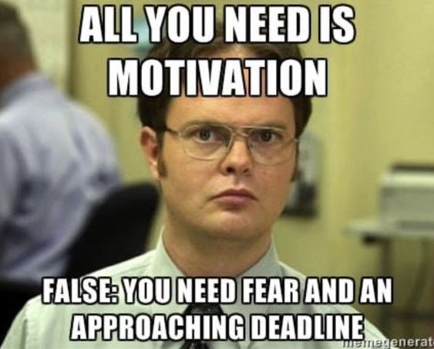
Special Education EOY – Annual Training
  Welcome and thank you for joining the training!
Webinar Training Date:
Tuesday May 9 10:00 – 11:30
  Slides and recording will be posted here
Special Education EOY - Lindsey Heitman - heitman_l@cde.state.co.us (303) 866-5759

Slide 3
Contact Information
Special Education EOY contact information
Data Services Contact:
Lindsey Heitman – heitman_l@cde.state.co.us 303-866-5759
  Collection manager
  All things regarding the Data Pipeline submission
Business Unit – ESSU Contacts:
Orla Bolger – bolger_o@cde.state.co.us ESSU Contact – data content expert/data requests
Alyssa Ohleyer – ohleyer_a@cde.state.co.us ESSU Contact – DMS/contact for uploading final reports to the Data Management System
*Find Special Education published data reports posted here
Emails should include:
AU #
error code # (if applicable)
any school codes #’s referenced

Slide 4
Weekly Data Pipeline Town Hall Webinars
Every Thursday from 9-10 am during the school year and every other Thursday during the summer
  Updates on open and upcoming data collections
  Find archived town hall slides and recordings here
Login Information:
  Microsoft Teams meeting
  Join on your computer or mobile app
  Click here to join the meeting
  Or call in (audio only)
  +1 929-341-4269, 760274086#
  Phone Conference ID: 760 274 086#

Slide 5
Agenda
Purpose/Content/Access/Timeline – slides 7-12
Special Ed IEP Interchange/Special Ed EOY Snapshot/Resources – slides 13-25
What’s New – slides 26-28
Who to Report- Content Details slides 30-39
Summary of Paths/When to Report – slides 40-53
Exceptions Process – slides 54-57
EOY Summer/Missing Exits – slides 58-62
Exit Tips- slides 63-66
Data Pipeline Process –slides 67-82
More on Cognos Reports – slides 83-87

Slide 6
Frequently Used Terms
Term | Definition
Cognos | A type of report in which the user can view applicable reports that are formatted in a user-friendly environment
Data Pipeline | A streamlined approach to efficiently move required education information from school districts to the CDE
DMS | The ESSU Data Management System (DMS) is a single sign on system that assists AUs in meeting accountability requirements for Special Education and Gifted Education.
Interchange | The data holding place within the Data Pipeline. A method of providing data to CDE in which LEA’s may choose from multiple file formats to submit data throughout the year.
LAM | Local Access Manager responsible for assigning the appropriate access to CDE applications
LEA | Local Education Agencies
IdM | Identity Management. A single sign on system, allowing the user to navigate between the applications without entering user ID information a second time.
Snapshot | A date in time when data is pulled from the appropriate interchanges, validated by additional business rules, and approval given that signifies it was accurately reported for a specific point in time by an LEA

Slide 7
Overview

Slide 8


Collection Process Overview
Schools
Track data throughout school year
Admin Unit/SOP
Combines data from schools. Determines the appropriate coding for each record.
Reports data to CDE
CDE via Data Pipeline
Provide data to Admin Unit/SOP
Verifies accuracy, corrects and approves data.
Checks data for accuracy
Collects data from Admin Unit/SOP
Edits data, all errors must be corrected
Federal Government
CDE Reviews and validates data and submits to U.S. Department of Education
Allows approval once passed all edit validations
Notes:
Admin Unit/SOPs collect data from schools and/or member districts. Data is compiled at the AU level and submitted to the CDE via the Data Pipeline.

Slide 9
Purpose and Content
Children with Disabilities Ages 14-21 Exiting Special Education as required by IDEA statute 34 CFR §300.618
State Performance Plan Indicators
  Indicator 1: Graduation: % of youth with IEPs graduating w/ regular diploma
  Indicator 2: Dropout – % of youth w/ IEPs dropping out
  Indicator 11: % of children evaluated for Part B Services within 60 days
  Indicator 12: Part C to B Transition - % of children with IEP by 3rd bday
Links to Special Education Data and SPP/APR webpages:
https://www.cde.state.co.us/cdesped/sped_data
https://www.cde.state.co.us/cdesped/spp-apr

Slide 10
Reporting Period
The Special Education End of Year reporting period is July 1, 2022 through June 30, 2023.
  The purpose of this snapshot is to obtain data on students who were referred, evaluated, and/or received special education services in your AU at any point during the reporting period.
*Enrich Users: Be sure you are selecting the EOY 22-23 option for your Child and Participation files now. Check collection parameters under collection settings to be sure it shows the full collection period of 07/01/22 – 06/30/2023

Slide 11
Identity Management:
Access to the Data Pipeline
INTERCHANGE ROLES *1 per account | ENABLES USER TO:
Viewer | read-only access
SPE~LEAUSER *only option for IEP Interchange | upload files, view interchange level errors
SNAPSHOT ROLES *1 per account | ENABLES USER TO:
EOY~LEAVIEWER | read-only access
EOY~LEAUSER | create snapshots and view snapshot level errors
EOY~LEAAPPROVER *Need at least 1 | create snapshots, view snapshot level errors, AND can approve data (Submit final snapshot to CDE)
Special Education IEP group is: SPE
*Assigned by LAM (Local Access Manager)
*LAMs click here to get to the IdM Home page
*Only 1 role per group/account
*Can have as many Viewers, Users, and Approvers as you need
Special Education EOY Snapshot group is: EOY

Slide 12
Special Education EOY 22-23 Timeline
Special Education End Of Year Timeline
May 1, 2023 | Sped EOY Snapshot official open
June 29, 2023 | IEP Interchange errors resolved and at least 1 Sped EOY Snapshot created
August 31, 2023 | Exception requests submitted to CDE by this date
September 7, 2023 | Snapshot and Interchange errors resolved
Sept. 8 – Sept. 15, 2023 | Initial Report Review
Sept. 18 – Sept. 22, 2023 | Resolving duplicates
Sept. 25 – Sept. 29, 2023 | Final Report Review
September 29, 2023 | Complete Snapshot – all errors resolved. Final Submission due to Data Pipeline and DMS.
Download full Timeline

Slide 13
Special Education IEP Interchange/Special Education EOY Snapshot

Slide 14

From where does the Special Education EOY Snapshot extract data?
*An Interchange is the data holding place where your data files may be uploaded and validated throughout the school year
Special Education EOY Snapshot
IEP Interchange
Child File
Participation File
Student Interchange
Student Dem File
Student School Association File
*A snapshot is a point in time “picture” of your data extracted from the Interchange files
You may begin creating snapshots once the required files are uploaded
Records with errors at the interchange level will not pull into your level 2 snapshot validations

Slide 15
Special Education IEP Interchange – 2 Files
Child File
Demographic information
1 record per student
The primary source of this information is the Student Interchange Student Demographic File -Untagged File IF LASIDS match between district and AU
If student is not required to be submitted in the Student Interchange (private school or facility students) the demographic data is pulled from this file into the snapshot
Participation File
Special Education services information
1 record per student
Record should reflect a student’s latest Sped status within the reporting period
The primary source of the Entry Grade Level field is the Student Interchange Student School Association File- Untagged File
If student is not required to be submitted in the Student Interchange (private school or facility students) the Grade Level is pulled from this file
Each record must have a valid SASID and/or a LASID
Each record must have matching record/SASID and/or LASID combo on both files

Slide 16
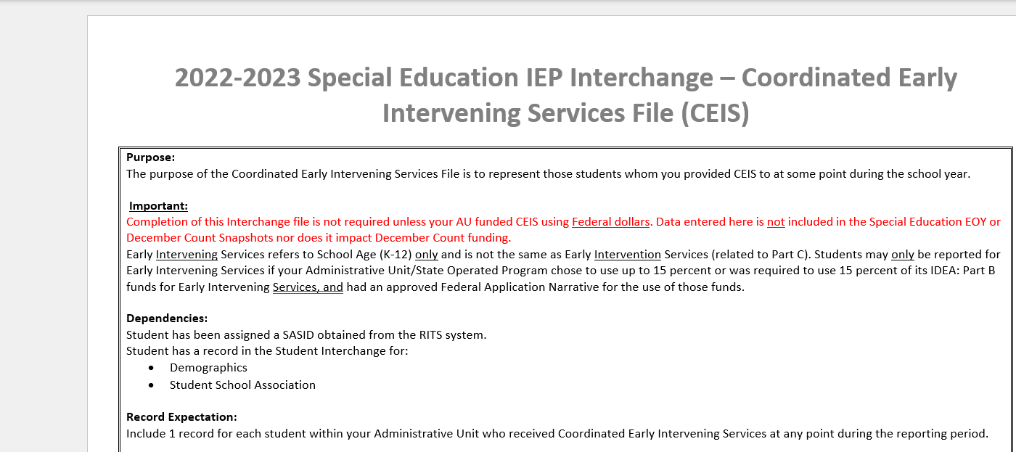
CEIS – Coordinated Early Intervening Services File
There is a third file in the IEP Interchange - Coordinated Early Intervening Services File
This file is only required for a small number of AUs that meet the circumstances below in a given reporting year:

Slide 17
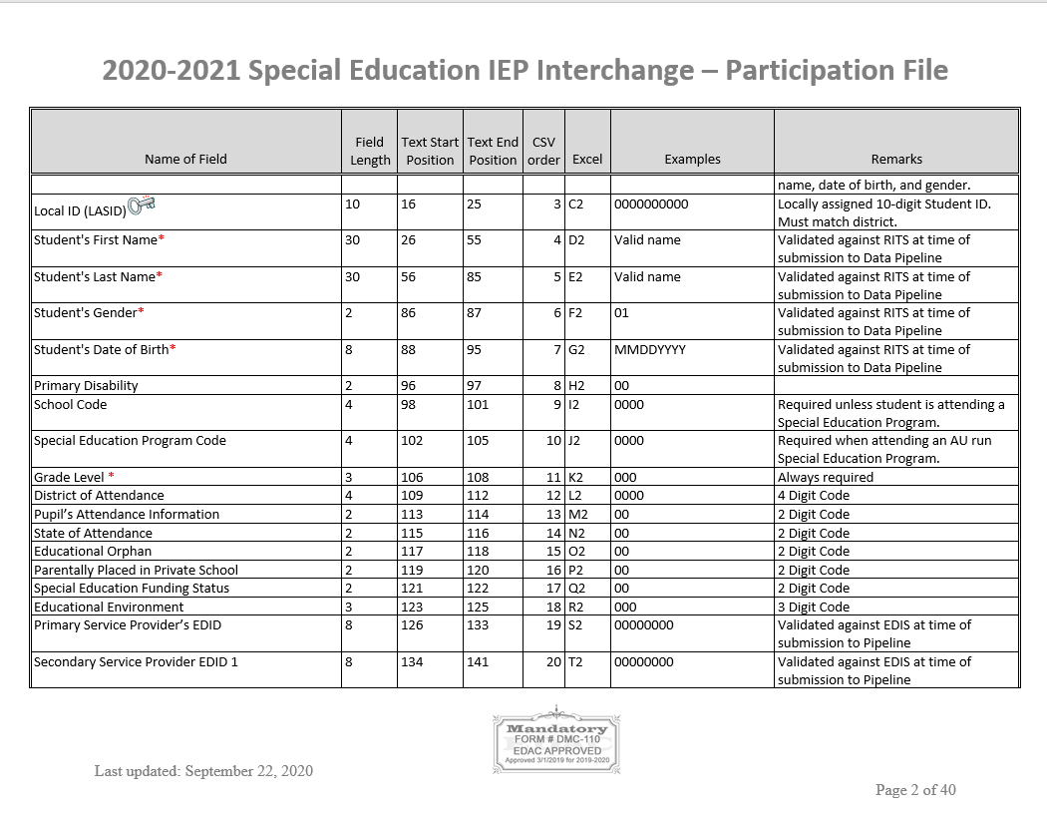
Participation File Layout Screenshot Continued
2022-2023
What’s included in the file layout?
Dependencies and record expectation
Name and Order (format) of the fields
Number of characters in each field
Examples and remarks that help clarify
Data field name, definition, and applicable codes for each field provided below the ordered format
Changes listed at bottom of layout and highlighted or crossed out in the name and definitions

Slide 18
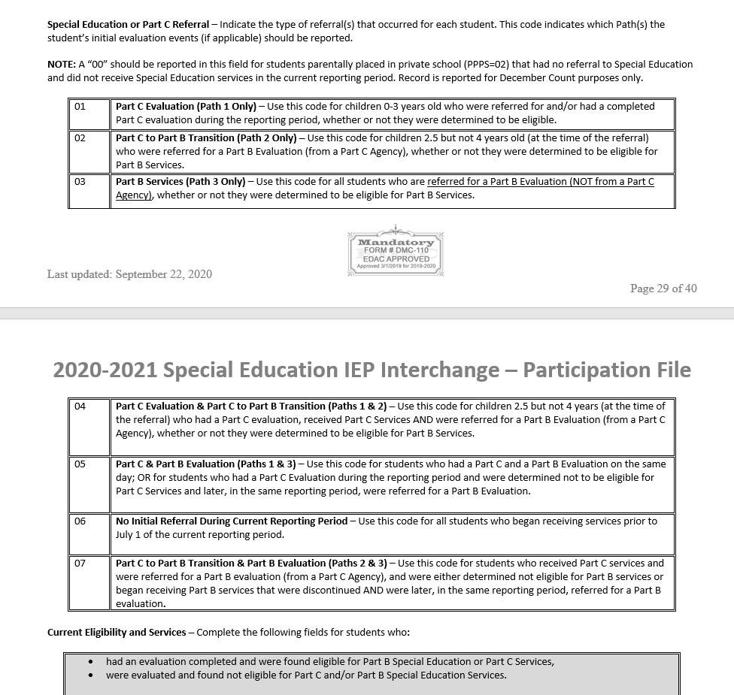
Special Education Participation File Layout
Field Name
Field Definition
All applicable codes and their definitions

Slide 19
Special Education EOY:
File Upload Tips
Excel, CSV, or Text formats are accepted
Excel templates for Child and Participation Files posted on the IEP Interchange page under Templates (if needed)
No blank fields (it likely won’t upload if there are blanks)
Be sure the file is not open when uploading it
Be sure each field has the correct number of digits
If your file won’t upload, add the filter to each column and scan the column filter box for those that have incorrect characters (i.e. letters instead of numbers or too few or too many digits)
PLEASE BE AWARE OF THIS ISSUE WITH CSV Files
  CSV files lose leading zeros within a data field after opening. A file will not upload/process successfully unless the field has the correct number of bytes so any field that could start with a zero will not have the correct number of bytes unless you format it to text in order to retain those leading zeros. Find steps for converting it to text posted here.
  Create a folder to save your files in.
  Use a simple versioning process to keep track of the files uploaded.
  Create an email folder for handling the Data Pipeline System Generated Emails as you will need to refer to them throughout the Data Pipeline Process.

Slide 20
Snapshot Criteria
Pull all error-free records from the Participation and Child
files (except those with a PAI code of 23, 24, 31, and 32 or Special Education Part C Referral code of 00) and match them with records in the Student Profile interchange (Student Demographic file and School Association file).
If the record is not submitted to the Student Interchange, the demographic fields will be pulled from the Special Education Child file.
The Special Education Child, Participation, and Student Interchange files will be joined based on the following criteria: SASID, LASID, school year, Admin Unit (or district), and error free records.
Data pulled from the Student Profile Interchange will be the untagged data
*Note: if records are missing from your snapshot, it is likely they have one of the following:
  errors at the Interchange level
  contain one of the excluded PAI codes above (which may be correct if student has already been exited)
  an incorrect SASID or LASID on one file
  missing a record altogether from one file

Slide 21
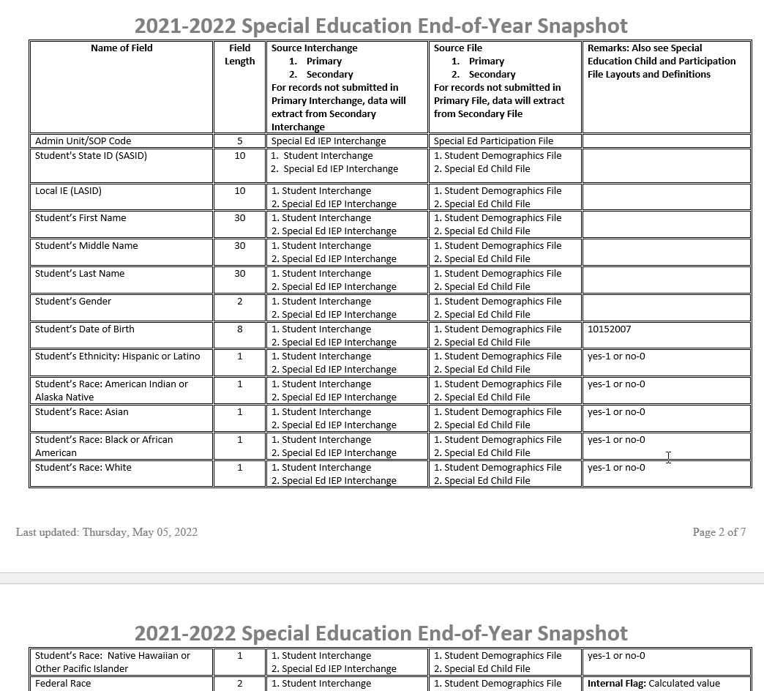
Snapshot File Layout:
Reference which data fields from the Interchange files are collected in this Snapshot
Special Education EOY Snapshot File Layout found here: http://www.cde.state.co.us/datapipeline/snap_sped-eoy
2022-2023

Slide 22
Snapshot Fields in which the data should pull from the Student Interchange district files
Student Interchange- Authoritative Source Fields
Student Demographic File
SASID
LASID
Student First Name
Student Middle Name
Student Last Name
Student Gender
Student Date of birth
Student Ethnicity
Student Race
Student School Association File
Grade Level
Every district should have Untagged Student Demographic and Student School Association files uploaded.
Be sure you are aware that the fields above pull into your Sped EOY Snapshot from these files in most cases.
  If the student is not submitted by a district (Facility School and Private School records) the data will be pulled from the IEP Interchange files
  *remember this when troubleshooting your errors around these fields!

Slide 23
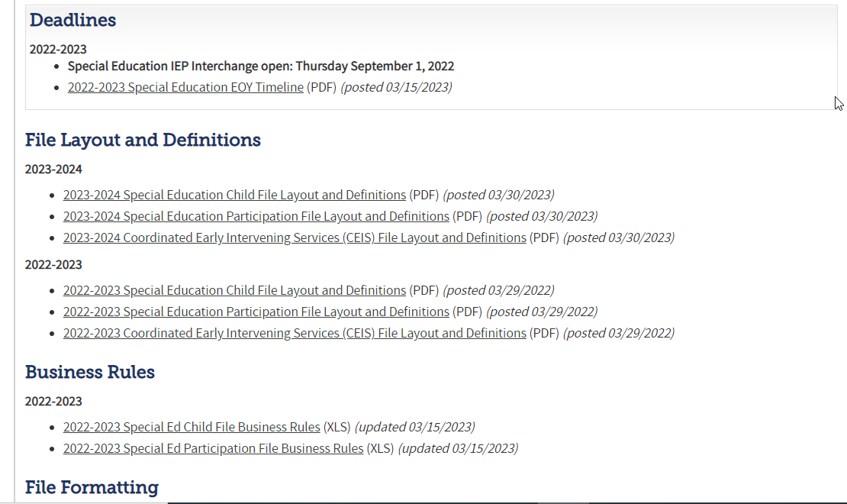
Special Education IEP Interchange Resources
At this link you will find the following helpful resources: http://www.cde.state.co.us/datapipeline/inter_sped-iep
File Layouts
Business Rules

Slide 24
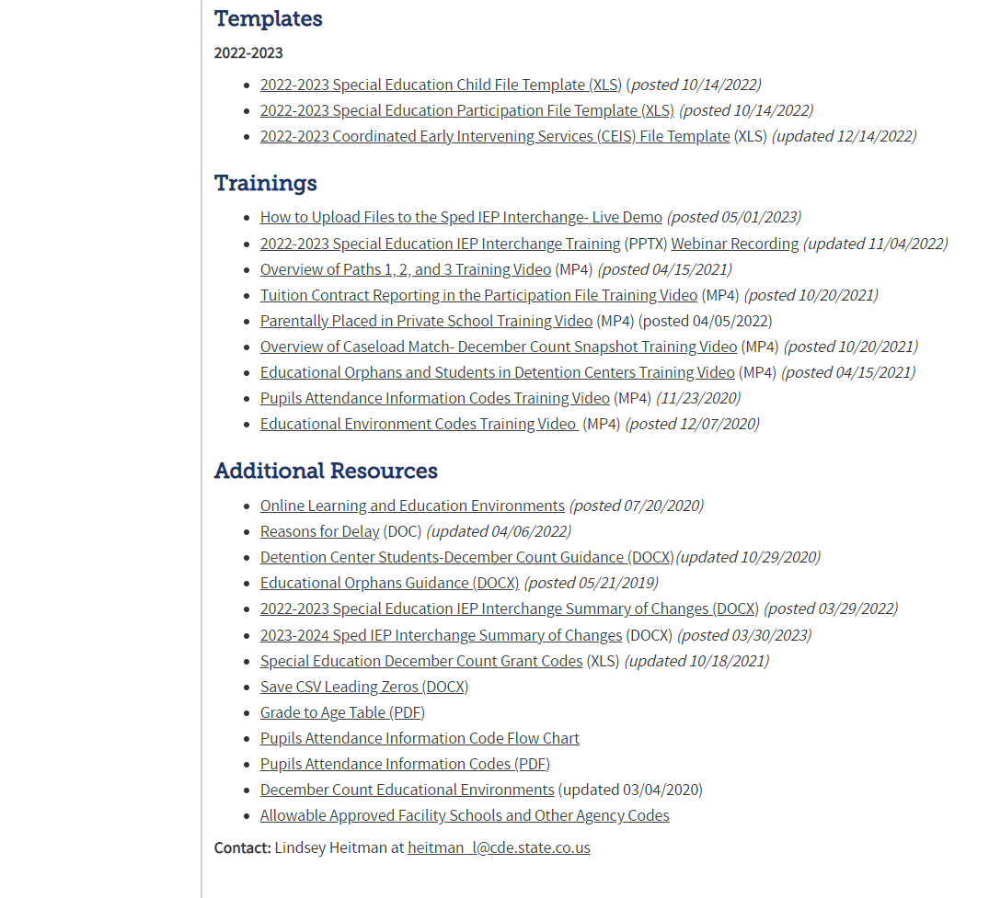
Special Education IEP Interchange Resources
Resources Continued: http://www.cde.state.co.us/datapipeline/inter_sped-iep
Templates
Trainings
Helpful Resources

Slide 25
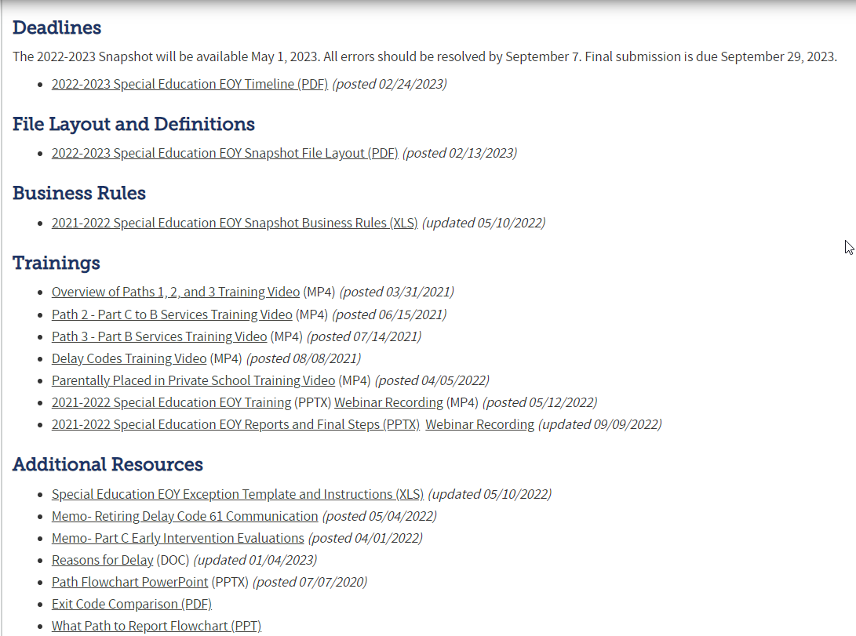
Special Education EOY Snapshot Resources
Resources Continued: http://www.cde.state.co.us/datapipeline/snap_sped-eoy
Timeline
Snapshot File Layout
Errors/Business Rules
Trainings - Overview of Paths, etc.
Exception Template
Delay Code Crosswalk
Path Flowchart
Collection Summary
Quick Reference Guide
Data Content Guide
Share with internal folks entering data/delay codes!

Slide 26
What’s New in 22-23?

Slide 27

Special Education IEP Interchange 22-23 Changes
2022-2023 IEP Interchange Changes
Child File:
  Remove data field District of Parent’s Residence from the file
Participation file:
  Remove delay code 61 – Not Valid Covid19- School Closure altogether in 22-23
  Add new delay code 41-Parent chose to extend Part C Services to the Participation File path 2 delay code options – Reason for Delay in IEP Implementation C to B
  Path 1 data fields should be zero-filled starting in this collection year. They will be removed from the file altogether in 23-24.
    22-23 – Part C data fields should be zero-filled starting July 1st, 2022.
    23-24- Part C data fields will be removed altogether from the Participation file.
Special Education EOY - Lindsey Heitman - heitman_l@cde.state.co.us (303) 866-5759

Slide 28
Special Education IEP Interchange:
22-23 Sped EOY Changes
PLEASE BE SURE YOU ARE AWARE OF THESE CHANGES IN THE 22-23 IEP PARTICIPATION FILE
2022-2023 Participation file
  1. Removed delay code 61 – Not Valid Covid19- School Closure
  2. If there is a delay in the path 2 - Reason for Delay in IEP Implementation C to B
    There is a new delay code option
    41-Parent chose to extend Part C Services -
      This code would be used if the parent chose to extend the Part C services past the 3rd birthdate
  3. Path 1 Part C data fields should be zero-filled starting this collection year
    22-23 – Path 1 data fields should be reported like this:
      Path 1 - Date Referred for Part C Evaluation = 00000000
      Path 1 - Date of Parental Consent to Evaluate Part C = 00000000
      Path 1 - Date Evaluation Completed Part C = 00000000
      Path 1 - Reason for Delay in Completing Evaluation Part C = 00
      Path 1 - Eligibility and Services = 00
      Do NOT report ‘Special Education or Part C Referral’ Codes 01, 04, or 05 because they indicate an evaluation for part c services
  These fields and referral codes will be removed from the file altogether in 23-24.

Slide 29
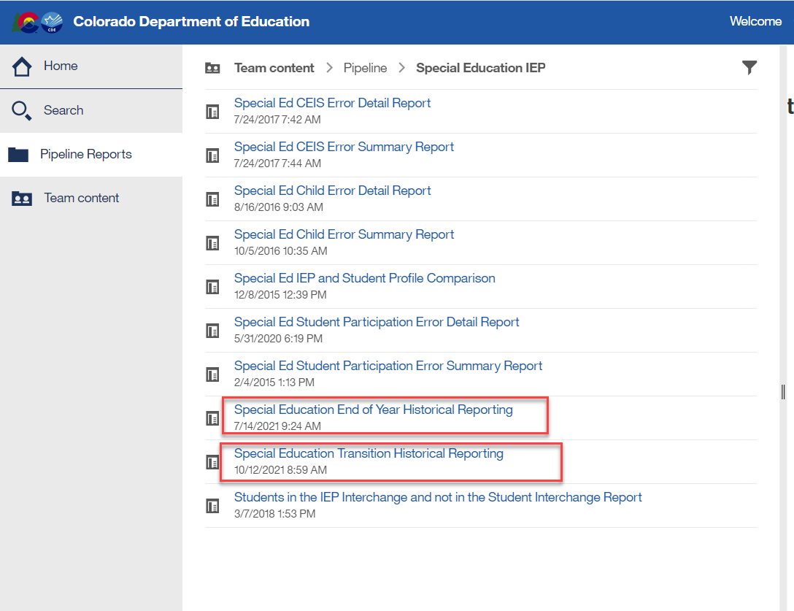
Special Education IEP -
Newer Reports Available
This report will indicate whether student was reported in Sped EOY for the last 3 years
Report cross references Student October and EOY snapshots for a list of transition students within the AU

Slide 30
Who to Report

Slide 31
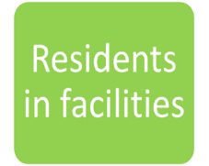

Who to Report
PART B SPECIAL EDUCATION SERVICES
AU
Served
Referred and Evaluated
Detained at Detention Center in your AU
Only report INITIAL referrals/evaluations. No need to report the annual or re-evaluation dates!

Slide 32
Report All Students Who:
Received services in your Administrative Unit (or a detention center within your AU) at any point during this reporting period (July 1-June 30)
Had an initial evaluation for Part B services:
  were 2.5 but not 4 years old when they were referred from Part C to Part B (path 2)
  were referred for a Part B special education Initial Evaluation (path 3)
Were placed in an Allowed Eligible Facility and you are the Administrative Unit of residence
Were detained at a Detention Center located within your AU boundaries
Were on an IEP and received services at a private school on a tuition basis or parentally placed in a private school, have an ISP and receive Sped services from the AU
*more specific details on who should be reported can be found on the Special Education EOY Data Content Guide pages 1 and 2. Posted here under Additional Resources: http://www.cde.state.co.us/datapipeline/snap_sped-eoy

Slide 33
Also, report students who:
were evaluated, even if they were found not eligible. Check your data extracts to make sure students found not eligible are being reported too!
were on an IEP (not an ISP) and received services at a private school on a tuition basis (these students are placed at a private school by the IEP team and should be reported by the Administrative Unit of Residence).
were parentally placed in a private school, have an ISP and received services from the Administrative Unit (these students must be reported by the Administrative Unit where the private school is located).
received services outside of the State of Colorado and are the responsibility of your Administrative Unit (these students are placed out of state per their IEP and should be reported by the Administrative Unit of Residence).

Slide 34
An Initial Evaluation includes students:
  who were not eligible at the time of evaluation* – student may have received Special Education Services in the past but had returned to regular education prior to this evaluation *exception to this are transfer students in which your AU decides to do their own initial evaluation
    for whom parents revoked consent for services – student received Special Education Services for a period of time prior to parent deciding to cease services. When child is again referred/re-evaluated, please report them as an initial evaluation.
    who have never been evaluated for Part B Services - these students have never had an evaluation in your Administrative Unit/State Operated Program , another Administrative Unit/State Operated Program, or an Eligible Facility in Colorado.
    who received Special Education Services in another state, for whom it was determined that an initial evaluation was needed.
    who are parentally placed in a private school and had a Part B Initial Evaluation during the current reporting period (these students are reported by the Administrative Unit in which the private school is located).
    who were educated in a non-public home-based educational program (i.e., homeschooled) and had a Part B initial evaluation during the reporting period.

Slide 35
Special Education EOY: Reporting Facility, Detention Center, SOP, Program Students
The term “Facility” is used throughout the state for different types of schools/entities. In Colorado we have:
  1. Allowable Approved Facilities (“facility” students for reporting purposes means this one!)
  2. Special Education Programs
  3. Detention Centers
  4. State Operated Programs
How to Code for Sped EOY:
  Report the student’s last attendance at a school within your AU.
  Report an exit if student transfers out of your AU at any point (even if you report them for December Count).
  Reporting for Sped EOY is different than December Count for these types of records! There are different reporting requirements for each. Sped EOY should include all students that your AU physically serves, along with resident students in Allowed Approved Facilities.
Helpful codes document with a tab for each type found under Frequently Requested Codes http://www.cde.state.co.us/datapipeline/org_orgcodes. Allowable Approved Facility Schools and Other Agency Codes

Slide 36
Detention Center Students
Division of Youth Services and Department Of Corrections only report committed students.
  AU 66070 or AU 66080 would report these students
The AUs where these detention centers are located should report any detained students if this was the latest status in the school year.
Detention Centers | District Code | Name
9801 | 0040 | Prairie Vista Youth Services Center ^{2020-2021 New Name}
9802 | 0130 | Marvin W Foote Youth Services
9803 | 0880 | Gilliam Youth Services Center
9804 | 0980 1020 | Spring Creek Youth Services Center - ²⁰¹⁹⁻²⁰²⁰ Zebulon Pike Youth Services Center - ^{2020-2021 New Name}
9805 | 1420 | Mountview Youth Service Center
9806 | 1520 | Robert Denier Youth Services Center
9807 | 2000 | Grand Mesa Youth Services Center
9808 | 2690 | Pueblo Youth Service Center
9809 | 3120 | Platte Valley Youth Services Center

Slide 37
Special Education End of Year “Facility” Student Reporting
Entity (facility) Type | Who Reports | School Code | PAI Code | Exit From Prior AU Required?
Allowed Approved Facility (located anywhere in the state) | AU of residence | Valid Facility Code | 22 | No. If an AU resident student transfers to an Allowed Approved Facility school located anywhere in the state, no exit is necessary because the responsible/reporting AU does not change.
Special Education Program (tuition contract) | AU where program is located | Zero-fill and report a valid Sped Program Code | 12 – on Dec Count For Sped EOY, “backdate” code back to last attendance circumstances in AU | Yes. For Sped EOY, the AU of residence must exit this student with code 13 and report the student’s last enrollment information within their AU.
Detention Center (detained student) | AU where DT Center is located reports detained students | Detention Center Code | 11 For Sped EOY, “backdate” code back to last attendance circumstances in AU | Yes. For Sped EOY, the AU of residence must exit this student with a code 13 and report the student’s last enrollment information within their AU.
State Operated Program (committed student) | SOP reports committed students | Zero-fill | 19 | Yes. For Sped EOY, the AU of residence must exit this student with a code 21 and report the student’s last enrollment information within their AU.
*Reporting guidance for attending AU
*Reporting guidance for exited AU

Slide 38
Reporting Private School Students
Parentally Placed in Private School Field –
For all students, indicate whether the student is placed by his/her parents in a private or parochial school and whether or not he/she is receiving services on an ISP.
00 Not Applicable
01 Special Education and related services are provided on an ISP. (SPED EOY)
02 Student with a disability – no services provided by administrative unit. (December Count only)
More Clarification on PPPS field definitions:
PPPS = 01
Those on ISPs who are receiving services from the AU and their staff, either salaried or contractual, have the same reporting requirements as any IEP student.
  These students should have PAI code of 14-17 and Funding Status reported as 54
PPPS = 02
Those who are parentally placed in a private school and receive NO SERVICES from the AU at all in any way, these are PPPS=02 and have PAI and Funding zero-filled.
Students with codes 00 and 01 will be pulled into Sped EOY Snapshot, most likely those with 02 will not unless they also happened to have a part b evaluation

Slide 39
Who Needs a SASID?
SASID REQUIRED
SASIDs are required for students in Path 2 or 3 who are found eligible for Special Education and any existing special education students receiving services.
PPPS = 01 Private school students on an ISP require a SASID
  Typically, the district in which the private school is located would apply for the student’s SASID in RITS. There is a designation in RITS upon entering a student in the School Type dropdown that would indicate the student is attending a Non-Public School. There are many non-public schools in the School drop down, but if the non-public school is not listed in the drop down then the submitter would choose NON-ATTENDING.
SASID NOT REQUIRED
Path 1 – Part C Students (LASID required if no SASID)
or those who are preschool age or younger (path 2) and found not eligible and do not receive Special Education service hours.
PPPS = 02 Parentally Placed in Private School students cannot have a SASID (edits will require you to zero-fill it)
*Keep in mind that each record on your Child and Participation Files must have a SASID and/or a LASID- both fields cannot be zero-filled.

Slide 40
What and When to Report

Slide 41
Special Education EOY: When to Report?
*Only report INITIAL referrals/evaluations*
*Report Path 2 and 3 students in school year the IEP was implemented
Path 1
Includes ages 0-3 evaluated for Part C
Path 2
Includes ages 2.5-3.9 referred from Part C to Part B services
Path 3
Includes ages 2.5-21 referred to Part B services (were not receiving Part C services at time of referral)
You no longer need to report path 1 referrals

Slide 42
Summary of Path 2 Data
Path 2 - Part B Services (ages 2.5 to 3.9)
What is it?
  Part B of IDEA governs how special education and related services are provided to school-aged children with disabilities.
  Path 2 only includes children ages 2.5 but not yet 4, who were referred from Part C to Part B services
  These students are being referred/evaluated for an IEP (individualized education plan).
Who to Report?
  All children receiving Part C Services that were referred to Part B services
  This includes those referred to Part B (even if they weren’t evaluated), those evaluated for Part B, those evaluated and found not eligible for Part B, as well as those who actually had an IEP implemented and received Part B Services during the reporting period.
When to Report?
  For those determined eligible, report in the school year in which the IEP was implemented
  If IEP was scheduled to be implemented this year but wasn’t, report referral and evaluation information from previous reporting period and indicate reason for delay
  For students determined NOT eligible for Part B, report them in the reporting period in which the Initial Eligibility Meeting occurs.

Slide 43
Summary of Path 3 Data
Path 3 - Part B Services (ages 2.5 – 21)
What is it?
  Part B of IDEA governs how special education and related services are provided to school-aged children with disabilities.
  These students are being referred/evaluated for an IEP (individualized education plan).
Who to Report?
  Students ages 2.5 – 21 who were referred, evaluated, and/or received special education Part B services and were not receiving Part C services immediately prior.
  This includes those referred to Part B (report ONLY if parental consent to evaluate was received), those evaluated for Part B, those evaluated and found not eligible for Part B, as well as those who actually had an IEP implemented and received Part B Services during the reporting period.
When to Report?
  For those determined eligible, report in the school year in which the IEP was implemented
  If IEP was scheduled to be implemented this year but wasn’t, report referral and evaluation information from previous reporting period and indicate reason for delay
  For students determined NOT eligible for Part B, report them in the reporting period in which the Initial Eligibility Meeting occurs.

Slide 44
The Special Education or Part C Referral field indicates which path should be filled out.
Code | Special Education or Part C Referral Type
01 | Part C Evaluation (Path 1 Only) – Use this code for children 0-3 years old who were referred for and/or had a completed Part C evaluation during the reporting period, whether or not they were determined to be eligible.
02 | Part C to Part B Transition (Path 2 Only) – Use this code for children 2.5 but not 4 years old (at the time of the referral) who were referred for a Part B Evaluation (from a Part C Agency), whether or not they were determined to be eligible for Part B Services.
03 | Part B Services (Path 3 Only) – Use this code for all students who are referred for a Part B Evaluation (NOT from a Part C Agency), whether or not they were determined to be eligible for Part B Services.
04 | Part C Evaluation & Part C to Part B Transition (Paths 1 & 2) – Use this code for children 2.5 but not 4 years (at the time of the referral) who had a Part C evaluation, received Part C Services AND were referred for a Part B Evaluation (from a Part C Agency), whether or not they were determined to be eligible for Part B Services.
05 | Part C & Part B Evaluation (Paths 1 & 3) – Use this code for students who had a Part C and a Part B Evaluation on the same day; OR for students who had a Part C Evaluation during the reporting period and were determined not to be eligible for Part C Services and later, in the same reporting period, were referred for a Part B Evaluation.
06 | No Initial Referral During Current Reporting Period – Use this code for all students who began receiving services prior to July 1 of the current reporting period or for students who received EIS only.
07 | Part C to Part B Transition & Part B Evaluation (Paths 2 & 3) – Use this code for students who received Part C services and were referred for a Part B evaluation (from a Part C Agency), and were either determined not eligible for Part B services or began receiving Part B services that were discontinued AND were later, in the same reporting period, referred for a Part B evaluation.
FIRST STEP when clearing errors is to be sure the ‘Special Education or Part C Referral’ field is correct.
Many of the edits are dependent on this field.
Most records will have 06 referral code

Slide 45
SPED EOY Record Reporting
How records come to be included in the SPED EOY Snapshot:
1st year - Initial referral to Special Education services should be reported (referral codes 02, 03, or 07)
  This record should include the applicable path referral dates and delay codes
  Should only be reported once!
2nd year – referral 06 should be reported to indicate student is an existing SPED student
  Report an 06 referral code and zero-fill the path data on the student’s record every year until student exits Special Education services within your AU

Slide 46
Data Fields in the 2 Paths
Path 1 Data Fields (5):
Date Referred for Part C Evaluation
Date of Parental Consent to Evaluate Part C
Date Evaluation Completed Part C
Reason for Delay in Completing the Evaluation Part C
Eligibility and Services Path 1
Path 2 Data Fields (10):
Date Child is Found Eligible for Part C Services
Date of Referral to Administrative Unit from the Local Community Centered Board
Date of Parental Consent to Evaluate C to B
Date Evaluation Completed C to B
Reason for Delay in Completing the Evaluation C to B
Date of Initial Eligibility Meeting
Reason for Delay in Initial Eligibility Meeting C to B
Date IEP was Implemented C to B
Reason for Delay in IEP Implementation C to B
Eligibility and Services Path 2
Path 3 Data Fields (9):
Date of Parental Consent to Evaluate Part B
Date Evaluation Completed Part B
Reason for Delay in Completing the Evaluation Part B
Date of Initial Eligibility Meeting Part B
Date Initial IEP was Finalized Part B
Reason for Delay in Finalizing the Initial IEP Part B
Date IEP was Implemented Part B
Reason the IEP was Never Implemented Part B
Eligibility and Services Path 3

Slide 47
Path Dates Applicable
Per Referral Code Reported
06 | No Initial Referral During Current Reporting Period – Use this code for all students who began receiving services prior to July 1 of the current reporting period or for students who received EIS only.
Path 1 Data Fields (5):
Date Referred for Part C Evaluation
Date of Parental Consent to Evaluate Part C
Date Evaluation Completed Part C
Reason for Delay in Completing the Evaluation Part C
Eligibility and Services Path 1
Path 2 Data Fields (10):
Date Child is Found Eligible for Part C Services
Date of Referral to Administrative Unit from the Local Community Centered Board
Date of Parental Consent to Evaluate C to B
Date Evaluation Completed C to B
Reason for Delay in Completing the Evaluation C to B
Date of Initial Eligibility Meeting
Reason for Delay in Initial Eligibility Meeting C to B
Date IEP was Implemented C to B
Reason for Delay in IEP Implementation C to B
Eligibility and Services Path 2
Path 3 Data Fields (9):
Date of Parental Consent to Evaluate Part B
Date Evaluation Completed Part B
Reason for Delay in Completing the Evaluation Part B
Date of Initial Eligibility Meeting Part B
Date Initial IEP was Finalized Part B
Reason for Delay in Finalizing the Initial IEP Part B
Date IEP was Implemented Part B
Reason the IEP was Never Implemented Part B
Eligibility and Services Path 3
*All of these data fields should be zero-filled on an 06 referral! This student was referred /evaluated in a prior reporting year and is already on an IEP.

Slide 48
Path Dates Applicable
Per Referral Code Reported
02 | Part C to Part B Transition (Path 2 Only) – Use this code for children 2.5 but not 4 years old (at the time of the referral) who were referred for a Part B Evaluation (from a Part C Agency), whether or not they were determined to be eligible for Part B Services.
Path 1 Data Fields (5):
Date Referred for Part C Evaluation
Date of Parental Consent to Evaluate Part C
Date Evaluation Completed Part C
Reason for Delay in Completing the Evaluation Part C
Eligibility and Services Path 1
Path 2 Data Fields (10):
Date Child is Found Eligible for Part C Services
Date of Referral to Administrative Unit from the Local Community Centered Board
Date of Parental Consent to Evaluate C to B
Date Evaluation Completed C to B
Reason for Delay in Completing the Evaluation C to B
Date of Initial Eligibility Meeting
Reason for Delay in Initial Eligibility Meeting C to B
Date IEP was Implemented C to B
Reason for Delay in IEP Implementation C to B
Eligibility and Services Path 2
Path 3 Data Fields (9):
Date of Parental Consent to Evaluate Part B
Date Evaluation Completed Part B
Reason for Delay in Completing the Evaluation Part B
Date of Initial Eligibility Meeting Part B
Date Initial IEP was Finalized Part B
Reason for Delay in Finalizing the Initial IEP Part B
Date IEP was Implemented Part B
Reason the IEP was Never Implemented Part B
Eligibility and Services Path 3
For an 02 referral, report the applicable Path 2 data fields!

Slide 49
Path Dates Applicable
Per Referral Code
03 | Part B Services (Path 3 Only) – Use this code for all students who are referred for a Part B Evaluation (NOT from a Part C Agency), whether or not they were determined to be eligible for Part B Services.
Path 1 Data Fields (5):
Date Referred for Part C Evaluation
Date of Parental Consent to Evaluate Part C
Date Evaluation Completed Part C
Reason for Delay in Completing the Evaluation Part C
Eligibility and Services Path 1
Path 2 Data Fields (10):
Date Child is Found Eligible for Part C Services
Date of Referral to Administrative Unit from the Local Community Centered Board
Date of Parental Consent to Evaluate C to B
Date Evaluation Completed C to B
Reason for Delay in Completing the Evaluation C to B
Date of Initial Eligibility Meeting
Reason for Delay in Initial Eligibility Meeting C to B
Date IEP was Implemented C to B
Reason for Delay in IEP Implementation C to B
Eligibility and Services Path 2
Path 3 Data Fields (9):
Date of Parental Consent to Evaluate Part B
Date Evaluation Completed Part B
Reason for Delay in Completing the Evaluation Part B
Date of Initial Eligibility Meeting Part B
Date Initial IEP was Finalized Part B
Reason for Delay in Finalizing the Initial IEP Part B
Date IEP was Implemented Part B
Reason the IEP was Never Implemented Part B
Eligibility and Services Path 3
For an 03 referral, report the applicable Path 3 data fields

Slide 50
Path Dates Applicable
Per Referral Code
07 | Part C to Part B Transition & Part B Evaluation (Paths 2 & 3) – Use this code for students who received Part C services and were referred for a Part B evaluation (from a Part C Agency), and were either determined not eligible for Part B services or began receiving Part B services that were discontinued AND were later, in the same reporting period, referred for a Part B evaluation.
Path 1 Data Fields (5):
Date Referred for Part C Evaluation
Date of Parental Consent to Evaluate Part C
Date Evaluation Completed Part C
Reason for Delay in Completing the Evaluation Part C
Eligibility and Services Path 1
Path 2 Data Fields (10):
Date Child is Found Eligible for Part C Services
Date of Referral to Administrative Unit from the Local Community Centered Board
Date of Parental Consent to Evaluate C to B
Date Evaluation Completed C to B
Reason for Delay in Completing the Evaluation C to B
Date of Initial Eligibility Meeting
Reason for Delay in Initial Eligibility Meeting C to B
Date IEP was Implemented C to B
Reason for Delay in IEP Implementation C to B
Eligibility and Services Path 2
Path 3 Data Fields (9):
Date of Parental Consent to Evaluate Part B
Date Evaluation Completed Part B
Reason for Delay in Completing the Evaluation Part B
Date of Initial Eligibility Meeting Part B
Date Initial IEP was Finalized Part B
Reason for Delay in Finalizing the Initial IEP Part B
Date IEP was Implemented Part B
Reason the IEP was Never Implemented Part B
Eligibility and Services Path 3
*Referred to Path 2 (from path 1) and either determined not eligible or received services for awhile. Then services stopped, or not receiving services for a period of time, then referred to Path 3. Report applicable data fields in both paths 2 and 3

Slide 51
Reporting Initial Evaluations/Referrals
If a record was reported as a Path 2 or Path 3 referral last year, those same path events should not be reported again this year. If an IEP was implemented, the record would be a referral 06 instead.
Remember:
  Only Initial Evaluations need to be reported in ONE reporting year
  Reporting referrals again affects your indicator percentages
Check for these errors and warnings for repeat referrals reported:
  Error SY262: This record was reported in Path 2 last year. If student is on an IEP as a result of last year's initial evaluation, they should be reported as a Referral 06 this year.
  Warning SY263: This Path 3 student was reported in your Administrative Unit last year as a Path 3 student, please verify whether your current reporting is correct.

Slide 52
Special Education End of Year - Parents request delay in start of services
How to report a referral in which parents request delay in start of services to the fall:
Ideally, a path 2 or 3 referral record should be reported in the school year in which the IEP was implemented. We generally advise to report the referral in the fall/school year – 23-24 - if you expect student to enroll next fall.
  If parent does not enroll their child once the evaluation process completes, delay code ’01’ is applicable
In Enrich- 2 options:
  1. Populate the Actual Start Date of Services with the expected first day of school for the 23-24 school year. Example: 08/16/2023
  System will automatically withhold the record from the 22-23 Sped EOY and report it in the 23-24 Sped EOY instead. A delay code of 45 (or 49 depending on age) would fit.
  2. End the record in 22-23 (meaning you will report the referral in the 22-23 Sped EOY) with a delay code of 01 and all applicable evaluation dates.
  Then reactivate the record in 23-24 if the student does go on to enroll. This record would require a Special Education or Part C Referral Code of 06. All referral dates should be zero-filled on this record, since they were reported in 22-23.

Slide 53
Keys to Reporting Recap
Know who to report
  Students your AU physically served or evaluated
  Report initial evaluations only (no need to report any re-evaluations)
  Students that reside in your AU and attend an Allowable Eligible Facility anywhere in the state
  Students attending a Detention Center located within your AU
Know when to report
  Paths 2 & 3 Part B records - report in school year the IEP was implemented
Know which path(s) record fits into
  Path 2 – ages 2.5 to yet 4 referred from Part C to Part B services
  Path 3 – ages 2.5 to 21 referred/evaluated for Part B services
  No Path – student already on an IEP and receiving services
Be sure to verify and double check that correct Delay Codes are being reported
  Delay codes affect your Indicator 11 and 12 percentages!
When in doubt, reference prior year snapshot records from Cognos to see how data/records were reported!

Slide 54
Exceptions

Slide 55
Exception to the Rule –
Save Exception Spreadsheet in Syncplicity Folder
Submit exception requests via Syncplicity – online platform used for secure file sharing
Let me know if you do not yet have a folder and I will send you email with a link to set it up
Once a file has been shared you can access Syncplicity at: my.syncplicity.com
File name is your AU code
Used for Exception requests, questions that include PII, facility students information, etc
Please email CDE to notify us you’ve placed something in the folder. We aren’t automatically notified when you’ve saved something in your Syncplicity folder.

Slide 56
Exception Edits
EXCEPTION TYPE
ERROR CODE (S)
INFORMATION NEEDED IN "COMMENTS AND EXPLANATION"
Grade to Age
SY250
Please provide student's age and details of why student is not
in an age appropriate grade. EXAMPLE:
Please provide the
Date of Birth, Date of Exit, and an
Student Dropped
SY247
explanation of details regarding the student's drop out prior to
Out Prior to Age 17
the age of 17 and attempts made to retain the student in
school. EXAMPLE:
Primary Disability
of 11 or 12 and
SY111, SY112,
Please provide the
Date of Birth, The Sped Part C Referral Code
outside acceptable
SY113
being reported, and an explanation of why the student's
age range
disability has not been updated. EXAMPLE:
Student Reported
Please provide the
Date of Exit, Basis of Exit and the reason the
in Error on Previous
SY108
student was reported in error on the previous SPED EOY.
SPED EOY
EXAMPLE:
Student Reported
Please provide the
Date of Exit, Basis of Exit, and reason the
in Error on
SY107, SY109
student was reported in error on the previous December Count.
December Count
EXAMPLE:
Business rules at the Snapshot level that may require an exception request.
Snapshot Exception Template found here under Additional Links.

Slide 57
Special Education End of Year: Exception Requests
Exception Requests Due to CDE By Thursday, August 31st
To find the Sped EOY Exception template click here and go to Additional Resources section
Please save your filled out exception template in your AU # Syncplicity folder and email me at Heitman_l@cde.state.co.us to let me know it’s ready for upload. I will email you if I have questions and/or once it has been uploaded to the Data Pipeline. The errors should resolve once you create a new snapshot.
Explanation box must have 400 characters or less
  LEN Function under “Formulas/Insert Function” tells you how many characters are in a cell
Be sure to download the Sped EOY template and not the EOY template – they are different
Format on the template must be exactly as specified or file won’t upload – double check sasid, error code, etc
SY247 exceptions? Check Warning SY282 first to be sure the student didn’t transfer to a different AU

Slide 58
EOY Missing Exits

Slide 59
ERROR CODE SY108
Error SY108 Triggers when a record that was on last year’s snapshot is missing from the current year snapshot
This error can trigger for the following reason(s) that do not need an exception:
    Student exited over the summer or in the prior year and has not returned to your AU this year (more information on next two slides regarding this)
  An error exists at the IEP Interchange
  An IEP Interchange file (child or participation) didn’t successfully process
  Criteria Issue (i.e. mismatched SASID or LASID between files, interchange error, etc)
    Check the Pipeline Report - Records Not in Snapshot for details
  Only reason an exception would be used for this error:
  Merged SASID or school closings/unusual circumstances

Slide 60
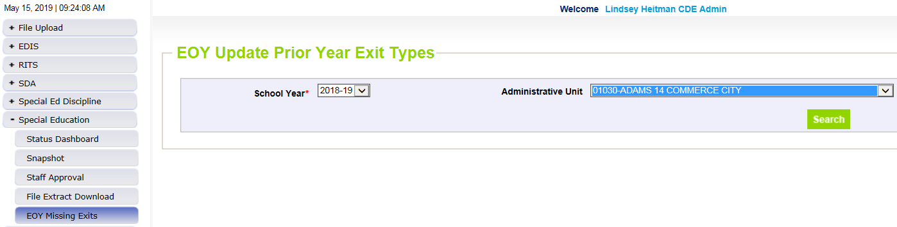
  EOY Missing Exits Screen – students that exited over the summer or didn’t return in the fall
Click Special Education/EOY Missing Exits. Select 2022-23 School Year and click “Search”.
This will bring up your AU’s list of records that are likely “Missed Exits” from prior year. The system will not include any records in this screen that are on your Child or Participation file (whether or not they’ve made it to snapshot yet).
Manually enter the “Missing Exit Type” on the records you have that information for and click “Save”. You don’t have to do them all at once. They will stay visible in this screen through the end of the collection.
Once you create a new snapshot, the saved records will be added to your 21-22 snapshot with a “Date of Entry to Sped” and “Date of Exit from Sped” of 07/01/2022 and the “Basis of Exit” reason you chose.
  This will resolve SY108 when you create a new Snapshot.
  In the COGNOS report “Snapshot Records: Special Education EOY Snapshot Records” you will see records that were added through the EOY Summer Exits screen in column B “EOY Summer Exit” = Y.
    You’ll notice the record count between the Participation file will be different than the EOY Snapshot with the addition of these records.
Select 2022-2023

Slide 61
Excluded from Snapshot:
PAI Code 31 – Contract Student
Records triggering an SY108 errors
  Excluded from the snapshot due to a 31 PAI Code
  If student exited to receive services from another AU on a tuition contract, they will need to be exited on your 22-23 Participation file for Sped EOY purposes. Student should have been reported on Dec Count for funding but should be exited for Sped EOY reporting requirements.
How to Report and clear error SY108:
  “Back date” the school enrollment info to what it was as of the last date of attendance in your AU. Adjust:
    PAI Code
    School Code
    District of Attendance
    Add a Date of Exit and Reason Exited
  This change should bring the record into you snapshot and clear error SY108
  Note: student only needs to be exited from your AU once, so if they have been attending the program for a couple of years and you exited them to the program the first year, leaving them excluded from the snapshot with a 31 PAI code is correct

Slide 62

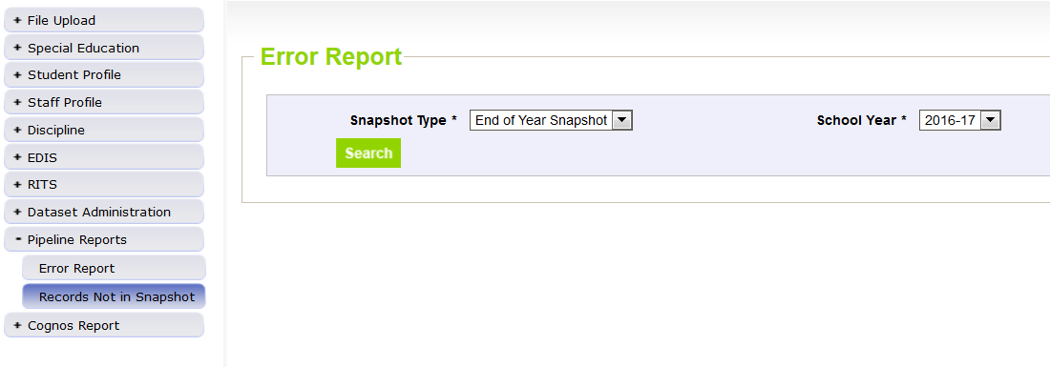
Special Education End of Year – Missing Snapshot Records
Missing Snapshot Records Report-Check it out!
Identify records missing from snapshot due to:
  Interchange errors
  Criteria issues such as excluded PAI codes or mismatched sasids or lasids
  Records missing from either Child or Participation file
Do you have SY107 or SY108 errors? Check this report first!
*2022-2023
Special Education EOY - Lindsey Heitman - heitman_l@cde.state.co.us (303) 866-5759

Slide 63
Exit Tips

Slide 64
Exit Tips
An exit for Sped EOY purposes is a student who has exited from Special Education services in your AU
Student records may have different Exit Codes in regular EOY
A student record that does not ever begin receiving Special Education Part B Services (i.e. Date of Entry to Special Education is zero-filled) should not contain a Date of Exit or Basis of Exit.
Students should never be reported with a Date of Exit or Basis of Exit if:
  He/she is in Path 1 or received only Part C Services.
  An evaluation was never completed.
  He/she was evaluated and found not eligible.
  He/she was evaluated and determined eligible, but services were never initiated.

Slide 65
Exit Codes Fine Print
13 | Transfer to a Public School in a Different Administrative Unit – A student who transfers to a public school, Special Education program, or Detention Center located in another AU within the state (examples: a Special Education student who transfers to another administrative unit and is known to be continuing in a Special Education program, a student going to a detention center run by another school district). This code should be used for students who transfer to CSDB or CMHI-Pueblo.
Note: this includes Special Education Programs and Detention Centers
40 | Discontinued Schooling/Dropped Out – A student who was enrolled at the start of the reporting period but was not enrolled at the end of the reporting period and did not exit special education through any of the other exit means. Students who are extremely ill and unable to continue special education services, not even indirect services, must be coded as Discontinued Schooling/ Dropped Out.
Note: use on any student who left and none of the other exit codes fit. Warning SY282 is there to notify you student is attending in another AU
50 | Expulsion – A student who leaves school involuntarily due to an expulsion approved by appropriate school authorities and is not receiving any education benefits. Students who receive services during expulsion are not considered expelled/exited for EOY purposes.
Note: Only reported when student is expelled and NOT receiving Special Education services during expulsion. Exit code of 50 should also be reported in your Special Education Discipline Snapshot. If they continue Sped services during expulsion, no exit is necessary.

Slide 66
Exit Code tips
Students with a regular End of Year exit code of 26 (transfer to a detention center out of district) would either be coded with an exit code of 13 or 21 on SPED End of Year. It depends on whether the student was detained or committed.
  Code 13 (Transfer to a Public School or program in a Different AU) would be used for detained students.
  Code 21 (Transfer to a Facility Operated by the Colorado Department of Corrections or Division of Youth Services) would be used for committed students.

Slide 67
Data Pipeline Process
Data Pipeline Process

Slide 68
Interchange/Snapshot Process Overview
Create/Update Data Files
Upload files in Data File Upload
Review Batch Maintenance Screen
Review Error Reports
Correct Data Files in Source System
Upload files in Format Checker (optional)
Once No Errors in All Files Needed -> Create Snapshot

Slide 69
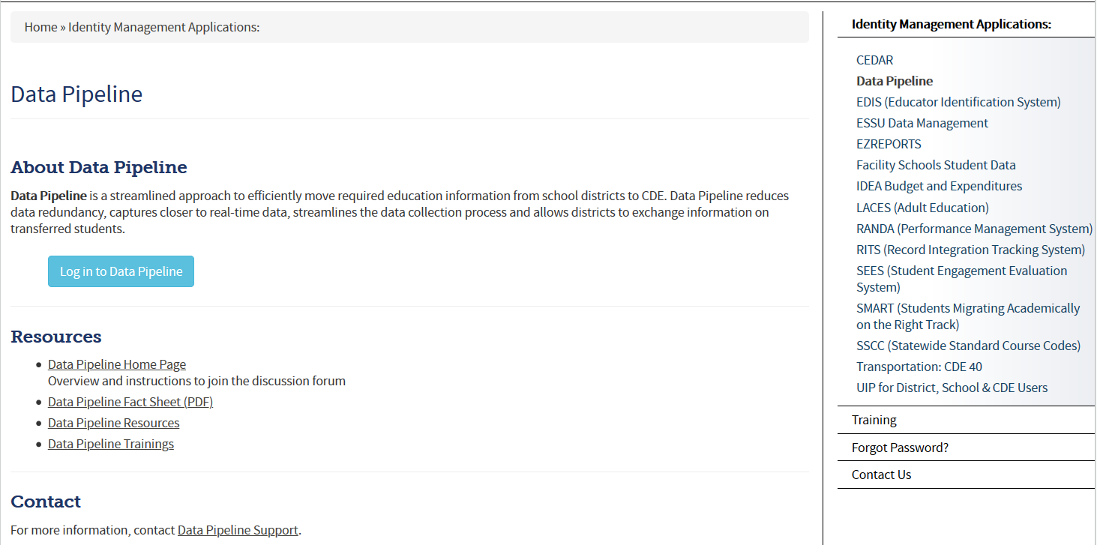
Accessing the Data Pipeline
*your single sign-on login may be used for all CDE applications listed here that you have access to
Bookmark this link: https://www.cde.state.co.us/idm
From this page click Data Pipeline to get to this screen.
Next click the blue login button.

Slide 70
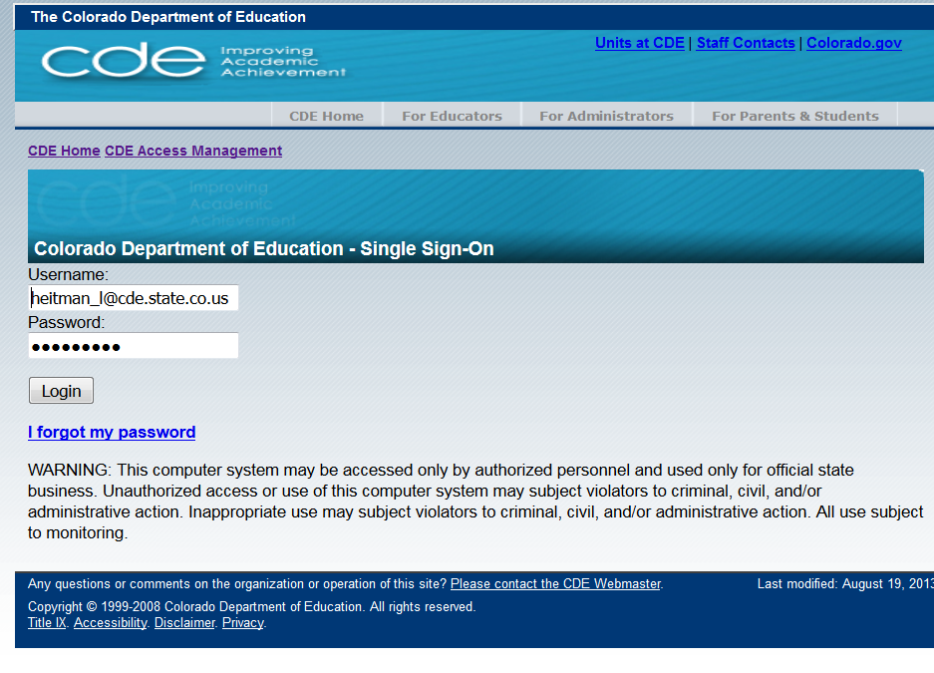
Single Sign On
Username is the email address associated with your IdM account
Password specified by you

Slide 71
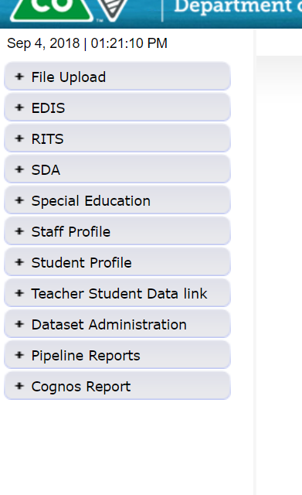
Pipeline System
Batch Maintenance, Format Checker and Data File Upload
Based on your Identity Management Roles
Error reports and other validation reports

Slide 72
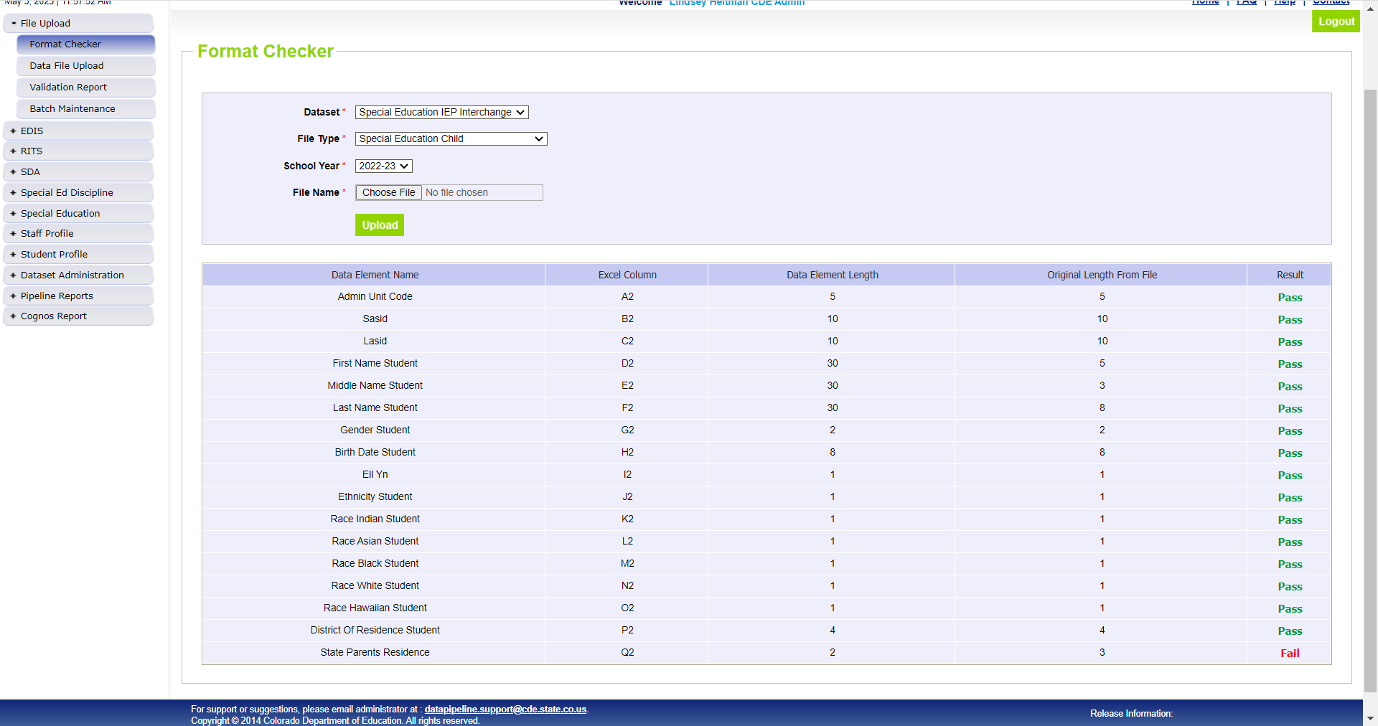
1st Step: Format Checker *optional
Once your file is created, you have the option to run it through the Format Checker to check the file format
The system only checks the first row of data within your file
Only data fields that have too many bytes will error (those with too few will not)
All fields PASS = Ready to upload
Choose appropriate dataset/file type/SY and click Upload
Pass Result – Proceed to Step 2: Data File Upload
Fail Result – compare field bytes to file layout expected # of bytes

Slide 73
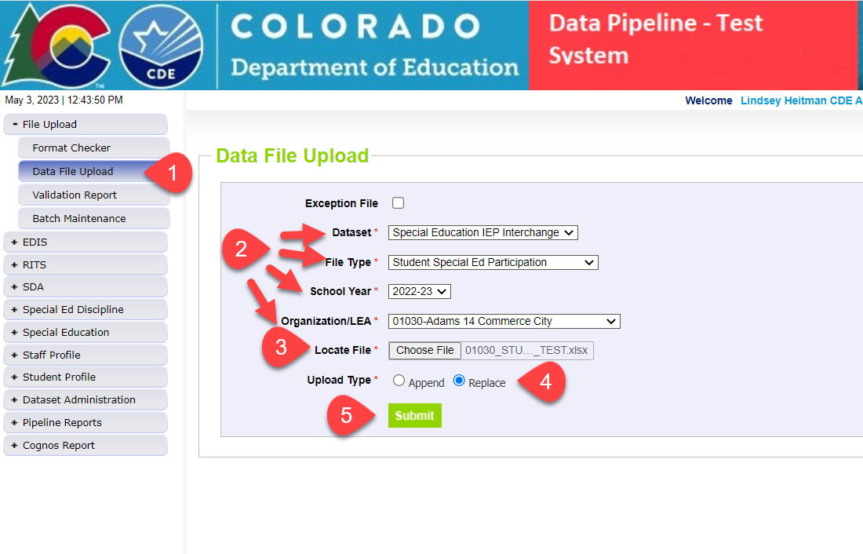
Step 2: Uploading Files to the IEP Interchange
1. Click on File Upload/Data File Upload
2. Select Dataset, File Type, School Year, and Organization/LEA
3. Click on Choose File to locate file
4. Select Replace
5. Click Submit message in green will display across the top indicating file submission has been attempted and a Batch ID will be created
6. Check Batch Maintenance Screen to verify file processed
*Email confirmation will be sent once complete
APPEND – adds to existing data files. Allows for multiple files to be uploaded at one time. Records on all files uploaded that meet the criteria will pull into snapshot.
REPLACE – deletes any prior uploaded data and replaces it with new file. *Most AUs use replace

Slide 74
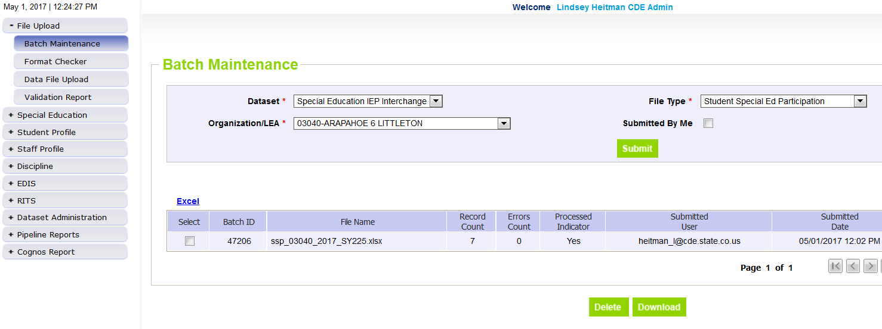
Step 3: Batch Maintenance – Important Step (don’t forget to check this screen after every upload or transfer from Enrich)
Check Batch Maintenance to ensure files have processed successfully.
Processed Indicator will say “YES”. If blank or “No”, file did not upload
Check Record Count, Error Count, and make sure submitted date and time look accurate.
Option to download or delete last uploaded file from this screen. Check the ‘select’ box and click ‘Download’ or ‘Delete’
AFTER EVERY FILE UPLOAD - Verify Record Count, Error Count, Processed Indicator = Yes, Submitted Date!

Slide 75
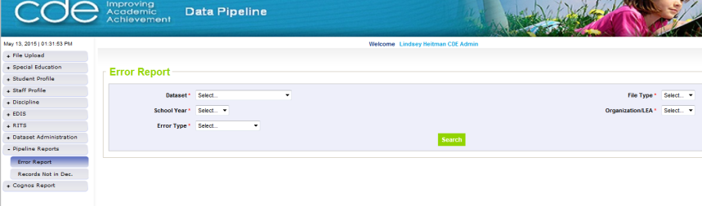
Step 4: Checking IEP Interchange Errors
2 options for viewing error reports
Pipeline Reports- Error Reports
  Interchange and Snapshot level error reports
  Dataset: Special Education IEP
  File Type: select which file you’re working on – Child or Participation
  Export to Excel to view errors in detail

Slide 76
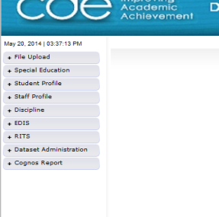
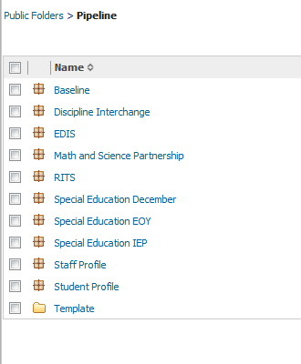
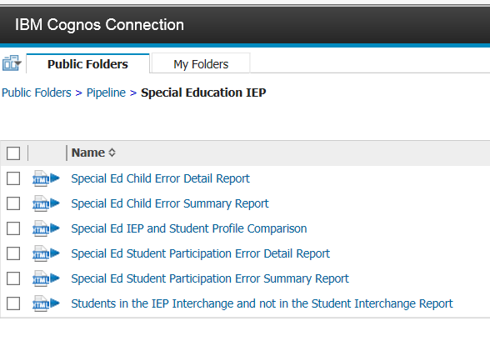
Cognos Reports Option for Checking Interchange Errors
  2. Data Pipeline-Cognos Reports-Special Education IEP:
    Detail and Summary Error Report for each File
    All errors located here so be sure to check before final submission

Slide 77
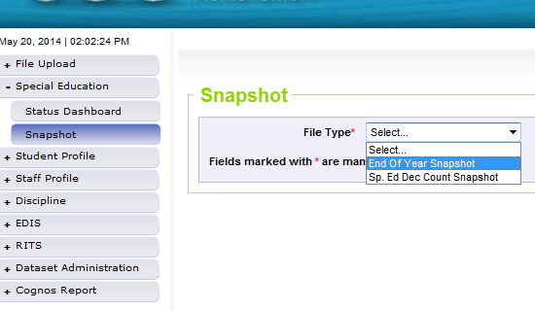
Step 5: Special Education EOY Snapshot
Create Snapshot
  Click the Special Education tab
  Click Snapshot tab
  Select “End of Year Snapshot”
  Click Search to bring up the “Create Snapshot” button in green.
It’s helpful to have all Interchange errors cleared before starting on your snapshot errors
Why? Because records with errors at Interchange level will not pull into snapshot validations so you may be wasting your time looking into snapshot errors

Slide 78
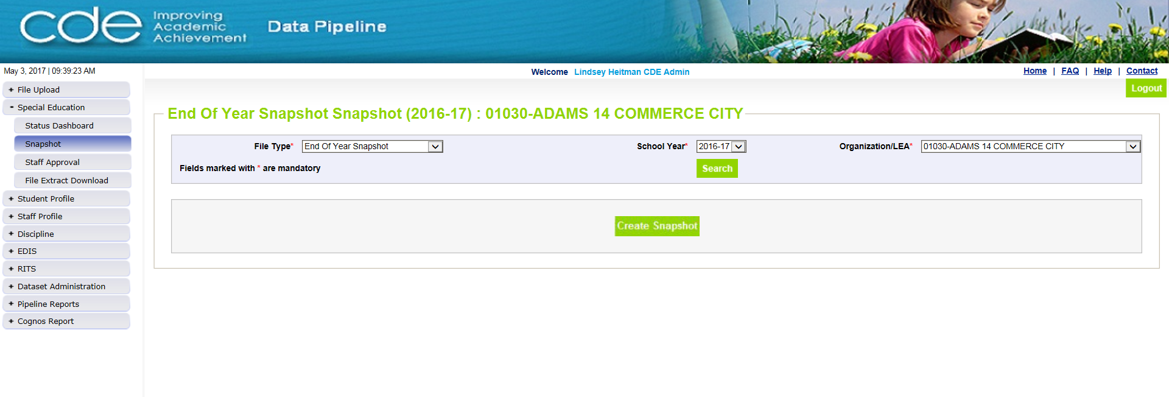
Creating a Snapshot
Select school year and organization
Click “Create Snapshot”
A message will display in green once it’s processing:
“Snapshot creation triggered and processing. A notification email will be sent upon completion.”

Slide 79
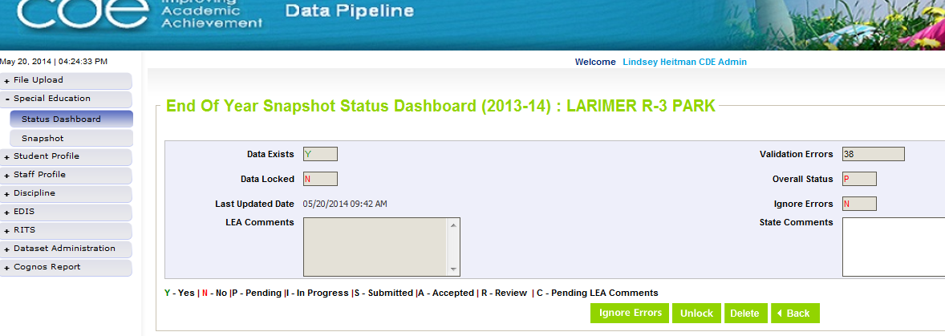
Step 6: Status Dashboard-
Check Status of Snapshot
Be sure that Data Exists (Y)
Check to see that Last Updated Date is the most recent snapshot created
View and resolve your Snapshot Errors (these are your level 2 snapshot errors)

Slide 80
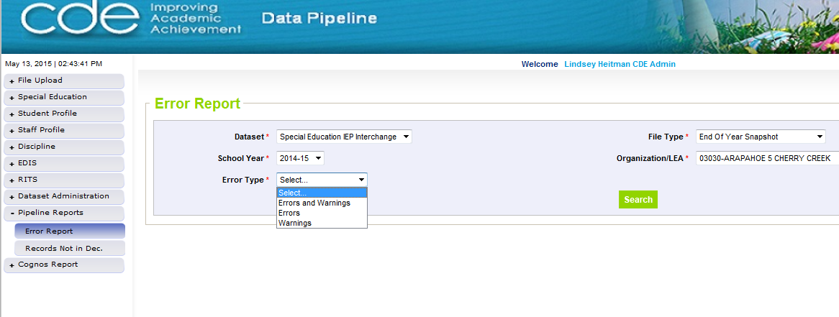
Step 7:
Check Snapshot Errors under Pipeline Reports
Pipeline Reports-Error Reports
This error report will only
show the first 1000 errors!

Slide 81
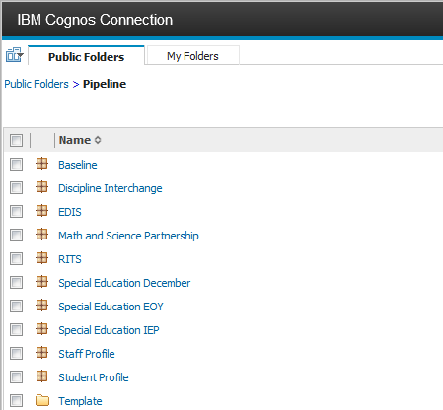
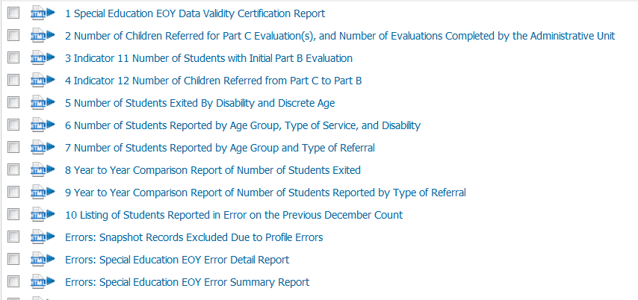
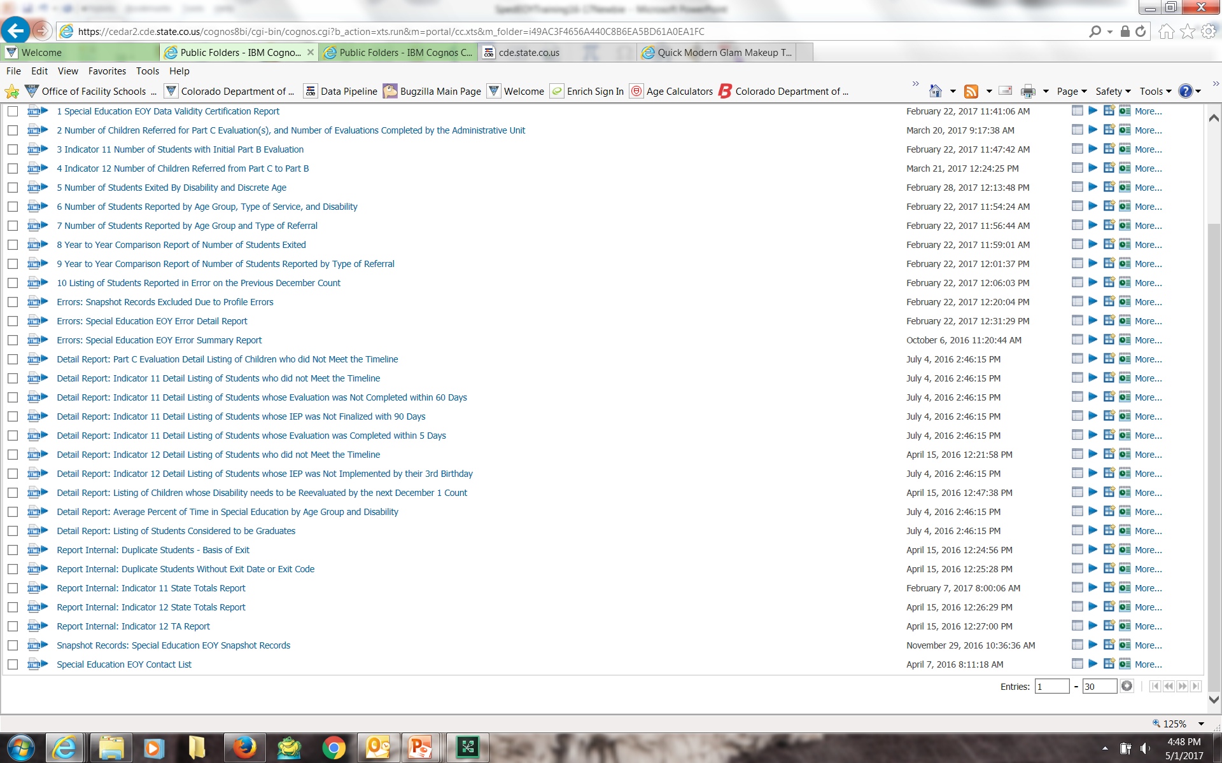
OR find errors under Cognos Reports
Click Cognos Reports (or Pipeline Reports) and then Special Education EOY:
Records with errors at Interchange
Snapshot error details
Snapshot error summary
re
snapshot records – check this report to ensure snapshot has the correct number of records you’re expecting

Slide 82
Records Not in Snapshot Report
Do you have the correct number of records in your snapshot? Verify and check this report for missing records!
Identify records missing from snapshot due to:
  Interchange errors
  Criteria issues such as excluded PAI codes or mismatched sasids or lasids
  Records missing from either Child or Participation file

Slide 83
More on Cognos Reports

Slide 84
Reviewing Data Reports AFTER you are error free
Once All Errors are corrected, review your Cognos validation/detail reports for accuracy. Errors do not catch everything!
If after reviewing, you notice something that needs to be fixed:
  IEP Interchange File(s) will need to be resubmitted
  Special Education EOY Snapshot will need to be re-created
    Reports are created from your last snapshot so any changes to files will change your reports.
Final Reports Submission and Data File Approval within Data Pipeline are the last steps-NOT until September after we complete the duplicate process:
  Once you’ve reviewed the reports and made all changes:
    Submit the 10 reports required for signature to the ESSU Data Management System
    Then in Data Pipeline, click the “SUBMIT TO CDE” button. Only the Sped EOY Approver will have ability to do this
    Finalizes the data for CDE to begin their validation process before submission to the federal government

Slide 85
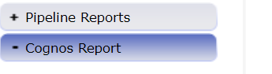
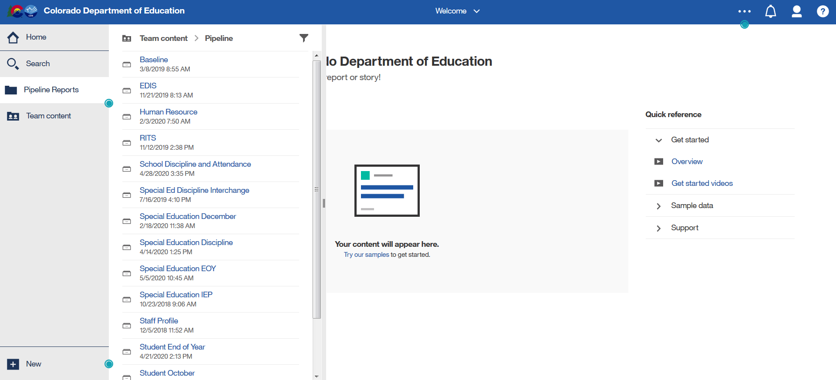
Cognos Reports – Special Education EOY
This screen is what you will see after clicking ‘Cognos Reports’
1.
2.

Slide 86
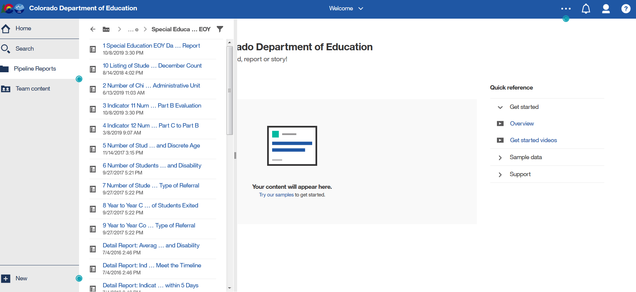
Sped EOY Cognos Report List
Scroll down to see full report list
Expand screen to the right to see full report name
*Ignore the date and time listed under the report (internal use)

Slide 87
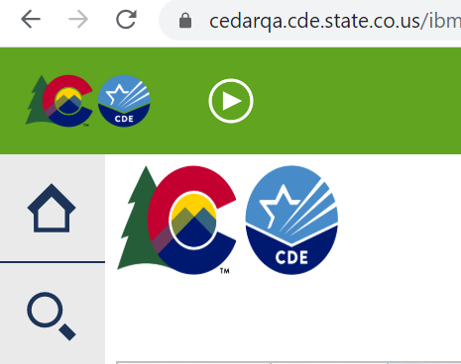
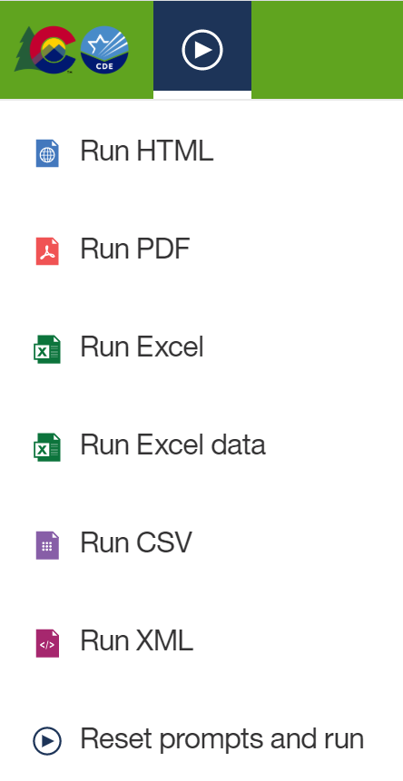
Exporting to Excel
Click on ‘Play’ Button
(available when a report is showing)

Slide 88
Cognos Tips – Strange error screen?
Clear your browser cache
Chrome is the recommended browser
Microsoft Edge is not compatible
If you run into errors or your report won’t run:
  Clear your browser cache
  Completely shutdown browser (close all tabs)
  Open a new browser (preferably Chrome)

Slide 89

Your participation is appreciated!

