Slide 1
Teacher Student Data Link (TSDL) Interchange and Snapshot 2020-2021

Slide 2
Agenda
TSDL Interchange
Overview
2020-2021 Steps
Interchange Process
Data Uses
Populate CRDC
Migrant Student Reporting
Course Participation Reports
Educator Preparation Program Report
General
Authority to Collect
Timeline
Overall Process
Resources
Online
Contacts
Resources
Overview of Updates from 2019-2020

Slide 3
General Information

Slide 4
Authority To Collect
Derived from both Colorado Revised Statutes (C.R.S) and the Colorado State Board of Education’s rules:
Concerning Statutory Changes to K-12 Education, House Bill 13-12-19: 22-2-116.5
Course Participation and Student Proficiency Reports, House Bill 14-1376: 22-11-503.5
Monitoring of Written Evaluation System, C.R.S. 22-9-106 (1.5) (a-b)
Rules for administration of a statewide system to evaluate the effectiveness of licensed personnel employed by school districts and boards of cooperative services 1 CCR 301-87(6.04) (i), (A), (C) (2) (b, d, and e), and (C) (3) (a).
Commissioner Duties - reviewing the content of educator preparation programs in Colorado, C.R.S. 22-2-112 (p-q); Commission directive--approval of educator preparation programs—review, C.R.S. 23-1-121 (6)

Slide 5
Overall Process
TSDL Interchange
Upload TSDL Upload File
TSDL Snapshot
Review Reports
Finalize Data
CDE Reports
Pre-populate CRDC
Migrant Student Reporting
Course Participation Reports
Educator Preparation Program Report

Slide 6
TSDL Timeline
Late October Interchange Opens
January 27th Snapshot
Opens
May 7th
Upload Interchange at least once
July 30th
Interchange and Snapshot Error Free
August 13th
Finalize Snapshot
June 11th
Create Snapshot at least once

Slide 7
Overview of Updates from 2019-2020

Slide 8
Process Updates
2019-2020 Process
2020-2021 Process
SSCC File
TSDL Snapshot
TSDL Upload File
TSDL Snapshot
COE File
COI File
THEN….
NOW
Teacher Student Data Link – Annette Severson – Severson_a@cde.state.co.us

Slide 9
TSDL File Fields
TSDL Interchange File Fields
School District/BOCES Code
School Code
Local Course Identifier/Code
Local Course Title
Course Level
Credits
Section Number
Term
State Course Code
Educator of Record EDID
Educator of Record Staff's First Name
Educator of Record Staff's Last Name
Contributing Professional EDID
Contributing Professional Staff's First Name
Contributing Professional Staff's Last Name
SASID
Student's Last Name
Student's First Name
Student's Gender
Student's Date of Birth
Student’s Grade Level
Roster Start Date
Roster End Date
Credits Granted
Course Completion Status
Previously in Course Instructor File
Previously in Course Enrollment File
Previously in State Course Code File

Slide 10
Record Expectations
Teachers
Courses
Students
Grade's 6th -12th
Class for 6+ Weeks
Math, Science, ELA, Social Sciences, AP* & Computer Science*
Migrant
8th-12th Grade
Class for 6+ Weeks
All Courses
Course Completion Status
Class for 6+ Weeks
Math, Science, ELA, & Computer Science*
Grades 6th -12th
District Employee
Include both Local & State Course Code in File
* Required for Civil Rights Data Collection Only

Slide 11
ALL Students
6th-12th grade students enrolled in one or more of the following for at least 6 weeks should be reported in the TSDL file:
Math
Science
English Language Arts
Social Sciences
*Any Advance Placement Course for Civil Rights Data Collection assistance
*Computer Science for Civil Rights Data Collection assistance

Slide 12
Migrant Students
8th-12th Grade migrant students must be reported in the TSDL File if enrolled for at least 6 weeks :
For ALL courses
including Course Completion Status &
Credits Earned

Slide 13
Course Codes
All Local Course Code must be reported with the corresponding State Course Code in the TSDL Upload file
To assist with finding the State Course Codes, you can use:
SCED Code Finder: http://nces.ed.gov/scedfinder/
Excel list of SCED codes: https://www.cde.state.co.us/datapipeline/scedcodesversion8oct2020
Crosswalk (prior year codes to updated codes): https://www.cde.state.co.us/datapipeline/scedcodescrosswalkpriorcodestocurrentcodes20202021
ALL Links found in the TSDL Interchange Page under ‘Additional Resources’

Slide 14
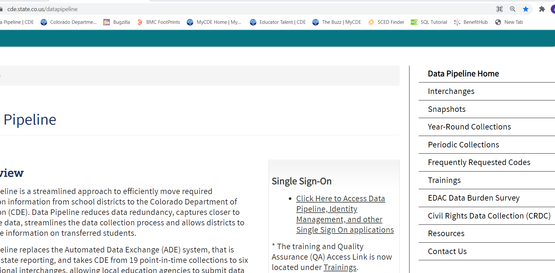
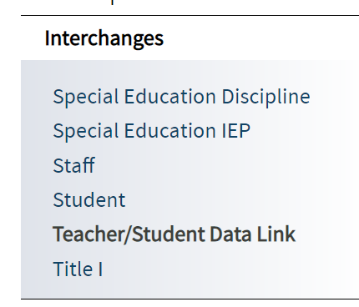
https://www.cde.state.co.us/datapipeline

Slide 15
SCED Codes - Common Questions
How is a course coded when it is mapped to 2 different state course codes?
The course would be reported in 2 records, with the difference being the State Course Code
Where do I find or map the local course code to a state course code?
The latest state course codes can be found on the SCED Code Finder website or the excel SCED Code list, info posted on the TSDL Interchange webpage
If the state course code you were previously using has been expired, you may reference the SCED Code Crosswalk (prior codes to current codes) to find the updated code to use instead.
The courses are mapped within your system only now. The SSCC System is no longer active. You report the Local Course code along with the mapped State course code in the TSDL Upload file.
Teacher Student Data Link – Annette Severson – Severson_a@cde.state.co.us

Slide 16
Educators
All district employed educators teaching a 6th-12th grade course for at least 6 weeks in the following subjects should be included in the TSDL File:
Math
Science
English Language Arts
*Computer Science for Civil Rights Data Collection assistance
If the educator is not a district employee or the course reported is not one of the subjects listed above, then the Educator fields can be left blank in the TSDL File

Slide 17
Summary of Changes
Instead of having 3 files uploaded that must all match exactly, now you will upload only 1 file
1 file will contain all pertinent information
Must have State Course Code included in the file
Must include teacher of record where applicable
Must include all 8th-12th grade migrant students and courses
Must include all 6-12th grade students enrolled in Math, Science, ELA, Social Sciences, AP* & Computer Science*

Slide 18
Interchange Process

Slide 19
Identity Management Roles (same as before)
Teacher Student Data Link Interchange Roles:
TSL~ LEAUSER – upload and modify TSDL interchange files OR
TSL~LEAVIEWER – view (only) TSDL interchange data
Teacher Student Data Link Snapshot Roles:
TLS~LEAAPPROVER – Approves, creates, views Snapshot OR
TLS~LEAUSER - creates, views Snapshot OR
TLS~LEAVIEWER- views snapshot

Slide 20
Interchange Process
Upload files in Data File Upload
Review Batch Maintenance
Review Error Reports in Cognos/Pipeline
Correct Data Files in Source System
Create/Update Data Files
- Continue until all errors are resolved

Slide 21
Creating Files
Pull data files from SIS Extract
Create TSDL File
File Layout found online at: https://www.cde.state.co.us/datapipeline/inter_teacherstudent
File Requirements:
Excel, CSV or Text File all accepted
Need 2 separate files
1st record of data must be field names/titles

Slide 22
Tips on Files
Excel, CSV, or Text formats are accepted
Simple Excel template for Course Enrollment and Course Instructor Files posted online https://www.cde.state.co.us/datapipeline/inter_teacherstudent under Templates (however, it is not necessary to use a template if your file already extracts in one of the accepted formats)
No spaces in file name
No blank fields
Be sure the file is not open when uploading
Be sure you haven’t lost all your leading zeros on a CSV file or it won’t upload (steps for saving them posted online)

Slide 23
Required 6th - 12th Grade Courses
Mathematics
Science
Social Studies
English Language Arts
Computer Science – to be included in CRDC
ALL AP Courses – to be included in CRDC
All other courses may be included but are not required to be reported in the Course Enrollment or Course Instructor files
CRDC is for Civil Rights Data Collection; 2020-2021 is a CRDC reporting year

Slide 24
Required for 8th-12th Grade Migrant Students
ALL courses attended must be reported
To view list of migrant students reported within your district:
Log into Data Pipeline
Click on the ‘Cognos Report’ tab on the left
In Cognos, go to the Pipeline Reports
Choose the Teacher Student Data Link folder
Open the Migrant Student List report

Slide 25
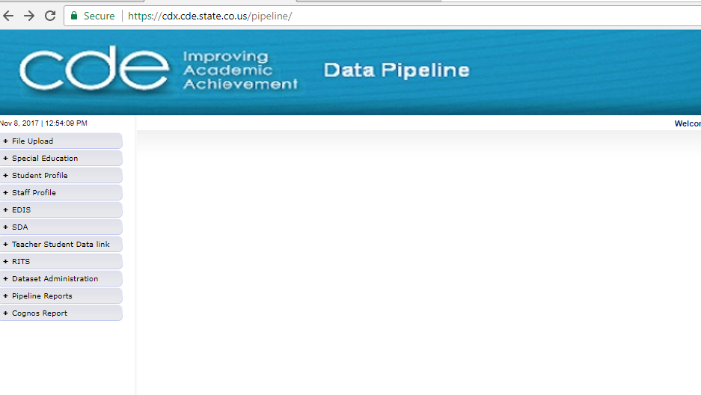
Pipeline Website Review
Batch Maintenance, Format Checker and Data File Upload
Based on your Identity Management Roles
Error reports and other validation reports

Slide 26
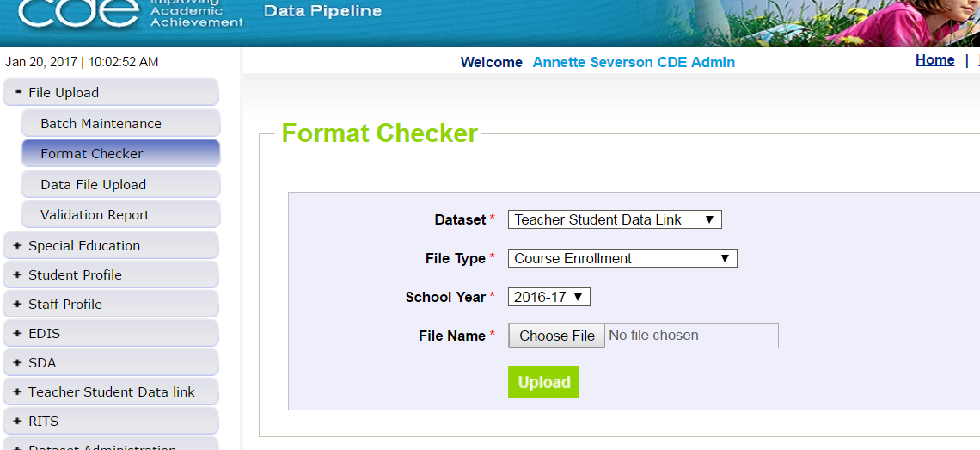
File Upload – Format Checker
TSDL file

Slide 27
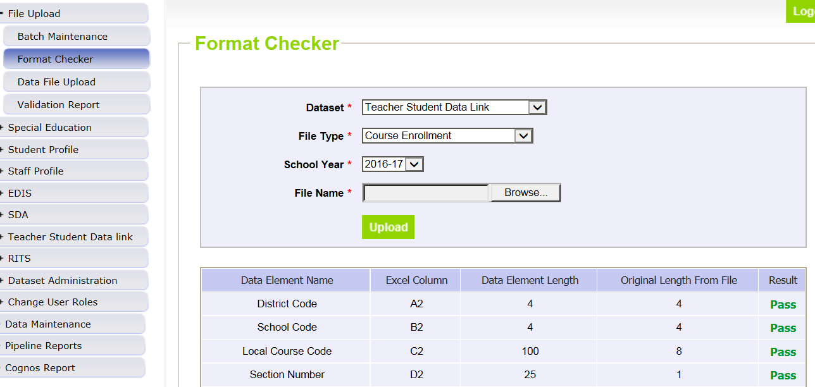
Format Checker – Upload Results

Slide 28
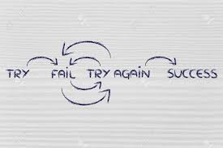
Format Checker Notes
Format Checker will only review the 2nd row in your file
Passing format checker Does Not Equal file will process
Green ‘Pass’ for each field is desired result
Red ‘Fail’ for a field indicates file is not in the correct format- please refer to the 2020-2021 file layout on web

Slide 29
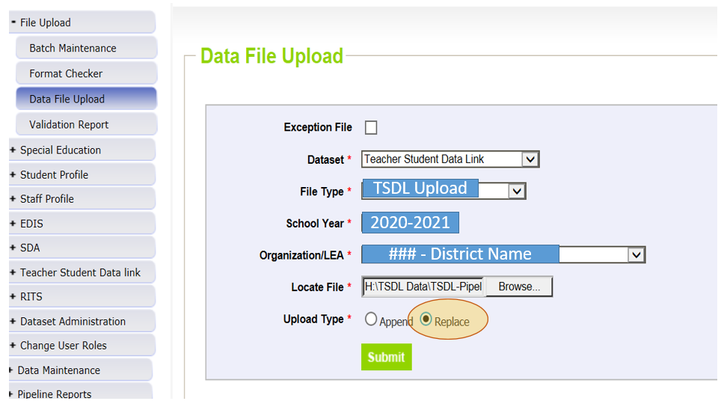
Data File Upload

Slide 30
Data File Upload Types
Append = adds file to existing file, all records from both files included
Can be tricky with fixing errors
Replace = deletes any prior data file and replaces it with the file being uploaded
RECOMMENDED

Slide 31
Batch Maintenance Screen – Not Processed

Slide 32
File Not Processed – Next Steps
Ensure file has all green ‘pass’ in format checker
YES?
Open file and review all records are formatted the same as the 2nd row
Be sure all codes and dates have leading zeros included
NO?
Review file layout posted online and re-format the file
For further assistance, contact Annette Severson
DO NOT INCLUDE THE FILE IN ANY EMAILS; instead email for assistance and a Syncplicity folder can be created and shared

Slide 33
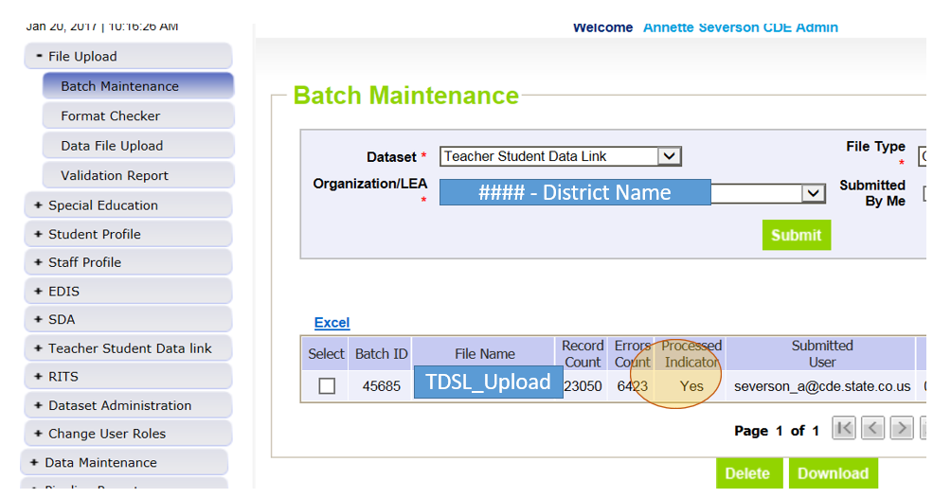
Batch Maintenance – File Processed

Slide 34
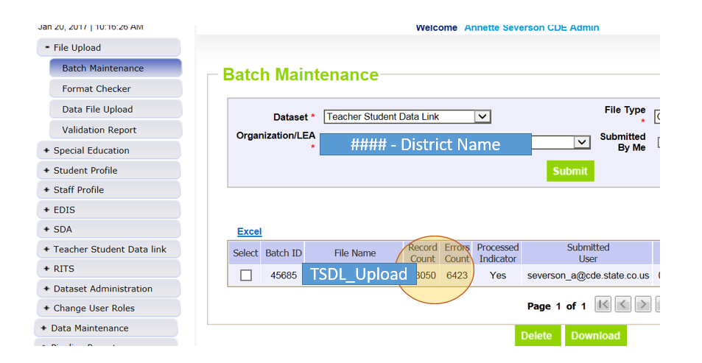
File Processed – Next Steps
Use same screen to see the Number of Errors:

Slide 35
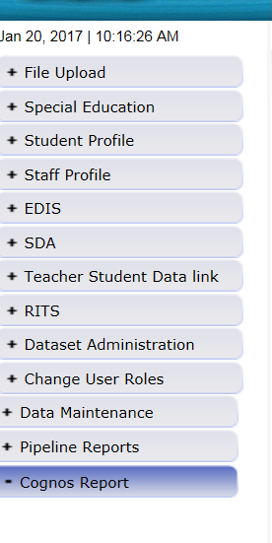
Review Errors in Detail
2 methods available:
Data Pipeline Reports -> Error Reports
Cognos Reports – > Teacher Student Data Link

Slide 36
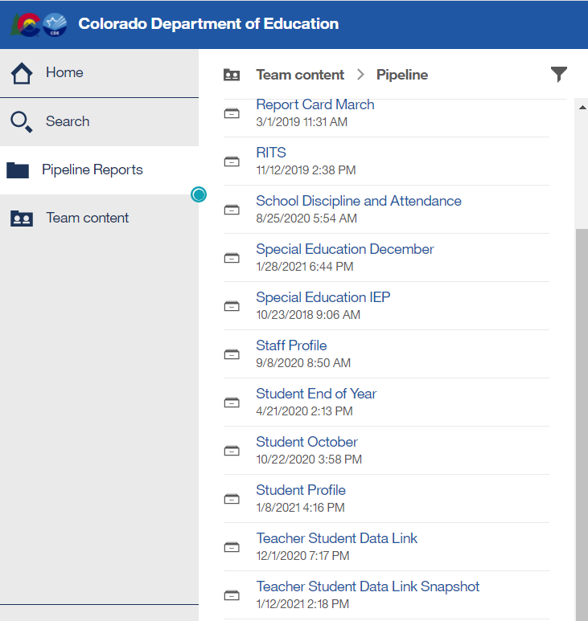
Clicking on Cognos Reports- Opens in a new Screen
Interchange File Reports
Snapshot Reports

Slide 37
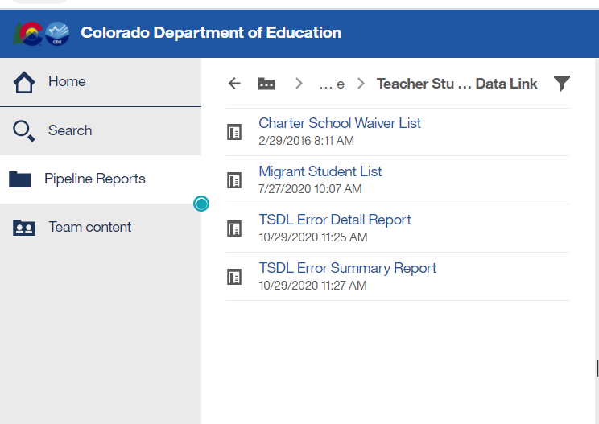
TSDL Interchange Reports
Charter School Waiver List – Schools that are waived from reporting Educator Records
Migrant Student List – Students indicated as Migrant based on the SASID and Student School Association file
Detail Reports – provides detailed records with descriptions of error
Summary Reports – provides a count of records by type of error
*Do Not Send reports via email to CDE for assistance; CDE has access to these reports in cognos already

Slide 38
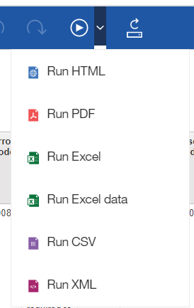
Error Detail Report- Excel
#1
First, click on the ‘play’ button on the top
Then, choose Run Excel report or Run Excel data
#2

Slide 39
Error Reports
Error Detail Report
Provides specific records causing the error with the error description
Can select to View ALL error records or 1 type of error at a time
Error Summary Report
Provides a count of errors generated per error type and description
Resubmit file as needed for corrections for all data errors to be resolved
Be sure to update source file with corrections as well

Slide 40
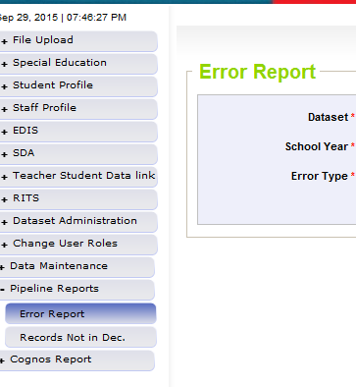
Pipeline Reports
Search:
Dataset = Teacher Student Data Link
School Year = 2020-2021
Error type = Errors and Warnings
File Type: TSDL Upload
Org/LEA = Code
Click ‘Search’

Slide 41
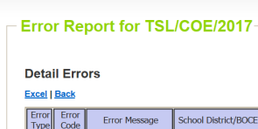
Pipeline Error Reports – Viewing Details
Summary of Errors in File are next provide
Click on ‘View Details’ to view each record with the error
Choose ‘Excel’ to download error report in Excel – recommended

Slide 42
Correcting Errors
Correct the errors in the file:
Keep file versions – in case updated file causes even more errors, you can re-start using a prior file version
CDE does not maintain these versions, once the file has been replaced, all prior data files have been deleted in pipeline
Resubmit your data records using the same process and replacing your existing data file using the Data File Upload tool
All errors must be corrected, all warnings should be reviewed

Slide 43
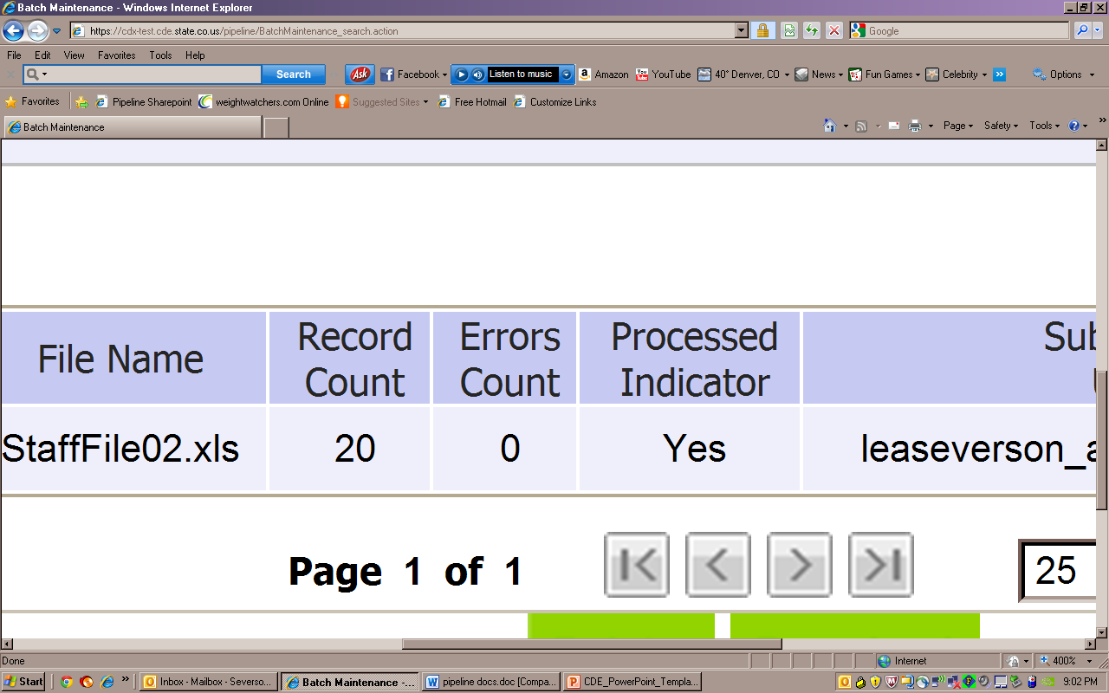
Batch Maintenance: No Errors
TSDL_Upload

Slide 44
Next Steps – TSDL Snapshot
TSDL Upload File Error Free
Create TSDL Snapshot

Slide 45
TSDL Interchange Resources
TSDL Interchange Documentation found at: http://www.cde.state.co.us/datapipeline/inter_teacherstudent
Contact:
Annette Severson: severson_a@cde.state.co.us or 303-866-6824

Slide 46
Snapshot Process

Slide 47
Snapshot Flowchart
Create TSDL Snapshot
Errors? If Yes, Review Error Reports
Correct Interchange File as Needed
Upload Corrected Error Files
Finalize (Data Reviewed as Accurate)
Create new TSDL Snapshot
Errors? If Not, Review Cognos Reports
Send Signed Verification form to CDE

Slide 48
Teacher Student Data Link Snapshot: Access
Local Access Manager (LAM) will need to assign you prior to logging into Pipeline
TLS_LEAAPPROVER – creates, views and finalizes data
TLS_LEAUSER – create and review snapshot data
TLS_LEAVIEWER – View the data only (not modify or submit)
Can only be assigned one or the other.

Slide 49
Creating Snapshot Steps
Log into Data Pipeline
Click on Teacher Student Data Link tab (on the left)
Select ‘Snapshot’ from the expanded list
Enter appropriate search criteria (Teacher Student Data Link Snapshot/2020-2021/Org Code)
Click on Search (green button on bottom)
Select ‘Create Snapshot’
New message should appear: “Snapshot creation triggered and processing. A notification email will be sent upon completion.”

Slide 50
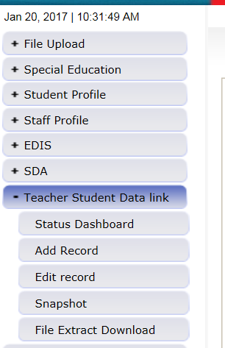
Selecting Teacher Student Data Link -> Snapshot

Slide 51
TSDL Snapshot Screen

Slide 52
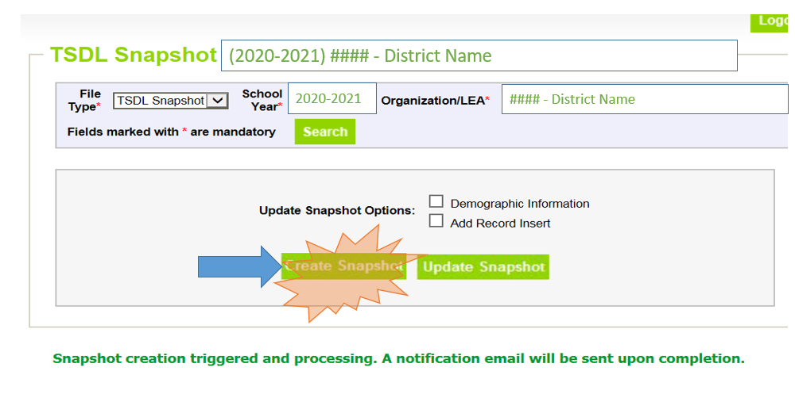
Creating Snapshot- Screenshot

Slide 53
Next Steps
View Status of TSDL snapshot
Email will be sent with status
Status Dashboard screen –shows if processed and # of errors
View Snapshot errors in Cognos or Data Pipeline
Make corrections to Teacher Student Data Link interchange file
Upload updated Teacher Student Data Link interchange file
Re-create Teacher Student Data Link snapshot

Slide 54
Status Dashboard Screen

Slide 55
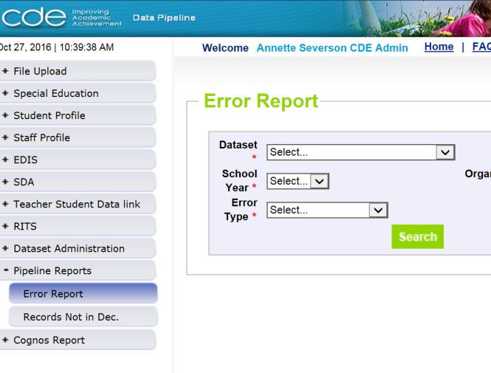
Viewing Errors in Data Pipeline

Slide 56
Edits
Edits are in place to assist with providing most accurate information to CDE which is published, analyzed and reviewed by legislators, federal government, researchers, etc.
Edits should provide adequate information to assist you with determining corrections needed.

Slide 57
Finalizing Steps
Once all Errors are resolved in Snapshot…
Review, review, review data reports for accuracy!
If mistakes/misreporting is found, correct files again and create new snapshot
If data reports are all accurate- you may finalize the data by submitting it to CDE
http://www.cde.state.co.us/datapipeline/tsdl-snap-reports-guide

Slide 58
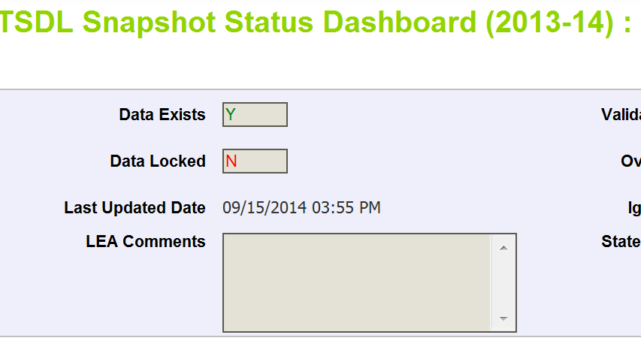
Finalizing Data
Once data is accurate-all reports reviewed and correct…
TLS~LEAAPPROVER for district will need to ‘Submit to CDE’
TSDL Snapshot Status Dashboard (2020-2021):
Star
Submit to CDE

Slide 59
Data Uses and Reports

Slide 60
Quick Overview
Course Taking Reports
Educator Preparation Program Report
Migrant Education
Civil Rights Data Collection (CRDC)
Educator Effectiveness Metrics*
*Timeline for incorporating TSDL data into the metrics has not yet been determined.

Slide 61
Course Participation Report

Slide 62
Course Participation Report Requirements
As outlined in legislation (HB 14-1376), the report must include:
Student participation in each core course level (math, English, science and social science) disaggregated by student groups; and
When available, the proficiency levels of students in each core course level as measured on the statewide assessments, disaggregated by student groups.
Schools and districts are required to conduct an analysis of the course enrollment data in their Unified Improvement Plans (UIPs). If disparities are discovered, then actions should be documented in the action plan.

Slide 63
Course Participation Report Components
TSDL
English Language Arts, Math, Science, and Social Studies course only
Student October/EOY
Assess-ment Data
CMAS ELA, CMAS Math, PSAT/SAT EBRW*, PSAT/SAT Math
Course Taking Report
Participation in Courses by Title and Rigor
Assessment Performance by Course (by Title and Rigor)
*EBRW = Evidence-Based Reading and Writing

Slide 64
Course Participation Report Access
http://www.cde.state.co.us/cdegen/studentopportunitygaps
Levels of Course Participation Report
 | District | School
Password-Protected | Includes student level drill-down No suppressions applied Counts/means rolled up to district level Accessible through identity management role permissions | Includes student level drill-down No suppressions applied Counts/means rolled up to school level Accessible through identity management role permissions
Public | N of 16 suppression applied to all data Counts/means rolled up to district level Accessible through report website | N of 16 suppression applied to all data Counts/means rolled up to school level Accessible through report website

Slide 65
Course Participation Report Screenshot
The landing page lets you select your school (or district) and the year
The district reports have a separate landing page

Slide 66
Course Participation Report Review
The Overview/Background Data tab displays enrollment data for context

Slide 67
Course Participation Report Review
The Participation and Achievement Data tab displays counts of students enrolled by subject and course level.
Assessment data is not yet available.

Slide 68
Course Participation Reports Available
2016-2017 and 2017-2018 data is currently available:
Reports include:
Course participation
Enrollment data
Assessment performance by course enrollment
Mean scale score
Assessment participation
2018-2019 data will not be available (year was paused)
2019-2020 data will also not be available due to the impact of COVID-19

Slide 69
Course Participation Report Contact
B Sanders
Accountability Senior Consultant
303.866.2865
Sanders_b@cde.state.co.us

Slide 70
Educator Preparation Program Report

Slide 71
Educator Preparation Program (EPP) Report
First released in December 2019
A joint agency report co-authored by CDE and Colorado Dept. of Higher Education
To fulfill statutory requirements in CRS titles 22 and 23. To include data on:
Preparation program enrollment & completers
Educator outcomes:
student academic growth
educator placement
educator mobility and retention
educator performance evaluation ratings
Enrollment and completion reported for all educators in a Colorado educator preparation program, but outcomes only reported for new teachers who completed a Colorado educator preparation program.
Reports will be produced annually
Due to TSDL pausing for 2018-2019 and state assessment requirements being paused in 2019-2020, student academic growth will not be included in the first report (released December 2019) or the second report (scheduled for December 2020).’
TSDL data are necessary because each teacher must be connected to their own students’ growth and achievement

Slide 72
Educator workforce pipeline: Enrollment in preparation program to retention in teaching
Enrollment and Completion
How many candidates enroll each year?
Employment
What is the in-state placement rate for initial licensure completers?
Classroom Performance
Overall, how do teachers perform in the classroom?
How many candidates complete prep program each year? In which endorsement areas?
Where are completers working?
What subject areas do these completers teach?
On average, what is their students’ academic achievement?
On which standard level do teachers excel or struggle?
What is the context in the districts where novice teachers work?
Teacher Retention and Mobility
How frequency are teachers leaving?
Are teachers more likely to leave in certain types of districts?

Slide 73
Statutory Requirements: Educator Preparation Report
22-2-112 and 23-1-121 (Annual Report on Effectiveness of Educator Preparation Programs)
22-2-112(1) Subject to the supervision of the state board, the commissioner has the following duties:
(q) (I) To assist the state board in reviewing the content of educator preparation programs offered by institutions of higher education within the state. In so doing, the commissioner shall direct the department to collaborate with the department of higher education to prepare an annual report on the effectiveness of educator preparation programs.
(II) For purposes of this paragraph (q), the department shall use data collected from an educator in his or her first three years of placement as the educator of record.
(III) … the report required pursuant to this subsection (1)(q) must include, but need not be limited to, the correlation between different educator preparation programs in the state, including alternative educator preparation programs, and student academic growth, educator placement, educator mobility and retention, and educator performance evaluation ratings.
(IV) The department shall work collaboratively with educator preparation programs and the department of higher education and make the report prepared pursuant to this paragraph (q) available to the public on its web site no later than thirty days after its completion. The department shall share the information with educator preparation programs to inform curriculum and program improvements.

Slide 74
Educator Preparation Program Report Contacts
Carolyn Haug
Director, Research & Impact
303-866-6923
Haug_c@cde.state.co.us
Molly Gold
Strategic Data Analyst
303-866-6223
Gold_m@cde.state.co.us

Slide 75
Migrant Education

Slide 76
TSDL and Migrant Education
The Migrant Education Program pulls on the following fields from TSDL to populate its Student Information System.
Migrant children often enroll in multiple schools and school districts for varying amounts of time each year.
Without timely access to the critical information contained in these records, school personnel may not be able to enroll migrant students, make appropriate grade and course placement decisions, and ensure the accrual of secondary school course credits.
District Code
School Code
State Course Code
Local Course Code
Section Number
Term
Course Title
SASID
Student’s Last Name
Student’s First Name
Gender
Student’s DOB
Roster Start Date
Roster End Data
Grade Level
Credits
Credits Granted
Course Completion Status

Slide 77
TSDL/Migrant Data
In addition to fields required for all students, districts are required to report the following field for students identified as migrant in grades 8-12.
Credits Granted

Slide 78
Migrant Contact Information
Brenda Meyer
Migrant Analyst and Data Manager
303.866.6744
meyer_b@cde.state.co.us

Slide 79
Civil Rights Data Collection (CRDC)

Slide 80
Data Reporting – CRDC on behalf of districts
Since 1968, the U.S. Department of Education (ED) has conducted the Civil Rights Data Collection (CRDC) to collect data on key education and civil rights issues in our nation's public schools
Collection is completed every other year; 2020-2021 will be a CRDC reporting year
TSDL data elements provide 23% of all data elements CDE pre-populates for LEAs
If data is missing from TSDL, these fields must be completed by the CRDC Contact
Communicate with your district CRDC contact on what is/isn’t being reported in the TSDL files this year

Slide 81
TSDL Data Used for CRDC
Student’s Grade Level (for Course)
Student’s Gender
State Course Codes:
Course Completion Status
Roster Start and End Dates
Educator of Record EDID
Algebra I and II
Geometry
Advanced Math
Calculus
Biology
Chemistry
Physics
IB Classes
AP Classes
Computer Science

Slide 82
Civil Rights Data Collection (CRDC) Contact
Annette Severson
Principal Data Specialist
303-866-6824
Severson_a@cde.state.co.us
Jan Petro
Director, Data Services
303-866-6838
Petro_j@cde.state.co.us

Slide 83
Educator Effectiveness Metrics

Slide 84
Educator Effectiveness (EE) Metrics
Annually released
Provides information regarding educator performance ratings
To fulfill statutory requirements in C.R.S. 22-9-106 (1.5) (a-b) and rule requirements in 1 CCR 301-87 (6.01).
Monitors district and BOCES implementation of the requirements for local licensed personnel evaluation systems. To include data on:
Distribution of overall performance evaluation ratings and standard level ratings
Equitable distribution of effective and highly effective educators
Correlation between student performance outcomes and the assignment of educators to performance evaluation ratings
TSDL data are necessary because each teacher must be connected to their own students’ growth and achievement
Correlation between student performance outcomes and educator effectiveness ratings will be implemented in Phase II of the EE Metrics. The timeline for Phase II has not yet been determined.

Slide 85
Educator Effectiveness Metrics Contacts
Carolyn Haug
Director, Research & Impact
303-866-6923
Haug_c@cde.state.co.us
Molly Gold
Strategic Data Analyst
303-866-6223
Gold_m@cde.state.co.us

Slide 86
Resources

Slide 87
Online Resources
Teacher Student Data Link Interchange (TSDL Interchange):
https://www.cde.state.co.us/datapipeline/inter_teacherstudent
Teacher Student Data Link Snapshot (TSDL Snapshot):
https://www.cde.state.co.us/datapipeline/tsdl

Slide 88
CDE Contacts
State Standard Course Codes Teacher Student Data Link Interchange Teacher Student Data Link Snapshot | Annette Severson – severson_a@cde.state.co.us
Educator Preparation Program Report Educator Effectiveness Metrics | Carolyn Haug – haug_c@cde.state.co.us Molly Gold – gold_m@cde.state.co.us
Migrant Education | Brenda Meyer - meyer_b@cde.state.co.us
Course Participation Reports | B Sanders – sanders_b@cde.state.co.us
Civil Rights Data Collection (CRDC) | Annette Severson – severson_a@cde.state.co.us Jan Petro – petro_j@cde.state.co.us

Slide 89
Thank you for Joining!
Questions?
Contact Annette Severson
at severson_a@cde.state.co.us

