Slide 1
2020 – 2021 Student End of Year Snapshot: SEY FUNDAMENTALS
Jesse Cooper
cooper_j@cde.state.co.us

Slide 2
Agenda
SEY Snapshot Overview
End of Year Collection Schedule
SEY Changes for 2020-2021
Regular Process Phase
Interchange Uploads
Interchange Errors
Exceptions
Snapshot
Snapshot Errors
Submission
Cross LEA Phase
Adjustments
Post-Cross LEA Phase
Adequate Documentation
Rates and Reporting

Slide 3
SEY Snapshot Overview

Slide 4
What is the End of Year Snapshot?
The purpose of the Student End of Year Snapshot is to summarize the annual educational history for students throughout the school year.
The data from this collection is used to derive the graduation, completion, dropout, mobility, and stability rates.

Slide 5
Purpose of SEY
Data from the Student End of Year snapshot produces graduation, completion, and dropout rates. This information informs policy at the state and federal level and becomes public information that is used in official reports and news articles.
Data from the Student End of Year snapshot is used in school and district-level accountability measures.
Accuracy is ESSENTIAL!

Slide 6
Ensuring Accuracy
Review, review, review!
Talk to the subject matter experts
Be best friends with COGNOS
Error free ≠ Accurate
Notes:
Review your data
SME – EL, finance, special ed department, registrar

Slide 7
End of Year Collection Schedule

Slide 8
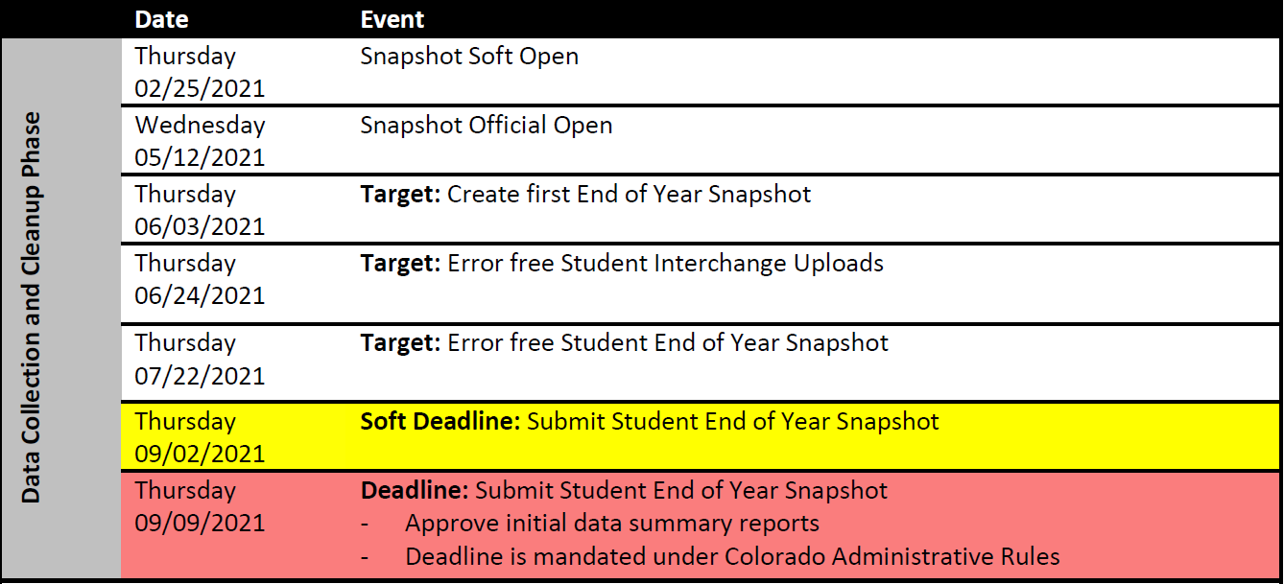
Collection Schedule: Regular Phase

Slide 9
Collection Schedule: Cross LEA Phase

Slide 10
Collection Schedule: Post-Cross LEA Phase

Slide 11
SEY Changes for 2020-2021

Slide 12
Overview of Changes
New Fields
Graduation Guidelines (GG)
Advanced Course Completion (ACC)
Special Education Transition Students
Military Enlisted
Extended Evidence Outcome Status
Homebased Education
Required for ALL graduating students
Flexibility (LM) for 20-21 graduates
New coding pattern: Students marked as graduates upon meeting graduation requirements, NOT upon completing transition program
Removed entirely from Student Interchange 2020-2021 and beyond

Slide 13
Regular Process Phase

Slide 14
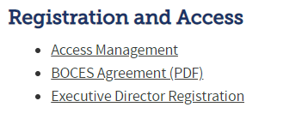
CDE Identity Management
1
http://www.cde.state.co.us/idm
Application | Collection | Role
Pipeline | Student Interchange | LEA USER OR APPROVER
Pipeline | Student End of Year | LEA USER OR APPROVER
2
3

Slide 15
CDE Identity Management
Application | Collection | Role | Access Level
Pipeline | Student Interchange | LEA User | Upload and Edit Records for the Student Demographic, School Association, and Advanced Course Completion files
Pipeline | Student End of Year | LEA User | Create Snapshot - cannot submit
Pipeline | Student End of Year | LEAAPPROVER | Create Snapshot and submit
Pipeline | Any | LEA Viewer | View Cognos reports – cannot edit
Pipeline | Title I Interchange | LEA User | Upload and Edit Records
You can only have one role for each Collection.
An LEAAPPROVER can do all the things an LEA User can do.
Link to full instructions: http://www.cde.state.co.us/datapipeline/assigneoyroles

Slide 16
Student Interchange Preparation
Get SASIDs for your new students
Through RITS or Data Pipeline
Resources on getting SASIDs can be found here:
http://www.cde.state.co.us/datapipeline/yr_rits
Create Extracts from your Student Information System
Pull data for the Student Demographic/Profile file and Student School Association
Data Pipeline accepts .csv, .xls, .xlsx formats
.xls is the recommended format
If opening file in Excel, please make sure you don’t lose leading zeros
CDE has a guide to keeping leading zeros on Student Interchange website
CDE recommends using a file naming convention:
Example: 0110_DEM_EOY_10112016.xls
Spaces in the file name are not allowed

Slide 17
Student Interchange Preparation
Upload interchange files
Wait for a Confirmation Email from the Pipeline System
The email will show you the number of errors in your upload
Resolve ALL errors in your interchange files
Check your error reports
Update your Interchange files to address the errors
Update in SIS → Extract → Upload to Pipeline
Edit Record Tool (Data Pipeline)
Upload Student Demographic File
Upload Student School Association File
Upload Advanced Graduation Guidelines File

Slide 18
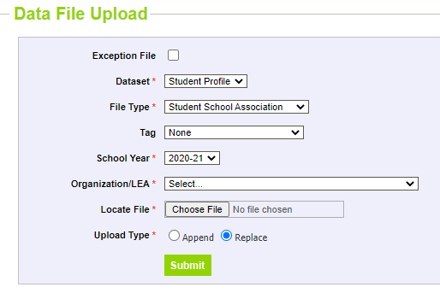
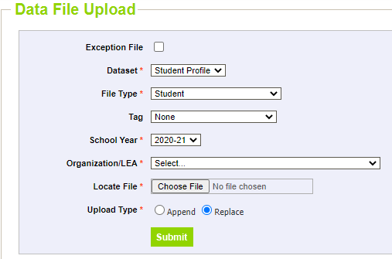
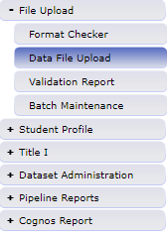
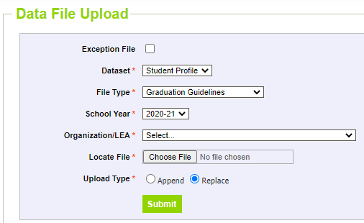
Data File Upload

Slide 19
Pipeline Reports: Error Report
Select file type:
Student (demographic)
Student School Association
Graduation Guidelines
Student End of Year
This will show you the entire record for the student flagging the error/warning

Slide 20
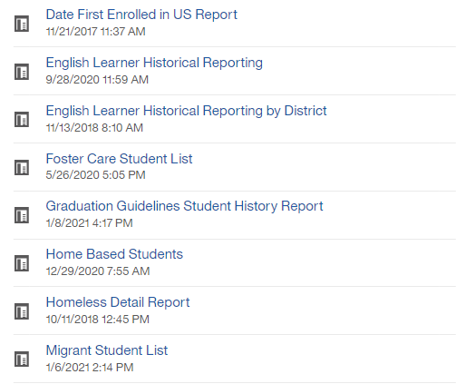
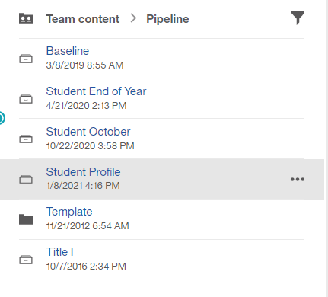
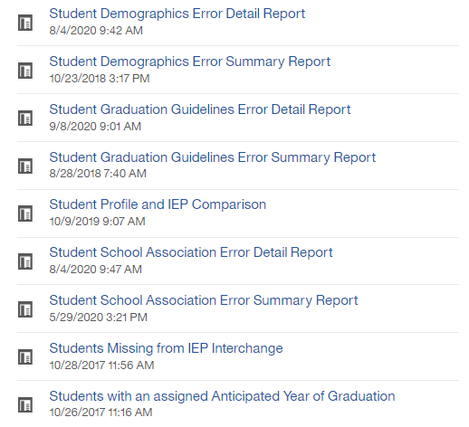
Student Interchange: Cognos Reports

Slide 21
Common Student Demographic Errors
Language Proficiency – A student's English language proficiency is described by his or her ability to speak, listen, read, and write in English.
English Learners (EL): (1) NEP Non-English Proficient (2) LEP Limited English Proficient (6) FEP Fluent English Proficient Monitor Year 1 (7) FEP Fluent English Proficient Monitor Year 2 (8) FEP Fluent English Proficient Exited Year 1 (9) FEP Fluent English Proficient Exited Year 2
Non-EL students must be coded as (0) NA or (4) PHOLTE Primary or Home Language Other Than English
Former English Learners are coded as (5) FELL- Former EL
*Student should have the same language proficiency as coded in Student October*

Slide 22
Common Student School Association Errors
Date First Enrolled in the United States
Districts may zero-fill this field and CDE will calculate the date of first enrollment based upon the date a student first had an entry date in a CDE student interchange data collection.
Student’s date of first enrollment will be calculated based on the earliest entry date in Kindergarten and greater.
If a date has been entered for a student, CDE will not override that field with a calculated value, though the entered value may not be more recent than the date CDE calculates.

Slide 23
Exceptions
my.syncplicity.com
This is where you will upload exceptions for me to review
The folder is Student
Exception template
Use this to add exceptions to and upload to Syncplicity
Please notify me via email when you have uploaded a new exception request to Syncplicity
Step by step directions here

Slide 24
Snapshot Process Overview
Create Student End of Year snapshot (Student Profile → Snapshot)
Creating a new snapshot will remove your previous snapshot
Go to “Cognos Report” on the Pipeline menu to download errors and warnings
Correct errors (within the Pipeline or by loading new interchange files)
Once all edit checks have passed, submit approval of your data to CDE
Use Cognos Report to validate data
Student Profile -> Status Dashboard -> Submit to CDE
You cannot download the signoff form until December
CDE identifies dropouts from prior years showing up in other districts
CDE checks across all districts to make sure student exit type is valid
Note: all errors must be resolved before continuing to the next step in the process

Slide 25
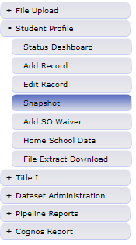
Creating a Snapshot
Snapshot creation confirmed

Slide 26
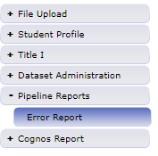
Snapshot Pipeline Reports - Errors
You can view your errors through Data Pipeline
Select warnings and/or errors
Click “view details” to see which students are flagging errors

Slide 27
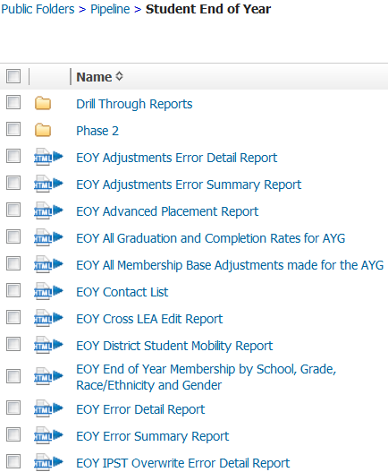
Snapshot Cognos Reports
These are the Snapshot Error Reports

Slide 28
Common Snapshot Errors
All Snapshot level errors are posted in the Student End of Year Business Rules file.
You can find the file on the Student End of Year website

Slide 29
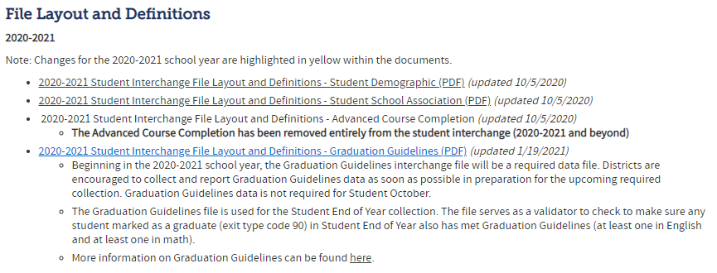
Entry and Exit Types
Entry and exit types and dates are used to track an overview of a student’s enrollment throughout the year.
A full list of the possible Entry and Exit types are available in the Student School Association (SSA) file format:
On the Student Interchange website

Slide 30
Why do we use entry and exit types?
Entry Type – Indicates how a student entered the school or district
02 – Continuous in same school (start of year)
05 – Transfer from out of country
11 – Transfer from school in same district
13 - Transfer from another district
14 – Transfer from out of state
70 – Return to school after transferring to a GED program

Slide 31
Why do we use entry and exit types?
Exit Type – Indicates how a student exits the school or district
11 – Transfer to school in same district
13 – Transfer to another district
40 – Drop out
90 – Graduate
00 – Student finished the year at the school

Slide 32
Why do we use entry and exit types?
Student returns from prior year (Entry Type 02)
Student exits to transfer to another district (Exit Type 13)
Later in the year student comes back from another district (Entry Type 13)
Student exits for the summer (Exit Type 00)
District | SASID | Entry Date | Entry Type | Exit Date | Exit Type
0180 | 1234567890 | 08212016 | 02 | 10022016 | 13
0180 | 1234567890 | 12102016 | 13 | 00000000 | 00

Slide 33
Common Errors
SE091 | Students with Exit Type Code 11 should be followed by record with Entry Type Code 11 or 12.
SE099 | Entry Code must <> 11 where Grade <> lowest grade for the school code and where no previous record exists with the same SASID, district with Exit Type = 11 in the same school year.
SE109 | Entry Type may be 11 (Transfer from a public school in the same district) for the first detail record, only if the student finished the prior year at a different School Building Code with Exit Type Code = 00.
SE102 | Entry Type may be 02 (Continuous in same school with no interruption of schooling) for the first detail record only if the student was reported in the prior year as finishing at the same School Building Code with Exit Type Code = 00.
SE104 | If a grade K-12 student was reported last year with Exit Type=00 in the last detail record, they must be reported this year with an Entry Type = 00, 02, 03, 10, 11, 90 or 91, in the first detail record.
SE171 | Exit Type cannot be 00 if Entry Grade Level = 120 and Retention Code = 0
SE171 errors will be resolved once you’ve recorded the graduation of seniors. Seniors have until August 31st to graduate during the 2020-2021 school year. Please record seniors who graduate after summer school with an exit date of the graduation with the rest of their class.

Slide 34
Common issues
SE 400’s Records not getting into snapshot
Please make sure primary school flag is set correctly in student school association file. The primary school flag must be set to 1 for the student to appear
Check to see if the record is in error in student interchange file
Validate the pupil's attendance code is correct
SE060 Student reported on Student October not in Student End of Year
If a student was reported on Student October, system expects record for student on October 1st in Student End of Year
Use Syncplicity to request an exception

Slide 35
Common Errors
SE104 | If a grade K-12 student was reported last year with Exit Type=00 in the last detail record, they must be reported this year with an Entry Type = 00, 02, 03, 11, 90 or 91, in the first detail record.
SE049 | If a student was reported in Student October in grade K-12 with Attendance Code 01-08 they must have at least 1 record in EOY. Note: Pre-K students who did not complete the school year in your district do not have to be reported on the Student End of Year.
SE404 | A K-12 student was reported last year with Exit Type=00 in the last detail record, they must have a record in your current year School Association file.
SE401 | A PK-12 grade student has errors at the interchange level (SSA).
SE405 | A PK-12 grade student has errors at the interchange level (DEM).
WSE412 | A grade PK-12 student was reported in the student school association file with a primary school flag set to zero. Please confirm that this status is approrpiate as the record will not be included in the End of Year snapshot.
WSE413 | A grade PK-12 student was reported in the student school association file with a pupil attendance code that is not between 01 and 08. Please confirm that this status is appropriate as the record will not be included in the End of Year snapshot.
Missing Record errors have mostly been changed to the SE400 range. SE104 now only triggers on an inappropriate entry type. SE049 and SE404 indicate a missing record. Please create a new record as appropriate, even if it’s just a one day record returning the student to school and then exiting them the same day.

Slide 36
SE404 One-Day Records
SE404 errors trigger when a student exited the previous year with a 00 exit type
Over the summer, the student left and never attended during the 2020-2021 school year
The student will still need a record indicating where they are attending school
For example:
District | Sasid | Entry Date | Entry Type | Exit Date | Exit Type
0180 | 1234567890 | 08212018 | 02 | 08212018 | 15

Slide 37
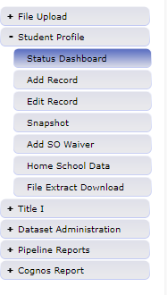
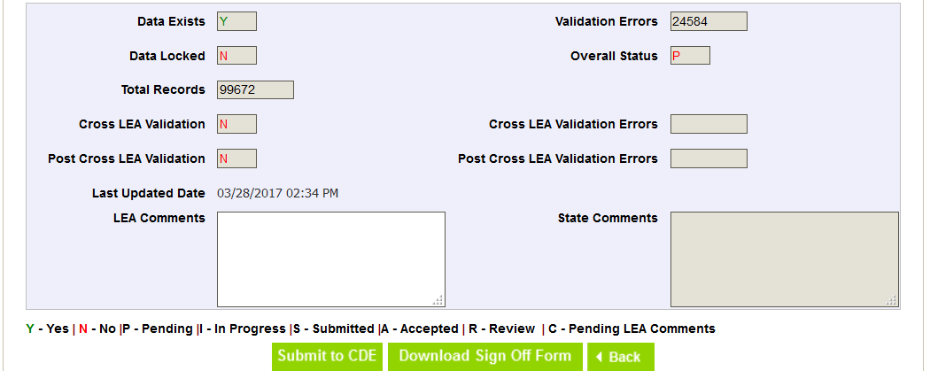
Submitting a Snapshot
Once you’ve completed resolving your snapshot errors, you will want to submit your snapshot.
Deadline is Thursday, September 9th
(Soft Deadline is Thursday, September 2nd)
Submit your snapshot through the status dashboard
The collection is not over at that point. There are two additional phases for data validation: 1) The Cross-LEA Phase and the 2) Post-Cross LEA Phase.

Slide 38
Cross LEA Phase

Slide 39
Cross LEA Process
Once all districts have their data submitted and locked CDE will run the Cross LEA process
Once the Cross LEA Validation is complete, districts will receive an email
New errors are generated during this process
Two types of Errors
Current Year Errors
Prior Year Errors

Slide 40
Cross LEA Process
Current Year Errors
May require editing records to change the exit type of a student
Edit Record Screen is in data pipeline under Student Profile
Just make sure you select the correct school year by the time we get to Cross LEA the 2021-2022 school year will be the default option
Prior Year Errors
How your district reported a student in the previous Student End of Year does not match this year’s records.
You may need to add a one-day record
Submit an Adjustment

Slide 41
Cross LEA Adjustment File
Adjustment File Resources on EOY Snapshot Webpage

Slide 42
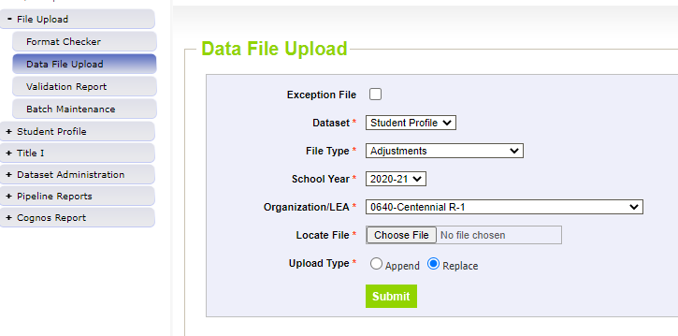
Cross LEA Adjustment File
Two ways to make an adjustment:
1. Upload an Adjustment File
If you have more than a couple of adjustments to make it is probably easier to complete a file upload.
This upload works just like a student interchange upload
2. Create an Adjustment Record within Pipeline
If you only have to create an adjustment for one or two students, then it might be easier to create an adjustment record within pipeline
Just use the Add Record option under Student Profile and select Adjustment

Slide 43
Cross LEA Adjustment File
Adjustments are used to modify records from the prior year for students who were reported as dropouts, expulsions, and HSED transfers
Adjustments may have errors and you will need to correct them to get the adjustment to work
Once your adjustments file is error free you will need to create a new Student End of Year snapshot to clear the errors/warnings that were triggered in the cross LEA process

Slide 44
Cross LEA Process
Once you have made changes to your data as a part of the Cross LEA process and added any necessary adjustments.
You will need to get your Student End of Year snapshot back to zero (0) errors
This may mean making changes to your SSA file or adding more adjustments
When you have another error-free snapshot you will want to:
Validate your data using Cognos reports to ensure your rates and other information is accurate
Submit snapshot to CDE again

Slide 45
Post-Cross LEA Phase

Slide 46
Post Cross LEA Process
Once all districts have resubmitted their data to CDE after the Cross LEA process CDE will run the Post Cross LEA process
The Post Cross LEA process identifies students that:
were listed as transfers but were not recovered by other districts
it also identifies dropouts who were recovered by other districts
The Post Cross LEA process will trigger three errors and two warnings:
SE 901, 902, 903, 904 (W), 905 (W)
There are instructions on how to resolve these errors on the Student End of Year Website

Slide 47
Record Request/ Confirmation of Enrollment and Attendance Template
Used by the receiving district when the student has begun attending the receiving school
Can be used as documentation of transfer ONLY if Date of Enrollment and Date of Attendance are provided
Other record request forms without that information will not be accepted
If the former district lacks this documentation, please use the Request for Confirmation of Enrollment and Attendance

Slide 48
Where can I find more information?
Adequate documentation page
Documents
Adequate Documentation of Transfer List
Record Request/Confirmation of Enrollment and Attendance
Request for Confirmation of Enrollment and Attendance
Notification of Withdrawal
Student Transfer Follow up

Slide 49
Reminder About Transfer Students
Students who tell you that they are transferring in the next school year but who complete all coursework in your district (up to three weeks before the end of school) should have an exit code of ‘00’. If they are coded with exit code ‘13’ they will be counted as a dropout because they will not have time to show up in another school/district before the end of the year.
When a student is transferring, make sure to follow up with that student immediately to get adequate documentation of the transfer. This way, you can avoid students unnecessarily being coded as dropouts.

Slide 50
Rates and Reporting

Slide 51
End of Year Data Online
Used for school, district and state rates
Graduation & Completion Rates
Dropout Rates
Mobility / Stability Rates
You have access to early versions of these rates in your Cognos reports.

Slide 52
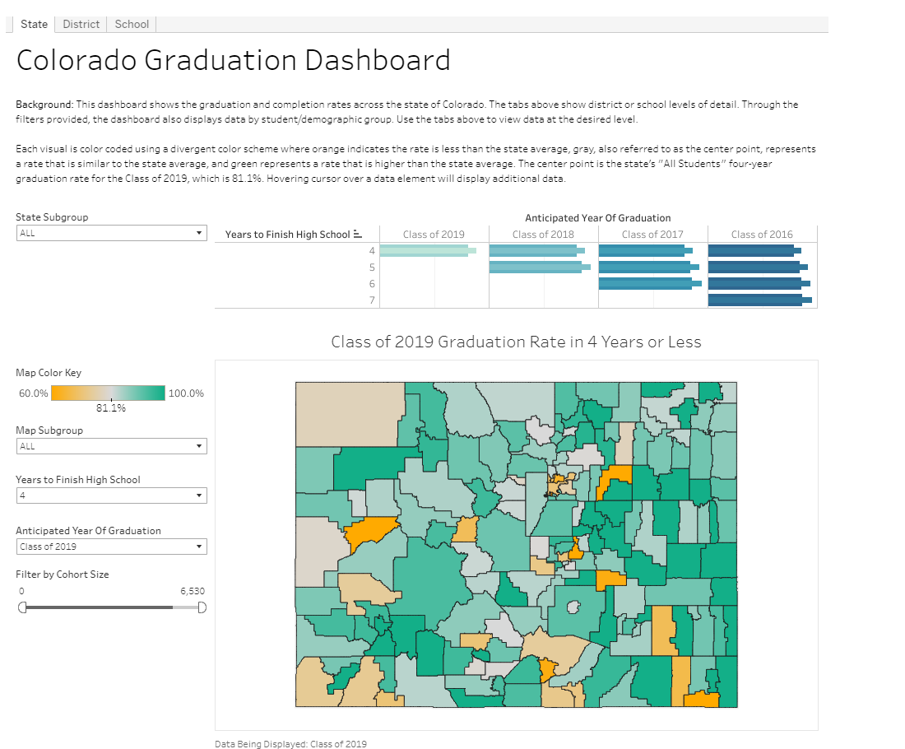
End of Year Data Online
Colorado Graduation Dashboard

Slide 53
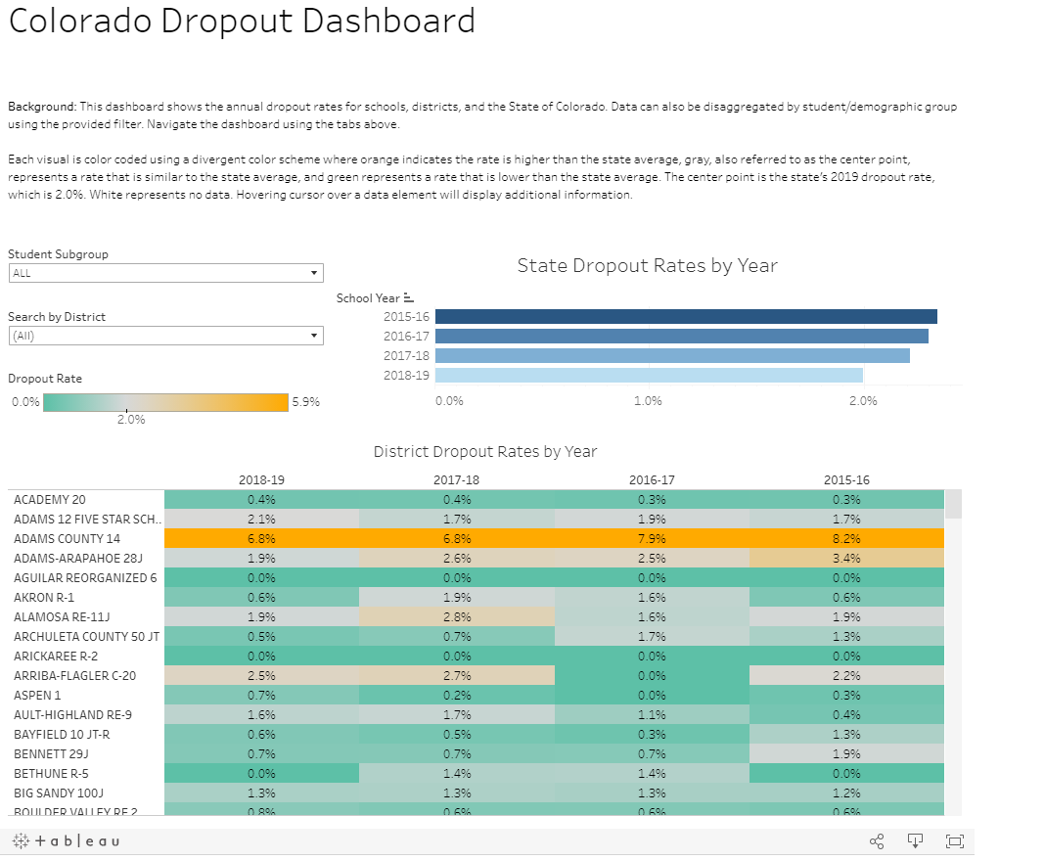
End of Year Data Online
Colorado Dropout Dashboard

Slide 54
Resources, Contacts, and Glossary

Slide 55
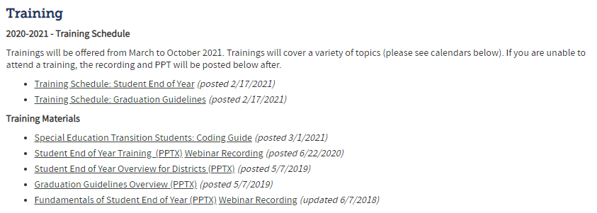
Resources
Student Interchange
Graduation Guidelines File Layout
GG, SSA, DEM Business Rules
GG, SSA, DEM Templates
Student End of Year
Timeline
File layout
Business rules
Trainings/schedule
Step by step instructions

Slide 56
Contacts
Name | Area of Expertise | Contact Info
Jesse Cooper | Student End of Year/Graduation Guidelines | Cooper_j@cde.state.co.us
Brooke Wenzel | October Count/Student Interchange | Wenzel_b@cde.state.co.us
Michelle Romero | Postsecondary Programs | Romero_m@cde.state.co.us
Ashley Idrees | Dropout Prevention | Idrees_a@cde.state.co.us
Kerry Wrenick | Homeless Reporting (McKinney-Vento) | Wrenick_k@cde.state.co.us
Robin Russell | Graduation Guidelines | Russel_r@cde.state.co.us
Debbie Puccetti | RITS/EDIS | Puccetti_d@cde.state.co.us

Slide 57
Glossary
AYG: Anticipated Year of Graduation (4 years after entering 9th grade)
IPST: Instructional program service type (Free and Reduced Lunch, Title 1, Migrant, etc.)
Cohort: Group of students with the same AYG and/or same IPST category
Graduate: Student receiving a High School diploma
Completer: Student receiving GED, certificate of completion
SPF: School Performance Framework
DPF: District Performance Framework
Summer Dropout: Student who leaves 8th grade and is not reported at a public school in Colorado the following year

Slide 58
Thank You! Jesse Cooper cooper_j@cde.state.co.us

