Slide 1
SPECIAL EDUCATION DISCIPLINE 2016-2017 TRAINING

Slide 2
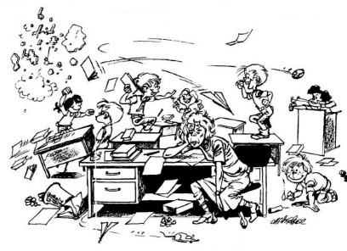

Slide 3
TRAINING TOPICS
General Overview
Purpose and Content
Data Pipeline Processes
Accessing the Data Pipeline
Reports
Working with Districts to resolve Errors
Creating a Snapshot
Discipline Action Interchange
Responsibility and Roles
What’s New
Types of Reports
Exceptions
Data Pipeline Access - IdM
Timeline

Slide 4
Overview

Slide 5
PURPOSE and CONTENT
Section 618(a)(I)(A)(vii) of IDEA requires that states report the number of children with disabilities by:
DISABILITY
RACE
GENDER
ELL STATUS
Who were subject to:
Unilateral Removals by School Personnel for one of the following reasons
Drug
Weapons
Serious Bodily Injury
Removal based on a Hearing Officer Determination regarding likely injury
Suspension (DISCIPLINE)
In-School and Out-of-School totaling less than 10 school days and totaling more than 10 school days
Expulsions (DISCIPLINE)
With and without educational services

Slide 6
DISCIPLINE ACTION TYPES
DISCIPLINES
In-School & Out-of-School Suspensions
Expulsions: With and Without Services
REMOVALS
Unilateral Removal By School Personnel for Drugs, Weapons, or Serious Bodily Injury
Unilateral Removal By A Hearing Officer
OR
Record Expectation:
A record will either contain a Discipline or a Removal. Not both

Slide 7
COLLECTION PERIOD
Incidences may span between July 1, 2015 through June 30, 2017
An exception is needed if Incident occurred in prior year. The exception template and instructions may be found here http://www.cde.state.co.us/datapipeline/inter_sped-discipline
Actions must occur in the current collection period of July 1, 2016 and June 30, 2017

Slide 8
SUPERINTENDENT SIGN-OFF FORM
Required for all districts including those with exempt status
COMPARISON REPORT BETWEEN SCHOOL DISCIPLINE AND ATTENDANCE AND SPECIAL EDUCATION DISCIPLINE
DETAIL REPORT: EXPULSIONS REPORTED IN THE SPECIAL EDUCATION DISCIPLINE AND SPECIAL EDUCATION END-OF-YEAR DATA COLLECTIONS

Slide 9
Roles and Responsibilities
DISTRICTS
Responsible for submitting valid and reliable data on students with disabilities with discipline incidences and actions.
ADMINISTRATIVE UNITS
Responsible for the Approval and submission of the Special Education Discipline Data Collection.
SPECIAL EDUCATION DIRECTORS
(in conjunction with Superintendents, Principals, Other School Personnel)
Responsible for the overall collection and the authorization of reports.
Collaboration
Notes:
CDE supports the collaborative efforts.

Slide 10
IdM Groups
DISTRICT
Interchange groups associated with the four digit DISTRICT code
DIS
District Name PIPELINE -District Number -DIS~LEAUSER Submit and Modify Role
District Name PIPELINE -District Number -DIS~LEAVIEWER Read-Only Role
ADMINISTRATIVE UNIT
Snapshot groups associated with the five digit ADMINISTRATIVE UNIT code
SPI
AU Name PIPELINE - AU Number -SPI~LEAVIEWER Read-Only Role
AU Name PIPELINE –AU Number -SPI~LEAUSER Submit and Modify Role
AU Name PIPELINE –AU Number -SPI~LEAAPPROVER Approver Role
https://cdeapps.cde.state.co.us/faqs.html

Slide 11
RESOURCES
INTERCHANGE
http://www.cde.state.co.us/datapipeline/inter_sped-discipline
Overview
Deadlines
File Layouts and Definitions
Business Rules
Template
Trainings
Additional Resources
Exempt Status ^{NEW}
SNAPSHOT
http://www.cde.state.co.us/datapipeline/snap_sped-discipline
Overview
Deadlines
File Layout
Business Rules
Trainings
Additional Links
Business Rule Guidance ^{NEW}

Slide 12
Interchanges that make up the Special Education Discipline Snapshot
INTERCHANGES
Discipline Action
Discipline Data
Student Demographics
Demographics
Student School Association
Grades
IEP Participation
Primary Disability
Special education discipline

Slide 13
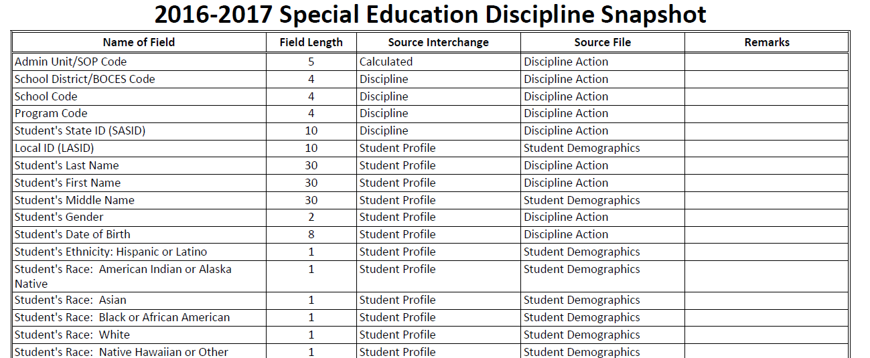
Special Education File Layout
http://www.cde.state.co.us/datapipeline/2016-2017specialeducationdisciplinefilelayout

Slide 14
Important Dates to Remember
Monday, April 3rd
Discipline Interchange officially open
Monday, May 8th
Date by which the interchanges files must be uploaded: DISCIPLINE/IEP/STUDENT
Thursday, June 8th
Date by which the Admin Unit must generate a snapshot.
Thursday, June 22nd
Date by which 90% of total record count must be included in Discipline Action file
Wednesday, July 12th
Date by which all Discipline Action Interchange errors must be resolved
Tuesday, August 15th
Report review week: Districts must be available to make any changes in the interchange
Tuesday, August 23rd
Date by which you must have generated a Complete Snapshot. All data records are included, Interchange & Snapshot Errors resolved
Wednesday, August 16th – Wednesday, August 23rd
Report Review Week. Districts need to be available to make any changes Admin Units deem necessary.
Wednesday, August 23rd
Final Data Approval and Report Submission

Slide 15
SNAPSHOT PROCESSES

Slide 16
Accessing the Data Pipeline
https://cdeapps.cde.state.co.us/index.html

Slide 17
Accessing the Data Pipeline
Email address associated with your IdM Group
The password you created in IdM

Slide 18
Discipline

Slide 19
Creating a Snapshot
Under “Discipline”
Choose “Snapshot”
File Type “Special Education Discipline”
“Create Snapshot”
Expected Message: Snapshot creation triggered and processing. A notification email will be sent upon completion.
3
1
2
4

Slide 20
Snapshot Created Email
What does this email message tell me?
0 Records were included in the Snapshot
Check the District Activity Report
Cognos
Special Education

Slide 21
Helpful Reports

Slide 22
District Activity Report
District | File | BatchID | Submitter | Date Processed | Processed Indicator | # of Records | # of Errors | # of Warnings
0900 | Discipline Action | 46844 | Gleason_k@cde.state.co.us |  | N | 0 | 0 | 0
0900 | Student Demographic | 46747 | Gleason_k@cde.state.co.us | March 21, 2017 12:22 11:01 PM | Y | 74,035 | 63 | 0
0900 | Student School Association | 46745 | Gleason_k@cde.state.co.us | March 21, 2017 19:59 AM | Y | 80,308 | 2,327 | 0
Look for
Submitted By - Not Loaded
Date Processed – how does that coincide with when Snapshot was created?
Processed Indicator Y or N
Processed Indicator Y but Number of Records 0
Number of Errors – if Discipline Errors check Excluded Report. If student errors check with Submitter

Slide 23
Uploading Discipline Action File
The Data Pipeline will accept Excel, CSV, or Text Files.
See “How to load the Discipline file in Data Pipeline” for additional information http://www.cde.state.co.us/displineinterchangefileuploadsteps

Slide 24
Format Checker
Since the file didn’t process it’s probably a good idea to run the file through Format Checker again

Slide 25
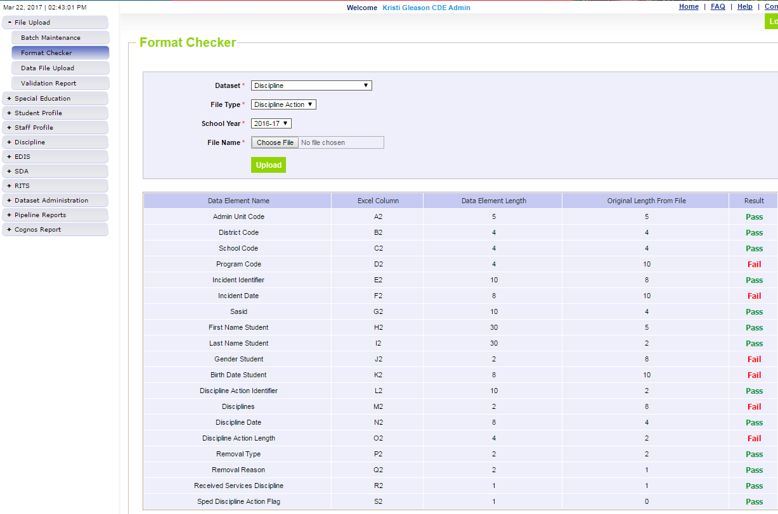
Format Checker Results
Pass Result – Proceed to Step 2: Data File Upload
Fail Result – check file against file layout. Upload the file to Format Checker until all fields = Pass
e.g. Program Code is 4 bytes. File shows 10 bytes.

Slide 26
Data File Upload
Once all fields Pass the Format Checker, the file can be re-uploaded
Click on Data File Upload
Locate File
Choose Replace
Hit Submit
Note message in green below. A Batch ID will be created.

Slide 27
Email Notification (DISTRICT)
Can the respondent with the SPI role see this email? No the District respondent will have to notify the Admin Unit the file was successfully uploaded. The AU can then take another snapshot.

Slide 28
Email Notification (SNAPSHOT)
What does this email tell me?
I know there are 583 records uploaded but only 572 are included in the snapshot. Either there are interchange errors or data doesn’t meet the Snapshot criteria

Slide 29
Snapshot Criteria
2016-2017 Special Education Discipline Snapshot https://www.cde.state.co.us/datapipeline/2016-2017specialeducationdisciplinefilelayout

Slide 30
Snapshot Records Excluded Due to Profile Errors
Cognos
Special Education Discipline
SPED Snapshot Records Excluded Due to Profile Errors
The report won’t let you know what the error or errors may be just which records have an error.

Slide 31
Email Notification (SNAPSHOT)
Once the District has cleared all errors and you know the data meets the Special Education Discipline Criteria follow the steps outlined previously for creating a Snapshot.
The record total matches the number of records reported in the file.

Slide 32
Email Notification (SNAPSHOT)
Let’s take a look at the Snapshot Errors

Slide 33
Resolving Snapshot Business Rules
New Guidance
https://www.cde.state.co.us/datapipeline/specialeducationdisciplinebusinessruleguidance
Errors
Errors requiring Exceptions
Warnings

Slide 34
Reviewing Reports
If you want to see a list of errors, go to
Cognos at the bottom of the Data Pipeline System Screen
Another window will open
Choose Special Education Folder and choose one of the following error reports
SPED Error Detail Report
SPED Error Summary Report

Slide 35
Interchange Errors Reports
You can choose to view all Errors and Warnings
Just one Error or Warning
Choose the Finish Button once you’ve made your selection.
If no selection is made all of the errors will be displayed on the report.
If there are no errors you will not see your district in the drop down as there is no report to display

Slide 36
Reviewing and Downloading Reports
You can view the errors and the records receiving the error on-line in the browser or you can download the report as PDF HTML or EXCEL
Be sure to choose the “Format” Option if you choose EXCEL
Remember if you are reviewing the report in the browser to hit page down to see the next set of records and their errors.
FIXING ERRORS
Once you know what records have which error, go to the source make a correction, make a change in the interchange file, and re-upload the updated file in the Data Pipeline website.
(Districts also have access to the Snapshot errors in COGNOS under Discipline Interchange)

Slide 37
SNAPSHOT Exceptions
Find the Template here http://www.cde.state.co.us/datapipeline/snap_sped-discipline
Business Rule | Description | Steps
SD020 | Student's age is outside of the valid range for the reported grade.. | Download the Exception template. Follow the instructions for data needed including reason for an exception and send to CDE
SD024 | The discipline date from the discipline action file must be between the start date of special education and the end date of special education.
SD025 | The student associated with this action was reported as expelled without services, please request an exception and provide the reason services were not received.

Slide 38
Snapshot Exceptions
Error Code | Error Type | District Code | Admin Code | School Code | Grade Level | SASID | EDID | Disability | Comments
SD020 | E | #### | ##### | #### | 060 | ########## |  | 04 | Reason why the students age is outside acceptable range for grade reported
SD024 | E | #### | ##### | #### | 040 | ########## |  | 13 | Reason why action date is not between the start and exit of special education
SD025 | E | #### | ##### | #### | 080 | ########## |  | 03 | Reason why no services were provided during the expulsion

Slide 39
Grade to Age Exception
1. Grade to Age: SD020 error - Calculated age is outside of the expected range for grade level. Please verify that the grade and birth date is correct.
Use Grade to Age Table posted under Frequently Requested Codes https://www.cde.state.co.us/datapipeline/gradetoageedits
Grade/Age |  |  | Warning |  | Error
Grade Level | Description | Expected Age | Minimum Age | Maximum Age | Minimum Age | Maximum Age
002 004 006 007 010 020 030 040 050 060 070 080 090 100 110 120 | Infant Preschool 1/2 Day Kindergarten Full Day Kindergarten Grade 1 Grade 2 Grade 3 Grade 4 Grade 5 Grade 6 Grade 7 Grade 8 Grade 9 Grade 10 Grade 11 Grade 12 | 0 - 2 3 - 5 5 - 6 5 - 6 6 - 7 7 - 8 8 - 9 9 - 10 10 - 11 11 - 12 12 - 13 13 - 14 14 - 15 15 - 16 16 - 17 17 - 18 | NA 2 4 4 5 6 7 8 9 10 11 12 13 14 15 16 | NA 6 7 7 8 9 10 11 12 13 15 16 17 18 20 21 | NA < 2 < 4 < 4 < 5 < 6 < 7 < 8 < 9 < 10 < 11 < 12 < 13 < 14 < 15 < 16 | > 4 > 7 > 8 > 8 > 9 >10 >11 > 12 > 13 > 14 > 16 > 17 > 18 > 19 > 21 > 22

Slide 40
Sharing Personally Identifiable Information
Syncplicity – online platform used for secure file sharing
Let us know if you do not yet have a folder. We will send you email with a link to set it up
File name is your AU code
Used for Exception requests, questions that include PII, facility students information, etc
Email CDE to notify us you’ve placed something in the folder. We don’t get notification
User Guide: http://www.cde.state.co.us/datapipeline/syncplicityinstructions

Slide 41
Common Snapshot Errors
Trying to resolve Snapshot errors when:
A file has not successfully uploaded
There are interchange errors
Records with Interchange errors can be seen in the SPED Snapshot Records Excluded Due to Profile Errors report
Fields where issues occur and why
Birth Date
Calculated age must be >= to 3 and < 22 as of December 1
Age is outside of valid range (send in exception)
A child cannot be reported as a having a Developmental Disability if they were 9 or older as of December 1
http://www.cde.state.co.us/datapipeline/snap_sped-discipline

Slide 42
Common Snapshot Errors (continued)
Discipline Action Length
Cannot Exceed
What happens if a student had an incident earlier in the year and then an expulsion later in the year.
Verify data. If accurate provide an exception
Grade Level
Make sure the Date and School Code in the Discipline file matches the information in the School Association File
Date of Incident
Must be Included
LASID
Check the District Activity Report has a file been successfully uploaded?
Primary Disability
The Date of the Action must come after the Entry Date of Sped and before the Exit Date of Sped.

Slide 43
Common Snapshot Errors
Special Education Suspensions/Expulsions vs Removal Types
Either a student was suspended OR expelled OR they were Unilaterally Removed
Both the “Discipline and the Removal Type cannot have a value nor can they both be zero-filled.
Only if you are reporting a Unilateral Removal by School Personnel should you be reporting a Reason.
See the following example

Slide 44
Common Snapshot Errors
Unilateral Removals and Removal by a H.O. Should never be more than 45 days
“0450” = 45.0 days
Unilateral Removals and Removal by a H.O. Should have “Discipline” “00” filled
 | Disciplines | Discipline Start Date | Discipline Action Length | Special Education Removal Type | Special Education Removal Reason | Received Education Services During Expulsion | Special Education Action Flag
Unilateral Removal | 00 | MMDDYYY | 0450 | 01 | 02 | 0 | 1
Removal by a Hearing Officer | 00 | MMDDYYY | 0450 | 02 | 00 | 0 | 1
In-School Suspension | 01 | MMDDYYY | 0005 | 00 | 00 | 0 | 1
Out-of-School Suspension | 02 | MMDDYYY | 0250 | 00 | 00 | 0 | 1
Expulsion | 03 | MMDDYYY | 1800 | 00 | 00 | 1 | 1
Unilateral Removals by School Personnel should always have a Reason – this is the only instance where a reason is recorded
Notes:
Every entry will have some field “0” filled. Note the highlighted areas.

Slide 45
Common Snapshot Errors
 | Disciplines | Discipline Start Date | Discipline Action Length | Special Education Removal Type | Special Education Removal Reason | Received Education Services During Expulsion | Special Education Action Flag
Unilateral Removal | 00 | MMDDYYY | 0450 | 01 | 02 | 0 | 1
Removal by a Hearing Officer | 00 | MMDDYYY | 0450 | 02 | 00 | 0 | 1
In-School Suspension | 01 | MMDDYYY | 0005 | 00 | 00 | 0 | 1
Out-of-School Suspension | 02 | MMDDYYY | 0250 | 00 | 00 | 0 | 1
Expulsion | 03 | MMDDYYY | 1800 | 00 | 00 | 1 | 1
“0005” = 0.5 days
Suspensions of any type should not exceed 25 days
“0250” = 25 days
Double check Expulsions
>180 days, does this make sense within the school year?
“1800” = 180 days
Notes:
Every entry will have some field “0” filled. Note the highlighted areas.

Slide 46
Common Snapshot Errors
 | Disciplines | Discipline Start Date | Discipline Action Length | Special Education Removal Type | Special Education Removal Reason | Received Education Services During Expulsion | Special Education Action Flag
Unilateral Removal | 00 | MMDDYYY | 0450 | 01 | 02 | 0 | 1
Removal by a Hearing Officer | 00 | MMDDYYY | 0450 | 02 | 00 | 0 | 1
In-School Suspension | 01 | MMDDYYY | 0005 | 00 | 00 | 0 | 1
Out-of-School Suspension | 02 | MMDDYYY | 0250 | 00 | 00 | 0 | 1
Expulsion | 03 | MMDDYYY | 1800 | 00 | 00 | 1 | 1
Provision of services required for removals >10 days, BUT are only REPORTED for Expulsions
Suspensions and Expulsions should have Removal Type and Reason “00”
Special Education Flag should = 1
Notes:
Every entry will have some field “0” filled. Note the highlighted areas.

Slide 47
SOMETHING’S AMISS

Slide 48
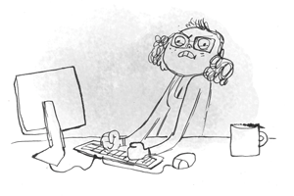

Slide 49
Something’s Amiss
You’ve uploaded your file and created a snapshot, but the errors are not reflecting the file’s data:
If this happens be sure to check:
The confirmation email that the Snapshot was created and when
The District Activity Report – timing around Interchange and Snapshot
The file upload TIME (from email) to ensure file was fully processed when you created the snapshot

Slide 50
Snapshot looking good
All the records that are to be included are
All Interchange and Snapshot Errors are resolved
Begin looking into Reports

Slide 51
REPORTS

Slide 52
COGNOS Reports

Slide 53
District Activity Report
Once a Snapshot is created, the Admin Unit has access to the “District Status Report” in Cognos under Special Education Discipline which provides files processed yes or no, number of records reported, number of errors, date of last submission for the following Interchanges:
Discipline Action
Student Demographics
Student School Association

Slide 54
District Activity Report
District | File | BatchID | Submitter | Date Processed | Processed Indicator | # of Records | # of Errors | # of Warnings
1234 | Discipline Action | ##### | Who | Day & Time | Y or N | # | # | #
1234 | Student Demographic | ##### | Who | Day & Time | Y or N | # | # | #
1234 | Student School Association | ##### | Who | Day & Time | Y or N | # | # | #
4321 | Discipline Action | ##### | Who | Day & Time | Y or N | # | # | #
4321 | Student Demographic | ##### | Who | Day & Time | Y or N | # | # | #
4321 | Student School Association | ##### | Who | Day & Time | Y or N | # | # | #
Look for
Submitted By - Not Loaded
Date Processed – how does that coincide with when Snapshot was created?
Processed Indicator N
Processed Indicator Y but Number of Records 0
Number of Errors – if Discipline Errors check Excluded Report. If student errors check with Submitter

Slide 55
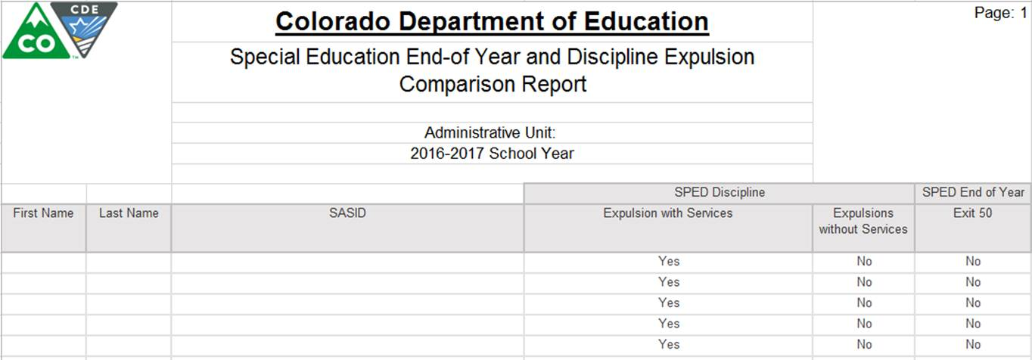
Special Education EOY/Discipline Expulsion

Slide 56
SDA & Discipline Data Comparison
 |  | Colorado Department of Education
 |  | SPED Discipline: School Discipline and Attendance & Special Education Discipline Data Comparison Report
 |  | Administrative Unit:
 |  | <school year> School Year
This report compares your Special Education Discipline (SPED Discipline) data to the data your district submitted for the School Discipline and Attendance (SDA) . You should review it carefully for completeness and accuracy.
 | Data for: <District Name>
 |  | In-School Suspensions | Out-of-School Suspensions | Expulsions with Services | Expulsions w/out Services*
 | SPED Discipline
 | SDA
 | Difference**
 | % Difference
*Schools are required to provide services if a student is removed from their placement for more than 10 days
**It is possible that numbers will not match exactly, but there should not be extreme differences. Extreme differences could indicate that data within the SPED Discipline or the SDA is not valid.

Slide 57
SPED Snapshot Records
These are all the records recorded in your SPED Discipline Snapshot
You can use this as a reference when questions arise from other reports.

Slide 58
Students Reported Inconsistently by more than 1 Admin Unit/SOP
The Errors appearing here may be legitimate entries.
For example a student’s disability identification may have changed at a mid-year staffing
A student’s parents may choose to report race differently when they move to a new district (A student is identified “Hispanic,” then “2 or More Races”)
Investigate things that don’t make sense

Slide 59
Incident and School Enrollment Date Comparison
This report details records where an incident is reported when a student was not enrolled.
This report should be blank
Are you receiving SD017?

Slide 60
2 Special Education Discipline Director Signed Reports + Flag Explanations
SPED Data Summary Report (2014-2015 and newer)
SPED Year to Year Comparison Report
+ Special Education Discipline Flag Explanations
Notes:
Revenant data for Indicator 4 can be found in the Data Summary Report. The report with the heading “Indicator 4” has been changed to a detail report and does not need to be submitted to the CDE.

Slide 61
SPED Data Summary Report
Sections A-D contain counts of discipline events and counts of children with disabilities by:
Unilateral removal by school personnel following a drug or weapon offense or serious bodily injury
Removal based on a hearing officer determination regarding likely injury
Suspension (both In-School and Out-of-School totaling less than 10 school days and totaling more than 10 school days
Expulsion with and without educational services.
TIP: The TOTALS for these areas should be the same across Sections A-D

Slide 62
SPED Data Summary Report
The final section, “Section E: Children subject to expulsion who did and did not receive educational services by disability status” is on page 13.
Note: Children with disabilities must receive educational services during an expulsion of more than 10 school days. The only children with disabilities who should be reported as not receiving services are those who were removed for less than 10 school days after an expulsion.

Slide 63
Year to Year Comparison Report
The report totals 13 pages
A section for “Disability: All” (1 page)
A section for Racial/Ethnic groups (6 pages)
A section for Gender groups (2 pages)
A section for ELL Status groups (2 pages)
The signature page

Slide 64
This page will repeat for all Racial, Gender and ELL Categories
You will only see flags - “A” – if both the number of the change is over 20 students AND the Percent of the Change is over 20%
These are the only data points that require explanation on the Flag Explanations sheet

Slide 65
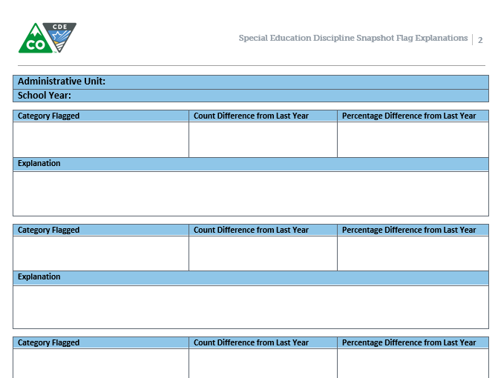
Year to Year Report Flag Explanations
Please remember to provide explanations for the A flags from the Year to Year Report no later than August 24, 2015
Remember, you can include multiple flag categories when the same explanation applies

Slide 66
Assistance Needed?
If you have ANY questions about the Special Education Discipline Data Collection please feel free to contact us. No question or concern should remain unanswered of unresolved.
We are just a phone call or email away!
Kristi Gleason 303-866-4620 gleason_k@cde.state.co.us Collection Lead
Lindsey Heitman 303-866-5759 heitman_l@cde.state.co.us
Email protocol – please include:
District # and Administrative Unit #
Phone number where you may be reached
Subject of the email
NOTE: Never send files or reports via email – contact us to determine best technical assistance avenue.
Thank you

Slide 67
Thank you for joining us today!

