Slide 1
Computer Science Differentiation
Five Research-based Options

Slide 2
Overview
Five research based differentiation strategies and examples using computer science standards
Flipping classroom (Siegle, 2014)
Constructionism (Israel et al., 2015)
MindTool assisted in-field learning– ubiquitous concept mapping (Hwang, Shi, & Chu, 2011)
Physical and virtual laboratories (DeJong, Linn, & Zacharia, 2013)
Deeper Learning – intrapersonal / interpersonal / cognitive approach (Grover, Pea, & Cooper, 2015)

Slide 3
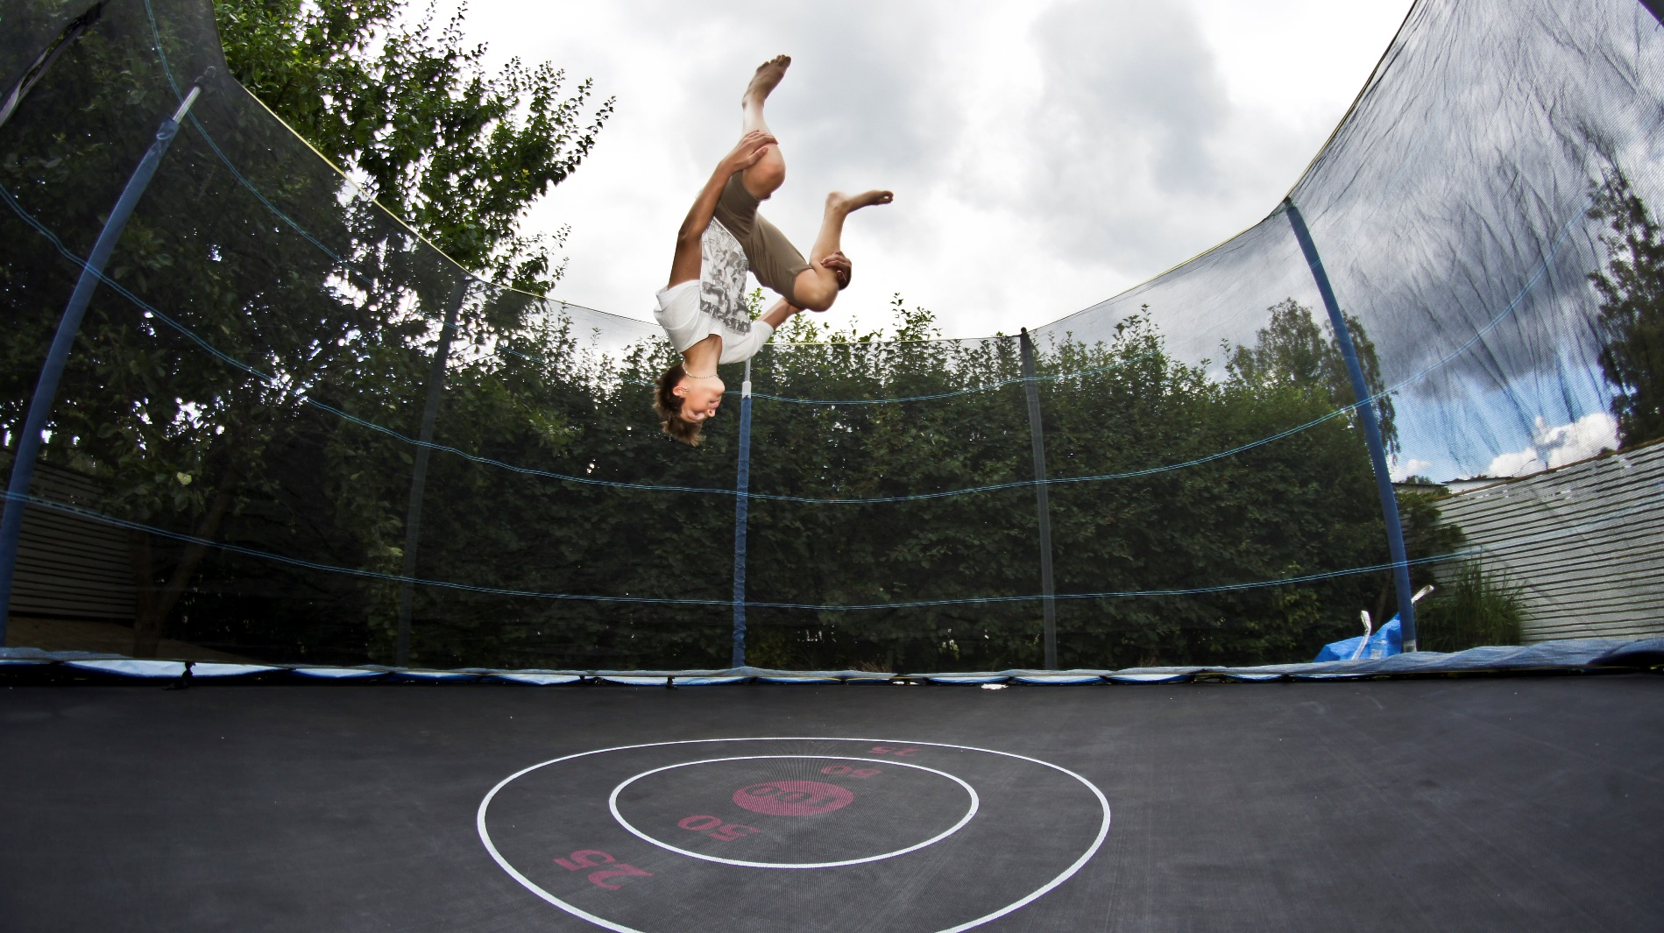
Flipped / Virtual Classroom

Slide 4
Flipped Classroom / Virtual Classroom - 1
Flipping the classroom means that students study some contextual, theoretical, or background information (solitary activities) on their own before the lesson.
Example:
Computational Thinking: Teaching the definition of computational thinking
Home study:
Provide a story describing an application of computational thinking, (the creation of the cell phone: https://www.artinstitutes.edu/about/blog/the-history-and-evolution-of-cell-phones)
The challenge or differentiation would be to have students brainstorm new ways to use technology for communication, design a draft of the invention, and outline the steps to design, build, and test the technology.
Another type of differentiation could come from students hypothesizing about what computer language might work best to program the alternative communication device.

Slide 5
Flipped Classroom / Virtual Classroom - 2
After students spend some solitary time studying the introductory material, teachers use class time to help students make connections, learn collaboratively, and apply critical thinking activities to deepen conceptual understanding.
IN CLASS
Students discuss aspects of the historical development of cell phones that relate to computational thinking as a concept (decomposition, problem-solving, abstraction, etc.)
Pairs or teams discuss possible alternative communication devices.
Play “Shark Tank” type game where inventors sell the viability of their inventions to classmates.

Slide 6

Constructionism

Slide 7
Constructionism
Constructionism is an instructional concept coined by Papert (1976). In a constructionistic learning environment, teachers guide learning organically with questions and suggestions. Students are encouraged to explore their interests and collaborate with peers. Constructionistic learning can be interpreted as student-led and teacher-guided.

Slide 8
Constructionism
Example:
Programming: Conditionals
Teaching conditionals – send students home with a video explaining conditionals and several examples of code using conditionals (possibly a variety of Scratch or AppInventor programs that students could deconstruct or modify). Students identify conditionals in three programs.
The challenge or differentiation could come from students remixing the programs and adding new conditionals.
Or students could create a conditional problem to challenge classmates. Students could then write programs with conditionals based on the challenge from the classmate.

Slide 9
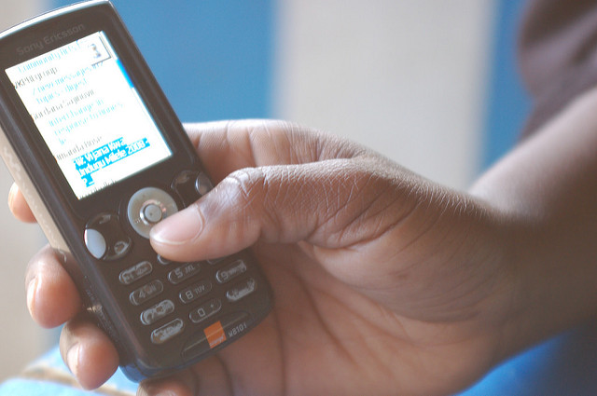
Assisted in-the-field Learning

Slide 10
Assisted in-the-field Learning
Ubiquitous concept mapping is an instructional strategy that allows students to use devices such as mobile phones in the field to help them learn.

Slide 11
Assisted in-the-field Learning
Example:
Computer Systems & Networks: Internet Connectivity
Create an app that allows students to check their knowledge of network systems in and around school (possibly on the weekend at home). Students would input the type of connectivity and amount, then the app would generate a related multiple choice or true/false question.
Have some students use the app in the field.
Other students who needed more guidance could work as a team in the classroom and assist the students in the field via cell phone.
Students in the classroom could also be mapping out connectivity with the aid of the students in the field.

Slide 12
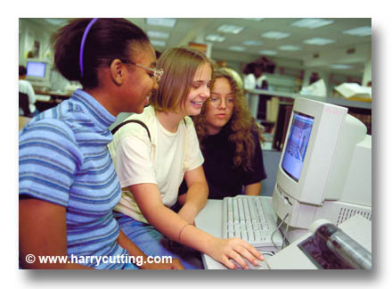
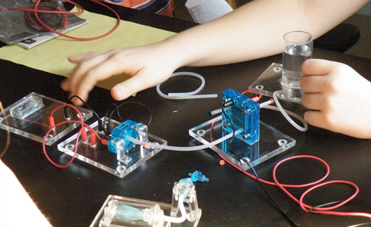
Physical and Virtual Lab Partners

Slide 13
Physical and Virtual Lab Partners
Sometimes it is helpful to have two groups of students conducting experiments in the classroom and virtually.
This differentiation strategy could assist students who have trouble imagining ideas and need kinesthetic manipulation to make sense of concepts.
It is also conceivable to use the physical laboratory like a CS Unplugged activity and then use the virtual laboratory to apply CS concepts.

Slide 14
Physical and Virtual Lab Partners
Example:
Programming: Teach modeling and prediction using data structures.
Some students could predict erosion rates to the classic mud volcano by measuring the mass of the mud, the volume of the vinegar and baking soda. Then after the volcano explodes measure everything. Have the whole class make different sizes of volcanoes and a variety of liquid quantities. Use tables and diagrams to depict the data.
Other students could construct a virtual volcano, and create lists with a variety of amounts for mud mass and liquid lava substitute. Then write a program to calculate mud erosion. Possibly also determine the scenario with the most and the least erosion.
Students can work in teams of a pseudo-coder, coder, and math-checker for additional differentiation.

Slide 15
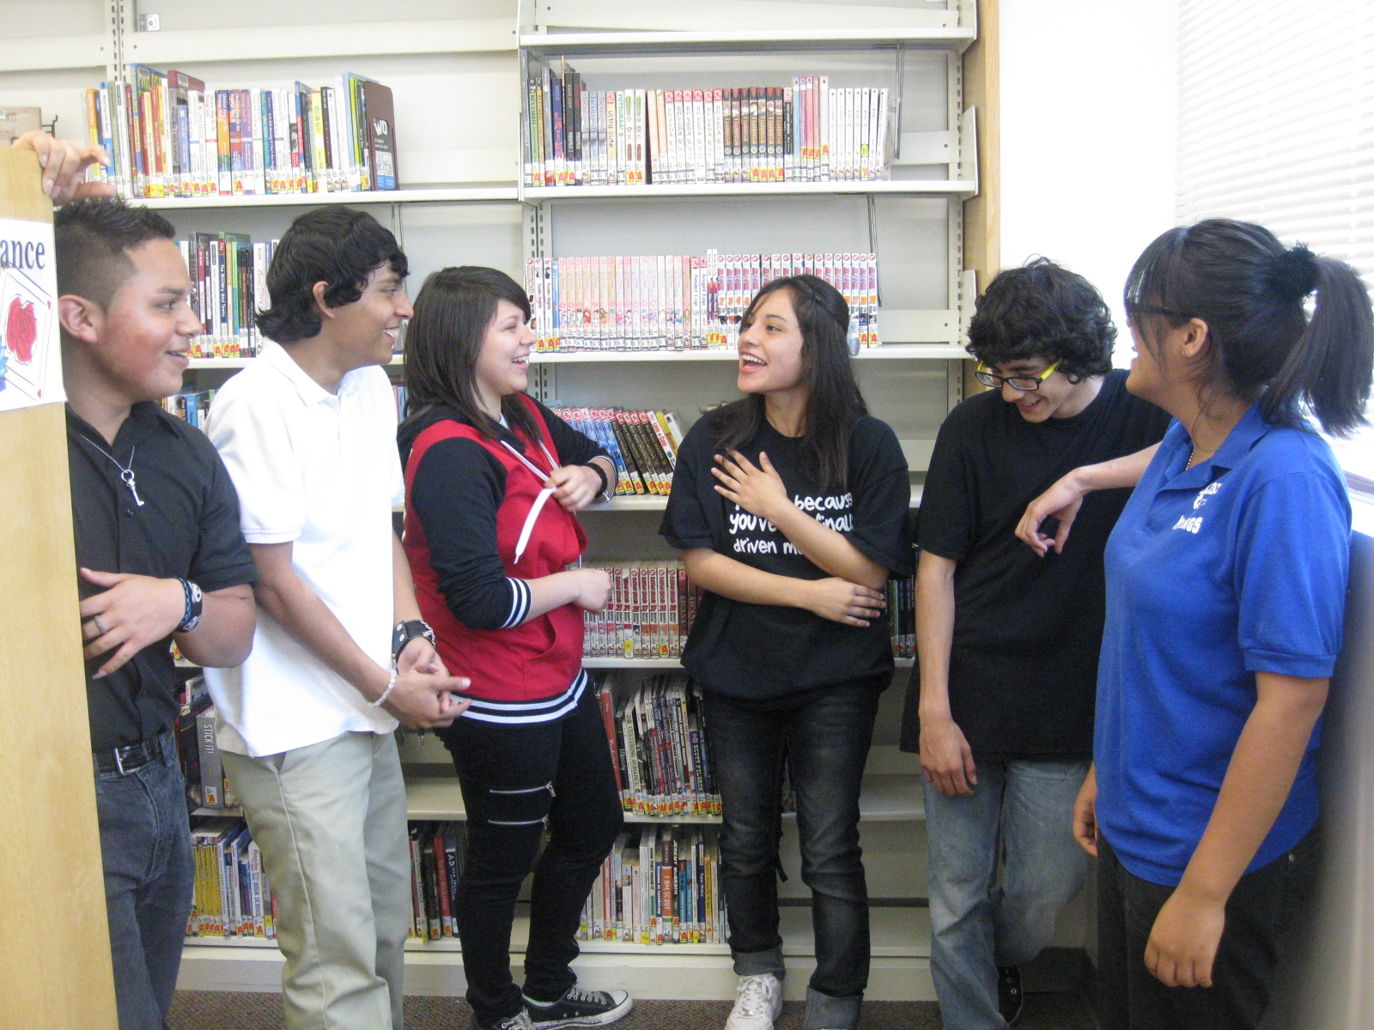
Deeper Learning

Slide 16
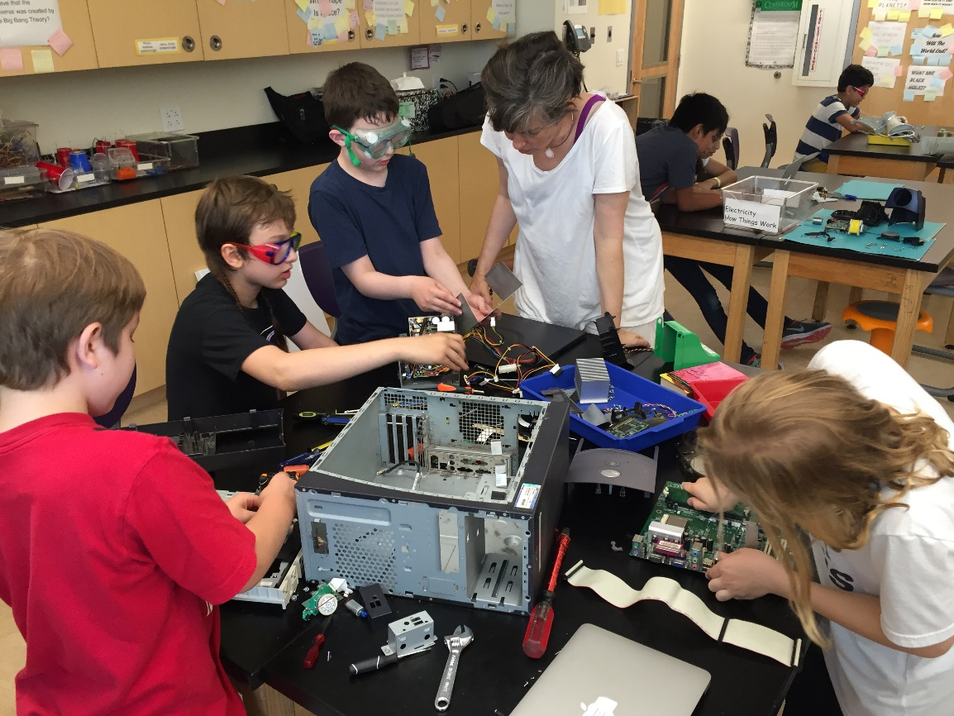
Deeper Learning
Deeper learning (Pellegrino & Hilton, 2013), is a teaching strategy that engages cognitive, interpersonal, and intrapersonal intelligences via mastering academic content, engaging in problem-solving, working collaboratively, communicating effectively, and learning how to learn.

Slide 17
Deeper Learning
Example:
Computer Systems & Networks:
Comparing & Contrasting Linux, Mac OS, and Microsoft OS
Have novice students use a graphic organizer to compare and contrast Mac and Microsoft OS. Then have students attempt to diagnose an OS problem with either a Mac or a PC.
Task students who are proficient with most CS concepts to compare and contrast all three operating systems. Students can use the graphic organizer or make their own version. Then have students give a demonstration explaining the difference between the operating systems of Linux, Macs, and PCs.
Challenge highly proficient students to create a YouTube video explaining how to install Linux on both a PC and on a Mac.
In order to provide “deeper learning” in each of the above scenarios, students must work collaboratively, speak and/or write about their experiences and critical thinking, demonstrate mastery of key OS concepts and terminology, and express metacognitively how they learned the differences and similarities with all the operating systems.

Slide 18
Summary
Method | Collaborative | Critical Thinking | Scaffolding | Metacognition
Flipped / Virtual Classrooms | Alone first Collaborative second | X | X | X
Constructionism | X | X | X | X
Assisted In-the-field Learning | X | X | X | X
Physical / Virtual Laboratories | X | X | X | X
Deeper Learning | X | X | X | X

Slide 19
References
De Jong, T., Linn, M. C., & Zacharia, Z. C. (2013). Physical and virtual laboratories in science and engineering education. Science, 340(6130), 305-308.
Grover, S., Pea, R., & Cooper, S. (2015). Designing for deeper learning in a blended computer science course for middle school students. Computer Science Education, 25(2), 199-237.
Hwang, G. J., Hung, P. H., Chen, N. S., & Liu, G. Z. (2014). Mindtool-assisted in-field learning (MAIL): an advanced ubiquitous learning project in Taiwan. Journal of Educational Technology & Society, 17(2).
Israel, M., Pearson, J. N., Tapia, T., Wherfel, Q. M., & Reese, G. (2015). Supporting all learners in school-wide computational thinking: A cross-case qualitative analysis. Computers & Education, 82, 263-279.
Siegle, D. (2014). Technology: Differentiating instruction by flipping the classroom. Gifted Child Today, 37(1), 51-55.
Waite, J., Curzon, P., Marsh, W., & Sentance, S. (2016, October). Abstraction and common classroom activities. In Proceedings of the 11th Workshop in Primary and Secondary Computing Education (pp. 112-113). ACM.

Slide 20
Presented by:
Christine Liebe, PhD Cand.
CDE Computer Science Content Specialist
1580 Logan Street, Suite 300
Denver, CO 80102
303-957-5656
liebe_c@cde.state.co.us

