Slide 1
VOCABULARY…
The Vehicle for Reading Success
Part 2
Deeper Considerations
Ann B. Fiala
annfiala@readinginstructionco.com
September 2016
CDE READING Conference

Slide 2
To expand a student’s vocabulary is to teach that child to think about the world. (Stahl)

Slide 3
It’s not what you say or do that
ultimately matters…It is what
you get the students to do as
a result of what you said
and did that counts.
(Archer, Feldman, & Kinsella, 2008)

Slide 4
Power of Reading Aloud
… reading aloud to students is building the knowledge required for their eventual success as readers
…across the grades…and onward…don’t shortchange older students
Fuhler, C and Walther, M. (2007) Literature is Back! Using the Best Books for Teaching Readers and Writers Across
Genres. Scholastic.

Slide 5
Reading aloud quality children’s literature can…
be a Lit Bit…that changes the tone of the classroom agenda
broaden & deepen background knowledge, especially ELLs
heighten interest in a
particular genre or topic

Slide 6
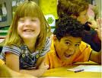
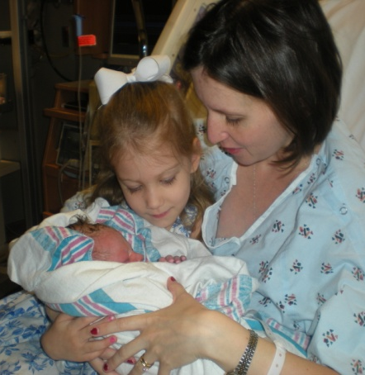
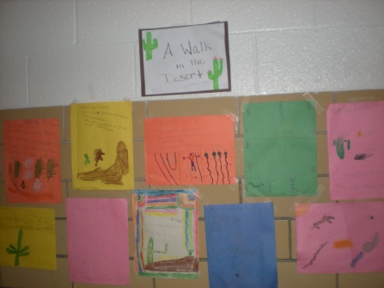
Reading aloud quality children’s literature can…
touch emotions
validate us as human beings
be the basis for teaching
essential skills & strategies

Slide 7
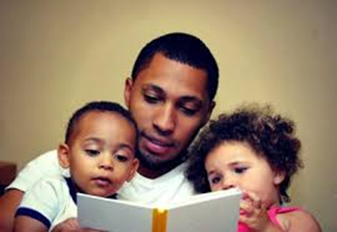
Handout
1
Reading aloud with children is an essential component to VOCABULARY and is one of the most important activities for preparing to succeed as readers.

Slide 8
Promote Vocabulary Development
Handouts 2-3
Read & share a variety books with differerent
Levels of difficulty
Reading Levels
Complexity of concepts
Genres
Purposes
Texas Education Agency. (2002). Promoting vocabulary development. Components of effective vocabulary instruction. Retrieved June 25, 2002, from Texas Education Agency. http://www.tea.state.tx.us/reading/practices/redbk5.pdf

Slide 9
Encourage Wide Reading
Maximize access to reading materials and quality, authentic text (different genres)
Capture students curiosity with read alouds, book talks and author studies.
Expect reading outside of class.
Accountabilty

Slide 10
Narrative/Stories Expository/Informational
Easy-to Read…
Realistic Fiction
Historical Fiction
Fantasy
Mystery
Fairy Tales
Folk Tales
News
Directions
Content-Specific
Biographies
Autobiographies
Picture Books
Concept Books
Alphabet Books
Counting
Wordless/Few Words
Stories
Popular Series
Classic & Contemporary Pairings
Poetry

Slide 11
More of the Matthew Effect
 |  | 1,800,000 words/yr
 | 282,000 words/yr
8,000 words/yr
< 1 minute per day | 4.6 minutes per day | 20 minutes per day
Time Spent Reading Connected Text

Slide 12
Vocabulary Instruction is Effective WHEN …
Expands word knowledge through
meaningful understanding
Actively involves ALL students
Models and teaches word-learning
strategies
Texas Education Agency. (2002). Promoting vocabulary development. Components of effective vocabulary instruction. Retrieved June 25, 2002, from Texas Education Agency. http://www.tea.state.tx.us/reading/practices/redbk5.pdf

Slide 13
Conventional Wisdom…
Words are learned from context
Students are learning words
Too many words to directly teach
BUT…
Beck, I., McKeown, M. and Kucan, L. (2002). Bringing words to life: robust vocabulary instruction. New York: The Guilford Press
Notes:
assumptions

Slide 14
Assumption
Student maximizing learning of
vocabulary from context
Reads enough text to encounter lots of words (including unfamiliar words)
Knows & applies skills to infer word meaning from context
Beck, I., McKeown, M. and Kucan, L. (2002). Bringing words to life: robust vocabulary instruction. New York: The Guilford Press

Slide 15
BIG Idea
VOCABULARY
SPECIFYING Vocabulary
Graves, M. (2006). The Vocabulary Book: Learning & Instruction. NY: Teaching Press.
Baumann, J. and Kame’enui, E. (eds.) (2004) Vocabulary Instruction Research to Practice, NY: Guilford Press

Slide 16
Tier
Three
Tier Two
Tier One
3 Tiers of Vocabulary
Technical (Limited-use) words
Taught when vital to comprehension
quill bold slavery
High frequency & high utility
Needed for comprehension
election sincere
Basic vocabulary
Limited instructional focus
thin letter sad

Slide 17
Focus on Tier 2 of Vocab
Word highly useful to reader
Most already know concept or really
need to know this word
Know related words (simpler, less
sophisticated)
Learn to relate & use appropriately
Increases comprehension of text
Handout
4
Vaughn, S, and Linan-Thompson, S. (2004). Research-based methods of reading instruction. Alexandria, VA: ASCD

Slide 18
ELL Considerations for 3 Tiers+
Tier 1
Basic words
KNOW concept & label in 1st language NEED English label
find search answer guest
Simple idioms
Unlikely to understand
make up your mind; hit the books
Connectors
so, if, then, however, finally, since
Calderon, M. (2007) Teaching Reading to English Language Learners. 978-1-4129-0926

Slide 19
ELL Considerations for 3 Tiers+
Tier 2
Importance & utility: mature language users; appear frequently across variety of domains
power cell primary right expression
Conceptual understanding: understand general concept but need precision and specificity in describing concept
because although likewise in particular
Polysemous Words: multiple meanings
root run line cell slip trunk
Calderon, M. (2007) Teaching Reading to English Language Learners. 978-1-4129-0926

Slide 20
ELL Considerations for 3 Tiers+
Tier 3
Cognates: Near sound-alike or spelled-alike and label same concept in 2 languages
Telephonen/telefono/telephone, education/education, the radio, el radio, le radio
Spanish cognates higher frequency than English
absurd/absurdo, coincidence/coincidencia
False cognates: multiple meanings or inaccurate
mass/masa or misa, round/Redondo, assist someone/attender a alguien/asistencia
Calderon, M. (2007) Teaching Reading to English Language Learners. 978-1-4129-0926

Slide 21
ELL Considerations for 3 Tiers+
Tier 4
Content-specific and infrequently used words
Words need to learn to benefit from instruction
Relate to simpler, less sophisticated known word(s)
NOTE: Cognates only helpful WHEN those words are already part of student’s vocabulary
in 1st language
AND
Calderon, M. (2007) Teaching Reading to English Language Learners. 978-1-4129-0926
Linan-Thompson, S., Vaughn, S.
(2007) Alexandria, VA: ASCD

Slide 22
Tier 4 per Marzano, et al
Academic Language
Handout
5
Related to Learning
instruction
instructional setting
Specialized or technical words with high frequency/topic or setting
summarize, evaluate, formula,
respond, cell, hypothesize,
subheading, composition, paragraph
Vaughn, S, and Linan-Thompson, S. (2004). Research-based methods of reading instruction. Alexandria, VA: ASCD

Slide 23
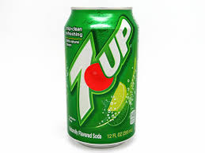
Intentional Vocabulary
Structure academic conversations by providing sentence starters:
I predict ___________________because _____.
In conclusion, ___________________________.
Encourage students to use “smart” words:
delighted not happy
accurate not good
hypothesize not guess
illustrate not draw
comment not tell
Encourage 7UP sentences!

Slide 24
Explicit Instruction of Specific Words
Example folded into the definition
If something is dazzling, that means
that it’s so bright that you can hardly
look at it. After lots of long, gloomy
winter days, the sunshine on the
beach is dazzling.
Beck, I., McKeown, M. and Kucan, L. (2002). Bringing words to life: robust vocabulary instruction. New York: The Guilford Press
Notes:
We will begin with the evidence presented by reading research . And, from among all of this evidence, research repeatedly points toward TIME as an integral factor . . .
which leads us to our next question:
What constitutes an interruption?
We will also consider what reading components are vital for building student reading proficiency.

Slide 25
BIG Idea
VOCABULARY
STRATEGIES
Graves, M. (2006). The Vocabulary Book: Learning & Instruction. NY: Teaching Press.
Baumann, J. and Kame’enui, E. (eds.) (2004) Vocabulary Instruction Research to Practice, NY: Guilford Press

Slide 26
Instructional Routine
Brief clarification before/during reading
Meaningful context
Student-friendly definitions
Additional context, beyond the one read
Opportunities to interact with the word
Application
Beck, I., McKeown, M. and Kucan, L. (2002). Bringing words to life: robust vocabulary instruction. New York: The Guilford Press

Slide 27
Assumptions
Student learn vocabulary only from context
Reads enough text to encounter lots of words (including unfamiliar words)
Knows & applies skills to infer word meaning from context
Handout
6
Beck, I., McKeown, M. and Kucan, L. (2002). Bringing words to life: robust vocabulary instruction. New York: The Guilford Press

Slide 28
Context Styles
Misdirective
Nondirective
General
Directive
Beck, I., McKeown, M. and Kucan, L. (2002). Bringing words to life: robust vocabulary instruction. New York: The Guilford Press
Notes:
Trainer needs to refer to Beck’s book for specificities.

Slide 29
Misdirective Context
The new campus coach, Ms. Brown,
was using cumulative choral reading
to build fluency with the struggling
third graders. “It seems so easy and
fun,” Ms. Adams said _________, as
she observed the demonstration.
grudgingly

Slide 30
Nondirective Context
The unexpected, but __________
invitation to Saturday’s workshop
on strategies for increasing
vocabulary development of
struggling students bewildered
the newest faculty members.
sophisticated

Slide 31
General Context
The research indicated effective
practices for providing explicit and
systematic vocabulary instruction.
The campus coach planned to
_________ one of those practices in
Ms. Smith’s 1st grade classroom.
manifest

Slide 32
Directive Context
The campus coach reminded the
teachers to monitor how students
_____________ vocabulary learning
strategies because it is very
valuable when teachers reinforce
students for engaging in these
activities correctly.
incorporate

Slide 33
Common Prefixes, Suffixes and Roots
Compiled by Alice Thomas from the Center for Development & Learning
The 20 Most Common Prefixes in Academic Texts & Others
TOP 4: un- re- in- im- …
Common Number Prefixes: mono- di- tri-…
Common Suffixes: -s, -es, -ed, -ing
Common Latin & Greek Roots
http://www.cdl.org/wp-content/uploads/2013/12/Common-Prefixes- Suffixes-and-Roots-8.5.13.pdf

Slide 34
Student-Friendly Explanation
tamper
To meddle, especially for purpose of altering, damaging, or misusing; to engage secretly or improperly in something (Random House Dictionary)
Handouts
7-8
To change something secretly so it doesn’t work correctly or will hurt someone
Beck, I., McKeown, M. and Kucan, L. (2002). Bringing words to life: robust vocabulary instruction. New York: The Guilford Press

Slide 35
Student-Friendly Dictionaries
Collins Cobuild Student’s Dictionary
ISBN: 0007126409
www.collinsdictionary.com/dictionary/
The pole vault is an athletics event in which athletes jump over a high bar, using a long flexible pole to help lift themselves up.
Longman Dictionary of American English
www.longman.com

Slide 36
BIG Idea
WORD CONSCIOUSNESS and
WORD PLAY
VOCABULARY
Graves, M. (2006). The Vocabulary Book: Learning & Instruction. NY: Teaching Press.
Baumann, J. and Kame’enui, E. (eds.) (2004) Vocabulary Instruction Research to Practice, NY: Guilford Press

Slide 37
Making Words Stick
Ideas that stick are those that are understood and remembered, and having a lasting impact. (Chip and Dan Heath)
Working memory/THINKING
Listening
Reading
Language Arts
Speaking
Writing

Slide 38
Life-long Fascination
Vocabulary instruction that
inspires such fascination needs to
be robust: vigorous, strong and
powerful in effect. It also needs to
be interactive and motivating.
Beck, I., McKeown, M. and Kucan, L. (2002). Bringing words to life: robust vocabulary instruction. New York: The Guilford Press

Slide 39
Vocabulary Instruction
EARNEST (Beck, grade 4)
Character in book
What it meant to be earnest
Earnest people and earnest
behavior
Beck, I., McKeown, M. and Kucan, L. (2002). Bringing words to life: robust vocabulary instruction. New York: The Guilford Press

Slide 40
Vocabulary Instruction
EARNEST (Beck, grade 4)
Word learning = Word awareness
Use in larger environment
Deeper understanding of familiar words plus learning additional (related) words
Explicitly & systematically taught
Beck, I., McKeown, M. and Kucan, L. (2002). Bringing words to life: robust vocabulary instruction. New York: The Guilford Press

Slide 41
Vocabulary Instruction
INFATUATE (McKeown, grade 7)
Introduced set of words
Dictionary definition
Assigned sentence writing
Group consideration & discussion
Beck, I., McKeown, M. and Kucan, L. (2002). Bringing words to life: robust vocabulary instruction. New York: The Guilford Press

Slide 42
Vocabulary Instruction
INFATUATE (McKeown, grade 7)
Talking about meaning and sharing reactions in contrast to memorizing definitions
Dictionary definitions are a very limited form of understanding the meaning(s) of a word
Beck, I., McKeown, M. and Kucan, L. (2002). Bringing words to life: robust vocabulary instruction. New York: The Guilford Press

Slide 43
I intended to say….
I am heartily sorry for all my sins.
Instead, I said…
I am hardly sorry for all my sins.

Slide 44
Categories of Word Play
Handout
9 & 10
Onomastics: names of people, places, etc.
Expressions: idioms, slang, slogans, etc.
Figures of Speech: similes, metaphors, etc.
Word Associations: synonyms, homophone, etc.
Word Formations: acronyms, portmanteaus, etc.
Word Manipulations: palindromes, anagrams, etc.
Word Games: alphabetic, tongue twisters, etc.
Ambiguities: ambiguous words, phrases, etc.

Slide 45
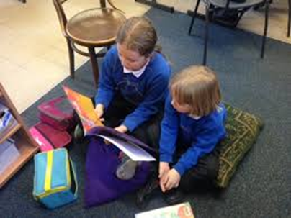
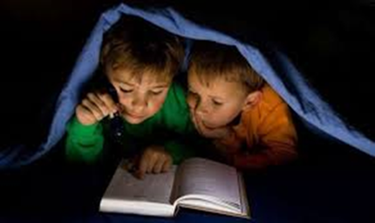
BIG Idea
VOCABULARY
OPPORTUNITIES for ALL
to
ACTIVELY ENGAGE With Text
Graves, M. (2006). The Vocabulary Book: Learning & Instruction. NY: Teaching Press.
Baumann, J. and Kame’enui, E. (eds.) (2004) Vocabulary Instruction Research to Practice, NY: Guilford Press

Slide 46
Word Wizard
If you hear a word--on TV, on the
radio, on the street, or at home--
you can earn 1 point. Tell the
teacher where you heard or saw
the word and how it was used.
Word Watcher
Word Wildcat
Beck, I., McKeown, M. and Kucan, L. (2002). Bringing words to life: robust vocabulary instruction. New York: The Guilford Press

Slide 47
Suggested Websites
Handouts
11 A & B
www.fcrr.org practice activities for vocabulary for grades K-5 (can be easily adapted)
www.scoe.org Anita Archer’s vocabulary instruction videos & Kevin Feldman’s presentations a & B
www.freereading.org Includes a wide variety of learning activities to develop and sharpen reading skills
www.interventioncentral.org Various reading interventions are explored and recommendations given
www.readingrockets.org Provides strategies for working with struggling readers, lessons, webcasts, techniques for teaching reading and podcasts to see it all in action
www.longman.com online dictionary with student-friendly explanations

Slide 48
Vocabulary is a lifelong pursuit….
Vocabulary knowledge is not something that can ever be fully mastered; it is something that expands and deepens over the course of a lifetime. (Stahl, 2005)
Handout
12

Slide 49
Good readers know more words, see more shades of meaning. Their worlds are larger.
annfiala@readinginstructionco.com

