Slide 1
District/BOCES Evidence-Based Training in Teaching Reading Webinar
to meet the requirements of the
Colorado Reading to Ensure Academic Development Act (READ Act)
Notes:
Hello and Welcome to the District and BOCES Evidence-Based Training in Teaching Reading Webinar. Thank you for your interest in learning more about district and BOCES responsibilities related to providing evidence-based training in teaching reading for Kindergarten through 3rd grade educators to meet the requirements of the Colorado READ Act.

Slide 2
Session Objectives:
Participants will:
Understand the District/BOCES responsibilities related to meeting the evidence-based training in teaching reading requirements when selecting to provide:
a CDE-approved district/BOCES reading course 13.01(C)(2)(c), or
a training program included on the department’s advisory list of professional development programs 13.01(C)(2)(f).
Rules for the Administration of the READ Act 1 CCR 301-92
Notes:
This webinar will help participants understand the district and BOCES responsibilities related to meeting the evidence-based training in teaching reading requirements when selecting to provide a CDE-approved District or BOCES-created reading course or when selecting a training program included on the department’s advisory list of professional development programs.

Slide 3
Agenda
Discuss:
The evidence-based training in teaching reading requirements.
The District/BOCES responsibilities if selecting to provide training.
The required components included on a certificate of completion.
Further professional development review.
Next steps for teachers.
Notes:
In this webinar we will discuss:
The evidence-based training in teaching reading requirements.
The District/BOCES responsibilities if selecting to provide training.
The required components included on a certificate of completion.
Further professional development review.
Next steps for teachers.

Slide 4
Evidence-Based Training in Teaching Reading Requirements
Notes:
Now we will talk about the evidence-based training in teaching reading requirements as outlined in the Colorado READ Act.

Slide 5
Evidence-Based Training in Teaching Reading Requirements
Rules
By the beginning of the 2021-22 school year and each school year thereafter, each Local Education Provider that receives PPI or ELG funding shall ensure that K – 3 teachers successfully complete or have successfully completed evidence-based training in teaching reading.
13.01(C)(2) A teacher is deemed to have successfully completed evidenced-based training in teaching reading if the LEP submits evidence that the teacher:
13.01(C)(2)(a) successfully completed a CDE-provided reading training designed to meet this training requirement and passed the end of course assessment of learning; or
13.01(C)(2)(b) passed a CDE-approved undergraduate or graduate reading course and passed the end of course assessment of learning; or
Rules for the Administration of the READ Act 1 CCR 301-92
Notes:
By the beginning of the 2021-22 school year and each school year thereafter, each Local Education Provider that receives Per Pupil Intervention or Early Literacy Grant funding shall ensure that Kindergarten through third grade teachers successfully complete or have successfully completed evidence-based training in teaching reading.
Per READ Act Statute and Rule, there are multiple options for teachers to meet this evidence-based training in teaching reading requirement. You may have heard us refer to these as pathways. We will review the options, or pathways as identified in the READ Act Rules.
A teacher is deemed to have successfully completed evidenced-based training in teaching reading if the LEP submits evidence that the teacher:
successfully completed a CDE-provided reading training designed to meet this training requirement and passed the end of course assessment of learning; or
passed a CDE-approved undergraduate or graduate reading course and passed the end of course assessment of learning; or

Slide 6
Evidence-Based Training in Teaching Reading Requirements
Rules Continued
13.01(C)(2)(c) passed a CDE-approved district or BOCES reading course or a course appropriate for license renewal and passed the end of course assessment of learning; or
13.01(C)(2)(d) holds a state of Colorado endorsement as a Reading Teacher or Reading Specialist; or
13.01(C)(2)(e) successfully completed a training program included on the department’s advisory list of professional development programs created pursuant to C.R.S. § 22-7-1209(2)(c) and passed the end of course assessment of learning.
13.01(C)(3) In the event that a teacher completes one of the evidence-based training options listed in 13.01(C)(2) but lacks proof of passing an end of course assessment, the teacher may take and pass an alternate assessment authorized by the State Board aligned to the expectations of this section.
Rules for the Administration of the READ Act 1 CCR 301-92
Notes:
passed a CDE-approved district or BOCES reading course or a course appropriate for license renewal and passed the end of course assessment of learning; or
holds a state of Colorado endorsement as a Reading Teacher or Reading Specialist; or
successfully completed a training program included on the department’s advisory list of professional development programs and passed the end of course assessment of learning.
In the event that a teacher completes one of the evidence-based training options listed in 13.01(C)(2) but lacks proof of passing an end of course assessment, the teacher may take and pass an alternate assessment authorized by the State Board aligned to the expectations of this section.

Slide 7
Evidence-Based Training in Teaching Reading Requirements
District/BOCES-Provided PD Options
13.01(C)(2)(c) passed a CDE-approved district or BOCES reading course;
13.01(C)(2)(e) successfully completed a training program included on the department’s advisory list of professional development programs created pursuant to C.R.S. § 22-7-1209(2)(c) and passed the end of course assessment of learning.
It is important to note that approval of courses is not retroactive.
Rules for the Administration of the READ Act 1 CCR 301-92
Notes:
Districts or BOCES have two options or pathways that they can choose to provide evidence-based training in teaching reading to teachers
One option includes a professional development created by the district or BOCES, approved by CDE and then provided by the district or BOCES.
The second option is for a district or BOCES to select an approved professional development from the CDE advisory list.
A district or BOCES that selects one of these options will need to follow certain steps which we will discuss in the next section.
It is important to note that approval of courses is not retroactive.
Professional development or courses submitted for this review are intended to be new professional development or course offerings, not ones that have already been delivered.
There are different pathway options available for courses or professional development that have been taken by educators in the past to be reviewed for approval to meet the requirements of the evidence-based training in teaching reading.

Slide 8
Evidence-Based Training in Teaching Reading Requirements
Minimum Statute Requirements
All courses must meet the following minimum statute criteria:
includes a minimum of 45 hours
addresses the content of the educator preparation literacy standards referenced in the state board’s Rules for the Administration of Educator License Endorsements, 1 CCR 301-101, section 4.02(5) through 4.02(12).
Elementary Education Endorsement (Grades K-6)
includes rigorous evaluations of learning throughout the course and an end of course assessment
includes evidence that the teacher passed an end of course assessment of learning at the completion of the evidence-based training
includes a process for documentation of successful completion of the course
certificate of completion
Colorado READ Act CRS §§ 22-7-1201-1214
Rules for the Administration of the READ Act 1 CCR 301-92
Notes:
To meet the requirements of the READ Act, all courses used to demonstrate completion of the minimum statute criteria must
contain a minimum of 45 hours of instruction and
address the content of the Educator Preparation Literacy Standards referenced in the state board’s Rules for the administration of Educator License Endorsements
Section 4.02(5) through 4.02(12) Address Elementary Education Endorsements and focus on components related to literacy and reading instruction.
Includes rigorous evaluations of learning throughout the course and an end of course assessment
Includes evidence that the teacher passed an end of course assessment of learning at the completion of the evidence-based training, includes a process for documentation of successful completion of the course
Such as a certificate of completion

Slide 9
District/BOCES Responsibilities
Notes:
In this section we will review the District and BOCES responsibilities related to the evidence-based training in teaching reading.

Slide 10
District/BOCES Responsibilities
Selecting a Professional Development Option
Schedule and deliver the training:
Submit a District/BOCES-created professional development application to CDE for approval, or
Work with a vendor who is on the Approved Professional Development list
Maintain records of teachers who participated in the training, completed the training, and passed the end of course assessment
Provide participants with a certificate of completion
Certificate of completion must meet CDE requirements
Notes:
When selecting a professional development option the District or BOCES will
Schedule and deliver the training--following one of two options:
Submit a District/BOCES-created professional development application to CDE for approval--the application process is hyperlinked here. OR
Work with vendor who is on the Approved Professional Development list--also hyperlinked here
The district or BOCES will
Maintain records of teachers who participated in the training, completed the training and passed the end of course assessment
Provide participants with a certificate of completion that meets CDE requirements

Slide 11
Components of the Certificate of Completion
Notes:
Now we will review the required components of a certificate of completion.

Slide 12
Components of the Certificate of Completion
Required Components
The required components included on a certificate of completion include:
District Name
Participant’s legal name pre-printed on the certificate
Certificates with handwritten names will not be accepted.
Title of the professional development or course
Type of professional development or course
Documentation that the teacher has met the minimum statute requirements:
45 hour minimum
Passed the end of course assessment
District leadership (e.g., Superintendent) signature
Stamp of approval by the CDE
Notes:
The Certificate of Completion will require certain components which we will review here. After reviewing those items on this slide, we will show a sample certificate.
The required components included on a certificate of completion include:
District or BOCES name
Participant’s legal name pre-printed on the certificate
Certificates with handwritten names will not be accepted.
Title of the professional development or course
Type of professional development or course
Documentation that the teacher has met the minimum statute requirements:
45 hour minimum
Passed the end of course assessment
District leadership (e.g., Superintendent) signature
Stamp of approval by the CDE

Slide 13
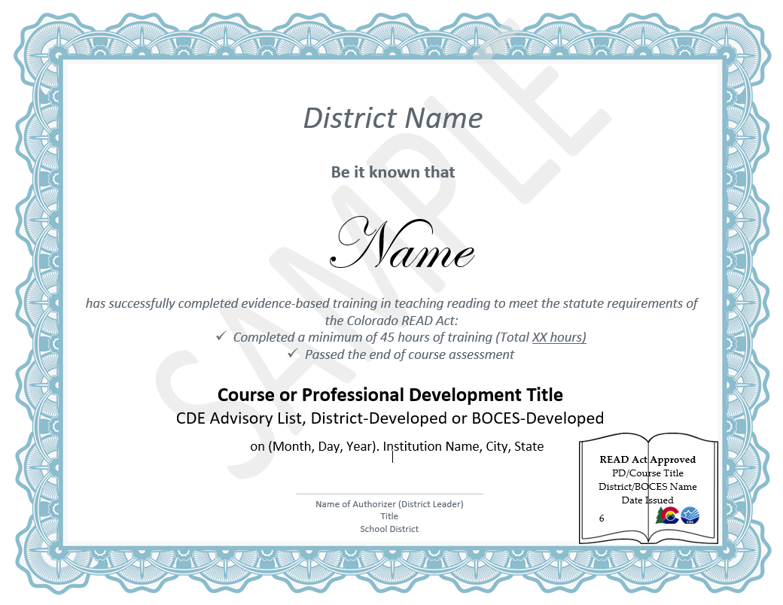
Components of the Certificate of Completion
Certificate of Completion Sample
Participant name must be pre-printed. No handwritten names will be accepted.
Mark that both requirements have been met.
Include type of PD/Course.
Include READ Act Approved stamp.
Signature and information from a district leader.
Notes:
Here is a sample certificate of completion. We will reiterate some of the components we discussed on the previous slide.
Participant name must be pre-printed on the certificate. No handwritten names will be accepted.
The certificate must include language stating that the participant has successfully completed evidence-based training in teaching reading to meet the statute requirements of the Colorado READ Act. It must indicate that the participant has completed a minimum of 45 hours of training. The actual number of hours, if more can be included so teachers can reuse this certificate to submit for future license renewal.
And the certificate must show that the participant has passed the end of course assessment.
The name of the course or PD must be listed as well as indicating what type of PD the session was: a training from the CDE-Advisory list, a District developed or a BOCES developed course.
A signature from a district leader must be provided.
CDE will provide the READ Act stamp of approval after reviewing the submitted professional development or upon notification that the district or BOCES will be providing a training from the advisory list.

Slide 14
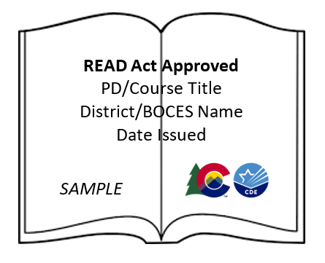
Components of the Certificate of Completion
Stamp of Approval Sample

Slide 15
Further Professional Development Review
Notes:
In this section we will talk about further professional development review.

Slide 16
Further Professional Development Review
Changes to Professional Development
CDE-approved district/BOCES-created professional development offerings will require CDE review if there are significant changes to the content over time.
A significant change includes:
removal of whole sections of the professional development
addition of whole sections to the professional development
new concepts or content are added to the professional development
Notes:
CDE-approved district or BOCES-created professional development or course offerings will require CDE review if there are significant changes to the content over time.
A significant change includes:
Removal of whole sections of the professional development
Addition of whole sections of the professional development
Or new concepts or content added to the professional development that are not based on updates to current research

Slide 17
Teacher Next Steps
Notes:
After the professional development is completed and participants have received their certificate of completion there are a few next steps that a teacher will take.

Slide 18
Teacher Next Steps
Documentation of Completion
Teacher submits his/her certificate of completion through the Colorado Online Licensing System. (anticipated date: January 2021)
Teacher receives and saves a copy of documentation from the CDE that demonstrates the “READ Act designation” attached to their CDE file.
Teacher provides the district with documentation as needed.
Notes:
Once a teacher has completed a professional development course and received a certificate that shows they have completed a course which meets the minimum statute requirements, the teacher will submit that certificate of completion through the Colorado Online Licensing System.
CDE anticipates that the Colorado Online Licensing System will be able to accept these certificates in January 2021.
The teacher will then receive notification that a READ Act designation is added to their CDE file.
The teacher will provide the district with that documentation as needed.

Slide 19
Resources
Notes:
Here are resources to support districts and BOCES with these processes.

Slide 20
Resources
General
Colorado READ Act Webpage
The Colorado READ Act
Rules for the Administration of the Colorado READ Act
Elementary Education Endorsement Standards (Grades K-6)
Notes:
READ Act Resources here include a link to the Colorado READ Act webpage and direct links to the Colorado READ Act, the READ Act Rules and the Elementary Education Endorsement Standards for Grades K-6.
These items will be helpful for districts or BOCES when creating a professional development.
All programs on the READ Act Professional Development Advisory list have been reviewed to meet the requirements outlined in these documents.

Slide 21
Resources
District-/BOCES-provided Reading Course
2020 READ Act Professional Development Process
Questions Regarding the Application Process Form
Notes:
The 2020 READ Act Professional Development Process link takes you to a webpage which includes the documents and process for submitting a District or BOCES-created professional development to the CDE for review and approval to meet the Evidence-Based Training in Teaching Reading requirements.
Questions about this application process can be submitted to the CDE Communications team using the form linked here.

Slide 22
Resources
Advisory List of Professional Development
CDE Professional Development Advisory List
Form to Request Stamp of Approval for a Professional Development from the Advisory List
Notes:
Here you will find links to the CDE Professional Development Advisory list and a short form to complete to request a CDE stamp of approval when providing one of those trainings.

Slide 23
Questions/Support
Notes:
Questions and support

Slide 24
Questions/Support
For additional questions or support please send an email to readact@cde.state.co.us.
Notes:
For any additional questions or support please submit an email to the READ Act Communications Team using this email address, readact@cde.state.co.us.
Thank you for your work to support Colorado educators!

