Slide 1
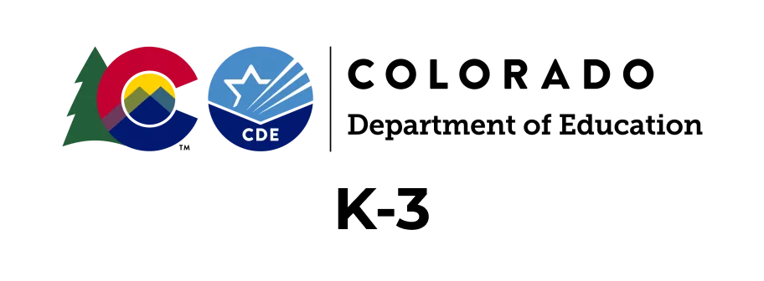
Information included is to support participants who registered for the CDE online training before Aug. 1, 2023, and have already started the online training to meet the READ Act Teacher Training requirements
Building a Strong Foundation: Developing Early Literacy Skills
Notes:
Existing K-3 educators will not lose access to their current K-3 modules. They will continue to complete the courses that they were automatically enrolled in.
Moving forward, they will need to request access the Final Assessment in the top blue ribbon, under K-3 Final (2022-23). They will only gain access if they have successfully completed pre-requisites of Modules 1-6 (same process that exists currently)
Access Pepper account by going to https://www.pepperpd.com/login
After July 1, 2023, all new K-3 educators will be rolled into the K-12 track. No new learners will be enrolled in the Phase 1 K-3 modules after July 1, 2023
The appearance of the dashboard will change on July 1, 2023. Existing K-3 learners will request access to the K-2 Final Assessment in the top blue ribbon (K-3 Final 2022-23)
Note: K-3 Educators will not be able to access the Leaders or K-12 Modules

Slide 2
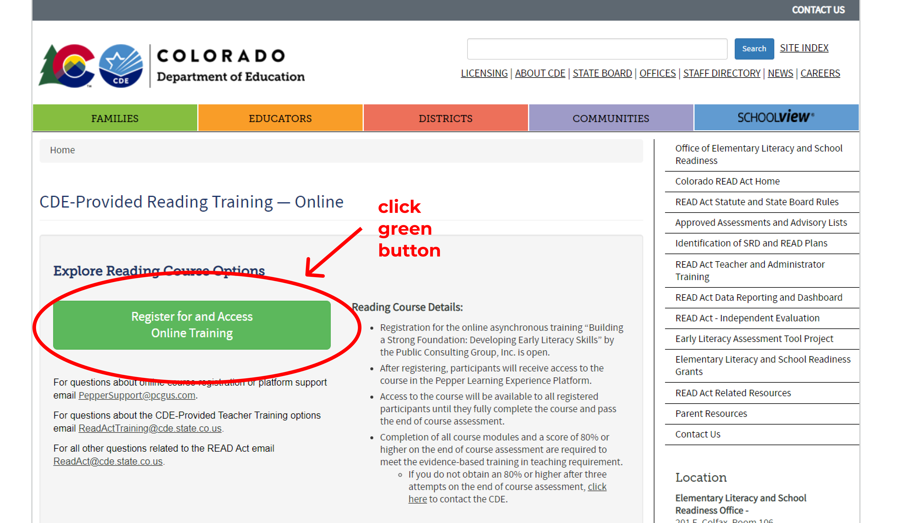
Accessing Your Pepper Account for Building a Strong Foundation: Developing Early Literacy Skills
Access your Pepper account by going to https://www.pepperpd.com/login
OR
Click on the green button on the CDE webpage titled: CDE Provided Teacher Training – Online (see screenshot to the right)
Notes:
K-3 user experience will not change with the exception of the appearance of the drop-down options in the blue menu ribbon.
They will maintain their enrollment in Modules 1-6, which must be completed before gaining access to the Final Assessment.

Slide 3
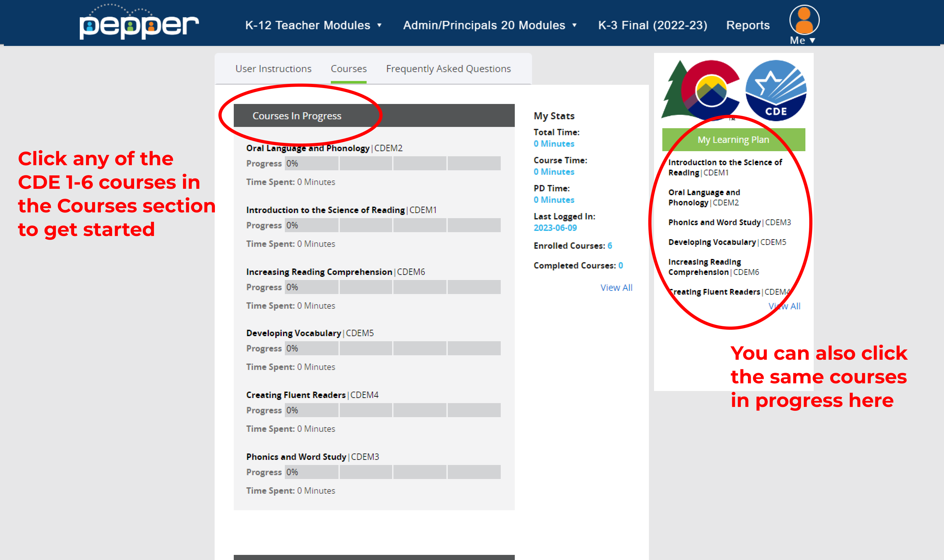
Access your Pepper account by going to https://www.pepperpd.com/login
To access your training courses, you can access them by:
1. Going to the “Courses” tab
2. Using the “Learning Plan” on the right bar
Notes:
K-3 user experience will not change with the exception of the appearance of the drop-down options in the blue menu ribbon.
They will maintain their enrollment in Modules 1-6, which must be completed before gaining access to the Final Assessment.

Slide 4
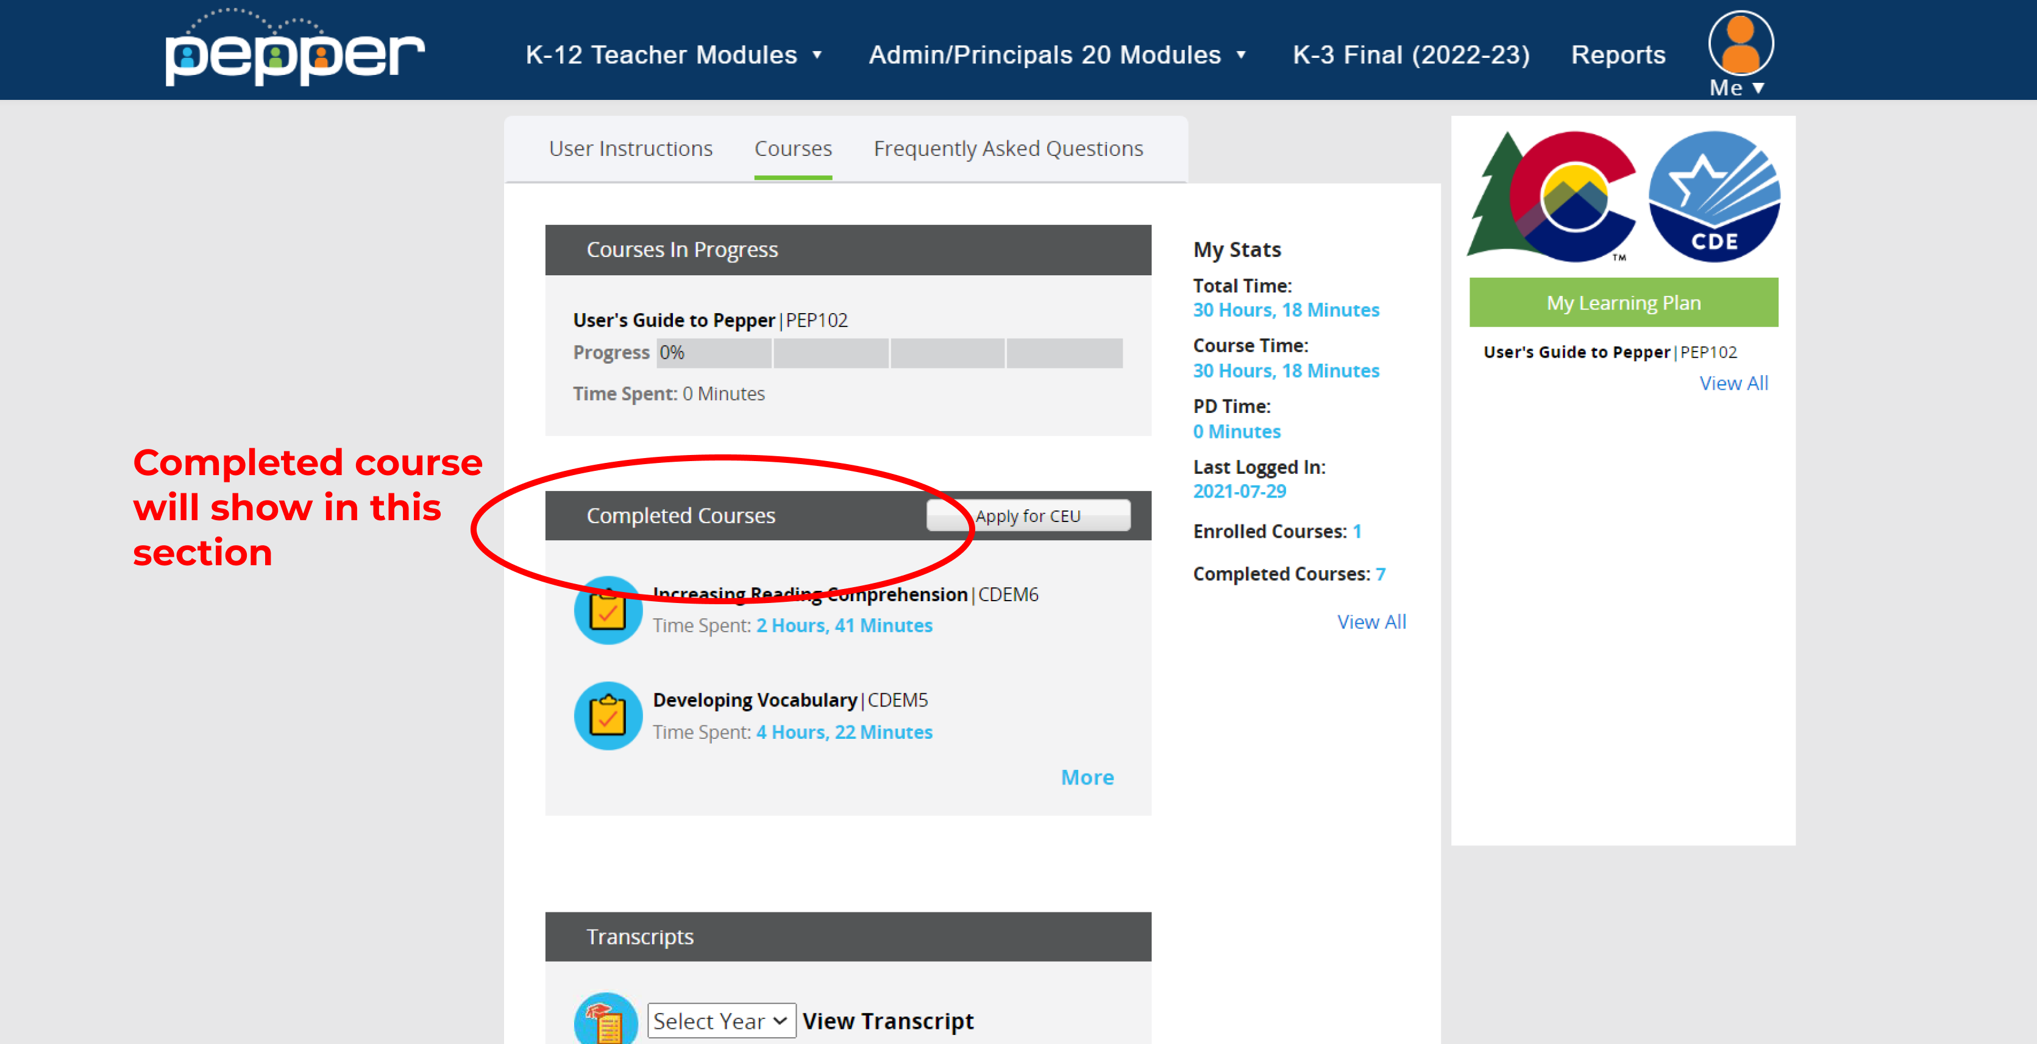
You must complete Courses 1-6 to access the Final Assessment
Once you complete the Final Assessment, your training is complete
You can confirm completion of any of your six courses in the “Courses” tab under “Completed Courses”

Slide 5
After you complete all six courses, you can now access the Final Assessment
To access the Final Assessment, click K-3 Final on the top navigation bar
Then, click “Request Access” on the Final Assessment Information page

Slide 6
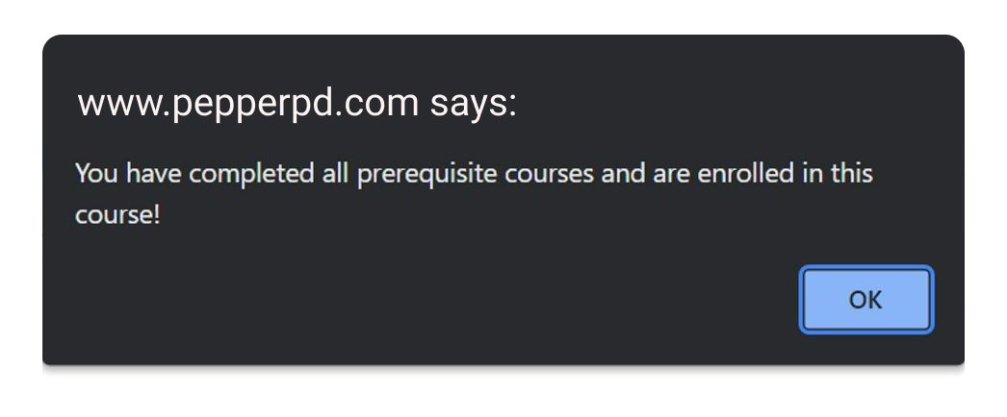
If granted access, a pop-up will state you have passed the pre-requisite to take the course

Slide 7
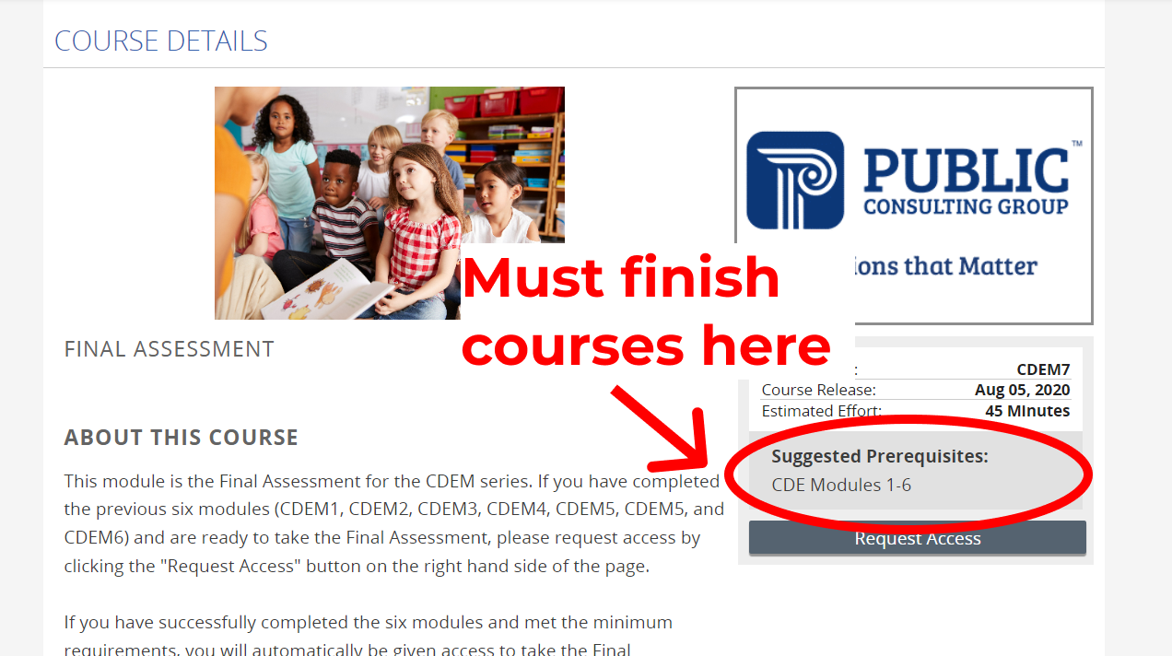
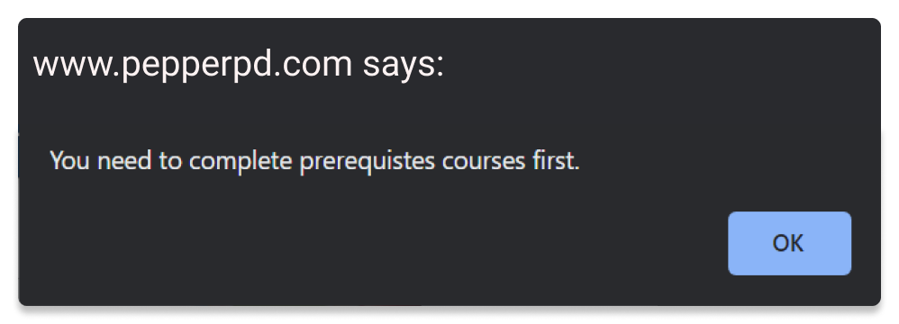
If you did not complete the prerequisite, a pop-up will notify you that you must finish all prerequisites instead. Check the prerequisites on the page to make sure you completed them all.

Slide 8
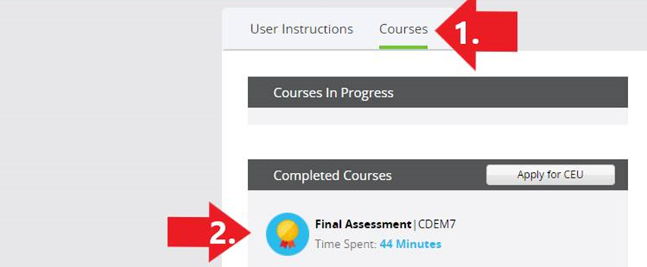
After completing the Final Assessment, you will gain access to a certificate indicating that you have completed the training.
To download your certificate, click the gold medal on the Final Assessment:
Congratulations, you have successfully completed your CDE K-3 training!

