Slide 1
Sound Walls vs. Word Walls
Presented by
Mary E. Dahlgren, Ed. D.
mary@tools4reading.com

Slide 2
OBJECTIVES
Apply our knowledge of the organization of language to maximize instruction
Generate awareness of how to articulate the phonemes in the English language using “Kid Lips”
Discuss common spelling patterns and how to connect instruction to phoneme articulation
Setting up a sound wall in your classroom for daily use

Slide 3
Components Making up Some of the English Language
26 letters in the alphabet
44 speech sounds
Over 200 different ways to spell these sounds
Notes:
Go through each card and make sure they can articulate each sound correctly. Match with kid lips.
1- 4 exposures to learn sight words 2nd grade and on (Retisma, 1983)
The ability to accurately identify words if you can blend the sounds together and come up with a close pronunciation.
Variations in dialect confirm this. Hearing words pronounced with a Boston accent but not being confused when seeing it in print.
Kilpatrick-pg. 86

Slide 4
What Does It Take to Retain Words?
Need phonemic analysis – segmenting and blending along with manipulation
Need to know major grapheme- phoneme correspondences
Need to know syllabic sound-spelling patterns
Need to be able to read unfamiliar words on their own
Self-teaching hypothesis (Share, 1995)
decoding, analogy, or prediction strategy (Ehri, 2004)
Notes:
Ehri – Orthographic mapping
Stanovich – It appears that reading is not determined by skill at contextual prediction; rather, the level of word recognition skill determines the extent to which contextual information will be relied on to complete the process of lexical access.
Differentiate between obligatory and strategic. It may be obligatory for a poor reader to rely upon context when resources for word recognition are deficient, causing the reader to rely more on contextual information. Progress in Understanding Reading, pg. 170.

Slide 5
Current Word Walls
The organization is A-Z … most of the time
Words are listed by the first letter
Focus tends to be different in every classroom
Functions as wallpaper

Slide 6
Limitations of A–Z Organization
Letter names
Disregard for sound
Shape

Slide 7
Why?
We know students need to master the most common words
High-Frequency Words – Dolch, Fry
Sight Words
Irregular words
Notes:
What started this?
We know sight words are important to the reading process
Dolch
Fry

Slide 8
True or False?
Irregular words require a different storage process compared to regular words.
Notes:
FALSE!
Some evidence as to why this false. (Kilpatrick, 2014).
Nearly the same process that is used to store phonically regular words is also used to store phonically irregular words.
Very few words in the English language are irregular in more than one letter-sound connection.
The letter-sound connections that are regular within irregular words can be used to build a phonological framework for remembering them.

Slide 9
Reading Words from Memory: Orthographic Mapping
Process of forming connections
Spelling
Meaning
GLUE
Pronunciation
Knowledge of the grapheme-phoneme system provides the glue connecting spelling to pronunciations in memory.
Notes:
Form connections between spelling and pronunciations, applying general knowledge of the writing system.
See new word and say OR hear its pronunciation – the spelling becomes mapped onto its pronunciation and meaning.

Slide 10
Stroop Effect
Evidence that bonded words are read from memory
BLUE
Seeing a known word (BFF) you recognize instantly
Looking for a person in a crowd based on specific characteristics (tall, thin, glasses, bald) takes more time to identify initially.
Cow
COW
CAT
Notes:
See Ehri’s presentation from the LETRS Summit
Cognitive dissonance is created. We see the word an immediately know it says cow or dog.

Slide 11
QUIZ! At the earliest stages of reading development, what is the most effective way for children to remember words?
By having words posted around the classroom – labeling – chair, clock, etc.
By anchoring letters in the word to whatever phonological aspects of the word they can notice/be aware of
By visual memorization techniques
All of the above are equally helpful for beginning readers.
Notes:
Answer B.

Slide 12
What Is a Sound Wall?
A sound wall is set up according to the articulation of speech sounds.
Moving from the front of your mouth to the back of the throat
Approaching things from a learner viewpoint rather than a teacher viewpoint
Anchor to teach letter-sound knowledge and articulatory gestures
Attaching phonemes to orthographic patterns
This has everything to do with print.
Notes:
Different from the typical ABC order
Moves from speech to print
We all need to know what speech pathologists know when it comes to phonemes
Recognizing the way students learn can make instruction more efficient and effective
Not just about phonemes – organizing speech and recognizing the various ways we have constructed print to represent spoken language
Once articulation is clear, it is easier to also make connections to the various graphemes/spelling patterns in English.
As the opportunity arises, make spelling and reading patterns obvious and link to their errors.

Slide 13
Why a Sound Wall?
Two purposes with a broader application:
Attending to articulation
Articulatory gestures help to concretize phonemes
Attending to the various graphemes and patterns representing phonemes
Providing access to and discussion around the various ways we spell words (orthography)
Notes:
Different from the typical ABC order
Moves from speech to print
We all need to know what speech pathologists know when it comes to phonemes
Recognizing the way students learn can make instruction more efficient and effective
Not just about phonemes – organizing speech and recognizing the various ways we have constructed print to represent spoken language
Once articulation is clear, it is easier to also make connections to the various graphemes/spelling patterns in English.
As the opportunity arises, make spelling and reading patterns obvious and link to their errors.

Slide 14
Why Use a Sound Wall along with Articulation Pictures?
Phonemic Awareness Instruction: Contribution of Articulatory Segmentation to Novice Beginners’ Reading and Spelling
Castiglioni-Spalten & Ehri, 2003
Contribution of Phonemic Segmentation Instruction With Letters and Articulation Pictures to Word Reading and Spelling in Beginners
Boyer & Ehri, 2011
Orthographic Mapping in the Acquisition of Sight Word Reading, Spelling Memory, and Vocabulary Learning
Ehri, 2014
Notes:
The favored explanation, consonant with the motor theory of speech perception, is that LPA training activated the articulatory features of phonemes in words as children practiced reading them, so that grapheme-phoneme connections were better secured in memory. Results also suggested that phoneme segmentation training with letters improved phonological short-term memory.

Slide 15
Focus on Phonemes and Articulation
Hearing sounds in words – “ear”
Articulatory gestures – “mouth movements”
Ease of processing favors gestures
Sounds are ephemeral and disappear as soon as they are heard.
Liberman (1999) suggests that articulatory gestures, rather than acoustic features, represent phonemes in the brain.
Mouth positions are tangible and can be felt, viewed in a mirror, and analyzed by learners (Ehri, 2014).

Slide 16
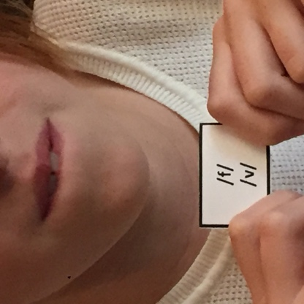
/f/ and /v/
Unvoiced: /f/ as in fish – does not cause any vibration in the vocal cords as you blow air over your lip with the voice turned off.
Voiced: /v/ as in volcano – does cause a vibration and tickles the lip when blowing air over your lip with your voice turned on.
Spanish speakers:
/f/ not found in final position in Spanish words
/v/ not a phoneme in Spanish. The typical pronunciation of the letter v is /b/ – e.g., bery for very.
Explicitly teach students articulation of teeth on lips.
Description:
Place upper teeth on bottom lip.
Blow until you run out of air.
Notes:
The power of concrete over abstract in helping people grasp the greatest thing.

Slide 17
/p/ and /b/
Unvoiced: /p/, as in pig, does not cause any vibration in the vocal cords.
Voiced: /b/, as in bat, does cause a vibration in the vocal cords.
Corrective feedback: Feel the difference in the vocal cords.
Practice oral differentiation between words like pig and big, pack and back, pike and bike.
Description:
Lips begin together.
Air is pushed through the mouth.
Lips quickly pop open.

Slide 18
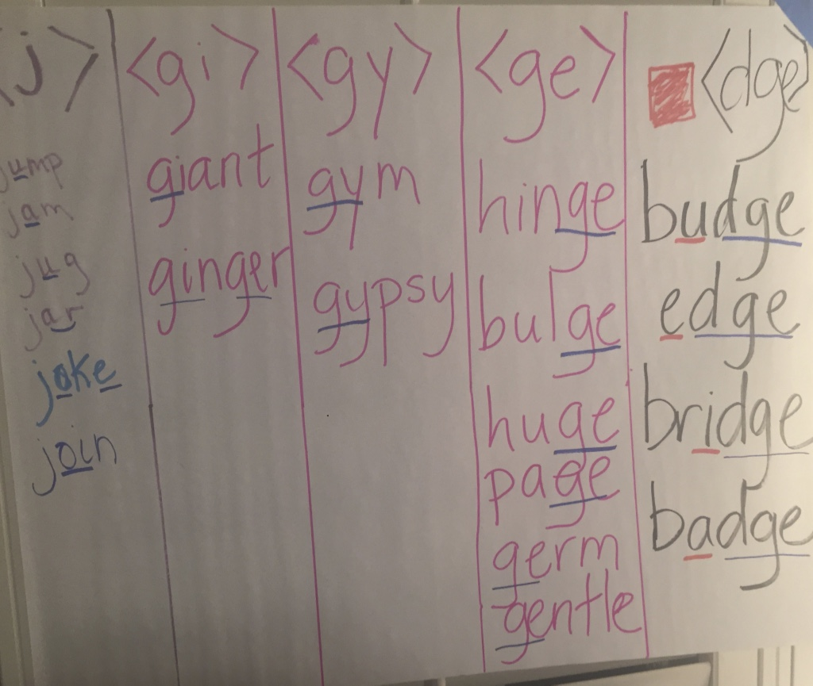

Slide 19
Orthographic Patterns: Permissible or Inadmissible?
Permissible sequences of letters and patterns
Can you list a few?
Word specific orthographic knowledge = was, not wuz
General orthographic knowledge = keep, not kepe
Inadmissible sequences
How do you know what is inadmissible?
Inventive spelling – does it interfere with developing a firm foundation in orthographic sequences?
Notes:
Chat box responses from participants – only take the first 10 responses and move on.
blends, digraphs, trigraphs, quadragraph
How often do patterns occur? c = 73% for /k/; k = 13% for /k/; -ck = 6% for K; and ch = 3% for K
Etymological influences
How do you know what is inadmissible? Rhetorical question – no answer from participants is necessary.
There is a sense of knowing when patterns are not correct when you have a foundation. Making sure students have a firm foundation is important.
Does inventive spelling make it difficult to place the correct pattern in the orthographic sequence?

Slide 20
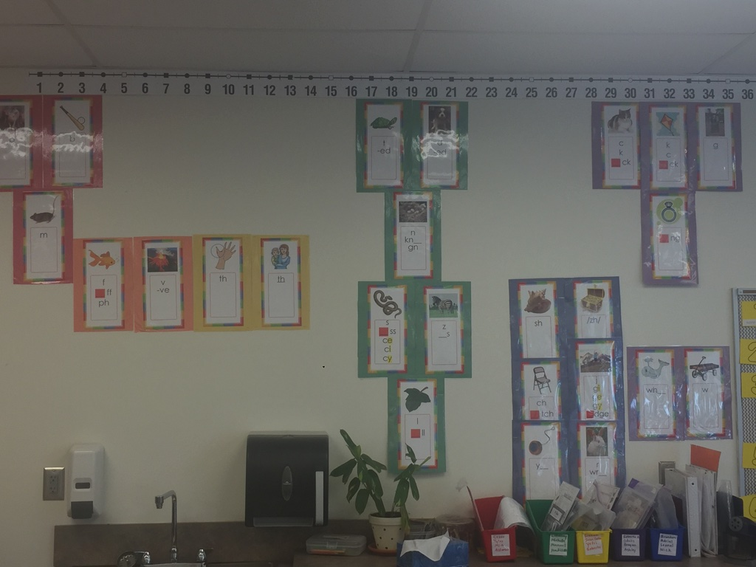
Notes:
Walk through color-coding and association

Slide 21
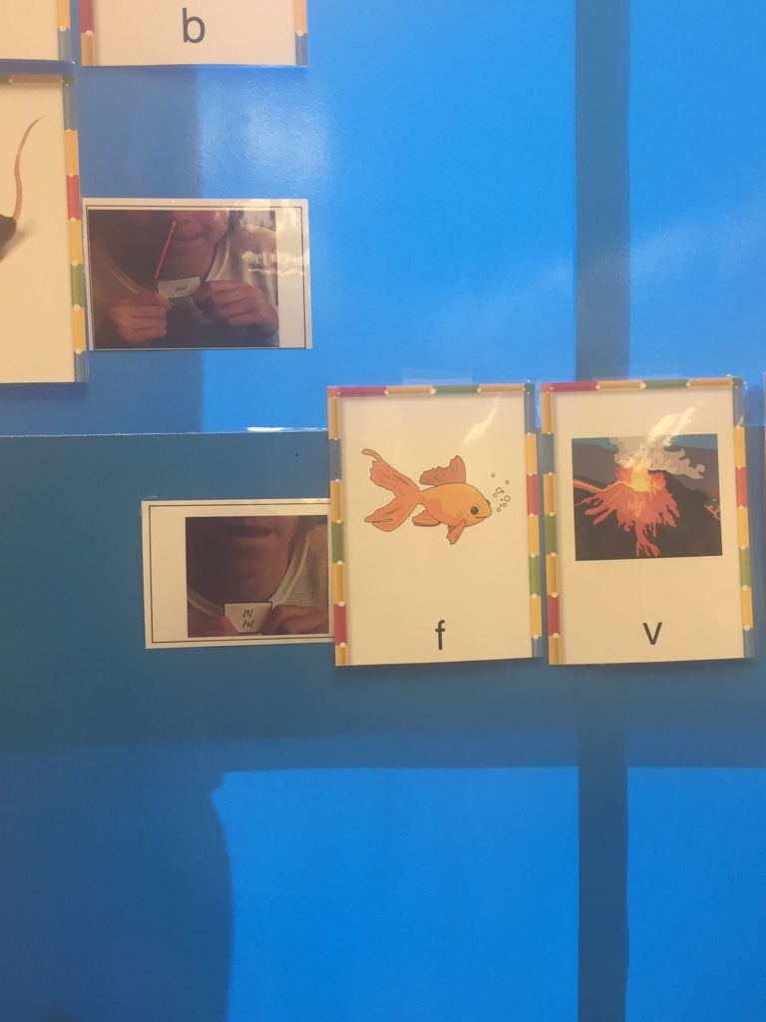

Slide 22
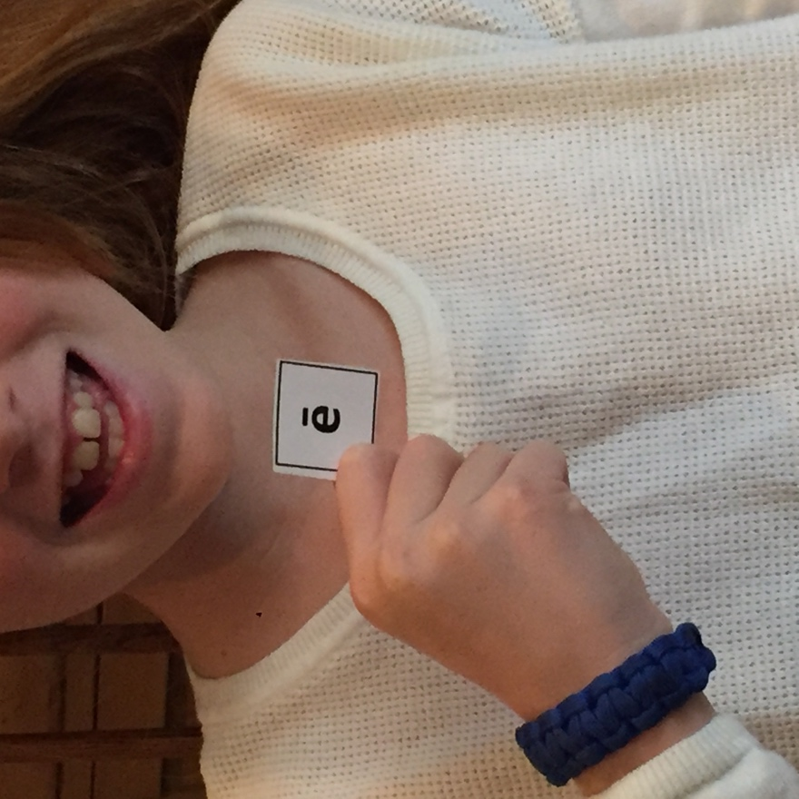
Vowel Phonemes
Description: Mouth is slightly open; the tongue is lifted high and the lips are tight in a smile.
A photographer asks you to say “cheese” because it causes your mouth to create a tight smile.
Voicing: All vowels are voiced
The tongue is high in the mouth and at the front when producing the long ē sound.

Slide 23
Teacher Knowledge
Be smarter than your program.
Understand how the language works.
Understand the written system.
Understand the phonological system.
Use assessments to combine these elements into good daily instruction to be more effective and efficient.

Slide 24
Thank you!
Mary Dahlgren
mary@tools4reading.com
www.tools4reading.com
Find us on Facebook:
facebook.com/tools4reading

Slide 25
References
Castiglioni-Spalten, M., & Ehri, L. (2003). Phonemic awareness instruction: Contribution of articulatory segmentation to novice beginners’ reading and spelling. Scientific Studies of Reading, 7(1), 25–52.
Boyer, N. & Ehri, L. C. (2011). Contribution of phonemic segmentation instruction with letters and articulation pictures to word reading and spelling in beginners. Scientific Studies of Reading, 15(5), 440–470.
Ehri, L. (2014). Orthographic mapping in the acquisition of sight word reading, spelling memory, and vocabulary learning. Scientific Studies of Reading, 18(1), 5–21.
Kilpatrick, D. (2015). Essentials of assessing, preventing, and overcoming reading difficulties. Hoboken, NJ: Wiley and Sons.

