Slide 1
Routines for Daily Practice Repetition, Repetition, Repetition Dr. Mary E. Dahlgren www.tools4reading.com mary@tools4reading.com

Slide 2
abcdefghijklmnopqrstuvwxyz
left
right
a | e | i | o | u
b | th | k | c | j
Phonemic Awareness- PGM
Irregular Word Practice
(Practice 2 words)
said
from
Handwriting
------------------------------
___________________
___________________
Sentence Builder: Who + Do
∧_____________ _____________ __________ ____________.?!
Notes:
----- Meeting Notes (4/15/15 14:26) -----
alphabetmat.com
abcderian.com

Slide 3
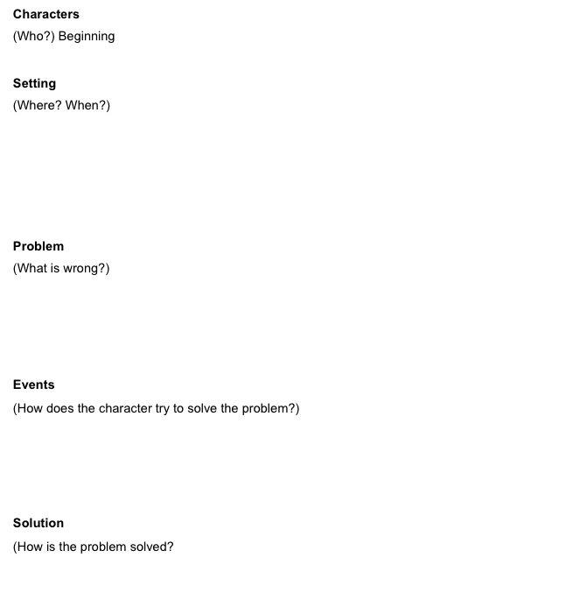
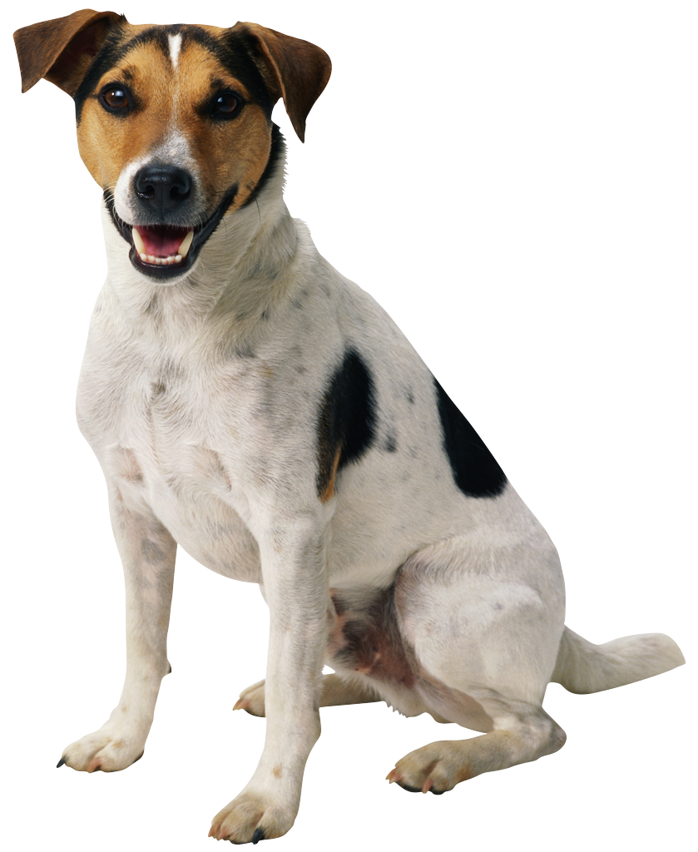
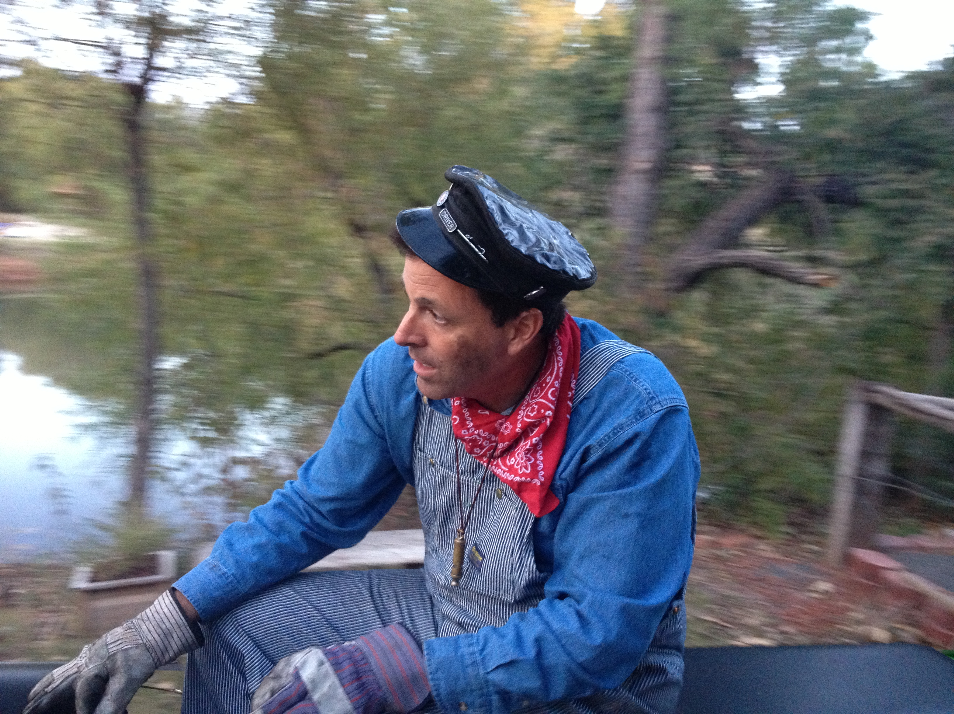
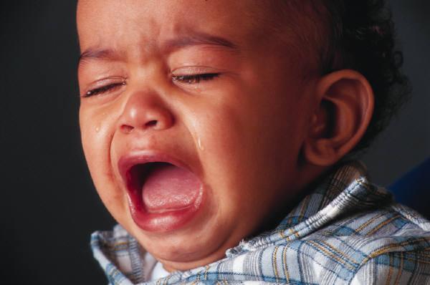
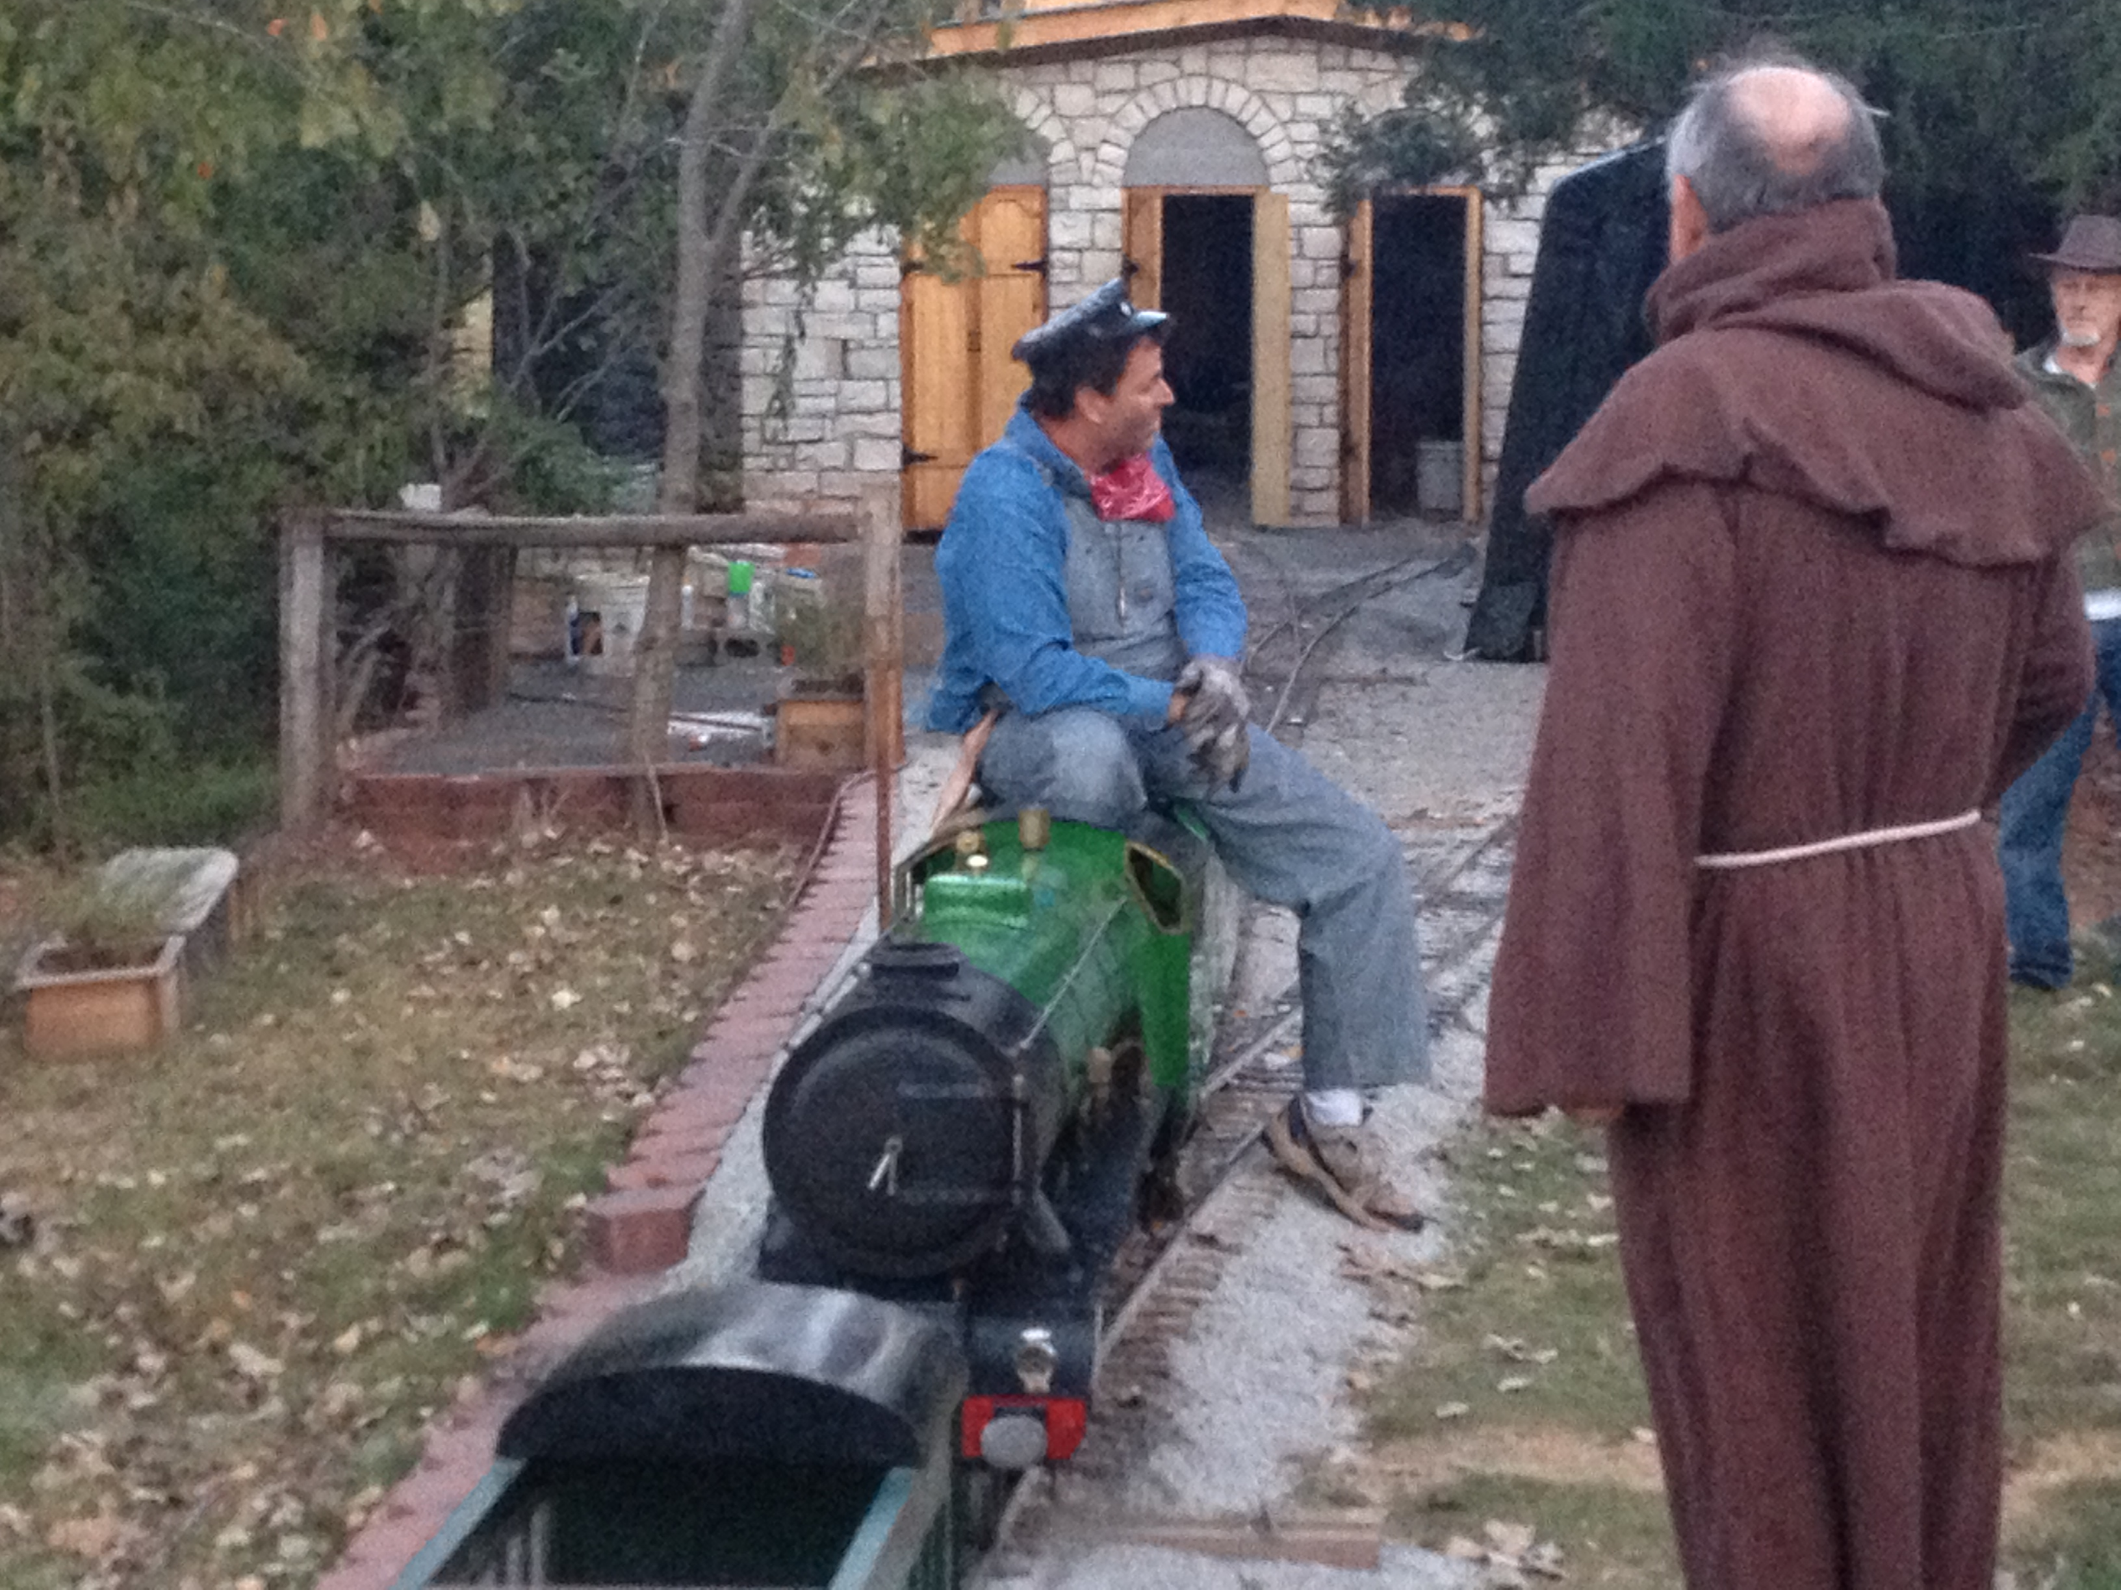
ABCDEFGHIJKLMNOPQRSTUVWXYZ
abcdefghijklmnopqrstuvwxyz
Sight Word Reading
(Practice 2 or 3 words)
build, country
Name grapheme and phoneme
ai ay | ee y | igh y | oa ow
Text Structures
ch -tch | -ck wh | ph th | wh -tch
Spelling or
Syllable Mapping
Narrative
Expository
Beginning
Main Idea
Supporting Idea
Detail
Detail
Supporting Idea
Detail
Detail
Detail
Middle
End
Sentence Builder: Who + Do
∧_____________ ____________ _____________ __________ ____________.?!

Slide 4
ABCDEFGHIJKLMNOPQRSTUVWXYZ
abcdefghijklmnopqrstuvwxyz
left
right
abcdefghijklmnopqrstuvwxyz
Notes:
Student folder handout.
Knowledge of letter names is a robust predictor of 1st grade reading success.
Naming letters helps to recall and recognize them
Builds letter-sound connection and word consciousness.
Develop links to reading and spelling.
DAILY WARM-UP (If students do not know all letter names, begin to introduce in order 1-4 a day. Once students have learned all of the letters begin this daily activity.)
“This is the alphabet. There are 26 letters in the alphabet.” How many letters in the alphabet? ___
“There are two kinds of letters in the alphabet, vowels and consonants.” Repeat after me, “vowels…and…consonants”.
Hold up your left hand and say, ‘my left hand points to a, my right hand points to z. Repeat, left – A, right-Z.
We are ready to name the letters, left hand on A and place your right hand on N.
We will touch and name the letters using our left hand until we get to M and then we will switch and use our right hand.

Slide 5
Syllables
Notes:
Student folder handout
Some activities for breaking words into Syllables:
Use DUCK LIPS to feel the syllables
Show the number of syllables using felt/foam/paper rectangles
Fist Stomp the syllables.
Start with 1-2 syllables and work up to 4-5 syllables.

Slide 6
Onset - Rime

Slide 7
Phonemic Awareness
Notes:
Student folder handout.
Once students have mastered syllable counting and on-set rime move into blending and segmenting phonemes.

Slide 8
Irregular Word Routine
Say the word and name the letters each time you trace and write the word.
_____________
(Print the irregular word on the line.)
________________________
________________________
________________________
Write from memory 3 x’s
Whisper the word and name the letters each time you write it.
________________________
________________________
________________________
Notes:
Full body words

Slide 9
Name
1
2
3
4
5
6
7
8
9
10
11
12
Notes:
Practice writing specific letters with description of the strokes.
Practice writing a single letter at least 4 times with precision until the children are automatic at writing without instruction.

Slide 10
Sentence Writing
Begin with a basic format. Use pictures or graphic organizer to develop sentence writing.
Every sentence has a Who + Do.
Begin with the action – use a strong verb.
Add the who or what the action is doing – noun.
Expand your sentences from there by asking questions about the verb and the noun.
∧_____________ ____________ _____________ __________ ____________.?!
How many? What kind? Which one? | Who? (what) | Do? (action) | When? Where? How? What?
Notes:
This is an opportunity for teaching parts of speech along with sentence structure.
Ask questions to expand the predicate (verb): use adverbs, adverb phrases, and adverb clauses answer the questions when, where, how, why?
Ask questions to expand the subject (doer): use adjectives, adjective phrases, and adjective/relative clauses :answer the questions what kind? Which one? Whose? Or How many?
Remind particpants to go back to the Oral Language instruction as a reminder of the questioning format.

Slide 11
Text Structure
Narrative Text
Expository Text
Characters
(Who?)
Setting
(Where? When?)
Problem
(What is wrong?)
Events
(How does the character try to solve the problem?)
Solution
(How is the problem solved?
Main Idea
Supporting Idea
Detail
Detail
Supporting Idea
Detail
Detail
Detail
Beginning
Middle
End

