Slide 1
Beginning of Year CLSD Grant Meeting
September 4, 2024
Notes:
Beginning of school year CLSD Grant Meeting, September 4, 2024
CLSD main contacts:
Laura Lay, CLSD Program Manager, lay_l@cde.state.co.us
Tricia Miller, CLSD Grants Fiscal Manager, miller_t@cde.state.co.us
New to the team as the Reading, Writing, and Communication Content Specialist in the standards office, Mykal Knight, will be joining us.
Mykal Knight, Reading, Writing, and Communicating Content Specialist, knight_m@cde.state.co.us

Slide 2
Main Topics:
Basic grant information – where to find it
Narrative and financial reporting
6-12 literacy activities share out and conversation (second half of meeting)
Desktop Reviews
Notes:
Today’s meeting will be split into two parts, the first part being an overview of information for managing your grant and the second part will be a conversation around literacy activities, learned lessons, and sharing of your work.
Part one main topics are based on frequently asked questions including where to find information about the CLSD grant, upcoming narrative and financial reporting, and a conversation about doing desktop reviews rather than site visits.

Slide 3
CLSD Grant Basics
$17.7 million federal grant across 5 years
15% birth-kindergarten entry activities
40% K-5 activities
40% 6-12 activities
5% state-level activities
Two Cohorts across 4 years
Main Cohort in year 3 (4 year)
PD Cohort in year 1 (2 year)
CDE CLSD Webpage
Notes:
In September 2020, CDE was awarded $16 million to support comprehensive literacy.
Grant funds are required to be spent to support literacy efforts meeting the following criteria: 15% on birth-kindergarten entry activities, 40% K-5 on activities, 40% on 6-12 activities, and 5% on state-level activities.
The CLSD grant supports two cohorts, the first beginning in the fall of the 2021/2022 fiscal year. We refer to this cohort as the Main cohort which spans 4 years.
A second cohort focusing specifically on professional development began their CLSD work this past October and is in its first of two years.
Resource page and CDE CLSD webpage are linked on the slide.

Slide 4
CLSD Information
All the needed information for the CLSD grant can be found:
https://www.cde.state.co.us/early/comprehensive-state-literacy-development-grant
Are you new to the CLSD Grant?
Check out the CLSD Program Overview Checklist:
https://www.cde.state.co.us/coloradoliteracy/program_overview_for_grantees
Information also found in pdf form in the Subgrantee Handbook:
https://www.cde.state.co.us/coloradoliteracy/clsd_subgrantee_handbook
Notes:
Here are some resources to help you find the information you need about the CLSD grant:
General Information: All the details about the CLSD grant can be found on the Comprehensive State Literacy Development Grant page.
https://www.cde.state.co.us/early/comprehensive-state-literacy-development-grant
New to the CLSD Grant? Check out the CLSD Program Overview Checklist for a helpful introduction.
https://www.cde.state.co.us/coloradoliteracy/program_overview_for_grantees
Subgrantee Handbook: More information is also available in PDF format in the CLSD Subgrantee Handbook.
https://www.cde.state.co.us/coloradoliteracy/clsd_subgrantee_handbook
Feel free to email me or set up a meeting if you have any specific questions. lay_l@cde.state.co.us
https://outlook.office365.com/owa/calendar/CLSDAssistance@cde.state.co.us/bookings/

Slide 5
Important Dates
Federal Fiscal Year:
Current performance Period: October 1, 2023 – September 30, 2024
Next Performance Period: October 1, 2024- September 30, 2025
Next Reporting Period:
Narrative reporting: would like to change this process
Annual Financial Report (AFR) due November 30, 2024:
Last day to request funds is October 15, 2024
Ledger includes expenses for the entire performance period: October 1, 2023 – September 30, 2024
Notes:
The federal fiscal year that this grant uses does not align with the state fiscal year or school calendar year.
The current performance period is from October 1, 2023- September 30, 2024. The last year of the grant is from October 1, 2024- September 30, 2025.
The financial reporting calendar will stay mostly the same- I’ve moved the AFR deadline to November 30 to give a little bit more to complete after then end of the fiscal year on September 30th. The last day to request funds for the performance period is October 15th and your general ledgers will need to show that the items were purchased within the performance period.
Narrative Reporting via Microsoft Forms: https://forms.office.com/r/PA4sVmraTn

Slide 6
Subgrantee Input on Narrative Reporting
Will move narrative reporting to the beginning of the school year using Microsoft Form
Three focus areas for self-evaluation: Leadership & Infrastructure, Professional Development & Instruction, Partnerships & Family Engagement
https://forms.office.com/r/PA4sVmraTn
Notes:
I plan to shift narrative reporting to the start of the school year using Microsoft Forms.
There are three focus areas for self-evaluation: Leadership & Infrastructure, Professional Development & Instruction, and Partnerships & Family Engagement.
No objections from the meeting- will plan to move to this reporting for the October 31st narrative deadline.
https://forms.office.com/r/PA4sVmraTn

Slide 7
Desktop Review Instead of Site Visits
District presents on CLSD grant activities
Pictures, videos of classroom instruction
Examples of student work
Feedback from teachers
Student data and progress towards goals
Lessons learned, challenges, bright spots
How the district plans to sustain activities and impact beyond grant period
Review grant working files- progress reports, program measures, budget and financial information, changes to policies
Collaborative discussion on areas for improvement, best practices
Discuss any action steps or follow-up as necessary
Notes:
I also plan to transition site visits to desktop reviews and would like to see if this approach works for everyone.
During these reviews, the district will present on CLSD grant activities and include:
Pictures and videos of classroom instruction
Examples of student work
Feedback from teachers
Student data and progress toward goals
Lessons learned, challenges, and successes
Plans for sustaining activities and impact beyond the grant period
This is a chance for you to showcase the excellent work you've been doing and present it in a format that I can also use for federal reporting or share with CDE leadership.
The review would also include a review of grant working files, including progress reports, program measures, budget and financial information, and any changes to policies.
Additionally, we will have a collaborative discussion on areas for improvement and best practices, as well as address any necessary action steps or follow-up.
I will connect with grantees to schedule a time that works best for each site. Would like all desktop reviews done by the end of the 24/25 school year.

Slide 8
Management or Fiscal Questions
We are available via email: lay_l@cde.state.co.us or miller_t@cde.state.co.us
Bookings Page:
https://outlook.office365.com/book/CLSDAssistance@cde.state.co.us/
Notes:
We are available via email: lay_l@cde.state.co.us or miller_t@cde.state.co.us
You may also set up a Teams Meeting through this Bookings Page:
https://outlook.office365.com/book/CLSDAssistance@cde.state.co.us/
Time slots are 30, 45, and 60 minutes.

Slide 9
Literacy Conversation and Share Out
Notes:
Part 2 of the meeting: literacy conversation and share out
By request, focus on 6-12 literacy

Slide 10
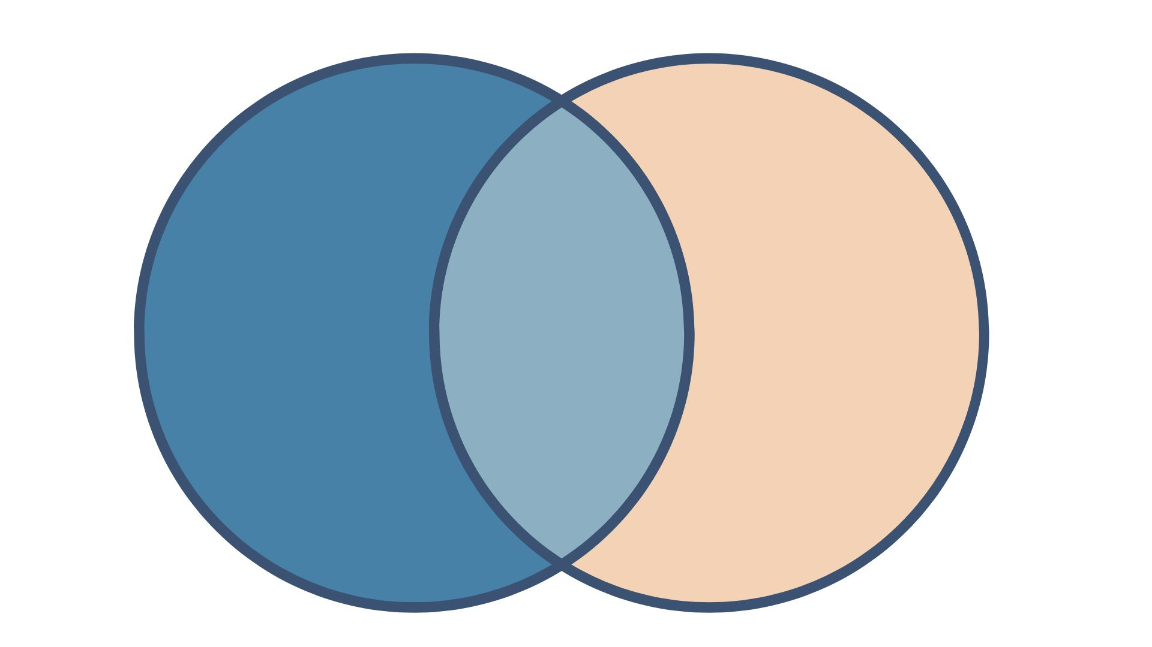
Content Area & Disciplinary Literacy
Content Area Literacy
Disciplinary Literacy
Focuses on using reading and writing to learn new content in different subjects.
Focuses on the specific ways of thinking and reading in different subjects.
Focus on helping students understand and engage with texts.
Emphasizes general strategies that can be applied across various subjects.
Each discipline (like math, science, or history) has unique methods for interpreting texts.
Prepares students for advanced learning and real-world problem-solving.
Helps with basic comprehension.
Involves advanced skills and deeper understanding.
Notes:
Content area and disciplinary literacy are crucial for students in grades 6-12 as they have transitioned from learning to read to reading to learn. In these grades, students encounter increasingly complex texts across various subjects, including science, social studies, mathematics, and English language arts. To succeed, they need to develop the ability to understand, analyze, and engage with these texts using both general strategies and strategies specific to each discipline.
Content area literacy involves the skills necessary to comprehend and interpret texts across different subjects, while disciplinary literacy focuses on the specialized practices unique to each field of study. Together, these literacy skills empower students to think critically, make connections, and apply their knowledge in meaningful ways, preparing them for academic success and real-world problem-solving.
What are Literacies within the Disciplines? Table
https://assets.ctfassets.net/cguvp07qpj80/4xAlY2y3gIbCjYIdY5uhbB/9969d1b11f7ac87c3a7e221ef071784c/1212_lent_table.pdf

Slide 11
Evidence-Based Secondary Literacy Practices
Students are explicitly taught the meanings of several new words everyday and provided with opportunities to review previously taught words.
Students are taught and encouraged to apply word-learning strategies (identifying morphemes, context clues) for newly encountered words.
Background knowledge is built through exposure to rich content in print and multimedia formats.
Students learn to monitor their comprehension by questioning, using graphic organizers, summarizing, and discussing texts with the teacher and peers.
Students work together with their classmates to read, write, and discuss texts.
The Meadows Center for Preventing Educational Risk. (2016). 10 key reading practices for all middle and high schools with strong evidence of effectiveness from high-quality research.
Notes:
To further strengthen content area and disciplinary literacy, it is crucial to adopt evidence-based reading practices that have been proven effective in middle and high school settings. By implementing these practices, educators can deliver targeted instruction that helps students navigate and understand complex texts in all subjects. The ten evidence-based practices presented on this and the next slide are from the Meadows Center for Preventing Educational Risk, highlighting strategies that support literacy development and academic success across the curriculum.

Slide 12
More Evidence-Based Secondary Literacy Practices
Students learn to analyze an author’s use of words, sentence structure, and organization of ideas to understand the text's purpose and meaning.
Students read a variety of texts daily, compare and evaluate them, discuss how they relate to the specific subject like history or science, and get feedback on their responses.
Students are taught to cite textual evidence when writing, answering questions, and talking about different texts.
Student learning is monitored to inform instructional decisions, such as collaborative group formation, lesson pacing, content for reviewing or reteaching, and intervention needs.
Students who are behind in reading are provided daily, supplemental intervention, including instruction in foundational reading and spelling skills.
The Meadows Center for Preventing Educational Risk. (2016). 10 key reading practices for all middle and high schools with strong evidence of effectiveness from high-quality research.
Notes:
The Meadows Center for Preventing Educational Risk. (2016). 10 key reading practices for all middle and high schools with strong evidence of effectiveness from high-quality research.

Slide 13
Challenges in 6-12 Literacy
Students are confronted with more text, more complex text, less structural support
Texts have multisyllabic words, complex syntax and sentence structures, more nuanced vocabulary
Students have varying levels of decoding, fluency, morphological analysis, vocabulary, and writing skills
“Every teacher is a reading teacher.” – Not without teacher prep for secondary literacy, effective professional development, ongoing support, the right resources and coaching
From last meeting: Need for 4-12 minimum reading competencies
Notes:
Teachers in secondary literacy encounter a range of challenges that impact their ability to effectively support student learning.
Some key challenges include:
Increased Text Complexity: Students face more extensive and complex texts with multisyllabic words, complex syntax, nuanced vocabulary, and less structural support compared to earlier grades.
Diverse Skill Levels: Students come with varying levels of decoding ability, reading fluency, morphological analysis, vocabulary knowledge, and writing skills, requiring tailored instructional approaches.
"Every Teacher is a Reading Teacher": Effective secondary literacy instruction requires more than just a belief in this principle. It necessitates proper teacher preparation, high-quality professional development, ongoing support, the right resources, and effective coaching.
Competency Needs: As discussed in our last meeting, there may be a need for a minimum set of reading competencies for grades 4-12 to address these challenges.
A New RAND report was published last week on supporting students reading in grades 3-8.
What's Missing from Teachers' Toolkits to Support Student Reading in Grades 3-8
Key Findings From the report/teacher panel:
U.S. grade 3–8 students spend more than half of their class time reading and writing.
44 percent of students always or nearly always experience difficulty reading the written content within their instructional materials.
40% of teachers in the study hold misconceptions about how students develop word reading skills, and nearly half of teachers in these grades report that their primary source of knowledge about reading instruction comes from their personal experiences in the classroom.
Almost three-quarters of teachers say they need access to more resources to identify and support students with reading difficulties.
While focuses specifically on grades 3-8, the RAND report's findings reinforce the need for targeted professional development and additional resources to address the challenges secondary teachers face in supporting diverse student needs.

Slide 14
Other challenges in Secondary Literacy?
Challenge with buy-in from secondary subject area teachers
Mindset shift often needed
Students with foundational deficits need to be in grade level text—how to approach at the secondary level
Scheduling has been a challenge—providing additional instruction, what will students miss?
No structures in place
Are we getting feedback from students on what they need/want?
Staffing issue for intervention services
Notes:
What would you add? What other challenges are there in 6-12 literacy? What resources are needed
Added to this slide during meeting from grantee feedback.

Slide 15
Current Secondary Activities
Professional development for 6-12 teachers
Content area & disciplinary literacy, standards alignment
AVID Critical Reading Strategies use in content areas
Seidlitz Language Rich Classrooms
Read 180 , StudySync, Lexia PowerUp implementation
Digital reading collections- Gale, Newsela
Focus on supporting multilingual learners & students with IEPs
Notes:
These are just a few of the secondary activities that are taking place through your CLSD projects.
Next, we will hear from Dr. Angela Valdez, Celeste Rivera, and Kasey Andrade Smith from Harrison District 2 in Colorado Springs, who will share their experience and work in advancing secondary literacy.

Slide 16
Next Steps
Will send link to and pdf of progress report form (due October 31, 2024)
Will contact each grantee to discuss when you'd like to share your work through a desktop review (October – End of School Year)
Topic and scheduling for next meeting??
Birth-Kinder Entry for November
From last meeting – highlight major projects on webpage so that you can learn and share with each other
Notes:
Requests included from meeting.

Slide 17
Important Info Reminders
All CLSD information can be found: CDE CLSD Webpage
We are available via email: lay_l@cde.state.co.us or miller_t@cde.state.co.us
For information on Reading, Writing & Communicating Standards: knight_m@cde.state.co.us
Bookings Page:
https://outlook.office365.com/book/CLSDAssistance@cde.state.co.us/
Notes:
All CLSD information can be found on the resource page or CDE CLSD webpage.
We are available via email: lay_l@cde.state.co.us or miller_t@cde.state.co.us
You may also set up a Teams Meeting through this Bookings Page:
https://outlook.office365.com/book/CLSDAssistance@cde.state.co.us/
Time slots are 30, 45, and 60 minutes.

