Slide 1
Colorado: 2019 Literacy Legislative Updates
December 2019

Slide 2
Introduction and Overview of Content
Introductions:
Anji Gallanos, Director, Preschool through Third Grade Office
Whitney Hutton, Business Analyst, Preschool through Third Grade Office
Content:
Brief overview of the Colorado READ Act
Changes to READ Act due to SB 19-199

Slide 3
The Colorado READ Act and the need for SB19-199

Slide 4
Colorado’s 3rd Grade CMAS ELA Scores Over Time

Slide 5
Significant Reading Deficiency Rates Over Time

Slide 6
Early Intervention Produces Results for Struggling Readers

Slide 7
What Does the Research Say?
Scientifically Based or Evidence-Based Literacy Instruction

Slide 8
Speaking vs. Reading
The human brain is “hard-wired” for spoken language, so speaking is natural
The human brain is not “hard-wired” for reading and writing, so these skills must be taught.
Birsh, J. & Carreker, S. (2018)
Notes:
Speaker notes:
Now that we know a bit about scientifically based reading research, Let’s talk about what has been learned while researching reading.
The first thing to know is that:
Speaking and listening are natural for humans. Our brains are “hard-wired” to learn how to speak and listen
All children, unless hearing impaired or neurologically impaired, will learn to speak.
Human brains are not “hard-wired” for reading and writing, so these skills do not come naturally and must be taught
Humans actually have to reorganize the speaking and listening system of their brain to be able to read.
Written language is a fairly new invention and has only been around for about 5000 years.
Learning to read is a skills that needs to be developed and requires explicit instruction and practice over multiple years
reading is a linguistic skill and not a visual skill
Very little of the visual system is used when reading.
Humans rewire the language speaking system to read, so reading changes how we speak.
As stated by Mattingly (1981), “Reading is a parasitic of speech.

Slide 9
Simple View of Reading
Word Level Reading
(Decoding)
Language Comprehension (Oral Language Comprehension)
Reading Comprehension
Learning to read consists of developing skills in two critical areas:
Reading each word in texts accurately and fluently and
Comprehending the meaning of texts being read.
Based upon Gough & Tunmer (1986); Hoover & Gough (1990) & Juel, Griffith, & Gough (1986).
Notes:
Talking Points: (Activity - have volunteers come up to hold cards to represent math problem)
When I was first introducing this section and was talking about the science of reading, I mentioned that reading is a product of decoding and language comprehension
Gough and Tunmer created this theoretical model, the simple view of reading to help us better understand this concept.
THis model helps us understand what it takes to be a proficient reader. To be a proficient reader, the reader must be automatic and fluent with word level reading (decoding) and also have strong language comprehension (understand the words they have read).
To become a proficient reader, a student must become automatic and fluent with word level reading and increasingly strategic with language comprehension skills. If there is a breakdown in either area, the student will not be a proficient reader.
This model also helps us understand that if there is a breakdown in either area ( word reading or language comprehension) the student is going to struggle with reading.
The simple view of reading also encompasses what the National Reading Panel confirmed to be necessary to teach learners to read in 2000. Many of you would know them as the “5 components”
We will talk more about the 5 components of reading in future slides
Activity: Take a minute and think about what it takes to become automatic and fluent with word level reading and what it takes to become increasingly strategic with language comprehension. What skills does a student need to develop? (click to next slide)
Trainer Support:
Word-level reading refers to the ability to sound out or decode new, unfamiliar words accurately and rapidly, but also to the ability to remember written words for later, instant recognition.
Decoding: More recent terminology distinguishes between decoding (sounding out unfamiliar words) and word recognition (automatic recall of familiar words). Skilled word reading requires both. For the purposes of clarity, in this document the terms word-level reading and word reading will be used interchangeably rather than decoding.
Language Comprehension (listening comprehension) refers to word-level, sentence-level, and discourse-level language and the cognitive skills needed to construct meaning from spoken language.
Linguistic Comprehension: Oral language comprehension or simply language comprehension will be used interchangeably in place of linguistic comprehension.
Reading Comprehension refers to the ability to understand written language by using semantic information to derive meaning from individual and related multiple sentences (Gough & Tunmer, 1986).
Anchor Resources:
Gough, P. B., & Tunmer, W. E. (1986). Decoding, Reading, and Reading Disability. Remedial and Special Education, 7(1), 6–10. https://doi.org/10.1177/074193258600700104https://journals.sagepub.com/doi/10.1177/074193258600700104
https://improvingliteracy.org/brief/learning-read-simple-view-reading
Catts, Hugh. (2018). Simple View of Reading The Simple View of Reading: Advancements and false impressions. Remedial and Special Education. 39. 10.1177/0741932518767563. https://www.researchgate.net/publication/325090673_Simple_View_of_Reading_The_Simple_View_of_Reading_Advancements_and_false_impressions
The Simple View of Reading: Research of Importance to All Educators By Linda Farrell, Marcia Davidson, Michael Hunter, Tina Osenga: https://static1.squarespace.com/static/56806e9ed8af10f889a11a50/t/5b91519570a6adf524e46c7d/1536250264101/SimpleView.pdf
https://www.thereadingleague.org/wp-content/uploads/2018/09/NRP-Report.pdf

Slide 10
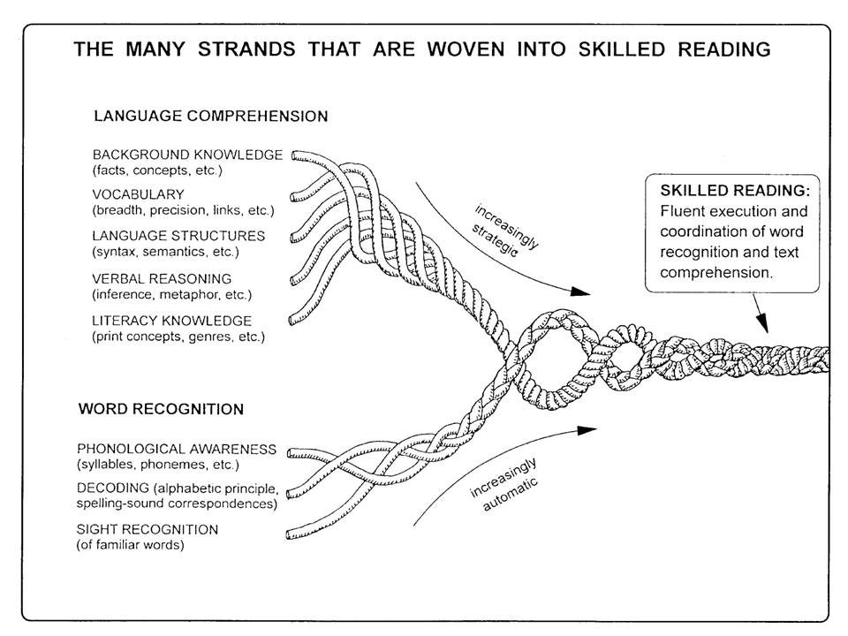
Scarborough, H. S. (2001)
Notes:
Talking Points:
Just like the Simple View of Reading, Scarborough's reading rope represents the complexity of the reading process. This model helps us better understand all the skills a student needs to develop to become a proficient reader.
“click” to have the Simple View appear
You can see how the Simple View of Reading aligns with the rope model
This theoretical model demonstrates that reading is a “multifaceted skill gradually acquired over years of instruction and practice.”
Like the Simple View, this model is helps us understand that to become a proficient reader, the student must become increasingly automatic in word level reading and increasingly strategic in language comprehension. The difference is that this model helps us better understand the skills needed to become a proficient reader.
This model helps educators understand which skills need to be included in reading instruction as well as helps understand which areas to assess when a student is having difficulties with learning to read.
Explain that when a student becomes a proficient reader the skills on the bottom part of the rope become automatic, so it is not necessary to spend much time providing instruction on skills listed on the bottom part of the rope.
Explain that the focus becomes the top part of the rope and supporting students with developing skills to support comprehension
Remind participants that students need to develop all these skills to become proficient readers
Anchor Resources:
Scarborough, H. S. (2001). Connecting early language and literacy to later reading (dis)abilities: Evidence, theory, and practice. In S. Neuman & D. Dickinson (Eds.), Handbook for research in early literacy (pp. 97-110). New York: Guilford Press.
https://dyslexiaida.org/scarboroughs-reading-rope-a-groundbreaking-infographic/
http://www.haskins.yale.edu/staff/scarborough.html
https://www.cambridge.org/core/services/aop-cambridge-core/content/view/D146BAFA4AEE48479DF4F5F2B230599A/S2058631015000021a.pdf/div-class-title-better-reading-through-science-using-research-based-models-to-help-students-read-latin-better-div.pdf

Slide 11
Effective Instruction:
Informed by Science
Explicit & Systematic
Skill development in:
phonological awareness
Phonics
Vocabulary
reading fluency including oral skills
reading comprehension
Review these terms in Appendix C in the Part 1 on the Instructional Programming Review Handout.
Notes:
Speaker notes: (refer to terminology document and have volunteer participants read aloud the definition of each point)
Reading research has been hugely funded over the last 30 plus year, so there are many studies that help us better understand how people learn to read, why some people struggle with learning to read and what instruction is most effective for supporting students with learning to read.
“Reading instruction is no longer based on opinion - it is informed by science – we have research data that shows what works” (Birsch, 2018 pg.4)
According to the National Reading Panel a truly effective reading program includes systematic, explicit instruction in all 5 components of reading: phonological awareness, phonics, vocabulary, reading fluency and reading comprehension.
Systematic Instruction: A carefully planned sequence of instruction that is thought out and designed before activities and lessons are planned, maximizing the likelihood that whenever children are asked to learn something new, they already possess the appropriate prior knowledge and understandings to see its value and to learn it effectively.
Explicit Instruction: Instruction that involves direct explanation in which concepts are explained and skills are modeled, without vagueness or ambiguity. The teacher’s language is concise, specific, and related to the objective, and guided practice is provided.
Effective instruction also requires a knowledgeable teacher who is able to teach the elements of language structure well.
This aligns with the requirements of the READ A

Slide 12
HB 12 –1238 Colorado READ Act Reading to Ensure Academic Achievement SB 19-199 Amendments

Slide 13
Overview
Passed in 2012 and repealed the Colorado Basic Literacy Act.
CO READ Act:
Preventative in nature
Focuses on all students – provides significant funding for those significantly below grade level in reading
Required READ Plans
Continual parent communication (READ Plan)
Includes a provision related to advancement decisions
Requires universal screening K-3
Requires progress monitoring and diagnostic testing
Notes:
Each layer has additional requirements and guidance – high level overview

Slide 14
READ Act – Key Updates from SB 19-199
Key Updates
READ Plans – additional language | daily literacy block timeframe school readiness plans
LEA Improvement Plans | beginning 2020-21 school year –documenting all literacy programming and professional development
K-3 Training | By 2021-22 all K-3 teachers Varying options, including a via the CDE
Public Info. Campaign | Starting 2019-20
External Evaluator | independent evaluations of the use of per-pupil and ELG funds multi-year evaluation of student outcomes
Funding Allocations | Change to allocations Additional uses for PPI
ELG Program | Additional 2.5 million
LEA Budget | Requirement changes to receive PPI funds CDE must monitor fund use throughout the year
Other

Slide 15
SB 19-199 – Deeper Dive

Slide 16
Key Provisions: Students on READ Plan
LEPs shall ensure that students receive educational services in a daily literacy block for the length of time identified as effective in research relating to best practices in teaching reading.
LEPs may include components of the student's individualized kindergarten school readiness plan that apply to teaching literacy as part of the student's READ plan after the student completes kindergarten, so long as the local education provider administers an approved reading assessment to the student in grades one through three.

Slide 17
Key Provisions for Unified Improvement Plans
Beginning with the 2020-21 school year, district plans must include the following:
Reading curriculum must be designed around foundational reading skills of phonemic awareness, phonics, vocabulary development, reading fluency including oral skills, and reading comprehension
Evidence-based or scientifically based core and supplemental reading instructional programs
Reading assessments used by each school
If applicable, plans for providing professional development using READ funds

Slide 18
K-3 Teacher Training
Beginning in 2021-22, each district that receives READ funding must ensure that K – 3 teachers complete evidence-based training in teaching reading. The training may be:
A course in an approved educator preparation or alternate teacher program;
A course in a post-graduate degree program in teaching reading or literacy;
CDE training or program on the CDE advisory list of professional development programs, or
Training provided by a local education provider or is appropriate for license renewal
A teacher is deemed to have successfully completed the training if districts submits evidence that the teacher passed an end-of-course assessment.

Slide 19
External Evaluator
By October 1, 2019, CDE must issue a request for proposals to contract with an entity to act as an independent evaluator to provide independent evaluations of the use of per-pupil and ELG funds by LEPS and to conduct a multi-year evaluation of student outcomes achieved by local education providers.

Slide 20
Changes to Budget Reporting

Slide 21
Allowable Uses of Funds
Continued Allowable Uses
Operate summer school programs (same requirements as currently in place)
Purchase tutoring services focused on increasing students' foundational reading skills
Provide other targeted, evidence-based or scientifically based intervention services approved by CDE
Purchase from a BOCES the services of a reading specialist or reading interventionist
Provide professional development programming to support educators in teaching reading
Hiring a reading coach who is trained in scientifically and evidenced based practices in reading to provide job-embedded, ongoing professional development to support kindergarten-through-third-grade teacher competence scientifically and evidenced based practices in reading

Slide 22
Allowable Uses of Funds
Additional Allowable Uses
Purchase CDE approved core instructional programs
Provide technology, including software, included on the advisory list of instructional programming in reading
Discontinued Allowable Uses
Full Day Kindergarten
State funding is now available for full-day kindergarten (HB19-1262)
Forthcoming communication to request school districts selected full day kindergarten to amend their previously submitted budget submission form to ensure that your per-pupil dollars are spent for allowable uses.

Slide 23
Reporting Requirements and Purpose of the READ Data Collection

Slide 24
Purpose of READ Collection
The purpose of the READ collection is to collect student level data needed to fulfill statutory requirements
Data collected in READ is also used to determine the distribution of per-pupil intervention funds for students identified as having significant reading deficiencies (SRD)
The Early Literacy Fund provides districts with per-pupil intervention funds to help support programs to meet the needs of students with SRD who received services

Slide 25
Reporting Requirements
Each spring districts create and submit records for all K-3rd grade students enrolled at the time of data submission and 4-12th grade cohort students who are included in the READ 4-12th grade cohort from any district
Number of students identified as having an SRD and receive instructional services pursuant to READ plans (same requirement, collected through READ data collection)
Student background information: SASID, name, gender, DOB, grade level, interim reading assessment and score, testing date, retention (same requirement, collected through READ data collection)

Slide 26
District Budget Planning and Reporting Requirements
Budget Planning (C.R.S. 22-7-1210.5)
Before the beginning of each budget year, to receive a distribution of per-pupil intervention money, an LEP must submit to the department the following information:
The number of K-3 students enrolled in schools operated by the LEP who are SRD and received instructional services pursuant to READ plans in the prior budget year
A budget, including a narrative explanation for the allowable uses of per-pupil intervention. Each LEP may only carry over 15% of funds from the previous budget year
The department must approve the LEAs proposed use of PPI money as being in compliance with the allowable uses of PPI

Slide 27
New Budget Reporting Process
Current READ Budget Planning Survey will no longer be a requirement and will be removed from Data Pipeline
READ Data Collection will remain in Data Pipeline
New data reporting system will be created to report budget information
DRAFT Timeline
Budget submission window opens | April 1, 2020
Deadline to have budget projections submitted to CDE | May 15, 2020
CDE reviews budgets and provides comments | June 2, 2020
Deadline to have budgets re-submitted | June 30, 2020
Final allocation revisions to CDE | August 2020 – December 2020

Slide 28
Resources
CDE will be hosting a series of informational webinars about the new budget reporting process
The next webinar will be January 7, 2020 at 1:00PM
Link to join webinar will be posted here: http://www.cde.state.co.us/coloradoliteracy/readdatapipeline
Please visit the Colorado READ Act Homepage for additional information regarding SB 19-199

Slide 29
Questions

