Slide 1
Colorado READ Act: 2021-22 Budget Submission Process
March 2021

Slide 2
Introduction and Overview of Content
Introductions:
Whitney Hutton, Business Analyst, Preschool through Third Grade Office
Andreia Simon, Senior Literacy Consultant, Preschool through Third Grade Office
Content:
Budget reporting requirement for PPI funds
Timeline for budget submissions and reviews
Budget reporting format and requirements
How to start preparing
READ– Whitney Hutton-hutton_w@cde.state.co.us

Slide 3
District Budget Requirement for PPI Funds
Per SB 19-199, prior to receiving per-pupil intervention (PPI) funds, LEAs must provide the following information to CDE:
Number of students identified as having an SRD and receive instructional services pursuant to READ plans (collected through Data Pipeline)
Student background information: SASID, name, gender, DOB, grade level, interim reading assessment and score, testing date, retention (collected through Data Pipeline)
A budget, including a narrative explanation, for the use of PPI money in accordance with the allowable use of READ fund categories. Each LEP may only carry over 15% of funds from the previous budget year
The department must approve the LEAs proposed use of PPI money as following the allowable uses of PPI
Budget submission will take place outside of data pipeline, separate from the READ data collection
READ– Whitney Hutton-hutton_w@cde.state.co.us

Slide 4
Allowable Uses of READ Funds
Allowable Uses of READ Act Funds
Operate summer school programs
Purchase tutoring services focused on increasing students' foundational reading skills
Provide other targeted, evidence-based or scientifically based intervention services approved by CDE
Purchase from a BOCES the services of a reading specialist or reading interventionist
Purchase CDE approved core instructional programs
Provide technology, including software, included on the advisory list of instructional programming in reading
Provide professional development programming to support educators in teaching reading
READ– Whitney Hutton-hutton_w@cde.state.co.us

Slide 5
Additional Information on Professional Development
Allowable Use of Funds for Professional Development
Hiring and compensation for a reading coach who is trained in scientifically and evidence-based practices in reading to provide job-embedded professional development
Registration for K-3 Teacher Training
Professional Development for approved instructional program implementation
Topic Specific Professional Development based on Colorado Elementary Literacy Teacher Standards
Initial approved list will be posted in June of 2021
Final approved list anticipated end of July 2021
READ– Whitney Hutton-hutton_w@cde.state.co.us

Slide 6
Budget Submission Timeline

Slide 7
Budget Submission & Review Timeline
Timeline
Budget submission window opens | April 1, 2021
Deadline to have budget projections submitted to CDE | June 30, 2021
CDE reviews budgets and provides comments by | June 31, 2021
Deadline to have budgets re-submitted | July 30, 2021
Distribution of READ funds | August 2021
Final allocation revisions | September 2021 – March 2022
READ– Whitney Hutton-hutton_w@cde.state.co.us

Slide 8
Budget Submission Format
CDEs Web Management team created a custom web-based application (similar to EASI application) where READ budgets will be submitted
There are 4 required elements of the budget submission
Part 1: LEA Information
Part 2: Allocation and Carryover Information
Part 3: LEA Budget Overview & Narrative Explanation
Part 4: Detailed Budget
Budget submissions must be signed and uploaded within the online system. These assurances must include original signatures of the Authorized Representative for the LEA
READ– Whitney Hutton-hutton_w@cde.state.co.us

Slide 9
READ Act Budget Submission
Overall Budget Narrative on the Use of Per-pupil Intervention Funding for the 2021-2022 School Year
Narrative explanation will include:
1. How district plans to use READ funds in the upcoming budget year
2. Must include school level information, but will be submitting one narrative for entire district
Overall Budget Details on the Use of Per-pupil Intervention Funding for the 2021-2022 School Year
Budget Details will include:
1. Allowable Activity
2. Name of Program
3. Budget Object Code
4. Budgeted Cost
5. Budget Line Narrative

Slide 10
Part 1: LEP Contact Information

Slide 11
Part 1: LEP Information
READ– Whitney Hutton-hutton_w@cde.state.co.us

Slide 12
Part 2: READ Funding Allocation & Carryover

Slide 13
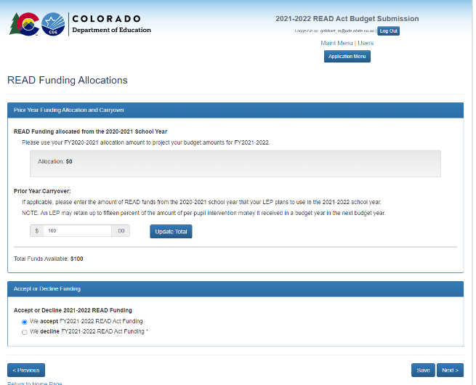
READ Funding Allocation & Carryover
If applicable, district will report the amount of funds from the 2020-21 school year that will be used in the 2021-22 school year. This amount cannot exceed the 15% carryover provision.
READ– Whitney Hutton-hutton_w@cde.state.co.us

Slide 14
Part 3: Budget Explanation & Narrative

Slide 15
Part 3: LEP Budget Explanation
READ– Whitney Hutton-hutton_w@cde.state.co.us

Slide 16
Part 3: LEP Budget Explanation
READ– Whitney Hutton-hutton_w@cde.state.co.us

Slide 17
Part 3: LEP Budget Explanation
READ– Whitney Hutton-hutton_w@cde.state.co.us

Slide 18
Part 2: LEP Budget Narrative
This question is new for 2021-22 budgets.
READ– Whitney Hutton-hutton_w@cde.state.co.us

Slide 19
Part 4: LEP Budget Details

Slide 20
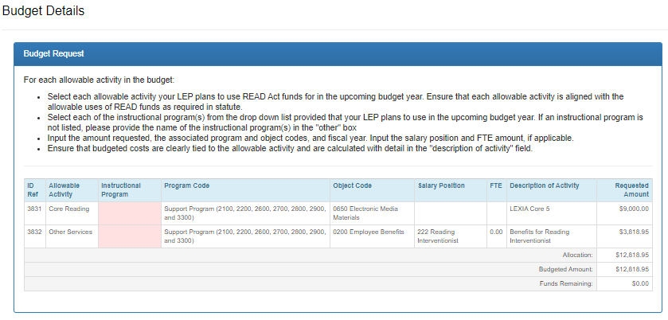
Part 4: Detailed Budget
Make sure to include name of program being purchased or utilized.
Drop down list of approved instructional programs will be available for 2021-22 budgets. You can view the CDE Advisory list of Approved Programming here.
Funds Remaining amount must equal $0.00 before system will allow you to submit budget
READ– Whitney Hutton-hutton_w@cde.state.co.us

Slide 21
Part 3: LEP Detailed Budget
READ– Whitney Hutton-hutton_w@cde.state.co.us

Slide 22
Budget Object Codes

Slide 23
Budget Summary
READ– Whitney Hutton-hutton_w@cde.state.co.us

Slide 24
Signature Page Upload
READ– Whitney Hutton-hutton_w@cde.state.co.us

Slide 25
Once Budget has been Submitted
District will receive message in system that budget has been successfully submitted
CDE will conduct review of the budget
CDE will provide reviewer comments within budget platform
District will receive automatic email that budget has been reviewed and reopened if necessary
District will log into budget submission platform to address reviewer comments
Once budget has been approved district will receive an automated email that budget has been approved
READ– Whitney Hutton-hutton_w@cde.state.co.us

Slide 26
How to Prepare
Before you can successfully login into the budget submission platform, you must have your Local Access Manager assign you to the READACTBUDGET group in the Identity Management System
Use 2020-21 allocation amount to project 2021-22 costs
Prepare a narrative explanation on the use of the per-pupil intervention funding for the 2021-22 school year
Determine which allowable activities you will use READ funds for: (§22-7-1210.5)
Work internally to create a system for gathering information by school (data respondents, READ Act specialist, fiscal contacts)
Compile information (allowable activity, name of program, budgeted cost, budget object codes)
Determine who will be submitting/revising budget in web application
READ– Whitney Hutton-hutton_w@cde.state.co.us

Slide 27
Note About 2020-21 Budget Revisions
All districts are required to revise 2020-21 budgets to reflect actual allocation amounts
2020-21 budget must be approved and finalized before CDE can review new 2021-22 budget submission
Please include the following information in your 2020-21 budget revision:
Changes to reflect actual costs and updates to line items to reflect final allocations
Need approval for new activities not included in approved budget
Changes to programming such as Core, Supplemental, or Intervention
Changes among object categories such as salaries, benefits, etc.
If using 2019-20 carryover funds, please include description of how you will use those funds in the first budget narrative question
READ– Whitney Hutton-hutton_w@cde.state.co.us

Slide 28
Resources
Please visit the READ Budget Submission Website to log into the budget application and to view budget submission resources
Please visit the Colorado READ Act Homepage for additional information regarding SB 19-199
Please contact Whitney Hutton at Hutton_w@cde.state.co.us with any questions

Slide 29
Questions

