Slide 1
What Every New Director Should Know about IDEA Dispute Resolution
Brandon Edelman, Esq.
Supervisor, Dispute Resolution and Policy
August 25, 2021

Slide 2
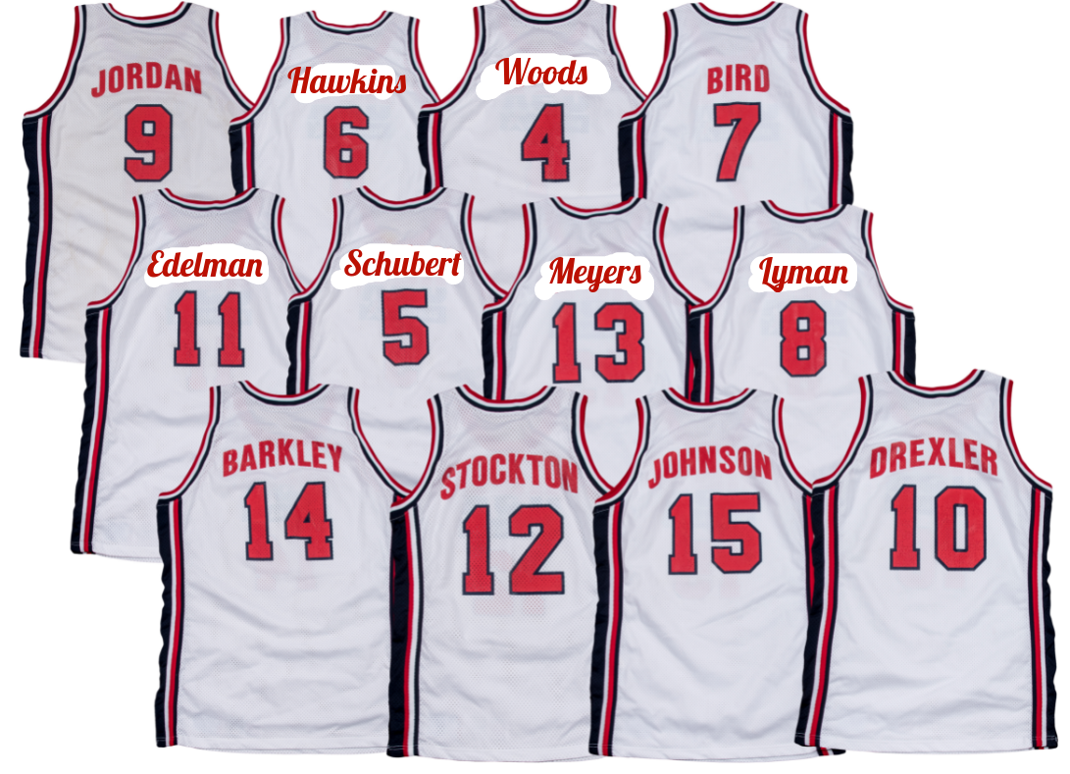
Welcome (Virtually) to IDEA Dispute Resolution
The Dispute Resolution (DR) Team
Candace Hawkins, Esq.: General Supervision and Monitoring Director
Brandon Edelman, Esq.: Dispute Resolution Supervisor
Jennifer Woods: Dispute Resolution Coordinator
Ashley Schubert, Esq.: State Complaints Officer
Ross Meyers, Esq.: State Complaints Officer
CiCi Lyman: Dispute Resolution Program Support

Slide 3
Sources of Conflict in Special Education
Design
Delivery
Relationship

Slide 4
CDE Protocol for Parent Telephone Calls
Questions and/or concerns about a student’s special education programming and services:
Encourage the parent to attempt resolving a dispute by first contacting the special education director.
Advise the parent to speak with a teacher and/or request an IEP team meeting.
Explain the Facilitated IEP Meeting process and IDEA Dispute Resolution options.

Slide 5
IDEA Dispute Resolution Processes
Mediation
State
Complaint
Due Process Complaint
These three processes are free. However, parties are responsible for costs incurred to produce evidence or obtain legal counsel.

Slide 6
Mediation: An Overview
Regulations and Rules: 34 C.F.R. § 300.506 and ECEA Rule 6.02(6)
Mediation: a problem-solving process facilitated by a neutral mediator that requires the parties to work together toward a mutually agreeable solution.
Scope: can be used to resolve any current dispute under Part B of IDEA.
Availability: in Colorado, only a parent or public agency may request mediation.
You may request mediation for any IDEA-related concern/dispute at any time.
Do not wait for things to get worse or for the parent to file a complaint.

Slide 7
Mediation: Key Features
Mediators: CDE currently uses impartial, independent contractors.
Participation and Cost: voluntary and free to both parties.
Confidentiality: discussions during mediation are confidential and may not be used as evidence in a subsequent state or due process complaint.
Enforceability: written agreements are enforceable in state or district court.
Requesting Mediation: mediation may be requested by contacting CDE’s mediation coordinator at (303) 866-6889 or by faxing a mediation request form to (303) 866-6767.

Slide 8
Mediation: What to Expect
(1) CDE will contact both parties to confirm agreement to mediate.
(2) Mediator will be assigned on a rotational basis.
(3) Assigned mediator will contact parties to schedule mediation and discuss the process.
Questions about mediation should be addressed with assigned mediator.
(4) Mediation Outcomes:
Impasse
Written Agreement
(5) Survey/Feedback

Slide 9
Mediation: The Benefits
Quick
Easy
Lowered financial and emotional costs
Least adversarial process
Broader and more creative
Parties are in control of the process and outcome

Slide 10
State Complaints: An Overview
Regulations, Rules, and Procedures: 34 C.F.R. §§ 300.151-300.153, ECEA Rule 5.01(11), and CDE’s State-level Complaint Procedures
State Complaint: individuals or organizations who believe that a public agency responsible for the provision of special education services is not in compliance with state (ECEA) and federal (IDEA) regulations may file a signed written complaint with CDE.
Investigated by CDE.
Must be accepted or rejected by CDE within ten (10) calendar days of filing.

Slide 11
State Complaints: Timelines/Requirements
Timelines: 60-Day Investigation
Response (due 15 days after receiving notice of investigation letter)
Reply (due 10 days after the Response is received)
Formal Fact Finding: may include interviews; a review of records and files; a request for additional information; consultation with CDE experts; and/or an on-site visit.
Extensions of 60-Day Timeline: (1) Exceptional Circumstances and (2) Mediation
Day 60 of Investigation: Final Decision

Slide 12
State Complaints: What to Expect
(1) Assigned State Complaints Officer (SCO) will contact you to verify receipt of the complaint. You may ask questions about the process.
(2) Acceptance Letter and Request for Documents.
Narrative
Additional Documentation
(3) Interviews
(4) Final Decision
(5) Corrective Action Plan

Slide 13
Due Process Complaints: An Overview
Regulations and Rules: 34 C.F.R. §§ 300.507-300.516 and ECEA Rule 6.02(7.5)
Due Process Hearing: may be used to resolve any dispute related to the identification, evaluation, educational placement, or the provision of a free appropriate public education (FAPE) for a specific child.
Availability: only parents, students who have reached the age of majority, or a public agency may request a due process hearing.
Decision-Maker: due process hearings are conducted by administrative law judges who are trained in special education law.

Slide 14
Due Process Complaints: Timelines/Requirements
Filing a Due Process Complaint: must be filed with CDE and the Special Education Director of the Administrative Unit.
CDE has two business days to forward a due process complaint to the Office of Administrative Courts.
CDE does not make any determination regarding sufficiency.
The Office of Administrative Courts conducts the due process hearings.
Resolution meeting: 15 days from notice to the AU and before hearing may be held.
Not required if parties jointly waive or agree to use mediation.
Consequences for failing to convene or participate in resolution meeting.
CDE Tracking Report.
Resolution Period: hearing may be held if AU has not resolved due process complaint to satisfaction of parent within 30 days of receipt of due process complaint.
Hearing and Final Decision: 45 days from impasse or the end of 30-day resolution period, unless extended by the ALJ at the request of either party.

Slide 15
Due Process Complaints: What to Expect
Upon receipt of a Due Process Complaint:
Notify Jennifer Woods (CDE Dispute Resolution Coordinator) at 303-866-6889 and fax complaint to 303-866-6767.
Verify the date that you received the complaint on the cover sheet.
You may not unilaterally determine sufficiency of the complaint.
-- ECEA Rule 6.02(7.5)(b)(iv)-(v).
CDE will send letter with timeline and verification/tracking form for Resolution Meeting.
You must complete and return the form to Jennifer Woods.
Questions about the process should be addressed with the assigned administrative law judge.

Slide 16
Due Process Complaints: Expedited Hearing
Expedited Due Process Hearing: dispute must involve parental disagreement with disciplinary placement, manifestation determination, or belief by an AU that maintaining student in current placement is substantially likely to result in injury to student or others.
Expedited Due Process Hearing Timelines:
Resolution Meeting: 7 days
Due Process Hearing: 20 school days
Decision: 10 days from hearing
Questions: contact the assigned administrative law judge

Slide 17
Due Process and State Complaints: A Comparison
Time Period for Filing a Complaint: Due Process (2 years) vs. State Complaint (1 year)
Formality of the Process: Due Process (formal court proceeding before an ALJ where parties present evidence, give testimony, and cross-examine witnesses) vs. State Complaint (state complaints officer investigates alleged violations through formal responses or replies from parties and interviews)
Who May File: Due Process (only parents, students who have reached the age of majority, or a public agency) vs. State Complaint (allows nonparents and organizations)
Subject Matter: Due Process (limited to identification, evaluation or educational placement of a child with a disability or the provision of a FAPE) vs. State Complaint (allows broader subject matter for a dispute, including the ability to file on behalf of a group of students)
Stay-Put: Due Process (applicable during pendency of any administrative or judicial proceeding involving a FAPE claim) vs. State Complaint (not applicable)
Remedies Available: Due Process (reasonable attorneys’ fees available) vs. State Complaint (reasonable attorneys’ fees not available)

Slide 18
Educational Surrogate Parents
ESP Assignment by Special Education Director:
Special Education Directors are responsible for assigning ESPs.
An ESP must be assigned where (a) parents cannot be identified or located, (b) the child is a ward of the State, or (c) the child is a homeless child.
Must be done within 30 days of determining that a child is in need of an ESP.
ESP Assignment by Court:
ESP may be appointed by the Court overseeing a child’s case after the child has been placed in the legal custody of the Department of Human Services.
Court appointment supersedes any previous assignment.
ESP Registry:
All assignments must be reported to CDE for the ESP registry on a CDE-specific form.
Special Education Directors (or authorized AU staff) can contact CDE to determine if a student already has an ESP at 303-866-6889.
Each AU is responsible for training ESPs and keeping a list of trained ESPs.

Slide 19
Dispute Resolution Resources
ESSU Dispute Resolution Web Page:
http://www.cde.state.co.us/spedlaw
Information on Mediation, State Complaints, and Due Process Complaints
OSEP Guidance, Rules and Regulations, and Past State Complaint Decisions
COVID-19 and Special Education:
State and Federal Guidance: https://www.cde.state.co.us/cdesped/covid19-spedguidance
COVID-19 FAQs: https://www.cde.state.co.us/cdesped/special_education_faqs
2022 Special Education Legal Conference:
https://www.cde.state.co.us/spedlaw/legalconf
To be held in-person on Friday, April 29, 2022.

Slide 20
Staff Contact Information
Brandon Edelman, Esq., Dispute Resolution Supervisor: (303) 866-6876
Jennifer Woods, Dispute Resolution Coordinator: (303) 866-6889
Mediation and Due Process
CiCi Lyman, Dispute Resolution Program Support: (303) 866-4797
Mary Anne Fleury, Alternative Dispute Resolution Specialist: (303) 866-6649
Facilitated IEP Requests
Training in facilitation skills and Educational Surrogate Parent Assignments

